Slide 1
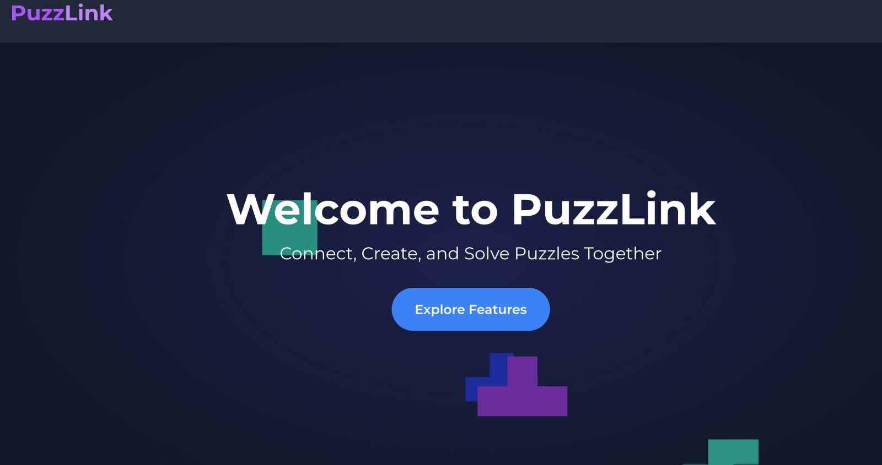
Partners :
Adi Vered
Shiran Reich

Slide 2
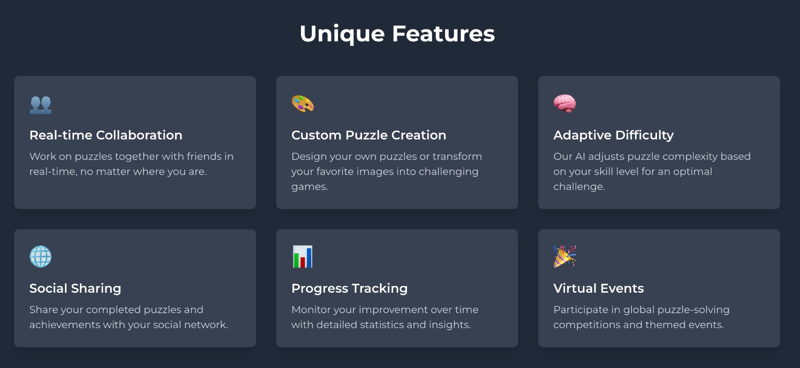
What is PuzzLink ?

Slide 3
Literature Review
Vision and Goals:
Vision: Redefine virtual interaction through creative collaboration and authentic connections.
Goal: Build meaningful relationships via intuitive, interactive shared experiences. Objectives:
Dynamic and personalized user experiences (e.g., coloring, creating).
Organize and display user-generated content visually.

Slide 4
Literature Review
Core Features:
Interactive Creativity: Collaborative puzzle-solving and coloring on interactive boards.
Real-Time Communication: Built-in chat for seamless user interaction.
Private Rooms: Dedicated spaces for focused collaboration.
Saving and Sharing: Options to save and share creations.

Slide 5
Literature Review
Metrics:
Puzzle Completion Rates: Insights into user behavior and preferences.
Chat Activity: Collaboration effectiveness.
User Satisfaction: Feedback through surveys and reviews.
Research Insights:
Collaborative drawing enhances emotional connection and empathy.
Shifts focus from the final product to the interaction process.
Technology enables creative expression without physical constraints.

Slide 6
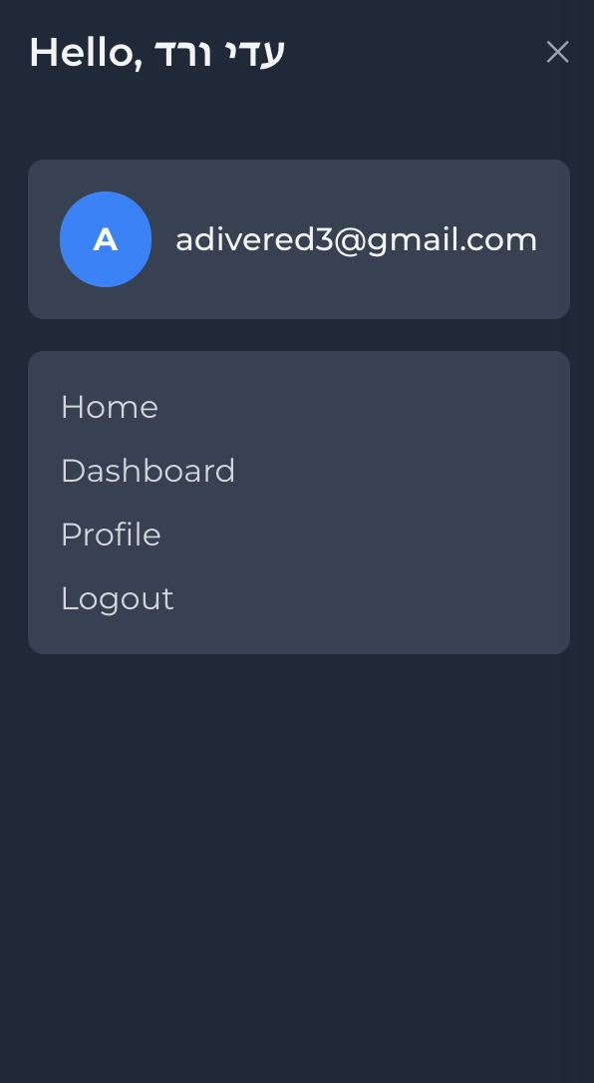
Functional Requirements
User Authentication:
Users can register an account using their email, username,
and password.
Users can log in to their account using their credentials.
Users will be tokenized and remembered with cookies.

Slide 7
Functional Requirements
Private Rooms
Users can create and join rooms to collaborate on a shared web page. The core feature is real-time collaboration,where multiple users can write on the shared board simultaneously.
Users can select between an image-based or plain whiteboard room for their activities.
Users can upload images to the board and start drawing directly on them.
Drawing tools include options for changing pencil width, color, and erasing.
Each room has a dedicated chat where users can send and receive real-time text messages.

Slide 8
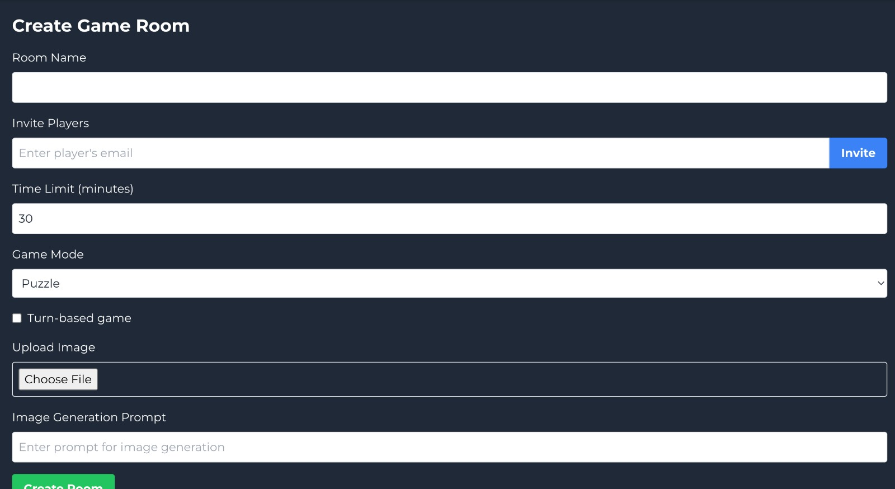

Slide 9
Non-Functional Requirements
Performance: Real-time updates (<1s latency), fast response (<2s avg).
Security: Secure authentication, encrypted data, and protected storage.
Reliability: 99% uptime with backups and recovery plans.
Usability: Intuitive interface and responsive design.

Slide 10
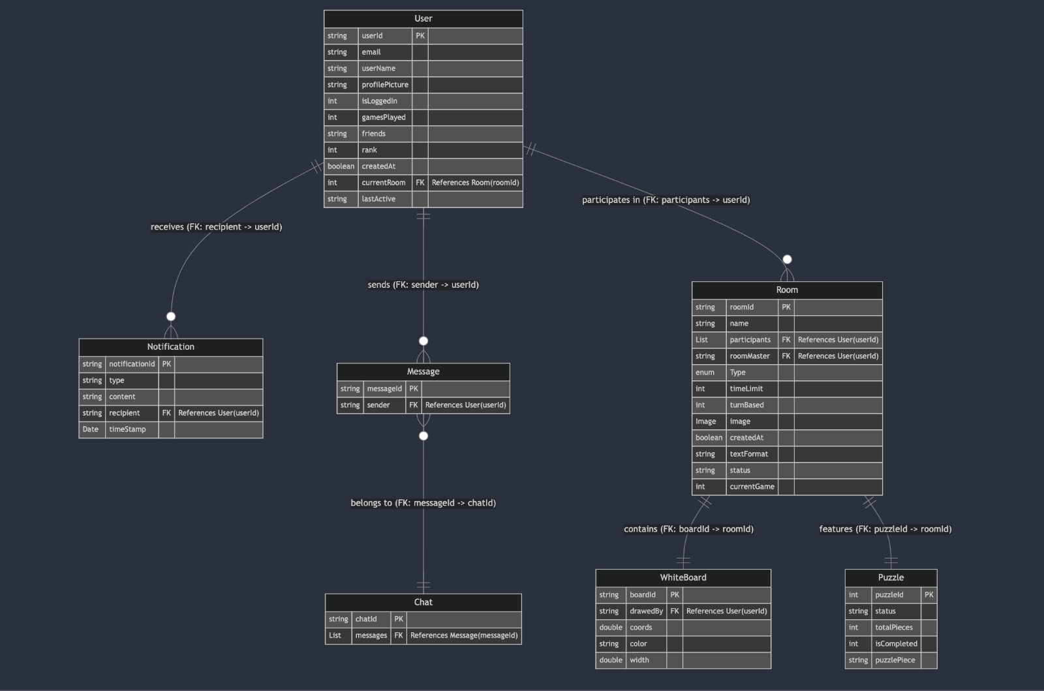

Slide 11
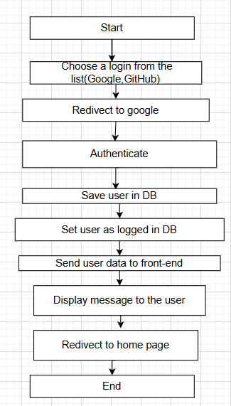
Detailed Design
Activity Diagram: Sequence of actions in the user login process for the application

Slide 12
Algorithm
We haven't decided yet. We will decide on the exact algorithm for image processing based on the limitations we experience while creating the puzzles. Specifically, each puzzle may require a different algorithm.

Slide 13
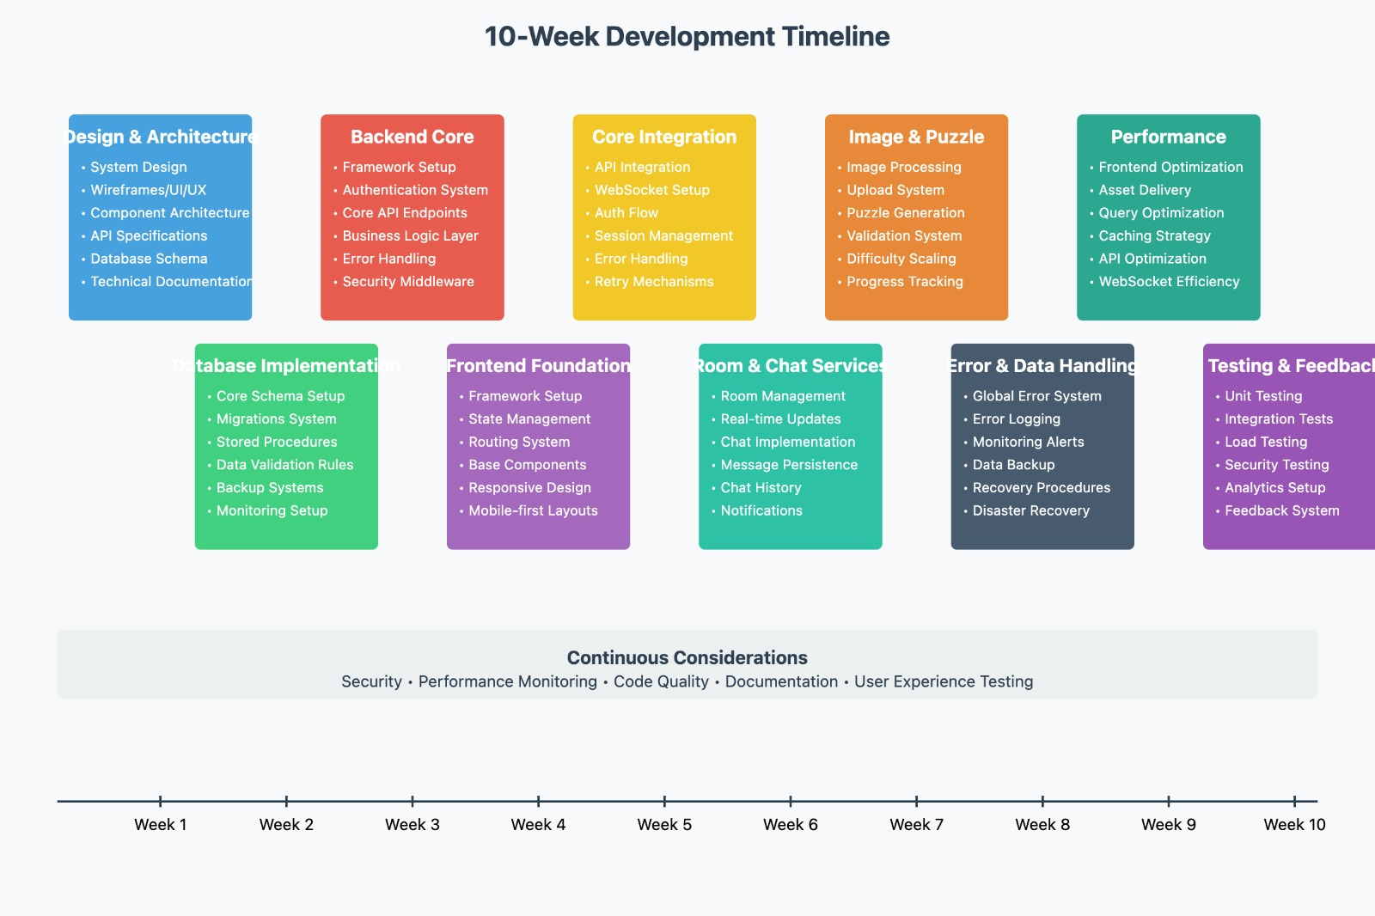

Slide 14
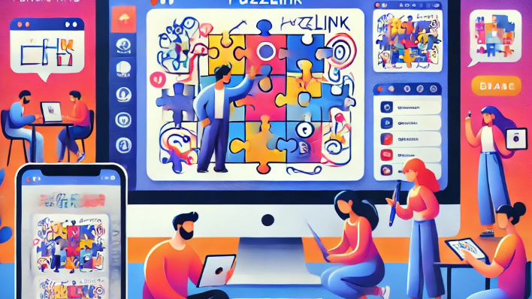

Thank you for listening!

