Slide 1
Data Science Project PX55PA/PB
Course Coordinators:
Marco Thiel (m.thiel@abdn.ac.uk)
Mamen Romano (m.romano@abdn.ac.uk)

Slide 2
Aims of the project
Conduct an independent research project on the area of data science.
Get experience in working with a real-world data set and apply a range of data science tools to extract information from the data.
Acquire breadth and depth of knowledge in the area of your project.
Acquire planning and analytical skills, as well as oral and written presentation skills.

Slide 3
Course assessment
There are 3 main components:
Oral presentation (mandatory, but not counting towards final mark): group presentation explaining the motivation of the project, main objectives, workplan, and preliminary results.
Thesis (65% of overall mark): written thesis to be submitted on the 29th of March (21st June for part-time students).
Viva (oral exam, 35% of overall mark): tentative date: 15th May - 19th May, subject to changes (beginning-mid July for part-time students).

Slide 4
Group/individual work
Oral presentation: teamwork. Work together to present main objectives of your topic of research, open questions, literature review, main methodology, and work plan.
Thesis: individual work. Each student needs to work individually on their own thesis, which needs to be submitted at the end of the project.

Slide 5
Oral presentation
Group presentation: 20 minutes + 10 minutes questions
Tentative date: week of the 19th February
Presentations should explain motivation and justification of the project, background information, main objectives of the project, plan to address those and preliminary results.
Plan structure of the talk, so that it is logical; highlight open questions; make sure you have a good timekeeping; prepare clear and legible slides with a good balance of text and graphics.
Both staff and peer students will give anonymous, constructive feedback.

Slide 6
Thesis
The thesis will consist of 2 parts:
Written report (4,000 words, excluding references and abstract; please provide final word count): the motivation, background, methodology, main results and discussion need to be presented in this report in the format of a scientific paper (in word or pdf format).
Supplementary Material (no length limit): main code, well commented and in a runnable form; supplementary figures and tables to support results presented in report.
Feedback from supervisor

Slide 7
Writing skills
Super important! 65% of your mark given based on your thesis.
You need to be concise and accurate. Thesis needs to be very well structured. Main figures and tables should highlight your main results including captions explaining what you show.
Figures: spend time on them.
Focus on concepts rather than implementation (implementation details provided by the code in Supplementary Material).
Interpret your results: what have you learnt from your analysis? Which conclusions can be drawn?

Slide 8
Help with writing skills
Academic Skills: Student Learning Services, Academic Writing: Come to the Writing Room!
https://www.abdn.ac.uk/students/academic-life/study-resources-3379.php#panel3953
There are academic writing sessions that you can book through the online course booking system.

Slide 9
Viva (oral exam)
20 minute oral exam: internal examiner, supervisor.
The exam consists of a discussion to test your understanding of the topic of your thesis, the methods that you have used to analyse the data, how you interpret your main results, which conclusions can be drawn from them and how they compare with the literature.
The viva will test your depth and breadth of knowledge, understanding of material and ability to communicate ideas.
No need to prepare slides: it will be a discussion rather than a presentation.

Slide 10
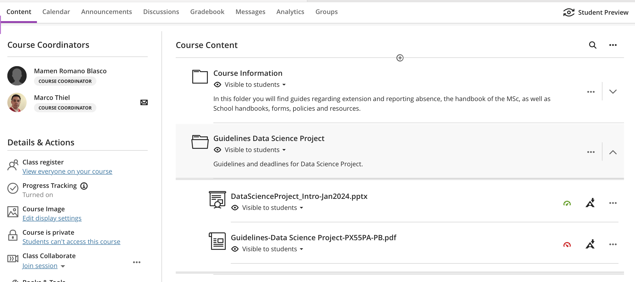
Please check detailed guidelines in MyAberdeen

Slide 11
Supervisory meetings
10 supervisory group meetings to review progress and discuss problems and questions.
Students expected to work independently; supervisors to provide some guidance and point in the right direction.
Any questions or problems, please contact us:
Marco Thiel (m.thiel@abdn.ac.uk)
Mamen Romano (m.romano@abdn.ac.uk)

