Slide 1
Cellular respiration
Synthetic stage 0 fixture

Slide 2
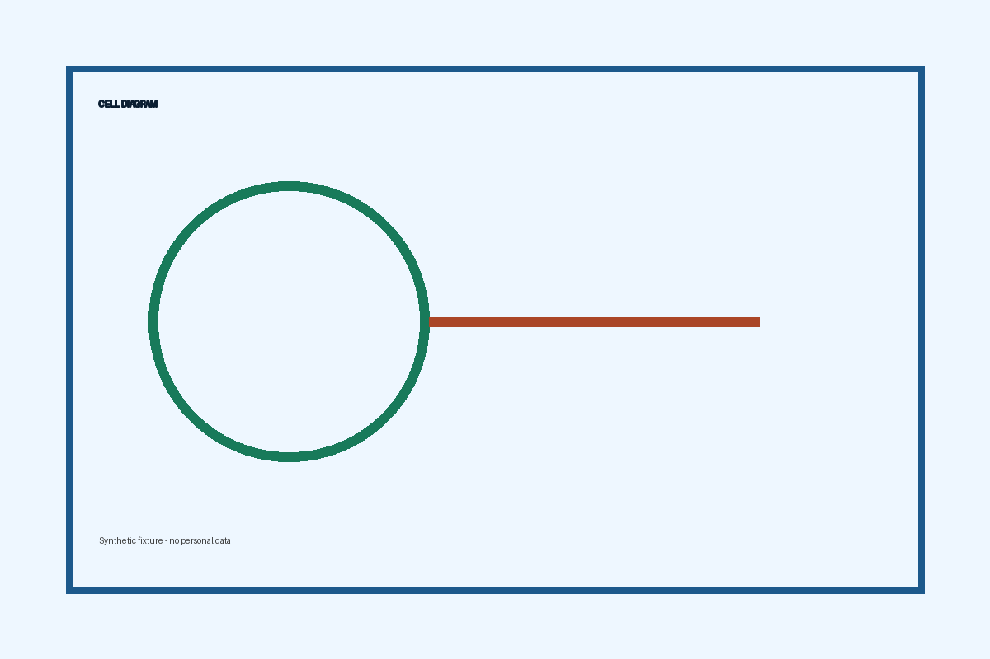
ATP production
Glycolysis occurs in the cytoplasm.
The citric acid cycle occurs in mitochondria.

