Slide 1
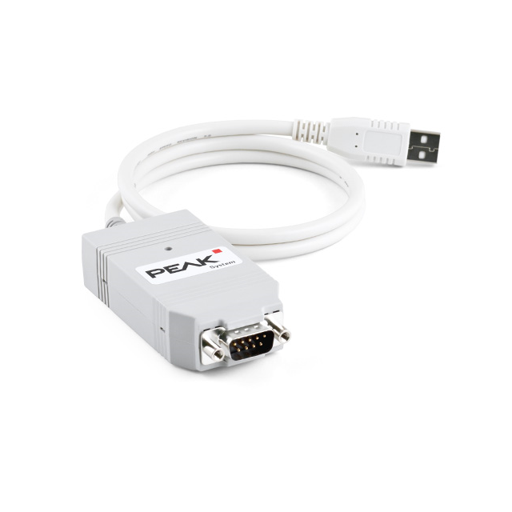
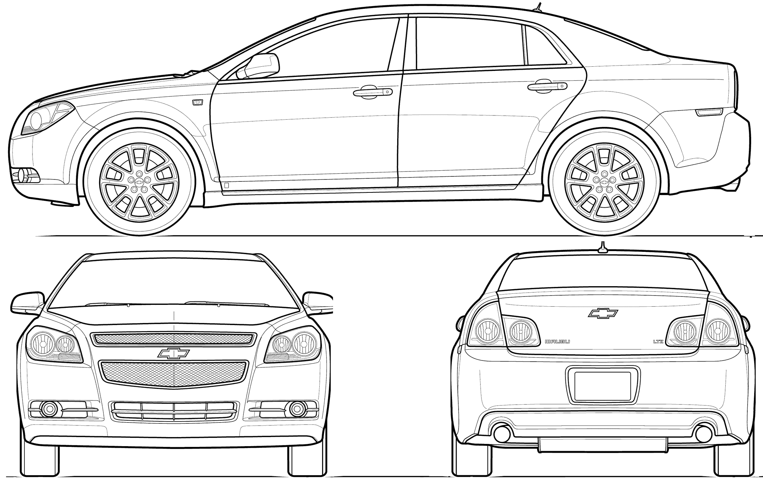




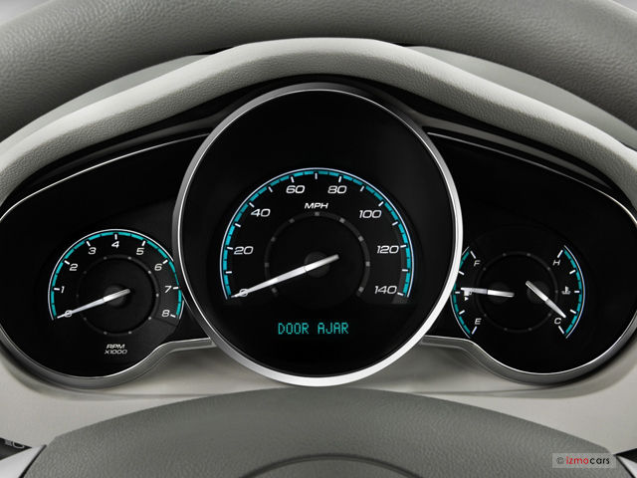





$$+$$
$$+$$
$$+$$
$$+$$
Vehicle Speed
Engine Speed
Engine Coolant Temperature
Fuel Level Percentage
Trip Odometer
Sampled every 0.1 sec
with
$$=$$

Slide 2
Engine Speed (RPM)
Vehicle Speed (km/hr)
Engine Coolant Temp (̊C)
Fuel Level %
Trip Distance (km)
305,000
Parallel
For
61,000
61,000
61,000
61,000
61,000
Parallel
Reduce
…
…
…
…
…
To get a min, max, and average for each value

Slide 3
Engine Speed (RPM)
Vehicle Speed (km/hr)
Engine Coolant Temp (̊C)
Fuel Level %
Trip Distance (km)
305,000
Parallel
For
Parallel
For
61,000
61,000
61,000
Fuel Efficiency =
Parallel
Reduce
…
…
…
To get a min, max, and average for each value

Slide 4
Engine Speed (RPM)
61,000
MAP
0-250
250-500
…
5750-6000
0-250
250-500
…
5750-6000
0-250
250-500
…
5750-6000
0-250
250-500
…
5750-6000
0-250
250-500
…
5750-6000
REDUCTION

