Slide 1

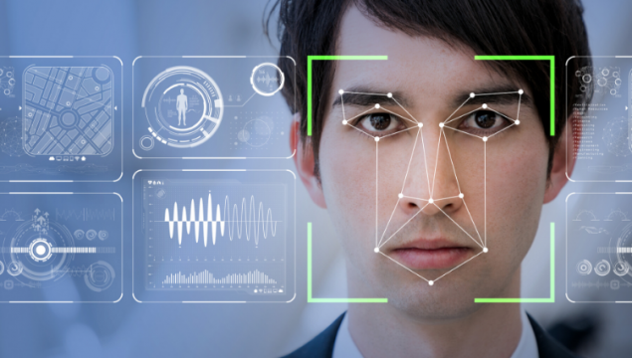
Biometric Backdoors
Project Under
Prof. Pritee Khanna
IIITDM Jabalpur
[ Associate Professor (CSE) and Chairperson Placement Cell ]

Slide 2
ABSTRACT
In recent years, biometric authentication has become one of the preferred ways to mitigate burdens associated with passwords. With a long history of research, face and fingerprint recognition are the most popular modalities and authentication systems based on them are commonly delivered with consumer products.
The Project aims for:
Building Face Recognition System.
Planning for Adversarial Attacks(White Box attack).
Adversarial Countermeasures and Evaluations.
Reference Research Paper - Biometric Backdoors: A Poisoning Attack Against Unsupervised Template Updating, proposed by Giulio Lovisotto, Simon Eberz, Ivan Martinovic.

Slide 3

Key Content
Face Recognition.
Introduction to Adversarial Machine Learning.
Poisoning Sample Generation.
Adversarial Attack Injection.
Samples Visualization.
Attack Countermeasures.
Evaluation.
NOTE :
All visualization shown are the part of project itself, if not mentioned.

Slide 4
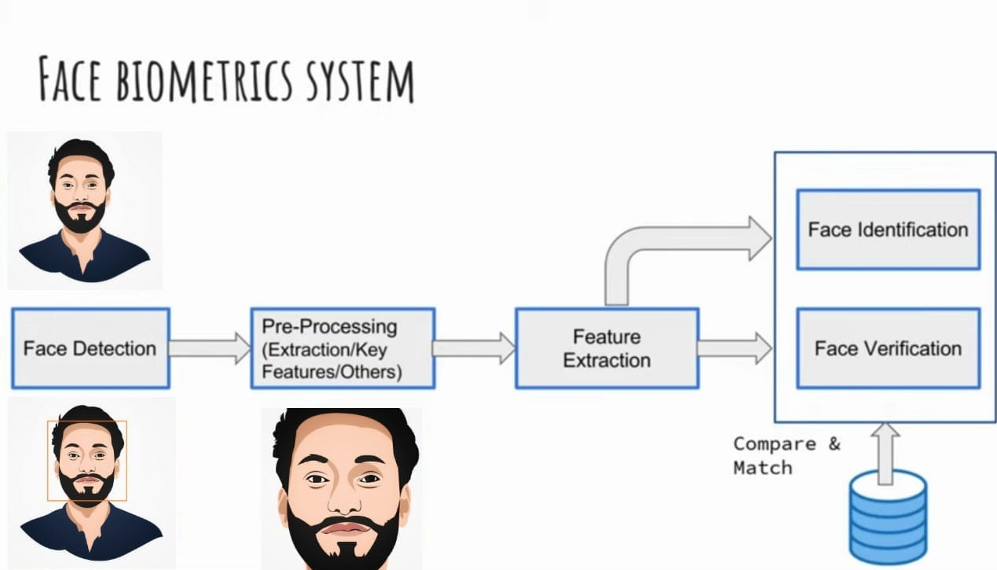
MTCNN
Face-Net
N-dim. vector

Slide 5
Face Recognition
Face Recognition is a recognition technique used to detect faces of individuals whose images saved in the data set. Despite the point that other methods of identification can be more accurate, face recognition has always remained a significant focus of research because of its non-meddling nature and because it is people’s facile method of personal identification.
Neural Network has continued to use pattern recognition and classification. I used them as a feature vector(128) extractor. There are many methods, which combined with tools like SVM's, logistic regression, etc and make a hybrid classifier for face recognition.
I used Multi-Task Cascaded Convolutional Neural Network (MTCNN) for face bounding box recognition (PAPER).
I used FACE-NET DL model for feature extractor and ONE-CLASS SVM as a system detector.
Visit NOTEBOOK for code implementation.

Slide 6
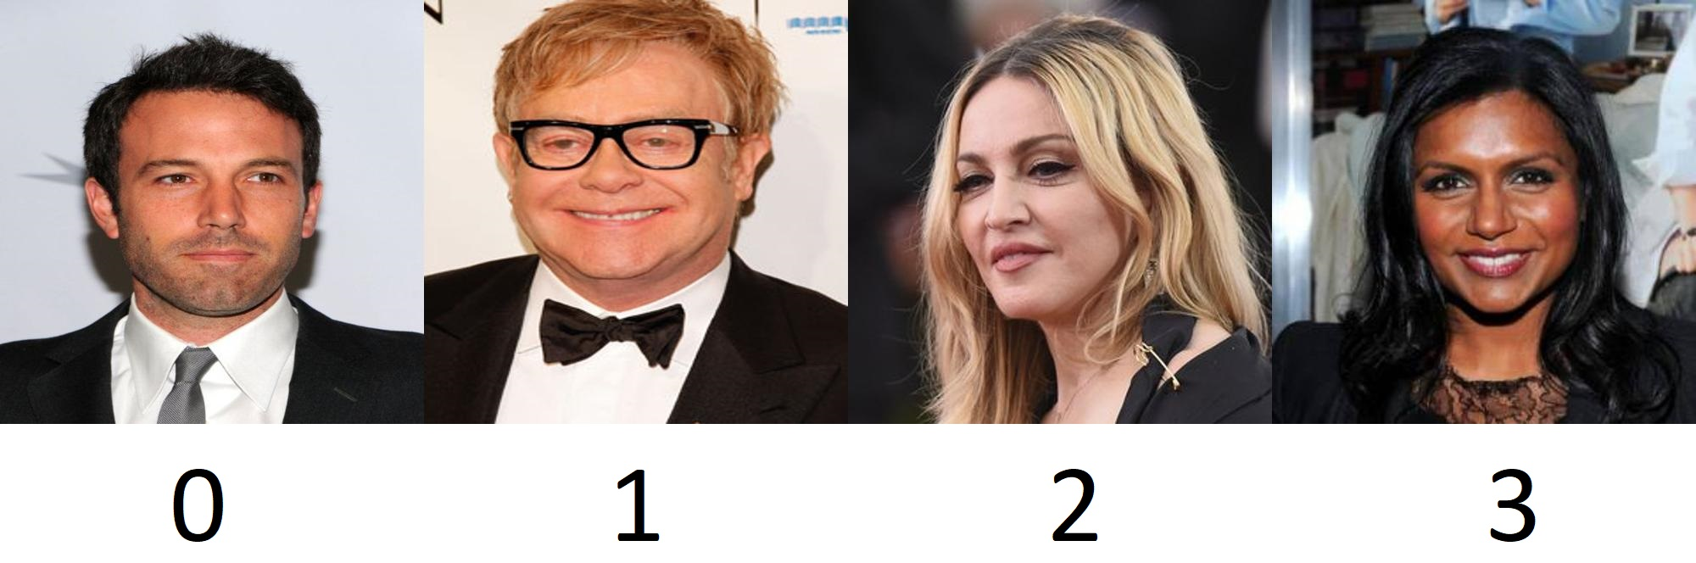
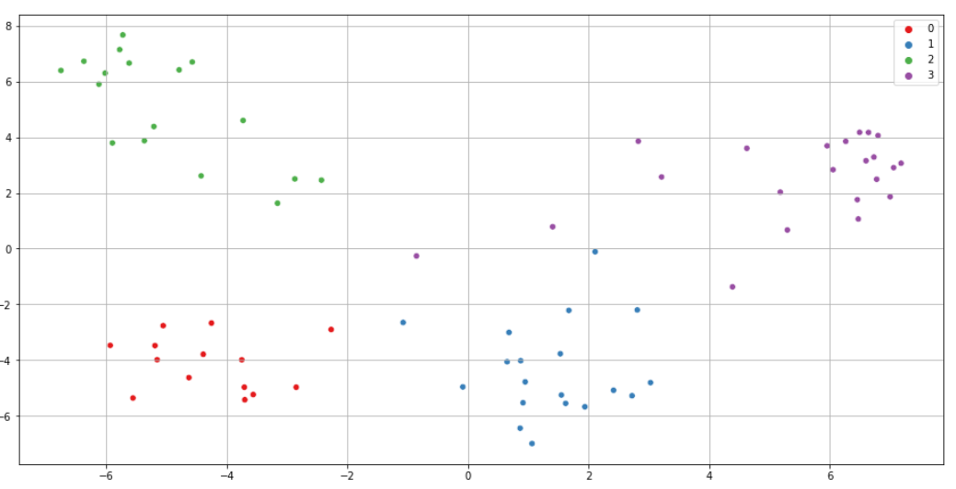
Assets
2D Feature Distribution-
Face-Net
Model

Slide 7
Adversarial Machine Learning
Adversarial machine learning is a machine learning technique that attempts to fool models by supplying deceptive input.
Our deep neural networks are powerful machines, but what we don’t understand can hurt us. As sophisticated as they are, they’re highly vulnerable to small attacks/changes that can radically change their outputs.
A targeted attack, for example, manipulates the input images to change the classifier. The input can be used to cause the machine to see what the attacker wants. In some cases, it’s possible to accomplish this by changing only one pixel. Attacker can control perturbations so that they aren’t detectable to standard noise filters. This is what makes these attacks so dangerous!

Slide 8
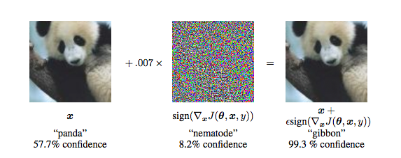
How IT works ?
When you ask a HUMAN to describe how she detects a panda in an image, she might look for physical characteristics such as round ears, black patches around the eyes, the snout, the furry skin. She might also give other context, such as the kind of habitat she would expect to see the panda in and what kind of poses a panda takes.
To an Artificial neural network or CNNs, as long as running the pixel values through the equation provides the right answer, it is convinced that what it is seeing is indeed a panda. In other words, by tweaking the pixel values in the image the right way, you can fool the AI into thinking it is not seeing a panda.
GoogleNet
Result -
PHOTO taken from PAPER - EXPLAINING AND HARNESSING ADVERSARIAL EXAMPLES

Slide 9
Poisoning Sample Generation
There are three categories of samples:
user (victim) samples: legitimate user samples.
attacker samples: samples coming from the biometric trait of the adversary.
poisoning samples: samples algorithmically crafted by the adversary.
Challenges for an adversary, given a deep model f , a starting sample from the adversary x, a target sample from the user y and their respective feature vectors computed by the model f(x) and f(y):
Finding a perturbation on the adversary sample features δx that minimizes ∥ f(x + δx) − f(y) ∥.
All the perturbations can be done on the area of the glasses.
Account for the glasses smoothness ( V(δx ) ) and real-world printability.
Maintain False rejection rate(FRR) for a legitimate user.
Increase Imposter (adversary) acceptance rate(IAR).
I have used SVM-OneClass Algorithm for classification on top of Face-Net (paper) deep neural network for the project. Also, considered ben affleck as a Legitimate user and Jerry Seinfeld as Attacker.
Visit NOTEBOOK for code implementation.

Slide 10
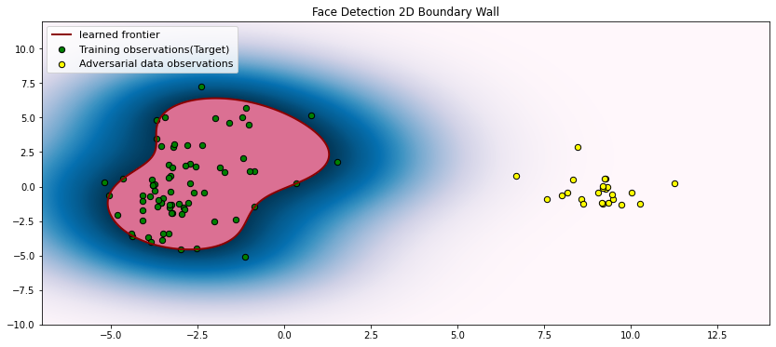
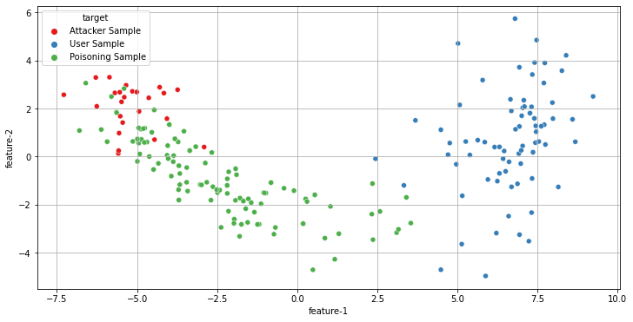
SVM-OneClass
Boundary wall.
2-D feature Distribution
Color
Confidence
Poisoning Sample Generation and it’s injections mapping from legitimate to attacker vector space while template updating.

Slide 11
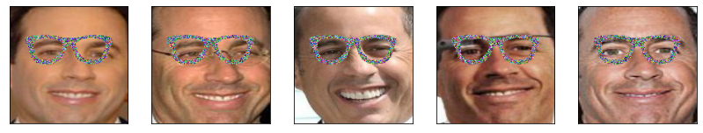
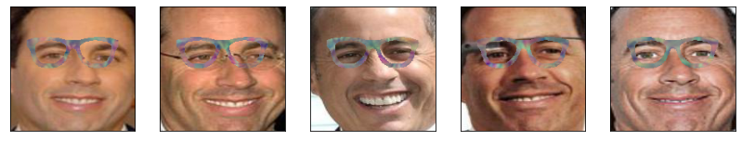
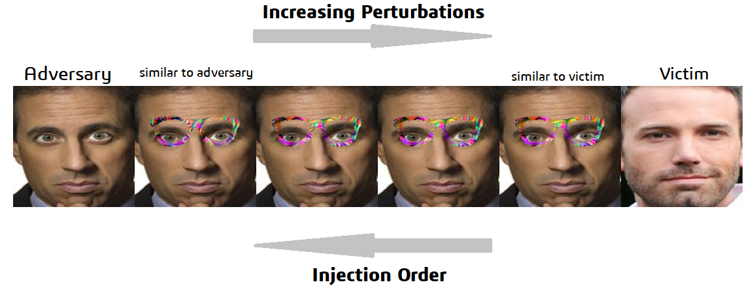

Random perturbation Samples
Adversaries‘ Centroid perturbation Samples
Final Output
Binary Mask

Slide 12
Adversarial Attack Injection
Adversary can successfully inject a sample when at least a θ2(0.6) fraction of the attackers samples (as they are wearing the glasses) are accepted by the system.
Whenever the adversary attempts to inject a sample, if less than θ2 of his samples are accepted by the system ,the attempt a failure. In this case, the adversary will increase the amount of perturbations on the glasses (move closer to the user’s template), and attempt again.
In the cases where more than θ2 samples are accepted, then the attempt successful and adversary now can inject one of these accepted samples into the current user template (chosen at random).
The algorithm stops when at least θ1(0.58) fraction of the attacker samples, while wearing no glasses , is accepted by the system.
On a Final call, adversary planted the Poisoning samples in system’s database. Which ultimately changed the Overall Detection Boundary of system.
Visit NOTEBOOK for code implementation.

Slide 13
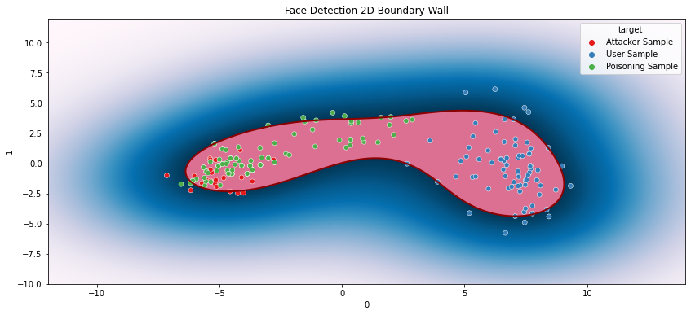
SVM-OneClass
modified
Boundary wall.
2-D feature Distribution
Color
Confidence

Slide 14
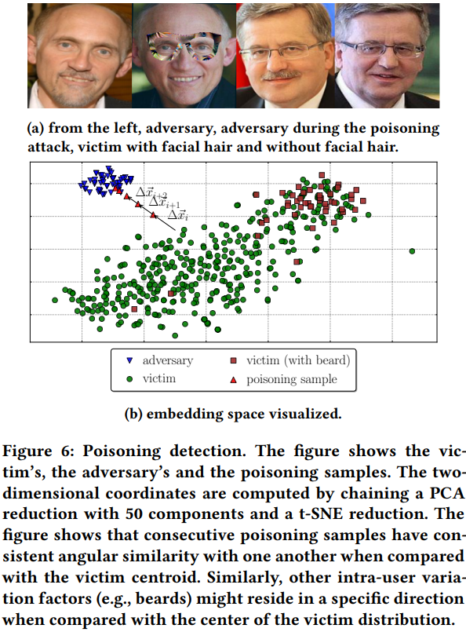
Attack Countermeasures
Given the user’s current centroid Xc and a set of template updates {Xi , Xi+1, ..., Xi+n }, which we refer to as an update sequence, we compute the direction of the update at time i: ∆Xi = Xc − Xi and we can obtain the directions at each step as {∆Xi , ..., ∆Xi+n }. We then compute the angular similarity for pairs of consecutive updates with the Cosine Similarity.
The underlying intuition is that COSθ (Cosine Similarity) will be higher for pairs of poisoning samples compared to legitimate updates because the poisoning attack needs to shift the current user centroid towards the adversary’s, which lies in a specific pre-defined direction.
Visit NOTEBOOK for code.
PHOTO taken from Reference Research Paper

Slide 15
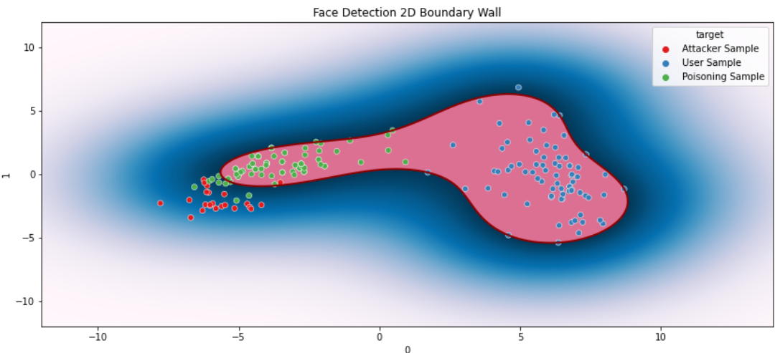
System
model get's notified before the boundary gets closer to actual attacker's feature space.

Slide 16
Evaluation
For End-to-End smooth execution of attack via template update, I consider IAR, and FRR as my Evaluation metrics.
Impostor acceptance rate (IAR): The proportion of attacker samples that are accepted by the system as legitimate.
False rejection rate (FRR):The proportion of victim’s samples that are rejected by the classifier.
Cosine Similarity.
Visit NOTEBOOK for code.

Slide 17
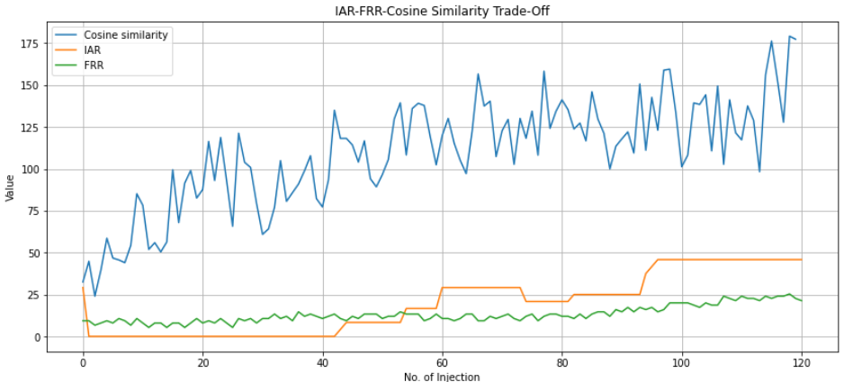
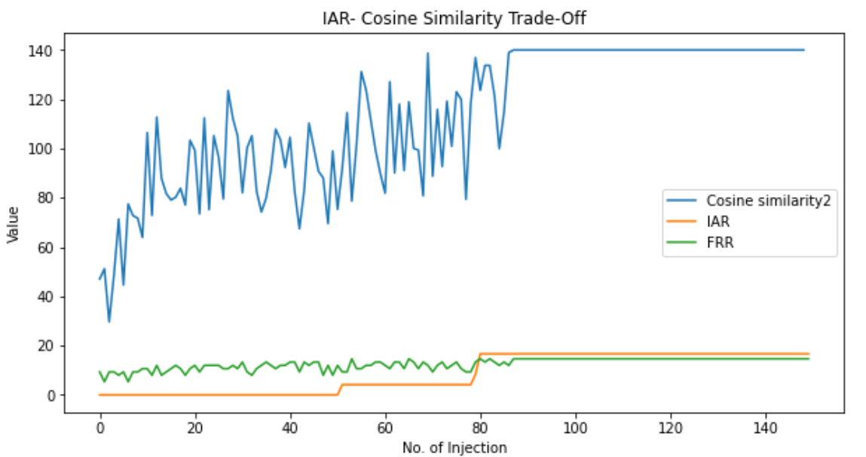
Without Countermeasures
With Countermeasures

Slide 18
Thank You

