Slide 1

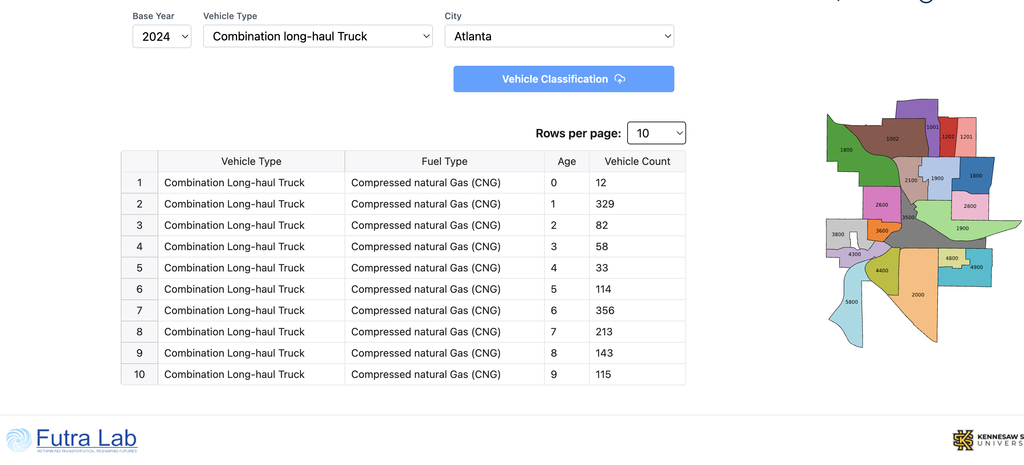
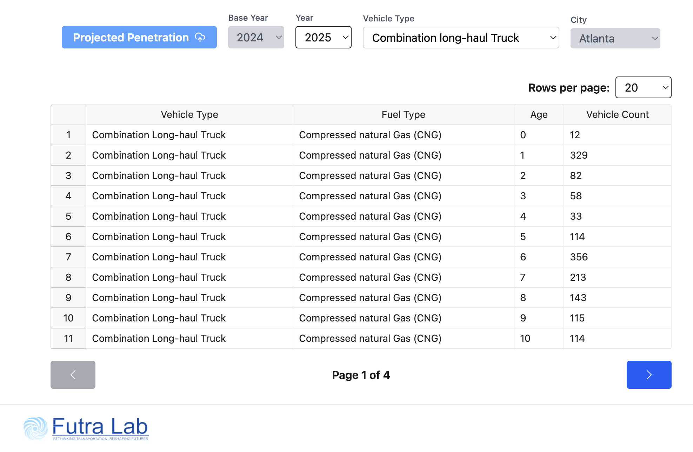
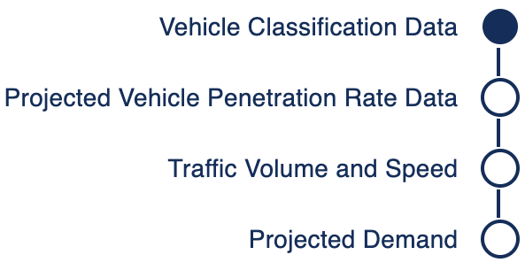
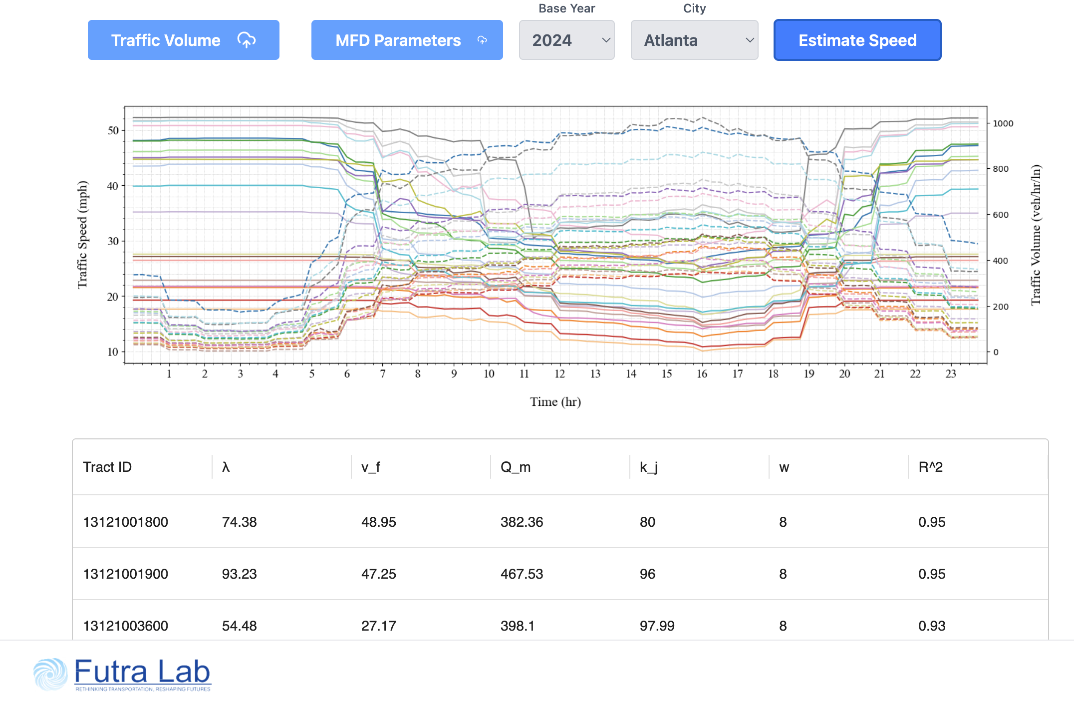
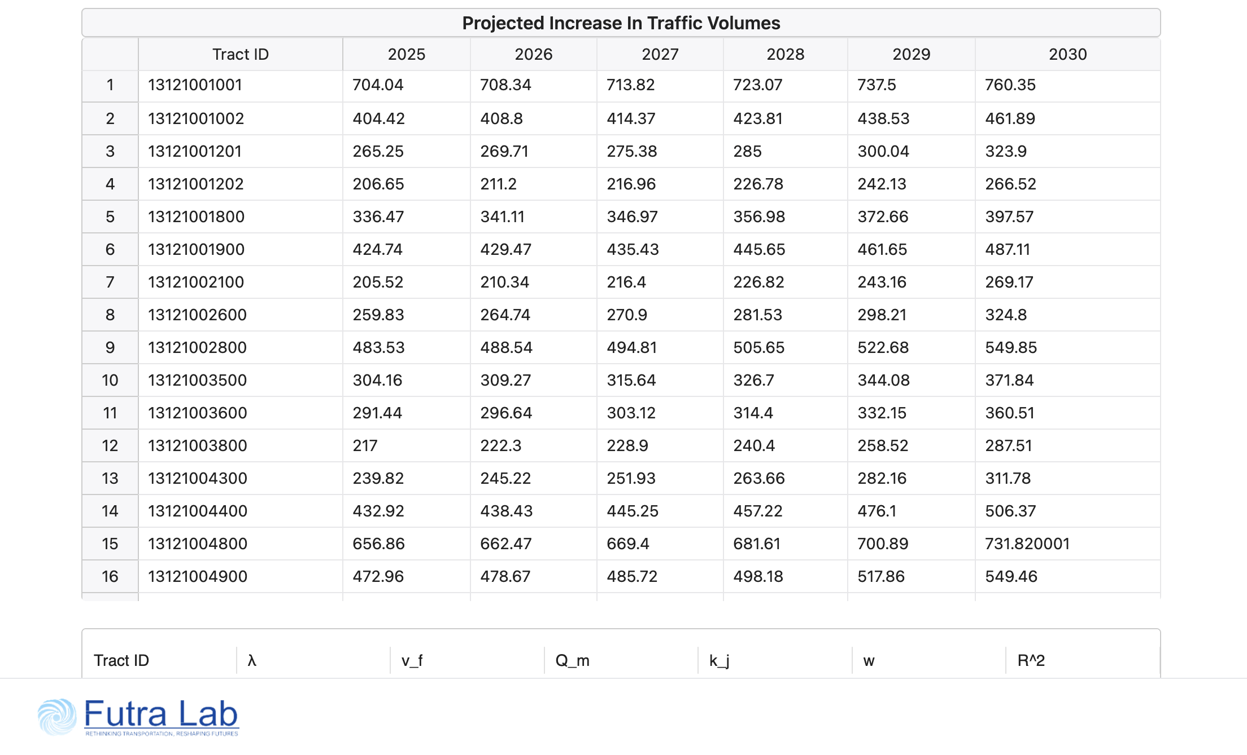
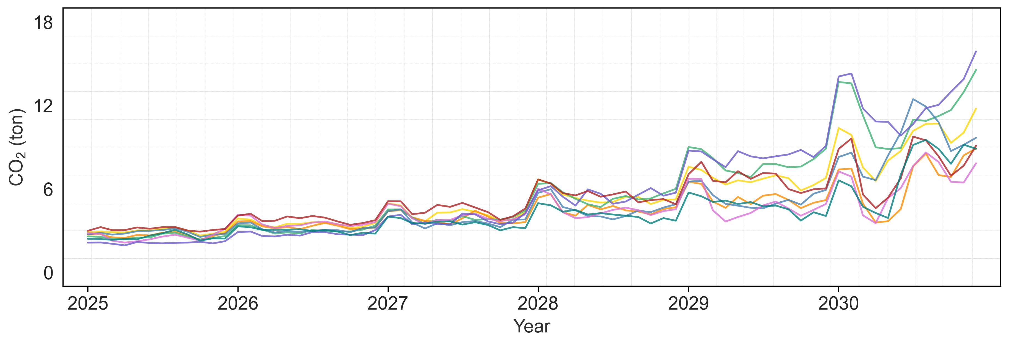
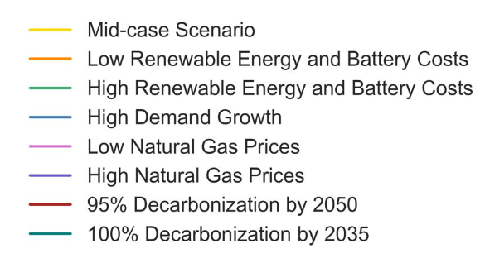
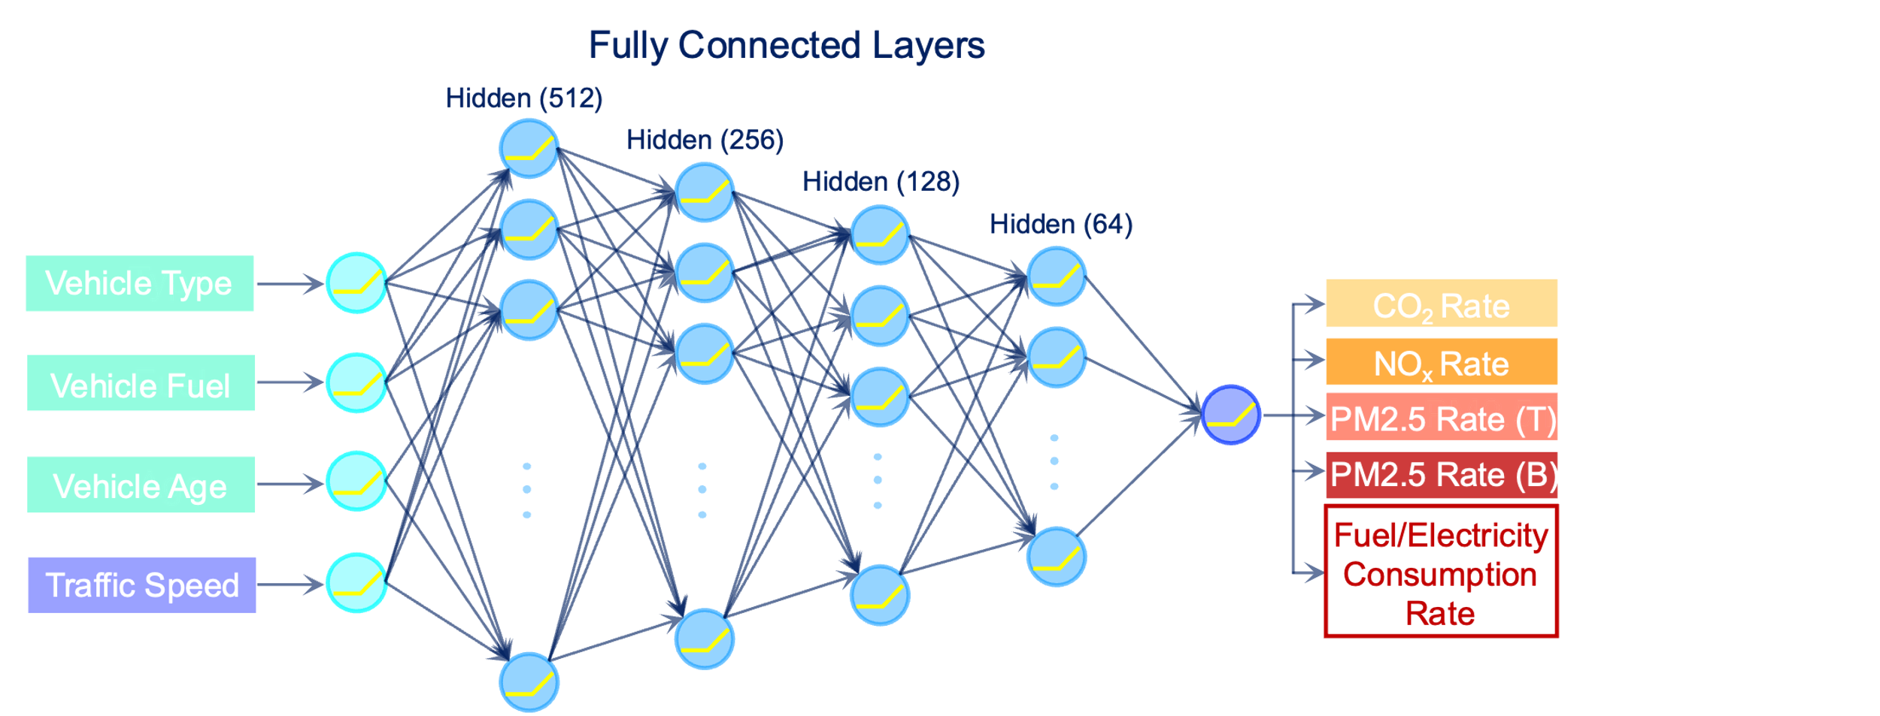
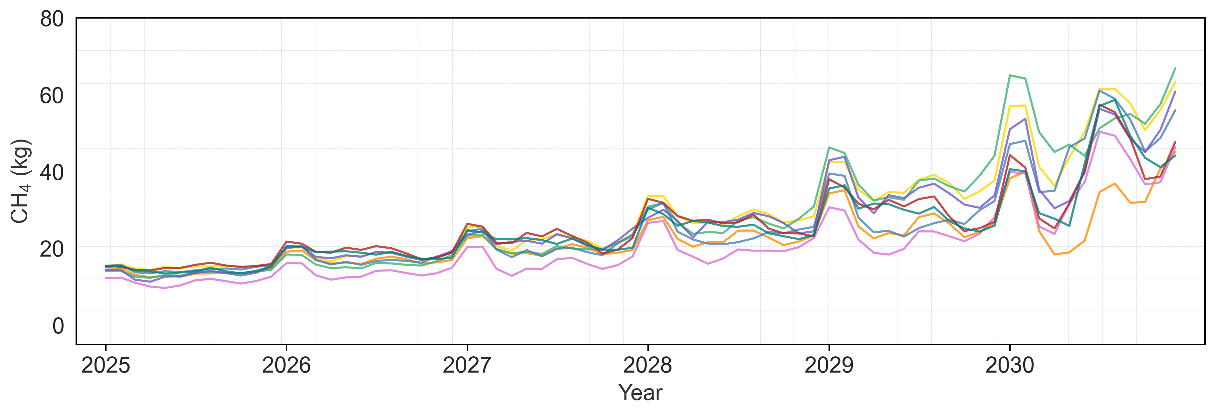
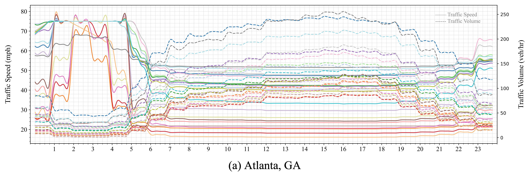
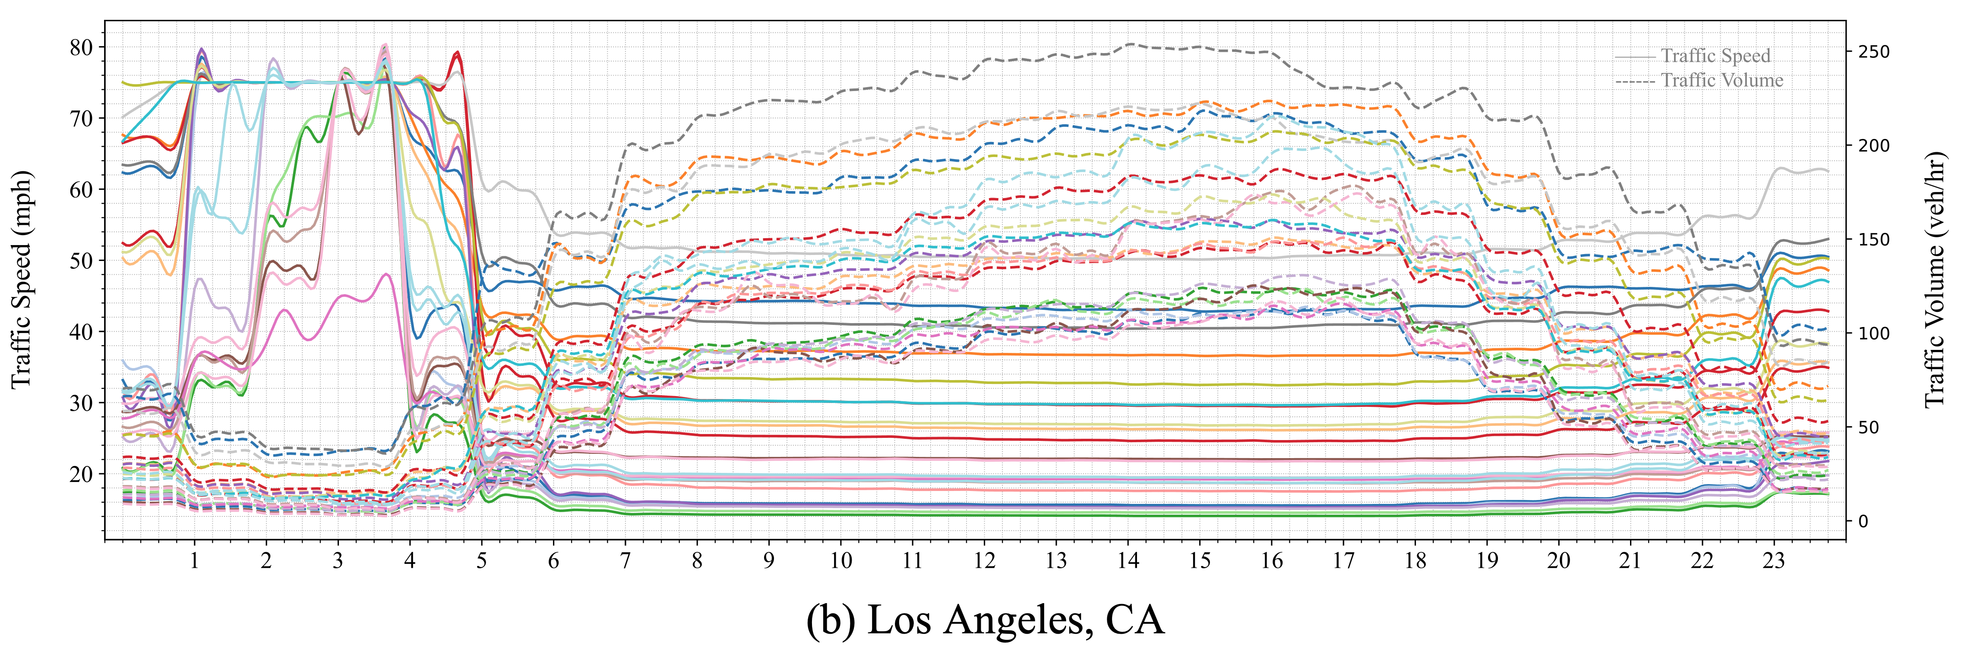
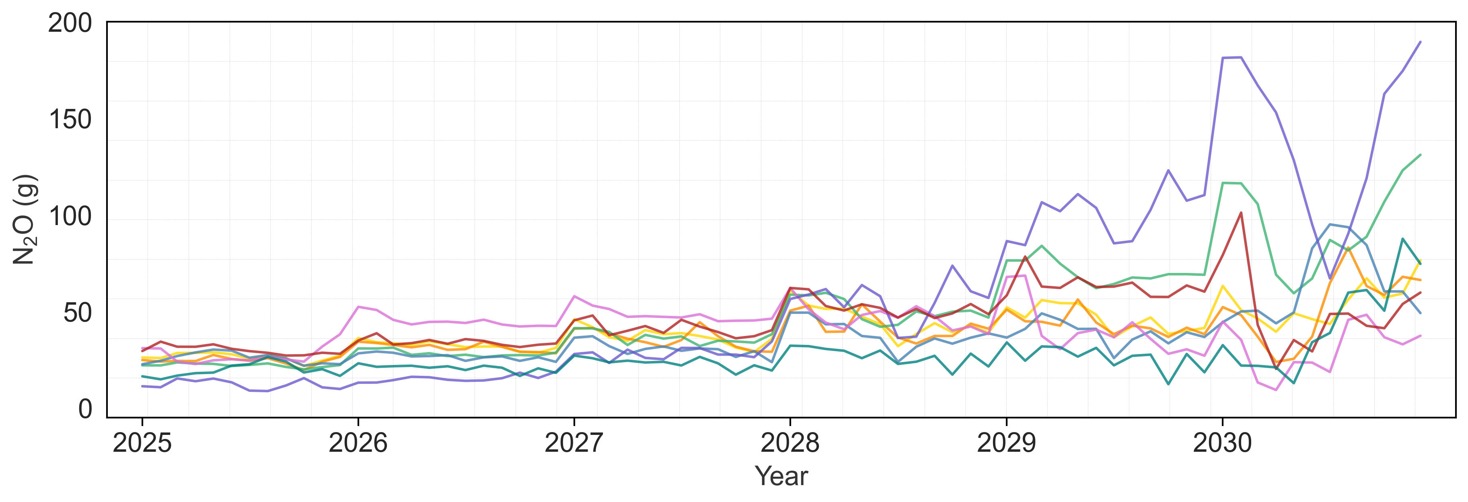
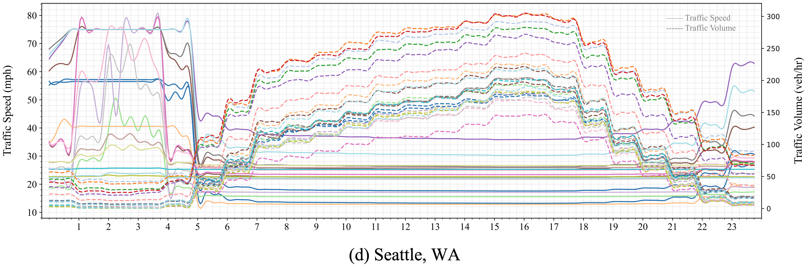
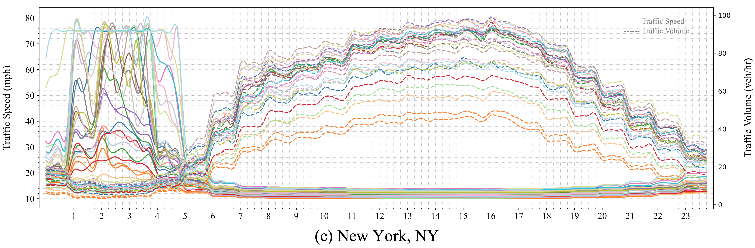
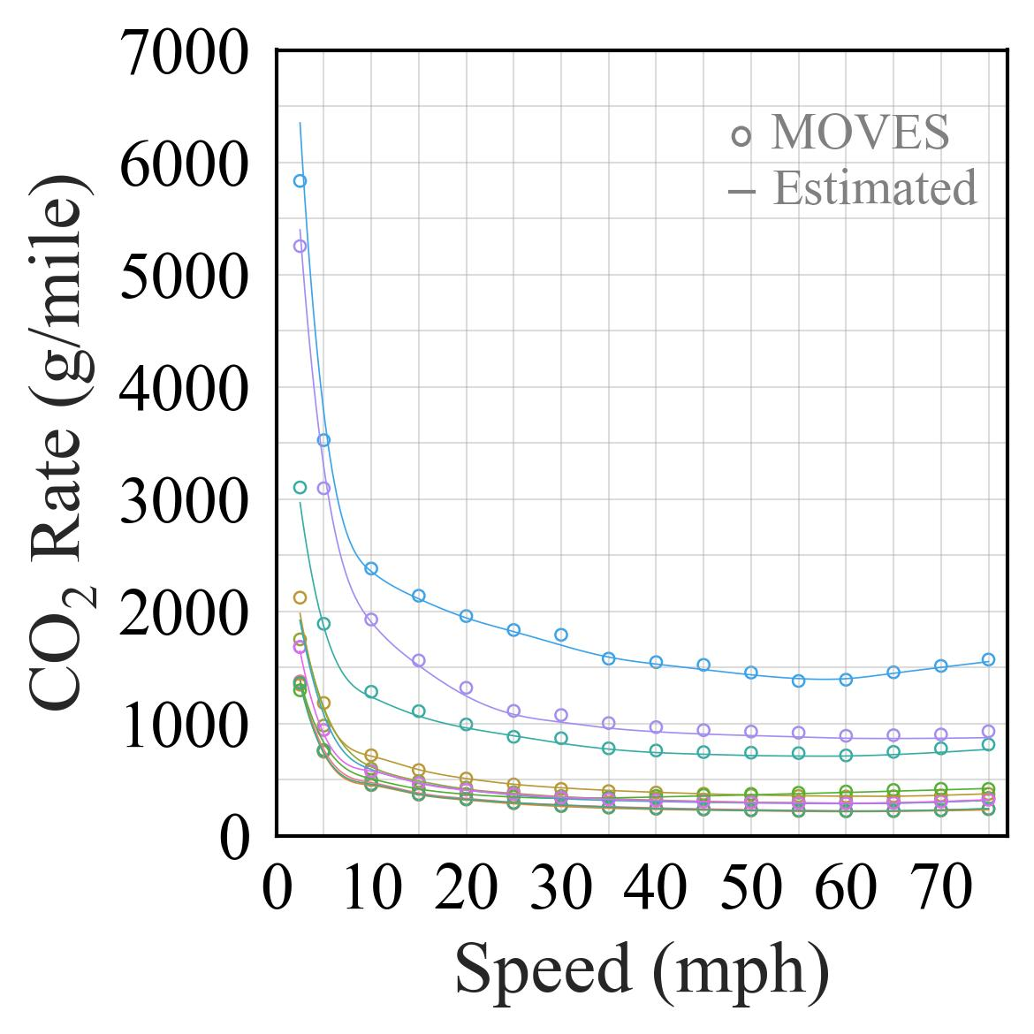
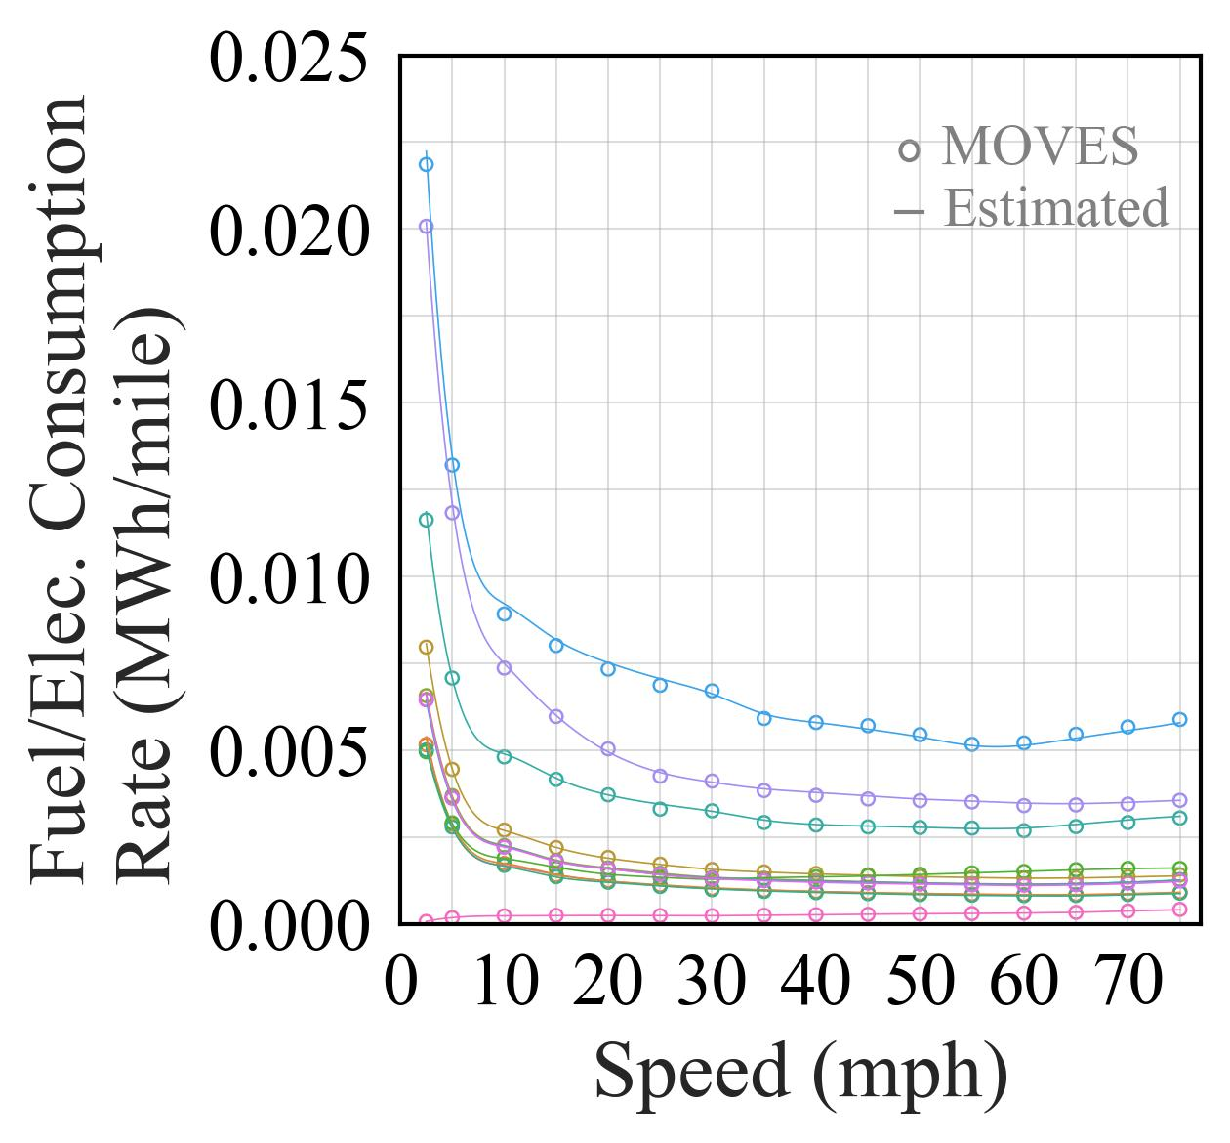
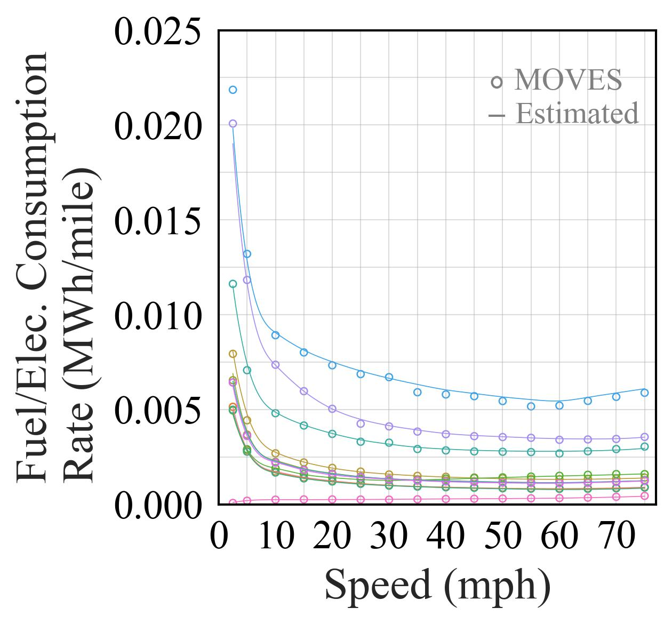
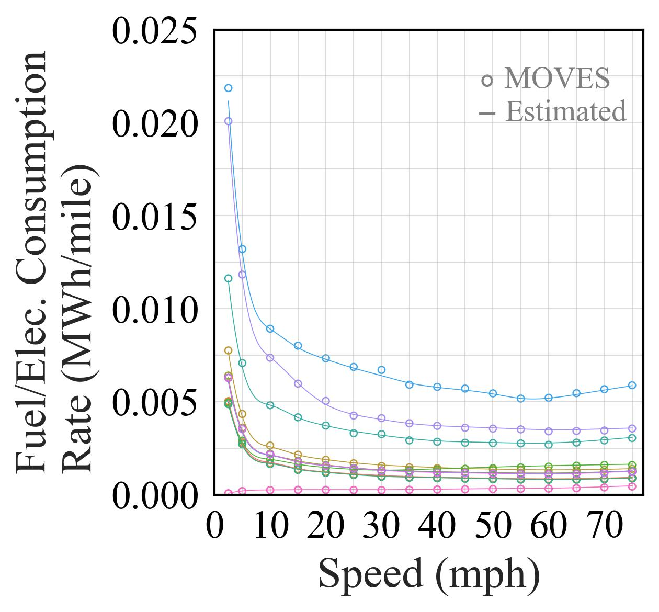
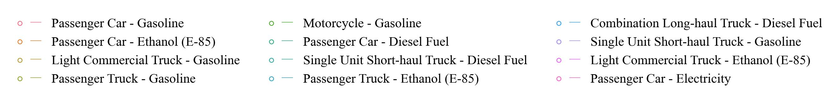
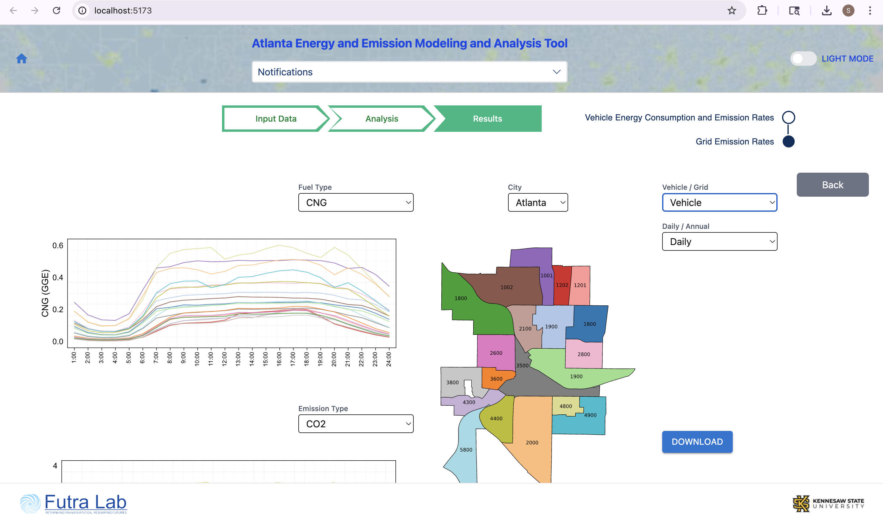
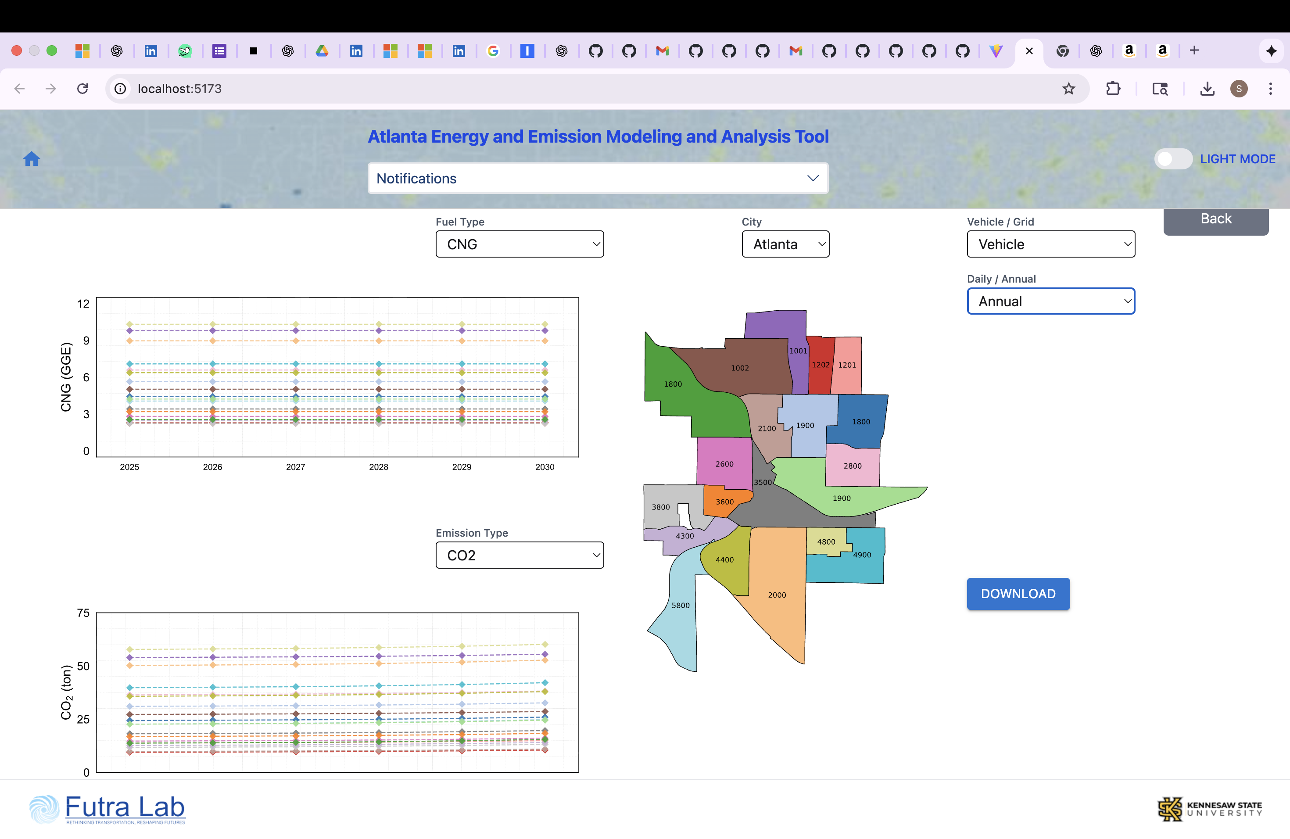
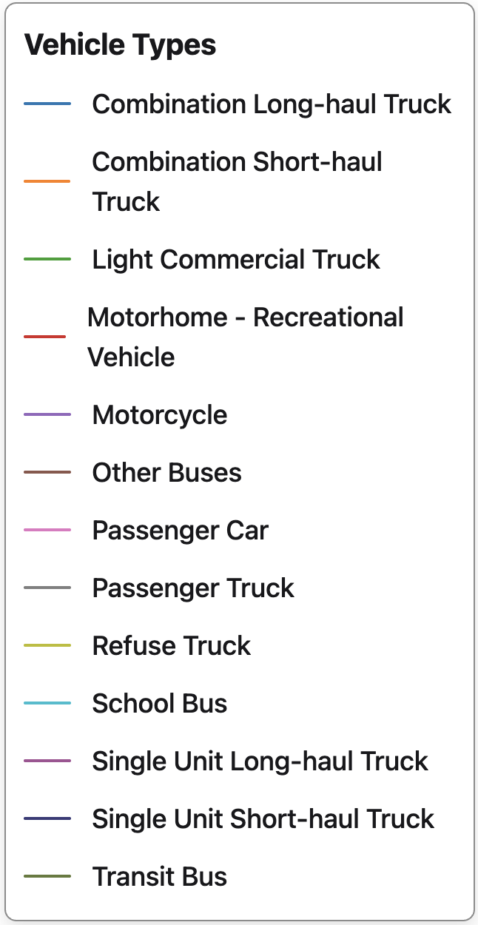
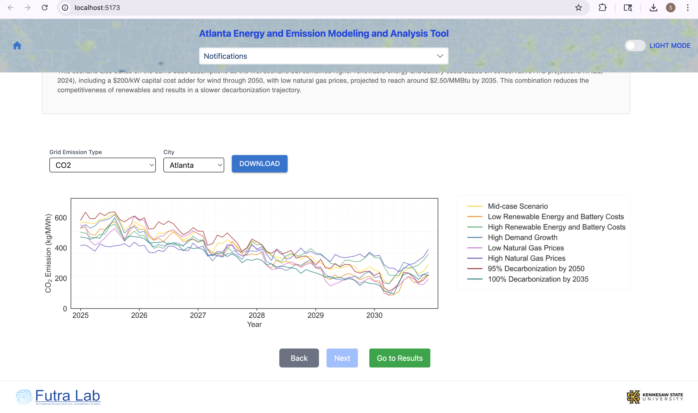
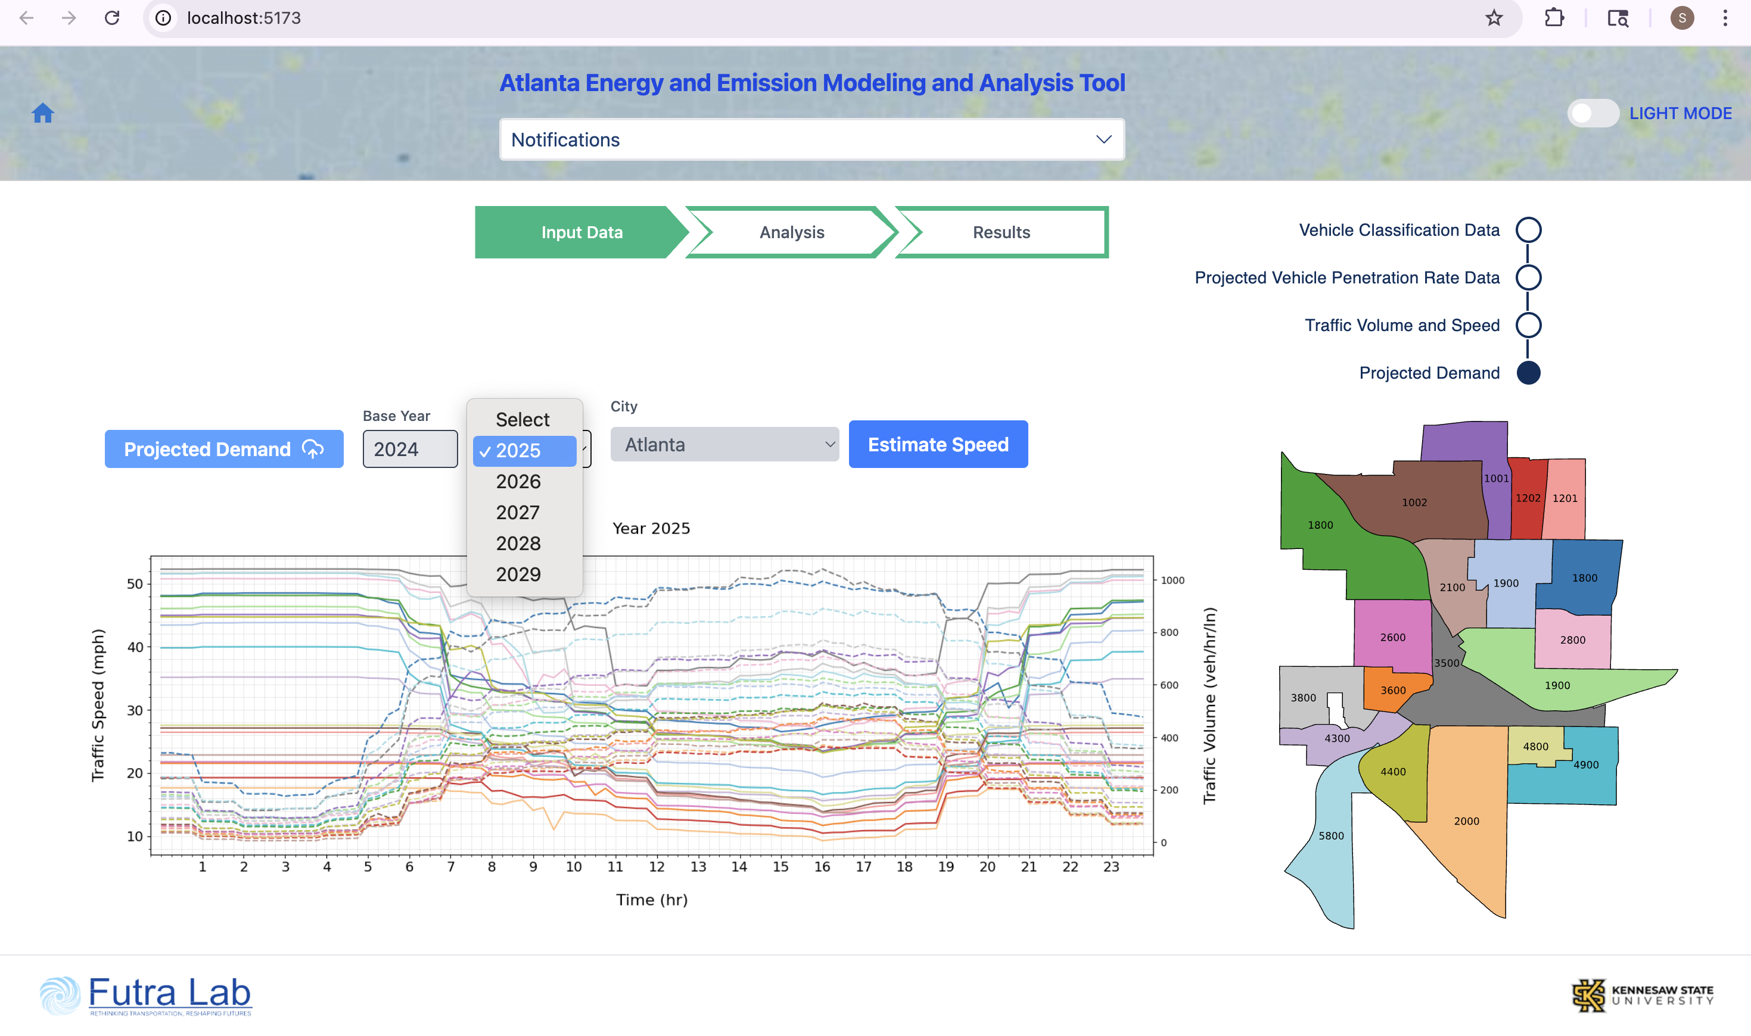
National Energy and Emission Modeling and Analysis Tool
NEEMAT
A Web-Based Decision-Support Platform for Vehicle and Grid Emission Prediction Under Rising EV Adoption
Abstract
NEEMAT Web Platform: Input Data Pipeline
Platform: Data, Models & Scenarios
NEEMAT is a web-based decision-support tool that predicts vehicle and power-plant emissions plus fuel/energy consumption under rising EV adoption for Atlanta, Los Angeles, New York, and Seattle. A feedforward neural network trained on EPA MOVES 4.0 estimates tract-level vehicle energy use and CO₂/NOx/PM2.5 by speed, vehicle type, fuel, and age, while a macroscopic traffic model (Modified MFD) captures flow effects. Grid-side CO₂/CH₄/N₂O from EV charging are forecast with a Meta-Prophet model trained on NREL Cambium data. Users upload city-specific fleet and traffic data, select future years (2025–2030), and interactively compare scenarios across six grid pathways. The platform outputs daily and annual emission profiles with interactive charts, census tract maps, and CSV exports.
1. Vehicle Classification (Base Year)
2. Projected Vehicle Penetration Rate
An integrated web platform quantifying emissions from EV charging and road traffic by combining traffic, vehicle, and grid models.
Data (Website Inputs) Vehicle Fleet: GA/CA/NY/WA registrations (base) and projected EV penetration.
Traffic: tract-level 15-min volume & density (base + projections).
Libraries: MOVES 4.0 vehicle rates; NREL Cambium marginal grid rates.
Models (Built-in) Vehicle: feed-forward NN → CO₂/NOx/PM₂.₅ & Energy vs speed (type × fuel × age).
Traffic Flow: Modified MFD to estimate speed from density.
Power Plant: Meta-Prophet for marginal grid emissions (CO₂, CH₄, N₂O).
Integration Combines EV energy demand, grid emissions, and traffic data to predict total GHG. Results page: Daily (24-hr) and Annual (multi-year) with Download.
Scenarios Projection years 2025–2030. EV adoption levels 25% to 100%. Study area: downtown tracts in Atlanta, LA, New York, Seattle.
System Architecture
3. Traffic Volume & Speed (Base Year)
4. Projected Demand
Web UI & User: City . Year . Vehicle . Fuel . Scenario
Grid Emission Rate Analysis
Views: Map (Census Tracts) . Tables . Graphs
Forecast Horizons: 24-hour Profiles . Multi-year Outlook
Actions: Compare Scenarios . Export Results (CSV)
Feedforward Neural Network Model
Annual CO₂ (ton) Projections
Traffic Speed & Volume: MFD Model (Base Year 2024)
Annual CH₄ (kg) Projections
Architecture: FC(512) → ReLU → FC(256) → ReLU → FC(128) → ReLU → FC(64) → ReLU → FC(1)
Inputs: Vehicle Type (13 one-hot) + Fuel Type (5 one-hot) + Age + Speed = 20 features
Outputs: CO₂, NOx, PM2.5 (Brake/Tire), Fuel/Energy rate per vehicle class
Training: EPA MOVES 4.0 inventory; 20 PyTorch models (5 per state: GA, CA, NY, WA)
(a) Atlanta, GA
(b) Los Angeles, CA
Annual N₂O (kg) Projections
NN Validation: MOVES vs. Estimated
Six NREL Cambium grid scenarios: mid-case, low/high renewable costs, high demand growth, low/high natural gas prices. Meta-Prophet time-series forecasting.
(c) New York, NY
(d) Seattle, WA
Key Findings & Model Validation
NEEMAT delivers highly accurate predictions:
• Vehicle NN on MOVES 4.0 achieves R² = 0.996 to 0.999
• MFD speed model holds R² > 0.85 across all city tracts
• Grid forecasts calibrated against NREL Cambium baselines
Atlanta (Georgia) by 2030 Projections:
• EV adoption: up to 46%
• Gasoline vehicle energy consumption: +86.61%
• GHG emissions from vehicles: +87.03%
• EV energy consumption from grid: +74.89%
• GHG emissions from power plants: +77.61%
Users select City and Domain (Vehicle or Grid) and choose a
Temporal View: Daily renders 24-hour profiles of fuel use,
emissions, and energy by tract; Annual traces multi-year
trajectories under user-selected EV penetration scenarios.
Modified MFD: volume → speed via nonlinear root-finding (scipy.optimize.fsolve). Calibrated R² > 0.85 for all census tracts across all 4 cities.
CO₂ Rate (g/mi)
Fuel/Elec. (MWh/mi)
NOx Rate (g/mi)
PM2.5 Rate (g/mi)
Web Application: Results & Visualization
Technology Stack
Frontend: React 19 + Vite 6 + MUI 7 + TailwindCSS 4 + Chart.js + Zustand
Backend: Flask + PyTorch + NumPy/SciPy + Pandas + scikit-learn + SQLite
ML Models: Modified NN (512→256→128→64→1) + Modified MFD + Meta-Prophet
Deploy: Docker + Docker Compose + Nginx + AWS EC2
Interactive Analysis Workflow
Results: Daily View (24-hour profile)
Results: Annual View (multi-year trend)
1. Upload Data
→
2. Select Filters
→
3. Run Prediction
→
4. View Charts
→
5. Compare
→
6. Export CSV
Users select City, Year, Vehicle/Grid domain, and Temporal View (Daily or Annual). Interactive charts with zoom, hover tooltips, tract-level map selection, and CSV export.
Authors: An Pham, Swetha Kakaraparthi, S M Tanvir Faysal Alam Chowdhoury
Advisors: Dr. Mahyar Amirgholy, Dr. Chenyu Wang
Kennesaw State University | Department of Civil Engineering | Futra Lab
Futra Lab
Kennesaw State University

