Slide 1
S . Adlin saro
REG NO : 962821104004
DEPARTMENT : COMPUTER SCIENCE AND ENGINEERING
FINAL PROJECT

Slide 2
PROJECT TITLE
GENERATIVE AI NETWORK FOR IMAGE SYNTHESIS

Slide 3
AGENDA
Problem Statement
Project Overview
End Users
Our Solution and its Value Proposition
The Wow in Our Solution
Modelling Approach
Results
Conclusion

Slide 4
PROBLEM STATEMENT
Many industries require large datasets of images for various purposes , such as training machine learning models , generative creative content , or enhancing visual effects in entertainment.
However , obtaining such datasets can be time-consuming ,expensive , or even impossible due to privacy concerns.
Therefore , there is a need for a solution that can generate synthetic images with high fidelity and diversity to address these limitations.

Slide 5
PROJECT OVERVIEW
The project aims to develop a Generative Adversarial Network (GAN) in python to generate realistic images resembling a given dataset.
The GAN will consist of a generator and a discriminator trained adversarially ,with the generator learning to produce increasingly convincing images and the discriminator learning to differentiate between real and generated images.

Slide 6
END USERS
Researchers and developers
Artists and designers
Entertainment Industry Professionals

Slide 7
OUR SOLUTION AND ITS VALUE PROPOSITION
Our solution offers a powerful tool for generating synthetic images with high fidelity and diversity , alleviating the need for large , expensive datasets.
By leveraging advanced deep learning techniques , our Generative AI Network empowers users to create realistic images efficiently and affordably , unlocking new possibilities for AI applications.

Slide 8
THE WOW IN OUR SOLUTION
The standout feature of our solution lies in its ability to produce images that not only exhibit high visual quality but also maintain diversity and realism across different domains.
Additionally , our solution provides an intuitive interface and customizable parameters , ensuring accessibility for users of all levels.

Slide 9
MODELLING APPROACH
We implement a state-of-the-art GAN architecture , possibly incorporating techniques such as Wasserstein GAN(WGAN) or Progressive Growing GAN(PGGAN) to improve stability and image quality.
The model will be trained on large-scale image datasets , such as CelebA or CIFAR-10,to capture diverse visual characteristics.

Slide 10
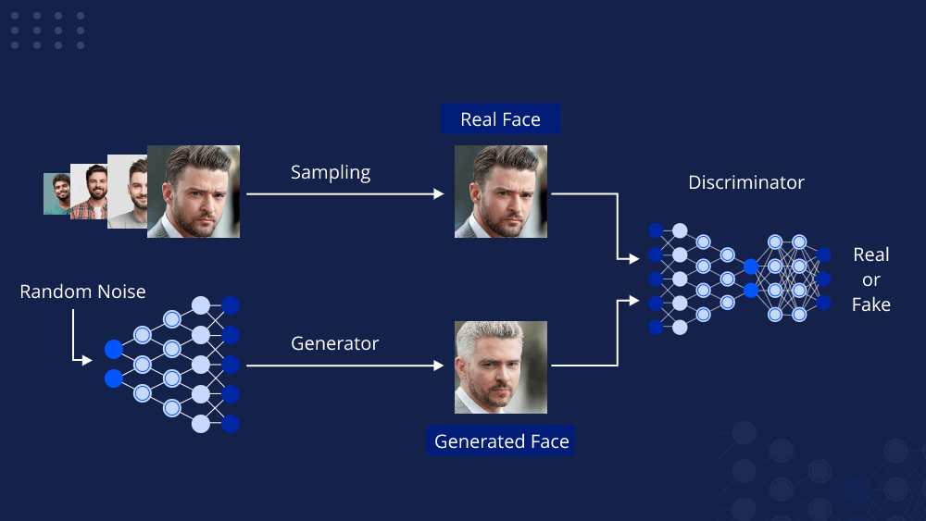
RESULTS

Slide 11
CONCLUSION
In conclusion , our generative AI network for image synthesis offers a powerful solution for generating realistic and diverse images across various domains.
By providing a user-friendly interface and advanced customization options , we empower users to unleash their creativity and explore new possibilities in image generation.

