Slide 1



ATLIQ HARDWARES
- Computer Hardware Producers
Consumer Goods Domain Ad_Hoc Insights
Presented by :
Adlina J

Slide 2
Agenda :
Introduction
Data & Requirements
Key Statistics & Insights
Appendix

Slide 3
Introduction:
Atliq Hardwares is one of the premier computer hardware producers in India and is rapidly expanding into other countries. By leveraging their cutting-edge technology and expertise, Atliq Hardwares is revolutionizing the industry and strives to set a new benchmark.
They have sought Ad-Hoc requests to gain the necessary business insights to make swift, data-driven decisions.

Slide 4
Data :
Customer details
Product details
Years when manufactured
Manufacturing prices
Gross price of products
Percentage of pre-invoice deductions
Sold quantity of products
Months & Years when sale occurred

Slide 5
Requirements :
Markets of Atliq Exclusive in APAC region.
Percentage of product increase in 2021 vs 2020.
Product counts for each segment.
Which segment has the highest increase in product count.
Products that have highest and lowest manufacturing costs.
Top 5 customers who received an average high pre-invoice discount percentage.
Atliq Exclusive monthly gross sales amount.
Which quarter of 2020 got the maximum total sold quantity.
Channel that brings more gross sales in the fiscal year 2021.
Top 3 product in each division with high total sold quantiy in the fiscal year 2021.

Slide 6
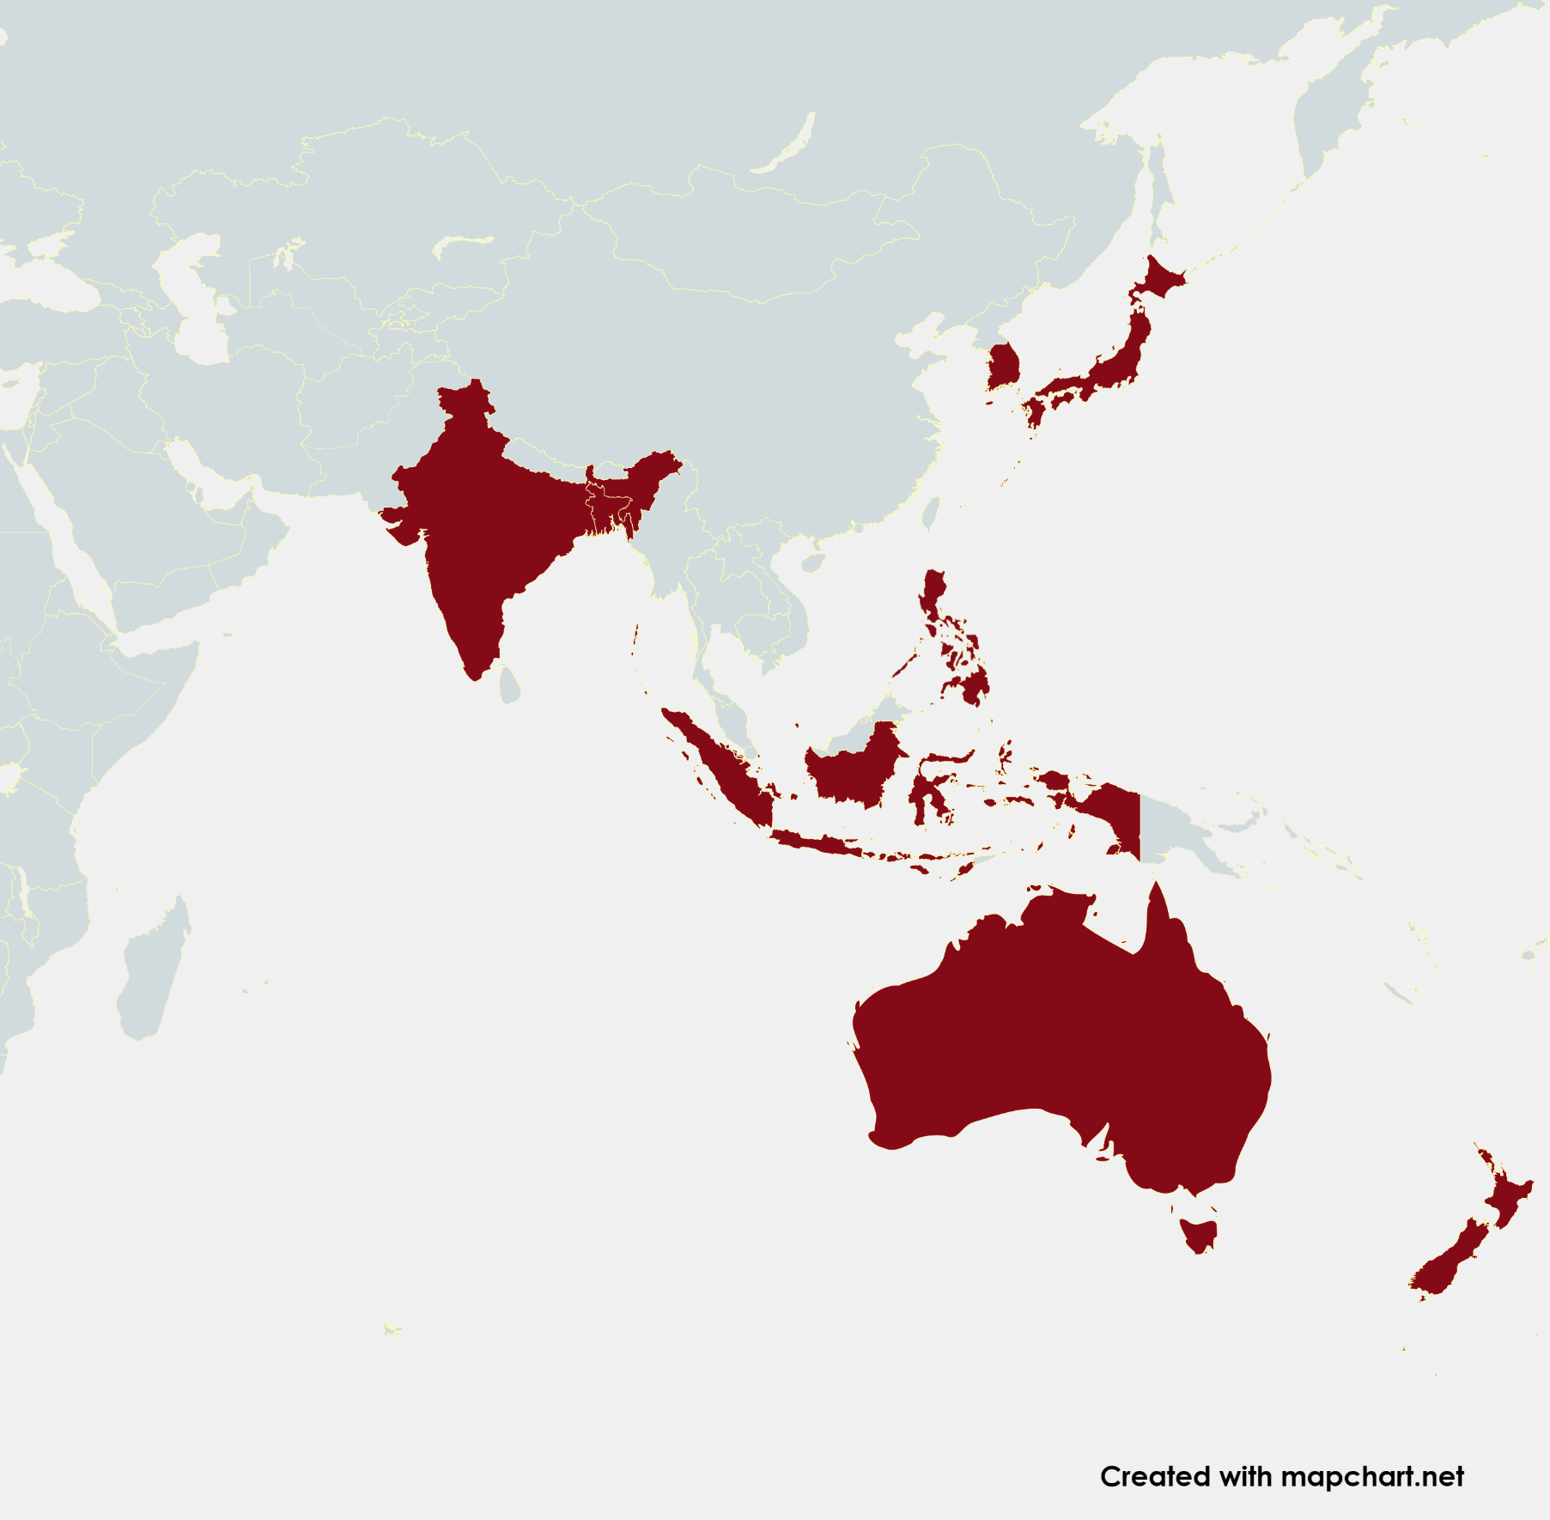
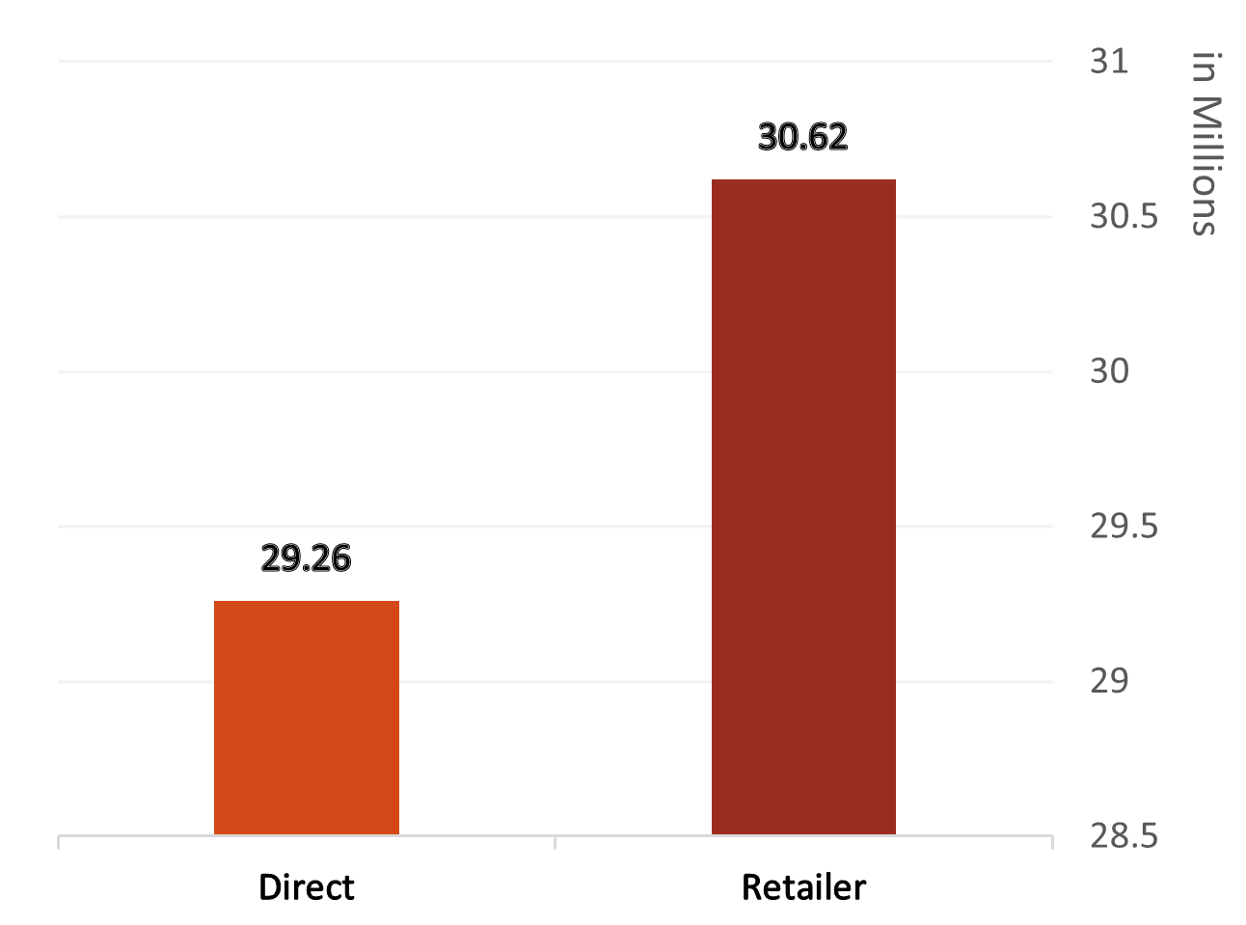
1. ‘Atliq Exclusive’ Markets in the APAC region :
The Atliq Exclusive has 8 markets in APAC region as listed on the map (Amazon and Atliq e Store has 9 markets).
India has the highest total sold quantity of 1.93M and uses both Direct and Retailer distribution methods (other markets distribute by direct means).
SOUTH
KOREA
INDIA
JAPAN
BANGLADESH
PHILIPHINES
INDONESIA
AUSTRALIA
NEWZEALAND
(Channel wise gross sales amount of Atliq Exclusive’s Indian Market)

Slide 7
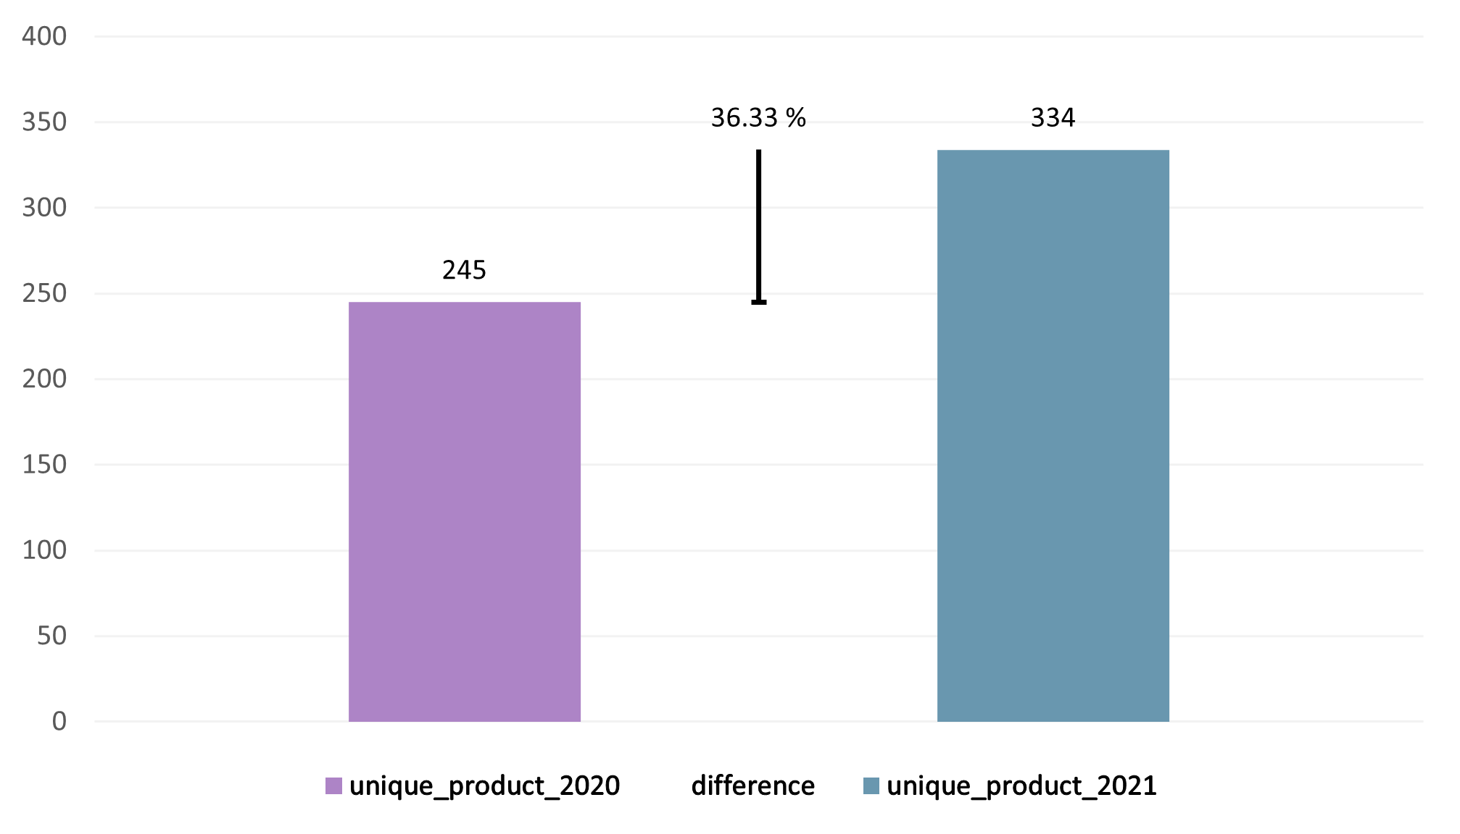
2. The Percentage of Product Increase in 2021 vs. 2020 :
13 unique products occurred in 2020. | 102 unique products are in the fiscal year 2021. | 232 products are recorded in both fiscal years.
Fiscal year is unknown (NULL) for 50 products.
89 unique products increased in 2021 fiscal year when compared to 2020.
There is 36.33% percentage of increase in products when compared to the previous year.

Slide 8
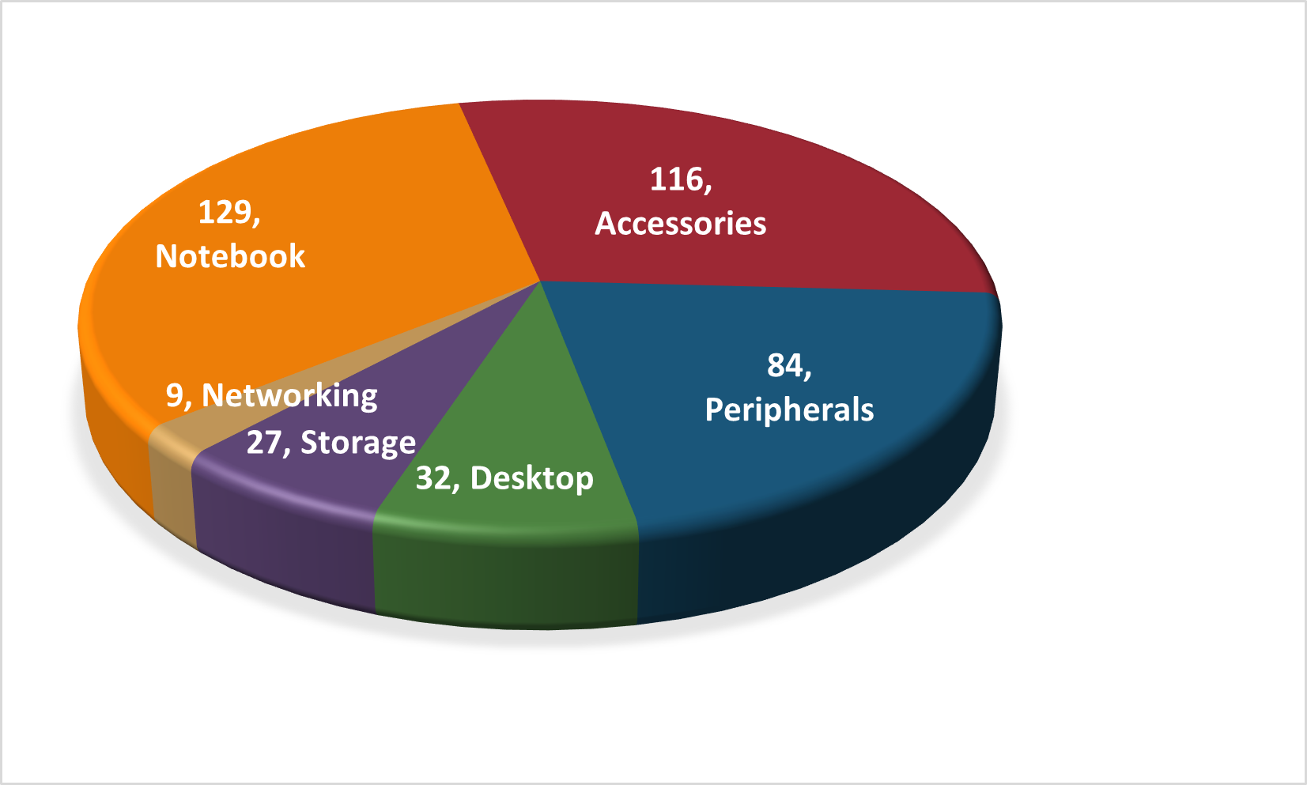
3. All the Unique Product Counts for each Segment :
The Notebook Segment has the highest number of unique products with 3 Categories.
Notebook Segment has 17 different products (eg: AQ Digit, AQ BZ 101) each has its variants.
The Segments Accessories and Peripherals has 20 different products with variants.
Networking segment owns the least number of unique products (WiFi Extender). It has 3 different products with 3 Variants each.

Slide 9
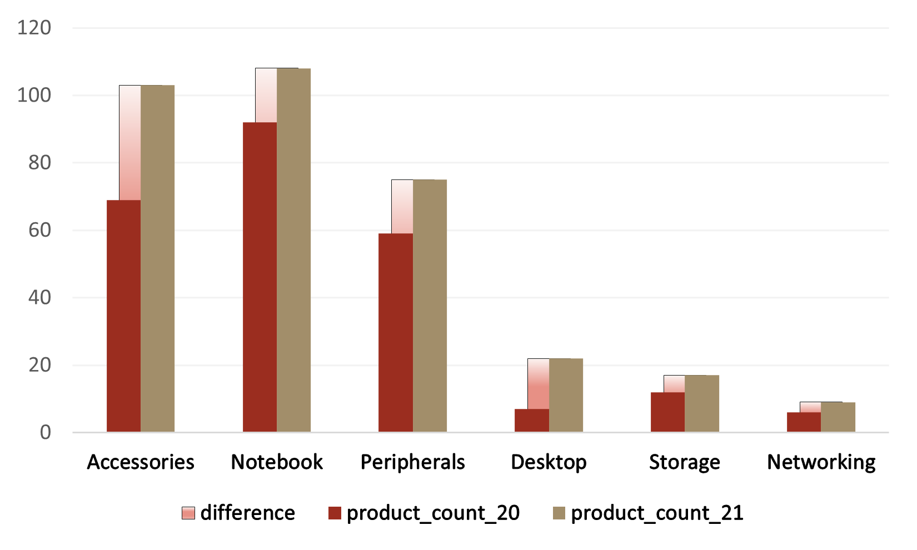
4. The Segment wise Increase in Unique Products in 2021 vs 2020 :
The Accessories is the highest segment in unique products increase (as it introduced 34 new products in 2021 fiscal year)
Notebook, Peripherals and Desktop have similar count of product increase.
Storage and Networking also introduce minimal number of new products in the fiscal year 2021.

Slide 10
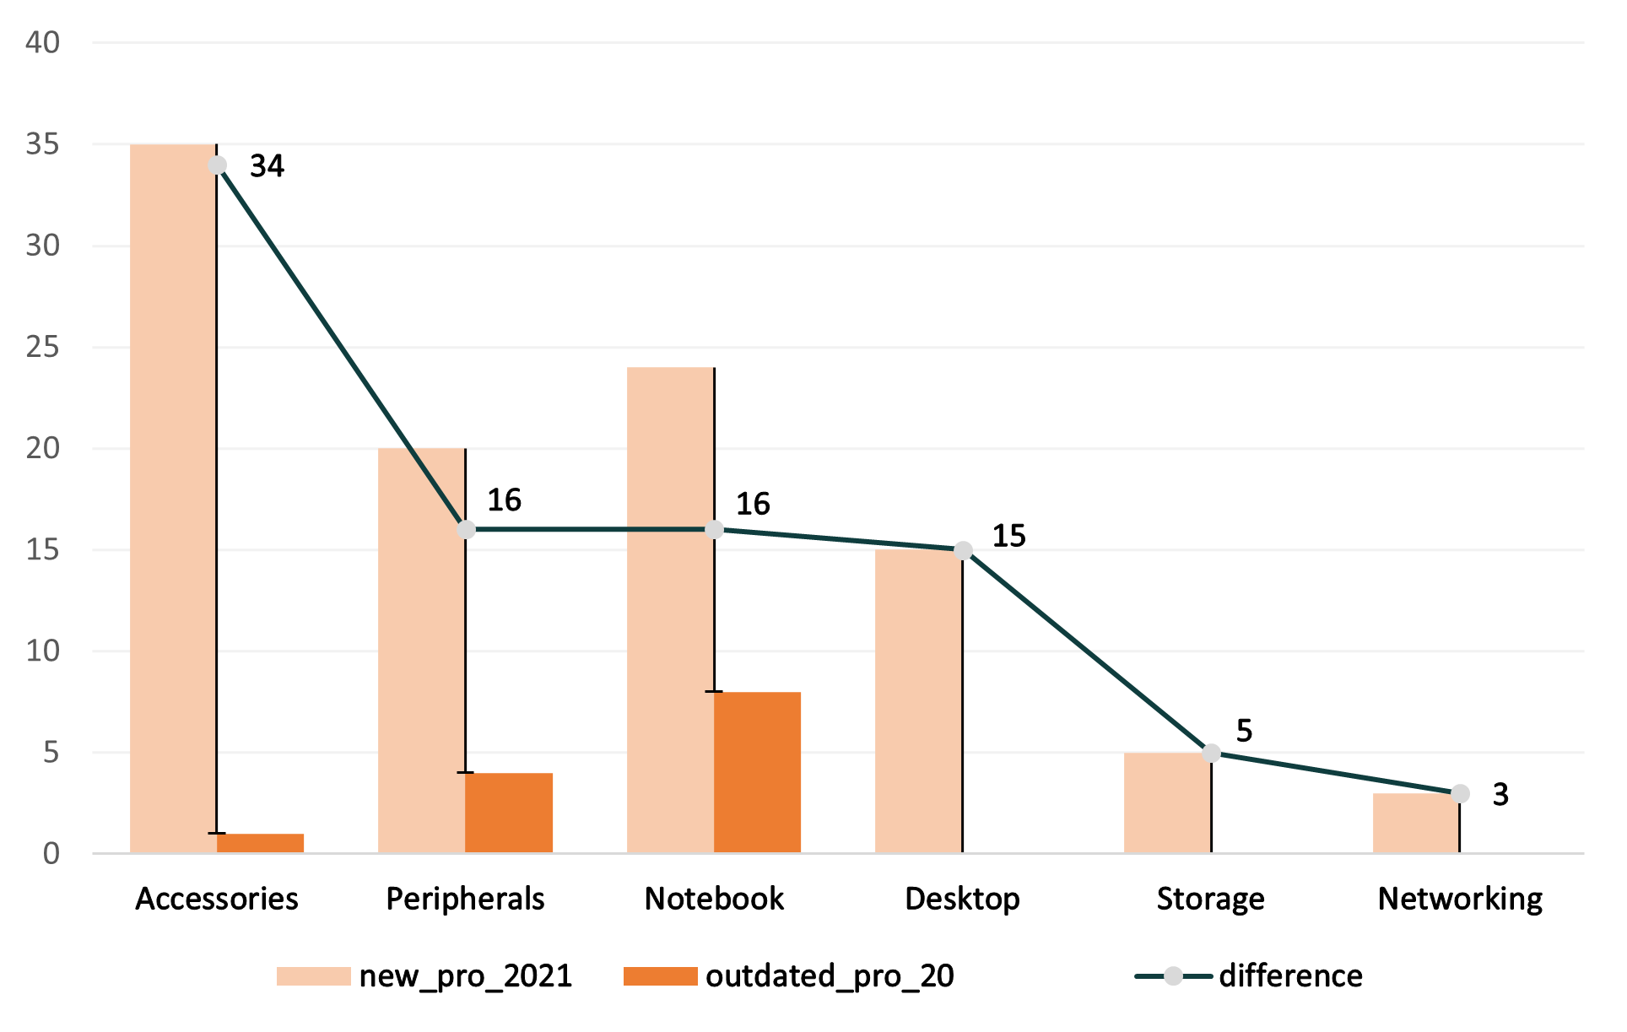
2020 vs 2021 Product Count Differences for each Segment:
The unique products count difference based on two factors
New products introduced in the fiscal year 2021.
Products occurred in sales record of 2020 is not available in 2021.
1 Battery
4 Graphic Cards
8 Laptops

Slide 11
5. The Products of Highest and Lowest Manufacturing Costs :
Product : AQ HOME Allin1 Gen 2 - Plus 3
Personal Desktop
M_Cost : 240.5364
- Manufactured in the fiscal year 2021
Highest
Product : AQ Master wired x1 Ms
Mouse
M_Cost : 0.8920
- Manufactured in the fiscal year 2020 (sales recorded in 2021 also)
Lowest

Slide 12
6. Top Customers with an Average Discount Percentage in Indian market :
2020
2021
28.85
30.83
Electricalslytical
Flipkart
1
1
2
Vijay Sales
2
Viveks
28.70
30.38
Flipkart
3
Ezone
3
28.26
30.28
Atliq Exclusive
Croma
4
4
26.56
30.25
Expression
5
Amazon
5
26.54
29.33

Slide 13
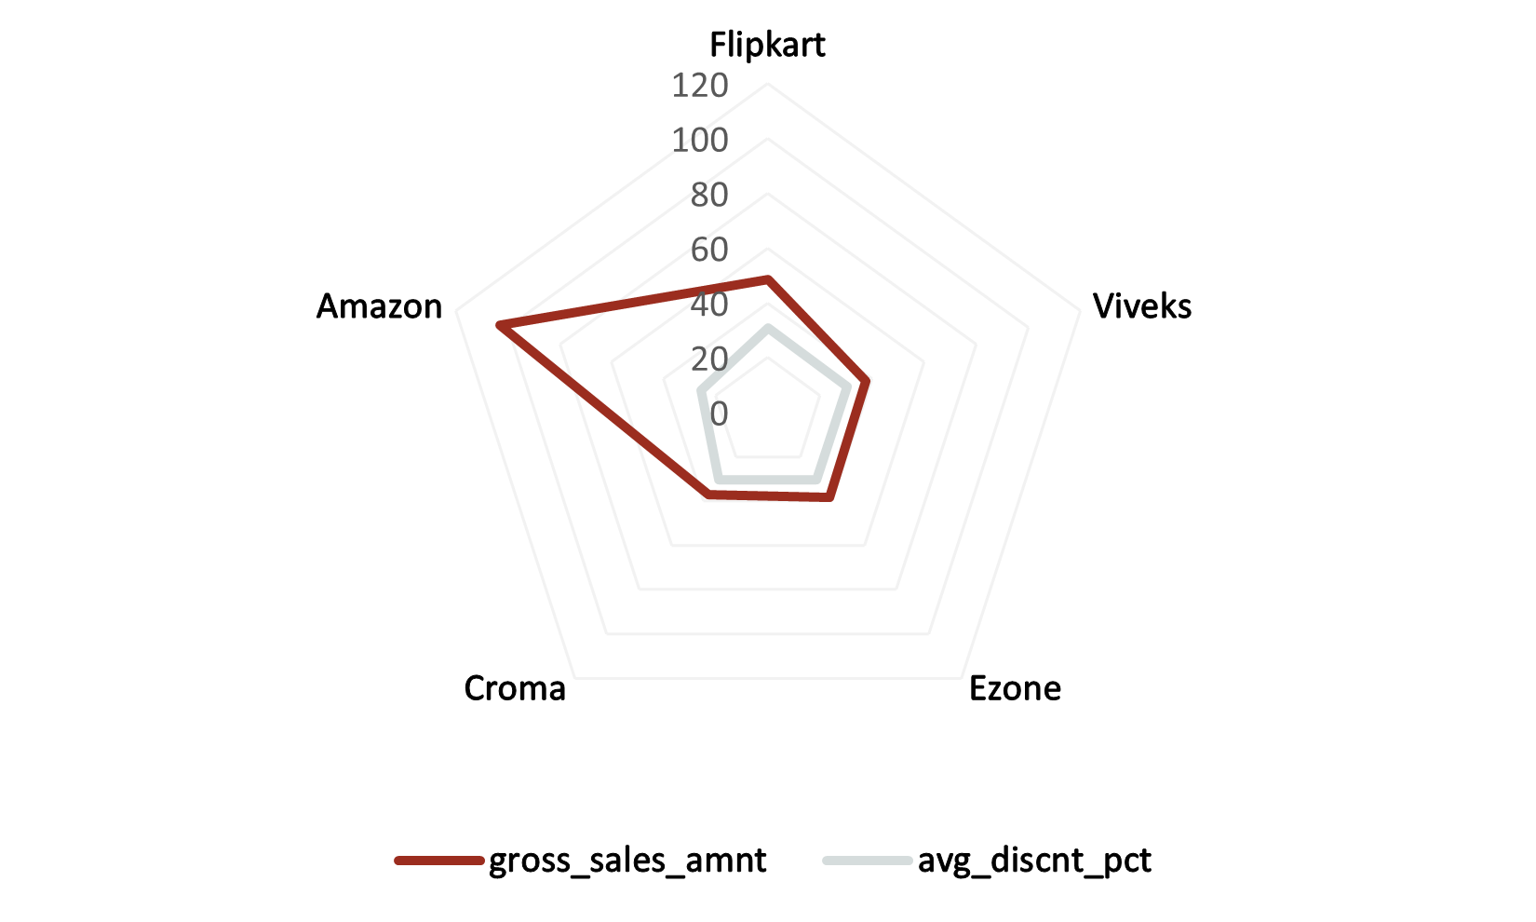
Flipkart has a consistent Average pre invoice deduction in both Fiscal years.
Among these Amazon attained the Highest Gross sales in 2021 Indian market.
Viveks, Ezone and Croma receives approximately similar discount percentage.

Slide 14
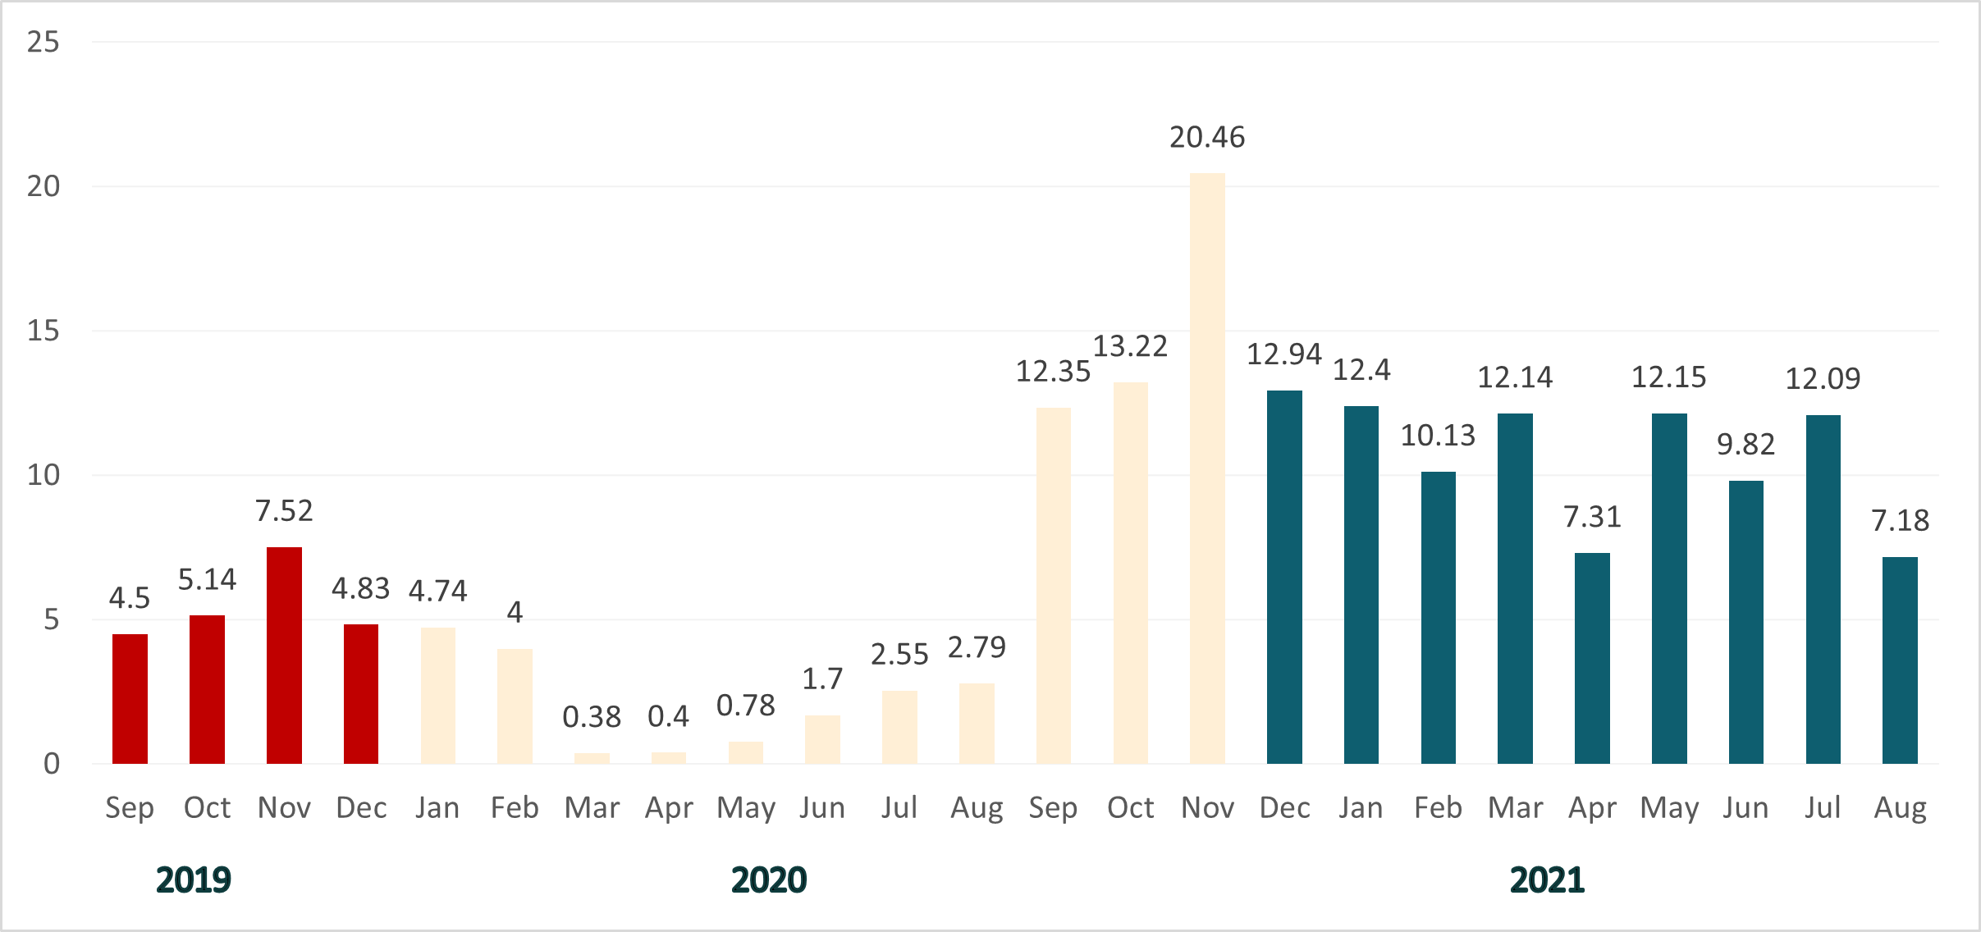
7. Monthly Gross Sales Amount for “Atliq Exclusive” :

Slide 15
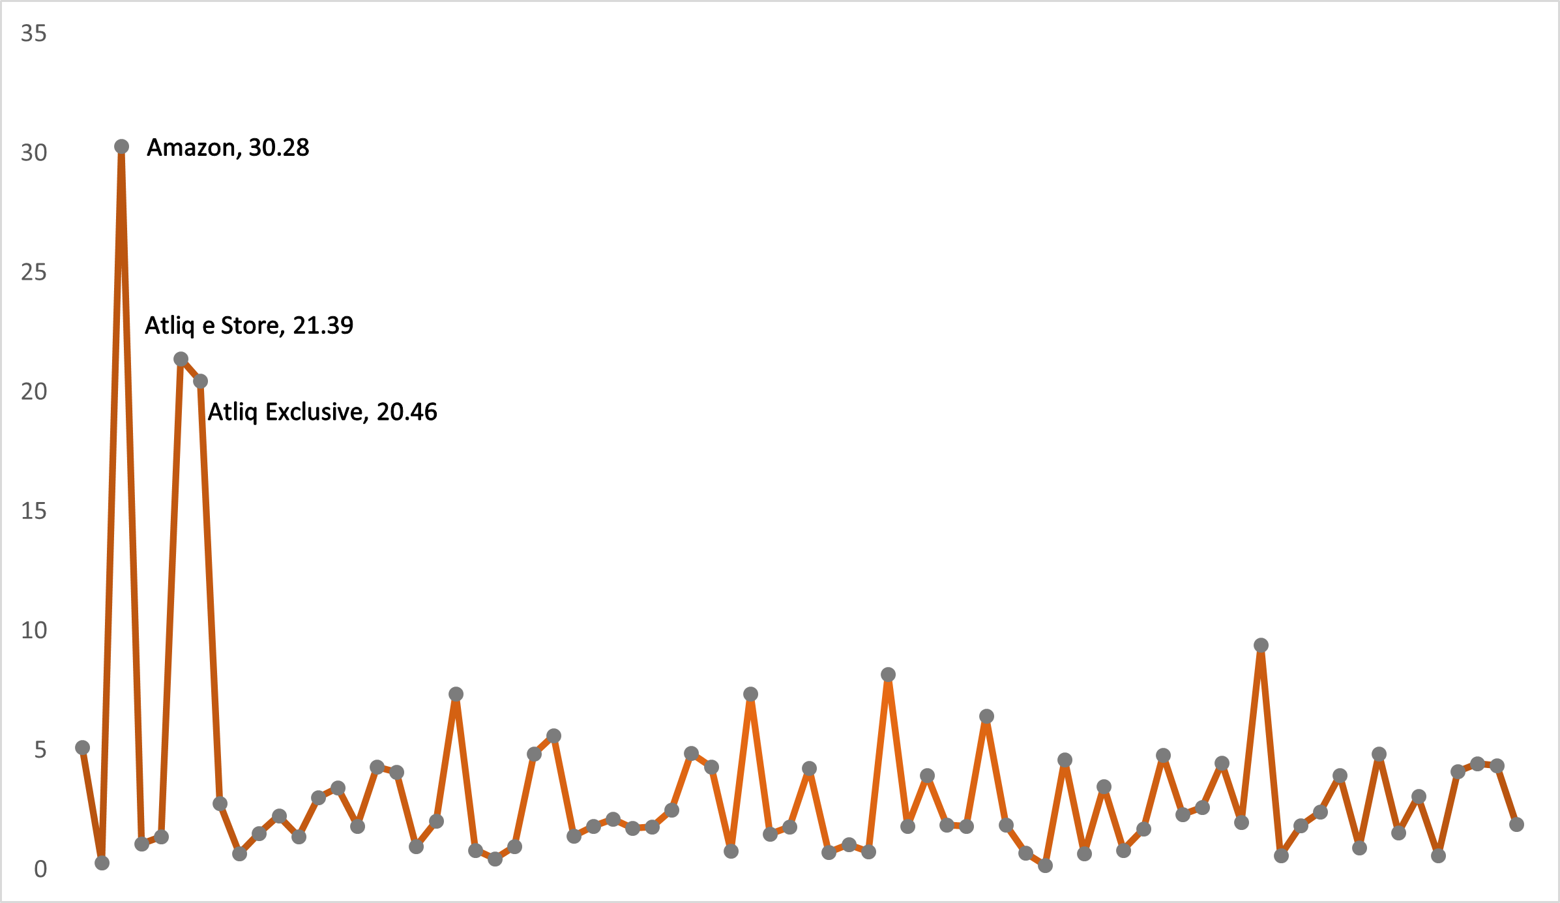
Highest Monthly Gross Sales Amount for all Customers :
customer | month_year | highest_gross_sales_amount
Amazon | Dec - 2020 | 30.28
Atliq e Store | Dec - 2020 | 21.39
Atliq Exclusive | Nov - 2020 | 20.46
Sage | Dec - 2020 | 9.4
Leader | Nov - 2020 | 8.18

Slide 16
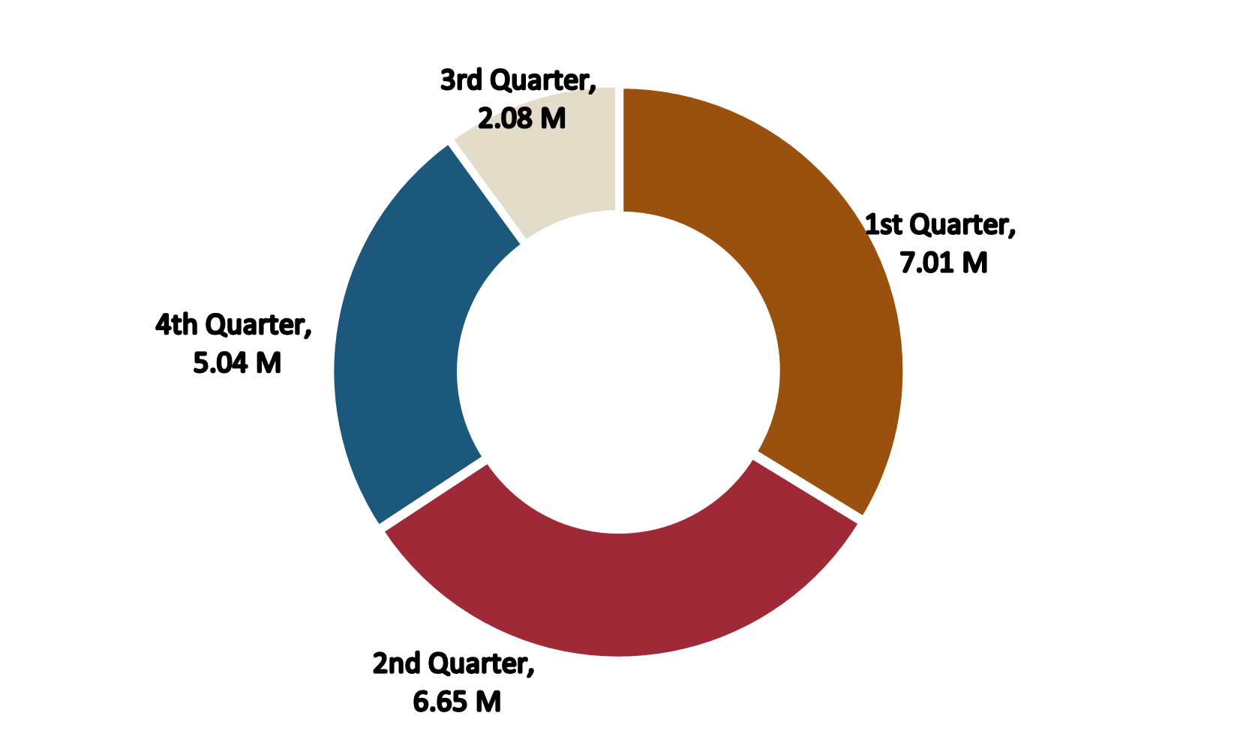
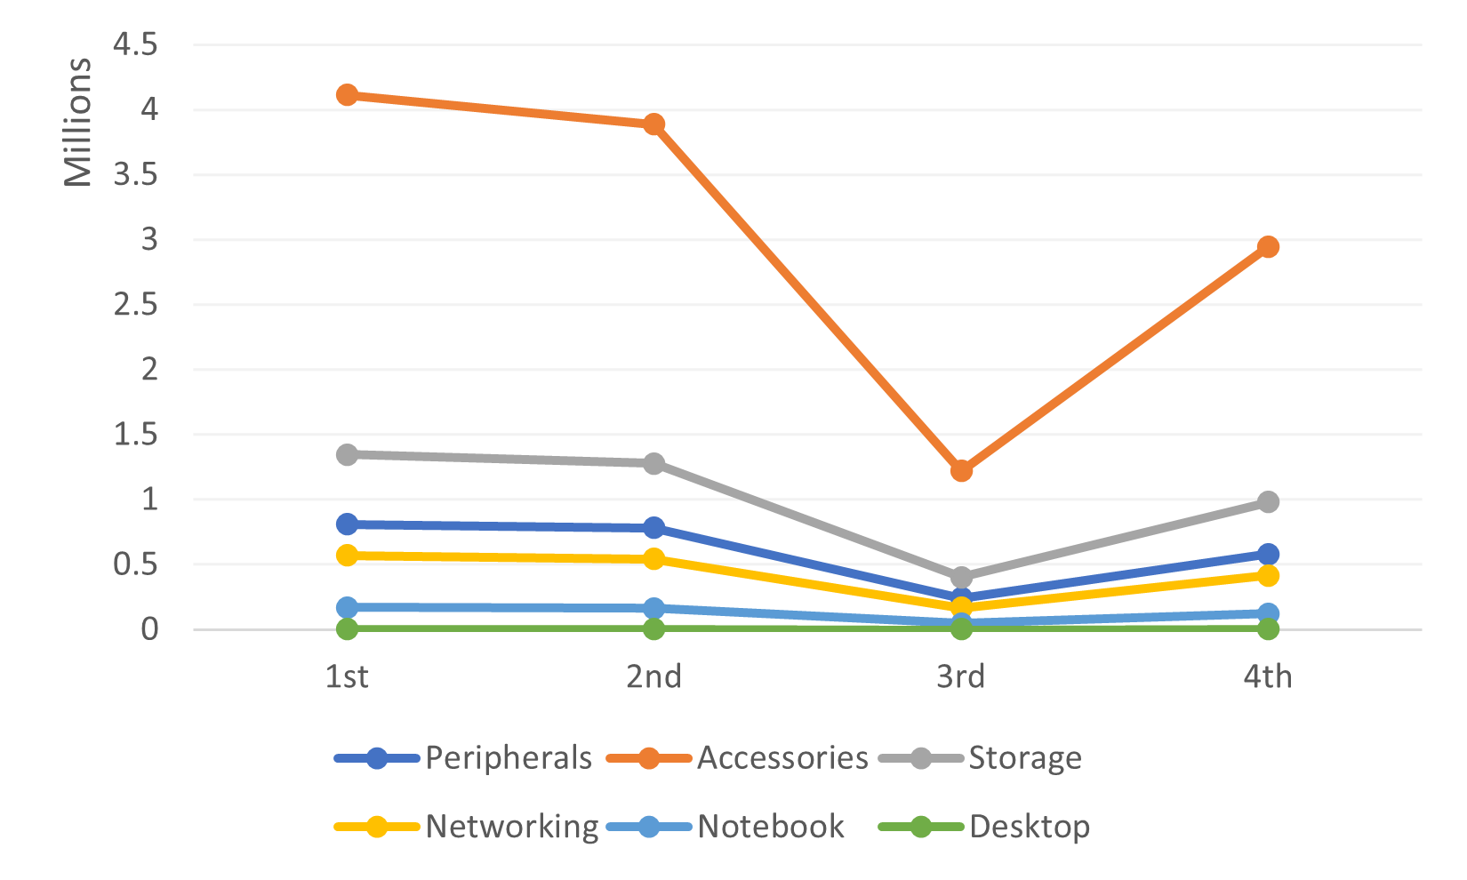
8. 2020 Quarters wise Total Sold Quantity :
Accessories Segment put on sale more; over the course of fiscal year 2020.
2020
1st Quarter of 2020 attains the maximum sold quantity followed by 2nd quarter and 3rd has the least.
(Segment wise total sold quantity for each Quarters in 2020 fiscal year)

Slide 17
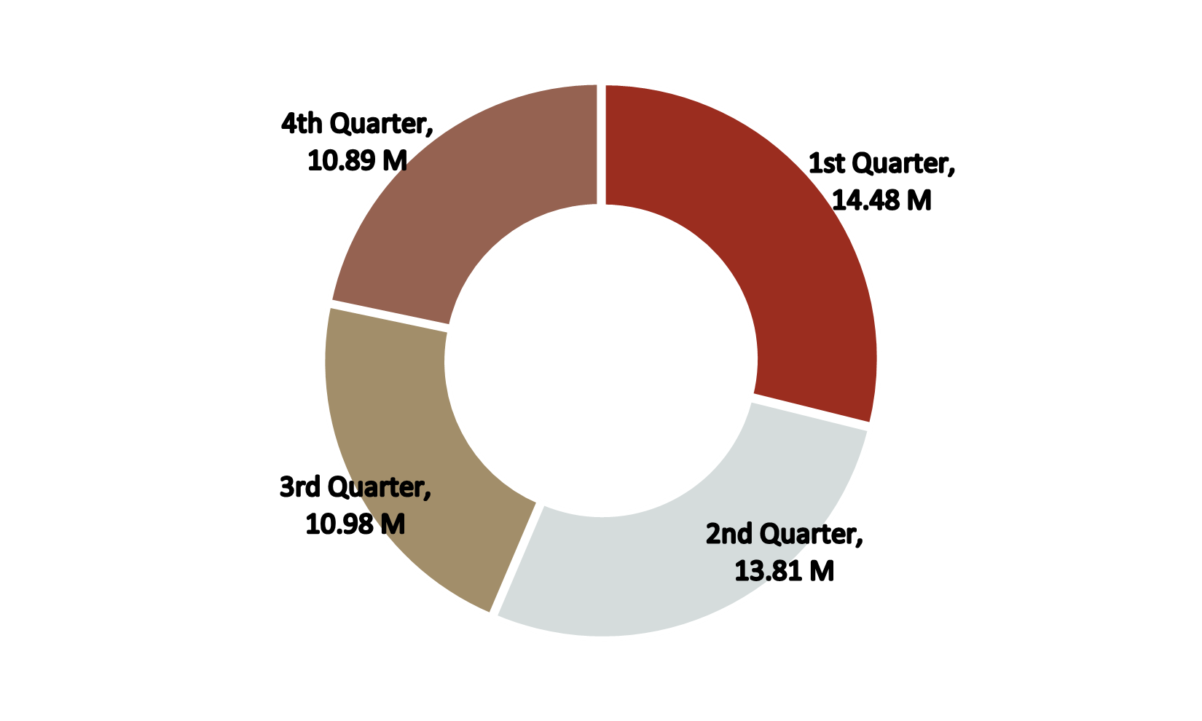
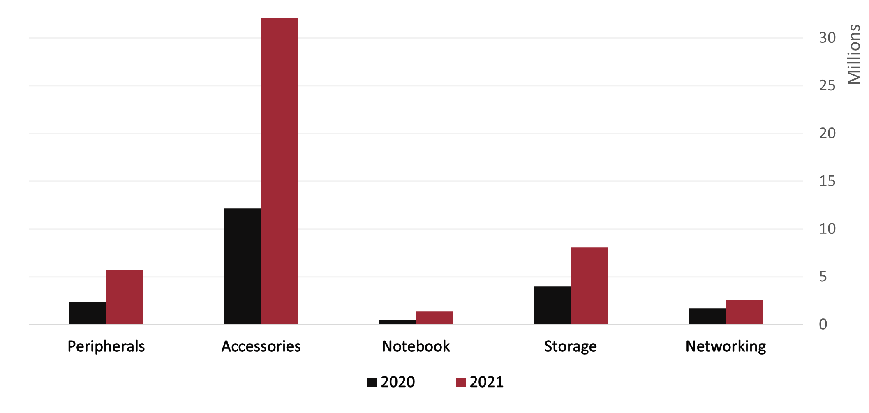
2021 Quarters wise Total Sold Quantity
1st Quarter has the Highest quantity of products sales.
Each Quarter’s data reveals that it is way better compared to the previous fiscal year.
2021
As 102 unique new products introduced in the fiscal year 2021 leads to the drastic increase in the sold quantity

Slide 18
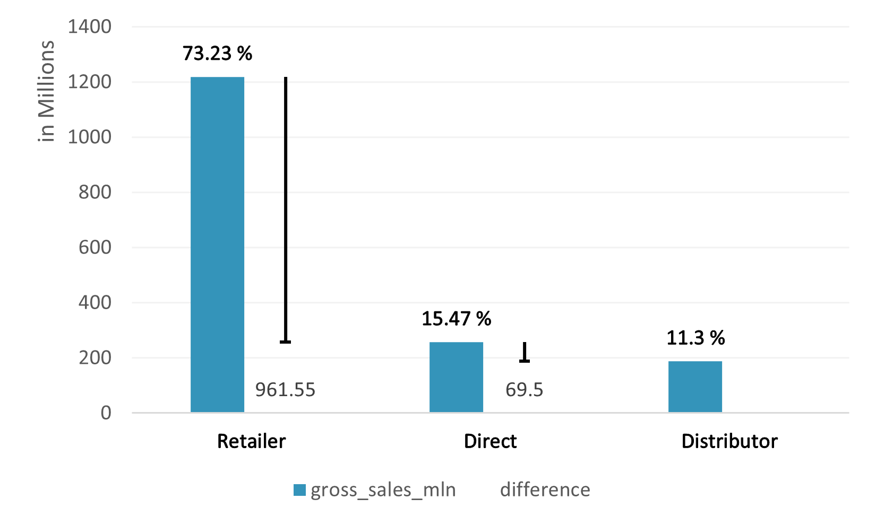
9. Channel vs Gross Sales in the fiscal year 2021
& Percentage of Contribution :
Retailer hands out maximum gross sales of 1219.08 M in 2021 fiscal year.
It is almost 2.7 times greater than the Direct and Distributor methods combined.

Slide 19
10. Division wise Top Products with High Total Sold Quantity in 2021 :
N & S | P & A | PC
1
2
3
AQ Digit - Standard Blue Qnty : 17434
AQ Velocity - Plus Red Qnty : 17280
AQ Digit - Premium Misty Green Qnty : 17275
AQ Pen Drive 2 IN 1 - Premium Qnty : 701373
AQ Pen Drive DRC - Plus Qnty : 688003
AQ Pen Drive DRC - Premium Qnty : 676245
AQ Gamers Ms - Standard 2 Qnty : 428498
AQ Maxima Ms - Standard 1 Qnty : 419865
AQ Maxima Ms - Plus 2 Qnty : 419471

Slide 20
Appendix :
GitHub link : https://github.com/Adlina-J/Atliq_Hardware

