Slide 1
Database
Final Project​
for a ride sharing application
Presented by: Adam Winther

Slide 2
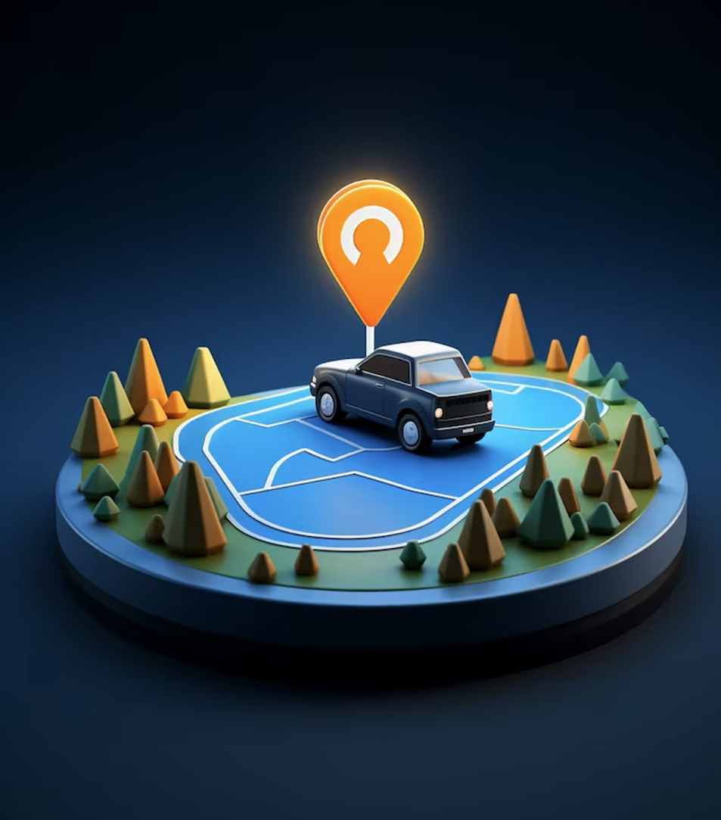
Project overview
Goal:
Build a database for an app like Uber.

Slide 3



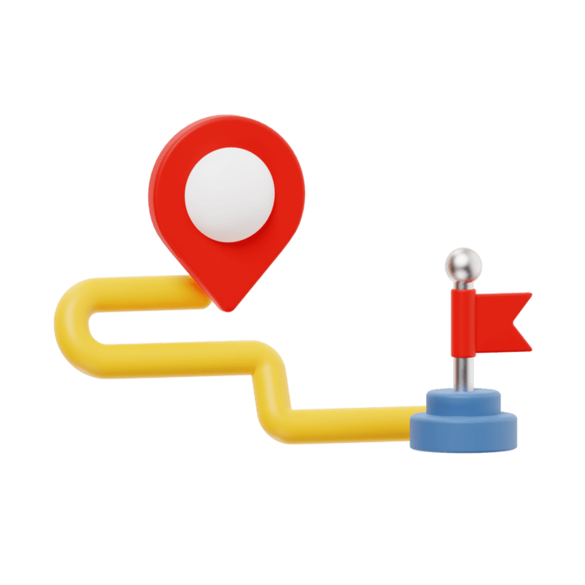
Main elements
Persons
Cars
Addresses
Rides

Slide 4
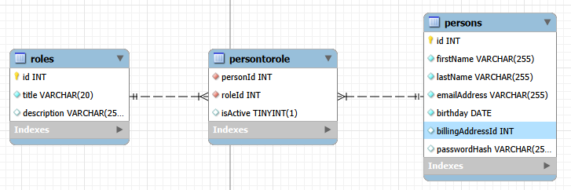
Persons
Roles: Admin, Passenger, Driver
Many to many between persons and roles , via person_To_Role table
Persons table includes basic persons data
Name
Email address (used as username too)
Password (hashed)
. . .

Slide 5
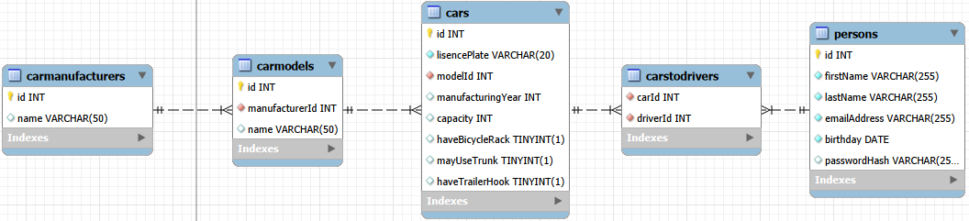
Cars
One to many relationship between car manufacturers and car models
One to many relationship between car models and car
Many to many relationship between cars and persons, via cars_to_drivers table.
A person can be related to many cars
For example, a young child that can borrow car from both parents
The same car can be used by several drivers
For example, a couple that both work for uber but they have only one car.

Slide 6
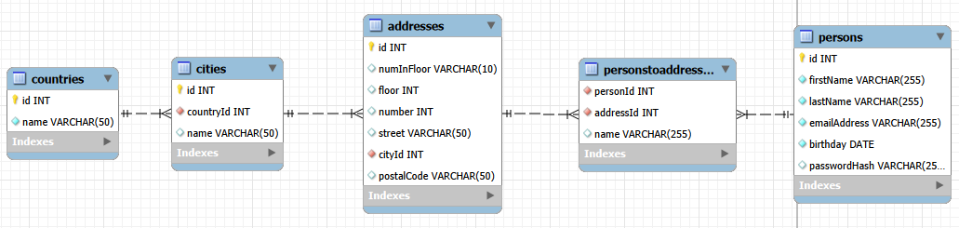
Addresses
One to many relationship between countries and cities
One to many relationship between cities and addresses
One to many relationship between cities and addresses.
Many to many relationship between address and persons
Future development:
Make a table for streets with a foreign key to cities.
Make a table for building number and use street ID as a foreign key

Slide 7
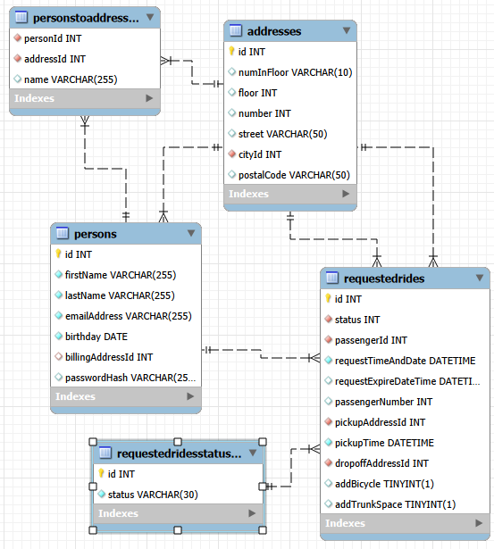
Rides
Passengers registers a ride request
Each ride refers to passenger ID, pickup address ID and drop off address ID
Each ride has a status:
Pending
Expired
Accepted
Cancelled
Each ride request has an expire time-date.

Slide 8
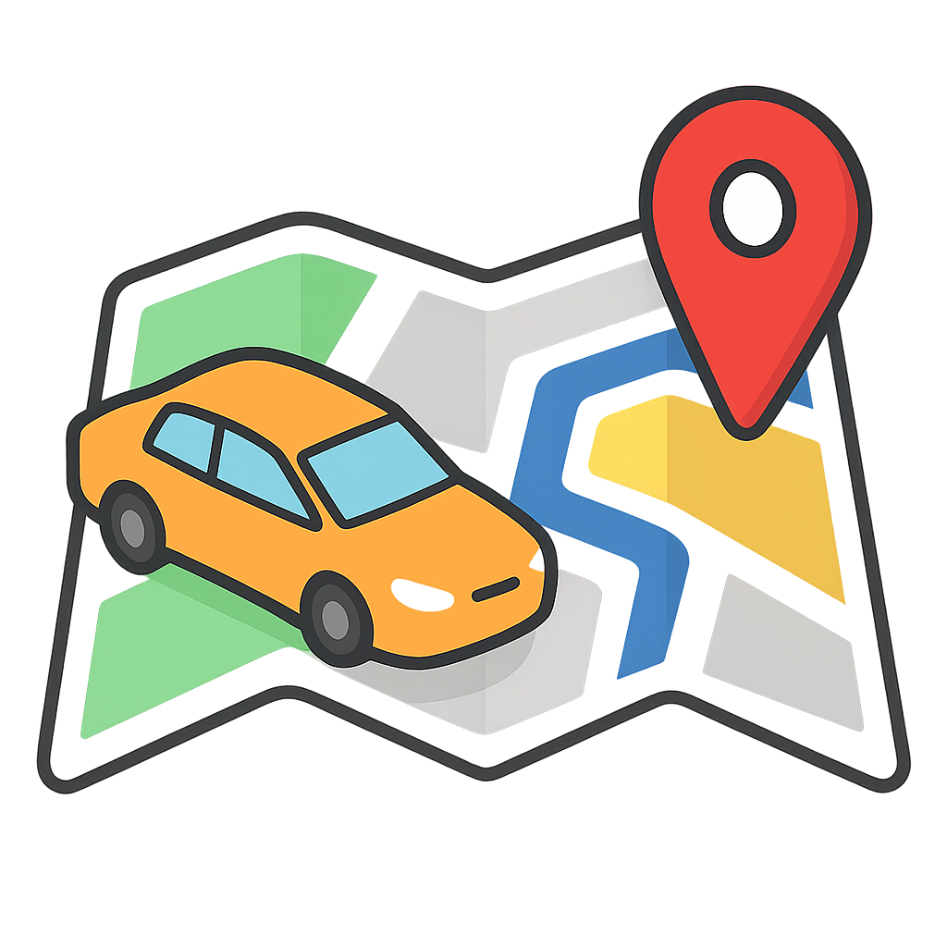
Lifecycle of a ride

Slide 9
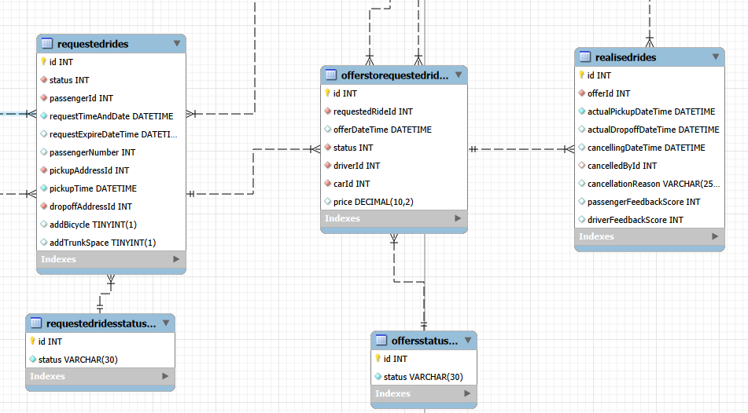

Slide 10

Achievements
An atomic, concistent, Isolated, and durable database
Built based on NF3
Automated trigger for changing status of expired requests
A very good learning experience by having hand on the job

Slide 11
Possible improvements
Make a separate table for street names
Make a separate table for the house numbers for each street
Make tables for payments and credits
Make a tables for messages between users
Make a table for logs

