Slide 1
PA1 Haskell Tutorial
Antwane Mason

Slide 2
Outline
What you get from PA1Helper.hs module
Where to put your code
How to run code

Slide 3
What You get from Module (PA1Helper.hs): Part 1
runProgram :: String -> (Lexp->Lexp)->IO()
data Lexp = Atom String | Lambda Lexp Lexp | Apply Lexp Lexp (line 12)
Instance of Eq typeclass (lines 15-19)
Instance of Show typeclass (lines 22-25)

Slide 4
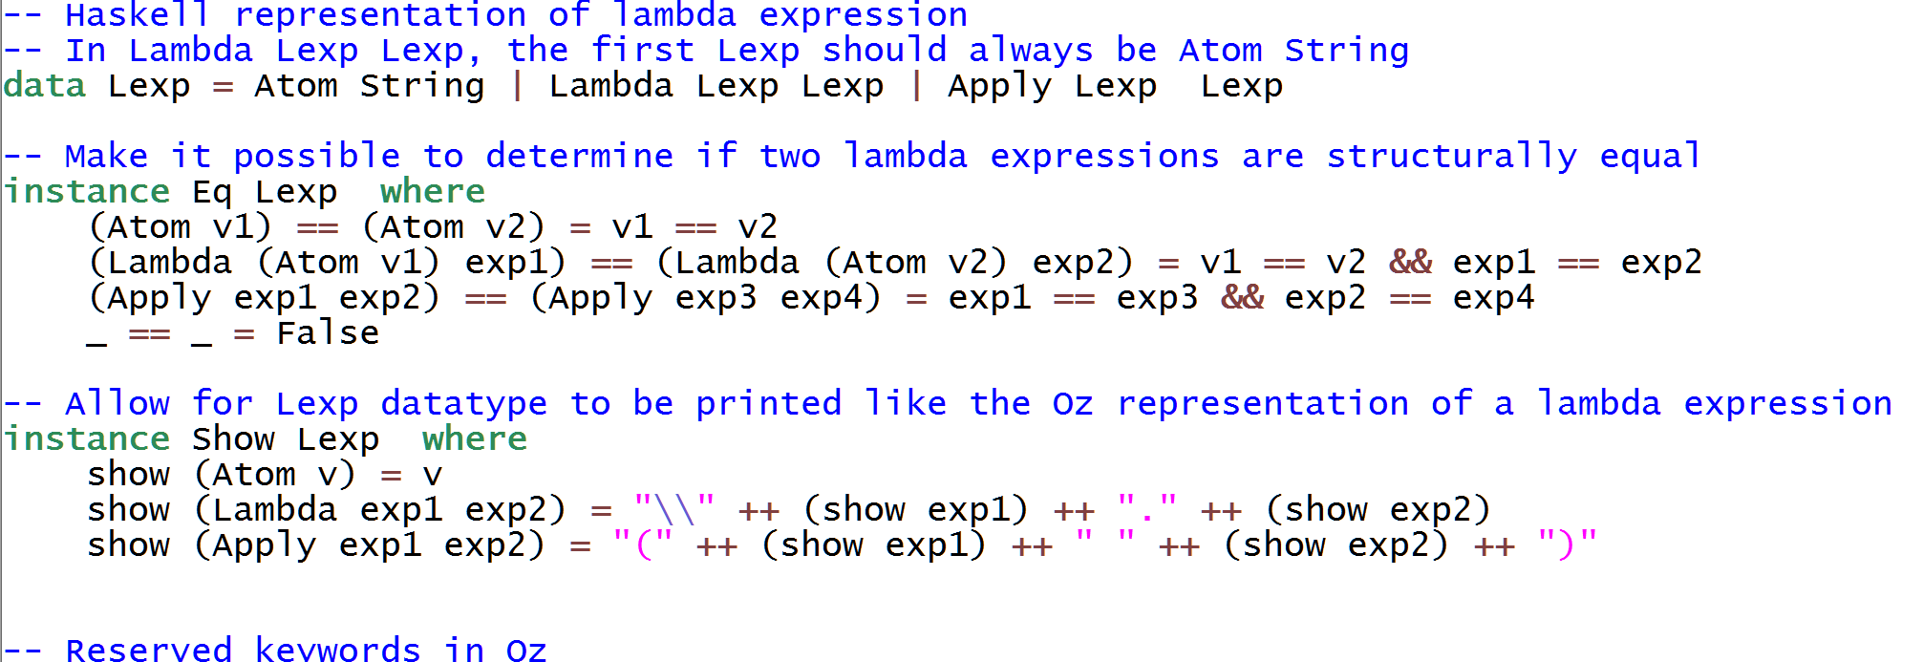
What you get from Module (PA1Helper.hs): Part 2

Slide 5
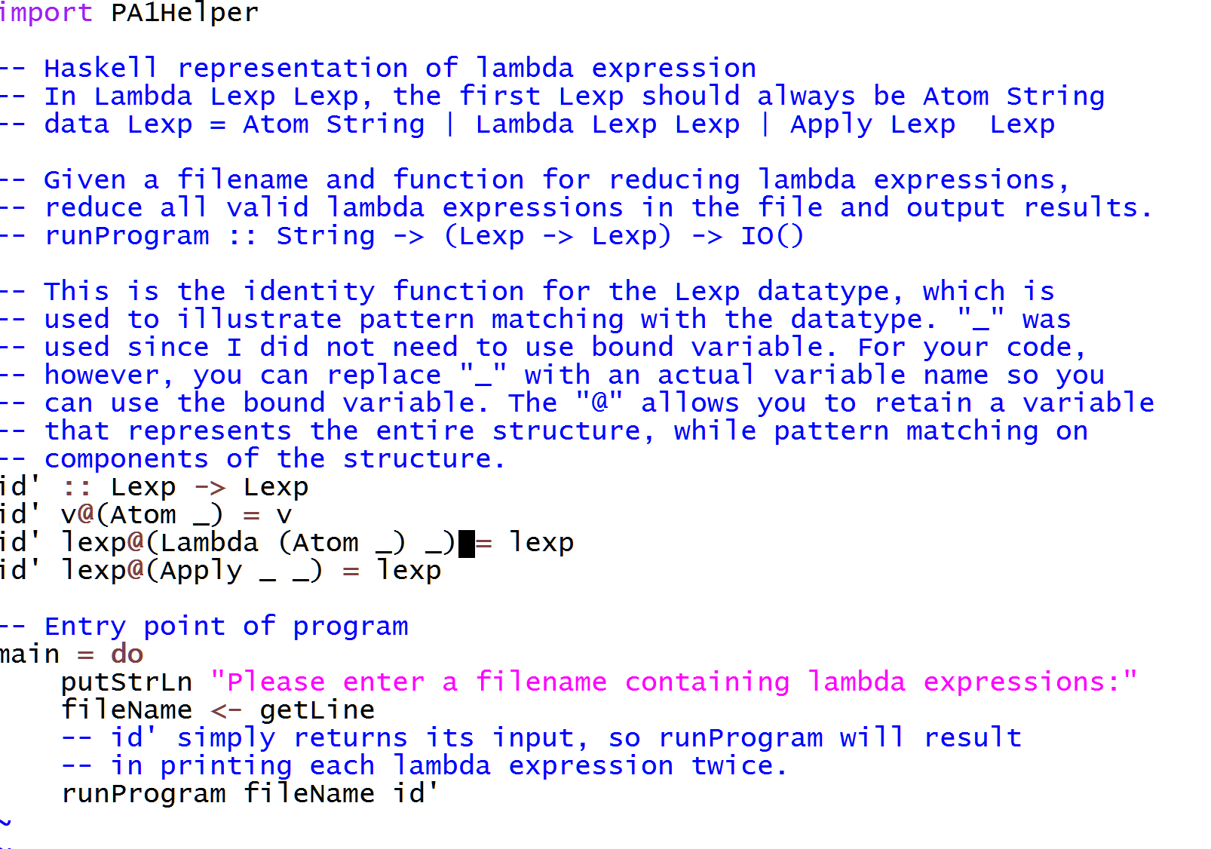
Where to Put Code

Slide 6
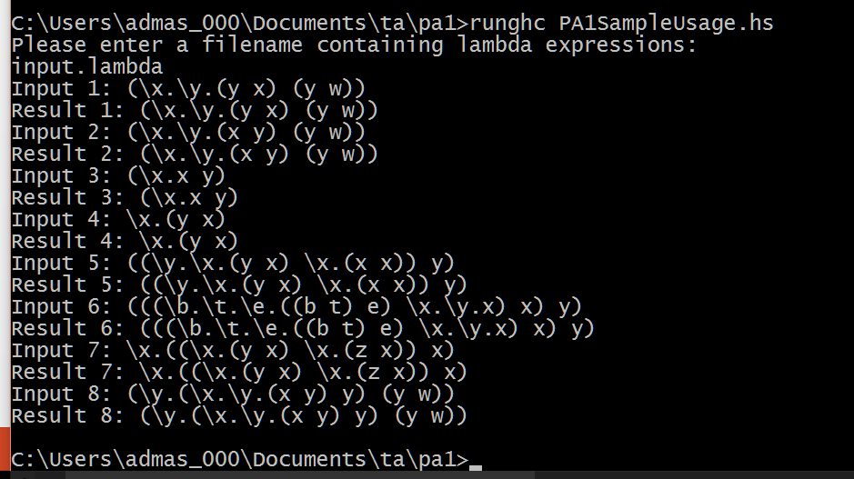
How to Run Code
Note: pa1.hs and PA1Helper.hs should be in same folder

Slide 7
Questions?

