Slide 1

Functional Principles for OO Development
Jessica Kerr
@jessitron
Notes:
I am not going to tell you how to do functional programming. The objective is to write clear, readable, maintainable, high-quality code in an OO language. Functional principles have some ideas for us about how to do that.

Slide 2


What do we love about OO?
Notes:
Stuff about the hype it had way back when Java was new:
We were going to grab objects off the shelf and plug them together like tinker toys and wa-la, applications would emerge.

Slide 3

Functional programming will solve all our problems
Notes:
Functional programming is yet another way to solve problems, providing its own kind of glue, its own ways of putting the pieces together.

Slide 4
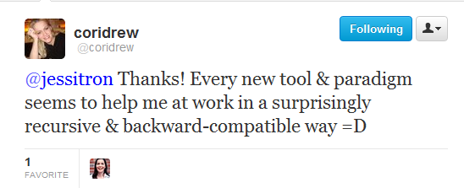

Slide 5
Programming paradigms
Imperative
Procedural
Object-Oriented
Functional
Aspect-oriented
Logic
Notes:
Wikipedia lists over 25 programming paradigms.
Each paradigm is suited to a particular problem set.
Each presents its own way of solving problems. The more we know, the more tools we have – not necessarily to use to solve the problem, either. We have more ways of thinking about the problem.

Slide 6
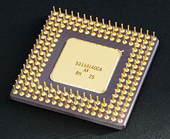

Haskell
Assembly
C
Prolog

Slide 7
Data In, Data Out
Immutability
Verbs Are People Too
Declarative Style
Strong Typing
Lazy Evaluation

Slide 8

Principle
What is it?
C#
We already do it
F#
What’s the point?
Notes:
For each principle, we will see these six points.
Counterclockwise, people, because this talk is about learning new ways to think.

Slide 9


Data In, Data Out

Slide 10

What’s the point?
Testable
Easier to understand
Notes:
The real reason is to reduce the moving parts.

Slide 11
Data In -> ? -> Data out
input
output
Notes:
The point is: for every variable you change to an immutable value, that’s one fewer thing you have to hold in your head.

Slide 12

We already do it
Injection
Utility methods
Notes:
Stateles s

Slide 13
good functions:
1. Don’t access global state
2. Don’t modify the input
3. Don’t bother the rest of the world
Notes:
Stateles s

Slide 14
What’s the point
Think about the data flow.
Notes:
Stateles s

Slide 15
Get unused deposits
Get unused donations
Create link record
Mark donation done
Deposit used up?

Slide 16
Get deposits
Get donations
unused
unused
List<Deposit>
List<Donation>
match
List<Match<Deposit,Donation>>
List<Donation>
Store matches
Mark donations

Slide 17
What’s the point?
Problem easier, because we know each step of the way of data.
Notes:
The real reason is to reduce the moving parts.

Slide 18

C#: data in
public string createAccount(UserDbService db,
String email,
String password) {
…
}
Notes:
body: boolean exists = db.AccountExists(email);
if (exists) { return “/forgotPassword”; }
if (invalidPassword(email, password)
{ return “/passwordAdvice”; }
db.CreateUser(email, password);
return “/welcome”;

Slide 19
C#: data ?
string password;
string email;
private boolean invalidPassword() {
return !password.Contains(email);
}

Slide 20
C#: data in, data out
private boolean ValidatePassword(
string email,
string password)
{
return !password.Contains(email);
}

Slide 21

Immutability

Slide 22

What is it?
You won’t change that object, because you can’t.
Notes:
The point is: for every variable you change to an immutable value, that’s one fewer thing you have to hold in your head.

Slide 23
What’s the point?
The less state that can change, the less you have to think about.
Concurrency!
Notes:
Locking is for wimps.
Concurrency is, frankly, a great excuse to favor immutability. The real reason is to reduce the moving parts.
Functional programming tries to reduce moving parts; OO tries to hide them inside of objects. We can do better: we can do both.

Slide 24
We already do it
System.String
Effective C#
Notes:
In Effective C#, Bill recommends only making atomic types immutable, but I advocate for most or all types to be immutable. Yes, go to the trouble of cloning on mod.
“Your ﬁrst choice for types that store data should be immutable, atomic value types.”

Slide 25

F#
let four = 4 // immutable
let mutable n = 2 // mutable
n = 4 // false
n <- 4 // “destructive update”
Notes:
Default mutability is accidental complexity.

Slide 26
C#: easy
public struct Address {
private readonly string city;
public Address(string city) : this() {
this.city = city;
}
public string City {
get { return city; }
}
Notes:
Is private the default field access? Is my constructor syntax right? Does this give a compiler error if not init-ed in constructor?

Slide 27
C#: defensive copy
public class Customer {
private readonly IEnumerable<Phone> phoneNumbers;
public Customer(IEnumerable phones) { this.phones = new List(phones);
}
Notes:
Is this right?
Points: 1) Ienumerable because it can’t be modified
2) Copy it, because it is not final – we might be passed a mutable object
3) Phone must also be immutable. All the way down the composition chain, we need immutable reference types, or else FAILURE.
This is why default mutability is a negative. Default mutability is accidental complexity.

Slide 28
C#: copy on mod
public Customer AddPhone(Phone newPhone) {
List<Phone> morePhones =
new List(this.phones);
morePhones.Add(newPhone);
return new Customer(morePhones);
}
Notes:
Transition: and we’re copying lists all over the place. Immutable -> more copying

Slide 29

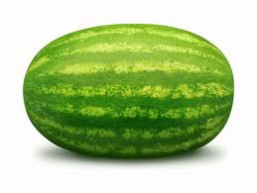



Immutable linked list
fruit
fruit.add(tomato)
Notes:
Functional programming deals often with list processing.
Think of it as a pipeline.
Because the original list is immutable, adding to the beginning does not copy the list.

Slide 30
F#: copy on mod
member this.AddPhone(newPhone:Phone) {
new Customer(newPhone :: phones)
}
Notes:
Confirm: can use F#’s list in C#

Slide 31
F# in C#
private readonly FSharpList<Phone> phones;
public Customer (IEnumerable phones) {
this.phones = SeqModule.ToList(phones);
}
public Customer AddPhone(Phone newPhone) {
return new Customer(
FSharpList<Phone>.Cons(newPhone, phones))
}
Notes:
Does this work?
There’s a library FSharpx that makes this prettier.

Slide 32
C#: copy on mod
public Customer AddPhone(Phone newPhone) {
IEnumerable<Phone> morePhones =
// create list, or cons
return new Customer(morePhones, name, address, birthday, cousins);
}
Notes:
This would be a great time for a story or a joke or something.

Slide 33
this talk is brought to you by… the Option type!
NullReferenceException
Thing
doStuff()
Option<T>
SomeThing
doStuff() {…}
Some<T>
NullThing
doStuff() {}
None

Slide 34
FSharpOption<T>
… because null is not a valid object reference.

Slide 35
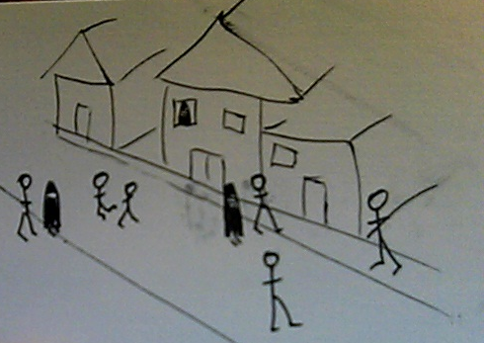

Verbs are people too
Notes:
Mention somewhere: we can abstract above the Von Neumann architecture. We don’t have to turn the problem into computer language anymore. We need to write about the problem in problem space.

Slide 36
What is it?
Functions are values.
Pass ‘em around
Notes:
Example of the Pricing Engine
This lets us separate the “how” from the “what.” basically, encode some design patterns.

Slide 37
We already do it
Strategy pattern
Command pattern
Callbacks
How
What
Notes:
HTTP
Every time we start a thread
onClick events to buttons
Dependency injection

Slide 38


We already do it
release ( )
OnClick()
Notes:
Javascript, we do this all the time.

Slide 39
What’s the point?
Passing around instructions is useful.
Notes:
Why, just yesterday I hit an instance where I needed to pass in how to implement one piece of an operation.
This can replace the template pattern or the strategy pattern.

Slide 40
Function types
C#: public delegate string CustomDelegate(string s, int i);
C#: Func<string, int, string>
F#: string -> int -> string

Slide 41
Java
class CostInflation implements FunctionOverTime
{
public float valueAt(int t) {
return // some calculated value;
}
}
Notes:
Mention testability. When you’re passing in the method to call, you don’t have to mock an object.

Slide 42
F#
let costInflation = Variable (
“Cost Inflation”, fun t -> pown 1.15 t)
let seasonalVolume = [| 0.95; 0.99; 1.01,…|]
let seasonalAdjustment = Variable(“Season”,
fun t -> seasonalVolume.[t % 12])
Notes:
this example needs:
type Something = | Variable of string * (int -> float)
let valueAt (Variable(_,calc)) (t:int) = calc t

Slide 43
C#
private readonly Func<int, double> calc;
public Func<int, double> ValueAt
{
get { return calc; }
}
Notes:
Mention testability. When you’re passing in the method to call, you don’t have to mock an object.

Slide 44
C#
var inflation = new Variable(“Inflation”,
t => Math.Pow(1.15,t));
inflation.ValueAt(3);
Notes:
Mention testability. When you’re passing in the method to call, you don’t have to mock an object.

Slide 45

Declarative style
Notes:
Mention that much of what we call functional programming is now better described as “expression-oriented”

Slide 46
What is it?
Say what you’re doing, not how you’re doing it.
Notes:
My husband won’t let me tell him how to do the stuff I ask him to do.

Slide 47
We already do it
Refactoring: single-line method
Notes:
Put an example in here!

Slide 48
We already do it
Select USER_NAME, count(*), max(update_date)
From USER_ROLES
Where USER_ID = :userId
Group by USER_NAME
Notes:
Excel is another example. We specify the relationships between the cells, not the order of calculation. LINQ, of course.

Slide 49
What’s the point?
Readable code
Smaller, simpler pieces
Familiar != readable
Notes:
Point out that we can separet the “what” from the “how” better because of the verbs. We can pass the “what” around into fucntions that know the “how”.

Slide 50
Java
List<String> output = new LinkedList();
for(String s : lines) {
if(s.startsWith(“BUG”)) {
output.add(s);
}
}
return output;
Notes:
Point out that we can separet the “what” from the “how” better because of the verbs. We can pass the “what” around into fucntions that know the “how”.

Slide 51
F#
List.filter
(fun (s:string) -> s.StartsWith(“BUG"))
lines
Notes:
Show a filter

Slide 52
C#
lines.Where(s => s.StartsWith(“BUG”)).ToList()
Notes:
You have to think about this. You have to follow the logic and picture it in order to name what it is doing.
This is very readable BECAUSE IT IS FAMILIAR.
We have the power to create new idioms!

Slide 53
this talk is brought to you by… the Tuple type!
function
new Tuple<string,int>(“You win!”, 1000000)

Slide 54
Tuple<T1,T2,…>
When one return value is not enough!

Slide 55

Strong typing
Notes:
String typing

Slide 56
What is it?
When the wrong type of data is passed in, the compiler complains.
Notes:
The more specific we are with the type of data, the more the compiler can help us.

Slide 57
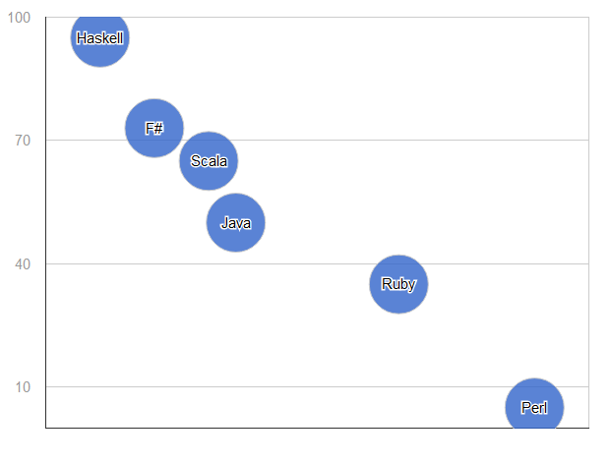
What’s the point?
% of errors found at compile-time
Typing
Notes:
Type Safety.
Catch errors as early as possible.
Provide meaning to data.
Encapsulation, while we’re at it.

Slide 58

We already do it
Notes:
Emphasizes creating a language to describe the domain, and carefully naming each type in the system.

Slide 59
We already do it
C# is strongly typed, right?
Notes:
Well, it is statically typed. How we use that is up to us.
When we pass in a firstname and the type is string, we’re not specifying what the object is. string is not the meaning of that data – it is how the data is stored.
Erasure messes up runtime type checking.

Slide 60
What’s the point?
The beginning of wisdom is to call things by their right names.
Notes:
Type Safety.
Catch errors as early as possible.
Provide meaning to data.
Encapsulation, while we’re at it.

Slide 61
F#
[<Measure>] type cents
let price = 599<cents>
Notes:
They say about Haskell, if you can get your program to compile, it’s probably right.
Catch the errors early, dammit.
There’s being picky about what we want, and then there’s being specific about what we want.

Slide 62
Haskell
type FirstName = String // type alias
data Customer = Customer FirstName EmailAddress
Notes:
They say about Haskell, if you can get your program to compile, it’s probably right.
Catch the errors early, dammit.
There’s being picky about what we want, and then there’s being specific about what we want.

Slide 63
F#
type FirstName = | FirstName of string
let jay = FirstName(“Jay”);
Notes:
They say about Haskell, if you can get your program to compile, it’s probably right.
Catch the errors early, dammit.
There’s being picky about what we want, and then there’s being specific about what we want.

Slide 64
C#
class FirstName {
private readonly string value;
public FirstName(string value)
{ this.value = value; }
public static implicit operator FirstName(string value)
{
return new FirstName(value);
}
}
Notes:
Specificness is another part of strong typing.

Slide 65
C#
public Customer(FirstName name, EmailAddress login) {…}
new Customer(“Jay”, (EmailAddress)“jay@aranasoft.com”);
Notes:
Specificness is another part of strong typing.

Slide 66
C#: weak
public boolean Valid(Customer cust)
{
EmailAddress email = cust.EmailAddress;
// exercise business logic
return true;
}
Notes:
Specificness is another part of strong typing.

Slide 67

C#: specific
public boolean Valid(IHasEmailAddress anything)
{
EmailAddress email = anything.EmailAddress;
// exercise business logic
return true;
}
interface IHasEmailAddress {
string EmailAddress {get; }
}
Notes:
This is more specific.

Slide 68

Lazy evaluation

Slide 69
What is it?
Delaying evaluation of an expression until the last responsible moment.
Notes:
Laziness as a programmer virtue

Slide 70
We already do it
Providers, Factories
SQL Cursors
Notes:
Pass around how to get something, instead of getting it every time.
Of course we do lazy initialization, such as in Hibernate. But that bites us because we’re not passing the full “how to do it” back to the remote-invocation system.
LINQ expressions work like this, passing around the “how.” this can burn you, because they get evaluated again at each access
C# 4.0 has a Lazy<T>.
Futures are another example.

Slide 71
What’s the point?
You may never even need it.
Separate “what to do” from “when to stop.”
Notes:
Instead of passing around the result of some calculation, we’re passing around how to get that result.
Two result expressions in a conditional – one of those will never be used.

Slide 72
C#: Imperative Style
int bugCount = 0;
string nextLine = file.ReadLine();
while (bugCount < 40) {
if (nextLine.StartsWith("BUG")) {
string[] words = nextLine.Split(' ');
Report("Saw the bug at " + words[1]
+ " on " + words[2]);
bugCount++;
}
WaitUntilFileHasMoreData(file);
nextLine = file.ReadLine();
}

Slide 73
C#: Declarative style
var lines = ReadLines(file)
.Where(line => line.StartsWith("BUG"))
.Select(FormatBugLine)
.Take(40);
foreach (var line in lines)
{
Report(line);
}

Slide 74
C#: Lazy & Declarative
IEnumerable<string> ReadLines(StreamReader r) {
while (true) {
WaitUntilFileHasMoreData(r);
yield return r.ReadLine();
}
}

Slide 75
Data In, Data Out
Immutability
Verbs Are People Too
Declarative Style
Strong Typing
Lazy Evaluation

Slide 76
FSharpOption<T>
Tuple<T1,T2,…>

Slide 77












Slide 78
Thank you
Jessica Kerr @jessitron
blog.jessitron.com
jessitron@gmail.com
github.com/jessitron/fp4ood

