Slide 1

Functional Principles for OO Development
Jessica Kerr
@jessitron
Notes:
I am not going to tell you how to do functional programming. The objective is to write clear, readable, maintainable, high-quality code in an OO language. Functional principles have some ideas for us about how to do that.

Slide 2

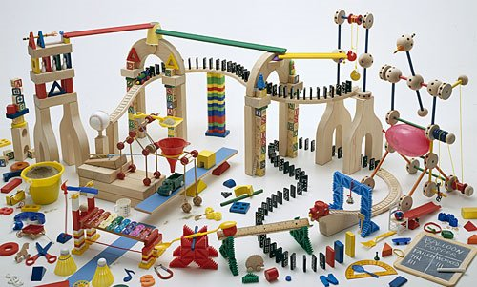
What do we love about OO?
Notes:
Stuff about the hype it had way back when Java was new:
We were going to grab objects off the shelf and plug them together like tinker toys and wa-la, applications would emerge.

Slide 3

Functional programming will solve all our problems
Notes:
Functional programming is yet another way to solve problems, providing its own kind of glue, its own ways of putting the pieces together.

Slide 4


Slide 5



Slide 6
Programming paradigms
Imperative
Procedural
Object-Oriented
Functional
Aspect-oriented
Logic
Notes:
Wikipedia lists over 25 programming paradigms.
Each paradigm is suited to a particular problem set.
Each presents its own way of solving problems. The more we know, the more tools we have – not necessarily to use to solve the problem, either. We have more ways of thinking about the problem.

Slide 7
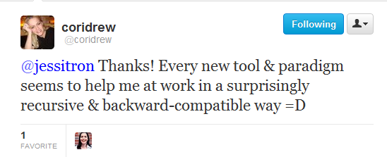

Slide 8
Goals for today
1. Look at functional principles
2. Learn how functional programmers solve problems
3. Solve more problems
Notes:
Or, solve problems more effectively.
Mention somewhere that OO works at a high level, like module level. Functional works better at a low level.

Slide 9
Data In, Data Out
Immutability
Verbs Are People Too
Declarative Style
Null Is Your Enemy
Strong Typing
Lazy Evaluation

Slide 10

Principle
What is it?
C#
We already do it
F#
What’s the point?
Notes:
For each principle, we will see these six points.
Counterclockwise, people, because this talk is about learning new ways to think.

Slide 11


Data In, Data Out

Slide 12

What is it?
input
output
Notes:
The point is: for every variable you change to an immutable value, that’s one fewer thing you have to hold in your head.

Slide 13

We already do it
Injection
Utility methods
Notes:
Stateles s

Slide 14
Static Methods Are Good When
1. Don’t access global state
2. Don’t modify the input
3. Don’t touch the rest of the world
Notes:
Stateles s

Slide 15

What’s the point?
Testable
Easier to understand
Notes:
The real reason is to reduce the moving parts.

Slide 16
Get unused deposits
Get unused donations
Create link record
Mark donation done

Slide 17
Get deposits
Get donations
unused
unused
List<Deposit>
List<Donation>
match
List<Match<Deposit,Donation>>
List<Donation>
Store matches
Mark donations

Slide 18
What’s the point?
Problem easier, because we know each step of the way of data.
Notes:
The real reason is to reduce the moving parts.

Slide 19

F#
let createAccount (db:UserDbService) email password =
let exists = db.AccountExists(email);
if (exists) “/forgotPassword”
else if (invalid (email, password))
“/passwordAdvice”
else
db.CreateUser(email, password);
“/welcome”;
}

Slide 20

C#: data in
public string createAccount(UserDbService db,
String email,
String password) {
boolean exists = db.AccountExists(email);
if (exists) { return “/forgotPassword”; }
if (invalidPassword(email, password)
{ return “/passwordAdvice”; }
db.CreateUser(email, password);
return “/welcome”;
}

Slide 21
C#: data ?
string password;
string email;
private boolean ValidatePassword() {
return !password.Contains(email);
}

Slide 22
C#: data in, data out
private boolean ValidatePassword(
string email,
string password)
{
return !password.Contains(email);
}

Slide 23
Immutability

Slide 24
What is it?
You won’t change that object, because you can’t.
Notes:
The point is: for every variable you change to an immutable value, that’s one fewer thing you have to hold in your head.

Slide 25
We already do it
System.String
Effective C#
Notes:
In Effective C#, Bill recommends only making atomic types immutable, but I advocate for most or all types to be immutable. Yes, go to the trouble of cloning on mod.
“Your ﬁrst choice for types that store data should be immutable, atomic value types.”

Slide 26
What’s the point?
The less state that can change, the less you have to think about.
Concurrency!
Notes:
Locking is for wimps.
Concurrency is, frankly, a great excuse to favor immutability. The real reason is to reduce the moving parts.
Functional programming tries to reduce moving parts; OO tries to hide them inside of objects. We can do better: we can do both.

Slide 27
F#
let four = 4 // immutable
let mutable n = 2 // mutable
n = 4 // false
n <- 4 // “destructive update”
Notes:
Default mutability is accidental complexity.

Slide 28
C#: easy
public struct Address {
private readonly string city;
public Address(string city) : this() {
this.city = city;
}
public string City {
get { return city; }
}
Notes:
Is private the default field access? Is my constructor syntax right? Does this give a compiler error if not init-ed in constructor?

Slide 29
C#: defensive copy
public class Customer {
private readonly IEnumerable<Phone> phoneNumbers;
public Customer(IEnumerable phones) { this.phones = new List(phones);
}
Notes:
Is this right?
Points: 1) Ienumerable because it can’t be modified
2) Copy it, because it is not final – we might be passed a mutable object
3) Phone must also be immutable. All the way down the composition chain, we need immutable reference types, or else FAILURE.
This is why default mutability is a negative. Default mutability is accidental complexity.

Slide 30
C#: copy on mod
public Customer AddPhone(Phone newPhone) {
List<Phone> morePhones =
new List(this.phones);
morePhones.Add(newPhone);
return new Customer(morePhones);
}
Notes:
Transition: and we’re copying lists all over the place. Immutable -> more copying

Slide 31

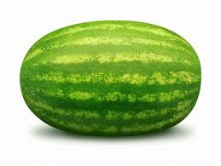



Immutable linked list
fruit
fruit.add(tomato)
Notes:
Functional programming deals often with list processing.
Think of it as a pipeline.
Because the original list is immutable, adding to the beginning does not copy the list.

Slide 32

C#
readonly
Immutable collections

Slide 33
F#: copy on mod
member this.AddPhone(newPhone:Phone) {
new Customer(newPhone :: phones)
}
Notes:
Confirm: can use F#’s list in C#

Slide 34
F# in C#
private readonly FSharpList<Phone> phones;
public Customer (IEnumerable phones) {
this.phones = SeqModule.ToList(phones);
}
public Customer AddPhone(Phone newPhone) {
return new Customer(
FSharpList<Phone>.Cons(newPhone, phones)
}
Notes:
Does this work?
There’s a library FSharpx that makes this prettier.

Slide 35
C#: copy on mod
public Customer AddPhone(Phone newPhone) {
IEnumerable<Phone> morePhones =
// create list, or cons
return new Customer(morePhones, name, address, birthday, cousins);
}
Notes:
This would be a great time for a story or a joke or something.

Slide 36
Immutability in Java
readonly
Immutable collections

Slide 37

Immutability in Java
ImmutableMap.copyOf(mutableMap)
ImmutableList.of(item, item, item)
Notes:
Functional Java is another library, for the extremely functional-minded.
Collections.unmodifiableList doesn’t copy the data

Slide 38
Immutability in Java
Sometimes data and behavior really should be separate.
Notes:
damn, wish I remember how I transitioned that.

Slide 39
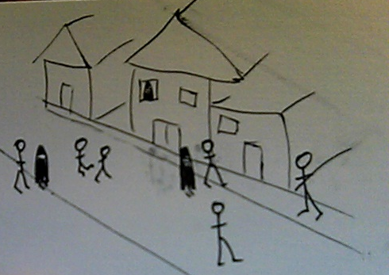

Verbs are people too
Notes:
Mention somewhere: we can abstract above the Von Neumann architecture. We don’t have to turn the problem into computer language anymore. We need to write about the problem in problem space.

Slide 40
What is it?
Functions are values.
Pass ‘em around
Notes:
Example of the Pricing Engine
This lets us separate the “how” from the “what.” basically, encode some design patterns.

Slide 41
We already do it
Strategy pattern
Command pattern
Callbacks
How
What
Notes:
HTTP
Every time we start a thread
onClick events to buttons
Dependency injection

Slide 42


We already do it
release ( )
OnClick()
Notes:
Javascript, we do this all the time.

Slide 43
What’s the point?
Passing around instructions is useful.
Notes:
Why, just yesterday I hit an instance where I needed to pass in how to implement one piece of an operation.
This can replace the template pattern or the strategy pattern.

Slide 44
Tell, Don’t Ask
Notes:
put diagram of object asking another object for its data, tell it what to do with its data.

Slide 45
Function types
C#: public delegate string CustomDelegate(string s, int i);
C#: Func<string, int, string>
F#: string -> int -> string

Slide 46
Java
class CostInflation implements FunctionOverTime
{
public float valueAt(int t) {
return // some calculated value;
}
}
Notes:
Mention testability. When you’re passing in the method to call, you don’t have to mock an object.

Slide 47
F#
let costInflation = Variable (
“Cost Inflation”, fun t -> pown 1.15 t)
let seasonalVolume = [| 0.95; 0.99; 1.01,…|]
let seasonalAdjustment = Variable(“Season”,
fun t -> seasonalVolume.[t % 12])
Notes:
this example needs:
type Something = | Variable of string * (int -> float)
let valueAt (Variable(_,calc)) (t:int) = calc t

Slide 48
C#
private readonly Func<int, double> calc;
public Func<int, double> ValueAt
{
get { return calc; }
}
Notes:
Mention testability. When you’re passing in the method to call, you don’t have to mock an object.

Slide 49
C#
var inflation = new Variable(“Inflation”,
t => Math.Pow(1.15,t));
inflation.ValueAt(3);
Notes:
Mention testability. When you’re passing in the method to call, you don’t have to mock an object.

Slide 50
Verbs in Java
Function<String,String> reformatBugLine = new Function<String, String>() {
public String apply(String input) {
String[] words = input.split(" ");
return "Saw the bug at " + words[0] + " on " + word[1];
}
};
Iterables.transform(bugLines, reformatBugLine)
Notes:
We already have Callable and Runnable

Slide 51

Declarative style
Notes:
Mention that much of what we call functional programming is now better described as “expression-oriented”

Slide 52
What is it?
Say what you’re doing, not how you’re doing it.
Notes:
My husband won’t let me tell him how to do the stuff I ask him to do.

Slide 53
We already do it
Refactoring: single-line method
Notes:
Put an example in here!

Slide 54
We already do it
Select USER_NAME, count(*), max(update_date)
From USER_ROLES
Where USER_ID = :userId
Group by USER_NAME
Notes:
Excel is another example. We specify the relationships between the cells, not the order of calculation. LINQ, of course.

Slide 55
What’s the point?
Readable code
Smaller, simpler pieces
Familiar != readable
Notes:
Point out that we can separet the “what” from the “how” better because of the verbs. We can pass the “what” around into fucntions that know the “how”.

Slide 56
Java
private Iterable<String> getBugLines(Iterable<String> lines) {
List<String> output = new LinkedList();
for(String s : lines) {
if(s.startsWith(“BUG”) {
output.add(s);
}
}
return output;
}
Notes:
Point out that we can separet the “what” from the “how” better because of the verbs. We can pass the “what” around into fucntions that know the “how”.

Slide 57
F#
List.filter
(fun (s:string) -> s.StartsWith(“BUG"))
lines
Notes:
Show a filter

Slide 58
C#
lines.Where(s => s.StartsWith(“BUG”)).ToList()
Notes:
You have to think about this. You have to follow the logic and picture it in order to name what it is doing.
This is very readable BECAUSE IT IS FAMILIAR.
We have the power to create new idioms!

Slide 59
Declarative style in Java
for (String line : list) {
if (line.startsWith("BUG")) {
report(line);
}
}
Notes:
You have to think about this. You have to follow the logic and picture it in order to name what it is doing.
This is very readable BECAUSE IT IS FAMILIAR.
We have the power to create new idioms!

Slide 60
Declarative style in Java
reportAll(filterForBugs(list));

Slide 61
Declarative style in Java
List<String> bugLines = new LinkedList<String>();
for (String line : list) {
if (line.startsWith("BUG")) {
bugLines.add(line);
}
}
return bugLines;
Notes:
Closer look at the filterForBugs method. We can make this a bit more declarative, too.

Slide 62

Declarative style in Java
Iterable<String> bugLines = filter(list, startsWithBug);
final Predicate<String> startsWithBug =
new Predicate<String>() {
public boolean apply(String s) {
return s.startsWith("BUG");
}
};
Notes:
Guava makes the filter operation one line, BUT you have to define the predicate as an anonymous class.
(define predicate)
What was twenty characters in Scala is five or six lines of code in Java, with curly braces and pointy braces and parentheses.

Slide 63

Null Is Your Enemy

Slide 64
What is it?
A null reference is not a valid object reference. Let’s stop treating it like one.
Notes:
NullPointerException happens because the compiler allows object references to point to something other than an object.

Slide 65
We already do it
Thingiebob
doStuff()
SomeThingiebob
doStuff() {…}
NullThingiebob
doStuff() {}
Notes:
This is a “Pattern Honorable Mention” in Head First Design Patterns
If null //blah else // blah is not very object-oriented.
This is a form of “Replace conditional with polymorphism”
Another way we do it is with the @Nullable annotation. We attempt to mark which parameters might be null.

Slide 66
What’s the point?
NullReferenceException

Slide 67
Defeating null in functional languages
Option<T>
Some<T>
None
Notes:
If you may or may not return something, call it out.

Slide 68
F#
Display pattern match on option

Slide 69
C#
Notes:
Option type, appropraited from F#, or use exceptions, or create your own type that might be like an Either..
http://bugsquash.blogspot.com/2011/10/10-reasons-to-use-f-runtime-in-your-c.html

Slide 70
Defeating null in Java
Optional<String> banana = Optional.of("banana");
Optional<String> noBanana = Optional.absent();
if (banana.isPresent()) {
String contents = banana.get();
}
Notes:
Three attempts:
@Nullable, @MayReturnNull
NullObjectPatterns
Optional in Guava
What else optional can do: you can always call .equals get it as a set; chain them with or; pull only the populated values out a list of them.
I would like to see: transform (map), filter, iter.

Slide 71
Defeating null in Java
Optional.fromNullable(mightBeNull);
Notes:
The biggest benefit is calling .equals. Too bad there aren’t more methods on it.

Slide 72

Strong typing
Notes:
String typing

Slide 73
What is it?
When the wrong type of data is passed in, the compiler complains.
Notes:
The more specific we are with the type of data, the more the compiler can help us.

Slide 74
We already do it
C# is strongly typed, right?
Notes:
Well, it is statically typed. How we use that is up to us.
Erasure messes up runtime type checking.

Slide 75
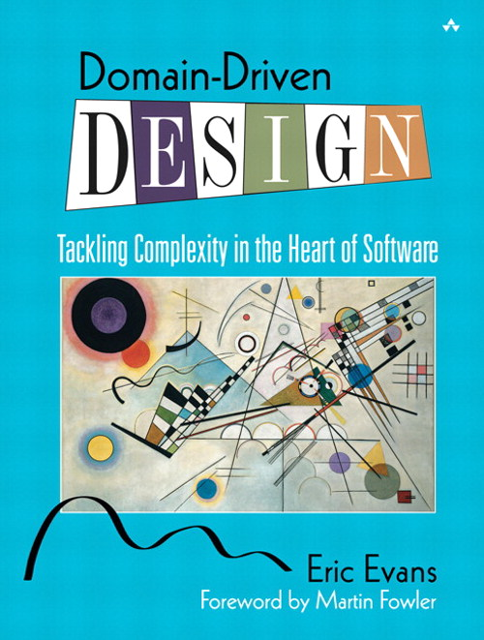
We already do it
Notes:
Emphasizes creating a language to describe the domain, and carefully naming each type in the system.

Slide 76
What’s the point?
The beginning of wisdom is to call things by their right names.
Notes:
Type Safety.
Catch errors as early as possible.
Provide meaning to data.
Encapsulation, while we’re at it.

Slide 77
Haskell
type FirstName = String // type alias
data Customer = Customer FirstName EmailAddress
Notes:
They say about Haskell, if you can get your program to compile, it’s probably right.
Catch the errors early, dammit.
There’s being picky about what we want, and then there’s being specific about what we want.

Slide 78
F#
How?? what way is best?

Slide 79
C#
Show example generated by ReSharper
Implicit conversion operator

Slide 80
Strong typing in Java
public boolean validateUser(User user)
{
EmailAddress email = user.getEmailAddress();
// exercise business logic
return true;
}
Notes:
Specificness is another part of strong typing.

Slide 81
Strong typing in functional languages
List [+A] // from Scaladoc
def indexOf [B >: A] (elem: B): Int
def sameElements (that: GenIterable[A]): Boolean

Slide 82
Strong typing in Java
public class FirstName { public final String stringValue; public FirstName(final String value) { this.stringValue = value; } public String toString() {...} public boolean equals() {...} public int hashCode() {...} }
public User(FirstName name, EmailAddress login)
Notes:
Benefits:
It is not true that “first name is a string.” Rather, “First name is _stored as_ a string.”
Arguments are more specific
Put validations in the particular types
You know when you switched the order – compile error
If you ever do need to change the underlying type, or the validations, or add a field, you have a place to do that. (Encapsulation)

Slide 83
Strong typing in Java
new User(firstName(“Joe”),
emailAddress(“joe@gmail.com”));
public static FirstName firstName(String value)
{
return new FirstName(value);
}
Notes:
Sure, it is a lot of cruft. But it has a purpose. Think hard about how important correctness is in your program.
Interesting contrast: C# won’t let you import the static method like Java does. But, you can create an implicit conversion.

Slide 84
Strong typing in Java
public boolean validateUser(User user)
{
EmailAddress email = user.getEmailAddress();
// exercise business logic
return true;
}
Notes:
Specificness is another part of strong typing.

Slide 85
Strong typing in Java
public boolean validate(HasEmailAddress anything)
{
EmailAddress email = anything.getEmailAddress();
// exercise business logic
return true;
}
interface HasEmailAddress {
EmailAddress getEmailAddress();
}
Notes:
This is more specific.

Slide 86

Lazy evaluation

Slide 87
What is it?
Delaying evaluation of an expression until the last responsible moment.
Notes:
Laziness as a programmer virtue

Slide 88
We already do it
Providers, Factories
SQL Cursors
Notes:
Pass around how to get something, instead of getting it every time.
Of course we do lazy initialization, such as in Hibernate. But that bites us because we’re not passing the full “how to do it” back to the remote-invocation system.
LINQ expressions work like this, passing around the “how.” this can burn you, because they get evaluated again at each access
C# 4.0 has a Lazy<T>.
Futures are another example.

Slide 89
What’s the point?
You may never even need it.
Separate “what to do” from “when to stop.”
Notes:
Instead of passing around the result of some calculation, we’re passing around how to get that result.
Two result expressions in a conditional – one of those will never be used.

Slide 90
Lazy evaluation in functional languages
Haskell is lazy by default
F# provides a Lazy<_> type
Infinite sequences
Notes:
Haskell can be very tricky to debug because of this.
F#’s Lazy type can also be used in C#

Slide 91
Lazy evaluation in Java
Callable
Iterable

Slide 92
Imperative Java
int bugCount = 0;
String nextLine = file.readLine();
while (bugCount < 40) {
if (nextLine.startsWith("BUG")) {
String[] words = nextLine.split(" ");
report("Saw the bug at "+words[0]+" on "+ words[1]);
bugCount++;
}
waitUntilFileHasMoreData(file);
nextLine = file.readLine();
}

Slide 93

Functional style
for (String s : take(new RandomFileIterable(br)) .filterBy(STARTS_WITH_BUG_PREDICATE)
.transformWith(TRANSFORM_BUG_FUNCTION)
.limit(40)
.asImmutableList()) {
report(s);
}

Slide 94
developer’s creed
I am more than an Object-Oriented Developer.
I am a solver of problems, a creator of solutions.
I will approach each problem with an open mind and solve it as best my team can devise.

Slide 95
Every new tool & paradigm seems to help me at work in a surprisingly recursive & backwards-compatible way. @coridrew

Slide 96
Thank you
Jessica Kerr @jessitron
Jessitron.blogspot.com
jessitron@gmail.com
(where are the slides posted?)
Look for me at KCDC, April 27-28 kcdc.info

Slide 97
Referential transparency
What is it?
Given a particular set of inputs, the function always returns the same output.
Nothing else changes.

Slide 98
We already do it
Unit tests are easier when methods depend only on parameters.

Slide 99
What is the point?
If a method is not predictable, is it ever really tested?
The pipeline. Show the white board example.
Notes:
memoization

Slide 100
Referential transparency in functional languages
Pure functional -> no mutable state, no side effects.
Every function is referentially transparent.
In real life: side effects are localized and called out.
Notes:
Scala recognizes that each class has methods that operate on the class, without belonging in the class.

Slide 101
Referential transparency in java
Static methods are not evil if:
- no internal state
- no side effects
- test, test, test!
Notes:
Separate data from behavior?

Slide 102
Encapsulation is not always the solution
Don’t hide complexity when you can reduce it.
Example of the UrlUtilImpl class?
What is it?
Stop compilation of code that uses data in an invalid way.

