Slide 1

Functional eye for the OO guy
What your mother never told you about Java
Jessica Kerr
@jessitron

Slide 2
developer’s creed
I am more than an Object-Oriented Developer.
I am a solver of problems, a creator of solutions.
I will approach each problem with an open mind and solve it as best my team can devise.

Slide 3

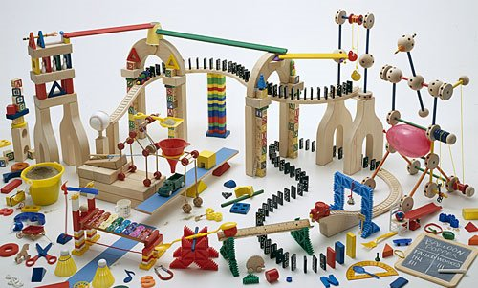
What do we love about OO?
Notes:
Stuff about the hype it had way back when Java was new:
We were going to grab objects off the shelf and plug them together like tinker toys and wa-la, applications would emerge.

Slide 4
Functional programming will solve all our problems
No.
Notes:
Functional programming is yet another way to solve problems, providing its own kind of glue, its own ways of putting the pieces together.

Slide 5
Programming paradigms
Imperative
Procedural
Object-Oriented
Functional
Aspect-oriented
Logic
Notes:
Wikipedia lists over 25 programming paradigms.
Each paradigm is suited to a particular problem set.
Each presents its own way of solving problems. The more we know, the more tools we have – not necessarily to use to solve the problem, either. We have more ways of thinking about the problem.

Slide 6
Goals for today
Look at functional principles
Learn how functional programmers solve problems
Solve more problems
Notes:
Or, solve problems more effectively.

Slide 7
Immutability
Verbs Are People Too
Declarative Style
Null Is Your Enemy
Strong Typing
Lazy Evaluation

Slide 8

Principle
What is it?
Java
We already do it
Functional
What’s the point?
Notes:
For each principle, we will see these six points.
Counterclockwise, people, because this talk is about learning new ways to think.

Slide 9


Immutability

Slide 10

What is it?
The value of an identifier never changes.
Objects never change state.
Notes:
The point is: for every variable you change to an immutable value, that’s one fewer thing you have to hold in your head.

Slide 11

We already do it
java.lang.String
Effective Java
Message Passing
Notes:
Stateles s

Slide 12

What’s the point?
The less state that can change, the less you have to think about.
Concurrency!
Notes:
Locking is for wimps.
Concurrency is, frankly, a great excuse to favor immutability. The real reason is to reduce the moving parts.
Functional programming tries to reduce moving parts; OO tries to hide them inside of objects. We can do better: we can do both.

Slide 13

Immutability in functional languages
Pure: everything is immutable.
Hybrid: immutable by default
Notes:
Default mutability is accidental complexity.

Slide 14

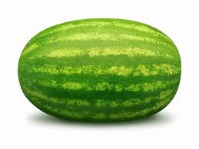



Immutability in functional languages
fruit
fruit.add(tomato)
Notes:
Functional programming deals often with list processing.
Think of it as a pipeline.
Because the original list is immutable, adding to the beginning does not copy the list.

Slide 15


Immutability in Java
final
Immutable collections

Slide 16

Immutability in Java
ImmutableMap.copyOf(mutableMap)
ImmutableList.of(item, item, item)
Notes:
Functional Java is another library, for the extremely functional-minded.
Collections.unmodifiableList doesn’t copy the data

Slide 17
Immutability in Java
Sometimes data and behavior really should be separate.

Slide 18
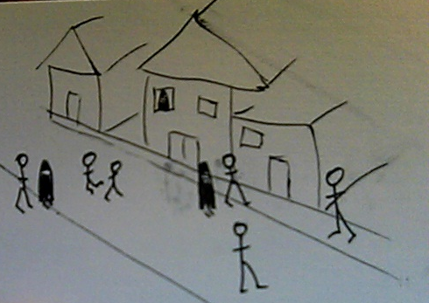

Verbs are people too

Slide 19
What is it?
Functions are values. They can be passed around just like data.
Notes:
Example of the Pricing Engine

Slide 20
We already do it
Strategy pattern
Command pattern
How
What
Notes:
HTTP
Every time we start a thread
onClick events to buttons
Dependency injection

Slide 21


We already do it
onClick
release ( )
Notes:
Javascript, we do this all the time.

Slide 22
What’s the point?
Passing around instructions is useful.
Notes:
Why, just yesterday I hit an instance where I needed to pass in how to implement one piece of an operation.

Slide 23
Verbs in functional languages
Functions are full data values.
Notes:
Mention testability. When you’re passing in the method to call, you don’t have to mock an object.

Slide 24
Verbs in Java
Function<String,String> reformatBugLine = new Function<String, String>() {
public String apply(String input) {
String[] words = input.split(" ");
return "Saw the bug at " + words[0] + " on " + word[1];
}
};
Iterables.transform(bugLines, reformatBugLine)
Notes:
We already have Callable and Runnable

Slide 25

Declarative style

Slide 26
What is it?
Say what you’re doing, not how you’re doing it.
Notes:
My husband won’t let me tell him how to do the stuff I ask him to do.

Slide 27
We already do it
Refactoring: single-line method

Slide 28
We already do it
Select USER_NAME, count(*), max(update_date)
From USER_ROLES
Where USER_ID = :userId
Group by USER_NAME
Notes:
Excel is another example. We specify the relationships between the cells, not the order of calculation.

Slide 29
What’s the point?
Readable code
Familiar != readable
Abstraction at a smaller scale

Slide 30
Declarative style in functional languages
Many small functions
One-line collection processing
linesFromFile.filter ( _.startsWith(“BUG”))

Slide 31
Declarative style in Java
for (String line : list) {
if (line.startsWith("BUG")) {
report(line);
}
}
Notes:
You have to think about this. You have to follow the logic and picture it in order to name what it is doing.
This is very readable BECAUSE IT IS FAMILIAR.
We have the power to create new idioms!

Slide 32
Declarative style in Java
reportAll(filterForBugs(list));

Slide 33
Declarative style in Java
List<String> bugLines = new LinkedList<String>();
for (String line : list) {
if (line.startsWith("BUG")) {
bugLines.add(line);
}
}
return bugLines;
Notes:
Closer look at the filterForBugs method. We can make this a bit more declarative, too.

Slide 34

Declarative style in Java
Iterable<String> bugLines = filter(list, startsWithBug);
final Predicate<String> startsWithBug =
new Predicate<String>() {
public boolean apply(String s) {
return s.startsWith("BUG");
}
};
Notes:
Guava makes the filter operation one line, BUT you have to define the predicate as an anonymous class.
(define predicate)
What was twenty characters in Scala is five or six lines of code in Java, with curly braces and pointy braces and parentheses.

Slide 35

Null Is Your Enemy

Slide 36
What is it?
A null reference is not a valid object reference. Let’s stop treating it like one.
Notes:
NullPointerException happens because the compiler allows object references to point to something other than an object.

Slide 37
We already do it
Thingiebob
doStuff()
SomeThingiebob
doStuff() {…}
NullThingiebob
doStuff() {}
Notes:
This is a “Pattern Honorable Mention” in Head First Design Patterns
If null //blah else // blah is not very object-oriented.
This is a form of “Replace conditional with polymorphism”
Another way we do it is with the @Nullable annotation. We attempt to mark which parameters might be null.

Slide 38
What’s the point?
NPE

Slide 39
Defeating null in functional languages
Option<T>
Some<T>
None
Notes:
If you may or may not return something, call it out.

Slide 40
Defeating null in Java
Optional<String> banana = Optional.of("banana");
Optional<String> noBanana = Optional.absent();
if (banana.isPresent()) {
String contents = banana.get();
}
Notes:
Three attempts:
@Nullable, @MayReturnNull
NullObjectPatterns
Optional in Guava
What else optional can do: you can always call .equals get it as a set; chain them with or; pull only the populated values out a list of them.
I would like to see: transform (map), filter, iter.

Slide 41
Defeating null in Java
Optional.fromNullable(mightBeNull);
Notes:
The biggest benefit is calling .equals. Too bad there aren’t more methods on it.

Slide 42

Strong typing

Slide 43
What is it?
When the wrong type of data is passed in, the compiler complains.
Notes:
The more specific we are with the type of data, the more the compiler can help us.

Slide 44
We already do it
Java is strongly typed, right?
Notes:
Well, it is statically typed. How we use that is up to us.
Erasure messes up runtime type checking.

Slide 45
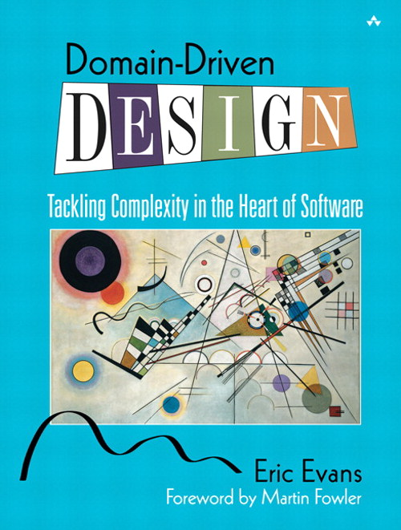
We already do it
Notes:
Emphasizes creating a language to describe the domain, and carefully naming each type in the system.

Slide 46
What’s the point?
The beginning of wisdom is to call things by their right names.
Notes:
Type Safety.
Catch errors as early as possible.
Provide meaning to data.
Encapsulation, while we’re at it.

Slide 47
Strong typing in functional languages
type FirstName = String // Haskell type alias
data User = User FirstName EmailAddress // Haskell data type
Notes:
They say about Haskell, if you can get your program to compile, it’s probably right.
Catch the errors early, dammit.
There’s being picky about what we want, and then there’s being specific about what we want.

Slide 48
Strong typing in functional languages
List [+A] // from Scaladoc
def indexOf [B >: A] (elem: B): Int
def sameElements (that: GenIterable[A]): Boolean

Slide 49
Strong typing in Java
public class FirstName { public final String stringValue; public FirstName(final String value) { this.stringValue = value; } public String toString() {...} public boolean equals() {...} public int hashCode() {...} }
public User(FirstName name, EmailAddress login)
Notes:
Benefits:
It is not true that “first name is a string.” Rather, “First name is _stored as_ a string.”
Arguments are more specific
Put validations in the particular types
You know when you switched the order – compile error
If you ever do need to change the underlying type, or the validations, or add a field, you have a place to do that. (Encapsulation)

Slide 50
Strong typing in Java
new User(firstName(“Joe”),
emailAddress(“joe@gmail.com”));
public static FirstName firstName(String value)
{
return new FirstName(value);
}
Notes:
Sure, it is a lot of cruft. But it has a purpose. Think hard about how important correctness is in your program.

Slide 51
Strong typing in Java
public boolean validateUser(User user)
{
EmailAddress email = user.getEmailAddress();
// exercise business logic
return true;
}
Notes:
Specificness is another part of strong typing.

Slide 52
Strong typing in Java
public boolean validate(HasEmailAddress anything)
{
EmailAddress email = anything.getEmailAddress();
// exercise business logic
return true;
}
interface HasEmailAddress {
EmailAddress getEmailAddress();
}
Notes:
This is more specific.

Slide 53

Lazy evaluation

Slide 54
What is it?
Delaying evaluation of an expression until the last responsible moment.
Notes:
Laziness as a programmer virtue

Slide 55
We already do it
Providers, Factories
SQL Cursors
Notes:
Pass around how to get something, instead of getting it every time.
Of course we do lazy initialization, such as in Hibernate. But that bites us because we’re not passing the full “how to do it” back to the remote-invocation system.

Slide 56
What’s the point?
You may never even need it.
Separate “what to do” from “when to stop.”
Notes:
Instead of passing around the result of some calculation, we’re passing around how to get that result.
Two result expressions in a conditional – one of those will never be used.

Slide 57
Lazy evaluation in functional languages
Haskell is lazy by default
F# provides a Lazy<_> type
Infinite sequences
Notes:
Haskell can be very tricky to debug because of this.
F#’s Lazy type can also be used in C#

Slide 58
Lazy evaluation in Java
Callable
Iterable

Slide 59
Imperative Java
int bugCount = 0;
String nextLine = file.readLine();
while (bugCount < 40) {
if (nextLine.startsWith("BUG")) {
String[] words = nextLine.split(" ");
report("Saw the bug at "+words[0]+" on "+ words[1]);
bugCount++;
}
waitUntilFileHasMoreData(file);
nextLine = file.readLine();
}

Slide 60

Functional style
for (String s : take(new RandomFileIterable(br)) .filterBy(STARTS_WITH_BUG_PREDICATE)
.transformWith(TRANSFORM_BUG_FUNCTION)
.limit(40)
.asImmutableList()) {
report(s);
}

Slide 61
developer’s creed
I am more than an Object-Oriented Developer.
I am a solver of problems, a creator of solutions.
I will approach each problem with an open mind and solve it as best my team can devise.

Slide 62
Every new tool & paradigm seems to help me at work in a surprisingly recursive & backwards-compatible way. @coridrew

Slide 63
Thank you
Jessica Kerr @jessitron
Jessitron.blogspot.com
jessitron@gmail.com
(where are the slides posted?)
Look for me at KCDC, April 27-28 kcdc.info

Slide 64
Referential transparency
What is it?
Given a particular set of inputs, the function always returns the same output.

Slide 65
We already do it
Unit tests are easier when methods depend only on parameters.

Slide 66
What is the point?
If a method is not predictable, is it ever really tested?
Notes:
memoization

Slide 67
Referential transparency in functional languages
Pure functional -> no mutable state, no side effects.
Every function is referentially transparent.
In real life: side effects are localized and called out.
Notes:
Scala recognizes that each class has methods that operate on the class, without belonging in the class.

Slide 68
Referential transparency in java
Static methods are not evil if:
- no internal state
- no side effects
- test, test, test!
Notes:
Separate data from behavior?

Slide 69
Encapsulation is not always the solution
Don’t hide complexity when you can reduce it.
Example of the UrlUtilImpl class?
What is it?
Stop compilation of code that uses data in an invalid way.

