Slide 1
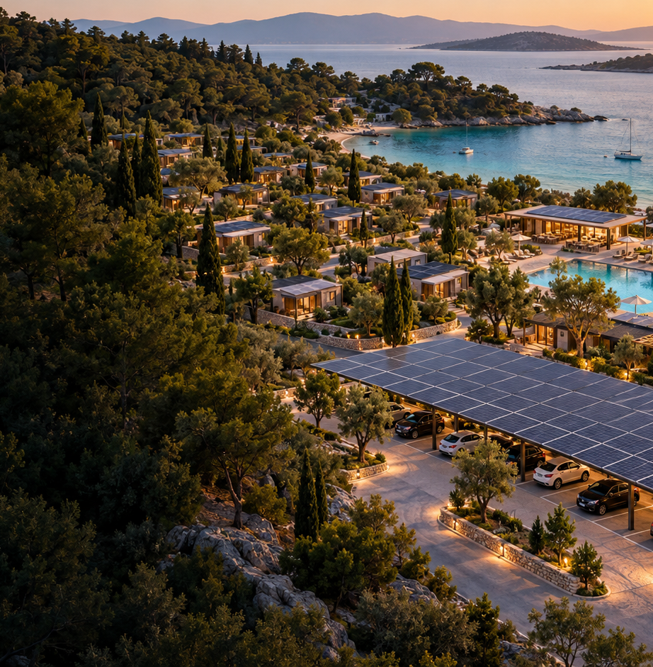
ECOGRID
RESORT
Outdoor hospitality.
Powered smarter.
Solar installations, funding support
and energy control for campsites
and holiday resorts.
€700,000 market-validation round
Confidential · October 2026
AI-generated concept visualization
Notes:
Founder brief and confirmed €700k ask, 4 October 2026. Both models, with direct sales leading. Concept visual generated with OpenAI image generation for this presentation. All commercial projections are proposed scenarios.

Slide 2
A 12,307-site launch-country inventory
Campsites first. Spain, Italy and France establish the starting prospect universe.
Country | Establishments | Reference year | Phase
Spain | 1,431 | 2025 | Launch
Italy | 2,880 | 2025 | Launch
France | 7,996 | 2025 | Launch
Belgium | 379 | 2025 | Expansion
Netherlands | 2,630 | 2025 | Expansion
United Kingdom | 6,169 | 2023 | Expansion
21,485 indicative sites across six markets · mixed scope and years
EU: 2025 NACE I553 establishments, all sizes / ratings. UK: broader parks + campsites, 2023. Eligible market is smaller.
ECOGRID RESORT · Confidential investor proposal · October 2026
02
Notes:
Verified 4 October 2026. Eurostat tour_cap_nat, freq A, accomunit ESTBL, unit NR, nace_r2 I553, time 2025: Spain 1431, Italy 2880, France 7996, Belgium 379, Netherlands 2630. API snapshot saved in .build/eurostat-market-source.json, updated 22 September 2026. https://ec.europa.eu/eurostat/databrowser/view/tour_cap_nat/default/table?lang=en . UKCCA 2024 report, 2023 operator base 6169 holiday parks and campsites: https://www.ukcca.org.uk/media/o3og4sel/ukcca-uk-report-2024.pdf tables 4.1 and 4.2. The six-country sum is indicative; UK scope and vintage differ. This inventory includes small and unclassified sites and is not the addressable 3–5-star / Small-Medium-Large segment. France adjacent segment: INSEE January 2026 mainland 3955 campsites at 3–5 stars and 799 holiday villages/family holiday homes https://www.insee.fr/fr/statistiques/8735173?geo=METRO-1 . Netherlands 1782 holiday-house parks, 2025 CBS https://www.cbs.nl/nl-nl/cijfers/detail/82062NED. These adjacent categories are outside the campsite totals and still need eligibility/deduplication.

Slide 3
Five parts of one offer
A shared back office connects acquisition, funding, engineering, delivery and operation.
1
CampaignBuilder + wizard
Complete site data and purchasing intent before technical review.
2
Grant team + back office
Screen support, prepare applications and track eco-label evidence.
3
Engineering + cost model
Size PV and storage. Price carports by square metre. Validate quotes.
4
Supplier + contractor portals
Confirm stock, lead times and installation slots with approved alternatives.
5
Eco Grid Pilot
Connect supported inverters and batteries to dispatch available energy.
ECOGRID RESORT · Confidential investor proposal · October 2026
03
Notes:
The five-part offer follows the user’s current brief. Product capability is planned scope, not a claim that production modules are deployed. Completion is a lead-interest signal. Technical and commercial qualification remain necessary.

Slide 4
Acquisition starts with a completed wizard
Year-1 targets convert 200 complete applications into 20 commissioned sites.
200
40
20
Completed wizards
Audited opportunities
Installed customers
Up to 12,000 prospect records, then filter the 12,307-site launch inventory
€180k sales + marketing budget. €9,000 acquisition cost per installed site.
New targets. Conversion and campaign reach require validation. Completion alone does not prove technical fit.
ECOGRID RESORT · Confidential investor proposal · October 2026
04
Notes:
Sources: SmartGrid/Commercial/notes_segmentation_energie_2026-06-12.md; BP/BP_interview_notes.md; BP/ECOGRID_Business_Plan_EN.docx; Investor_Package_2026-07/English/ECOGRID_RESORT_Investment_Memorandum_EN.html. New package rates and rollout assumptions: investor-teaser/scenario-data.json and assumptions-and-sources.md. All values are planning hypotheses unless explicitly identified as documented inputs. The up-to-12,000-record database is a target against a 12,307 establishment broad inventory, all sizes and ratings. Eligible campaign records are a smaller segment; qualify decision-makers and deduplicate. 10% completion-to-install conversion, 20% completion-to-audit and 50% audit-to-install. Signed and commissioned counts are equal in this scenario. Acquisition cost includes €90k marketing and €90k sales expense.

Slide 5
Nine profiles across size and star rating
ECOGRID delivery cost and net facility savings for the proposed solar-first package.
Facility | ECOGRID cost | Client price | Net savings / yr
3★ Small | €50.2k | €77.2k | €4.6k
4★ Small | €60.7k | €93.3k | €7.0k
5★ Small | €80.0k | €123.0k | €11.2k
3★ Medium | €229.6k | €353.2k | €31.9k
4★ Medium | €301.5k | €463.8k | €45.8k
5★ Medium | €399.6k | €614.8k | €64.6k
3★ Large | €600.2k | €923.4k | €95.9k
4★ Large | €790.5k | €1.22m | €131.6k
5★ Large | €982.6k | €1.51m | €168.5k
Baseline €0.22/kWh, no grant. Net savings deduct software + maintenance. Costs are budget estimates, excluding VAT.
ECOGRID RESORT · Confidential investor proposal · October 2026
05
Notes:
Sources: SmartGrid/Commercial/notes_segmentation_energie_2026-06-12.md; BP/BP_interview_notes.md; BP/ECOGRID_Business_Plan_EN.docx; Investor_Package_2026-07/English/ECOGRID_RESORT_Investment_Memorandum_EN.html. New package rates and rollout assumptions: investor-teaser/scenario-data.json and assumptions-and-sources.md. All values are planning hypotheses unless explicitly identified as documented inputs.

Slide 6
Medium and Large sites lead the rollout
The mix weights project scale without forcing costly storage onto smaller sites.
20%
55%
25%
Small
Medium
Large
50–150 pitches
150–350 pitches
350–700 pitches
Weighted delivery cost €398.1k / site
Weighted client price €612.5k
Small-site paybacks are weaker. Selective solar-only entry offers need individual commercial validation.
ECOGRID RESORT · Confidential investor proposal · October 2026
06
Notes:
Sources: SmartGrid/Commercial/notes_segmentation_energie_2026-06-12.md; BP/BP_interview_notes.md; BP/ECOGRID_Business_Plan_EN.docx; Investor_Package_2026-07/English/ECOGRID_RESORT_Investment_Memorandum_EN.html. New package rates and rollout assumptions: investor-teaser/scenario-data.json and assumptions-and-sources.md. All values are planning hypotheses unless explicitly identified as documented inputs.

Slide 7
A 4-star Medium site, priced by quantity
374 modules. 205.7 kWp PV. 130 kWh storage. 194 m² carport structure.
Installation scope | Cost basis | Budget
PV package | 205.7 kWp × €900 | €185,130
Battery package | 130 kWh × €300 | €39,000
Carport structure | 194 m² × €180 | €34,920
Engineering + controls | Medium-site allowance | €15,000
Delivery contingency | 10% of subtotal | €27,405
Total delivery cost | Excluding VAT | €301,455
PV €900/kWp. Battery €300/kWh. Structure €180/m². New budget hypotheses, subject to engineering and partner quotes.
ECOGRID RESORT · Confidential investor proposal · October 2026
07
Notes:
Sources: SmartGrid/Commercial/notes_segmentation_energie_2026-06-12.md; BP/BP_interview_notes.md; BP/ECOGRID_Business_Plan_EN.docx; Investor_Package_2026-07/English/ECOGRID_RESORT_Investment_Memorandum_EN.html. New package rates and rollout assumptions: investor-teaser/scenario-data.json and assumptions-and-sources.md. All values are planning hypotheses unless explicitly identified as documented inputs.

Slide 8
Funding support is a dedicated service
Country rules and application evidence live in one back-office workflow.
Launch markets
Expansion and EU routes
Spain
Current regional / IDAE eligibility
Belgium, Netherlands, UK
Separate country and regional support screens
Italy
Regional calls / GSE configuration checks
European Union
Competitive LIFE calls and eco-label criteria
France
ADEME / regional funding eligibility
Dedicated team prepares and tracks dossiers
No grant awards or success fees in the forecast. Grants, tax relief, loans and export payments are different instruments.
ECOGRID RESORT · Confidential investor proposal · October 2026
08
Notes:
Official sources reviewed 4 October 2026: IDAE RD477 programme https://www.idae.es/ayudas-y-financiacion/para-energias-renovables-en-autoconsumo-almacenamiento-y-termicas-sector/incentivos-autoconsumo-y-almacenamiento-con-fuentes-de-energias-renovables-rd-4772021 (programme ended 31 Dec 2023); https://www.ademe.fr/nos-missions/financement/; GSE https://assistenza.clienti.gse.it/csm/it/differenze-tra-configurazioni-di-autoconsumo?id=faq&sys_id=8d36cf8ec34246143fd7bffb05013182; https://energie.wallonie.be/home/soutiens-financiers/entreprises/audits-et-etudes-amureba/amureba-pour-les-entreprises.html; https://www.vlaio.be/nl/subsidies-financiering/subsidiedatabank/maatregelen/zonnepanelen-steun; https://english.rvo.nl/subsidies-financiering/sde; https://www.ofgem.gov.uk/environmental-and-social-schemes/smart-export-guarantee-seg/electricity-suppliers; https://cinea.ec.europa.eu/programmes/life/clean-energy-transition_en; https://green-forum.ec.europa.eu/green-business/eu-ecolabel/product-groups-and-criteria/tourist-accommodation_en. No blanket grants promised. Ecolabel eligibility does not itself confer grant entitlement.

Slide 9
Eco Grid Pilot follows the site load
Planned control software directs production, storage and permitted export.
At noon
95 kW serves the site
35 kW charges storage
20 kW exports to the grid
Supported device APIs and fail-safe settings govern automation.
Illustrative kW values, not telemetry. Battery availability, local controls and grid permission constrain dispatch.
ECOGRID RESORT · Confidential investor proposal · October 2026
09
Notes:
Illustrative energy demonstration. Noon balance: 150 kW solar = 95 kW site + 35 kW charging + 20 kW export. Evening 20 kW solar + 60 kW battery = 80 kW site. Not a battery sizing or state-of-charge simulation. No export or flexibility income in forecasts. Founder brief defines planned inverter/battery integration.

Slide 10
Direct sales lead. Asset finance stays separate.
Both routes use the same platform. The €700k raise funds the operating company.
Resort-funded installation
Separately funded asset
€463,777
Proposed €0 resort plant CAPEX
ECOGRID earns 35% target project margin
€8,000 annual software + maintenance
Resort retains €45,845 net savings / year
60% asset-owner / 40% resort savings share
€28,307 asset cash / year before reserves
16.4 years simple asset payback
4★ Medium baseline. Financed partner funds quoted plant price. Asset returns exclude debt, tax and replacement reserves.
ECOGRID RESORT · Confidential investor proposal · October 2026
10
Notes:
Sources: SmartGrid/Commercial/notes_segmentation_energie_2026-06-12.md; BP/BP_interview_notes.md; BP/ECOGRID_Business_Plan_EN.docx; Investor_Package_2026-07/English/ECOGRID_RESORT_Investment_Memorandum_EN.html. New package rates and rollout assumptions: investor-teaser/scenario-data.json and assumptions-and-sources.md. All values are planning hypotheses unless explicitly identified as documented inputs. The reference case asset payback exceeds the earlier 15-year contract assumption, so the financed route requires a different structure before approval. Financed comparison uses the quoted client installation price as SPV capital invested, including EPC margin. Maintenance is borne by asset owner. Asset-owner cash deducts maintenance and excludes software revenue, which belongs to ECOGRID. Resort cash after software equals 40% of gross energy savings less software. No grant assumed. Simple payback does not prove a financeable return within the contract term. No financed installations in opco forecasts.

Slide 11
200 connected sites in three commercial years
20 / 60 / 120 new installations. An acceleration of the July plan’s 15 / 40 / 80.
€1.71m
Year-3 software + maintenance run rate
€790.0k
Software-only run rate within that total
Growth target, not signed pipeline. Direct sales only. Half-year service revenue for new cohorts, no churn.
ECOGRID RESORT · Confidential investor proposal · October 2026
11
Notes:
Sources: SmartGrid/Commercial/notes_segmentation_energie_2026-06-12.md; BP/BP_interview_notes.md; BP/ECOGRID_Business_Plan_EN.docx; Investor_Package_2026-07/English/ECOGRID_RESORT_Investment_Memorandum_EN.html. New package rates and rollout assumptions: investor-teaser/scenario-data.json and assumptions-and-sources.md. All values are planning hypotheses unless explicitly identified as documented inputs.

Slide 12
Revenue and cost grow with delivered projects
Illustrative operating-company performance. All values in EUR millions.
EUR millions | 2027 | 2028 | 2029
Revenue | 12.34 | 37.18 | 74.70
Installation cost of sales | 7.96 | 23.89 | 47.78
Service revenue recognised | 0.09 | 0.43 | 1.20
Gross profit | 4.34 | 13.14 | 26.50
Operating expenses | 0.59 | 1.10 | 1.80
Illustrative EBITDA | 3.75 | 12.04 | 24.70
Targets: 35% works / 65% service gross margin. EBITDA excludes software CAPEX, depreciation, financing and tax.
ECOGRID RESORT · Confidential investor proposal · October 2026
12
Notes:
Sources: SmartGrid/Commercial/notes_segmentation_energie_2026-06-12.md; BP/BP_interview_notes.md; BP/ECOGRID_Business_Plan_EN.docx; Investor_Package_2026-07/English/ECOGRID_RESORT_Investment_Memorandum_EN.html. New package rates and rollout assumptions: investor-teaser/scenario-data.json and assumptions-and-sources.md. All values are planning hypotheses unless explicitly identified as documented inputs. Forecast formulas: works revenue = new sites × weighted quoted price. Works COGS = new sites × weighted delivery cost. Service revenue = (opening sites + 50% of new sites) × weighted annual fees. Service COGS = 35% of service revenue. Gross profit = works revenue minus works COGS plus 65% of service revenue. OPEX = €590k / €1.1m / €1.8m. Software development €250k remains outside EBITDA. Very high EBITDA depends on unvalidated 35% project margin and conversion. No asset or grant revenues.

Slide 13
Delivery capacity is part of the growth plan
Supplier and contractor portals turn demand into confirmed delivery slots.
2 / 6 / 12
10
€9k / €6k / €5k
Installation crews
Year 1 / 2 / 3
Sites commissioned
per crew per year
Sales + marketing CAC
Year 1 / 2 / 3
Launch: Spain, Italy and France
Then Belgium, Netherlands and UK after repeatable site economics
Crew capacity is a planning assumption. Country expansion follows demonstrated delivery and collections.
ECOGRID RESORT · Confidential investor proposal · October 2026
13
Notes:
Founder geography sequence. Proposed delivery capacity 20/60/120 sites divided by 10 per crew per year. Confirm contractor coverage and two approved alternatives for each critical region. Sales + marketing expense €180k/€360k/€600k, included in OPEX rather than charged twice. Schedule installation around seasonal demand.

Slide 14
Round 1: €700k to test the market
Prove acquisition, delivery margins and cash collection before funding expansion.
€700k
Software + integrations
€250k
Launch hires + grant capability
€180k
Campaigns + commercial launch
€120k
Control capital exposure
Working capital
€100k
Stage campaign and hiring spend
Secure deposits and delivery terms
Measure savings on commissioned sites
Contingency reserve
€50k
Staged customer receipts fund delivery. Financed assets need separate capital. Valuation and investment terms remain open.
ECOGRID RESORT · Confidential investor proposal · October 2026
14
Notes:
Confirmed founder ask €700,000. Proposed allocation sums exactly €700,000. €250k software development from June interview. The €300k team+campaign allocation covers about six months of €590k annual OPEX; subsequent expenses rely on collected project margin. €100k working capital and €50k reserve. Negotiate 40% client order / 50% before delivery / 10% acceptance versus supplier payment milestones. Four concurrent average projects and 90% supplier prepayment imply roughly €453k initial bridge need, above the allocation. A monthly cash plan and finance facility may be required. Allocation is not additional to P&L OPEX.

Slide 15
First projects can support launch economics
The proposed mix produces €214k average project contribution at a 35% gross margin.
4
8
projects exceed €700k
projects exceed €700k after costs
€858k project gross contribution
Before software development + OPEX
€875k business surplus after deducting
€250k development + €590k year-1 OPEX
At 20% achieved margin, these thresholds rise to 6 and 13 projects.
Conditional scenario. Surplus excludes tax, financing, cash-cycle changes and further CAPEX. No investor repayment promised.
ECOGRID RESORT · Confidential investor proposal · October 2026
15
Notes:
Sources: SmartGrid/Commercial/notes_segmentation_energie_2026-06-12.md; BP/BP_interview_notes.md; BP/ECOGRID_Business_Plan_EN.docx; Investor_Package_2026-07/English/ECOGRID_RESORT_Investment_Memorandum_EN.html. New package rates and rollout assumptions: investor-teaser/scenario-data.json and assumptions-and-sources.md. All values are planning hypotheses unless explicitly identified as documented inputs. Fixed average client price €612530.346, delivery cost €398144.725, gross contribution €214385.621. Four projects contribute €857542.485 before fixed launch costs. Eight contribute €1715084.969; deduct €250000 development and €590000 full year-1 OPEX once, leaving €875084.969. This is a business-surplus illustration, not investor principal recovery or a guaranteed cash return. Recurring contribution excluded. Costs already overlap round allocations; allocations are not added again. Capital and project cash timing, working capital, taxes, debt and extra CAPEX excluded. At 20% of fixed average quoted price, margin contribution is €122506.069; ceil(700000/contribution)=6, ceil((700000+840000)/contribution)=13. No signed orders or independently validated cost quotes. Risk is controlled through milestones, direct sales and contract cash terms, not inherently minimal.

Slide 16
Round 2 follows campaign and delivery evidence
Use observed acquisition, project economics and collections to size expansion capital.
01
Demand by country and facility
Reach, complete wizards, audits, signed orders and paid deposits.
02
Economics of delivered projects
Realised gross margin, CAC, savings, installation time and collections.
03
Capital required by the proven pipeline
Monthly cash gaps, signed backlog, crew capacity and staged hiring.
Expansion spend + peak cash gap + reserve − available cash
Second-round amount and valuation remain open. Owned energy assets need separate committed capital.
ECOGRID RESORT · Confidential investor proposal · October 2026
16
Notes:
Founder requests a first round to test the water and a more precise second round after the marketing campaign returns. Proposed readiness: a full campaign-to-collection cohort, at least four commissioned and collected projects to test gross contribution coverage, measured customer savings, reproducible realised margins and validated supplier/contractor capacity. Four projects do not statistically establish country- or segment-wide conversion. Measure completed applications / unique decision-makers reached, completion-to-audit, audit-to-contract, contract-to-commissioning, collections, CAC and margin by country/star/size. Review after the full cycle and repeat by segment. Next-round funding = expansion development, hiring and market launch spend + peak modelled cash deficit + contingency reserve − cash available for expansion. Keep earned operating cash and any separate asset-finance commitment distinct from opco equity. No arbitrary second-round amount is offered before evidence.

Slide 17
Appendix: acquisition by facility profile
New commissioned sites by year. Mix remains fixed in the growth-target scenario.
Profile | Demand MWh / yr | 2027 | 2028 | 2029
3★ Small | 75 | 1 | 3 | 6
4★ Small | 95 | 2 | 6 | 12
5★ Small | 130 | 1 | 3 | 6
3★ Medium | 330 | 2 | 6 | 12
4★ Medium | 445 | 5 | 15 | 30
5★ Medium | 600 | 4 | 12 | 24
3★ Large | 900 | 1 | 3 | 6
4★ Large | 1195 | 2 | 6 | 12
5★ Large | 1500 | 2 | 6 | 12
Total new sites |  | 20 | 60 | 120
Representative pitches: S 100 / M 250 / L 500. Star-specific loads are modelling assumptions.
ECOGRID RESORT · Confidential investor proposal · October 2026
17
Notes:
Sources: SmartGrid/Commercial/notes_segmentation_energie_2026-06-12.md; BP/BP_interview_notes.md; BP/ECOGRID_Business_Plan_EN.docx; Investor_Package_2026-07/English/ECOGRID_RESORT_Investment_Memorandum_EN.html. New package rates and rollout assumptions: investor-teaser/scenario-data.json and assumptions-and-sources.md. All values are planning hypotheses unless explicitly identified as documented inputs.

Slide 18
Appendix: assumptions and package boundaries
New solar-first economics are distinct from the earlier full-microgrid packages.
Documented planning inputs
New budget hypotheses
S 50–150 / M 150–350 / L 350–700 pitches
1,400 kWh/kWp Southern Europe reference
35% target works gross margin
€250k software CAPEX + €590k year-1 OPEX
55% bill offset / 85% PV self-use
€900/kWp PV / €300/kWh battery
€180/m² carport / 10% contingency
Limited M/L storage. No S battery.
Software €2.5k / €4k / €5k per year
Maintenance €2k / €4k / €8k per year
Earlier full packages: S €0.20–0.35m,
M €0.9–1.2m, L €2.1–2.7m, with larger
batteries and EV equipment.
No granted aid, export revenue, EV income or flexibility revenue. Simple payback is not IRR.
ECOGRID RESORT · Confidential investor proposal · October 2026
18
Notes:
Sources: SmartGrid/Commercial/notes_segmentation_energie_2026-06-12.md; BP/BP_interview_notes.md; BP/ECOGRID_Business_Plan_EN.docx; Investor_Package_2026-07/English/ECOGRID_RESORT_Investment_Memorandum_EN.html. New package rates and rollout assumptions: investor-teaser/scenario-data.json and assumptions-and-sources.md. All values are planning hypotheses unless explicitly identified as documented inputs.

