Slide 1

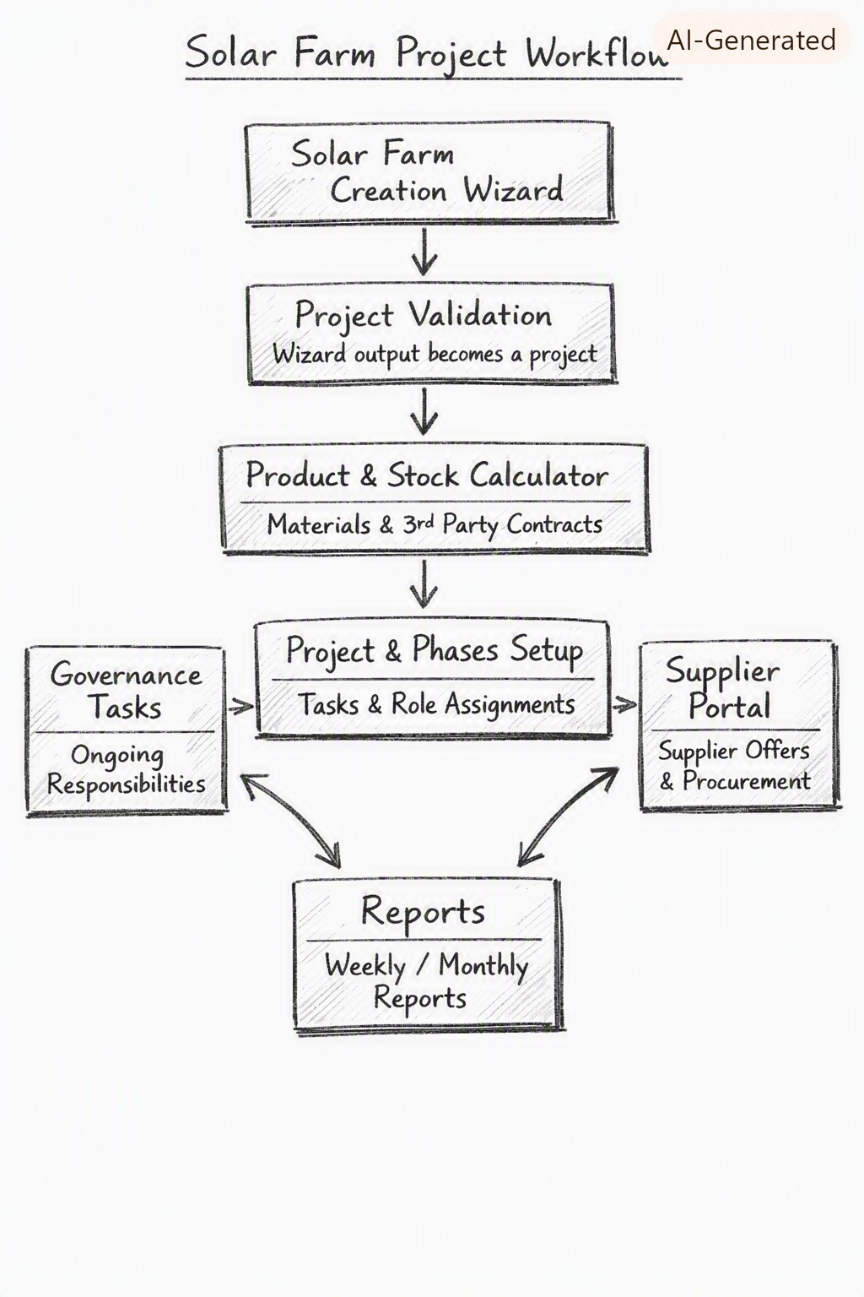
COREPROMA
Solar Farm
Project
Workflow
Operational Architecture
& Governance Framework
PREPARED FOR
Ethical Power
2026
Project Workflow — Reference Diagram

Slide 2
Overview
COREPROMA Solar Farm Platform
COREPROMA's solar farm platform guides project teams from initial client brief through to on-site execution — capturing every technical, regulatory, environmental, and financial input along the way.
COREPROMA's Role
End-to-end digital workflow for solar farm delivery
Seven integrated modules:
Automated bill-of-materials and contractor scoping
B1
Solar Farm Creation Wizard
B2
Integrated procurement marketplace with ESG alignment
Project Validation
B3
Product & Stock Calculator
Phase-based project governance with recurring oversight tasks
B4
Supplier Portal
B5
Project & Phases Setup
Real-time reporting for management and investors
B6
Governance Tasks
B7
Reports
Prepared for Ethical Power · COREPROMA Solar Farm Platform · Confidential

Slide 3
B1
Solar Farm Creation Wizard
Purpose: Project initiation & data capture
Description
200+
An automated step-by-step workflow that collects all inputs required to define a solar farm project — including site dimensions, terrain data (via GEOALT / Google Maps), access road requirements, fencing needs, panel layout, regulatory permits, and financial parameters.
Data points captured per project
Key Features
Investor Value
Step-by-step guided data entry
Scalable, repeatable onboarding removes costly manual scoping errors. Every project starts from a validated, standardised data baseline — accelerating time-to-quote and reducing rework.
GIS / terrain model integration (GEOALT, Google Maps)
Road & fencing requirement flags
Panel layout & pile count estimation
Regulatory & environmental checklist

Slide 4
B2
Project Validation
Purpose: Feasibility & compliance check
Description
35+
Converts wizard output into a formal, validated project record. Runs automated feasibility checks — verifying site suitability, regulatory compliance, budget envelope, and technical specifications — before committing resources.
Validation checks automated
Key Features
Investor Value
Automated feasibility scoring
Risk reduction at the source. Feasibility issues caught here cost a fraction of those identified on-site. Investors gain confidence that every project in the pipeline has cleared a documented compliance gate.
Regulatory compliance verification
Budget envelope validation
Technical specification sign-off
Formal project record creation

Slide 5
B2b — Risk Register & Provisions
Purpose: Risk identification & cost quantification
A structured risk register populated immediately after Project Validation (B2), before the BoM is calculated (B3). Each identified risk is captured with full context and a named £ cost provision — so nothing is hidden in a catch-all contingency percentage.
B2b
RISK
DATA CAPTURED PER RISK
RISK CATEGORIES (8)
8
▸ Risk type & category (8 categories)
▸ Ground conditions & geotechnical
risk
categories
▸ Status: Known Risk / Potential Risk / Information Gap
▸ Information gaps (pending surveys)
100%
▸ Likelihood: High / Medium / Low
▸ Grid connection & DNO requirements
provisions
named
▸ Named £ cost provision (not a % contingency)
▸ Planning & permitting
▸ Basis of estimate (survey, benchmark, assumption)
▸ Environmental & ecology
▸ Mitigation action & responsible owner
▸ Access, logistics & site constraints
▸ Resolution stage (at what point risk closes)
▸ Commercial & contractual
▸ Force majeure & unforeseen events
Investor value: Itemised risk pricing eliminates hidden contingencies. Each risk appears as a named budget line in the tender — clients see exactly what is priced and why. Provisions feed directly into B3. Reduces mid-project disputes.
Prepared for Ethical Power · COREPROMA Solar Farm Platform · Confidential

Slide 6
B3
Product & Stock Calculator
Purpose: Materials & third-party requirements
Description
Auto
Automatically generates a full bill-of-materials from the validated project record — solar panels, piles, cabling, inverters, mounting structures, and all ancillary materials. Also identifies third-party contractor requirements and logistics needs.
BoM line items generated
Key Features
Investor Value
Full bill-of-materials generation
Cost transparency from day one. Accurate BoM generation eliminates under-ordering and emergency procurement. Investors see a credible, data-driven cost model before any capital is committed.
Pile & panel count calculation
Cabling & inverter sizing
Contractor scope identification
Logistics & delivery planning inputs

Slide 7
B4
Supplier Portal
Purpose: Procurement marketplace
Description
12+
A structured digital marketplace where pre-qualified suppliers and contractors submit competitive offers against the project BoM. Procurement teams validate bids, compare on price, lead time, and ESG credentials, and award contracts — all within the platform.
Supplier categories onboarded
Key Features
Investor Value
Pre-qualified supplier network
Cost efficiency through competitive tendering, with built-in ESG alignment scoring. Full audit trail of procurement decisions supports governance reporting and investor due diligence.
Competitive bid submission & comparison
ESG credential scoring
Contract award workflow
Full procurement audit trail

Slide 8
B5
Project & Phases Setup
Purpose: Execution planning
Description
Multi
Translates the validated project and awarded contracts into a phased execution plan. Defines milestones, tasks, resource assignments, and dependencies — providing the project management backbone for on-site delivery.
Execution phases defined
Key Features
Investor Value
Phase milestone definition
Governance and reliability. A structured phase plan with clear ownership reduces delivery risk and gives investors a milestone-based view of progress and capital deployment.
Task & dependency mapping
Resource & contractor assignment
Integration with Supplier Portal (B4)
Feeds Governance Tasks (B6) & Reports (B7)

Slide 9
B6
Governance Tasks
Purpose: Operational discipline
Description
8+
Manages recurring operational responsibilities throughout project execution — including daily stock level updates, contractor on-site presence verification, equipment delivery confirmations, and safety & compliance checks.
Recurring task categories
Key Features
Investor Value
Daily stock level monitoring
Oversight and accountability. Recurring governance tasks ensure no operational obligation is missed. Investors benefit from a documented, auditable record of on-site management throughout the project lifecycle.
Contractor presence verification
Equipment delivery confirmation
Safety & compliance check-ins
Automated task assignment & escalation

Slide 10
B7
Reports
Purpose: Management insights & transparency
Description
6+
Generates weekly and monthly management reports covering project progress, procurement status, budget vs. actual, risk register updates, and governance task completion. Distributable to internal teams, clients, and investors.
Report types available
Key Features
Investor Value
Weekly progress reports
Transparency as a differentiator. Timely, accurate reporting builds stakeholder trust and supports investment committee reviews. Real-time dashboards reduce information asymmetry between the field and the boardroom.
Procurement & budget tracking
Risk register updates
Governance task completion rates
Investor-ready monthly summaries

Slide 11
Workflow Summary
End-to-end module connections
↓ Main Flow
B1 → B2 → B2b → B3 → B5
Wizard → Validation → Risk Register → BoM → Execution Planning
→ Procurement
B5 → B4
Phases setup drives Supplier Portal procurement
← Governance
B5 ↔ B6
Bidirectional: ongoing governance tasks feed back into phases
↓ Reporting
B4 + B6 → B7
Supplier Portal & Governance Tasks both feed Reports
All modules operate within a single unified platform — data flows automatically between stages, eliminating manual hand-offs.
Prepared for Ethical Power · COREPROMA Solar Farm Platform · Confidential

Slide 12
COREPROMA Brand Guidelines
Color · Typography · Layout · Iconography
Color Palette
#1A2E5A
#C9A44A
#FFFFFF
#F4F6FA
#0F1F3D
COREPROMA Blue
COREPROMA Gold
White
Light Blue-Grey
Deep Navy
Typography
Heading 1
Solar Farm Project Workflow
Heading 2
Module Title — B1 Wizard
Body
Project description and feature details.
Caption
Source reference · Footnote · Metadata
· 0.5" minimum slide margins · 0.3–0.5" spacing between content blocks · Left-align body text; center titles only · No gradients · No heavy shadows · No accent stripes
Prepared for Ethical Power · COREPROMA Solar Farm Platform · Confidential

