Slide 1
Team 5 – Recruitment and Training System
By Michael Young – 18050174 Josh Williams – 18034055 Ben Phillips – 18034012 Josh Medhurst - 17131049

Slide 2
Group roles
Josh Medhurst – First Phase Leader/ Scrum Master
Josh Williams – Product Owner/ In charge of the QA and Issue Tracking
Ben Phillips – Policies
Michael Young – Communications Manager

Slide 3
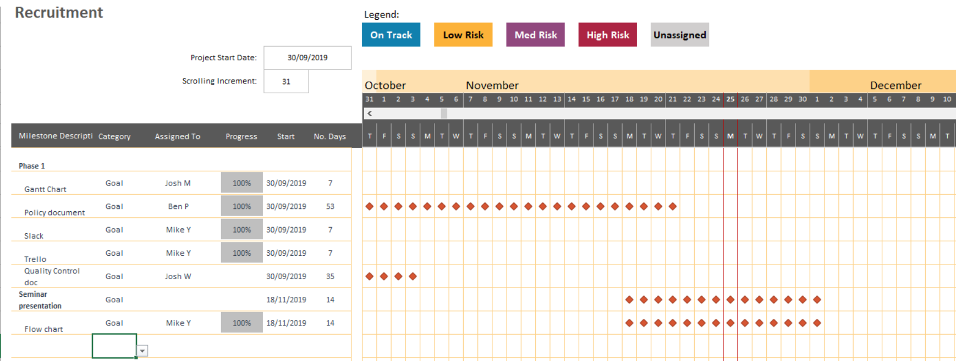
GantT Chart

Slide 4
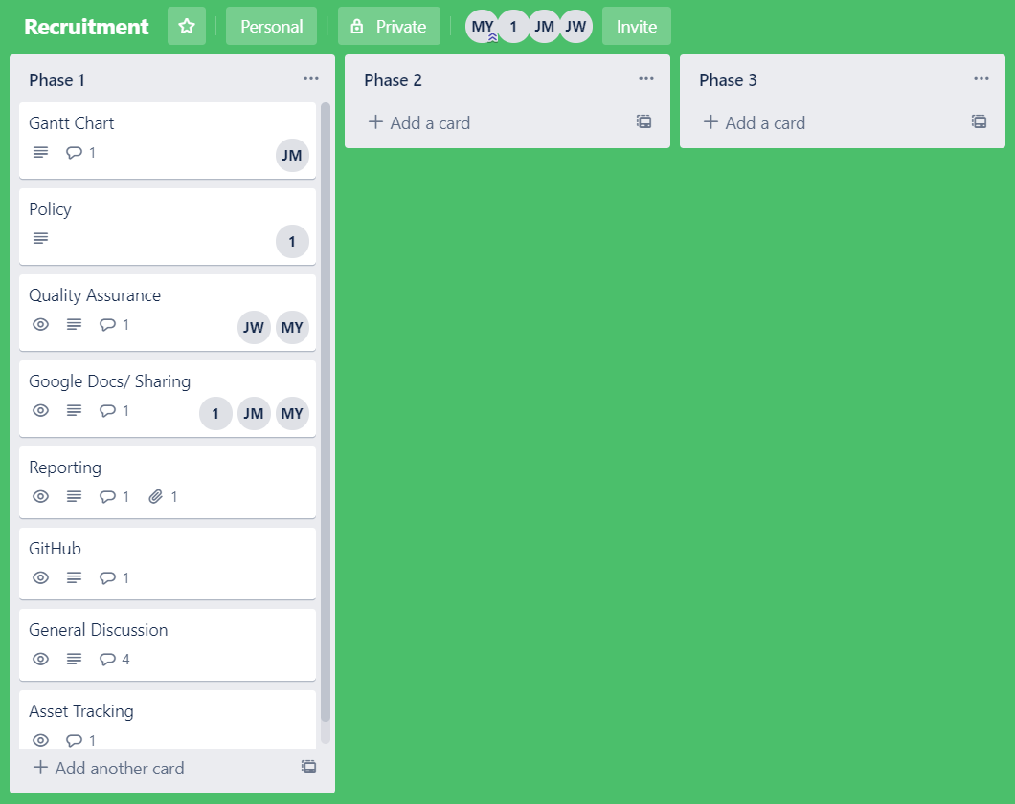
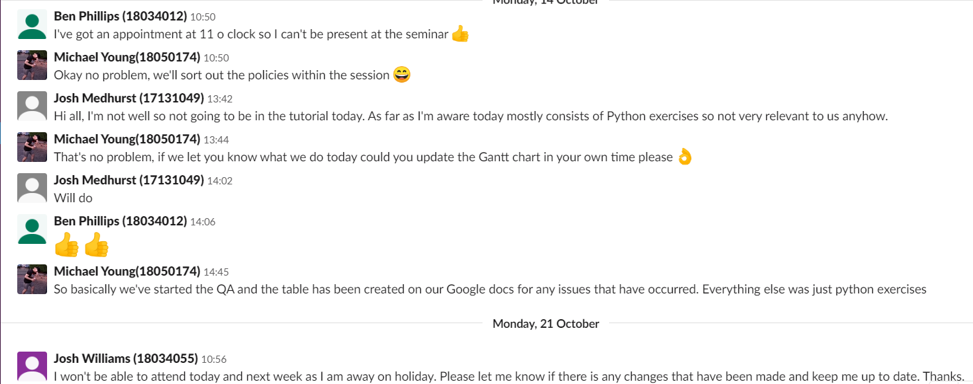
Communications

Slide 5
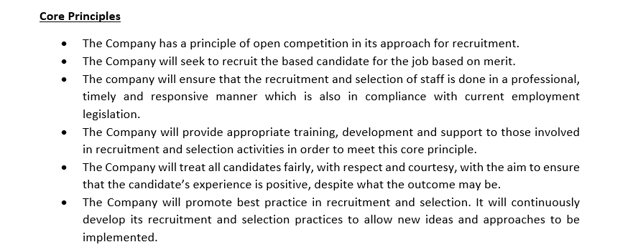
Lsepi - Policies
We realise that staff are fundamental to the company’s success. Therefore the company needs to attain and attract employees of high quality.
The purpose of the policy is to lay out sound framework for recruitment and selection purposes. The principles included coincide with the Equal Opportunities Employment Policy, The Equality Act 2010 and other employment legislation that is relevant.

Slide 6
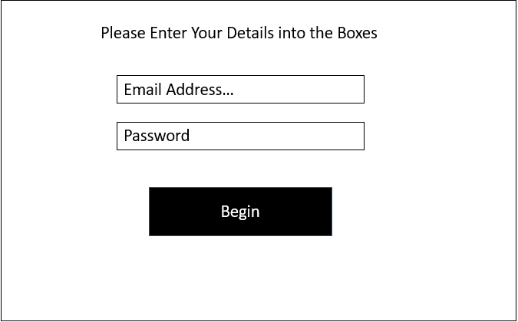
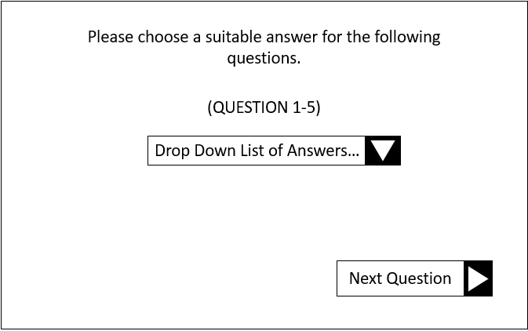
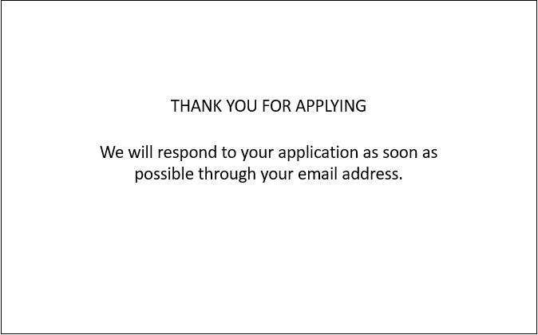
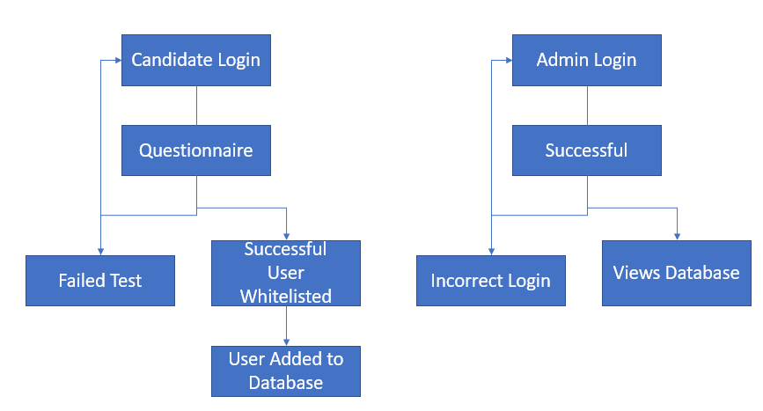
Design
1.
2.
3.

Slide 7
Quality Assurance
Updating the team’s QA portfolio document for the first six weeks.
Ensuring that all tasks are completed within the time they are set.
Meeting every week to discuss our progress.
As a group, we look at each piece of completed work to ensure it is up to standard.
We made changes to any piece of work that we felt could be improved.

Slide 8
Issue tracking
Overseeing the team’s Issue Tracking portfolio document for the first six weeks.
Documenting any issues that may arise within the team’s project management phase.
We have had an issue of absence within the team, however we have used the communication platforms effectively and have done every task within the time set.
Another issue we had was with Pycharm where we had no interpreter, however this is down to inexperience with the IDE and have resolved the issue.

Slide 9
Any questions?

Slide 10
Thank you for listening

