Slide 1
VIRTUAL PRIVATE NETWORKS (VPN)
Basics

Slide 2
What is VPN?
A VPN (Virtual Private Network) is a technology that creates a private network over a public network (like the Internet). to establish a secure and encrypted communication tunnel between a device or entire networks and a remote server, thus replacing the need for traditional dedicated lines.

Slide 3
VPN Abbreviation lay down
Virtual: The connection is logical, established over public infrastructure (the Internet), not physical.
Private: The data traveling through this tunnel is isolated and unreadable to anyone outside of it.
Network: Once connected, you are logically part of the private network of the VPN server.

Slide 4

Why use a VPN?
Privacy from snooping eyes of your ISP.
Data privacy from apps and services.
Some VPN’s have tracker/ad blocking built in
Far better encryption than normal connections.

Slide 5
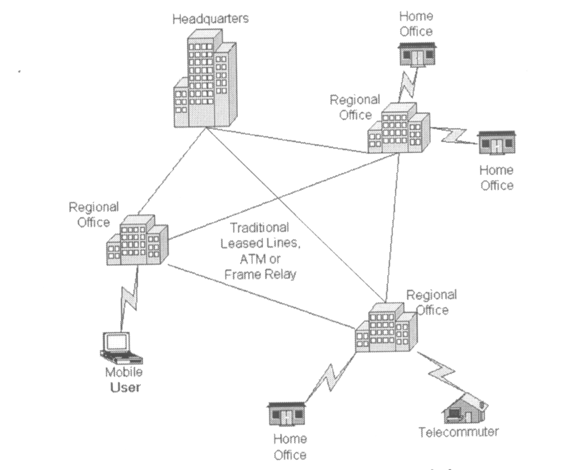
Traditional Connectivity
(From Gartner Consulting)

Slide 6
Private Networks vs. Virtual Private Networks
Employees can access the network (Intranet) from remote locations.
Secured networks.
The Internet is used as the backbone for VPNs
Saves cost tremendously from reduction of equipment and maintenance costs.
Scalability

Slide 7
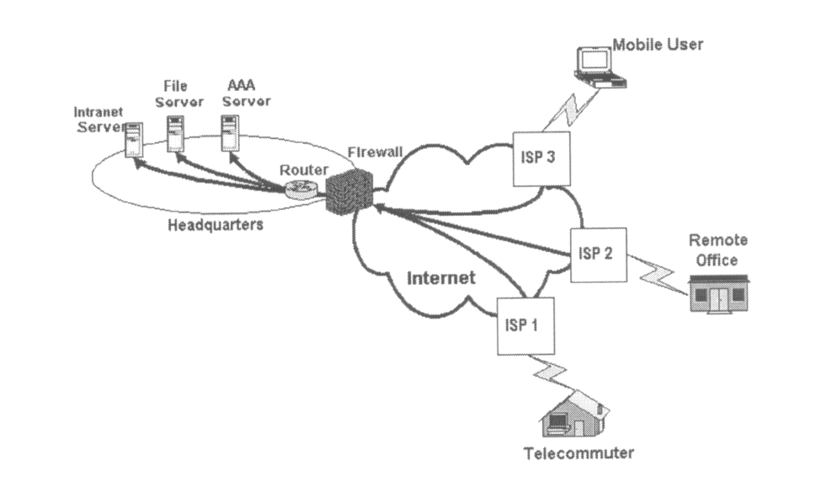
Remote Access Virtual Private Network
(From Gartner Consulting)

Slide 8
How Does a VPN Work? and Critical Functions
The operation of a VPN can be summarized in a four-step process, which fulfills four critical security functions.
Connection and Authentication
Encryption
Tunneling
Decryption and Access

Slide 9
Four Critical Functions
Authentication – validates that the data was sent from the sender.
Access control – limiting unauthorized users from accessing the network.
Confidentiality – preventing the data to be read or copied as the data is being transported.
Data Integrity – ensuring that the data has not been altered

Slide 10
Encryption
Encryption -- is a method of “scrambling” data before transmitting it onto the Internet.
Public Key Encryption Technique
Digital signature – for authentication

Slide 11
Tunneling
A virtual point-to-point connection
made through a public network. It transports
encapsulated datagrams.
Two types of end points:
  Remote Access
  Site-to-Site
Original Datagram
Encrypted Inner Datagram
Datagram Header Outer Datagram Data Area
Data Encapsulation [From Comer]

Slide 12
Four Protocols used in VPN
PPTP -- Point-to-Point Tunneling Protocol
L2TP -- Layer 2 Tunneling Protocol
IPsec -- Internet Protocol Security
SOCKS – is not used as much as the ones above

Slide 13
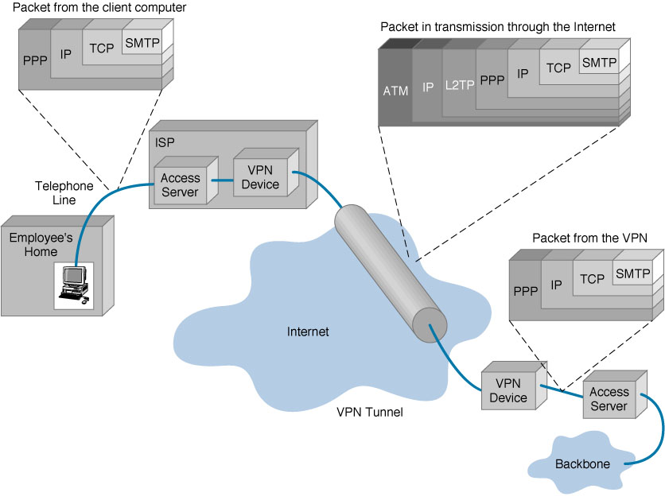
VPN Encapsulation of Packets
(From Gartner Consulting)

Slide 14
Types of Implementations
What does “implementation” mean in VPNs?
3 types
  Intranet – Within an organization
  Extranet – Outside an organization
  Remote Access – Employee to Business

Slide 15
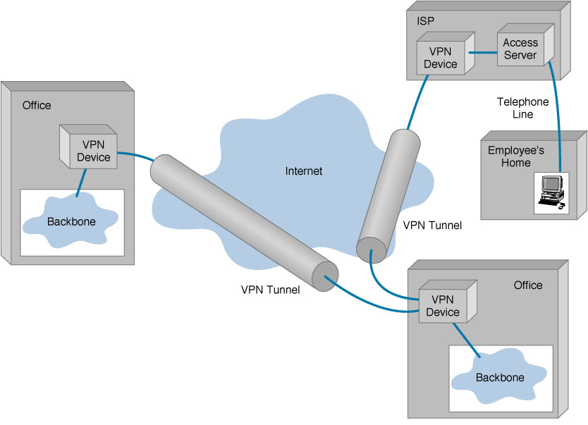
Virtual Private Networks (VPN)
Basic Architecture

Slide 16
Device Types
What it means
3 types
  Hardware
  Firewall
  Software

Slide 17
Device Types: Hardware
Usually a VPN type of router
Pros
Highest network throughput
Plug and Play
Dual-purpose
Cons
Cost
Lack of flexibility

Slide 18
Device Types: Firewall
More security?
Pros
“Harden” Operating System
Tri-purpose
Cost-effective
Cons
Still relatively costly

Slide 19
Device Types: Software
Ideal for 2 end points not in same org.
Great when different firewalls implemented
Cons
Lack of efficiency
More labor training required
Lower productivity; higher labor costs
Pros
Flexible
Low relative cost

Slide 20
Advantages vs.
Disadvantages

Slide 21
Advantages: Cost Savings
Eliminating the need for expensive long-distance leased lines
Reducing the long-distance telephone charges for remote access.
Transferring the support burden to the service providers
Operational costs

Slide 22
Advantages: Scalability
Flexibility of growth
Efficiency with broadband technology

Slide 23
Disadvantages
VPNs require an in-depth understanding of public network security issues and proper deployment of precautions
Availability and performance depends on factors largely outside of their control
Immature standards
VPNs need to accommodate protocols other than IP and existing internal network technology

Slide 24

Applications: Site-to-Site VPNs
Large-scale encryption between multiple fixed sites such as remote offices and central offices
Network traffic is sent over the branch office Internet connection
This saves the company hardware and management expenses

Slide 25
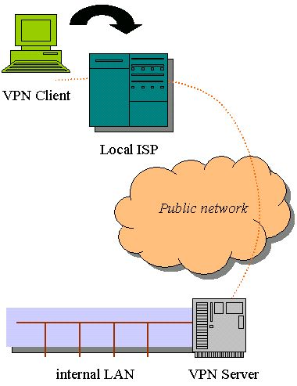
Site-to-Site VPNs

Slide 26
Applications: Remote Access
Encrypted connections between mobile or remote users and their corporate networks
Remote user can make a local call to an ISP, as opposed to a long distance call to the corporate remote access server.
Ideal for a telecommuter or mobile sales people.
VPN allows mobile workers & telecommuters to take advantage of broadband connectivity.
i.e. DSL, Cable

Slide 27
Industries That May Use a VPN
Healthcare: enables the transferring of confidential patient information within the medical facilities & health care provider
Manufacturing: allow suppliers to view inventory & allow clients to purchase online safely
Retail: able to securely transfer sales data or customer info between stores & the headquarters
Banking/Financial: enables account information to be transferred safely within departments & branches
General Business: communication between remote employees can be securely exchanged

Slide 28
Where Do We See VPNs Going in the Future?
VPNs are continually being enhanced.
Example: Equant NV
As the VPN market becomes larger, more applications will be created along with more VPN providers and new VPN types.
Networks are expected to converge to create an integrated VPN
Improved protocols are expected, which will also improve VPNs.
Managed Security Service providers

Slide 29
QUESTIONS
Which of the following is NOT a main advantage of using a VPN?
A) Increased Internet speed
B) Enhanced privacy from ISP
C) Secure remote access
D) Reduced need for leased lines
✅ Réponse : A
Which critical VPN function ensures that data has not been altered during transmission?
A) Authentication
B) Access Control
C) Data Integrity
D) Confidentiality
✅ Réponse : C

Slide 30
Which VPN protocol is rarely used compared to others listed?
A) PPTP
B) L2TP
C) IPsec
D) SOCKS
✅ Réponse : D
What type of VPN connects two fixed locations, like a headquarters and a branch office?
A) Remote Access VPN
B) Site-to-Site VPN
C) Extranet VPN
D) Intranet VPN
✅ Réponse : B

Slide 31
Which VPN device type offers the highest throughput but is less flexible and more costly?
A) Software VPN
B) Firewall-based VPN
C) Hardware VPN
D) Router-based VPN
✅ Réponse : C
In which industry are VPNs commonly used to securely transfer confidential patient information?
A) Retail
B) Banking
C) Healthcare
D) Manufacturing
✅ Réponse : C

Slide 32
What process is used to wrap data packets with additional headers for secure transmission through a VPN tunnel?
A) Encryption
B) Encapsulation
C) Authentication
D) Compression
✅ Réponse : B
Which of the following is a known disadvantage of VPNs?
A) Cost savings
B) Scalability
C) Dependency on external Internet performance
D) Ease of setup
✅ Réponse : C

Slide 33
What type of VPN allows external partners, such as suppliers or clients, limited access to a company’s internal network?
A) Intranet VPN
B) Extranet VPN
C) Remote Access VPN
D) Site-to-Site VPN
✅ Réponse : B
Which encryption technique is commonly associated with VPNs for ensuring data confidentiality?
A) Hashing
B) Public Key Encryption
C) Tokenization
D) Steganography
✅ Réponse : B

Slide 34
What does L2TP stand for in VPN terminology?
A) Layer 2 Transfer Protocol
B) Layer 2 Tunneling Protocol
C) Link 2 Transport Protocol
D) Local 2 Teleport Protocol
✅ Réopnse : B
Which of the following is a primary function of a VPN that verifies the identity of a user or device before granting network access?
A) Data Integrity
B) Tunneling
C) Authentication
D) Encapsulation
✅ Réponse : C

Slide 35
THANKS FOR PAYING ATENTION

