Slide 1
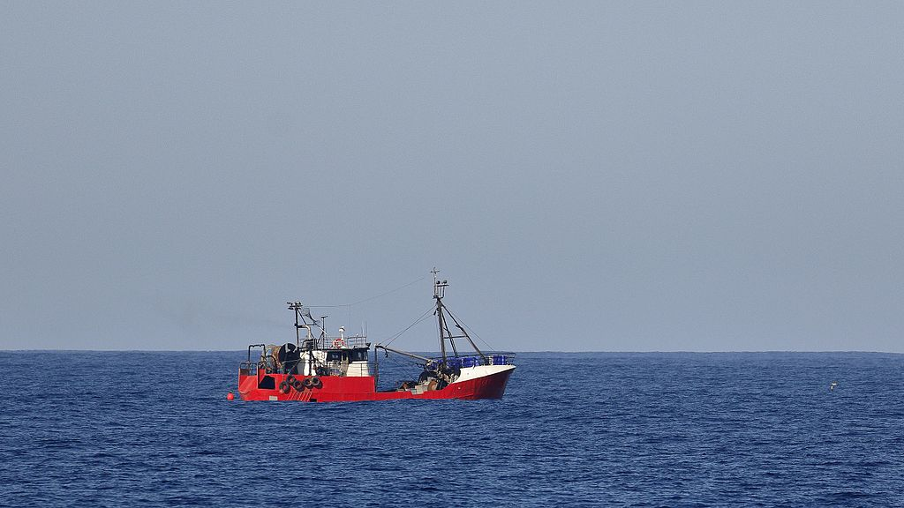
Trawler
Machine learning dataset creation program

Slide 2
Key Scripts
Filename | Description
cropper.py | Detects object in an image using mobilenetv2 then crop and saves it Currently it sets to detect faces, can be modified
videoFrame.py | Extracts frames from a video, frames can be skipped to improve performance Currently extracts 1 image per 10 frames, can be modified
Flip.py | Multiply images by augmenting them (rotating, flipping, tilting, etc)
taio-lite.py | Simplified version of Tensorflow Assisted Image Organizer* Compares the whole image and move them according to their class
modelBuilder.py | Builds a model for taio-lite.py from cropped object images Has the same layers as taio-lite
Trawler.py | Unifies all of the above scripts to run in a single process
Cave.py | Taio alternative, CBIR method by getting the color average of image tiles Benefits from little but unique dataset, a bit slower
* https://github.com/AdmiralPuni/tensorflow-assisted-image-organizer

Slide 3
Trawler.py flow
Iterates through video files in a folder
Extract frames with videoFrame
Crop and saves desired object to a folder with cropper
Pauses the program
User needs to categorize the images to a folder according to the object name
If the model is deemed to be accurate this step and the next step will be ignore, hastening the process
Builds a model for comparison with modelBuilder
Compare and move unsorted images with taio-lite
Flipper needs to be ran manually

Slide 4
cave.py
Slice images to (256/16) tiles, and get the average color per tile of an image
Rgb color is converted using pairing function
Alleviates the average being the same for different color (30,0,0) has the same average to (10,10,10)
Ex : (30,20,30) > (pair(30,1), pair(30,2), pair(30,3)) > (497,255,564)
Then average it to 438.6666666666667
Model is created from a set of images separated by character name and saved with pickle.
Can be slower or faster than taio

Slide 5
modelBuilder.py
Model will improve over each iteration unless ignored

