Slide 1
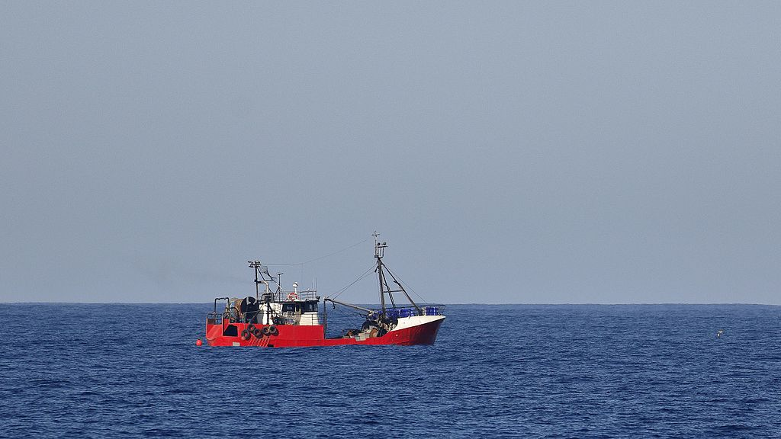
Trawler
Machine learning dataset creation program

Slide 2
Key Scripts
Filename | Description
cropper.py | Detects object in an image using mobilenetv2 then crop and saves it Currently it sets to detect faces, can be modified
videoFrame.py | Extracts frames from a video, frames can be skipped to improve performance Currently extracts 1 image per 10 frames, can be modified
Flip.py | Multiply images by augmenting them (rotating, flipping, tilting, etc)
taio-lite.py | Simplified version of Tensorflow Assisted Image Organizer* Compares the whole image and move them according to their class
modelBuilder.py | Builds a model for taio-lite.py from cropped object images Has the same layers as taio-lite
Trawler.py | Unifies all of the above scripts to run in a single process
* https://github.com/AdmiralPuni/tensorflow-assisted-image-organizer

Slide 3
Trawler.py flow
Iterates through video files in a folder
Extract frames with videoFrame
Crop and saves desired object to a folder with cropper
Pauses the program
User needs to categorize the images to a folder according to the object name
If the model is deemed to be accurate this step and the next step will be ignore, hastening the process
Builds a model for comparison with modelBuilder
Compare and move unsorted images with taio-lite
Flipper needs to be ran manually

Slide 4
modelBuilder.py
Model will improve over each iteration unless ignored

