Slide 1


Essay Assessment Tool
(Bachelor Thesis)
by Ivan Shtetinski

Slide 2
Motivation
Time consuming
Overworked Teachers
The Feedback that Students receive is often delayed and therefore meaningless

Slide 3
What is automated essay scoring?
Graded Essays
Text Processing / Feature Extraction
Processed Features
Creating a machine learning model
Grade and feedback generation
New Ungraded Essay
Text Processing / Feature Extraction
Automated Essay Scorer
(text classifier)
New Graded Essay

Slide 4
Criticism of AES:
1. Not Reliable:
2. Does not promote authentic writing:
students who know that they are writing only for a machine may be tempted to turn their writing into a game, trying to fool the machine into producing a higher score, which is easily done (McGee, 2006; Powers, Burstein, Chodorow, Fowles, & Kukich, 2001; see item 6, above)
as a result, the machine grading of high-stakes writing assessments seriously degrades instruction in writing (Perelman, 2012a), since teachers have strong incentives to train students in the writing of long verbose prose, the memorization of lists of lengthy and rarely used words, the fabrication rather than the researching of supporting information, in short, to dumb down student writing.
computer algorithms cannot recognize the most important qualities of good writing, such as truthfulness, tone, complex organization, logical thinking, or ideas new and germane to the topic (Byrne, Tang, Truduc, & Tang, 2010)
machines over-emphasize grammatical and stylistic errors (Cheville, 2004) yet miss or misidentify such errors at intolerable rates (Herrington & Moran, 2012)

Slide 5
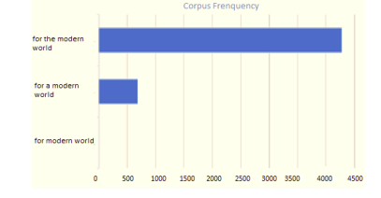
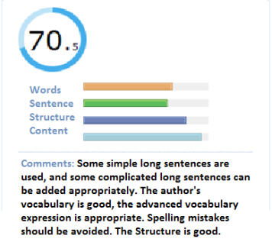
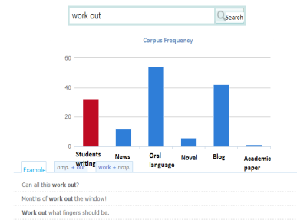
Examples of feedback provided by the “Pigai” System

Slide 6
Main Concept of the Thesis
Create a tool that supports a human reader, rather than excluding him by debugging an essay scorer
Determine what type of automated feedback helps students the most
Find the best way to present information via visualisations

Slide 7
Debugging an Automated Essay Scorer
How to find out what the computer is “thinking” ?
How to present this information in a comprehensible manner?

Slide 8
Local Interpretable Model-agnostic Explanations
(LIME)
Create distorted versions of the text we want to grade.
Predict probabilities for those distorted texts using the Essay Scorer.
Train another classifier and modify its weights so that when we pass the distorted texts we get the same probabilities.
Get the weight of the feature we want from the new classifier.
Profit!

Slide 9
Additional features
Wordcloud
Spelling correction
Plagiarism detection

Slide 10
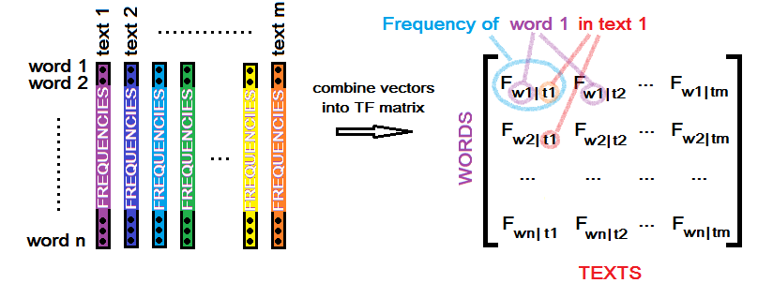
Latent Semantic Analysis (LSA)

Slide 11
Weight = [Term Frequency] x [Inverse document frequency]
# times a term is present in a text
# words in the text
Term Frequency =
# documents
# documents where the term is present
Inverse Document Frequency =

Slide 12
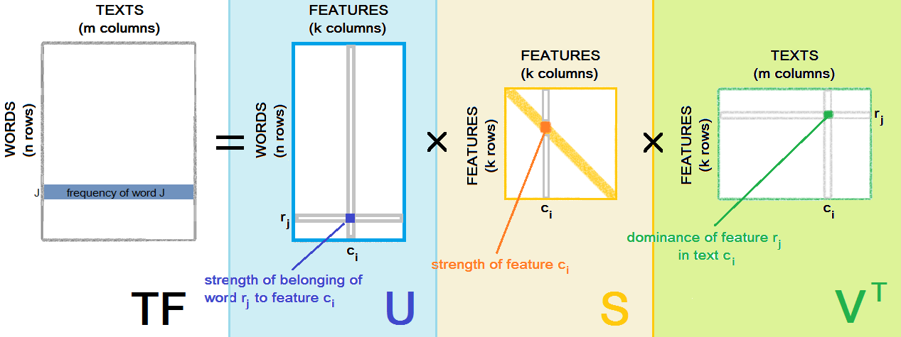
Truncated Singular Value Decomposition

Slide 13
Support Vector Machines
Text A = [a1, a2, a3 …, aK] has a given Grade 2
.
.
.
Text Y = [y1, y2, y3 …, yK] has a given Grade 5
Text Z = [z1, z2, z3 …, zK] has a given Grade 5
A
Grade 2
Z
Y
Grade 5

Slide 14

Dataset used
8 different sets on different topics
anonymised by Stanford’s Name Entity Recogniser (I talked to Homer Simpson -> I talked to @Person1)
Set # | Grade Level | Training set Size | Average essay length | Scoring scale
1 | 8 | 1785 | 650 | 2-12
2 | 10 | 1800 | 150 | 1-6 and 1-4
3 | 10 | 1726 | 150 | 0-3
4 | 10 | 1772 | 150 | 0-3
5 | 8 | 1805 | 150 | 0-4
6 | 10 | 1800 | 150 | 0-4
7 | 7 | 1730 | 250 | 0-30
8 | 10 | 918 | 650 | 0-60

Slide 15
Evaluation of the implemented classifier

Slide 16
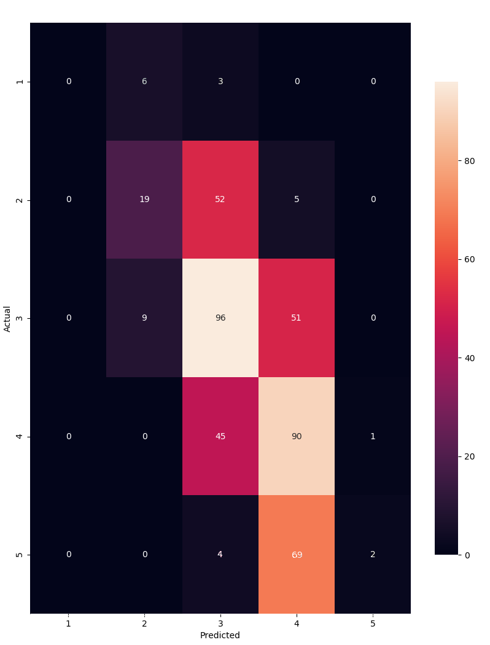
Heatmap Confusion matrix example

Slide 17
#Correct predictions
Accuracy =
#All predictions made
#Correct predictions for class X
Recall =
(for class X) #All elements that belong to class X
#Correct predictions for class X
Precision =
(for class X) #All predictions for class X
(Precision x Recall)
F-score = 2x
(for class X) (Precision + Recall)

Slide 18
Essay score | Precision | Recall | f-score | # essays
1 | 0.00 | 0.00 | 0.00 | 4
2 | 0.00 | 0.00 | 0.00 | 32
3 | 0.50 | 0.78 | 0.61 | 212
4 | 0.44 | 0.31 | 0.36 | 166
5 | 0.00 | 0.00 | 0.00 | 32
Accuracy
446 | 0.49

Slide 19
A quick demonstration...

Slide 20
Directions for the future:
Better grade estimation method
More Features
Implementation into an Online Learning Environment

Slide 21
Thank You for the attention

