Slide 1
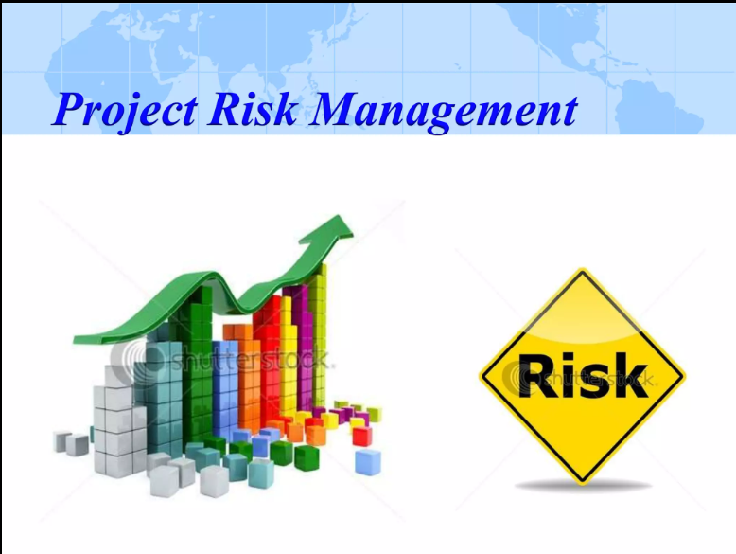

Slide 2
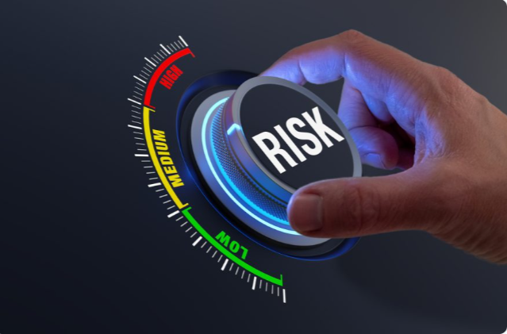
Risk
A risk is “uncertain event or condition that, if it occurs, has a positive or negative effect on a project’s objectives.

Slide 3
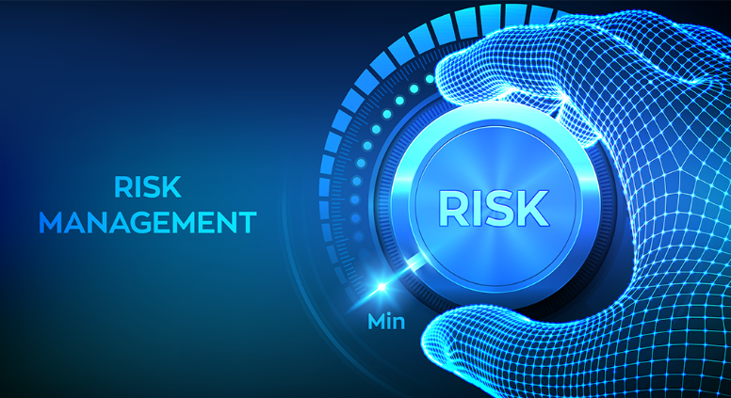
Risk Management
A risk management plan is a document that a project manager prepare to foresee (پیش گوئی) risks , identifying, analyzing, and responding to potential risks that may impact the achievement of project objectives.

Slide 4
Components of risk management
Strategy and planning
Risk identification
Analysis (quantitative and qualitative)
Response planning
Monitoring and control.

Slide 5
Strategy and planning
Strategy and planning activities set the foundation for a risk management programme and ultimately determine whether the initiative(آغاز) is successful.
During the strategy and planning phase an organization will define how risks are addressed and managed. Strategy and planning should take into consideration:
» Corporate or enterprise-wide risk management guidelines (including tolerance level for risk).
» Available resources (staffing, budgets);
» Preferred reporting and communication protocols; and
» The organization’s strategic objectives.

Slide 6
Risk Identification
The process of recognizing and documenting potential risks that could affect the project, both positively (opportunities) and negatively (threats).
Brainstorming sessions, reviewing historical project data, analyzing project documentation, and consulting with stakeholders to identify possible risks.

Slide 7
Analysis
Evaluating the likelihood and impact of each identified risk to determine its significance and prioritize it among other risks.
Using qualitative and quantitative risk assessment techniques to assign a level of risk to each identified item. This helps in focusing efforts on the most critical risks.

Slide 8
Response planning
Developing strategies and plans to address and respond to identified risks, including both mitigation plans for threats and exploitation plans for opportunities.
Creating contingency plans, developing risk response strategies, and establishing monitoring and control mechanisms. This involves outlining specific actions to be taken if a risk occurs.

Slide 9
Monitoring and control
Continuously tracking and supervising identified risks throughout the project lifecycle to ensure that risk responses are implemented effectively.
Regularly reviewing the status of risks, reassessing their impact and likelihood, and implementing risk response plans. This ensures that the project team remains vigilant to changing circumstances.

Slide 10
Why do we manage risk?
Project problems can be reduced as much 90% by using risk analysis.
Improve probability of success

Slide 11
Benefits of risk assessment
Ignore risk does not make the risk away
Protects project investments
Proactive management – early warning
Achieve project objectives

Slide 12
Submitted by:
Adnan Tanveer
Roll no (26132506)
M. Umar
Roll no (26132519)
M. Jahanzaib
Roll no (26132520)
THE END

