Slide 1
ADNAN HAMID WANI Roll No: A25 12018640 CA2 IFD803

Slide 2
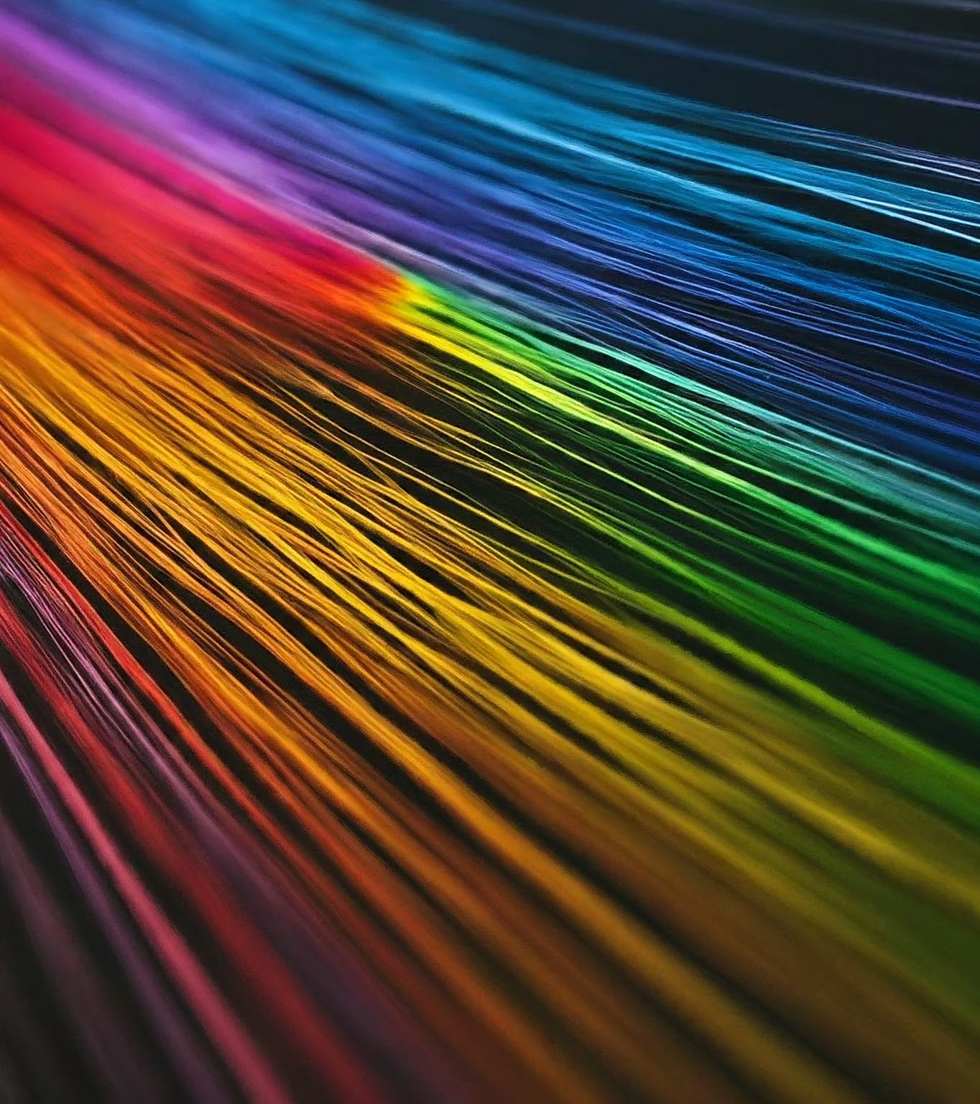
TASK :
Individually assess different types of lights and different colors and link it with different moods of a person.
The relationship between light, colors, and mood is a fascinating area that has been studied in fields like psychology and design. Different types of lights and colors can indeed influence a person's mood in various ways.

Slide 3
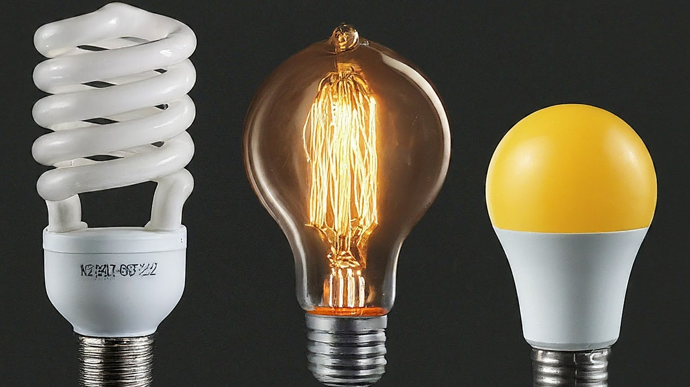
Types of Lights
Incandescent lights: Traditional bulbs that emit warm, yellow light, often associated with a sense of comfort and nostalgia.
LED lights: Energy-efficient, long-lasting lights available in a wide range of colors, offering versatility in mood creation.
Fluorescent lights: Common in offices and commercial spaces, emit a cool, blue-white light that can promote alertness and focus.

Slide 4
fluorescent lights, with their cool tones, can enhance focus and productivity..
Incandescent lights, with their warm glow, can create a cozy and inviting environment.
LED lights, with their color options, offer flexibility,

Slide 5
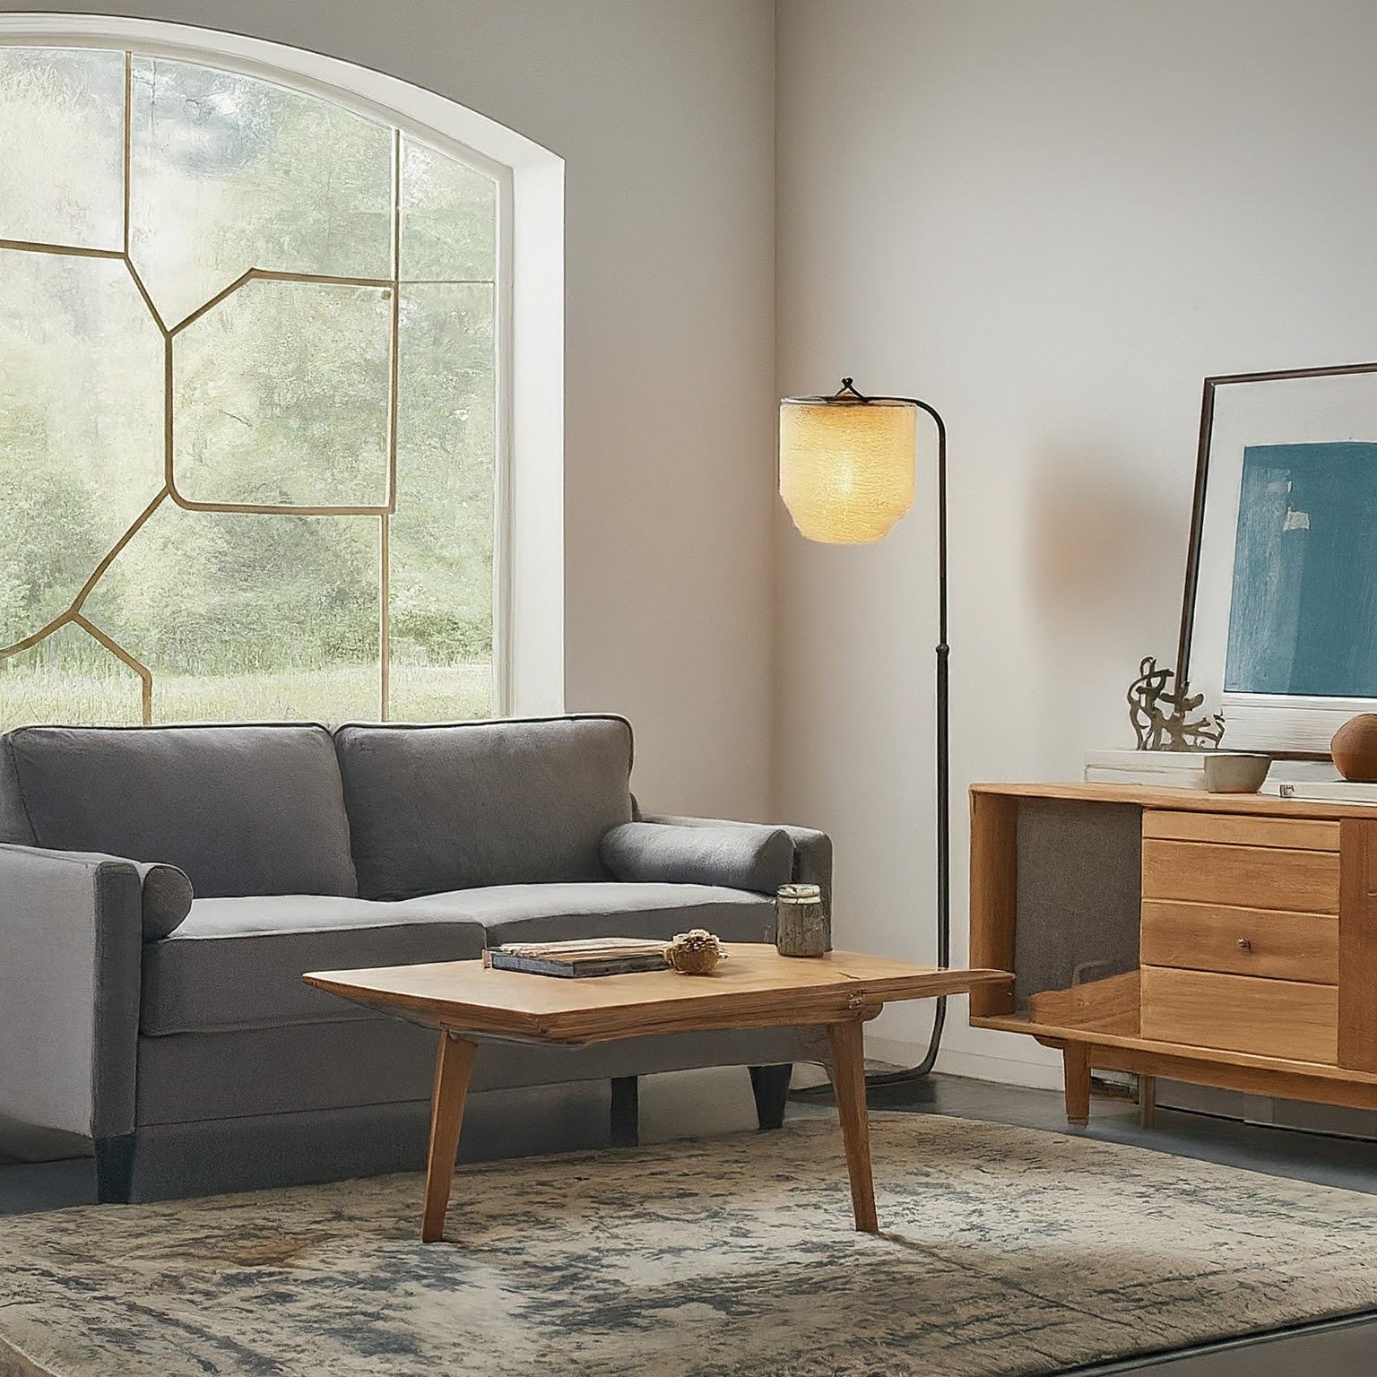
Light and Mood: Practical Applications
Living room: warm white or soft yellow lights for a cozy and inviting atmosphere.
Bedroom: Use dimmable lights and warm tones to create a relaxing and sleep-conducive environment.
Workspace: Utilize cool white or natural light to promote focus and productivity.

Slide 6
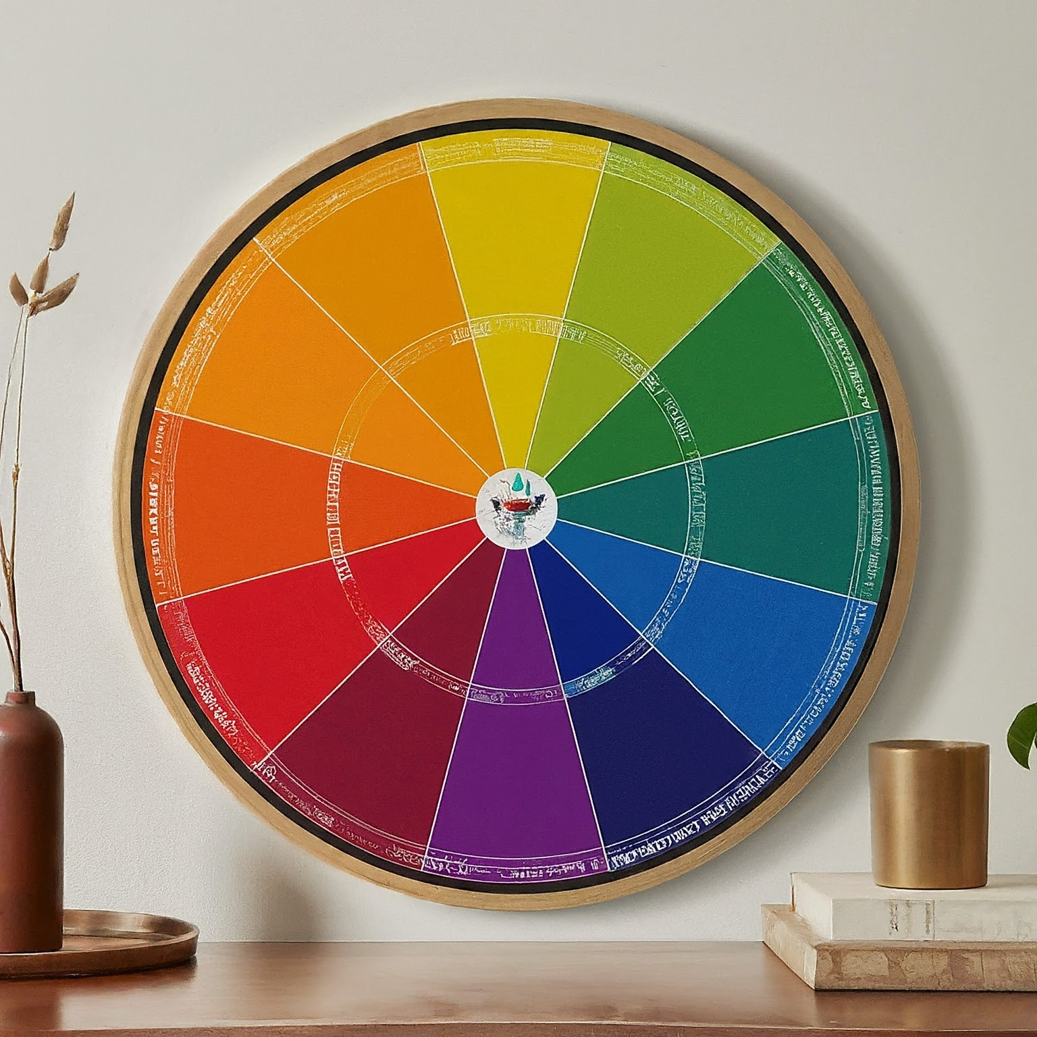
The Psychology of Colors
Colors have the power to evoke various emotions and psychological responses.
Warm colors (red, orange, yellow) are often associated with feelings of energy, happiness, and excitement.
Cool colors (blue, green) are generally linked to calmness, peace, and relaxation.

Slide 7
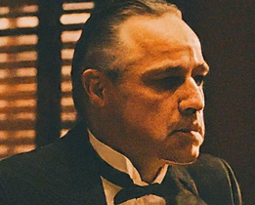
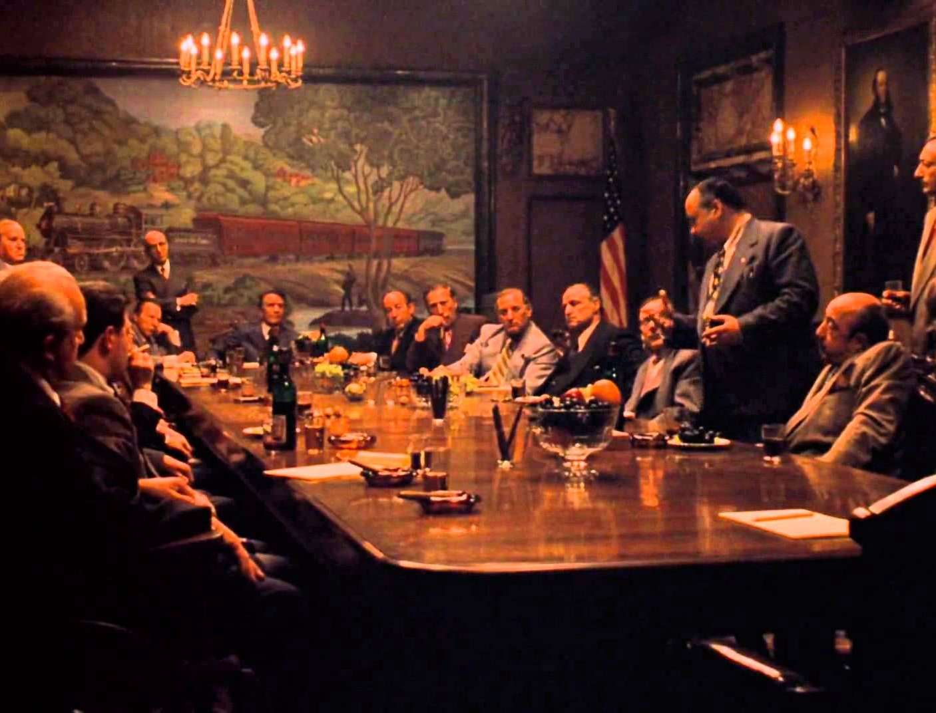
CA1 : THE MEETING SCENE FROM GODFATHER

Slide 8
Color used ,Mood and Ambiance
Color Scheme Analysis : Brown dominates the overall tone, conveying a sense of
tradition, seriousness, and masculinity.
Dim lighting creates a sense of mystery and secrecy, reflecting the characters' hidden intentions.
• Deep shadows cast on their faces obscure their emotions and add to the suspense.
• Single spotlight on Michael emphasizes his isolation and
potential for darkness.
Warmth and Comfort: Brown is often associated with the color of the earth, wood, and natural materials. This can evoke feelings of warmth, coziness, and a sense of being grounded.
Security and Stability: The earthy qualities of brown can provide a sense of security, stability, and dependability, creating a comforting and safe atmosphere.

