Slide 1

SHER E KASHMIR UNIVERSITY OF AGRICULTURAL SCIENCES AND TECHNOLOGY
SYNOPSIS SEMINAR
FACULTY OF AGRICULTURE, WADURA
DIVISION OF ENTOMOLOGY

Slide 2
Post Graduate Degree Programme | M.Sc. Entomology
Division | Entomology
Name of the student | Farhat Fayaz
Registration number | MSA-2024-1796
Major Subject | Entomology
Minor Subject | Agronomy & Genetics and Plant breeding

Slide 3
ADVISORY COMMITTEE
Major advisor | Dr. Shafeeq Ahmad Hakeem (Associate Professor , Division of Entomology, FoA ,Wadura)
Member from major subject | Dr. Ishtiyaq Ahad , (Professor, Division of Entomology, FoA ,Wadura)
Member from minor subject | Dr. Mohd Altaf Wani, (Associate Professor , Division of Plant breeding and Genetics, DARS Budgam)
Member from supporting subject | Dr. Faheem Jeelani (Assistant Professor, Division of Agri. Statistics and Economics, FoH ,Shalimar)
External member from major subject | Dr. Kamlesh Bali (Professor of Entomology , Division of Sericulture , FoA Skuast -J)
Dean’s nominee | Dr. Kauser Javeed (Assistant Professor, Division of Horticulture, FoA, Wadura.)

Slide 4
PROPOSED TITLE
“Evaluation of Maize Inbred Lines against Chilo partellus (Swinhoe) (Lepidoptera:Crambidae) and its Natural Enemy Complex under Temperate Conditions’’
OR
“To Screen Maize Genotypes against Chilo partellus (Swinhoe) (Lepidoptera: Crambidae) and its associated Natural enemy complex under Temperate Ecology’’

Slide 5
INTRODUCTION
Maize (Zea mays Linnaues), the miracle crop, is the third most important cereal crop of the world. Its also known as ‘the queen of cereals’ and has immense yield potential.
Its one of the most versatile crops grown under a wide range of agro-ecological locations of tropical , sub-tropical and temperate regions of the world.

Slide 6
Among the biotic constraints , insect pests cause considerable loss in yield. Maize is attacked by 140 different species of insect pests .
Among these, maize stem borer (Chilo partellus) is of greater importance. It’s a key crop destroyer and cause severe losses in maize crop throughout its geographical distribution and the yield losses of 75 percent has been documented and crop may even fail if it remains uncontrolled (Latif et al;1960).
It belongs to tribe Maydeae of the family poaceae.

Slide 7
However, the productivity is limited by a large number of biotic and abiotic constraints.
The larvae of Chilo partellus after hatching feed on the soft surface of leaves and enter the stem through whorl for feeding on the pitch of the stem .The growth of the plant becomes stunted and resulting in dead heart formation. The larvae migrate from other plants and enter the stem through lower nodes by making the holes.(Lella and Srivastav 2013)

Slide 8
OBJECTIVES OF THE RESEARCH
To screen maize inbreds against Chilo partellus.
2. To identify the natural enemies associated with the crop pest.

Slide 9
TECHNICAL PROGRAMME

Slide 10
OBJECTIVE 1
Screening of inbred lines against Chilo partellus under natural infestation
50 inbred lines provided by division of Genetics and plant breeding shall be raised in the ‘Entomological research farm’ (FoA) Wadura.
“List of Maize Inbred Lines used for screening against Chilo Partellus : ”
1. WM-10
2. WM-17
3. WM-23
4. WM-25
5. WM-12
6. WM-16
7. WM-27
8. WM-24
9. WM-8
10. WM-5
11. WM-18
12. WM-2
13. WM-4
14. WM-1
15. WM-9
16. WM-7
17. WM-15
18. WM-37
19. WM-33
20. WQPM-1
21. WQPM-2
22. WQPM-3
23. WQPM-4
24. WQPM-5
25. WQPM-6
26. WQPM-7
27. WQPM-9
28. WQPM-27
29. WMI-8
30. WMI-14
31. WMI-26
32. WM1-8
33. G-59
34. G-40
35. G-35
36. G-74
37. G-63
38. G-90
39. G-58
40. G-44
41. G-73
42. G-92
43. G-29
44. G-19
45. G-78
46. CML-72
47. G-57
48. G-67
49. G-76
50. G-50

Slide 11
Spacing of 60 x 20 cm²
Weekly visual observations shall be taken from the plants of maize crop.
The crop observations for infestation by insect pest shall be taken on the basis of presence of pinholes, window panes, dead hearts and stem tunneling.
The package of practices shall be followed as per recommendations of SKUAST-K (excluding insecticide).
Weekly observations will be recorded and data on leaf injury rating shall be taken randomly from 10 infested plants per line as per scale of 1 – 9. Given by (Annual report of AICRP on maize)

Slide 12
Category | Description
1 | Plants showing no infestation symptom
2 | 1-2 leaves with pinholes
3 | 3-4 leaves with holes
4 | 1/3 leaves showing infestation symptoms
5 | Half the number of leaves with infestation symptoms
6 | 2/3 leaves with infestation symptoms and the holes becoming window
7 | Leaves with long window and plant growth is stunted
8 | Almost all leaves displaying heavy infestation and plant growth is Stunted
9 | Dead heart formation observed

Slide 13
LIR | CATEGORY
1-3 | Resistant
>3-6 | Moderately resistant
>6-9 | Susceptible

Slide 14
The per cent leaf infestation shall be calculated by the formula:
No. of infested leaves
Per cent infestation = --------------------------- x 100
Total NO. of leaves
Per cent dead heart shall be calculated by the formula:
No. of dead hearts counted
Per cent dead heart = ----------------------------------- x 100
Total No of plants

Slide 15
OBJECTIVE 2
To identify the natural enemies associated with the crop pest
The natural enemies associated with the crop pest shall be collected from the experimental farm both at FoA, Wadura and DARS.
Collected specimens shall be euthanized using ethyl acetate, properly preserved and subjected to morphometry to aid in accurate identification.

Slide 16
Collection and rearing of immature stages (eggs, larvae and pupae) of crop insect pest from the field to ensure the presence of associated natural enemies under laboratory conditions.

Slide 17
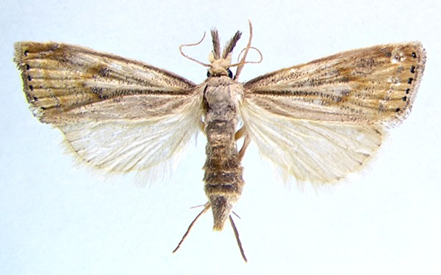
THANK YOU!

