Slide 1

Sher-e-Kashmir University of Agricultural Sciences and Technology
Faculty of agriculture,Wadura
Synopsis Seminar
Name : B.Lakshmikalyani
Registration number : MSA-2024-1809
Major subject : Entomology
Minor subject : Vegetable science

Slide 2
ADVISORY COMMITTEE
Major advisor | Dr. MD Jamal Ahmad Professor&Head, Division of Entomology, FoA, Wadura
Member from major subject | Dr. Ishtiyaq Ahad Professor, Division of Entomology, FoA, Wadura
Member from minor subject | Dr. Angrej Ali Professor, Division of Horticulture, FoA, Wadura
Member from supporting subject | Dr. Showkat Maqbool Professor, Division of Agricultural Economics & Statistics, FoA, Wadura
Member under Sandwich Programme | Dr. Saurav Gupta Sr.Scientist, Division of Entomology, KVK, SKUAST-Jammu
Dean’s Nominee | Dr. Tanveer Ahmad Wani Professor&Head, Division of Plant Pathology, FoA, Wadura

Slide 3
PROPOSED TITLE OF THE RESEARCH
Potentials of Diaeretiella rapae (Mcintosh) (Hymenoptera:Aphidiidae) against Cabbage Aphid(Brevicoryne brassicae) infesting Cole Crops in Kashmir

Slide 4
UTILITY OF RESEARCH WORK
In vitro evaluation of indigenous parasitoid, Dieretiella rapae of cabbage aphid shall reflect its future exploitation against cabbage aphids
Host stage susceptibility and Parasitoid: Host ratio study shall help in releasing rate of parasitoids in field condition
Study on cold storage of parasitoids shall indicate its shelf life for future field release program
Study on diet composition shall help viable production of parasitoids for augmentative releases in future bio control program

Slide 5
OBJECTIVES OF THE RESEARCH
To study biology and bioefficacy of Diaeretiella rapae
To study the effect of cold storage and diet on viability and survival ability of Diaeretiella rapae

Slide 6
OBSERVATIONS TO BE RECORDED
To study biology and bioefficacy of Diaeretiella rapae
1.1. To study host stage preference for parasitism by D. rapae
1.2. To study important biological parameters of D. rapae (Developmental duration, % emergence and sex ratio)
1.3. To determine rate of parasitism by D. rapae and its hyper parasitoid, Pachyneuron sp.

Slide 7
OBSERVATIONS TO BE RECORDED
2.1. To study the effect of cold storage on viability of D. rapae
Effect of cold storage on % emergence, sex ratio and longevity of D. rapae
To study parasitizing potential of females under cold storage
Comparison of parasitizing potential with normal females
2.2. To study the effect of different diet composition on survival ability of
D. rapae
Longevity

Slide 8
TECHNICAL PROGRAMME
Objective-1:To study biology and bioefficacy of Diaeretiella rapae
In vitro study on biological parameters of D. rapae such as developmental period, % emergence, sex ratio (F:M) shall be conducted at ambient conditions of temperature and humidity
Nucleus and pure culture of both B. brassicae and D. rapae shall be maintained in separate insect rearing wooden cages (45x45x45 cm) in laboratory during entire experimental period from June to October 2025

Slide 9
1.1. To study host stage preference for parasitism by D. rapae
25 aphids from 1st nymphal instar to adult aphids shall be exposed to a mating pair of D. rapae for 3 days
Data on parasitism shall be compared for host susceptibility
Host stage exhibiting maximum parasitism shall be selected for studying biological parameters of D. rapae

Slide 10
1.2. To study important biological parameters of D. rapae (Developmental duration, % emergence and sex ratio)
30 cabbage aphids shall be exposed to parasitism by a 2 day old mating pair of
D. rapae for 24 hrs. in glass test tube (200 x30 mm)
Relevant data regarding time taken for the formation of aphid mummy from parasitism, duration of mummy, emergence of parasitoids, female and male sex ratio shall be duly recorded
Numerical counts of total mummified aphids and total number of emerged parasitoids shall be done

Slide 11
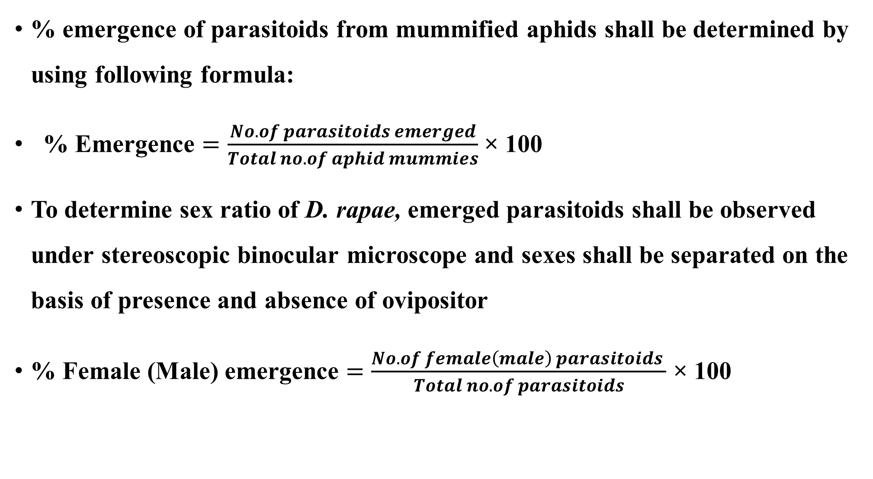
% emergence of parasitoids from mummified aphids shall be determined by using following formula:
% Emergence $=\frac{No.of parasitoids emerged}{Total no.of aphid mummies}$ × 100
To determine sex ratio of D. rapae, emerged parasitoids shall be observed under stereoscopic binocular microscope and sexes shall be separated on the basis of presence and absence of ovipositor
% Female (Male) emergence $=\frac{No.of female\left(male\right) parasitoids }{Total no.of parasitoids}$ × 100

Slide 12
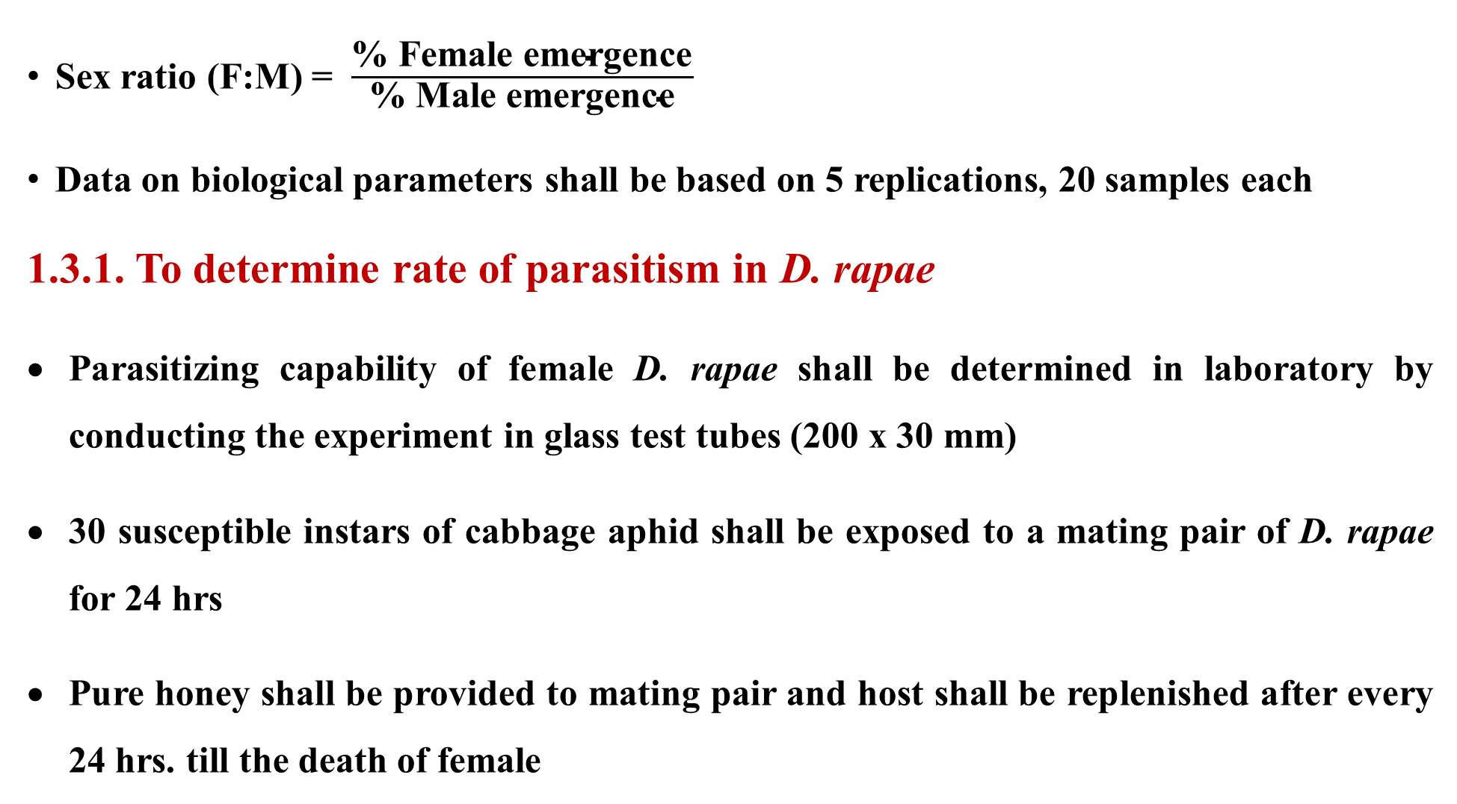
Sex ratio (F:M) = $\frac{\text{\% }\text{Female} \text{emergence}}{\text{\% }\text{Male} \text{emergence}}$
Data on biological parameters shall be based on 5 replications, 20 samples each
1.3.1. To determine rate of parasitism in D. rapae
Parasitizing capability of female D. rapae shall be determined in laboratory by conducting the experiment in glass test tubes (200 x 30 mm)
30 susceptible instars of cabbage aphid shall be exposed to a mating pair of D. rapae for 24 hrs
Pure honey shall be provided to mating pair and host shall be replenished after every 24 hrs. till the death of female

Slide 13
Data shall be recorded for the longevity of mating pairs, number of aphids parasitized/ day, effect of age on host parasitism, % emergence and sex ratio
Data shall be based on 50 samples divided into 5 replications
1.3.2. To determine rate of hyper parasitism by Pachyneuron sp. against
D. rapae
Culture of hyperparasitoid, Pachyneuron sp. shall be maintained in laboratory on freshly mummified aphids of Brevicoryne brassicae
5, 10 and 20 freshly mummified aphids shall be exposed to 1, 2 and 3 hyperparasitoid for 24 hrs. for parasitism for 5 days and day wise rate of hyper parasitism shall be recorded

Slide 14
Objective-2
2.1. To study the effect of cold storage on viability of D. rapae
100 susceptible instars of cabbage aphids from nucleus culture shall
be exposed to parasitism by 5 pairs of D. rapae in glass test tubes
(200 x 30 mm) for 24 hrs. and observed for mummification
Mummified aphids shall be counted and kept in refrigerator at -1, 3,6,9,12 and 15ºC for 5,10,15,20, 25 and 30 days
The samples shall be de refrigerated at room temperature

Slide 15
Data on duration of emergence, % emergence and sex ratio shall be determined for each treatment and period of storage
Interaction between storage temperature and duration of storage shall be worked out to elucidate optimum viability of D. rapae
Parasitizing potential of cold stored D. rapae for 5, 10 and 15 days at -1, 3 and 15°C shall be determined
Data shall be based on 25 observations divided into 5 replications

Slide 16
2.2. To study effect of different diet composition on survival ability of D. rapae
Treatment | Diet composition
T1 | Pure Honey
T2 | 50% diluted Honey
T3 | 10% sugar solution
T4 | Honey dew
T5 | Maize pollen
T6 | Musk melon
T7 (Control) | Water

Slide 17
To study effect of feeding on survival ability, 5 pairs of D. rapae shall be supplied to above mentioned diet separately in glass test tube (200x30 mm)
Each experiment shall be done separately and replicated five times
Longevity of males and females against each diet shall be recorded after
every 24 hrs
Data shall be statistically analyzed

Slide 18
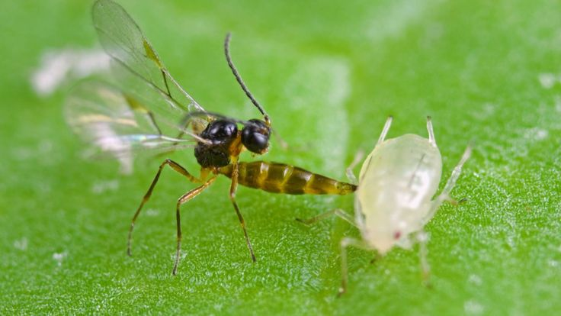
Thank you

