Slide 1

IoT-Based Smart Waste Management System with Reward System

Slide 2
Team : 01
Member 1:
MAHFUZ ANAM
Roll : 374
Exam Roll : 202186
Member 2:
S.I.M. ADNAN
Roll : 378
Exam Roll : 202190
Member 3:
TAUFIQ ISLAM
Roll : 384
Exam Roll : 202196

Slide 3
TABLE OF CONTENTS
1.Project Overview
2. Features
3. Hardware Components
4. Software Components
5. System Operation Workflow
6. Flowchart
7. Circuit Diagram
8. Website Interface
9. Mobile App Interface
10.Conclusion

Slide 4
Project Overview
IoT- Integrated Smart Bin: Uses ESP32, sensors, and servo for automated waste disposal.
RFID Access: Ensures secure, user-specific waste tracking.
Reward Points: Users earn points for responsible disposal.
Web & IoT Dashboard: Blynk and Web interface enable remote monitoring.

Slide 5
Features
.
RFID-based User Authentication
Ensures only registered users can dispose of waste.
Tracks individual user activity for rewards.
Automated Lid Operation
Opens lid automatically after successful RFID scan.
Touchless and hygienic waste disposal.

Slide 6
Features
Real-time Fill Level Detection
Ultrasonic sensors measure waste level continuously.
Reward System
Awards points based on waste deposited.
Motivates responsible disposal
Monitoring via web interface
Accessible through web interface and mobile app.

Slide 7
HARDWARE COMPONENTS
ESP32 Microcontroller
Ultrasonic Sensors (HC-SR04) (2)
RFID Reader(MFRC522)
Servo Motor(SG90)
Power Supply

Slide 8
SOFTWARE COMPONENTS
C++ with Arduino IDE for embedded software
HTML, CSS, React.js for web interface
Blynk for IoT data handling

Slide 9
SYSTEM OPERATION FLOW
Idle State
Waits for RFID scan.
RFID Scan
Reads user card.
Authentication
Valid card → proceed.
Invalid card → show error, return idle.
Lid Control
Opens lid for 7 seconds.
Closes lid automatically.
Fill Level Check
Measures waste level before and after disposal.
Reward Allocation
Increase ≥1cm → award 10 points.
Else → no points.
Data Update
Update reward points and waste level.
Send data to IoT platform.
Reset
Return to idle state.

Slide 10
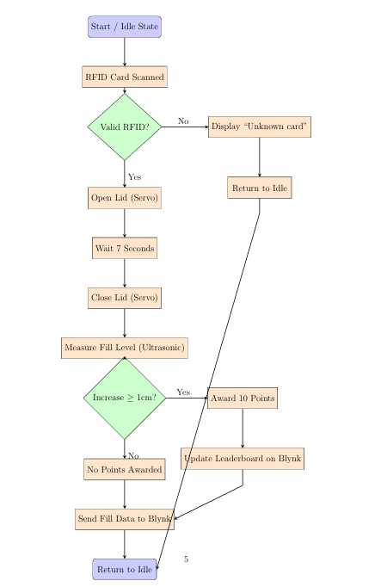
FLOWCHART

Slide 11
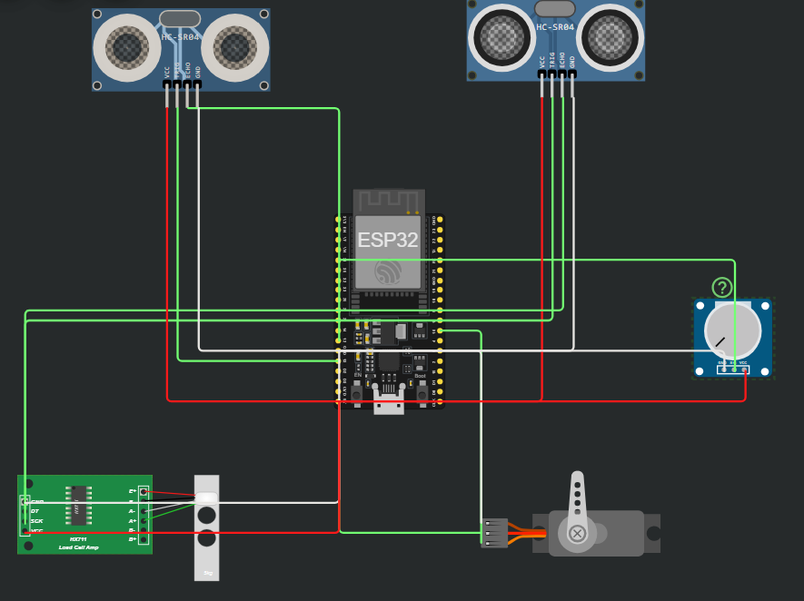
CIRCUIT DIAGRAM

Slide 12
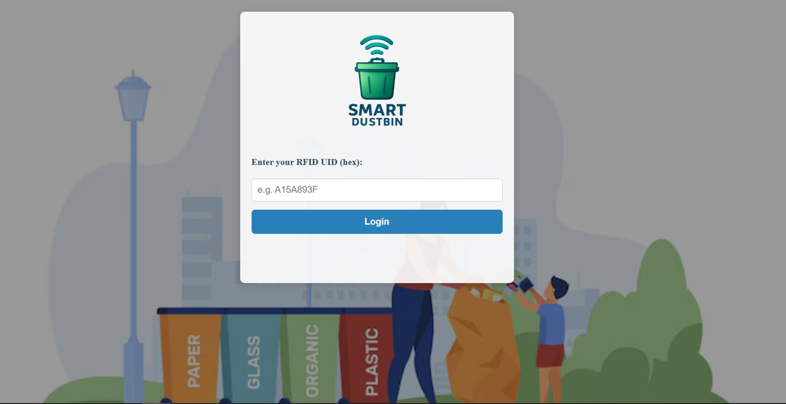
WEBSITE INTERFACE

Slide 13
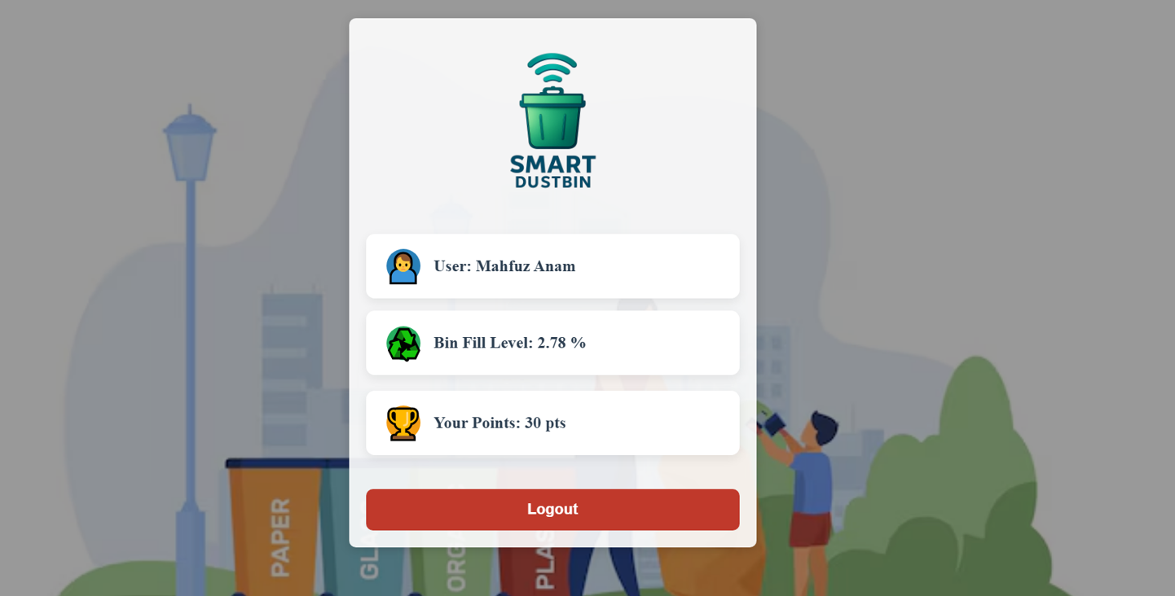
WEBSITE INTERFACE

Slide 14
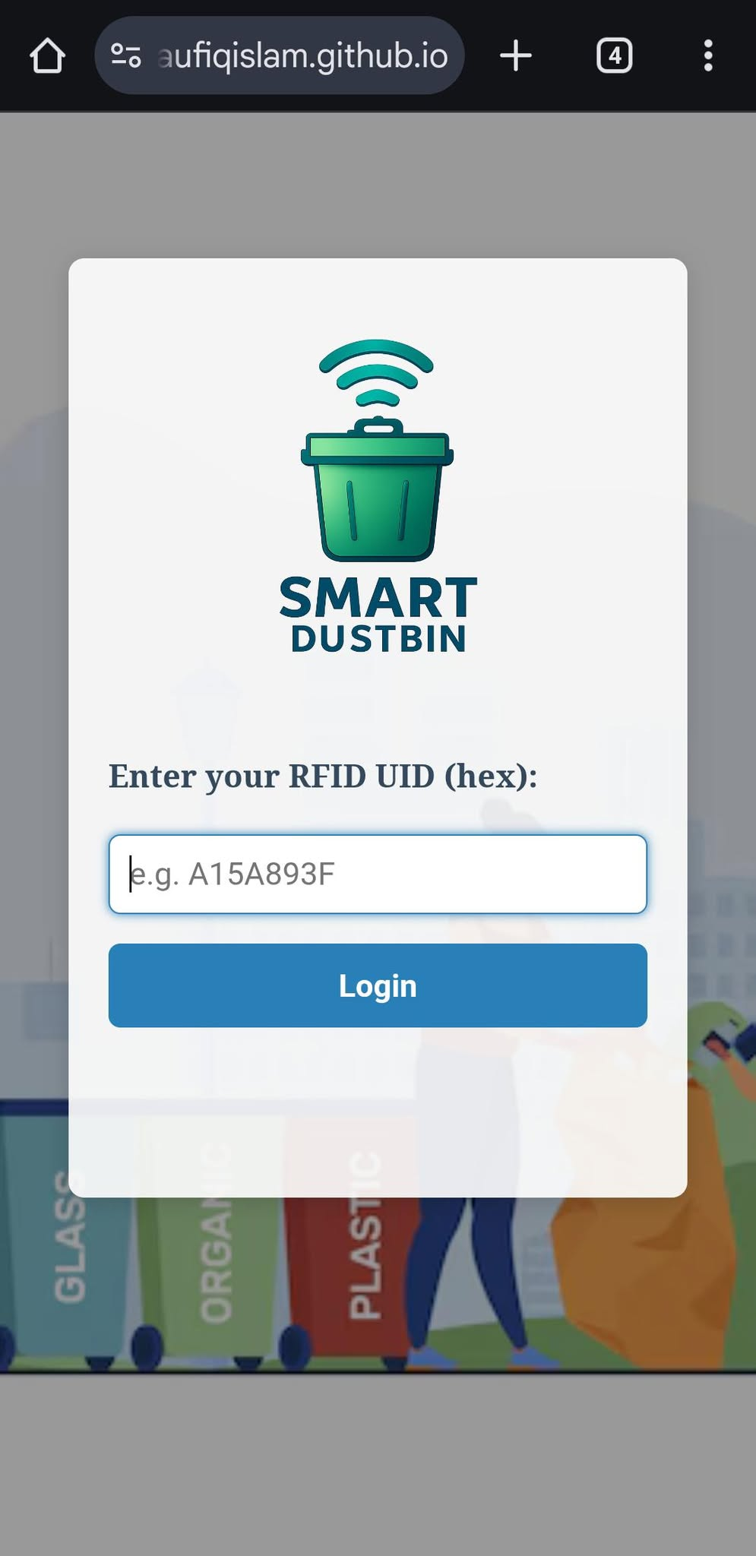
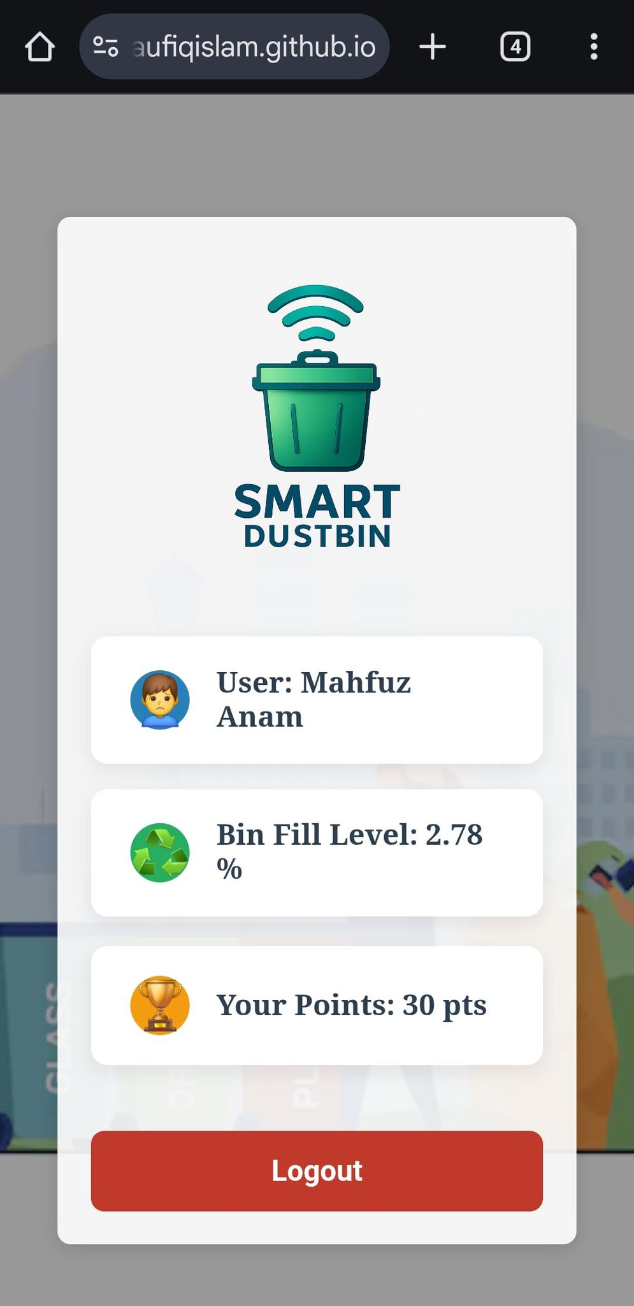
MOBILE APP INTERFACE

Slide 15
Conclusion
The system improves waste management efficiency through real-time monitoring and automation.
The reward mechanism encourages user participation and promotes responsible disposal.
The scalable IoT platform enables remote monitoring and potential city-wide deployment.

Slide 16
THANK YOU
ANY QUESTIONS??

