Slide 1

Budge Budge Institute of Technology
PROJECT TOPIC:
STUDENT PERFORMANCE PREDICTION & CLASSIFICATION SYSTEM
Presented by : SHAH MD HAIDER ALI – 27600122049
AFTAB MANSOORI – 27600122082
YASIR JAMAL NOORI – 27600122105 SANIYA PARMIN – 27600122194
MD ADNAN KARIM – 27600122237
SUPERVISIOR – Prof. Mr. JYOTIPRIO KHANRA
Department of Computer Science & Engineering

Slide 2

The objective of this project is to develop a machine learning-based system that :
Classifies students based on academic performance.
Predicts future student outcomes using historical data.
Helps teachers identify weak and high-performing students.
Provides early warning indicators to reduce student failure and dropout risk.
Enhances personalized learning by analyzing individual student performance patterns.
Supports data-driven academic decision making.

Slide 3

This project focuses on predicting student performance using machine learning algorithms.
The system analyzes student academic records such as attendance, marks, and participation.
It classifies students into performance categories (Excellent, Average, At Risk).
Prediction results help educators provide early intervention and personalized learning strategies.
The system improves academic monitoring and institutional performance analysis.

Slide 4

Traditional Approaches :
Earlier systems primarily relied on manual analysis and basic statistical methods (like Linear Regression) which struggle with complex, non-linear student data.
Recent ML Implementations:
Recent studies have used algorithms like SVM and Naive Bayes for prediction, but they often lack a modern, real-time user interface
for educators.
Most existing systems only focus on binary classification (Pass/Fail) rather than holistic grading.
Limitations / Problem Statement :
Missing user-friendly platforms Lack of comparative model analysis (e.g., checking which model works best dynamically). No actionable insights or categorization for early intervention.
Datasets & Analysis:
Kaggle: Student Performance Analysis
UCI Machine Learning Repository: Student Data
Research & Methodology:
Google Scholar: ML in Education
Tools & Frameworks:
React Documentation | Flask Documentation

Slide 5

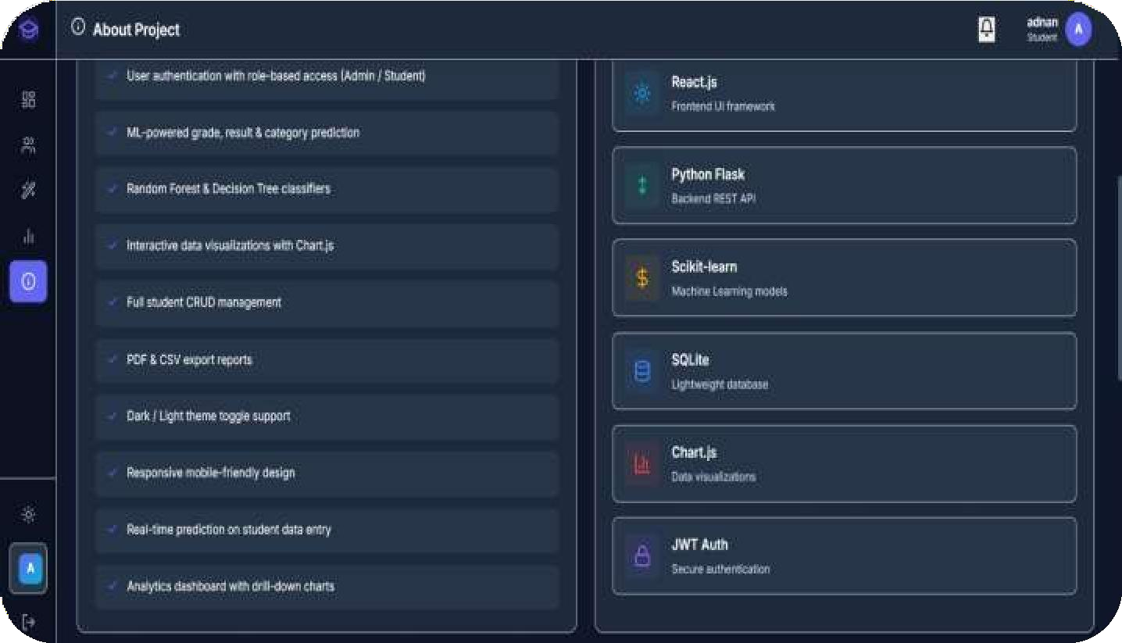

Frontend :
HTML
CSS
React.js
Backend: Python Flask
Machine Learning : Scikit-learn
Database : SQlite
Tools : VS Code

Slide 6
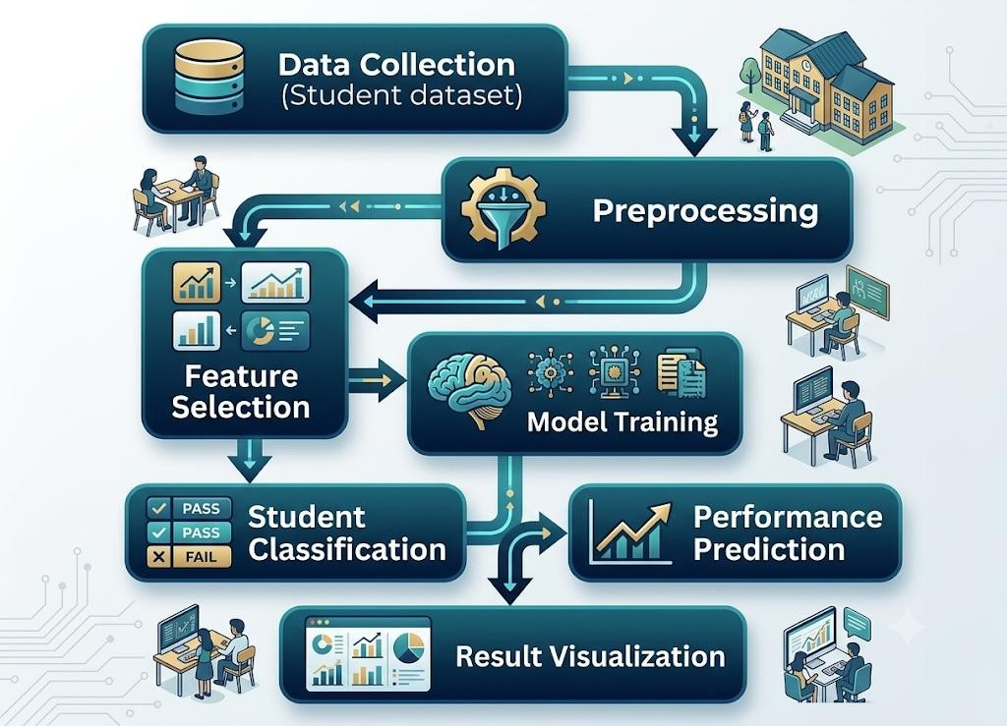
The system works through the following steps :
Data Collection (Student dataset)
Data Preprocessing
Feature Selection
Model Training
Student Classification
Performance Prediction
Result Visualization
Focus Areas:
Accuracy optimization
User-friendly dashboard
Real-time prediction

Slide 7

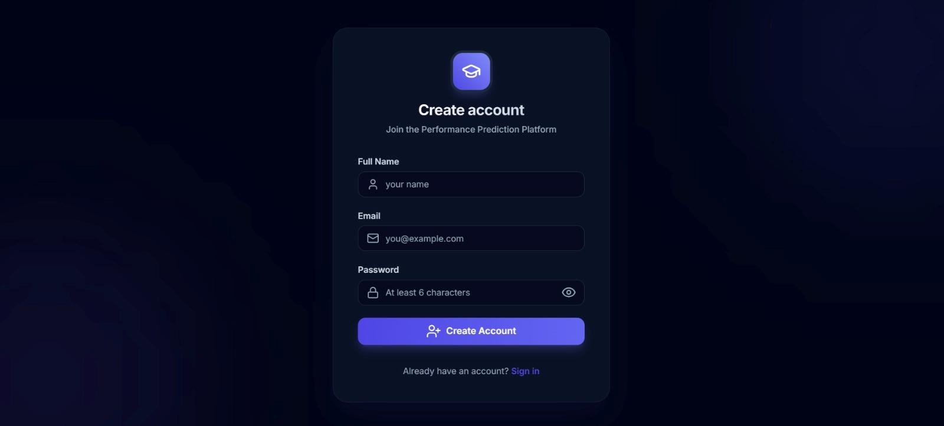
Login & Registration Page:

Slide 8
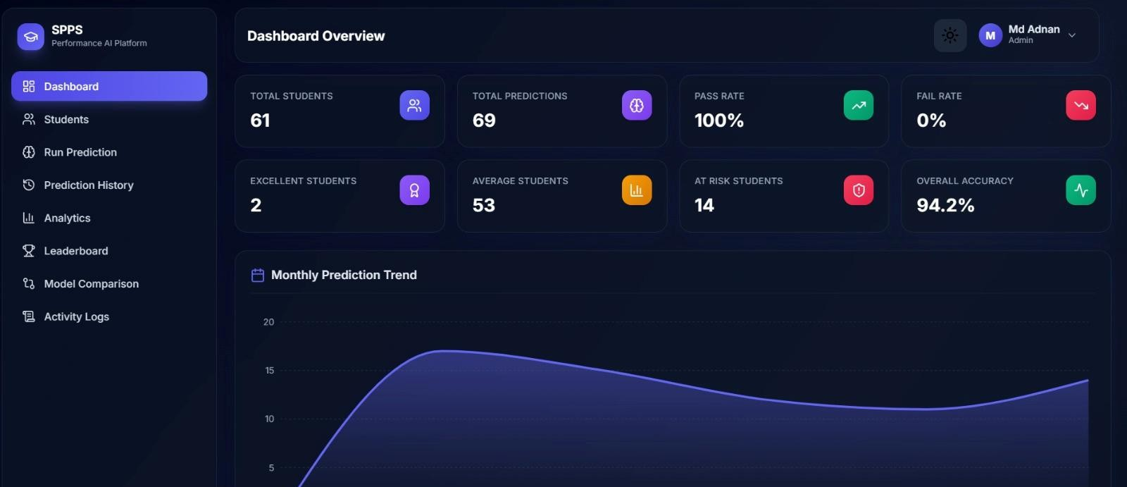
Student Dashboard overview:

Slide 9



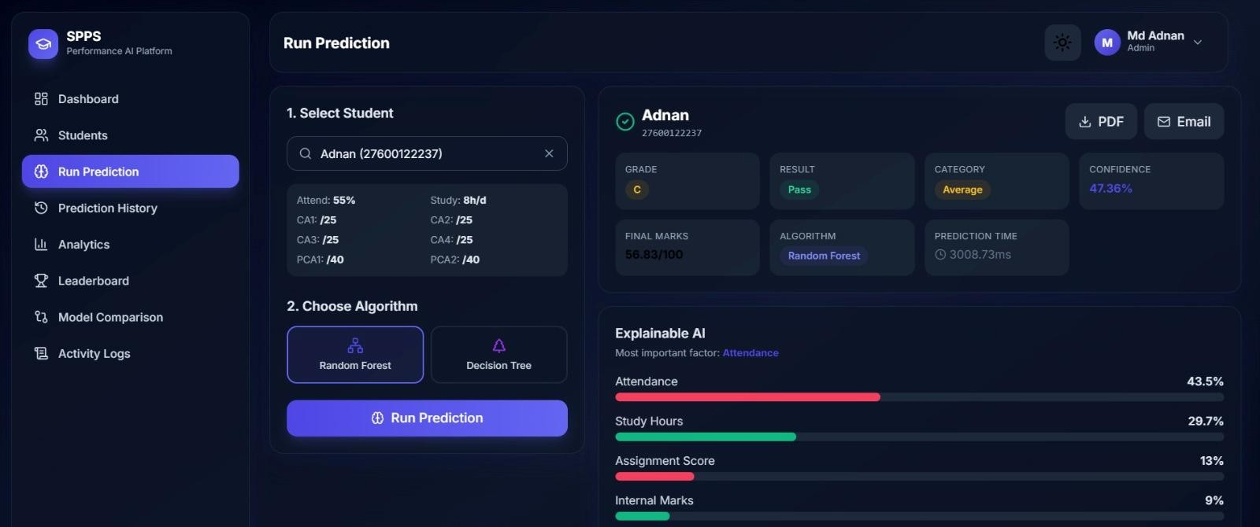
Prediction Result Page:

Slide 10
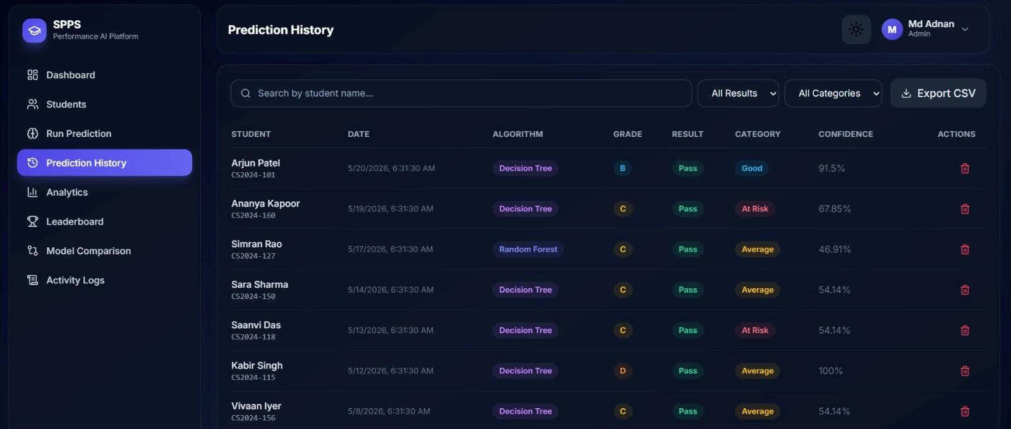
Prediction History:

Slide 11
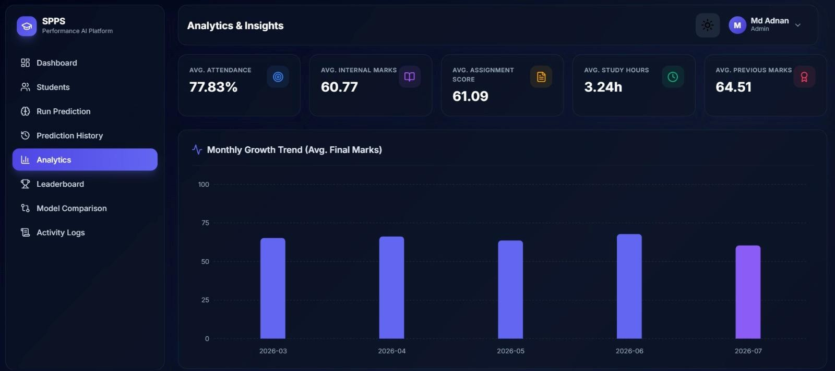




Features :
View predicted performance.
Academic progress tracking. Performance analytics graphs.
Improvement suggestions.

Slide 12



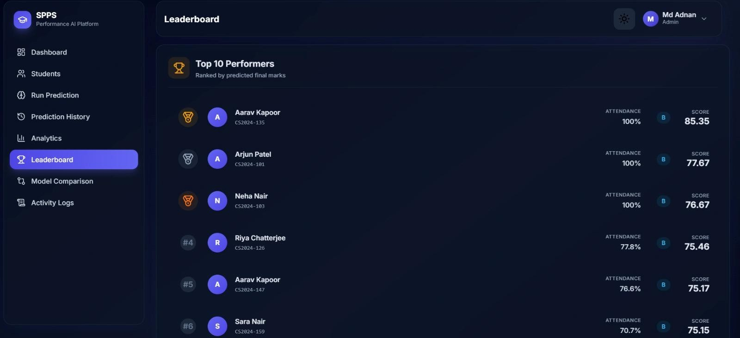
Features :
Upload student dataset
Train prediction model
View classification results
Identify at-risk students

Slide 13

Deep Learning integration for higher accuracy.
Mobile application development.
Real-time student monitoring system.
AI-based personalized learning recommendations.
Cloud deployment.

Slide 14

It helps educators:
The Student performance Classification and Prediction system provides an intelligent approach to analyzing academic performance.
Detect weak students early
Improve learning outcomes
Make data-driven academic decisions
The system enhances educational efficiency using machine learning techniques.

Slide 15


