Slide 1
Customer Churn
Prediction Analysis
XGBoost • Random Forest • Logistic Regression

Slide 2
Agenda
01 Dataset Overview
06 ROC & Precision-Recall Curves
02 Exploratory Data Analysis
07 Feature Importance
03 Modelling Approach
08 SHAP Analysis
04 Model Performance
09 Key Findings
05 Confusion Matrices
2

Slide 3
Dataset Overview
3,150
13
15.7%
Total Records
Features
Churn Rate
2,655
495
0
Retained
Churned
Null Values
3

Slide 4
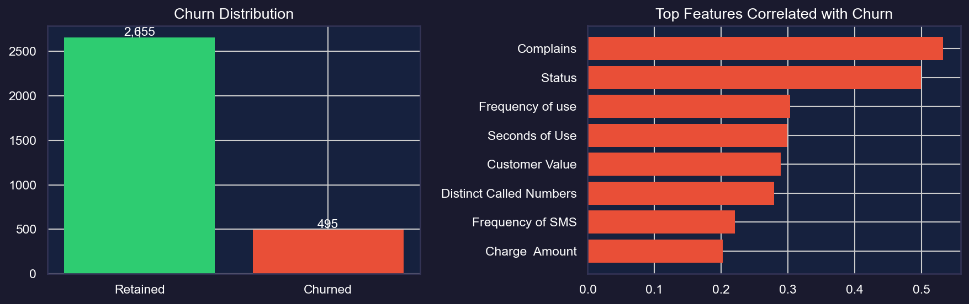
EDA Highlights
4

Slide 5
Modelling Approach
Logistic Regression
Random Forest
XGBoost
Baseline linear model with L1/L2 regularisation. Class-weight balancing for imbalanced data.
Ensemble of decision trees with Gini impurity. Naturally handles non-linear relationships.
Gradient boosted trees with scale_pos_weight. Best suited for tabular churn data.
All models tuned with 5-fold StratifiedKFold GridSearchCV • Scoring: F1
5

Slide 6
Model Performance
Model | Accuracy | Precision | Recall | F1-Score | ROC-AUC
LogisticRegression | 0.840 | 0.494 | 0.879 | 0.633 | 0.921
RandomForest | 0.971 | 0.893 | 0.929 | 0.911 | 0.985
XGBoost | 0.962 | 0.838 | 0.939 | 0.886 | 0.993
Best model by F1-Score: RandomForest
6

Slide 7
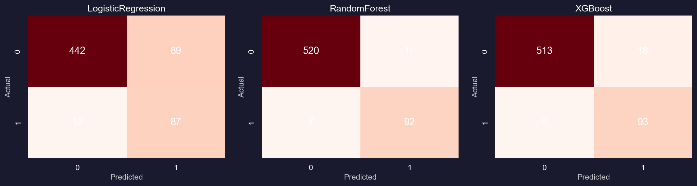
Confusion Matrices
7

Slide 8
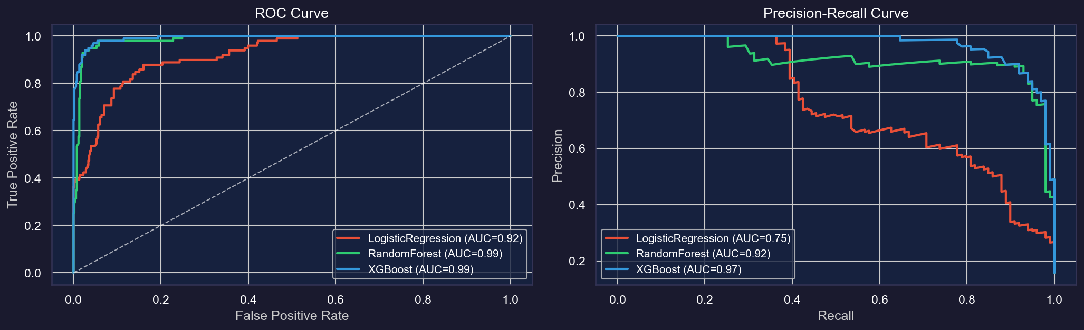
ROC & Precision-Recall Curves
8

Slide 9
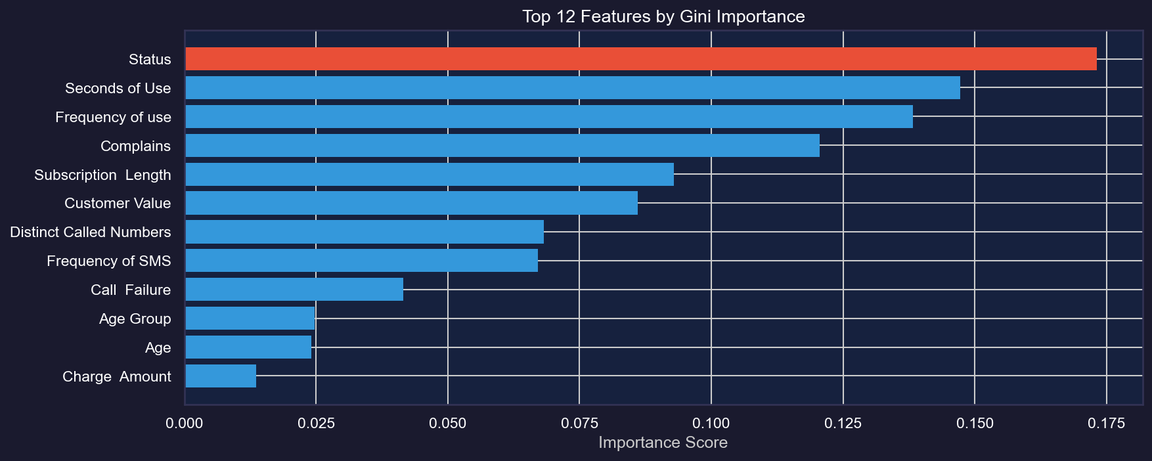
Feature Importance (RandomForest)
9

Slide 10
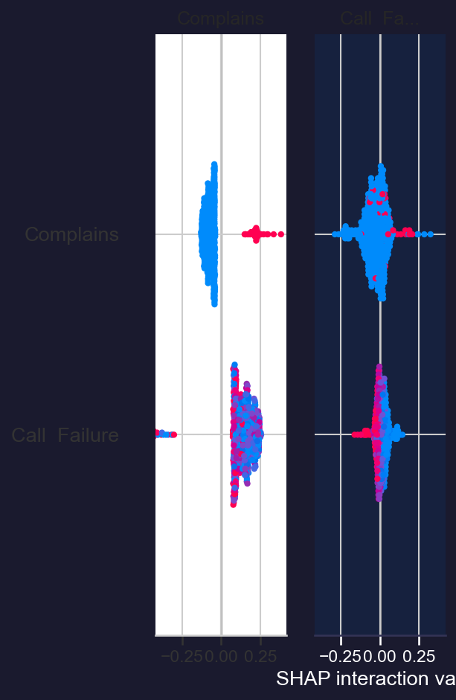
SHAP Analysis (RandomForest)
10

Slide 11
Key Findings
Overall churn rate: 15.7% of customers churned
Customers with complaints churn at 83.0% vs 10.1% without
Best model: RandomForest | F1=0.911 | ROC-AUC=0.985
Complaints & Call Failures are the strongest churn predictors
High-value customers have significantly lower churn rates
11

