Slide 1



Machine Learning
Lecture 6: Linear Regression
Instructor: Dr. Shazia Saqib

Slide 2

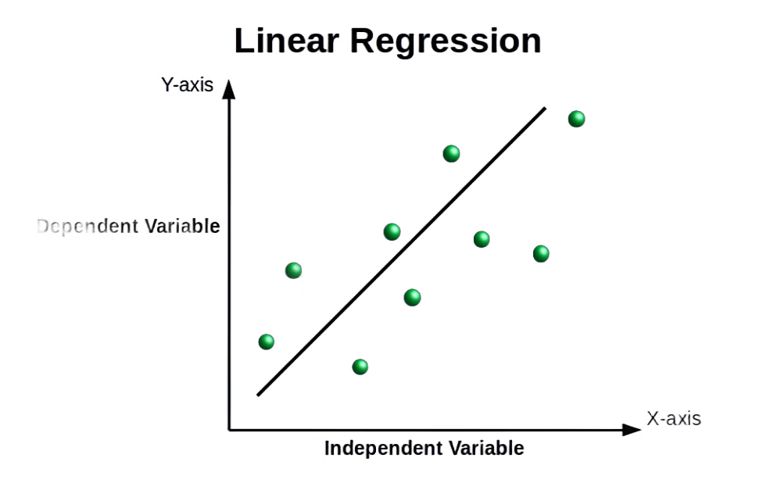
Introduction to Linear Regression
Linear Regression is a method to find a relationship between a dependent variable and one or more independent variables using a straight line.

Slide 3
Types of Linear Regression
Simple Linear Regression
Multiple Linear Regression
One independent variable X and one dependent variable Y.
More than one independent variable (predictors).
Polynomial Regression
Ridge Regression
A type of linear regression where the relationship is modeled as a polynomial (non-linear in nature).
A variant of linear regression that adds a penalty (regularization) term to prevent overfitting.
Lasso Regression
Another regularized version of linear regression, using L1 penalty to induce sparsity.
Notes:
change image add image related to the content of the slide

Slide 4
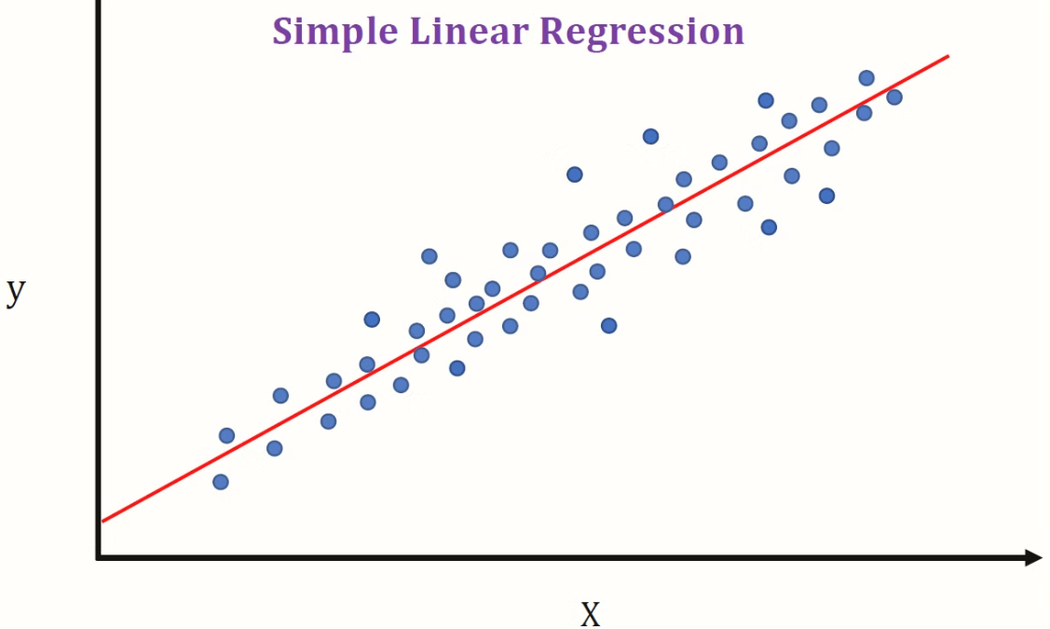
Simple Linear Regression
Definition: Linear relationship between a dependent variable Y and a single independent variable X. Equation:

Slide 5
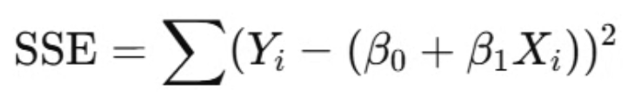
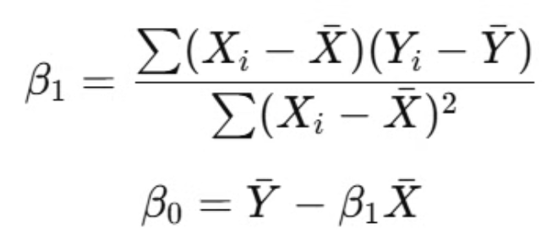
The Mathematics of Linear Regression
Least Squares Method:
Objective: Minimize SSE to find optimal values for β0​ and β1.
Normal Equation
Notes:
align equations to center

Slide 6

Multiple Linear Regression
Definition: Multiple Linear Regression (MLR) is a statistical method used to predict an outcome (dependent variable) based on two or more input features (independent variables).
Formula:
Notes:
dont copy paste add in text form

Slide 7
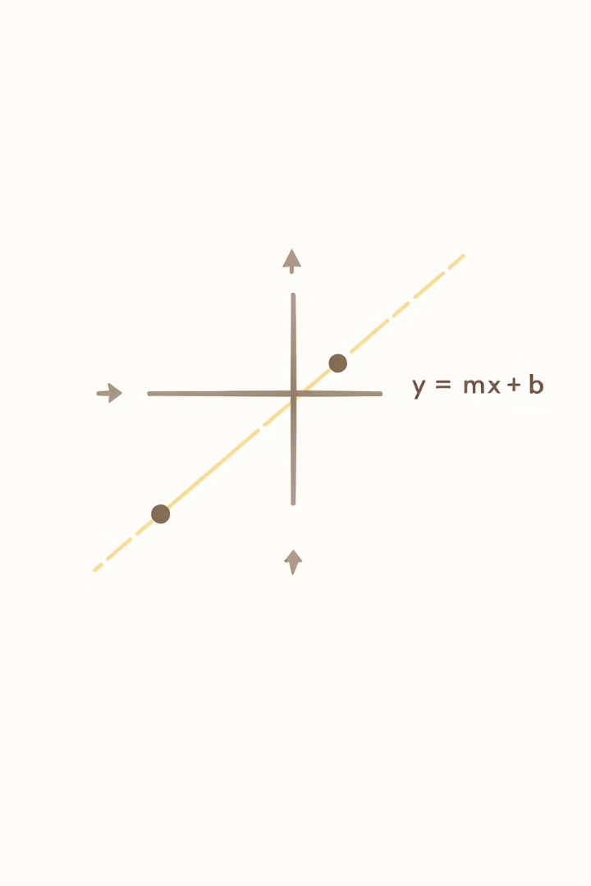
Mathematics Behind Linear Regression
y = mx + b
y: dependent variable, x: independent variable, m: slope, b: intercept

Slide 8
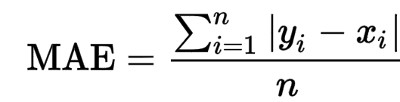
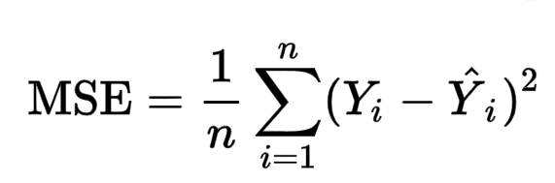
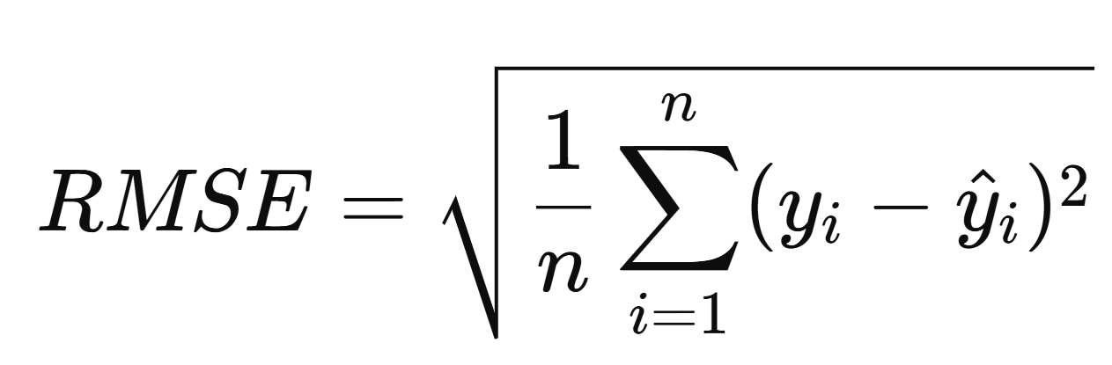
Evaluating Linear Regression Models
Common metrics to assess model performance:
Mean Absolute Error (MAE)
Mean Squared Error (MSE)
Root Mean Squared Error (RMSE)
R-squared (R²)
Proportion of variance explained by the model
Average of absolute differences between predictions and actual values
Average of squared differences between predictions and actual values
Square root of MSE, provides error in original units
Notes:
remove image add image related to the content of the slide

Slide 9
Overview of Linear Regression
The linear regression workflow follows these key steps:
1
Define the Problem
2
Collect and Prepare Data
3
Split Data
Identify dependent and independent variables.
Clean, preprocess, and handle missing values.
Divide into training and testing sets.
4
Fit the Model
5
Train the Model
6
Evaluate Performance
Use the linear regression equation Y= b0 + b1X +ϵ
Estimate coefficients using the Least Squares Method.
Use metrics like MAE, MSE, RMSE, and R2.
7
Make Predictions
8
Interpret Results
Apply the trained model to new data.
Analyze coefficients and impact of variables.

Slide 10

The Goal of Linear Regression
Objective:
To find the best-fitting line that minimizes the difference between the predicted and actual values of Y.
Key Concept: Minimizing the Sum of Squared Errors (SSE).
Notes:
grammatical errors

Slide 11
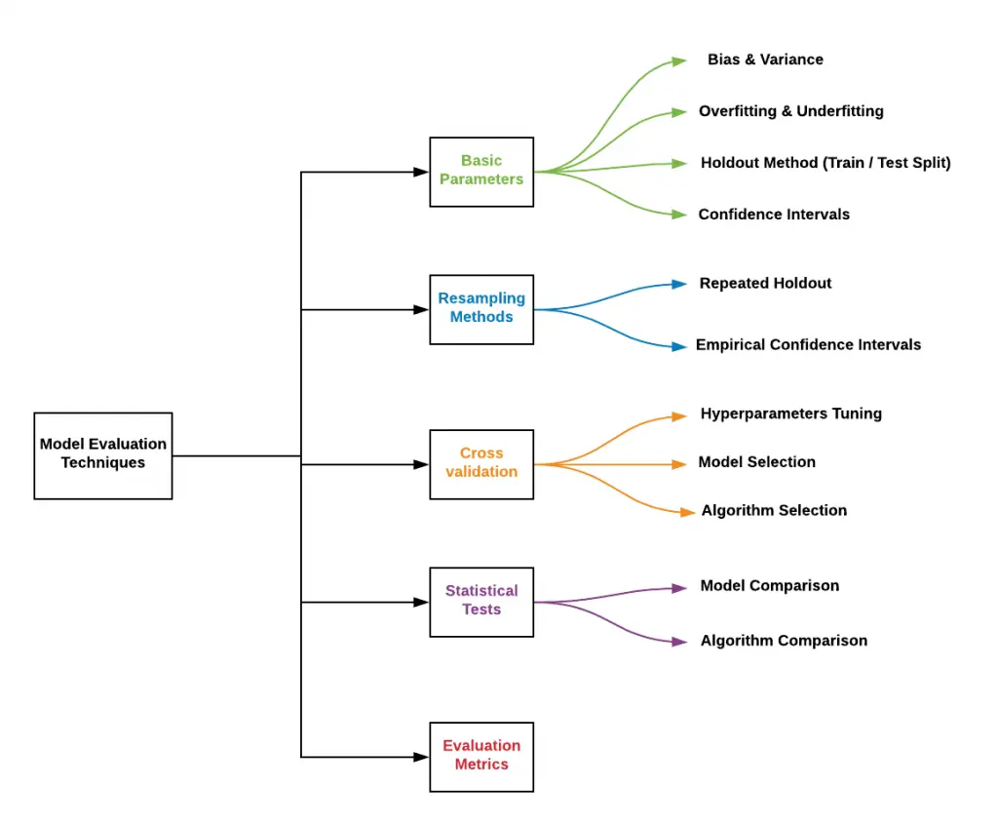
Model Evaluation

Slide 12

Making Predictions
The linear regression prediction process follows these sequential steps:
Train the Model
Fit data to learn relationships
Input New Data
Provide unseen values for prediction
Apply the Equation
Use 𝑌= 𝑏0 + 𝑏1𝑋 + ... + 𝑏𝑛𝑋𝑛
Generate Predictions
Get estimated outcomes
Evaluate Accuracy
Compare predictions with actual values
Notes:
improve this slide

Slide 13
Common Challenges in Linear Regression
Multicollinearity
1
Highly correlated independent variables can distort coefficient estimates.
2
Overfitting/Underfitting
Overfitting: Model fits training data too well but fails on test data. Underfitting: Model is too simple to capture patterns in data.
Outliers
3
Extreme values can heavily influence the regression line and coefficients.
4
Non-Linearity
Assumes a linear relationship between features and target; fails if the relationship is non-linear.
Heteroscedasticity
5
Variance of residuals isn't constant, violating the assumption of homoscedasticity.
6
Autocorrelation
Residuals are correlated, common in time-series data.
Feature Scaling
7
Large differences in feature scales can affect gradient descent convergence.
Notes:
convert in two slides add columns

Slide 14
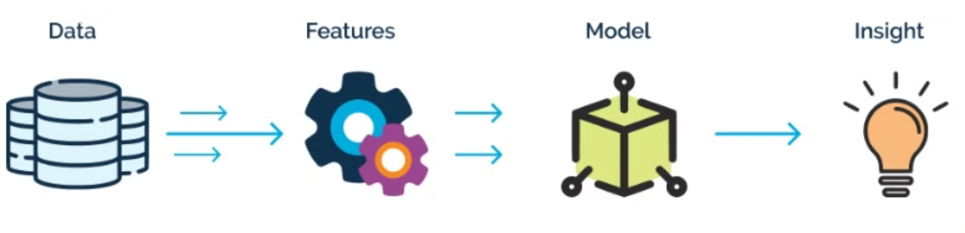
Feature Engineering for Better Results
Improve model performance by scaling features to a common range.
Notes:
remove image

Slide 15






Implementation in Code
Steps to apply Linear Regression in Python:
Load dataset
Import and prepare your data source
Preprocess data
Clean, normalize, and prepare variables
Split into training & testing
Create separate datasets for model training and evaluation
Apply Linear Regression model
Fit the model to your training data
Check results
Evaluate performance using statistical metrics
Visualize predictions
Create plots to interpret model predictions

Slide 16
Train-Test Split in Code
The essential function for properly evaluating machine learning models:
Ensure Fair Evaluation
Split Your Data
Guarantees model is trained and tested on different data samples
Import Function
Divides dataset into training (80%) and testing (20%) portions
train_test_split(X, y, test_size=0.2, random_state=42)

Slide 17
Applying Linear Regression Model
Code:
model = LinearRegression()
model.fit(X_train, y_train)
y_pred = model.predict(X_test)
X_train, Y_train: Training data
X_test: Used for prediction
y_pred: Model’s predicted values

Slide 18
Checking Model Performance
Compare: y_test vs. y_pred
Goal: Minimize error
Check coefficients:
print(model.coef_)
print(model.intercept_)
Making Predictions with New Data
Example: Predict salary based on age
new_ages = [[25], [30], [35]]
new_salaries = model.predict(new_ages)
Model predicts salary for new ages

Slide 19
Summary
Linear Regression Concept
Finding relationship between variables using a straight line.
Mathematical Formula
y = mx + b, where m is slope and b is intercept.
Key Assumptions
Linearity, independence, homoscedasticity, normality, no multicollinearity.
Python Implementation
Using Scikit-learn for model building and evaluation.

Slide 20
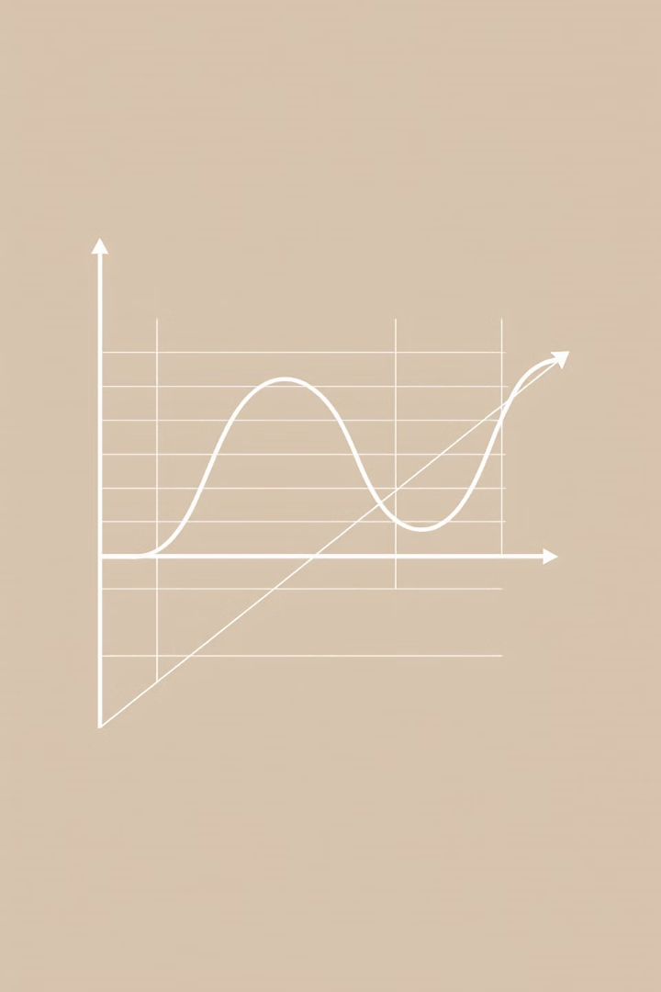
Next Steps: Logistic Regression for Classification
Our next lecture will cover Logistic Regression, crucial for handling binary outcomes in classification problems.

