Slide 1



Machine Learning
Lecture 01: Introduction to Machine Learning
Instructor: Dr. Shazia Saqib

Slide 2
Course Overview
Module 1
Module 2
Introduction to ML, fundamental concepts, types of learning, data formatting & preprocessing.
Key ML algorithms, supervised, unsupervised, and reinforcement learning.
Module 3
Module 4
Convolutional Neural Networks (CNNs), dimensionality reduction, evaluation matrices.
Advanced topics – AutoML, explainability, and model deployment.

Slide 3





Course Learning Objectives
Essential Skills
Hands-on Experience
Critical Thinking
Develop essential machine learning skills.
Gain hands-on experience with coding.
Improve problem-solving and critical thinking.
Portfolio Building
Knowledge Sharing
Work on practical projects and build a portfolio.
Learn effective knowledge-sharing techniques.

Slide 4
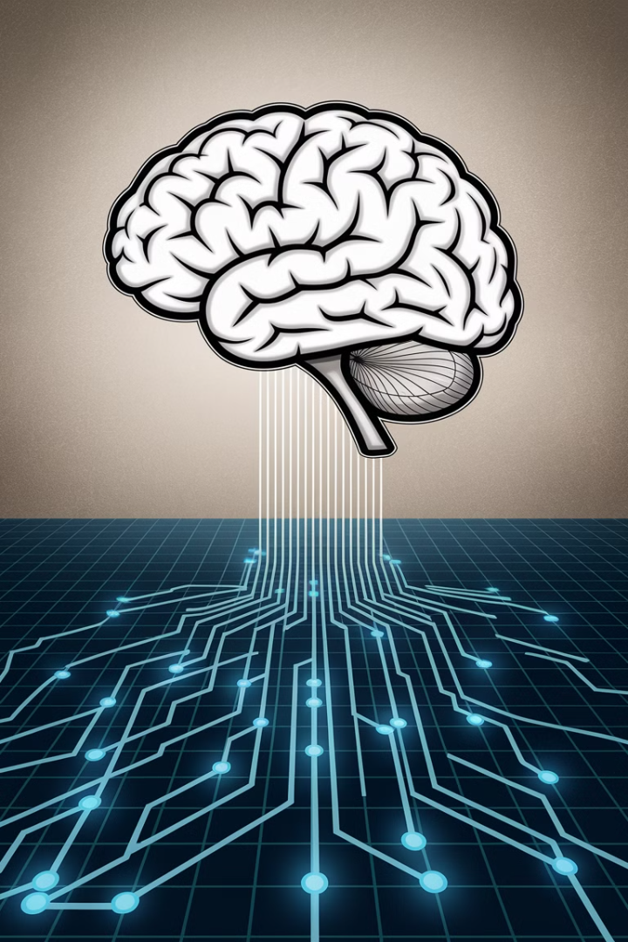
What is Learning?
Process of Improvement
Process of improving performance or knowledge over time.
Performance Enhancement
Performance enhancement through repeated experiments.

Slide 5
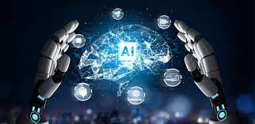
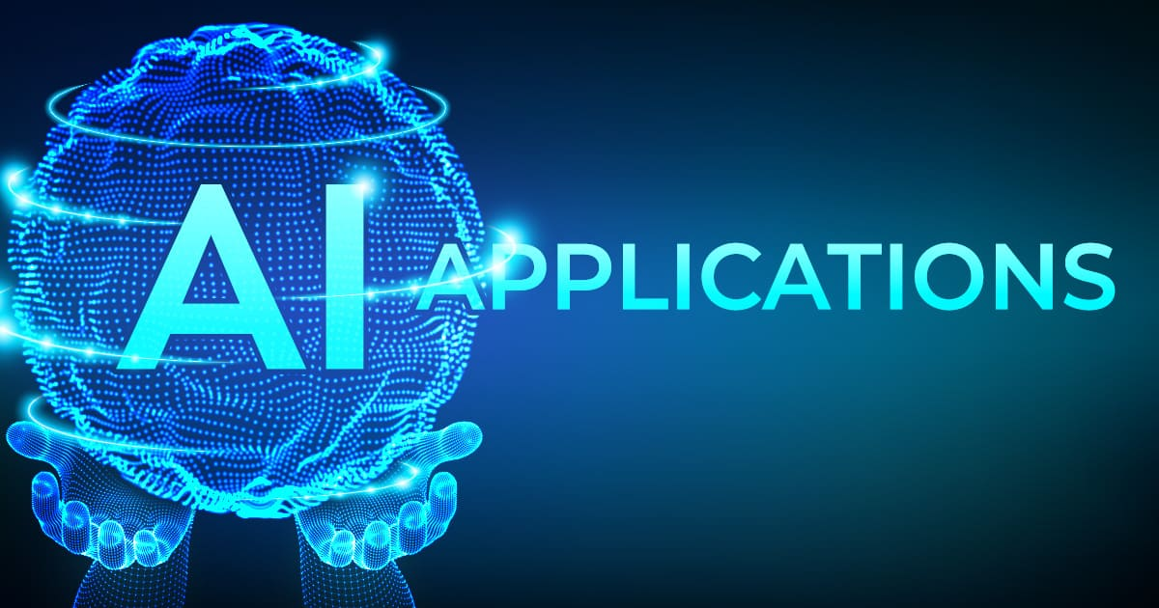

What is AI?
Definition
Applications
Learning Process
Ability of computers to think, learn, and make decisions like humans.
AI applications: Speech recognition, text understanding, predictions, problem-solving.
AI learns from data using machine learning and deep learning techniques.

Slide 6
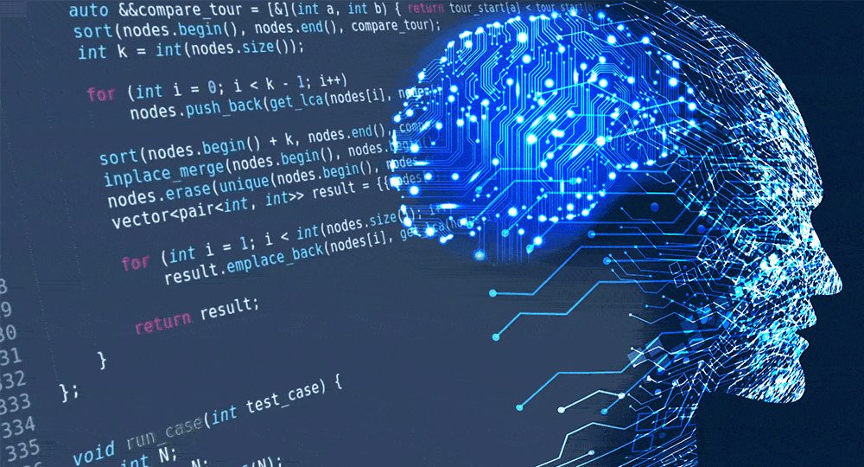
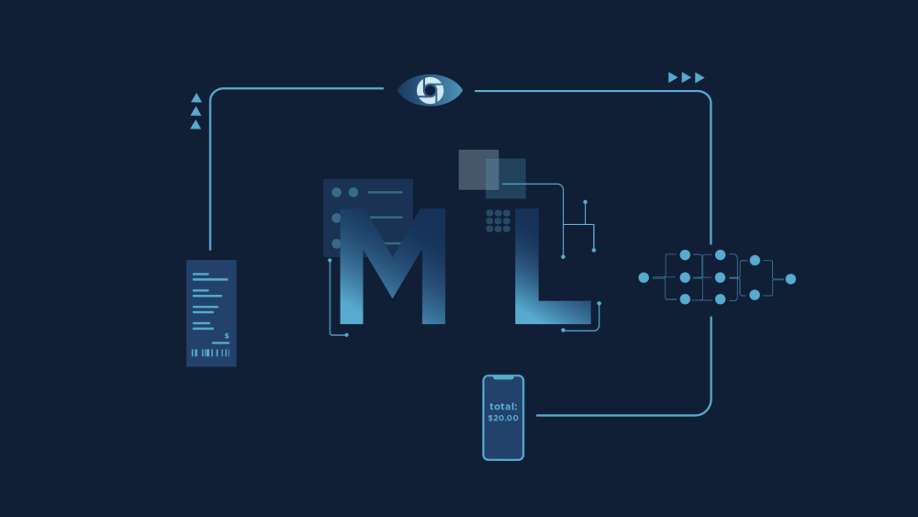

Relationship Between AI, ML, and DL
AI
ML
DL
Includes search algorithms, rule-based systems, and inference methods.
Subset of AI, includes supervised, unsupervised, and reinforcement learning.
Subset of ML, includes CNNs, RNNs, transformers, GANs, and autoencoders.

Slide 7
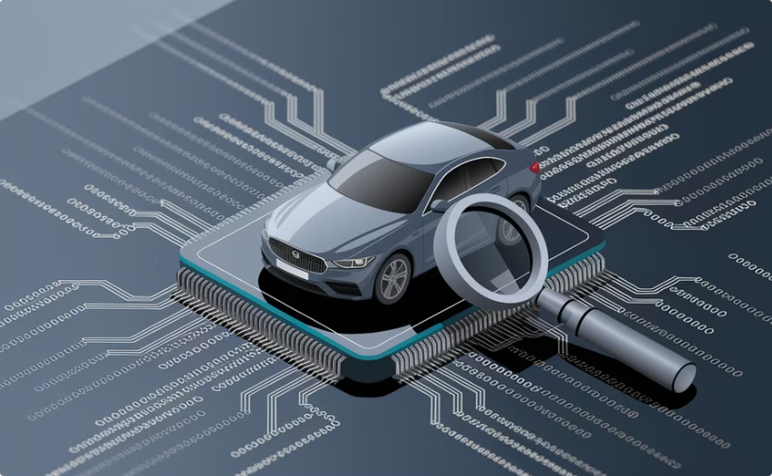
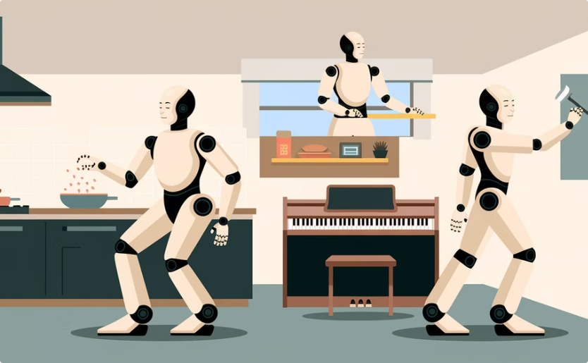
AI Categories
ANI (Artificial Narrow Intelligence)
AGI (Artificial General Intelligence)
Used in self-driving cars, search engines, farming, factories.
AI capable of performing all human tasks.

Slide 8
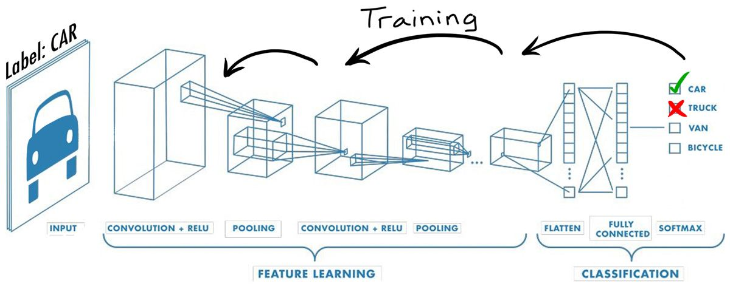
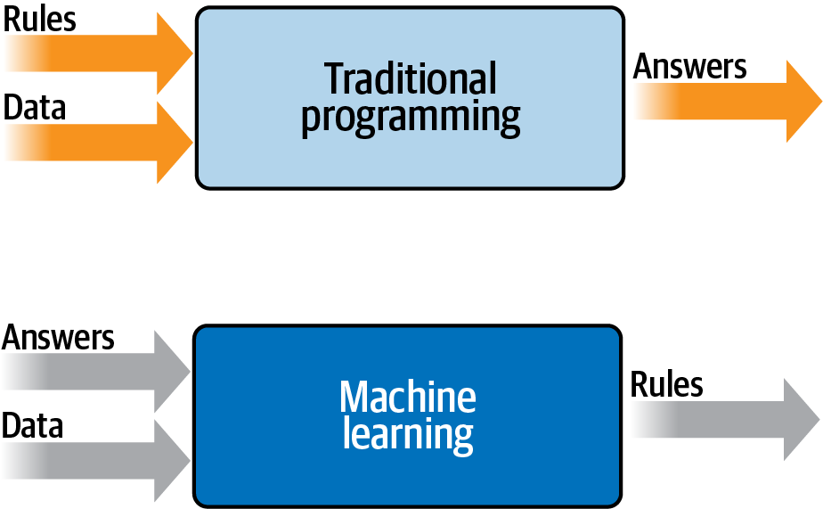
Machine Learning vs. Traditional Systems
1
Traditional Systems
2
ML Systems
3
Pattern Recognition
Traditional systems rely on pre-defined rules.
ML systems analyze past data to form predictive models.
ML helps in pattern recognition and decision-making without explicit programming.

Slide 9
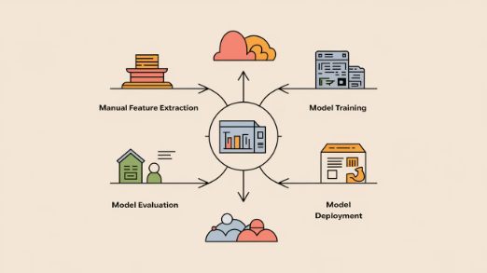

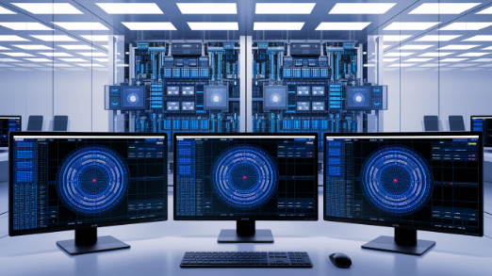
Machine Learning vs. Deep Learning
ML
DL
DL Applications
Requires explicit feature engineering and domain expertise for effective classification and prediction.
Autonomously learns hierarchical feature representations from raw data, eliminating manual feature extraction but reducing interpretability.
Excels with large, complex datasets in areas like computer vision, natural language processing, and speech recognition.

Slide 10
Key Components of Machine Learning
1
Data & Features
2
Algorithms & Training
Data: Foundation of learning. Features: Key attributes extracted from data.
Algorithms: Build ML models. Training & Testing Data: Train model and evaluate performance.
3
Loss & Optimization
4
Evaluation & Deployment
Loss Function: Measures difference between expected and actual results. Optimization: Minimizes loss function to improve accuracy.
Evaluation Metrics: Assess model performance (precision, recall, accuracy). Hyperparameters: Tunable parameters like learning rate, activation functions. Deployment: Making trained models accessible.

Slide 11
History of Machine Learning (Part 1)
1642
1
Pascal develops the first mechanical machine.
2
1679
Binary-coded machines emerge.
1847
3
Boolean logic introduced.
4
1950
Alan Turing develops the Turing Test.
1952
5
First machine learning application created.

Slide 12
History of Machine Learning (Part 2)
1970
1
Automated ML models introduced.
2
1979
First self-driving car developed.
1986
3
Paper on neural networks published.
4
1997
Advancements in speech recognition.

Slide 13



Applications of Machine Learning
Consumer Technology
Smart Cities
Cybersecurity
Recommendation systems for shopping, movies, books.
Traffic prediction, energy optimization, AI-driven governance.
Facial recognition, spam detection, cyberattack prevention.

Slide 14


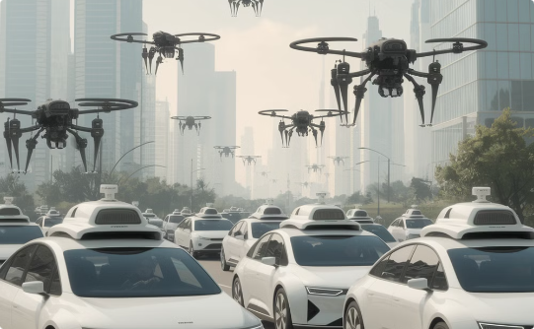
Applications of Machine Learning
Healthcare
Finance
Autonomous Systems
Predicting patient readmission, diagnosis, treatment outcomes.
Fraud detection, profit forecasting, customer retention prediction.
Self-driving cars, drones, robotics.

Slide 15




ML in Everyday Life
Machine Learning seamlessly integrates into our daily lives through various technologies.
Mobile Technology
Smart Homes
Online Shopping
Navigation
Facial recognition and voice assistants that learn from user interactions.
Systems that learn usage patterns to adjust lighting, temperature, and settings.
Analysis of browsing history to deliver personalized product recommendations.
Processing of real-time traffic data to predict optimal routes.
ML processes data to predict preferences, automate tasks, and make intelligent decisions previously exclusive to humans.

Slide 16
Course Expectations
1
Theory
2
Practice
3
Skills
4
Projects
Engage with theoretical components.
Engage with practical components.
Gain programming and analytical skills.
Complete projects for hands-on learning.

Slide 17
Learning Goals for This Session
1
2
3
Understanding AI
Key Components
Real-world Applications
Understand AI, ML, and DL.
Recognize key components of ML.
Explore real-world applications of ML.

Slide 18
Summary of Lecture
AI, ML, and DL
Differences
Introduction to AI, ML, and DL.
Differences between ML and DL.
Components
Applications
Key ML components and historical milestones.
Applications of ML in various domains.

Slide 19



Next Session Preview
Types of ML
In the next class, we will start with different types of Machine Learning.
Detailed Discussion
Stay prepared for a detailed discussion on Supervised, Unsupervised, and Reinforcement Learning.
Conclusion
Thank you, and see you in the next session!

