Slide 1



Machine Learning
Lecture 02: Overview of Types of Machine Learning and Basic Workflow
Instructor: Dr. Shazia Saqib

Slide 2
Recap of the last lecture
In our previous session, we explored the fundamental types of machine learning approaches:
1
Supervised Learning
2
Unsupervised Learning
3
Reinforcement Learning
Uses labeled data for training
Works with unlabeled data
Learns through interaction with environment
Each approach serves different purposes and has unique applications in the field of machine learning.

Slide 3
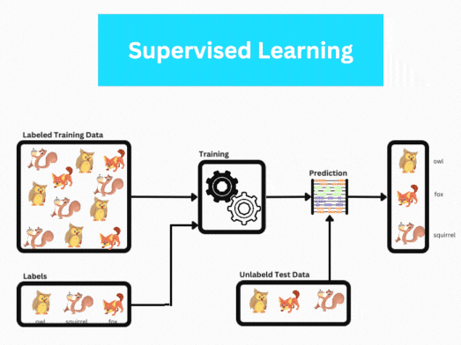
Supervised Learning
Uses labeled data with paired inputs and outputs
Learns patterns from examples to predict results on new data
Easily measured performance against expected outputs

Slide 4

Example of Supervised Learning
1
Training a model with labeled fruit images.
2
After training, the model can classify new fruit images.

Slide 5



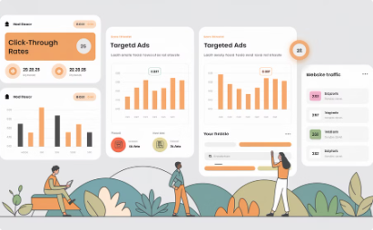
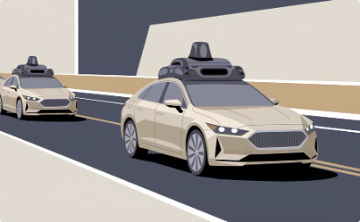
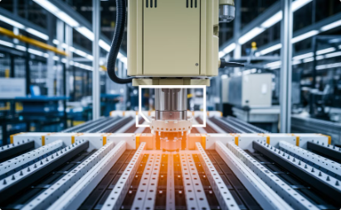
Applications of Supervised Learning
Spam filtering
Speech recognition
Machine translation
Spam vs. non-spam emails
Audio-to-text conversion
Language translation
Online advertising
Self-driving cars
Visual inspection
Predicting ad clicks
Detecting vehicles using radar
Detecting product defects

Slide 6
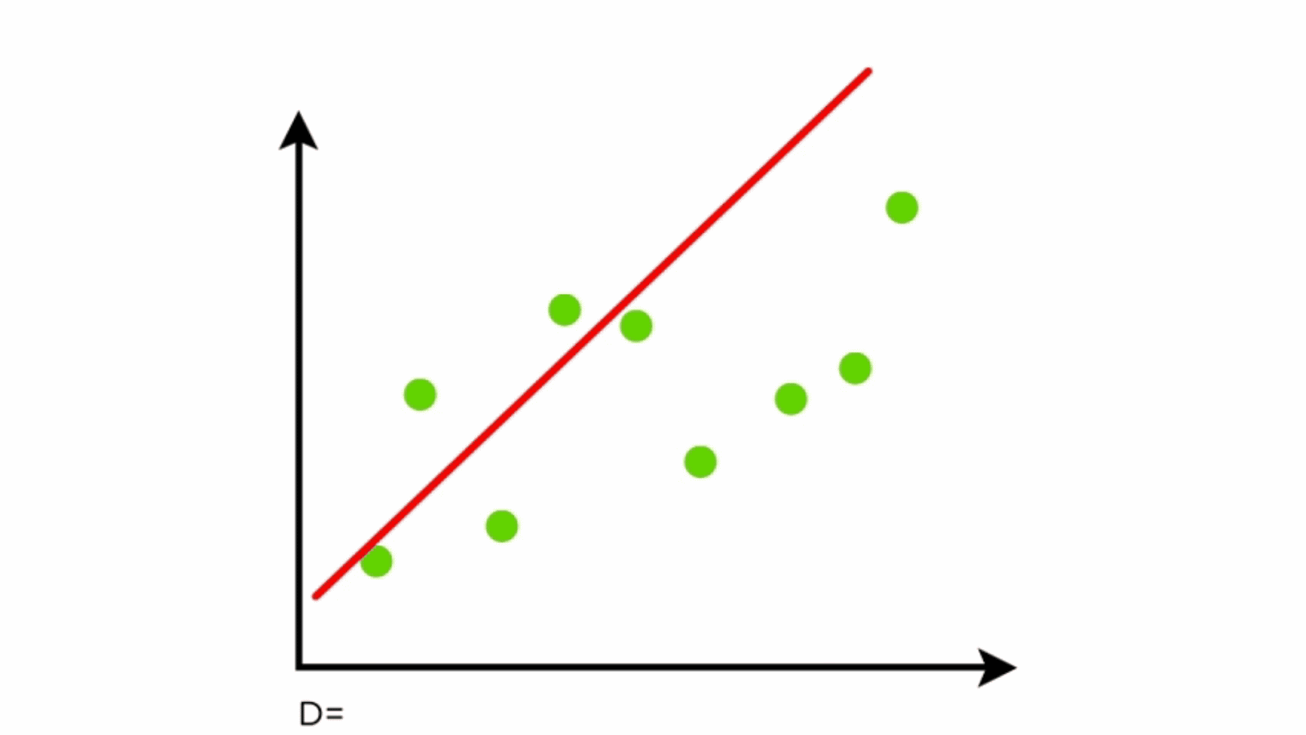
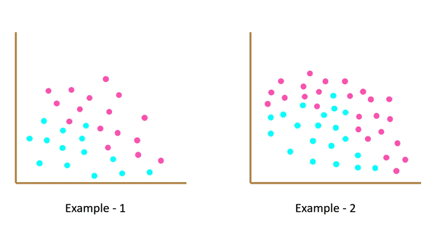
Two Types of Supervised Learning
1. Classification
2. Regression
Categorizing data into predefined labels (e.g., spam or not spam).
Predicting continuous values (e.g., house prices, future sales).

Slide 7
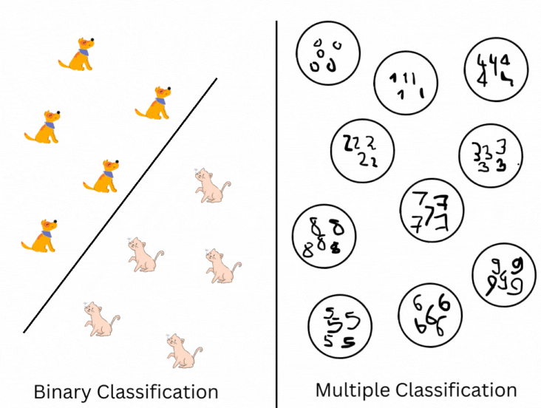
Types of Classification
Binary Classification
Two possible outcomes (Yes/No, Spam/Not Spam).
Multi-Class Classification
More than two outcomes (child, young adult, elderly).

Slide 8
Common Supervised Learning Algorithms
1
k-Nearest Neighbors (KNN)
2
Support Vector Machines (SVM)
Classifies data points based on the majority class among k nearest neighbors, using distance metrics to determine similarity.
Creates optimal hyperplanes to separate data classes, excelling at classification tasks with clear margins between categories.
3
Linear Regression
4
Logistic Regression
Predicts continuous values by modeling relationships between features using a linear approach, finding the best-fitting line through data points.
Despite its name, primarily used for binary classification, modeling probability of outcomes using the logistic function.
5
Decision Trees
6
Random Forest
Creates a flowchart-like structure that splits data based on feature values, making decisions through a series of questions.
Combines multiple decision trees to reduce overfitting and improve accuracy, using ensemble learning techniques.

Slide 9
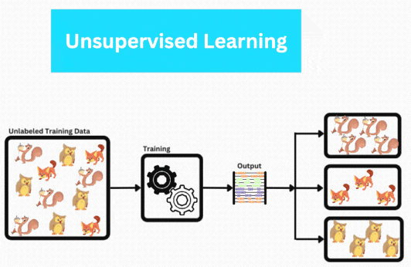
Unsupervised Learning
1
No labeled data.
2
Model identifies patterns and groups similar data points.
3
Primary method: Clustering.

Slide 10
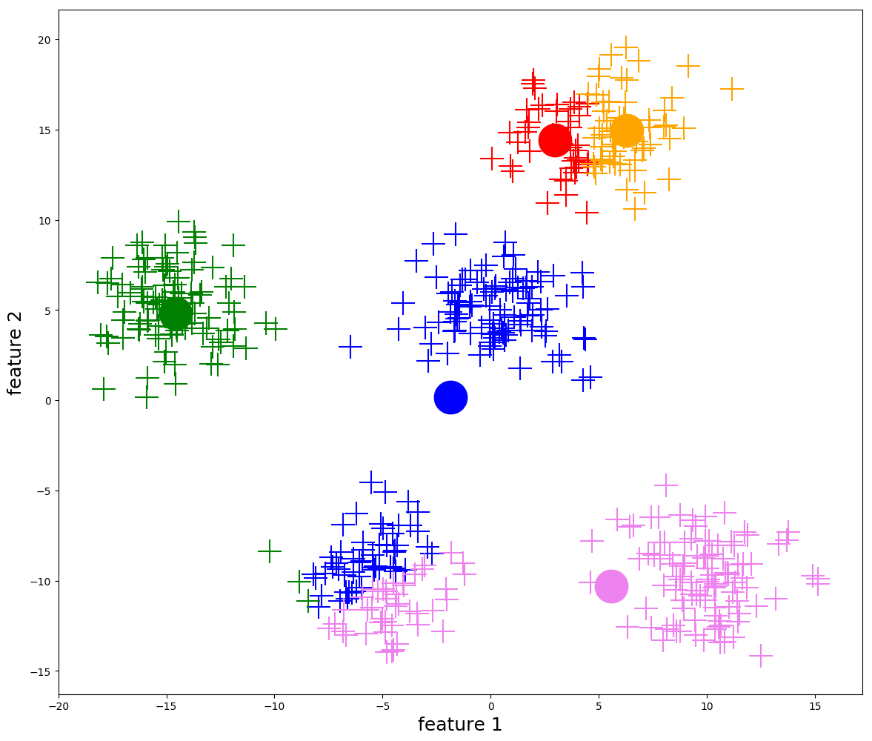
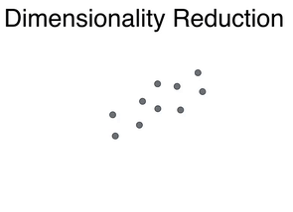
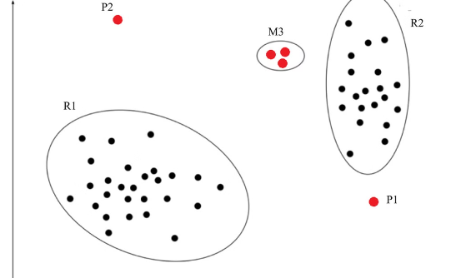
Applications of Unsupervised Learning
Clustering
Dimensionality Reduction
Anomaly Detection
Grouping similar objects (customer segmentation).
Removing unnecessary data while retaining key features.
Identifying unusual behavior (fraud detection).

Slide 11
Common Unsupervised Learning Algorithms
1
k-Means Clustering
2
DBSCAN
3
Hierarchical Clustering
Partitions data into k clusters by minimizing distances between points and cluster centers.
Groups points based on density, identifying clusters of arbitrary shapes and detecting outliers.
Creates a tree of clusters by progressively merging or splitting groups of data points.
4
Principal Component Analysis (PCA)
5
One-Class SVM
Reduces dimensionality by transforming data to a new coordinate system of uncorrelated variables.
Identifies anomalies by learning a boundary that encompasses normal data points.

Slide 12
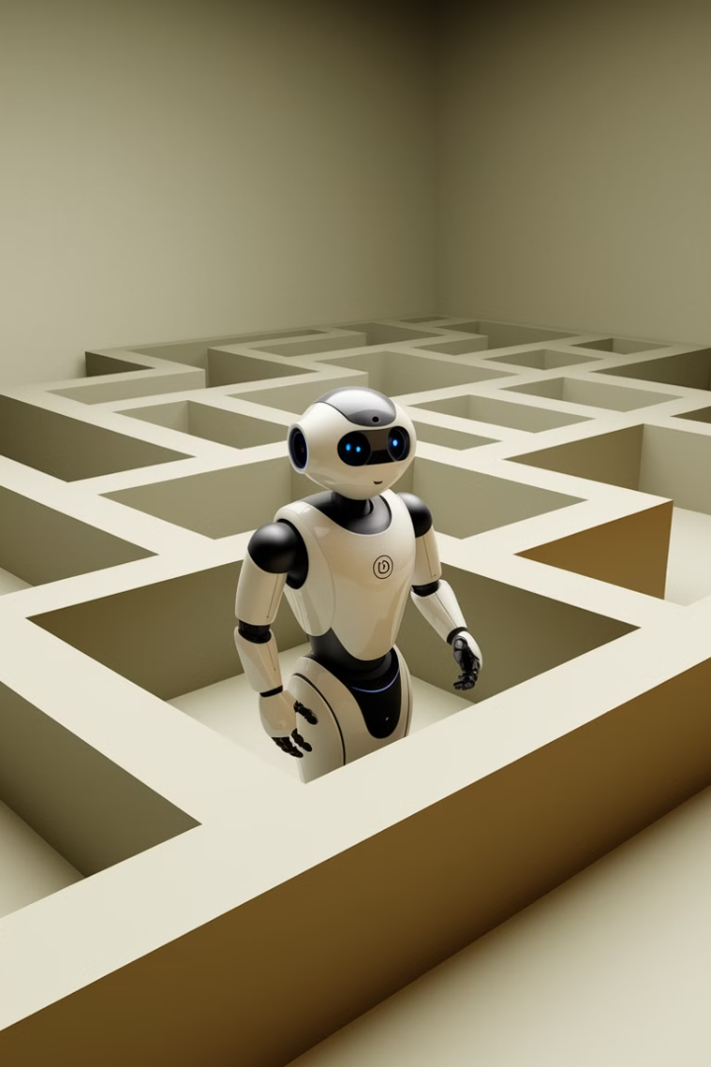

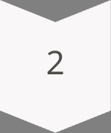
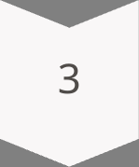
Reinforcement Learning
The model (agent) interacts with an environment.
Receives feedback (rewards or penalties) based on its actions.
The goal is to maximize cumulative rewards.

Slide 13
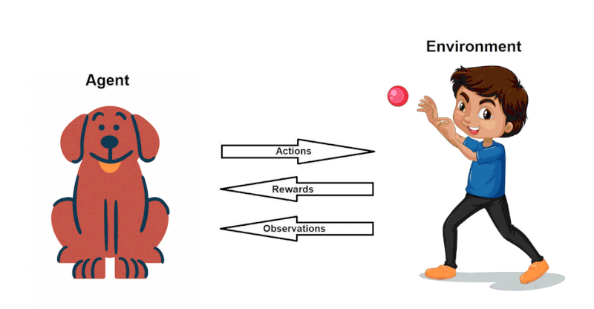
Example of Reinforcement Learning
The Learning Process
Agent (Dog): Learns by interacting with the environment.
Environment (Boy): Provides feedback to the agent.

Slide 14
Reinforcement Mechanism
The reinforcement learning process works through a continuous cycle of interaction:
1
Actions
2
Observations
3
Rewards
The agent (dog) performs actions (e.g., jumping, catching the ball)
The agent perceives the environment (ball being thrown)
The agent receives feedback (praise, treats for catching) or no reward for incorrect actions
Learning Goal: The agent improves decision-making by maximizing rewards over time.

Slide 15
Common Reinforcement Learning Algorithms
1
Q-Learning
2
SARSA
Value-based algorithm that learns optimal action-value function without requiring a model of the environment
On-policy learning algorithm that considers the current policy's action when updating Q-values
3
Deep Q-Networks
4
Policy Gradient Methods
Combines Q-learning with deep neural networks to handle high-dimensional state spaces
Directly optimize policy by following the gradient of expected rewards
5
Actor-Critic Methods
6
Markov Decision Process
Hybrid approach using two networks: one for policy selection (actor) and one for value estimation (critic)
Mathematical framework for modeling decision-making in situations where outcomes are partly random and partly under control

Slide 16
Machine Learning Workflow
1. Data Collection
2. Data Preprocessing
3. Model Selection
Gather relevant data.
Clean and format data.
Choose the best ML algorithm.
4. Training the Model
5. Evaluation
6. Deployment
Teach the model using data.
Assess model performance.
Integrate into an application.

Slide 17
Data Preprocessing Steps
1
Removing missing values
2
Scaling different attributes
3
Converting categorical data into numerical form

Slide 18
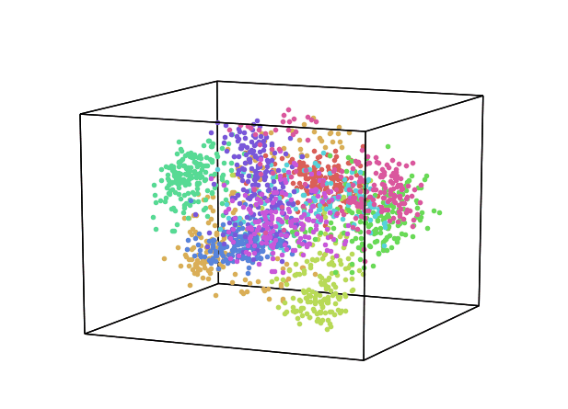
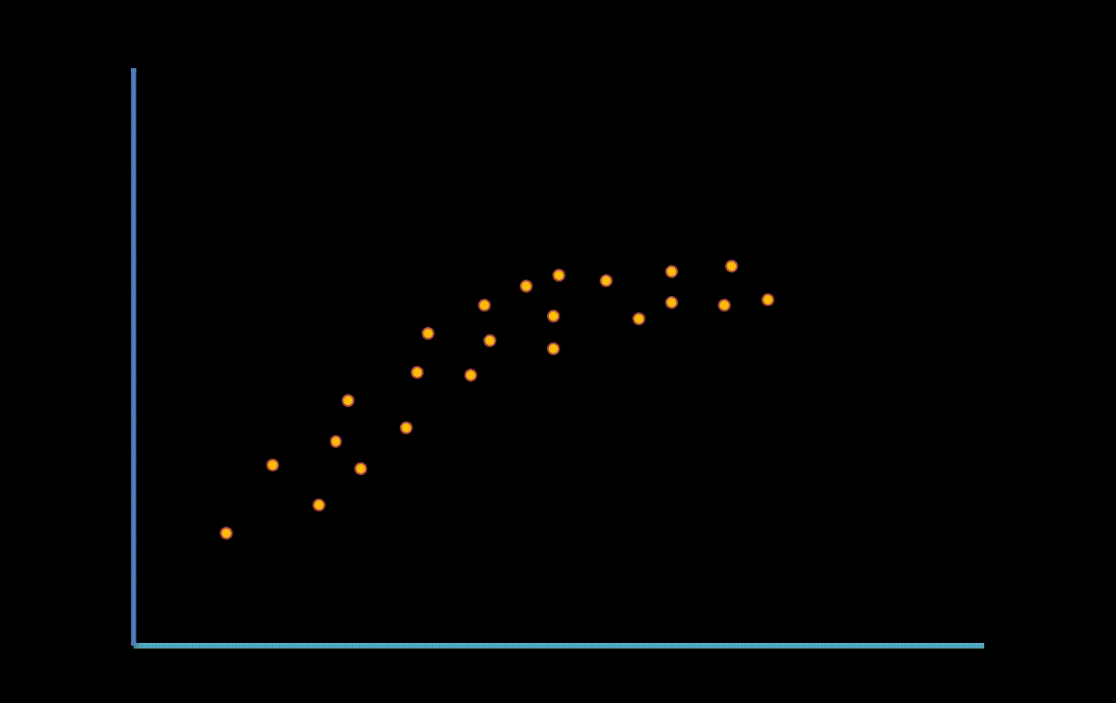
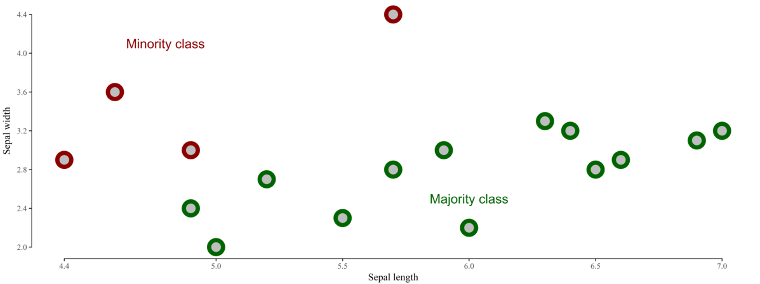
Challenges in Machine Learning
Data Imbalance
Feature Selection
Overfitting
Some classes have much more data than others.
Identifying relevant features and removing redundant ones.
Model works well on training data but poorly on new data.

Slide 19
Recap of Key Topics
Learning Type
Data Type
Key Characteristic
Supervised Learning
Labeled data
Uses labeled data
Unsupervised Learning
Unlabeled data
Uses unlabeled data to identify patterns
Reinforcement Learning
Feedback data
Optimizes rewards through interaction

Slide 20
Next Session Preview
1
In the next lecture, we will continue our exploration of machine learning.
2
Wishing all of you success in your learning journey!
3
Closing Statement
May you excel and transform your lives through this course!

