Slide 1

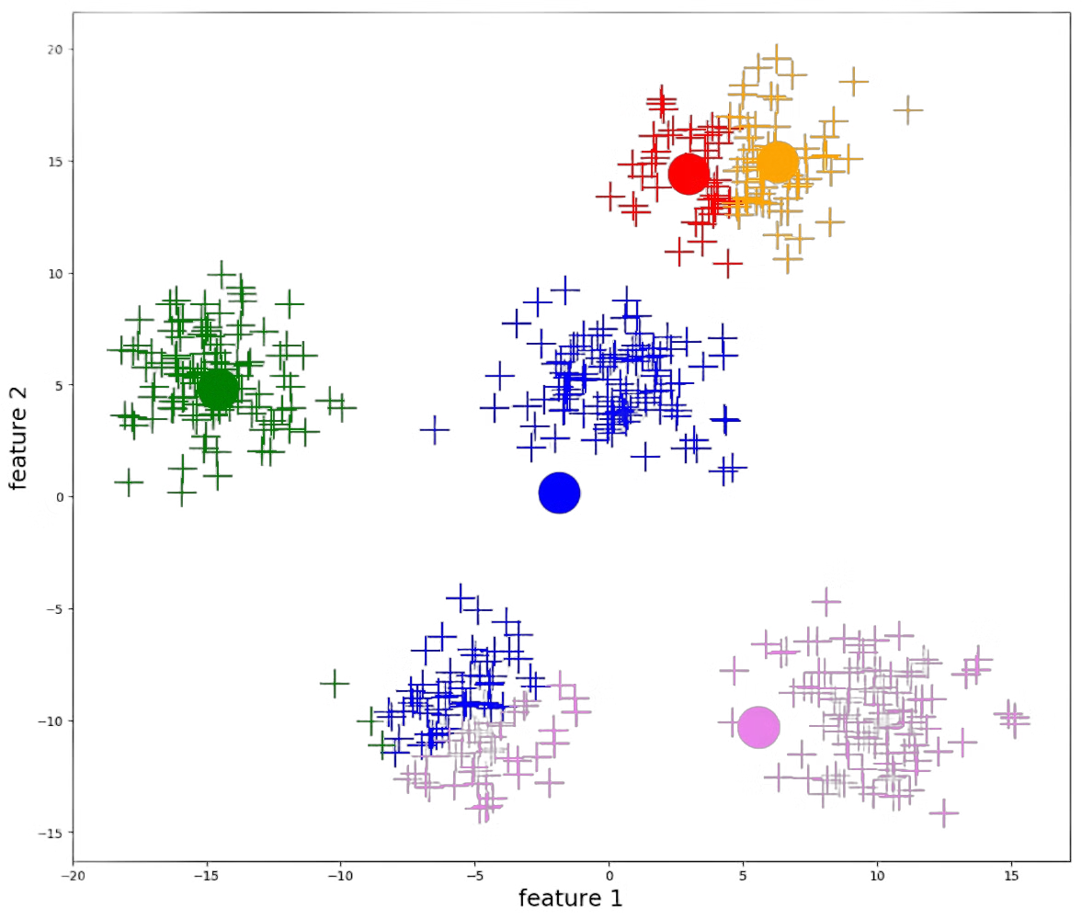

Machine Learning
Lecture 13: K-Means Clustering
Instructor: Dr. Shazia Saqib

Slide 2

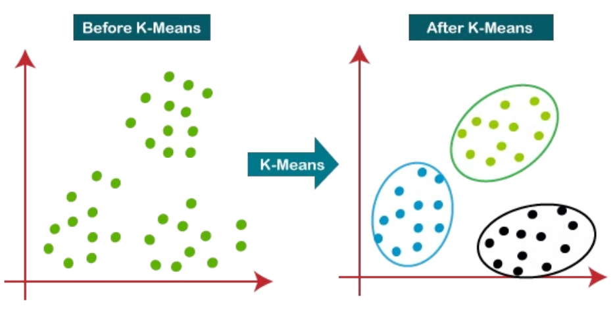
K-means Clustering
Unsupervised Algorithm
Data Grouping
Practical Applications
K-Means Clustering is an unsupervised machine learning algorithm that operates without labeled data.
It automatically groups the unlabeled dataset into different clusters based on similarity.
This technique is widely used for customer segmentation, image compression, and anomaly detection.

Slide 3
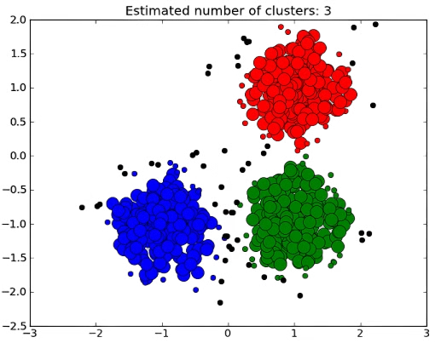
What is Clustering?
Grouping Objects
The task of grouping data points based on their similarity with each other is called Clustering or Cluster Analysis. This method is defined under the branch of Unsupervised Learning, which aims at gaining insights from unlabelled data points, that is, unlike supervised learning we don’t have a target variable.

Slide 4
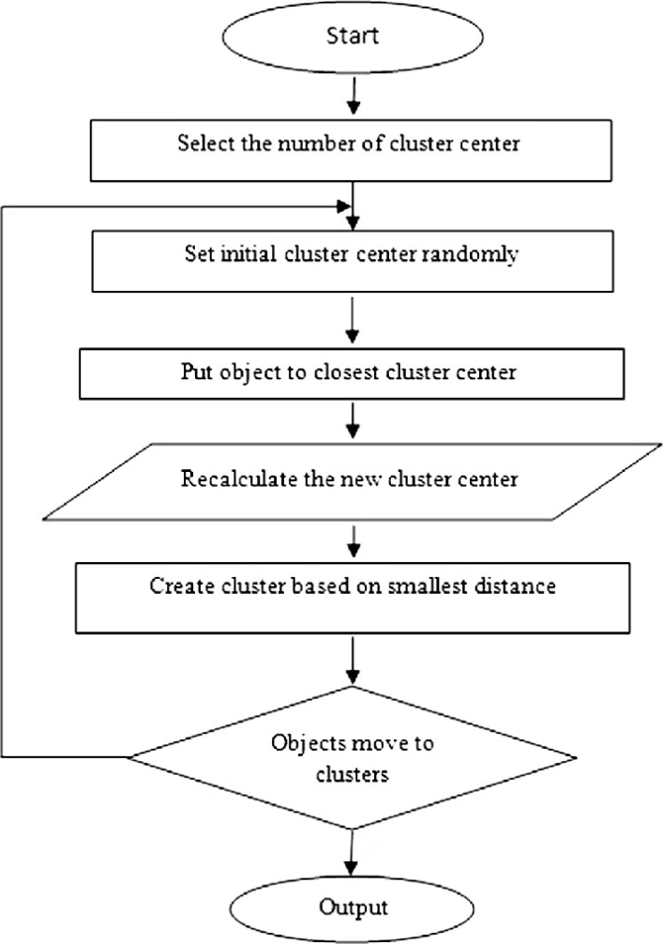
How k-means clustering works?
Initialize: Select ‘k’ initial cluster centers (centroids).
Assign: Assign each item to the nearest centroid based on Euclidean distance.
Update: Recalculate centroids by averaging the points in each cluster.
Repeat: Reassign and update until convergence (centroids stabilize).

Slide 5
Distance Metrics in K-Means
1
2
3
4
Euclidean Distance
Manhattan Distance
Cosine Similarity
Minkowski Distance
The most common metric, measuring straight-line distance between points in space
Measures angle between vectors, ideal for high-dimensional data
Sum of absolute differences between points, useful for grid-like structures
Generalization of Euclidean and Manhattan distances, offering flexible distance calculation

Slide 6
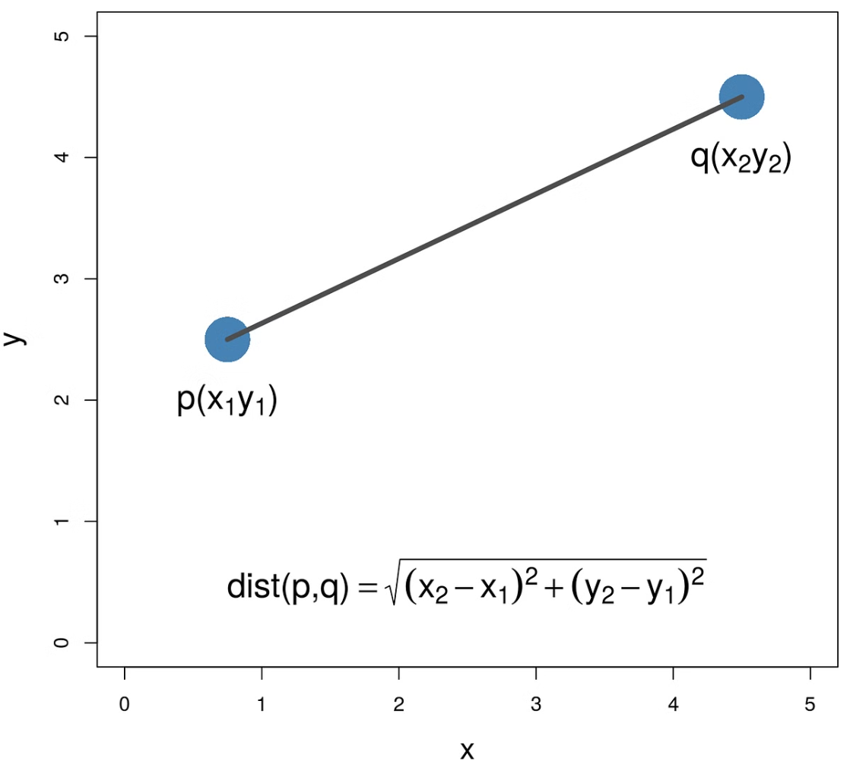
Euclidean Distance
The Euclidean distance is the most widely used distance measure in clustering. It calculates the straight-line distance between two points in n-dimensional space.
The formula for Euclidean distance between two points A(x₁, y₁) and B(x₂, y₂) is:
d(A,B) = √[(x₂ - x₁)² + (y₂ - y₁)²]
The Euclidean distance always measures the shortest possible path between two points, represented by a straight line.

Slide 7
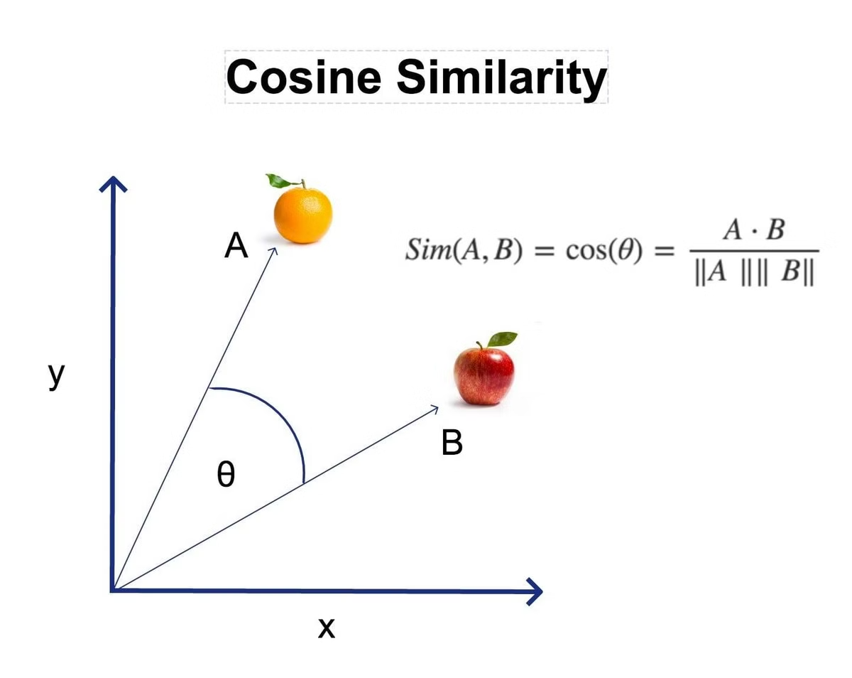
Cosine Similarity
Measures the cosine of the angle between two vectors, focusing on orientation rather than magnitude.
cos(θ) = (A·B)/(||A||·||B||)
Definition
Key Property
Calculates alignment between vectors by finding the cosine of their angle
Higher values (closer to 1) indicate greater similarity between vectors
Applications
Advantage
Ideal for text analysis, document comparison, and recommendation systems
Ignores magnitude differences, focusing on directional similarity

Slide 8
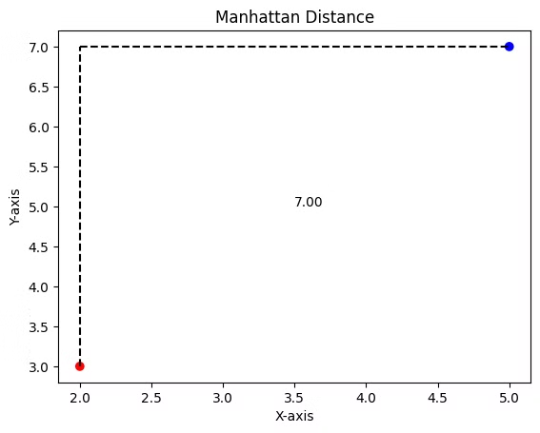

Manhattan Distance
Measures the total absolute differences between the Cartesian coordinates of two points.
Analogy: Like moving across a city grid, where only horizontal and vertical moves are allowed.
Formula: Sum of the absolute differences in each dimension:

Slide 9

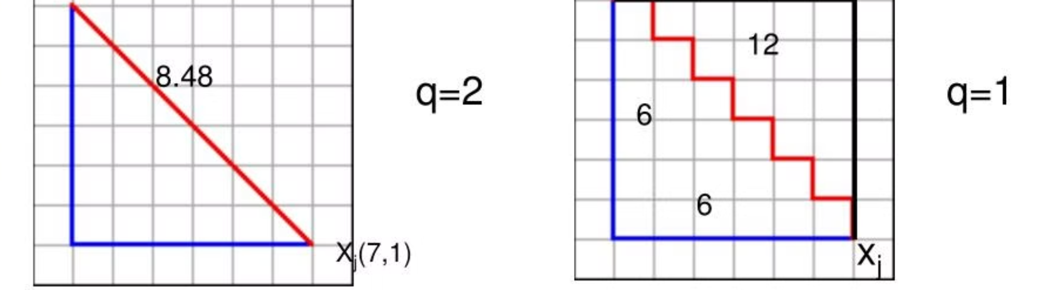
Minkowski Distance
A generalized form of both Euclidean and Manhattan distances, controlled by the parameter p.
Formula:
When q = 1: Equivalent to Manhattan distance.
When q = 2: Equivalent to Euclidean distance.
Allows flexibility in distance measurement based on the value of p.

Slide 10
Advantages of K-Means
Simplicity
Scalability
Interpretability
Straightforward implementation with minimal parameters and intuitive mathematical foundation, making it accessible even for beginners
Handles large datasets efficiently with linear time complexity, allowing for practical application to real-world big data problems
Produces clearly defined clusters with centroids that have direct physical meaning, enabling straightforward analysis and business insights

Slide 11






Use Cases of K-Means
Customer Segmentation
Image Compression
Document Clustering
Group customers by behavior and demographics for targeted marketing.
Reduce file sizes by clustering and replacing similar colors.
Organize text collections into thematic groups for easier analysis.
Anomaly Detection
Market Basket Analysis
Patient Grouping
Identify unusual data points for fraud detection and system monitoring.
Discover product associations to optimize store layouts and promotions.
Categorize patients with similar traits to improve personalized healthcare.

Slide 12
Choosing the Optimal Distance Metric for Clustering
1
Data Type
2
Scale Sensitivity
3
Interpretability
Consider binary, categorical, or numerical data types.
Address data scale issues through standardization.
Ensure results are meaningful and comprehensible.
4
Computational Efficiency
5
Outlier Handling
6
Clustering Algorithm
Choose metrics less affected by outliers if present.
Match metric to the specific clustering method.
Consider complexity, especially for large datasets.

Slide 13
Choosing the Right Distance Measure
1
Euclidean Distance
Best choice for continuous data with a Gaussian distribution where all dimensions carry equal importance
2
Cosine Similarity
Perfect for text data analysis or when the angle between vectors matters more than their magnitude
3
Manhattan Distance
Optimal for data with uniform distribution or when dimensions have different levels of importance
4
Minkowski Distance
Ideal when you need to generalize between Euclidean and Manhattan distances with flexible parameters

Slide 14
Visualizing the Clusters
2D/3D Scatter Plots
Libraries
Matplotlib or Seaborn for plotting
Plot data points in two or three dimensions, using different colors or markers to represent distinct clusters and their centroids.

Slide 15
Summary and Next Steps
Key Points
Further Exploration
K-Means clustering fundamentals and mathematical foundations
Advanced clustering algorithms such as DBSCAN, hierarchical clustering, and spectral clustering
Step-by-step implementation process from initialization to convergence
Optimizing K-Means through parameter tuning and initialization strategies
Cluster evaluation methods including silhouette score and inertia
Applying distance metrics to real-world datasets across various domains

