Slide 1


Machine Learning
Lecture 8: Logistic Regression
Instructor: Dr. Shazia Saqib

Slide 2

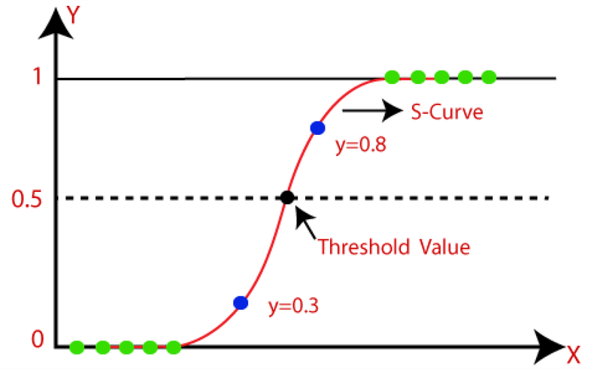
Logistic Regression
Logistic regression is a supervised machine learning algorithm used for classification tasks
where the goal is to predict the probability that an instance belongs to a given class or not.
Logistic regression is a statistical algorithm which analyze the relationship between two data factors. The article explores the fundamentals of logistic regression, it’s types and implementations.

Slide 3
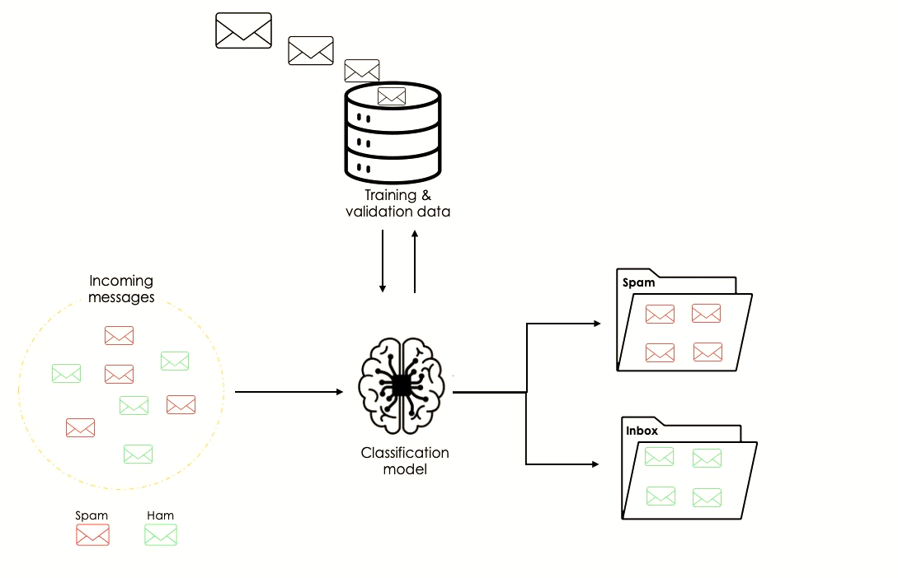
Binary Classification
Definition
Applications:
Medical diagnosis: Disease present (1) or absent (0)
Binary classification is a type of classification task where there are only two possible outcomes (e.g., Yes/No, 0/1, True/False).
0.5 threshold for pass/fail prediction
Example:
Predicting whether an email is spam (1) or not spam (0).
Identifying whether a student will pass (1) or fail (0) based on study hours.

Slide 4
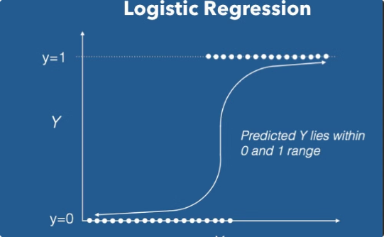
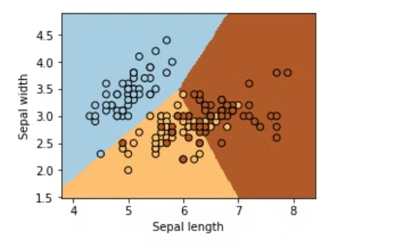
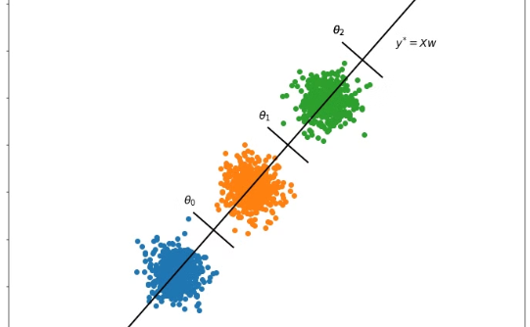
Types of Logistic Regression
1. Binomial Logistic Regression
2. Multinomial Logistic Regression
3. Ordinal Logistic Regression
Two possible outcomes (e.g., 0/1, Pass/Fail, True /False)
more than two possible outcomes (e.g., Classifying animals as cat, dog, or sheep)
more than two possible outcomes but with some degree (e.g., Rating as Low, Medium, or High)

Slide 5
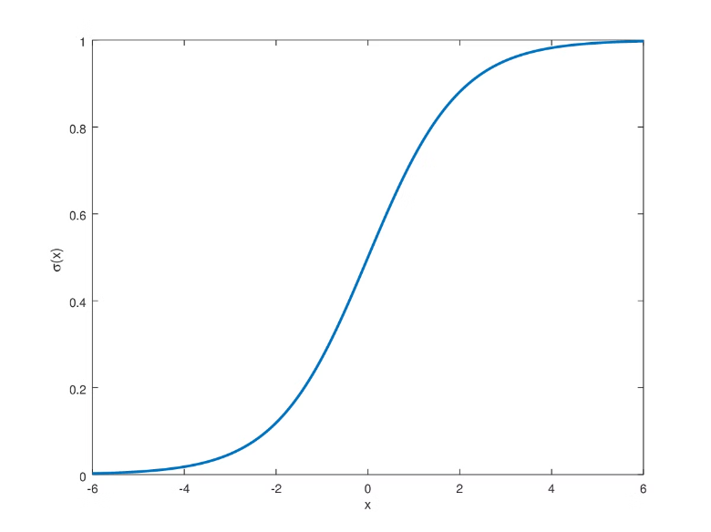
Sigmoid Function (Logistic Function)
The sigmoid function is a mathematical function used to map the predicted values to probabilities.
The S-form curve is called the Sigmoid function.
In logistic regression, we use the concept of the threshold value, which defines the probability of either 0 or 1. Such as values above the threshold value tends to 1, and a value below the threshold values tends to 0.
Purpose:
Converts linear regression outputs into probabilities.
Formula:
Graph of Sigmoid Function: An S-shaped curve representing how values get mapped between 0 and 1.
S(x) = 1/(1 + e^(-x))

Slide 6
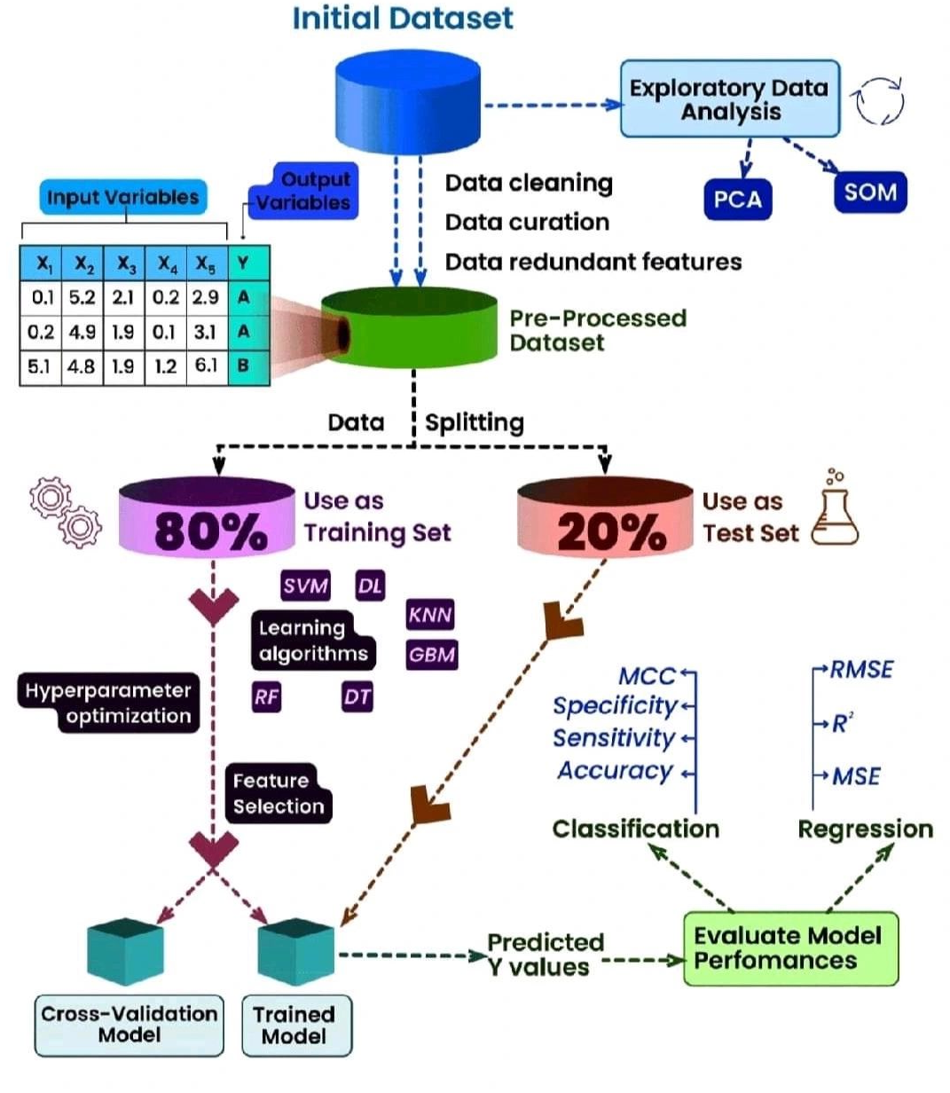
Building a Logistic Regression Model
Import Libraries (sklearn, pandas, numpy).
Load & Preprocess Data (handle missing values, encode categorical variables).
Split Data (train-test split).
Train Model (LogisticRegression() from sklearn).
Make Predictions (predict() on test data).
Evaluate Model (accuracy, precision, recall, F1-score).
Optimize & Deploy (tune hyperparameters, handle imbalances, save model).

Slide 7




Common Challenges
Imbalanced Datasets
Overfitting
Apply regularization.
Use resampling techniques.
Multicollinearity
Feature selection or PCA.

Slide 8
Logistic Regression: A Powerful Classification Algorithm
Feature | Linear Regression | Logistic Regression
Output | Continuous | Probability (0-1)
Function | Straight Line (y = wx + b) | S-shaped Sigmoid
Usage | Prediction (e.g., house prices) | Classification (e.g., spam detection)
Cost Function | Mean Squared Error | Log Loss(Binary Cross Entropy)

Slide 9
Visualizing Results: Health
True Positive (TP): Model correctly predicts a positive case. E.g., predicts "disease" and the patient actually has it
False Positive (FP): Model incorrectly predicts positive. E.g., predicts "disease" but the patient is healthy.
True Negative (TN): Model correctly predicts a negative case. E.g., predicts "no disease" and the patient is healthy.
False Negative (FN): Model misses a positive case. E.g., predicts "no disease" but the patient actually has it.

Slide 10
Visualizing Results: Bank Fraud
True Positive (TP): Model correctly flags a fraudulent transaction. E.g., predicts fraud and it really is fraud.
False Positive (FP): Model incorrectly flags a genuine transaction as fraud. E.g., predicts fraud but it’s a valid transaction.
True Negative (TN): Model correctly identifies a legitimate transaction. E.g., predicts no fraud and it’s truly not fraud.
False Negative (FN): Model fails to detect a fraud. E.g., predicts no fraud but it was actually fraudulent.

Slide 11
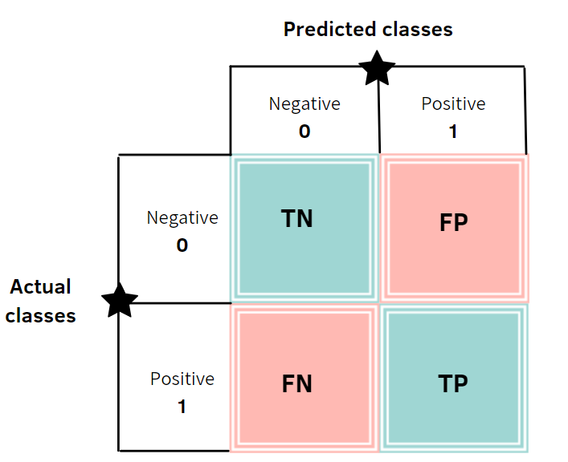
Visualizing Results
Confusion Matrix
Helps evaluate model performance.
Shows actual vs. predicted classifications.
Used to compute metrics like accuracy, precision, recall, and F1-score.

Slide 12
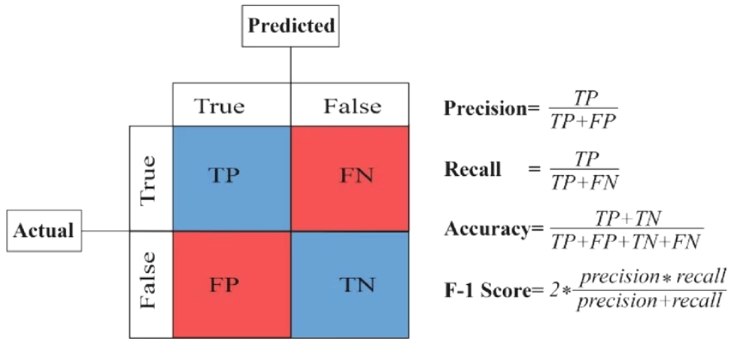
Model Evaluation
ROC-AUC
F1-Score
Precision & Recall
Accuracy
Evaluates model performance across different thresholds
Balances precision and recall
Precision: predicted positives that are correct; Recall: actual positives correctly predicted
Overall correctness of the model

Slide 13
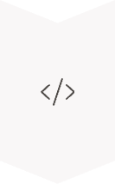



Implementing Logistic Regression
Train the Model
model = LogisticRegression()
model.fit(X_train, y_train)
Make Predictions
y_pred = model.predict(X_test)
Evaluate the Model
print(accuracy_score(y_test, y_pred))
print(classification_report(y_test, y_pred))
Optimize the Model
model = LogisticRegression(C=0.1)
Tune hyperparameters like regularization strength (C).

