Slide 1

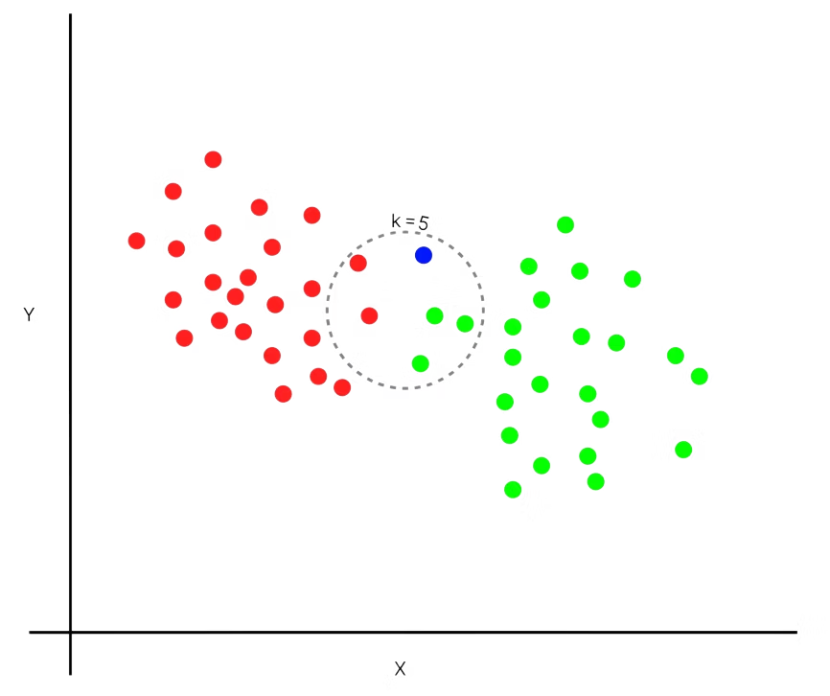

Machine Learning
Lecture 9: Introduction to k-Nearest Neighbors (k-NN)
Instructor: Dr. Shazia Saqib

Slide 2

Bias Variance Tradeoff
Bias
Variance
Bias is the difference between our actual and predicted values. When the Bias is high, assumptions the model can’t capture the important features of our data.
This instance, where the model cannot find patterns in our training set and hence fails for both seen and unseen data, is called Underfitting.
Variance as the model’s sensitivity to fluctuations in the data. Our model may learn from noise. This will cause our model to consider trivial features as important.
When variance is high our model will capture all the features of the data given to it, including the noise, will tune itself to the data, and predict it very well but when given new data, it cannot predict on it as it is too specific to training data. This is called Overfitting.
An optimized model will be sensitive to the patterns in our data, but at the same time will be able to generalize to new data. In this, both the bias and variance should be low so as to prevent overfitting and underfitting.

Slide 3
What is KNN?
Simple supervised machine learning algorithm
Works for both classification and regression problems
Instance-based learning (no explicit training phase)
Makes predictions based on similarity to known data points

Slide 4
Basic KNN Workflow (Step 1)
1
Initialization
Given a new data point to classify
2
Existing Classes
Three existing classes shown (Class 1, Class 2, Class 3)

Slide 5
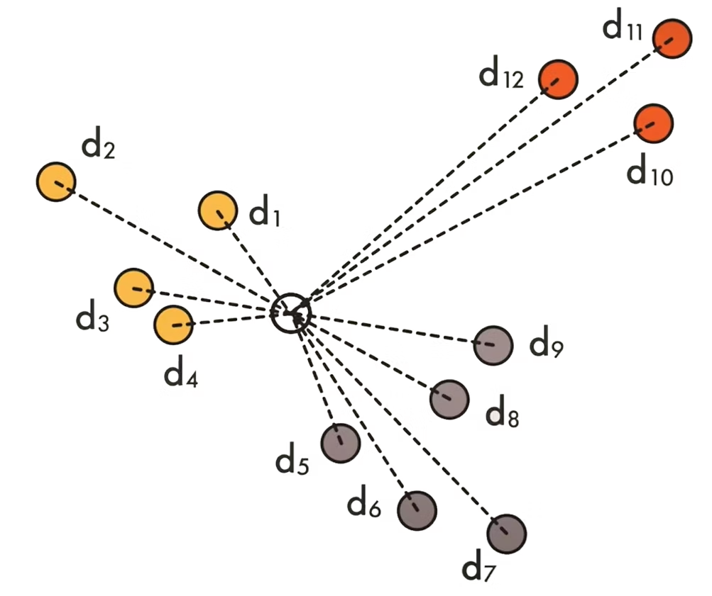
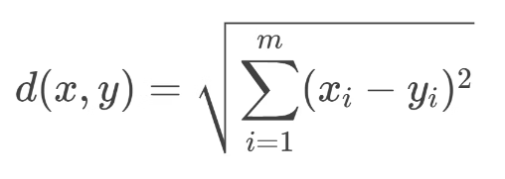
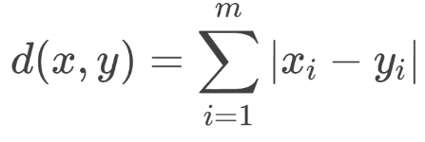
Distance Calculation (Step 2)
Key Step: Measure Distance to All Points
Two common distance metrics:
Euclidean Distance
(Straight-line distance between points)
Manhattan Distance
(Sum of absolute differences)

Slide 6
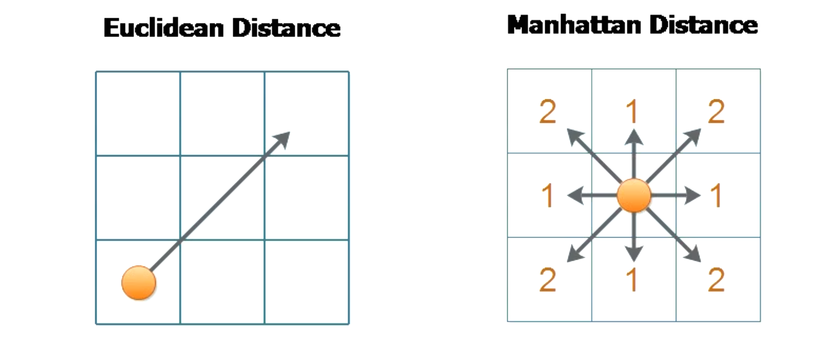
Euclidean Vs Manhattan Distance Visual Representation

Slide 7
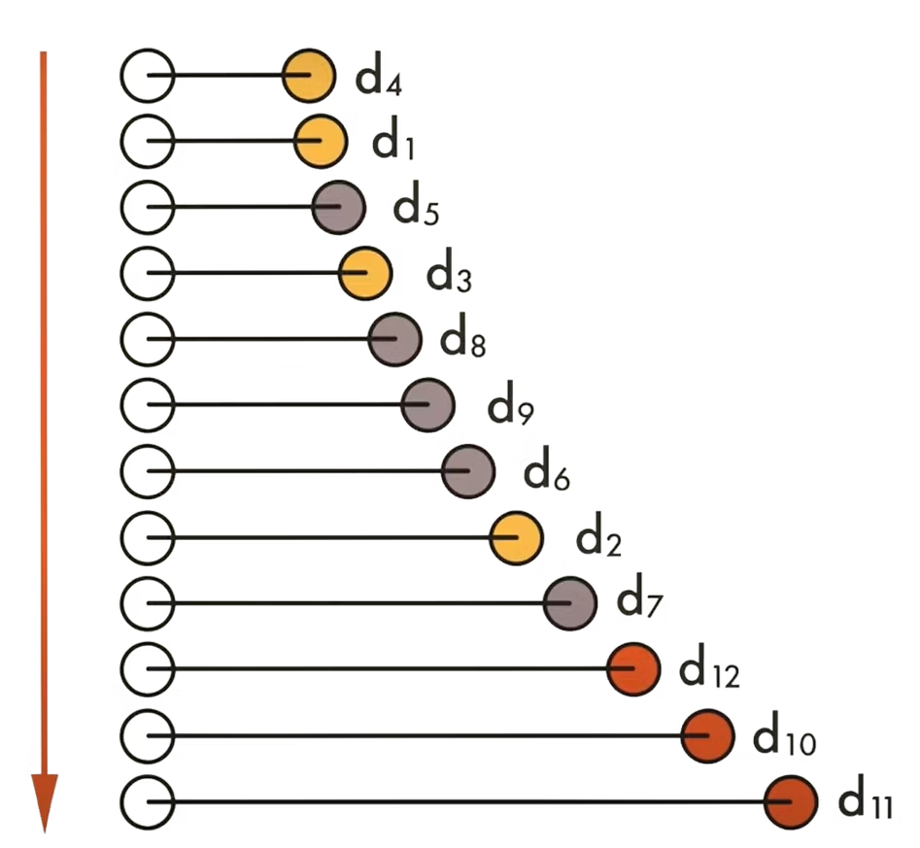



Sorting Neighbors (Step 3)
Sort All Points by Distance
Create ordered list from nearest to farthest
Example distances
d4, d1, d5, d3, d8, etc.
Select top K neighbors
From this sorted list

Slide 8
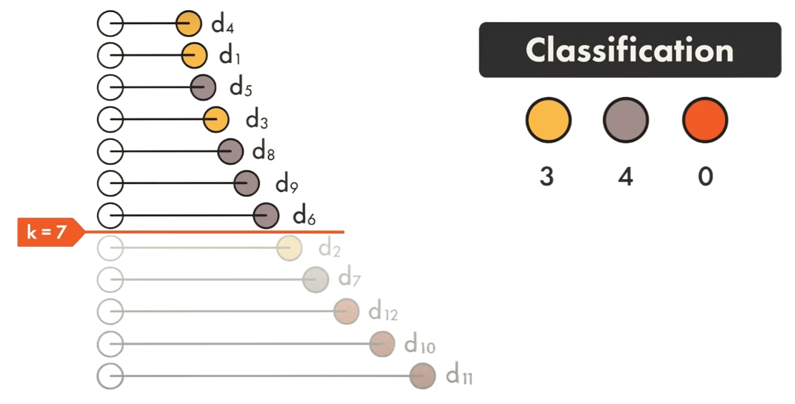
Classification with KNN
Majority Vote Among Neighbors
Assign the most frequent class
Example
For k=7: Count class labels of 7
nearest neighbors
e.g., 3 votes for Class A,
3 (Class 1) | 4 (Class 2) | 0 (Class 3)
→ Predicted: Class 2
4 for Class B and
0 for Class C

Slide 9
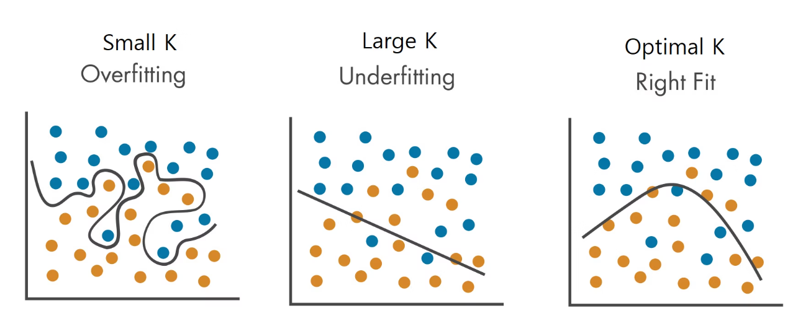
Choosing K Value
Critical Hyperparameter: K represents the number of nearest neighbors considered for prediction.
Small K (e.g., k=3)
Large K (e.g., k=15)
Best K balances bias-variance tradeoff
Low bias, high variance, Risk of Overfitting (noisy decision boundaries)
High bias, low variance, Risk of Underfitting (oversimplified model)
Find via cross-validation

Slide 10
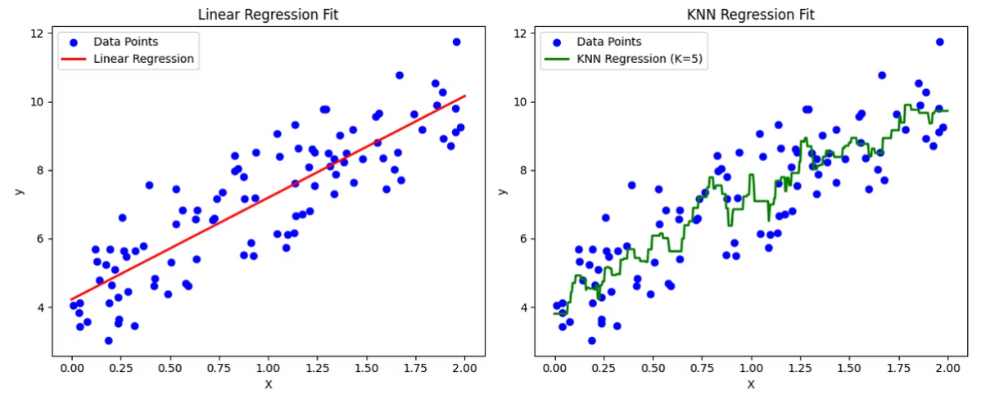
KNN for Regression
How KNN Helps in Regression
For regression problems, KNN works similarly but with a key difference:
Interpolation for Missing Values: Predicts continuous target values by learning from similar data points
Average of Neighbors' Values: Instead of voting, calculate mean of target values
Local Approximation: Captures complex patterns by focusing on nearby points rather than global trends
Formula: y = (y4 + y1 + y5 + y3 + y8) / k
Same Process: Uses same distance/sorting steps as classification

Slide 11
Advantages of k-NN
Simple
Multi-class
Non-parametric
Intuitive algorithm with straightforward implementation and minimal training requirements
Naturally handles multiple classes without modification and maintains effectiveness regardless of class count
Makes no assumptions about underlying data distribution, allowing flexibility with complex datasets

Slide 12



Limitations of k-NN
Computationally expensive
Requires calculating distances between the query instance and all training examples, making it prohibitively slow for large datasets with many samples or features.
Sensitive to irrelevant features
Does not distinguish between important and unimportant attributes, so irrelevant features can disproportionately influence distance calculations and reduce classification accuracy.
Memory-intensive
Needs to store the entire training dataset in memory during prediction, creating significant storage requirements for large datasets and limiting deployment on memory-constrained systems.

Slide 13
Code Implementation
Using scikit-learn
Key steps:
Load data
from sklearn import neighbors, datasets
# Load iris dataset (first two features only)
iris = datasets.load_iris()
X = iris.data[:, :2]
y = iris.target
# Create KNN classifier (k=15)
clf = neighbors.KNeighborsClassifier(n_neighbors=15)
clf.fit(X, y)
Initialize model with chosen K
Fit to training data

Slide 14





Summary & Key Points
Simple but powerful algorithm
No training phase
Distance metric choice affects results
Stores all training data
For classification/regression
Euclidean common
K value controls bias-variance tradeoff
Computationally expensive
Feature scaling important
For large datasets
Distance-based

