Slide 1



Machine Learning
Lecture 04: Data Preprocessing
Instructor: Dr. Shazia Saqib

Slide 2





Introduction to Data Preprocessing
Essential for Model Performance
Compatible Format
Preprocessing steps ensure that data is in a compatible format for machine learning models.
Data preprocessing is essential for improving model performance.
Data Handling
Improved Results
Helps in handling missing values, normalization, and scaling.
Accurate preprocessing increases the accuracy and interpretability of results.
Key Steps
We will cover key preprocessing steps like data splitting, cleaning, and handling missing values.

Slide 3

Data Preprocessing in Machine Learning

Slide 4
Why Do We Need Data Preprocessing?
Improved Performance
Reduced Complexity
Algorithm Compatibility
Data preprocessing improves the performance of machine learning models.
Reduces the complexity of relationships in data.
Makes data compatible for use in machine learning algorithms.
Format Suitability
Critical for Success
Ensures that data is in a format suitable for model interpretation.
Without proper preprocessing, models will fail to perform well.

Slide 5
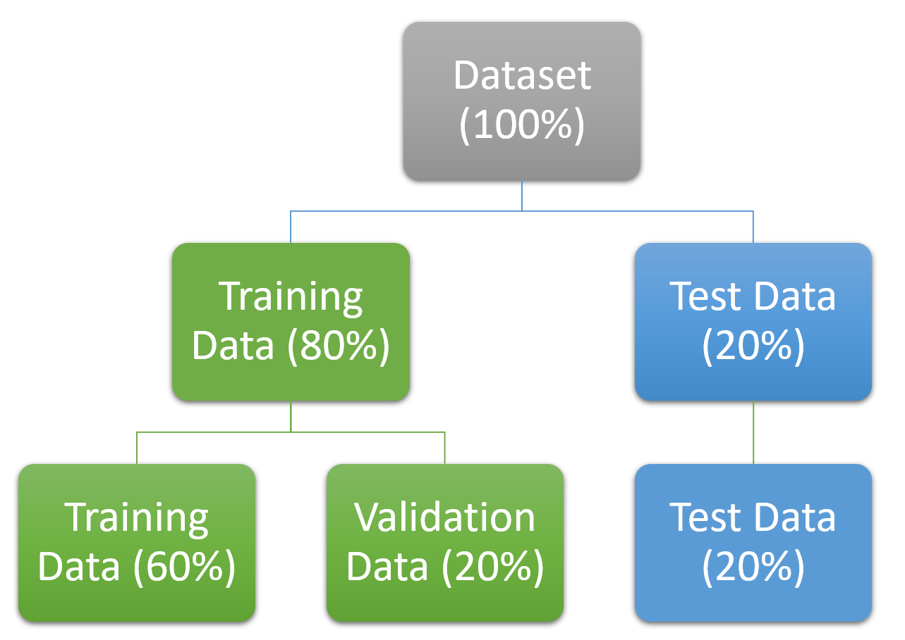



Data Splitting
Training Data
Testing Data
Used to train the model
Used to evaluate model performance
Validation Data
Used to check for model overfitting and ensure accuracy (if applicable)
Common ratios: 70-30, 80-20, 75-25, 85-15, or 90-10.

Slide 6
Purpose of Training and Testing Data
Training Data
Testing Data
Used for model learning
Used to check the model's learning
Should be accurate to ensure good learning
If the testing results are incorrect, it means the model has not learned well
The model "learns" from this data

Slide 7
Data Splitting with Validation
1
Initial Split
2
Model Training
3
Performance Testing
4
Fine-Tuning
Splitting data into three parts: training, testing, and validation
The model is first trained on the training data
The performance is tested using testing data
Validation helps fine-tune the model to prevent overfitting
Validation data helps in evaluating model performance.

Slide 8
Splitting Data Using Code
from sklearn.model_selection import train_test_split # For an 80-20 split X_train, X_test, y_train, y_test = train_test_split(X, y, test_size=0.2)
1
Command for Splitting
2
Ratio Specification
3
Example Usage
The command used for data splitting: train_test_split
You can specify the ratio of training to testing data
Example: train_test_split(X, y, test_size=0.2) for an 80-20 split
4
Ease of Use
5
Practical Application
This command allows for easy and accurate data splitting
In practice, you will often use this command for model evaluation

Slide 9





Target Variable in Supervised Learning
Prediction Goal
Example
In supervised learning, the target variable is the output you are predicting
Example: Predicting whether a patient is a cancer patient or not
Representation
Inputs
The target variable is represented by y
Inputs are represented by X
Importance
Knowing the target variable is crucial for classification and prediction tasks

Slide 10





Independent Variables and Labels
Independent Variables (X)
Labels
Labeled Data
Labels refer to the known outputs that correspond to the inputs
In labeled data, we know the expected output for a given input
Independent variables are the input features, represented by X
Mapping
Training Data
The model learns to map inputs (X) to outputs (y)
Training data contains labeled data for model learning

Slide 11
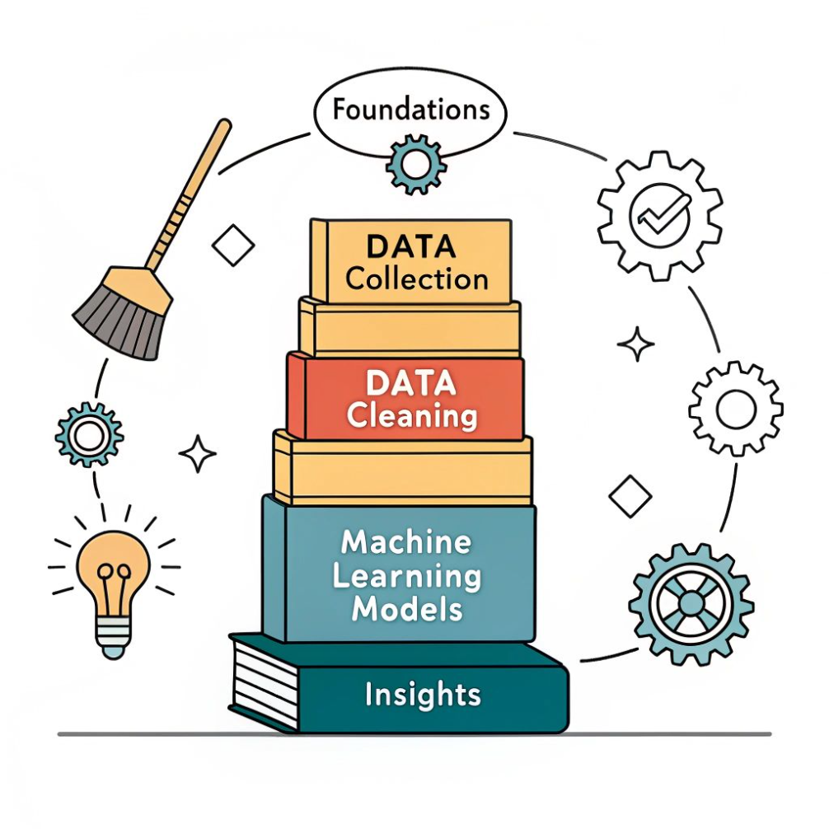





Data Cleaning
Accurate Data
Removing Issues
Ensures that data is accurate and free from errors
Data cleaning removes duplicate rows, inconsistencies, and illogical values
Standardizing
Correction
Example: Standardizing the format of qualifications (e.g., "PhD")
Data cleaning may involve removing or correcting incorrect data
Critical Step
It's a critical step in preparing data for machine learning models

Slide 12
Handling Missing Values
Missing values are common in datasets. Missing data could be names, cities, or numeric values like salaries. Proper handling ensures better model performance.
Issue
Solution
Example
Missing text data
Assign default values
"Unknown" for missing city
Missing numeric data
Assign most frequent value (mode)
Most common salary in dataset
Missing numeric data
Assign mean/median
Average age for missing age values
Excessive missing values
Remove rows
Delete records with too many missing fields

Slide 13
Normalization and Scaling
Normalization
Scaling
Normalization: Rescales data to a specific range (e.g., 0 to 1).
Scaling: Adjusts data to have a similar scale, preventing features with larger ranges from dominating.
For example, distances in kilometers and meters can be normalized to a common range. Normalization and scaling improve the model's ability to learn from data. These techniques are especially important for distance-based models like KNN.

Slide 14
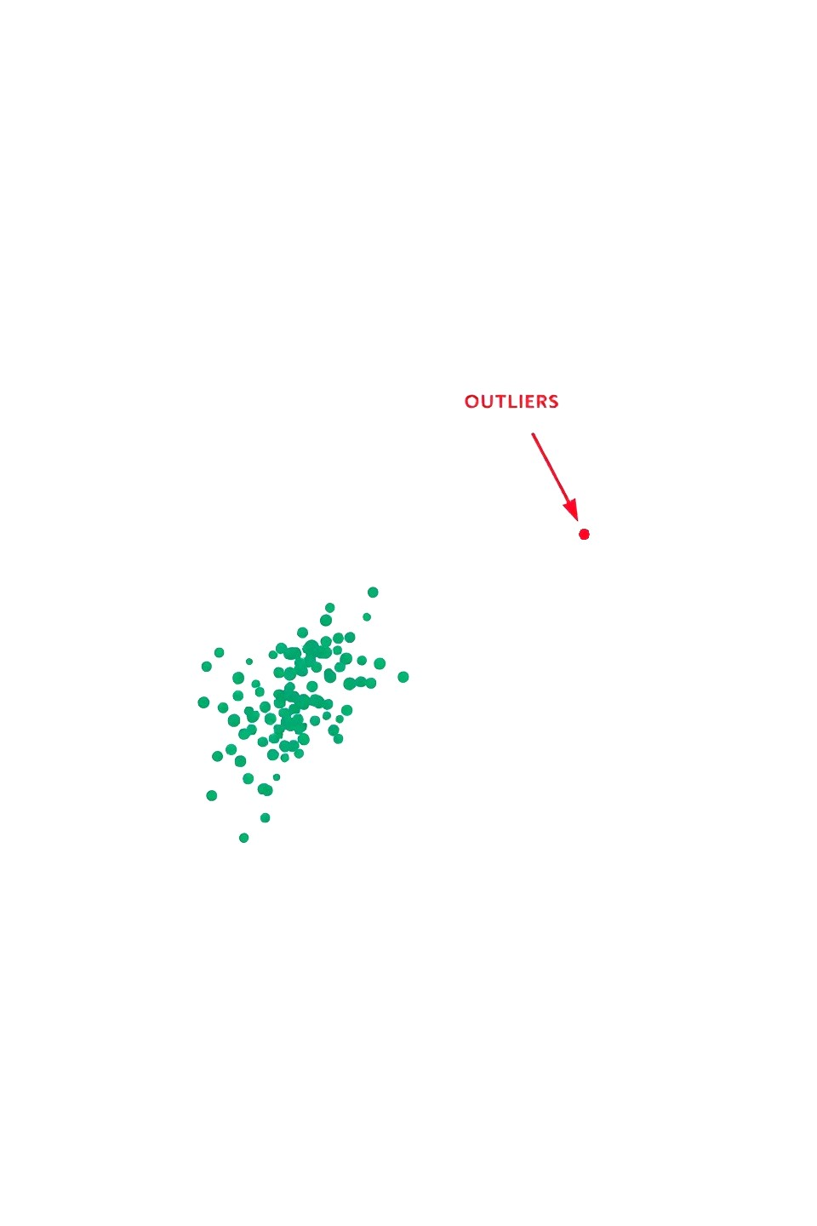
Handling Outliers
Identifying Outliers
Methods to Handle Outliers
Outliers are values that are significantly different from the rest of the data.
Removing extreme outliers
Capping outliers to a reasonable range
Outliers can distort model training and prediction accuracy.
Transforming data to reduce the impact of outliers
Proper handling of outliers is essential for accurate modeling.

Slide 15
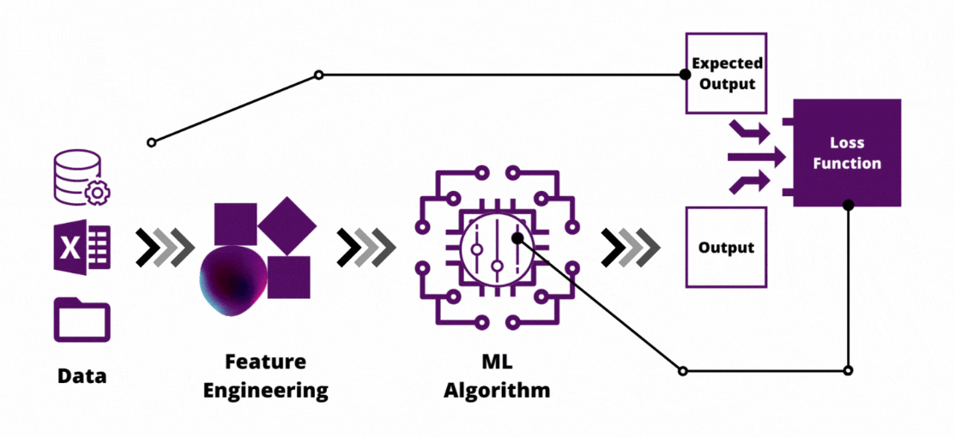
Feature Engineering
1
Transformation
2
Combination
3
Enhancement
Feature engineering is the process of transforming raw data into meaningful features
This process includes grouping, combining, or transforming features
Feature engineering can help enhance model performance by providing better input data
4
Example
5
Ongoing Process
Example: Combining multiple features like age and experience into a single "experience level" feature
It is an ongoing process to refine and improve the input data

Slide 16
Label Encoding
Label Encoding: Assigns a unique number to each category.
Example: Assigning "red" as 0, "blue" as 1, and "green" as 2.
0
1
2
Red
Blue
Green
Assigned numerical value
Assigned numerical value
Assigned numerical value
Used when categories have no meaningful order.
Label encoding is useful for models that require numerical input.
However, it may not be suitable for ordered categories (ordinal data).

Slide 17
One-Hot Encoding
One-Hot Encoding: Converts categorical variables into binary columns.
Example: For three cities (Lahore, Karachi, Islamabad), three columns are created:
Lahore: [1, 0, 0]
Karachi: [0, 1, 0]
Islamabad: [0, 0, 1]
City
Lahore
Karachi
Islamabad
Lahore
1
0
0
Karachi
0
1
0
Islamabad
0
0
1
One-hot encoding is useful for models that can handle categorical data.
It avoids the ordinal relationship issue in label encoding.

Slide 18
Ordinal Encoding
Ordinal Encoding: Assigns numerical values to ordered categories.
Example: Low = 0, Medium = 1, High = 2.
High = 2
Medium = 1
Low = 0
Highest level in the order
Middle level in the order
Lowest level in the order
It is used when categories have a meaningful order.
Ordinal encoding preserves the order of the categories.
This method is suitable for categorical data with inherent ranking.

Slide 19
Summary of Encoding Techniques
1
Label Encoding
2
One-Hot Encoding
3
Ordinal Encoding
Assigns numbers to categories without any order
Creates binary columns for each category
Assigns numbers to ordered categories
Each encoding technique serves different purposes depending on data and model requirements. Choosing the right encoding method is critical for accurate model training.

Slide 20
Key Concepts Recap
Data Splitting
Data Cleaning
Normalization and Scaling
Dividing data into training, testing, and validation sets
Removing duplicates, handling missing values, and correcting inconsistencies
Adjusting data for consistent ranges and scales
Feature Engineering
Encoding
Transforming raw data into meaningful features for better model performance
Converting categorical data into numerical formats for model use

Slide 21



Conclusion and Next Steps
Understanding and applying preprocessing techniques is essential for effective machine learning.
Study Thoroughly
Study these concepts thoroughly, as they form the foundation of working with machine learning models.
Practice Techniques
Practice data cleaning, encoding, and splitting using sample datasets.
Next Class
In the next class, we will implement these concepts practically using Python.
Looking forward to our next session!
May Allah grant you success in your learning journey.

