Slide 1



Python Programming
Lecture 22: FastAPI Complex endpoint

Slide 2
FastAPI Complex Endpoints
Last Lecture
Today's Focus
Basics and "Hello World" app.
Building more complex endpoints.
Approach
Learning Goal
We'll combine previous concepts to enhance functionality.
Learn how to modify, validate, and handle inputs.

Slide 3
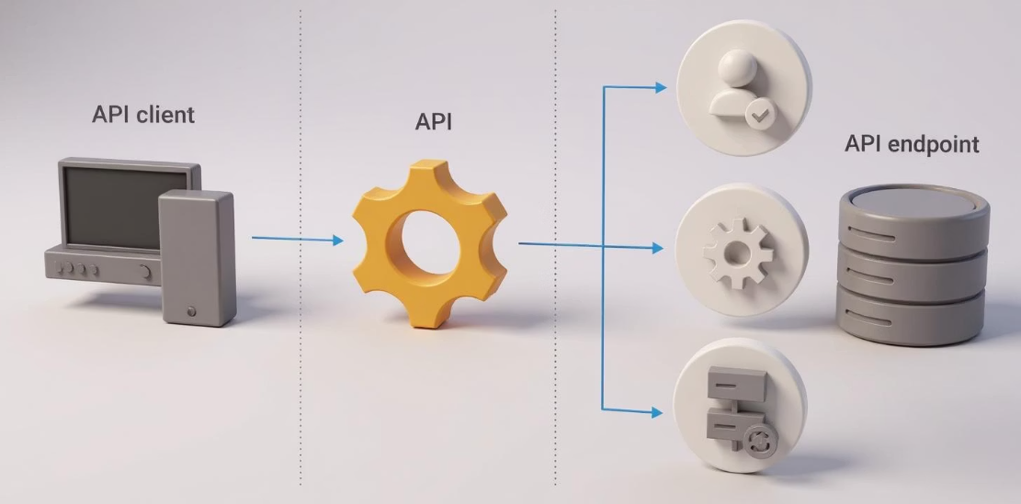
What Are We Building?
Complex POST Endpoint
Server Processing
Accept data from user input (POST request).
Send data to server, process it, and respond.
Input Validation
Validation Library
Handle input validation — avoid accepting wrong or malformed data.
Use validation library: Pydantic.

Slide 4
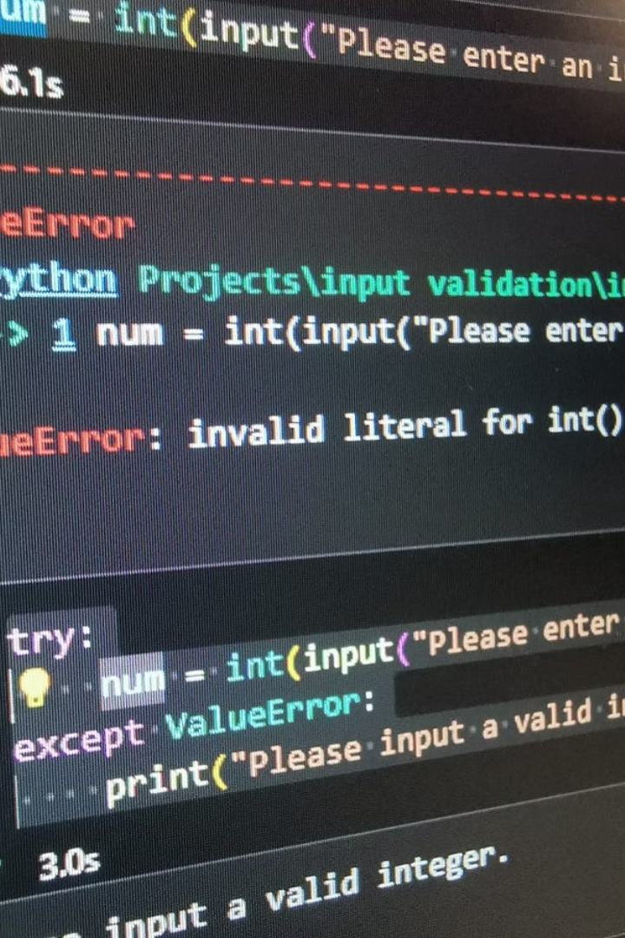
Why Input Validation?
The Problem
Earlier endpoints accepted any input, including invalid data.
We must ensure:
Input is of correct type (e.g., string, not digits).
Input meets format requirements.
Validation Purpose
Prevent errors.
Provide meaningful feedback to users.
Ensure API robustness.

Slide 5





Required & Optional Parameters
API Parameters as Orders
Parameters = inputs you provide to API.
Required Parameters
Required parameters must be given.
Optional Parameters
Optional parameters may be omitted.
Example
If you order food: you must specify dish name (required).
You may optionally specify spice level (optional).

Slide 6

HTTP Exceptions & Pydantic
Importing FastAPI Components
Pydantic for Validation
FastAPI class to create API instance.
Import BaseModel to define data models.
HTTPException to raise errors with status codes.
Use Optional for optional fields.

Slide 7



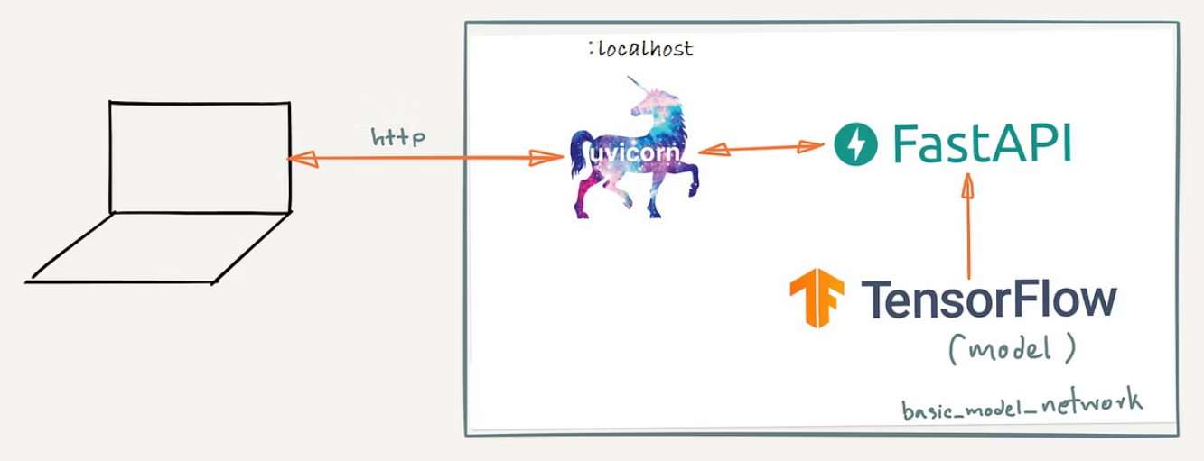
FastAPI & Uvicorn Setup
Standard Setup
Python Code
Server Configuration
Create FastAPI app instance with metadata:
app = FastAPI( title="Simple Text API", description="A simple API for text processing", version="1.0.0" )
Uvicorn to run the app.

Slide 8

Defining Pydantic Request Model
TextRequest Model
Class inherits from BaseModel.
Fields
text: string (required).
uppercase: boolean (optional, defaults to False).

Slide 9




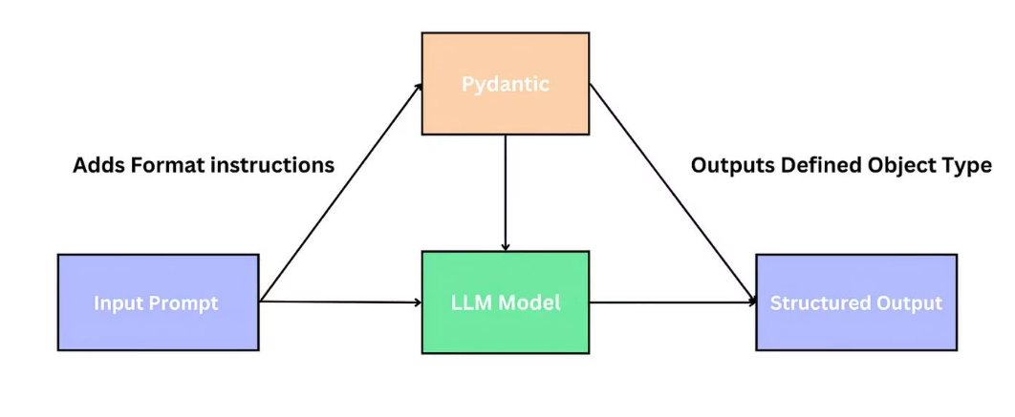
Defining Pydantic Response Model
TextResponse Model: Fields
Processed Text
processed_text: string.
Text Length
Purpose
text_length: integer.
Describes output structure after processing.

Slide 10
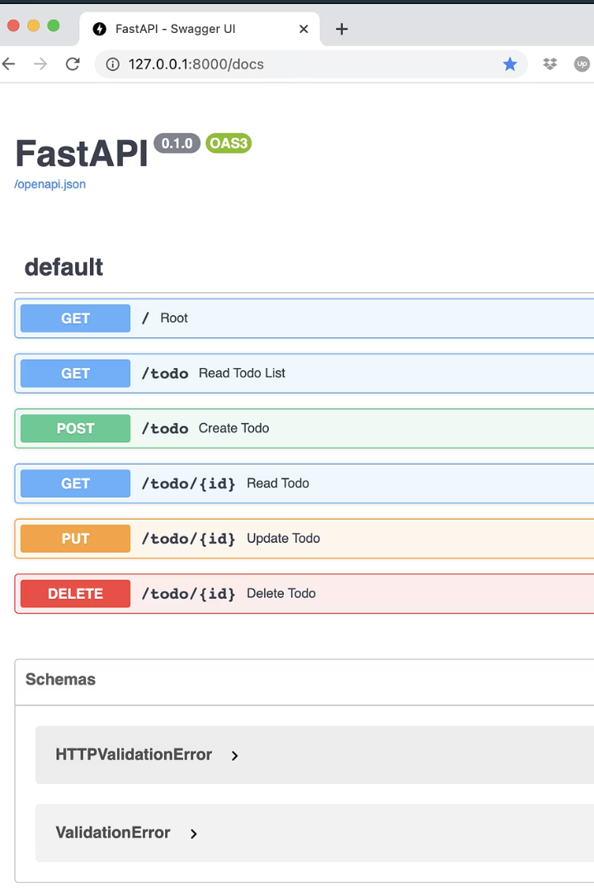
Root Endpoint
Basic Welcome Message
@app.get("/")
def read_root():
return {"message": "Welcome to our Text Processing API!"}
Purpose
Confirm API is running.
Accessible at /.

Slide 11



Creating POST Endpoint
Decorator & Function Signature
@app.post("/process-text/", response_model=TextResponse)
def process_text(request: TextRequest):
Endpoint Configuration
POST endpoint named process-text.
Validation
Validates input against TextRequest.
Response validated against TextResponse.

Slide 12
Handling Input in Endpoint
Accessing Request Data
Get text from request.text.
Get uppercase from request.uppercase.

Slide 13


Input Validation Logic
Check Empty Input
Error Response
if not text:
Return HTTP 400 error if text is empty.
raise HTTPException(status_code=400, detail="Text cannot be empty")

Slide 14
Processing Text
Conditional Uppercase Conversion
If uppercase is True, convert text to uppercase.
Else, keep original text.

Slide 15


Preparing Response
Create Response Object
Response Content
response = TextResponse(
Return processed text and its length.
processed_text=processed_text,
text_length=len(processed_text)
)
return response

Slide 16
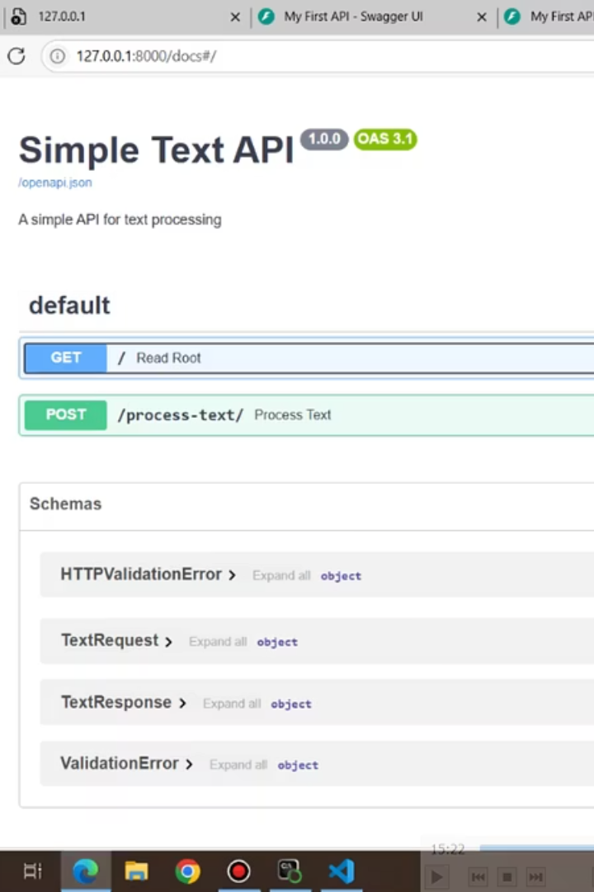
Testing the API - Using Docs
Interactive Documentation
Using Try it out
Enter sample text.
Access Swagger UI: http://localhost:8000/docs
Toggle uppercase option.
Submit POST request.
Response Viewing
See formatted response with text and length.

Slide 17
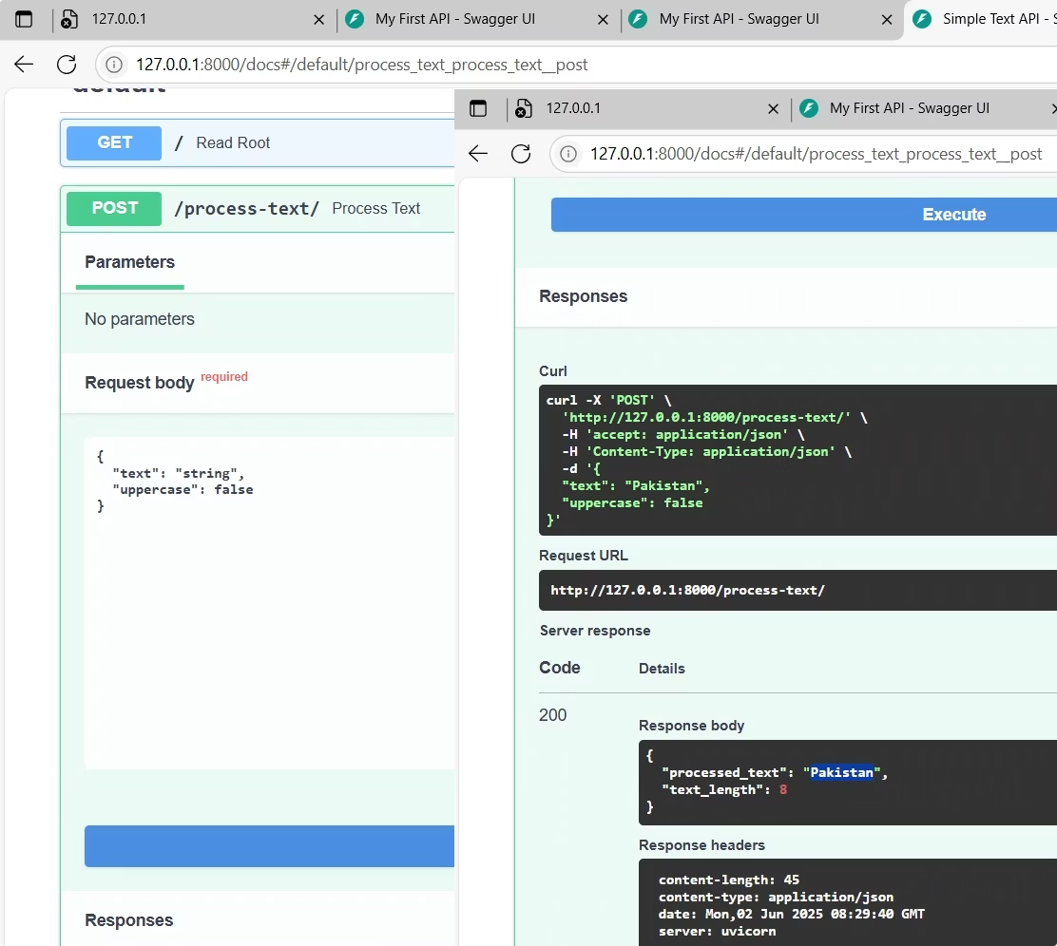


Example Test
Case 1
Input
Output
text = "Pakistan", uppercase = False
processed_text: "Pakistan"
text_length: 8
Case 2
Input
Output
text = "I love my country", uppercase = True
processed_text: "I LOVE MY COUNTRY"
text_length: 17

Slide 18






Summary of Features Covered
POST Endpoints
Validation
POST endpoints with request body.
Validation with Pydantic models.
Parameters
Error Handling
Required vs optional parameters.
Raising HTTP exceptions for errors.
Conditional Processing
Response Structure
Conditional processing based on optional input.
Response validation and structure.

Slide 19
Preparing for Next Lecture
What's Next?
Connect FastAPI with AI models from earlier lessons.
Build complete APIs that expose AI capabilities.
Practice this endpoint and prepare for project work.

Slide 20





Final Notes
Review Code
Review code comments carefully.
Practice
Practice sending POST requests via docs or tools.
Understand Concepts
Make sure concepts of validation and error handling are clear.
Keep Practicing
Keep practicing to build confidence before project.

