Slide 1
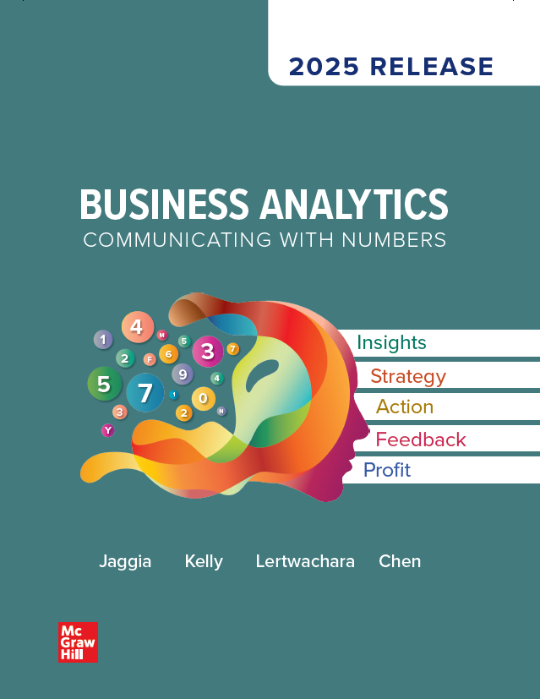
Chapter 1
Introduction to Business Analytics
Access the text alternative for slide images.
© McGraw Hill LLC. All rights reserved. No reproduction or distribution without the prior written consent of McGraw Hill LLC.

Slide 2
Chapter 1 Learning Objectives (L Os)
L O 1.1: Discuss various analytics applications.
L O 1.2: Explain data privacy, data ethics, and artificial intelligence.
L O 1.3: Explain the various types of data.
L O 1.4: Describe variables and types of measurement scales.
L O 1.5: Describe different data sources and file formats.

Slide 3
Introductory Case: Vacation in Belize
After graduating college, Emily is planning a vacation in Belize.
She is worried about staying within her budget, and researches her options for flights and hotels by looking for deals and packages.
Flights: where does she depart from and arrive at?
Hotels: location, amenities, activities, reviews.
Find a flight that is convenient as well as affordable.
Choose a reputable hotel that is priced under $200 per night.

Slide 4
1.1: Overview of Business Analytics 1
Data and analytics capabilities have made a leap forward.
Data science is focused on advanced modeling and computer algorithms.
Business analytics is the process of analyzing data to gain valuable insights and inform business decisions:
Use data and statistical techniques to make informed business decisions.
Improve performance and decision making.

Slide 5
1.1: Overview of Business Analytics 2
Data analysis has been simplified due to improved computational power.
Business analytics starts with understating the business context.
Ask the right question.
Identify the appropriate statistical analysis and computational model.
Communicate information.
Numerical results are not very useful unless they are accompanied with clearly stated actionable business insights.

Slide 6
1.1: Overview of Business Analytics 3
There are three broad categories:
Descriptive analytics: what has happened?
Predictive analytics: what could happen in the future?
Prescriptive analytics: what should we do?
Differences depend on the sophistication and business value.
Using predictive analytics to predict the future may be more valuable than summarizing and describing.
Predictive analytics requires more complex modeling and analysis.

Slide 7
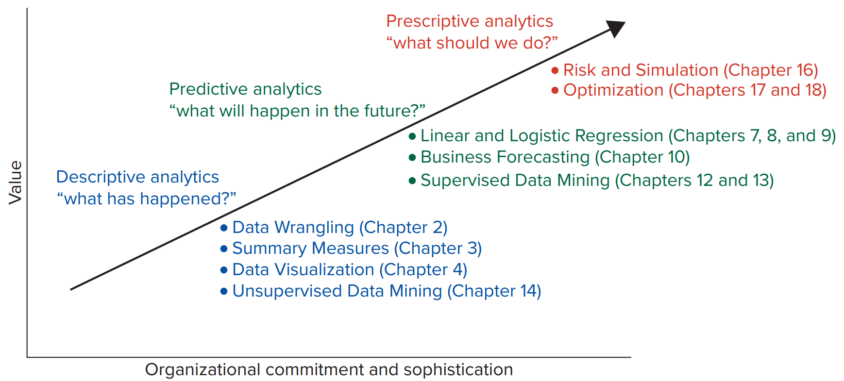
1.1: Overview of Business Analytics 4
Access the text alternative for slide images.

Slide 8
1.1: Overview of Business Analytics 5
Descriptive Analytics: what has happened?
Gather, Organize, Tabulate, Visualize, Summarize.
Descriptive analytics is referred to as Business Intelligence.
Access and manipulate data interactively through dashboards, applications and visualization tools.
Descriptive information can be presented in a number of traditional formats:
Written reports.
Tables and graphs.
Maps.

Slide 9
1.1: Overview of Business Analytics 6
Predictive Analytics: what could happen in the future?
Statistical models help identify associations between variables.
Use these models to predict specific outcomes or the likelihood of an event.
Examples:
Estimate sales based on marketing spend and seasonality.
Identify customers most likely to respond to marketing campaigns.
Detect potentially fraudulent transactions.

Slide 10
1.1: Overview of Business Analytics 7
Prescriptive Analytics: what should we do?
Use optimization and simulation algorithms to provide advice.
Explore several possible actions and suggests course of action.
Examples:
Scheduling employees’ works hours.
Select a mix of products to manufacture.
Choose an investment portfolio.

Slide 11
1.1: Overview of Business Analytics 8
Business | Important Analytics Applications
Accounting | Fraud detection, budgeting and forecasting, auditing and internal controls, cost analysis, and tax planning.
Finance | Algorithmic trading, risk management, credit scoring, portfolio management, and sentiment analysis.
Human Resources | Talent acquisition, performance management, workforce planning, retention, and diversity and inclusion.
Information Systems | Network security, user behavior, data quality and governance, IT asset management, and predictive maintenance.
Marketing | Customer segmentation, campaign monitoring, marketing mix optimization, A/B testing, and optimal social media utilization.
Operations | Process optimization, maintenance and reliability, supply chain optimization, resource allocation, and inventory management.

Slide 12
1.1: Overview of Business Analytics 9
Nonbusiness | Important Analytics Applications
Education | Student performance analysis, assessment analysis, adaptive learning, enrollment management, retention, and graduation rate analysis.
Entertainment | Box office prediction, content recommendation, audience segmentation, social media engagement, and piracy prevention.
Public Policy | Policy evaluation, social welfare analysis, diversity and inclusion, environmental policy and sustainability, and resource planning.
Healthcare | Treatment recommendations, analysis of risk factors, health management, discovery, and healthcare resource optimization.
Politics | Microtargeting, election forecasting, public opinion analysis, campaign strategy optimization, and constituent engagement.
Sports | Player performance, health and injury prevention, recruitment and scouting, game strategy and tactics, and fan engagement.
Transportation | Traffic management, route optimization, safety analysis, traffic flow analysis, and transportation demand forecasting.

Slide 13
1.2: Data Privacy, Data Ethics, and Artificial Intelligence 1
Data analytics allows companies to effectively target and understand their customers.
Companies can capitalize on the data collected from their customers and constituents.
But companies must also realize there are enormous risks and responsibilities, especially when using data for purposes different from why it was collected.
Data ethics and data security/privacy are critical!

Slide 14
1.2: Data Privacy, Data Ethics, and Artificial Intelligence 2
Data privacy is a branch of data security related to the proper collection, usage, and transmission of data.
Concerns revolve around:
a. How data are legally collected and stored.
b. If and how data are shared with third parties.
c. How data college, usage and transmission meet regulations.
Also called information privacy.

Slide 15
1.2: Data Privacy, Data Ethics, and Artificial Intelligence 3
Three are three key principles.
Confidentiality:
Customer data and identify remain private.
Medical and financial data are highly sensitive.
Transparency:
Data processing and automated decisions are transparent.
Risks including are understood: social and ethical.
Accountability:
Reflective, reasonable and systematic use and protection of data.
Protections against unauthorized or unlawful processing, or accidental loss or destruction.

Slide 16
1.2: Data Privacy, Data Ethics, and Artificial Intelligence 4
Marriott International had a massive data breach in 2018 that affected up to 500 million guests.
Hackers accessed names, addresses, phone numbers, passport numbers and encrypted credit cards.
Data breaches such as this can lead to identity theft and/or financial fraud.
Others: Capital One Financial in 2019.

Slide 17
1.2: Data Privacy, Data Ethics, and Artificial Intelligence 5
Cases involving data breach and misuse have given rise to data privacy laws.
These regulate how data are collected and used.
Necessary safeguards for data security.
Privacy protections for people.
U S Privacy Act contains important rights and restrictions on data maintained by the government.
U S Health Insurance Portability and Accountability (H I P P A A) outlines regulations for medical data.

Slide 18
1.2: Data Privacy, Data Ethics, and Artificial Intelligence 6
Data Ethics is a branch of ethics that studies moral problems related to data.
Evaluates if data are being used for doing the right thing for people and society.
There are two key considerations:
a. Human first: the human being stays at the center and human interests always outweigh institutional and commercial interests.
b. No biases: the algorithms do not absorb bias or amplify them in analysis.

Slide 19
1.2: Data Privacy, Data Ethics, and Artificial Intelligence 7
Artificial Intelligence (A I) aims to create machines capable of performing tasks that would typically require human intelligence.
Reasoning and problem-solving.
Natural language understandability.
Creativity.
Result of improved computer processing and availability of large data sets.
Taken the business world by storm!

Slide 20
1.2: Data Privacy, Data Ethics, and Artificial Intelligence 8
Deep Learning is a subset of A I techniques designed for solving complex analytics problems.
Image and speech recognition.
Natural language processing.
Multimedia analytics.
Generative A I is a subset of A I techniques that focus on creating new content: text, images, computer programs and music.
OpenA I has introduced ChatG P T.
Human-like text for interactive conversations with users.
Marks the beginning of the A I arms race.

Slide 21
1.2: Data Privacy, Data Ethics, and Artificial Intelligence 9
A I has revolutionized the analytics field by enabling more nontechnical users to access insights from data.
Assist analysts in exploring data to identify potential trends, patterns, and hypotheses.
A I models can be employed to automatically generate summaries and reports of insights found in data.
Extract valuable insights from data, enhance decision making, automate processes, and optimize operations.
There are challenges and ethical considerations.

Slide 22
1.2: Data Privacy, Data Ethics, and Artificial Intelligence 10
A I and Generative A I learn from training data.
If the training data have biases, A I models will generate biased content.
A I models may create content that is erroneous or misleading.
The decisions made by A I systems may not always align with human values and ethics.
A I should not be used to make life-and-death decisions without human intervention.
A I may be misused by malicious actors to launch cyberattacks or create deepfake content.
A I intelligence may surpass humans?

Slide 23
1.3: Types of Data 1
An important first step for making decisions is to find the right data and prepare it.
Data are compilations of facts, figures, or other content.
Numerical and non-numerical.
Often we have a large amount of data.
Even small data can give insights.
Data that have been organized, analyzed, and processed in a meaningful and purposeful way become information.
Use a blend of data, contextual information, experience, and intuition to derive knowledge.

Slide 24
1.3: Types of Data 2
A population consists of all items of interest in an analytics application.
Not feasible to collect data that comprise a population.
Too expensive or too big.
A sample is a subset of the population.
Representative of the population.
Compute a sample statistic to estimate the unknown population parameter.
Make inferences about the unknown population parameter.

Slide 25
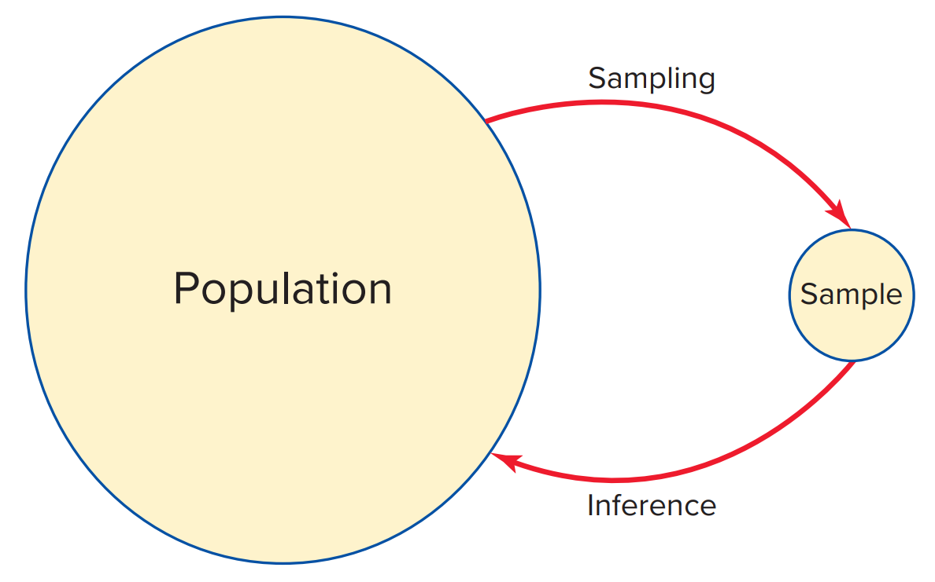
1.3: Types of Data 3
Access the text alternative for slide images.

Slide 26
1.3: Types of Data 4
Cross-sectional data:
Record a characteristic of many subjects at the same point in time, or without regard to time.
People, households, firms, industries, regions.
Example: N B A team performance.
Team name | Wins | Losses | Winning percentage
Philadelphia 76ers | 49 | 23 | 0.681
Brooklyn Nets | 48 | 24 | 0.667
Milwaukee Bucks* | 46 | 26 | 0.639
New York Knicks | 41 | 31 | 0.569
Atlanta Hawks | 41 | 31 | 0.569
Miami Heat | 40 | 32 | 0.556
Boston Celtics | 36 | 36 | 0.500
Washington Wizards | 34 | 38 | 0.472
*The Milwaukee Bucks won the 2021 N B A championship.

Slide 27
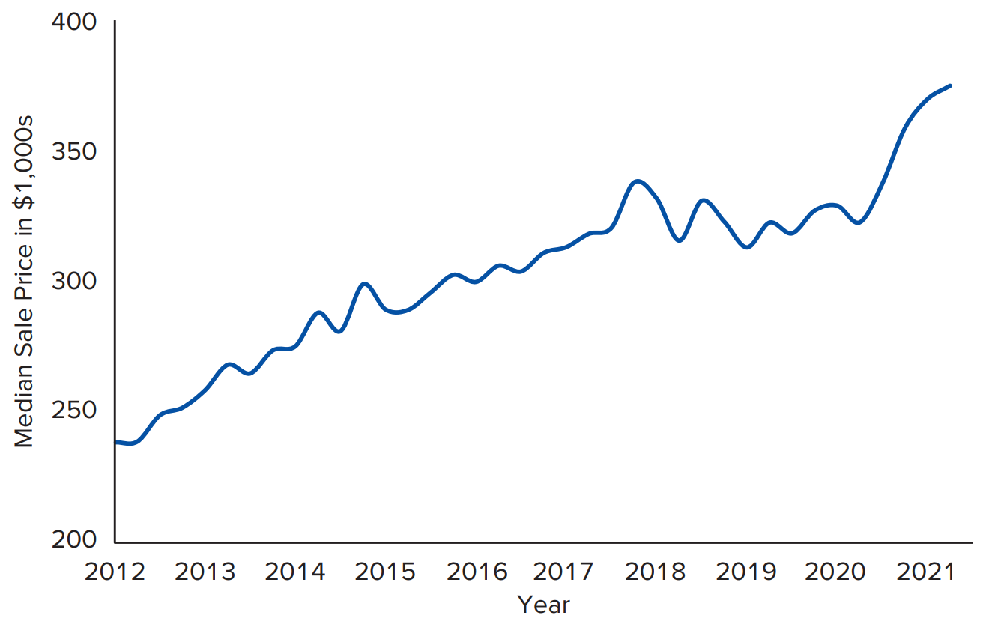
1.3: Types of Data 5
Time series data:
Collected over several time periods focusing on certain groups of people, specific events, or objects.
Hourly, daily, weekly, monthly, quarterly, or annual observations.
Example: median home price.
Access the text alternative for slide images.

Slide 28
1.3: Types of Data 6
Structured data reside in a predefined row-column format.
Use spreadsheet or database applications to enter, store, query and analyze.
Includes numerical values, dates, categories, and combinations of words and numbers.
Numerical information is objective and not open to interpretation.
Examples: point-of-sale and financial data.

Slide 29
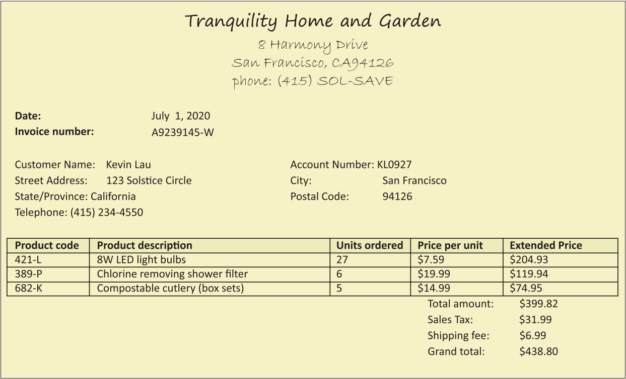
1.3: Types of Data 7
Example: invoice from a retail transaction.
Access the text alternative for slide images.

Slide 30
1.3: Types of Data 8
Unstructured data do not conform to a predefined row-column format.
Textual includes written reports, messages and open-ended survey questions.
Multimedia is typically photographs, videos and audio.
Metadata gives structure through titles, names, time stamps or locations.
Example: social media posts.

Slide 31
1.3: Types of Data 9
Data can be human- or machine-generated.
Structured human: price, income, retail sales.
Structured machine: sensors, speed cameras, web server logs.
Unstructured human: email, text, social media, presentations.
Unstructured machine: satellite images, video data, camera images.

Slide 32
1.3: Types of Data 10
Businesses generate and gather more and more data at an increasing pace.
Big data are a massive volume of both structured and unstructured data that are extremely difficult to manage, process, and analyze using traditional data-processing tools.
Does not imply the data are a complete population.
Present great opportunities to gain knowledge and game-changing intelligence!

Slide 33
1.3: Types of Data 11
Three characteristics or three V’s of big data:
Volume: immense amount of data compiled from a single source or multiple sources.
Velocity: generated at a rapid speed, managing data streams can be critical issue.
Variety: all types, forms, granularity and structures.
Additional characteristics:
Veracity: credibility and quality of the data, reliability.
Values: methodological plan for formulating questions, curating the right data, and unlocking hidden potential.

Slide 34
1.3: Types of Data 12
Having a plethora of data does not guarantee that useful insights or measurable improvements will be generated.
We may choose not to use big data in its entirety even when they are available.
Inconvenient to analyze a very large data set as it is computationally burdensome.
Benefits of working with big data may not justify the associated costs.
We often work with relatively smaller data sets drawn from big data.

Slide 35
1.4: Variables and Scales of Measurement 1
In business analytics, we focus on people, firms or events with characteristics.
A variable is a characteristic of interest that differs in kind or degree among various observations.
There are two types of variables:
Categorical or qualitative.
Numeric or quantitative.

Slide 36
1.4: Variables and Scales of Measurement 2
Categorical variables represent categories, names or labels.
Identify distinguishing characteristics.
Defined by two or more categories.
Arithmetic operations on the labels/values are not meaningful.
Coded into numbers for data processing.
Example: marital status or course grade.

Slide 37
1.4: Variables and Scales of Measurement 3
Numerical variables assume meaning numerical values.
Further classified as discrete or continuous.
Discrete: assumes a countable number of values.
Continuous: assumes an uncountable number of values within an interval.
Arithmetic operations are meaningful with numerical variables.

Slide 38
1.4: Variables and Scales of Measurement 4
Techniques for summarizing and analyzing variables depends on the type of data.
There are four major scales:
Nominal (categorical).
Ordinal (categorical).
Interval (numeric).
Ratio (numeric).

Slide 39
1.4: Variables and Scales of Measurement 5
Nominal: observations differ by name or label.
Least sophisticated level of measurement.
All we can do is categorize or group them.
Example: exchange of publicly traded firms.
Company | Exchange | Company | Exchange
3M (M M M) | NYSE | Johnson & Johnson (J N J) | NYSE
American Express (A X P) | NYSE | JPMorgan Chase (J P M) | NYSE
Apple (A A P L) | Nasdaq | McDonald’s (M C D) | NYSE
Boeing (B A) | NYSE | Merck (M R K) | NYSE
Caterpillar (C A T) | NYSE | Microsoft (M F S T) | Nasdaq
Chevron (C V X) | NYSE | Nike (N K E) | NYSE
Cisco (C S C O) | Nasdaq | Pfizer (P F E) | NYSE
Coca-Cola (K O) | NYSE | Procter & Gamble (P G) | NYSE
Disney (D I S) | NYSE | Travelers (T R V) | NYSE

Slide 40
1.4: Variables and Scales of Measurement 6
Ordinal: observations can be categorized or ranked.
A stronger level of measurement than nominal.
Cannot interpret the differences between the ranked observations.
Example: customer service ratings.
Category | Rating
Excellent | 5
Very good | 4
Good | 3
Fair | 2
Poor | 1

Slide 41
1.4: Variables and Scales of Measurement 7
Interval: rank and find meaningful differences.
A stronger level of measurement than interval.
Zero value is arbitrary and does not reflect the absence of a characteristic.
Ratios are not meaningful.
Ratio: like interval but zero value is not arbitrary.
Most sophisticated type of data.
True zero: represents absence of characteristic.
Ratios are meaningful.

Slide 42
1.4: Variables and Scales of Measurement 8
Example: The owner of a ski resort is interested in serving the needs of the pre-teen population.
Question 1: On your car drive to the resort, which music streaming service was playing?
Question 2: On a scale of 1 to 4, rate the quality of the food at the resort (where 1 is poor, 2 is fair, 3 is good, and 4 is excellent).
Question 3: Presently, the main dining area closes at 3:00 pm. What time do you think it should close?
Question 4: How much of your own money did you spend at the lodge today?

Slide 43
1.4: Variables and Scales of Measurement 9
Example:
Question 1: nominal.
Question 2: ordinal.
Question 3: interval.
Question 4: ratio.

Slide 44
1.5: Data Sources and File Formats 1
Data analytics boom partially driven by growing availability of data and improved computational power.
90% of the data in the world today was created in the last two years.
Data sources for this book mostly come from Google.
Bureau of Economic Analysis.
Bureau of Labor Statistics.
Federal Research Economic Data.
U S Census Bureau.

Slide 45
1.5: Data Sources and File Formats 2
We need the ability to exchange and share data.
Formatting data in a standardized manner allows people to understand data files.
Two common layouts for text files:
Fixed-width format.
Delimited format.
Markup languages provide a structure:
X M L.
H T M L.
J S O N.

Slide 46
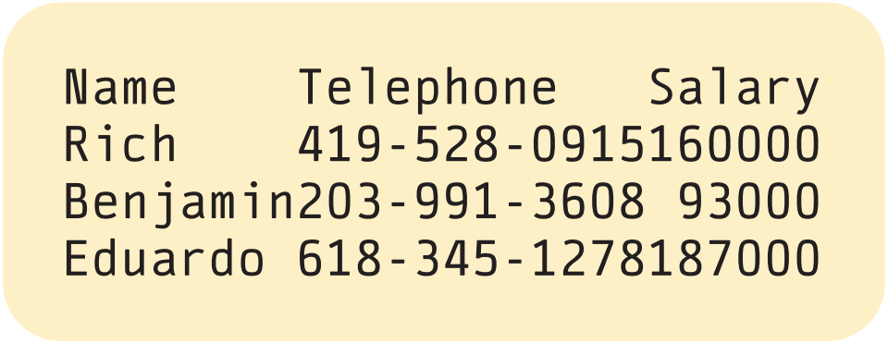
1.5: Data Sources and File Formats 3
Fixed-width format: each column starts and ends at the same place in every row.
Specific data can be found at the exact location for every record.
The data are stored as plain text characters.
Simple files that are smaller in size.
Example: name, number and salary.
Access the text alternative for slide images.

Slide 47
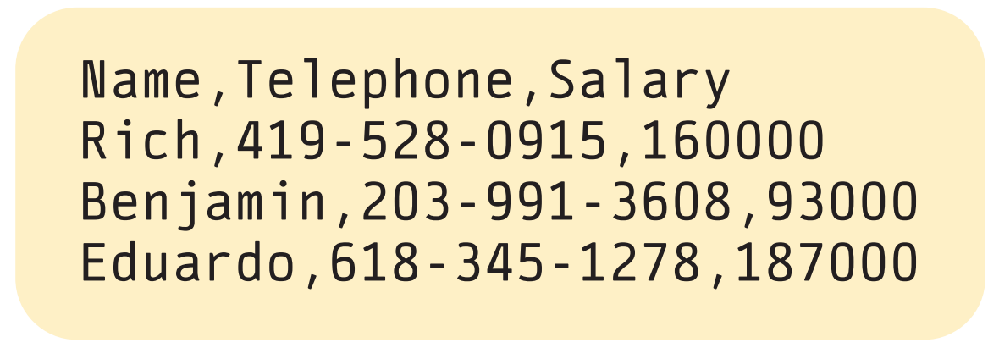
1.5: Data Sources and File Formats 4
Delimited format: each column is separated by a delimiter.
Delimiter is a character to separate fields.
A comma is typical giving C S V files.
Each column can contain as many characters as applicable.
Example: name, number and salary.
Access the text alternative for slide images.

Slide 48
1.5: Data Sources and File Formats 5
Extensible Markup Language (X M L) is a simple text-based markup language for representing structured data.
X M L is widely used to share structured information.
It uses user-defined markup tags to specify the structure of data.
Each piece of data is enclosed in a pair of tags.
Designed to support readability.
Because of tags, files are much larger.

Slide 49
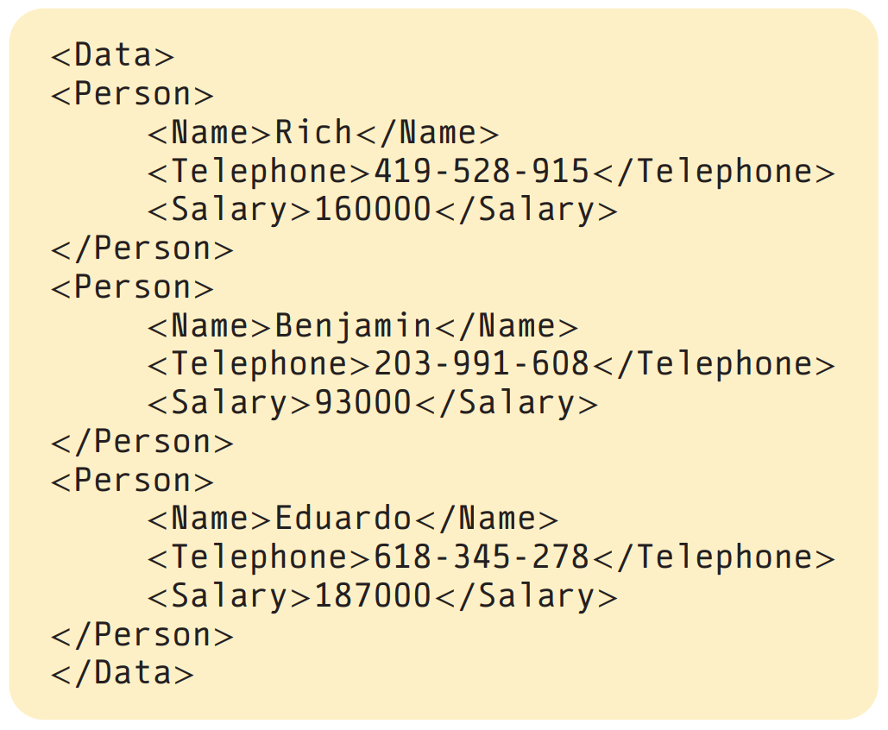
1.5: Data Sources and File Formats 6
Example: name, number and salary.
Access the text alternative for slide images.

Slide 50
1.5: Data Sources and File Formats 7
HyperText Markup Language (H T M L) is a mark-up language that uses tags to define data for web pages.
Gives information on how to display the data.
Different tags for different elements.
Conforms to standards maintained by organizations such as the World Wide Web Consortium.
For example, <table> provides structure for textual data.

Slide 51
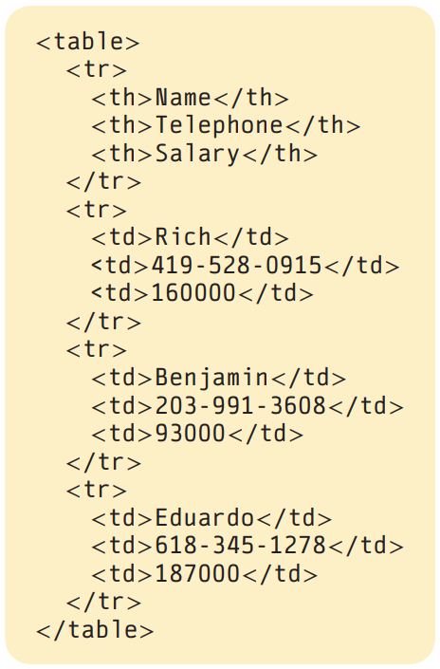
1.5: Data Sources and File Formats 8
Example: name, number and salary.
Access the text alternative for slide images.

Slide 52
1.5: Data Sources and File Formats 9
JavaScript Object Notation (J S O N) is a standard for transmitting human-readable data.
Popular alternative to X M L.
Supported by many programming languages such as C and Python.
Not as verbose as X M L, making files smaller.
Supports wide range of data types.
Parsing is faster and less resource intensive.

Slide 53
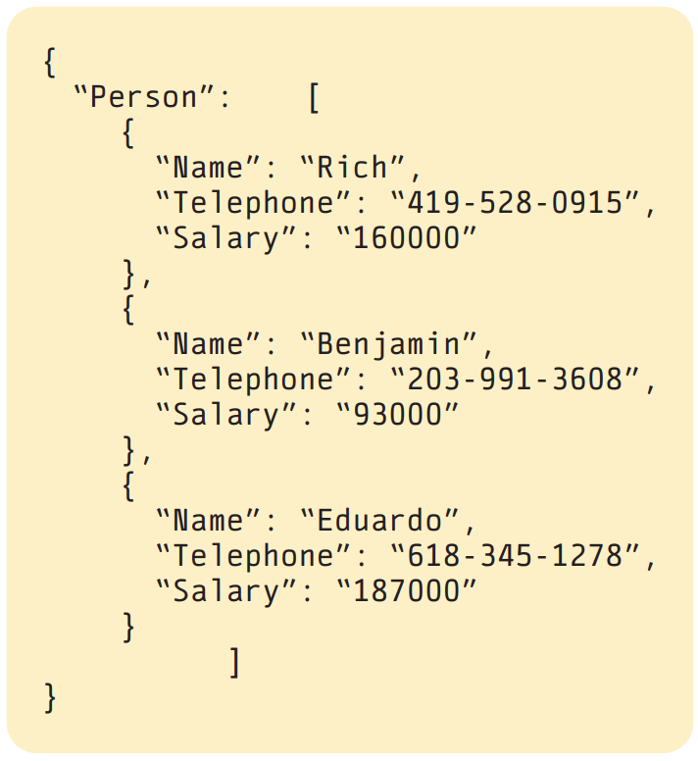
1.5: Data Sources and File Formats 10
Example: name, number and salary.
Access the text alternative for slide images.

Slide 54
End of Main Content
© McGraw Hill LLC. All rights reserved. No reproduction or distribution without the prior written consent of McGraw Hill LLC.

Slide 55
Accessibility Content: Text Alternatives for Images

Slide 56
Chapter 1 – Text Alternative
Return to parent-slide containing images.
Below the title is a stylised, abstract illustration of a woman’s profile. The back of her head extends into bubbles of numbers and letters. Words beside the illustration read, insights, strategy, action, feedback, profit. The authors are listed below, side by side. Jaggia, Kelly, Lertwachara, Chen. The McGraw Hill logo is at the bottom left of the page.
Return to parent-slide containing images.

Slide 57
1.1: Overview of Business Analytics 4 – Text Alternative
Return to parent-slide containing images.
The chart represents the increasing value of different analytical approaches as organizational commitment and sophistication grow. Descriptive analytics, focusing on understanding what has happened, holds the lowest value. Its techniques include data wrangling, summary measures, data visualization, and unsupervised data mining. The next higher value is predictive analytics, which forecasts what will happen in the future. Its techniques include linear and logistic regression, business forecasting, and supervised data mining. Finally, prescriptive analytics, which determines what actions to take, represents the highest value. Its techniques are risk simulation and optimization. The chapters of these techniques are given.
Return to parent-slide containing images.

Slide 58
1.3: Types of Data 3 – Text Alternative
Return to parent-slide containing images.
A large circle represents the population, a smaller circle represents a sample. An arrow from the population to the sample is labeled sampling. An arrow from the sample to the population is labeled inference.
Return to parent-slide containing images.

Slide 59
1.3: Types of Data 5 – Text Alternative
Return to parent-slide containing images.
It plots a fluctuating line in an increasing trend. The line begins at (2012, 240) and ends at (2021, 380). Values are approximated.
Return to parent-slide containing images.

Slide 60
1.3: Types of Data 7 – Text Alternative
Return to parent-slide containing images.
It details an order placed on July 1, 2020. The customer, Kevin Lau, located at 123 Solstice Circle in San Francisco, California, ordered 3 products. The account number is KL0927. The postal code is 94126. The order includes 27 8W L E D light bulbs, 6 chlorine removing shower filters, and 5 compostable cutlery sets. The product codes are 421 L, 389 P, and 682 K. The price per unit is $7.59, $19.99, and $14.99. Their extended price are $204.93, $119.94, and $74.95. The total amount is $399.82. The sales tax is $31.99. The shipping fee is $6.99. The grand total is $438.80.
Return to parent-slide containing images.

Slide 61
1.5: Data Sources and File Formats 3 – Text Alternative
Return to parent-slide containing images.
The column for name lists Rich, Benjamin, and Eduardo. The column for telephone lists 4195280915, 2039913608, and 6183451278. The salary column lists 160000, 93000, and 187000.
Return to parent-slide containing images.

Slide 62
1.5: Data Sources and File Formats 4 – Text Alternative
Return to parent-slide containing images.
The data in row 1 is Rich, 4195280915, and 160000. The data in row 2 is Benjamin, 2039913608, and 93000. The data in row 3 is Eduardo, 6183451278, and 187000.
Return to parent-slide containing images.

Slide 63
1.5: Data Sources and File Formats 6 – Text Alternative
Return to parent-slide containing images.
It briefs the personal information of three people: Rich, Benjamin, and Eduardo. The data is organized using XML tags. Line 1 is <Data>. Line 2 is <Person>. The text in lines 3 to 5, 8 to 10, and 13 to 15, follow the following pattern. The first line includes <Name>, name of the person, </Name>. Second line includes <Telephone>, telephone number, </Telephone>. The third line includes <Salary>, value of the salary, </salary>. These are followed by </Person> and <Person> in separate lines. The last line is </Data> instead of <Person>.
Return to parent-slide containing images.

Slide 64
1.5: Data Sources and File Formats 8 – Text Alternative
Return to parent-slide containing images.
It organizes data for three employees: Rich, Benjamin, and Eduardo. The table structure uses standard HTML tags like for headers (Name, Telephone, Salary) and for data cells. Line 1 is <table>. Line 2 is <t r>. Line 3 is <t h>, Name,</t h>. Line 4 is <t h>, Telephone, </t h>. Line 5 is <t h>, Salary, </ t h>. The text in lines 8 to 10, 13 to 15, and 18 to 20, follow the following pattern. The first line includes <t d>, name of the person, </t d>. The second line includes <t d>, telephone number, </t d>. The third line includes <t d>, value of the salary, </t d>. These are followed by </t r> and <t r> in separate lines. The last line is </table> instead of <t r>.
Return to parent-slide containing images.

Slide 65
1.5: Data Sources and File Formats 10 – Text Alternative
Return to parent-slide containing images.
The data within the curly braces represents a collection of "Person" objects. Each "Person" object contains key-value pairs, where keys like "Name", "Telephone", and "Salary" correspond to specific employee attributes. The values associated with these keys provide the details for each employee. For example, the first "Person" object shows "Rich" with a phone number and salary. The second and third "Person" objects show "Benjamin" and "Eduardo" with a phone number and salary.
Return to parent-slide containing images.

