Slide 1
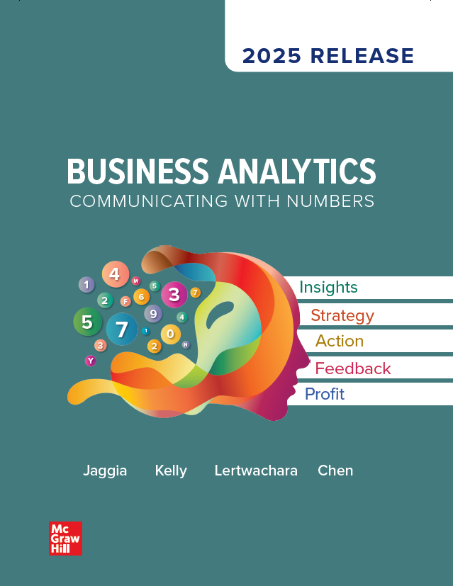
Chapter 2
Data Management and Wrangling
Access the text alternative for slide images.
© McGraw Hill LLC. All rights reserved. No reproduction or distribution without the prior written consent of McGraw Hill LLC.

Slide 2
Chapter 2 Learning Objectives (L Os)
L O 2.1: Describe the key concepts related to data management.
L O 2.2: Inspect and explore data.
L O 2.3: Apply data preparation techniques to handle missing values and to subset data.
L O 2.4: Transform numerical variables.
L O 2.5: Transform categorical variables.
L O 2.6: Append and merge multiple data sets.

Slide 3
Introductory Case: Retail Customer Data
Catherine is a marketing manager at Organic Food Superstore.
They would like to use the company’s marketing dollars to market a new line of Asian-inspired meals to college-educated millennials.
They have acquired a representative sample.
They want to use the data for the following tasks.
Identify Organic Food Superstore’s college-educated millennial customers.
Compare profiles of female and male college-educated millennial customers.

Slide 4
2.1: Data Management 1
The increasing volume and variety of data compel organizations to spend large amounts of time and resources gathering, cleaning, and organizing data before performing any analysis.
As the amount of data grows, the need and difficulties involving data wrangling increases.
The inability to clean and organize big data is among the primary barriers preventing organizations from taking full advantage of business analytics.

Slide 5
2.1: Data Management 2
Analytics professionals no longer rely solely on the corporate I T department for data retrieval and preparation.
Spend 50% to 80% of their time collecting and preparing data.
Have to become more self-reliant and possess the necessary skills for data wrangling.
Need a broader skill set than statistics and data mining techniques.
This self service model allows organizations to address business problems much more quickly.

Slide 6
2.1: Data Management 3
Data wrangling is the process of retrieving, cleansing, integrating, transforming, and enriching data to support subsequent analysis.
Transform raw data into a format that is more appropriate and easier to analyze.
There are several objectives:
Improve data quality.
Reduce time/effort required to perform analytics.
Reveal the true intelligence in the data.

Slide 7
2.1: Data Management 4
Organizations today have a plethora of data created and stored using different, often incompatible, technologies.
Data management is a process that an organization uses to acquire, organize, store, manipulate, and distribute data.
A database is a collection of data logically organized to enable easy retrieval, management, and distribution of data.
Most organizations have adopted a database approach for storing and managing data.

Slide 8
2.1: Data Management 5
The most common type of database used in organizations is the relational database.
Consists of one or more logically related data files.
Called tables or relations.
Each table is a two-dimensional grid.
Columns: fields or attributes, characteristics of a physical object, an event, a person.
Rows: records or tuples.
A collection of related fields makes a record, which represents an object, event, or person.

Slide 9
2.1: Data Management 6
A database management system (D B M S) is a software application.
Define, manipulate and manage data.
Examples: Oracle, I B M D B2, S Q L Server, MyS Q L, Microsoft Access.
To understand how and where data can be extracted, one needs to understand the structure of the data or the data model.
Data modeling is the process of defining the structure of a database.
Relational databases are modeled in a way to offer flexibility and ease of data retrieval.

Slide 10
2.1: Data Management 7
An entity-relationship diagram (E R D) is a schematic used to illustrate the structure of the data.
An E R D shows a graphical representation of the data structure.
Entity: generalized category to represent people, places, things.
Instance: a single occurrence of an entity; typically a single record.
Two entities can have a relationship with each other that represent business facts or rules.
1:1.
1:M.
M:N.

Slide 11
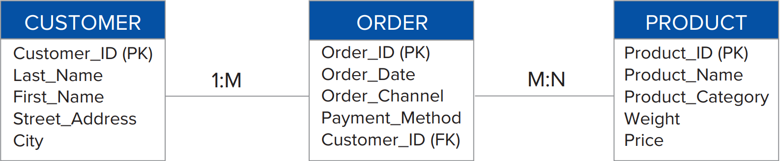
2.1: Data Management 8
Example: Organic Food Superstore.
Three entities: CUSTOMER, ORDER and PRODUCT.
Each entity is represented in a rectangular-shaped box in which attributes of the entity are listed.
CUSTOMER and ORDER are 1:M: one customer can place many orders over time.
ORDER and PRODUCT are M:N: an order can contain many products and the same product can appear in multiple orders.
Access the text alternative for slide images.

Slide 12
2.1: Data Management 9
For each entity, there is an attribute called a primary key.
A primary key uniquely identifies each instance of the entity.
Used to create a data structure called an index for fast data retrieval and searches.
Example: Organic Food Superstore.
Customer_I D is the primary key for CUSTOMER.
Each customer has a unique I D.
Access the text alternative for slide images.

Slide 13
2.1: Data Management 10
Some entities have a special type of attribute called a foreign key.
A foreign key is a primary key of a related entity.
A primary key belongs to the table on one side of the relationship.
The foreign key belongs to the table on many sides of the relationship.
A pair of primary and foreign keys establish a 1:M relationship.
Example: Organic Food Superstore.
Customer_I D is the primary key of CUSTOMER.
Customer_I D is a foreign key of ORDER.
Access the text alternative for slide images.

Slide 14
2.1: Data Management 11
Example.
By matching the values in the Customer_I D fields of the CUSTOMER and ORDER entities, we can find out which customer placed which order.
The E R D is not complete: missing the ordered products and purchase quantities in the ORDER entity.
Cannot add to ORDER since it is unknown in advance.
Access the text alternative for slide images.

Slide 15
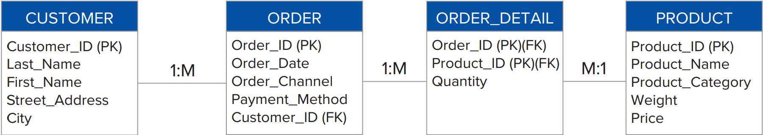
2.1: Data Management 12
Example.
Create an intermediate entity, ORDER_DETAIL.
Decompose the M:N into two 1:M relationships.
An order has many detailed line items, but each line item can only belong to one order.
A product may appear in many order and order lines, and order line can only contain one product.
Access the text alternative for slide images.

Slide 16
2.1: Data Management 13
A composite primary key is a primary key that consists of more than one attribute.
This is used when none of the individual attributes alone can uniquely identify each instance of the entity.
Example: Organic Food Superstore.
ORDER_DETAIL includes Order_I D and Product I D.
ORDER_DETAIL is a composite primary key.
Access the text alternative for slide images.

Slide 17
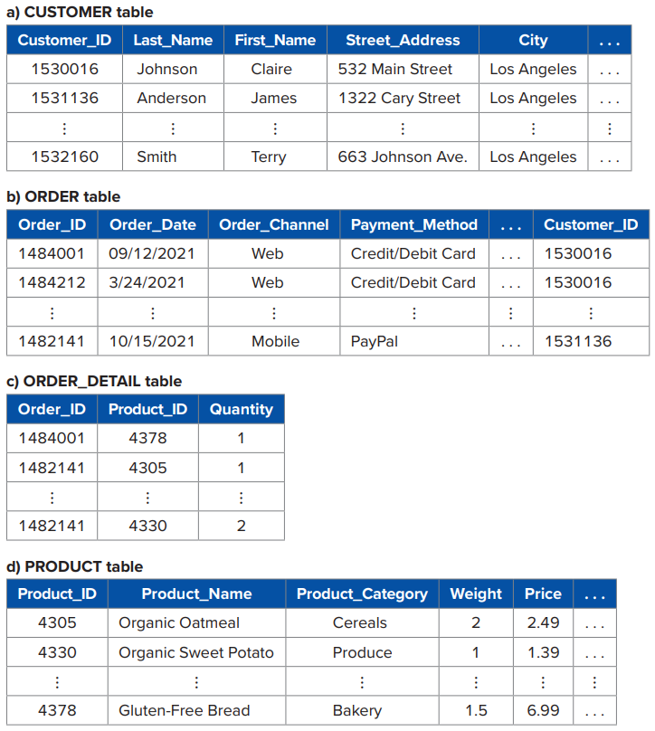
2.1: Data Management 14
An E R D can be converted into database tables.
Example: Organic Food Superstore.
Access the text alternative for slide images.

Slide 18
2.1: Data Management 15
Once data are stored in a relational database, we can retrieve them using database queries.
The most popular query language used is Structure Query Language (S Q L).
Manipulate data using a relatively simple and intuitive approach.
Specify the attributes, tables, and criteria the retrieved data must meet.
Uses three key words: SELECT, FROM, and WHERE.
SELECT: specifies the attributes.
FROM: specifies the tables (more than one).
WHERE: specifies selection criteria and/or conditions.

Slide 19

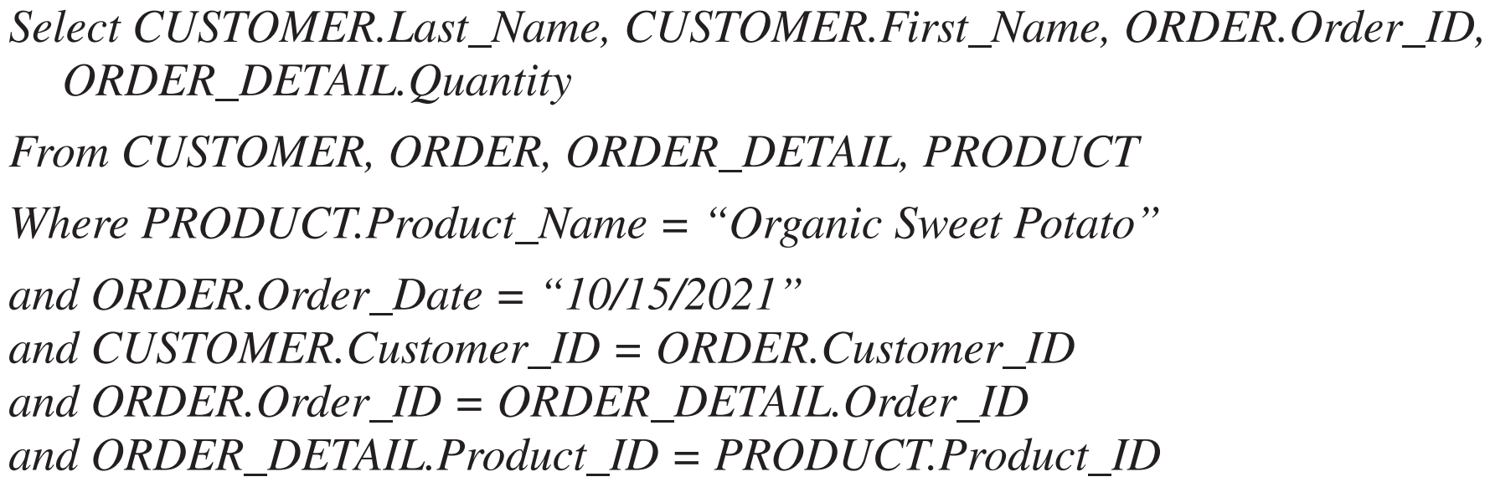
2.1: Data Management 16
Example: Organic Food Superstore.
Simple:
Complex:
Access the text alternative for slide images.

Slide 20
2.1: Data Management 17
The relational database environment provides businesses with an efficient and effective way to manage data.
However, different business departments have their own individual and isolated databases.
It becomes difficult to analyze data across departments and business units.
Creates data redundancy and inconsistency.

Slide 21
2.1: Data Management 18
An enterprise data warehouse or data warehouse is a central repository of data from multiple departments within an organization.
Integrated and accurate.
Supports managerial decision making.
“Single version of the truth.”
Organized around subjects such as sales, customers, or products.
Data must be integrated from different databases in different departments.
Extraction, transformation, and load (E T L) process is used.
Retrieve, reconcile, and transform data into a consistent format.
Load the final data into the data warehouse.

Slide 22
2.1: Data Management 19
The volume of data in a data warehouse can become large very quickly.
A data mart is a small-scale data warehouse.
A subset of the enterprise data warehouse.
Focuses on one particular subject or decision areas.
Conforms to a multidimensional data model called a star scheme with two types of tables.
Dimension table: describes business dimensions such as customer, product, location, and time.
Fact table: facts about the business operation, often quantitative format.

Slide 23
2.1: Data Management 20
Each of dimension table has a 1:M relationship with the fact table.
Primary keys of the dimension table are also the foreign keys in the fact table.
Combination of the primary keys of the dimension tables forms the composite primary key of the fact table.
The fact table is usually depicted at the center surrounded by multiple dimension tables, forming the shape of a star.
Not uncommon to see multiple fact tables sharing relationships with a group of dimension tables in a data mart.
Star schemas can ”slice and dice” data based on different dimensions.

Slide 24
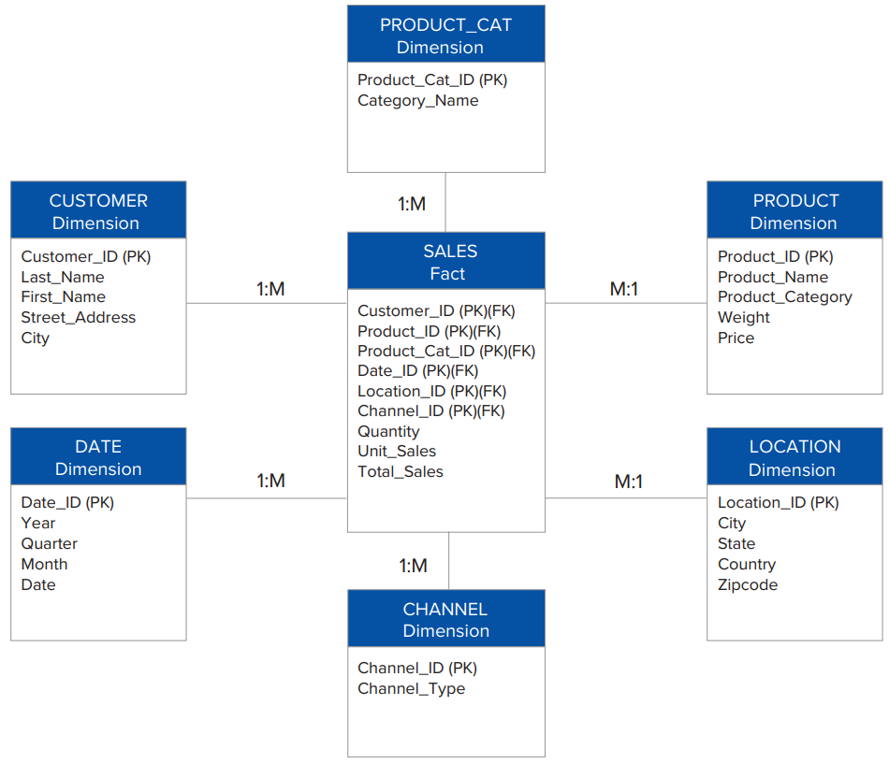
2.1: Data Management 21
Example: Organic Food Superstore.
Access the text alternative for slide images.

Slide 25
2.1: Data Management 22
New forms of databases have emerged to support big data.
NoS Q L: “Not Only S Q L” database.
Nonrelational database that supports the storage of a wide range of data types.
Structured, semi-structured, and unstructured.
Flexibility, performance, and scalability to handle extremely high volumes of data.
NoS Q L will likely be implemented alongside relational databases to support organization data needs.

Slide 26
2.2: Data Inspection
Once the raw data are extracted from the database, data warehouse or data mart, review and inspect the dataset to assess data quality and relevant information for subsequent analysis.
In addition to visually reviewing data, counting and sorting are among the very first tasks most data analysts perform to gain a better understanding and insights into the data.
Counting and sorting data help us verify that the data set is complete or that it may have missing values, especially for important variables.
Sorting data also allows us to review the range of values for each variable. We can sort data based on a single variable or multiple variables.

Slide 27
2.3: Data Preparation 1
Once we have inspected and explored data, we can start the data preparation process.
We examine two important data preparation techniques: handling missing values and subsetting data.
There may be missing values in the key variables that are crucial for subsequent analysis.
Most data analysis projects focus only on a portion (subset) of the data, rather than the entire data set.
Sometimes the objective of the analysis is to compare two subgroups of the data.

Slide 28
2.3: Data Preparation 2
Missing values are a common quality problem found in data sets of all sizes.
Can lead to a significant reduction in the number of usable observations and bias results.
Example: 20 variables with 5% of the values randomly missing across observations and variables => 35.85% of the observations are usable.
Understanding why the values are missing is the first step in the treatment of missing values.
Respondents decline to provide the information due to its sensitive nature; the missing values are not randomly distributed across observations and are concentrated within on or more subgroups.
Some of the items do not apply to every respondent.
Can also be caused by human errors, sloppy data collection, or equipment failures.

Slide 29
2.3: Data Preparation 3
There are two strategies for dealing with missing values: omission and imputation.
Omission: complete-case analysis.
Exclude observations with missing values.
Appropriate when the amount of missing data is small or concentrated in a small number of observations.
Imputation: replace missing values with some reasonable values.

Slide 30
2.3: Data Preparation 4
For numerical values, replace missing values with the mean/average value across across relevant observations.
Easy to implement.
Doesn’t increase the variability in the data set.
If a large number of values are missing, mean imputation will likely distort the relationships among variables, leading to biased results.
More advanced methods include regression mean imputation.
For categorical variables, the most frequent category is often used.
Create an “unknown” category.
Useful for when data are missing for a reason.

Slide 31
2.3: Data Preparation 5
Example: The manager of a local restaurant has conducted a survey to gauge customers’ perception about the eatery.
Each customer rated the restaurant on its ambience, cleanliness, service, and food using a scale of 1 (lowest) to 7 (highest).
Use the Restaurant_Reviews data to first detect the missing values.
Then use both omission and imputation strategies to handle the missing values.

Slide 32
2.3: Data Preparation 6
If the variable that has many missing values is deemed unimportant or can be represented using a proxy variable that does not have missing values, the variable may be excluded from the analysis.
Some analytics techniques such as decision trees are robust and can be applied to data sets even with the inclusion of missing values.
Another important data preparation task involves the treatment of extremely small or large values, referred to as outliers.
It is noteworthy that in the presence of outliers, it is preferred to use the median instead of the mean to impute missing values.

Slide 33
2.3: Data Preparation 7
The process of extracting portions of a data set that are relevant to the analysis is called subsetting.
It is commonly used to pre-process the data prior to analysis.
For time series data, we may choose to create subsets of recent observations and observations from the distant past in order to analyze them separately.
Subsetting can also be used to eliminate unwanted data such as observations that contain missing values, low quality data, or outliers.

Slide 34
2.3: Data Preparation 8
Sometimes, subsetting involves excluding variables instead of observations.
Irrelevant to the problem.
Contain redundant information.
Excessive amounts of missing values.
Subsetting can also be performed as part of descriptive analytics that helps reveal insights in the data.

Slide 35
2.3: Data Preparation 9
Example: Organic Food Superstore.
They feel that sex, household size, income, total spending in 2021, total number of orders in the past 24 months, and channel through which the customer was acquired are useful for her to create a profile of these customers.
Use software to first identify college-educated millennial customers in the Customers data file.
Then, create subsets of female and male college-educated millennial customers.

Slide 36
2.4: Transforming Numerical Data 1
Data transformation is the process of converting data from one format or structure to another.
It is performed to meet the requirements of statistical and data mining techniques used for the analysis.
Sometimes, it makes sense to group a vast range of numerical values into a small number of “bins.”

Slide 37
2.4: Transforming Numerical Data 2
Binning is the process of transforming numerical variables into categorical variables by grouping the numerical values into a small number of groups or bins.
It is important that the bins are consecutive and nonoverlapping so that each numerical value falls into only one bin.
Binning can be an effective way to reduce noise in the data if we believe that all observations in the same bin tend to behave the same way.

Slide 38
2.4: Transforming Numerical Data 3
Outliers in the data will be part of the last bin and, and therefore, will not distort subsequent data analysis.
Binning is also useful in categorizing observations and meeting the categorical data requirements of some data mining analytics techniques such as naïve Bayes.
Bins are also often created to have equal intervals.
We can also create bins of equal counts, where individual bins have the same number of observations.

Slide 39
2.4: Transforming Numerical Data 4
Example: Organic Food Superstore.
They would like to perform the R F M analysis which stands for recency, frequency, and monetary.
The R F M ratings can be created from the DaysSinceLast (recency), NumOfOrders (frequency), and Spending2021 (monetary) variables.
Bin customers into five equal-size groups, with 20% of the customers included in each group. Each group is also assigned a score from 1 to 5, with 5 being the highest.
They would like to assign the bronze membership status to customers who spent less than $250, silver membership status to those who spent $250 or more but less than $1,000, and the gold membership status to those who spent $1,000 or more.
Use software to bin variables according to these specifications and summarize the results.

Slide 40
2.4: Transforming Numerical Data 5
Data transformation is an important step in bringing out the information in the data set, which can then be used for further data analysis.
Another common approach is to create new variables through mathematical transformations of existing variables.
Similarly, in order to analyze trend, we often transform raw data values into percentages.
Sometimes, data on variables such as income, firm size, and house prices are highly skewed.
Extremely high (or low) values of skewed variables significantly inflate the average for the entire data set.
Difficult to detect meaningful relationships with skewed variables.

Slide 41
2.4: Transforming Numerical Data 6
Another common data transformation involves calendar dates.
Statistical software usually stores date values as numbers.
In R, date objects are stored as the number of days since January 1, 19 70.
Excel implements a similar approach to store date values but uses a reference value of 1 for January 1, 1900.
Transformation of date values is often performed to help bring useful information out of the data.
Transforming date values into seasons helps enrich the data set by creating relevant variables to support subsequent analyses.

Slide 42
2.4: Transforming Numerical Data 7
Example: Organic Food Superstore.
They want to generate two new variables that capture the year-to-year difference and the percentage difference in spending.
They also notice that the income variable is highly skewed, with most customers’ incomes falling between $40,000 and $100,000, with only a few very-high-income earners.
They have been advised to transform the income variable into natural Logarithms.
They would also like to convert customer birthdates into ages as of January 1, 2022, for exploring differences in purchase behaviors of customers across age groups.
Finally, they would like to create a new variable that captures the birth month of the customers so that seasonal products can be marketed to these customers during their birth month.
Use software to transform variables according to these specifications.

Slide 43
2.5: Transforming Categorical Data 1
Use labels or names to identify the distinguishing characteristics of a categorical variable.
Categorical variables can also be defined by two or more categories.
We use nominal and ordinal measurement scales to represent categorical variables.
Categorical variables are known to represent less sophisticated levels of measurement, they are often the most important variables in the analysis.
Many analysis techniques are limited in their abilities to handle categorical data directly.
Categorical data do present unique challenges in data wrangling.

Slide 44
2.5: Transforming Categorical Data 2
Nominal or ordinal variables may have too many categories.
Several parameters associated with the categories.
Hurts model performance.
If a variable has some categories that rarely occur, it is difficult to capture the impact of these categories accurately.
A small sample may not contain any observations in certain categories; this creates errors when applied to larger data with observations in all categories.
If one category clearly dominates in terms of occurrence, the categorical variable will not differentiate among observations.

Slide 45
2.5: Transforming Categorical Data 3
An effective strategy is category reduction.
Collapse some of the categories to create fewer nonoverlapping categories.
Determining the appropriate number of categories often depends on the data, context, and disciplinary norms.
Categories with very few observations may be combined to create the “Other” category.
The rationale behind this approach is that a critical mass can be created for this “Other” category to help reveal patterns and relationships in data.
Categories with a similar impact may be combined.

Slide 46
2.5: Transforming Categorical Data 4
In many analytical models, such as regression models, categorical variables must first be converted into numerical variables.
For other models, dealing with numerical data is often easier than categorical data because it avoids the complexities of the semantics pertaining to each category of the variable.
A dummy variable is commonly used to describe two categories of a variable.
Also referred to as an indicator or a binary variable.
A value of 1 for one of the categories.
A value of 0 for the other category, referred to as the reference or the benchmark category.
Interpreting results is done relative to the reference category.

Slide 47
2.5: Transforming Categorical Data 5
For a categorical variable with k categories, create k − 1 dummy variables.
Another common transformation of categorical variables is to create category scores.
Most appropriate if the data are ordinal.
Allows the categorical variable to be treated as a numerical variable.
Then do not convert the variable into several dummy variables or to reduce its categories.

Slide 48
2.5: Transforming Categorical Data 6
Example: Organic Food Superstore.
They would like to analyze race but there are a large number of categories.
Some categories have very few observations.
Use software to create a new category called Other that represents the two least-frequent categories.

Slide 49
2.6: Appending and Merging Data 1
Essential data may be scattered among different sources.
We often need to integrate multiple data sets into one.
By combining diverse data sources, we can enrich the consolidated data with relevant variables to perform a more meaningful analysis and gain additional insights.
Appending data involves adding new rows to an existing data set.
Merging data involves combining two data sets based on a common variable.

Slide 50
2.6: Appending and Merging Data 2
Example: An epidemiologist collects COVID-19 testing data from three different public health districts.
The data includes the following variables: presence of coughing, fever, sore throat, shortness of breath, and headache (1 = presence of the respective symptom, 0 otherwise), whether the patient is 60 years or older (Yes or No), sex (female or male), and the test result (positive or negative).
The format of the testing data from the three districts are similar, but the data are stored separately.
Use software to consolidate the three data sets into one.
Report the number of records in the consolidated file and find the number of patients who were 60 years or older and tested positive.

Slide 51
2.6: Appending and Merging Data 3
Example: A retail store manager wants to analyze purchase history across various customer demographics such as sex, age group, income, and education attainment.
However, the demographic data are stored in a data set that is separate from the retail transactions.
The manager extracts a sample of relevant data from different sources and stores them into two data sets.
Note that the CustI D variable provides the linkage between the two data sets.
Use software to merge the customers’ demographic data with the retail transactions.

Slide 52
End of Main Content
© McGraw Hill LLC. All rights reserved. No reproduction or distribution without the prior written consent of McGraw Hill LLC.

Slide 53
Accessibility Content: Text Alternatives for Images

Slide 54
Chapter 2 – Text Alternative
Return to parent-slide containing images.
Below the title is a stylised, abstract illustration of a woman’s profile. The back of her head extends into bubbles of numbers and letters. Words beside the illustration read, insights, strategy, action, feedback, profit. The authors are listed below, side by side. Jaggia, Kelly, Lertwachara, Chen. The McGraw Hill logo is at the bottom left of the page.
Return to parent-slide containing images.

Slide 55
2.1: Data Management 8 – Text Alternative
Return to parent-slide containing images.
3 connected blocks. The block for contains information about Customer ID of P K, Last Name, First Name, Street Address, and City. The block for order includes details about each order, such as the Order ID of P K, Order Date, Order Channel, Payment Method, and the foreign key Customer ID. The link between customer and order blocks is labeled 1 is to M. The block for product contains the Product ID of P K, Product Name, Product Category, Weight, and Price. The link between order and product blocks is labeled M is to N.
Return to parent-slide containing images.

Slide 56
2.1: Data Management 9 – Text Alternative
Return to parent-slide containing images.
3 connected blocks. The block for contains information about Customer ID of P K, Last Name, First Name, Street Address, and City. The block for order includes details about each order, such as the Order ID of P K, Order Date, Order Channel, Payment Method, and the foreign key Customer ID. The link between customer and order blocks is labeled 1 is to M. The block for product contains the Product ID of P K, Product Name, Product Category, Weight, and Price. The link between order and product blocks is labeled M is to N.
Return to parent-slide containing images.

Slide 57
2.1: Data Management 10 – Text Alternative
Return to parent-slide containing images.
3 connected blocks. The block for contains information about Customer ID of P K, Last Name, First Name, Street Address, and City. The block for order includes details about each order, such as the Order ID of P K, Order Date, Order Channel, Payment Method, and the foreign key Customer ID. The link between customer and order blocks is labeled 1 is to M. The block for product contains the Product ID of P K, Product Name, Product Category, Weight, and Price. The link between order and product blocks is labeled M is to N.
Return to parent-slide containing images.

Slide 58
2.1: Data Management 11 – Text Alternative
Return to parent-slide containing images.
3 connected blocks. The block for contains information about Customer ID of P K, Last Name, First Name, Street Address, and City. The block for order includes details about each order, such as the Order ID of P K, Order Date, Order Channel, Payment Method, and the foreign key Customer ID. The link between customer and order blocks is labeled 1 is to M. The block for product contains the Product ID of P K, Product Name, Product Category, Weight, and Price. The link between order and product blocks is labeled M is to N.
Return to parent-slide containing images.

Slide 59
2.1: Data Management 12 – Text Alternative
Return to parent-slide containing images.
4 connected blocks. The block for customer contains information about Customer ID of P K, Last Name, First Name, Street Address, and City. The block for order includes details about each order, such as the Order ID of P K, Order Date, Order Channel, Payment Method, and the foreign key Customer ID. The link between customer and order blocks is labeled 1 is to M. The block for order detail includes order ID of P K and F K, product ID of P K and F K, and quantity. The link between order and order detail is labeled 1 is to M. The block for product contains the Product ID of P K, Product Name, Product Category, Weight, and Price. The link between order detail and product blocks is labeled M is to 1.
Return to parent-slide containing images.

Slide 60
2.1: Data Management 13 – Text Alternative
Return to parent-slide containing images.
4 connected blocks. The block for customer contains information about Customer ID of P K, Last Name, First Name, Street Address, and City. The block for order includes details about each order, such as the Order ID of P K, Order Date, Order Channel, Payment Method, and the foreign key Customer ID. The link between customer and order blocks is labeled 1 is to M. The block for order detail includes order ID of P K and F K, product ID of P K and F K, and quantity. The link between order and order detail is labeled 1 is to M. The block for product contains the Product ID of P K, Product Name, Product Category, Weight, and Price. The link between order detail and product blocks is labeled M is to 1.
Return to parent-slide containing images.

Slide 61
2.1: Data Management 14 – Text Alternative
Return to parent-slide containing images.
The first table is titled customer table and it lists customer I D, last name, first name, street address and city. The second one is titled order table. It lists order I D, order date, order channel, payment method, and customer I D. The third table is titled order detail table. It lists order I D, product I D, and quantity. The fourth table is titled Product table. It lists product I D, product name, product category, weight and price
Return to parent-slide containing images.

Slide 62
2.1: Data Management 16 – Text Alternative
Return to parent-slide containing images.
For the first image, Select last underscore name, first underscore name, from customer, where city = open quotes Lod Angeles close quotes.
For the second image, Select customer. Last underscore name, customer first underscore name, order. Order underscore I D, order underscore detail. Quantity. From customer, order, order underscore detail, product. Where product. Product underscore name = open quotes organic sweet potato close quotes and order. Order underscore date = open quotes 10 slash 15 slash 2021. And customer. Customer underscore I D = order. customer underscore I D. and order. Order underscore I D = order underscore detail. Order underscore I D and order underscore detail. Product underscore I D = product. Product underscore I D.
Return to parent-slide containing images.

Slide 63
2.1: Data Management 21 – Text Alternative
Return to parent-slide containing images.
It illustrates a star schema data model. The sales fact is the center table. The sales fact block includes customer ID of P K and F K, product ID of P K and F K, product cat ID of P K and F K, date ID of P K and F K, location ID of P K and F K, channel ID of p K and F K, quantity, unit sales, and total sales. The product cat dimension includes product cat ID of P K and category name. Customer dimension includes customer ID P K, last name, first name, street address, and city. Date dimension includes date ID of P K, year, quarter, month, and date. The channel dimension includes channel ID of P K and channel type. The link between the above dimensions and the sales fact is labeled 1 is to M. The product dimension includes product ID of P K, product name, product category, weight, and price. Location dimension includes location ID of P K, city, state, country, and zipcode. The link between the above two dimension and the sales fact is labeled as M is to 1.
Return to parent-slide containing images.

