Slide 1

Chapter 3
Summary Measures
Access the text alternative for slide images.
© McGraw Hill LLC. All rights reserved. No reproduction or distribution without the prior written consent of McGraw Hill LLC.

Slide 2
Chapter 3 Learning Objectives (L O’s)
L O 3.1: Calculate and interpret measures of location.
L O 3.2: Calculate and interpret measures of dispersion, shape, and association.
L O 3.3: Use a boxplot and a z-score to identify outliers.

Slide 3
Introductory Case: Investment Decision 1
Dorothy Brennan works as a financial advisor at a large investment firm.
They meet with an inexperienced investor who has some questions regarding two approaches to mutual fund investing: growth investing versus value investing.
The investor has heard that growth funds invest in companies whose stock prices are expected to grow at a faster rate, relative to the overall stock market.
On the other hand, value funds invest in companies whose stock prices are below their true worth.
The investor has also heard that the main component of investment return is through capital appreciation in growth funds and through dividend income in value funds.

Slide 4
Introductory Case: Investment Decision 2
The investor shows Dorothy the annual return data for Fidelity’s Growth Index Fund (Growth) and Fidelity’s Value Index fund.
It is difficult for the investor to draw any conclusions from the data in their present form.
Dorothy will use the sample information for the following tasks:
Calculate and interpret the typical return for these two mutual funds.
Calculate and interpret the investment risk for these two mutual funds.
Determine which mutual fund provides the greater return relative to risk.

Slide 5
3.1: Measures of Location 1
The term central location refers to how numerical data tend to cluster around some middle or central value.
Measures of central location attempt to find a typical or central value that describes a variable.
We will examine the three mostly widely used measures of central location: mean, median and mode.
Then we discuss a percentile: a measure of relative position.

Slide 6
3.1: Measures of Location 2
The arithmetic mean is the primary measure of central location:
Referred to as the mean or the average.
Simply add up all the observations and divide by the number of observations.
The population mean is denoted as μ.
𝑁 observations in the population:
μ is a parameter.
The sample mean is denoted as
n observations in the sample:
is a statistic.

Slide 7
3.1: Measures of Location 3
The mean can give a misleading description of the center in the presence of extremely small or large observations, or outliers.
The median is another measure of central location not affected by outliers.
The median is the middle value of a data set.
There is an equal number of observations above and below the median.
Arrange the data in ascending order.
The middle value if the number of observations is odd.
The average of the two middle values if the number of observations is even.
If the mean and median are different, it is likely the variable contains outliers.

Slide 8
3.1: Measures of Location 4
The mode of a variable is the observation that occurs most frequently.
There can be more than one or no modes.
One mode: unimodal.
Two modes: bimodal.
Two more more mode: multimodal.
The model is less useful when there are more than three modes.
The mode is a useful summary for a categorical variable.

Slide 9
3.1: Measures of Location 5
Example: Calculate the mean, median and mode for the Growth and Value variables in the Growth_Value file for the Investment Decision case.
 | Growth | Value
Mean | 15.989 | 11.996
Median | 16.05 | 15.09
Mode | #N/A* | #N/A

Slide 10
3.1: Measures of Location 6
As discussed in Chapter 2, sometimes it is useful to subset the observations in a sample or a population.
This process often reveals important information that would not be uncovered if the variable is analyzed for the entire data set.

Slide 11
3.1: Measures of Location 7
Example: The marketing analyst of an online retail company is trying to understand spending behavior of customers during the holiday season.
They have compiled information on 130 existing customers that includes the customer’s sex and spending (in $) in the following categories: clothing (Clothing), health and beauty (Health), technology (Tech), and miscellaneous items (Misc) in the file Online.
Find the average spending for each of the product categories for female customers and for male customers. Then, help the manager determine whether it seems appropriate to target females or males for the different product categories.
Sex | Clothing | Health | Tech | Misc
Female | 225.67 | 100.25 | 47.10 | 159.88
Male | 97.93 | 100.64 | 310.97 | 85.84

Slide 12
3.1: Measures of Location 8
The median is the middle observation. Half of the observations fall below and above the median.
The median is also called the 50th percentile.
A percentile is technically a measure of location, however it is also used as a measure of relative position.
The pth percentile divides a variable into two parts.
Approximately p percent of the observations are less than the pth percentile.
Approximately (100−p) percent of the observations are greater than the pth percentile.

Slide 13
3.1: Measures of Location 9
Calculate the 25th, 50th and 75th percentiles to divide the data into four equal parts.
25th = first quartile (Q1).
50th = second quartile (Q2).
75th = third quartile (Q3).
A five number summary includes:
Minimum.
25th percentile.
50th percentile.
75th percentile.
Maximum.

Slide 14
3.1: Measures of Location 10
Example: Calculate the quartiles of the Growth and Value variables in the Growth_Value file for the Investment Decision case.
 | Min | Q1 | Q2 | Q3 | Max
Growth | −40.90 | 2.13 | 16.05 | 37.19 | 79.48
Value | −46.52 | 1.20 | 15.09 | 22.61 | 44.08

Slide 15
3.2: Measures of Dispersion, Shape, and Association 1
Measures of central location reflect the typical or central value.
But they fail to describe other characteristics.
Measures of dispersion gauge the underlying variability of the variable.
Measures of shape reveal whether the distribution of the variable is symmetric or if the tails are more or less extreme than the normal distribution.
Measures of association show whether two numeric variables have a linear relationship.

Slide 16
3.2: Measures of Dispersion, Shape, and Association 2
Measures of dispersion are numerical values:
0 indicates all the observations are identical.
Increases as the observations become more diverse.
The range is the simplest measure:
Difference between the maximum and minimum.
Not good because it focuses solely on extreme observations.
The interquartile range (I Q R) is the difference between the third quartile and the first quartile.
The range of the middle 50% of the variable.
Does not depend on the extreme observations.

Slide 17
3.2: Measures of Dispersion, Shape, and Association 3
A good measure of dispersion should consider differences of all observations from the mean (or the median).
Averaging all differences to the mean yields a value of zero (positives and negatives cancel out).
The mean absolute difference (M A D) is the average of the absolute differences between the observations and the mean.
Population:
Sample:

Slide 18
3.2: Measures of Dispersion, Shape, and Association 4
The variance and the standard deviation are the two most widely used measures of dispersion.
Compute the average of the squared differences.
The squaring of the differences emphasizes larger differences.
The population variance is denoted
The sample variance is denoted
The units of each are the units of the underlying variable squared.
The standard deviation of each is the positive square root.

Slide 19
3.2: Measures of Dispersion, Shape, and Association 5
In some instances, analysis entails comparing the variability of two or more variables that have different means or units of measurement.
The coefficient of variation (C V) is a relative measure of dispersion and adjusts for differences in the magnitudes of the means.
The coefficient of variation (C V) for a variable is calculated by dividing its standard deviation by its mean.
Sample:
Population:

Slide 20
3.2: Measures of Dispersion, Shape, and Association 6
Example: Find the range, interquartile range (I Q R), mean absolute deviation (M A D), variance, standard deviation, and coefficient of variation for the Growth and Value variables in the Growth_Value file for the Investment Decision case.
 | Growth | Value
Range | 120.38 | 90.60
I Q R | 35.055 | 21.41
M A D | 18.914 | 13.824
Variance | 657.952 | 323.923
Standard deviation | 25.651 | 17.998
Coefficient of variation | 1.604 | 1.500

Slide 21
3.2: Measures of Dispersion, Shape, and Association 7
In general, investments with higher returns also carry higher risk.
The average return represents an investor’s reward, whereas variance, or equivalently standard deviation, corresponds to risk.
The Sharpe ratio is the “reward-to-variability” ratio.
Calculated as
is the mean return for a risk-free asset such as a Treasury bill (T-bill).
The numerator measures the extra reward for the added risk, and the difference is excess return.
The higher the Sharpe ratio, the better the investment compensates its investors for risk.

Slide 22
3.2: Measures of Dispersion, Shape, and Association 8
Example: Compute the Sharpe ratios for the Growth and Value
fund assuming
Because the standard deviation of Growth is greater than the standard deviation of Value, 23.799 > 17.979, Growth is considered riskier than Value.
Growth C V:
Value C V:
Growth provides a higher Sharpe ratio than Value (0.58 > 0.56); therefore, Growth offered more reward per unit of risk.

Slide 23
3.2: Measures of Dispersion, Shape, and Association 9
A symmetric distribution is one that is a mirror image of itself on both sides of its center.
The skewness coefficient measures the degree to which a distribution is not symmetric about its mean.
Calculated as
Symmetric: coefficient of 0 (normal).
Positively skewed: positive coefficient.
Negatively skewed: negative coefficient.

Slide 24
3.2: Measures of Dispersion, Shape, and Association 10
The kurtosis coefficient is a summary measure that tells us whether the tails of the distribution are more or less extreme than the normal distribution.
A distribution that has tails that are more extreme than the normal distribution is leptokurtic (lepto from the Greek word for slender).
A return distribution is often leptokurtic, which means that its tails are longer than the normal distribution—implying the existence of outliers.
If a return distribution is in fact leptokurtic, but we assume that it is normally distributed in statistical models, then we will underestimate the likelihood of very bad or very good returns.
A platykurtic (platy from the Greek word for broad) distribution is one that has shorter tails, or tails that are less extreme, than the normal distribution.

Slide 25
3.2: Measures of Dispersion, Shape, and Association 11
The kurtosis coefficient is calculated as
The kurtosis coefficient of a normal distribution is 3.
Kurtosis more than three: more extreme tails than a normal distribution.
Kurtosis less than three: less extreme tail than a normal distribution.
The excess kurtosis is the kurtosis coefficient minus
Positive: more extreme tails than a normal distribution.
Negative: less extreme tail than a normal distribution.

Slide 26
3.2: Measures of Dispersion, Shape, and Association 12
Example: Compute and interpret the skewness and the kurtosis coefficients for the Growth and Value variables in the Growth_Value file for the Investment Decision case.
 | Growth | Value
Skewness coefficient | −0.021 | −0.918
(Excess) Kurtosis coefficient | 0.549 | 1.532

Slide 27
3.2: Measures of Dispersion, Shape, and Association 13
Measures of association quantify the direction and strength of the linear relationship between two numeric variables.
It is important to point out that these measures are not appropriate when the underlying relationship between the variables is nonlinear.
Covariance measures the direction of the linear relationship.
Population:
Sample:

Slide 28
3.2: Measures of Dispersion, Shape, and Association 14
The sign of the covariance indicates the type of relationship:
Negative: negative linear relationship.
Positive: positive linear relationship.
Zero: no linear relationship.
Covariance is hard to interpret because it is sensitive to the units of measurement. We cannot comment on the strength of the linear relationship.
The correlation coefficient describes both the direction and strength of the linear relationship between x and y.
Population:
Sample:

Slide 29
3.2: Measures of Dispersion, Shape, and Association 15
The sign of the covariance indicates the type of relationship:
Negative: negative linear relationship.
Positive: positive linear relationship.
Zero: no linear relationship.
The correlation is unit-free:
The correlation is between −1 and 1.
Correlation is −1: perfect negative linear relationship.
Correlation is 0: not linearly related.
Correlation is 1: perfect positive linear relationship.

Slide 30
3.2: Measures of Dispersion, Shape, and Association 16
Example: Find and interpret the correlation coefficient between the Growth and the Value variables in the Growth_Value file for the Investment Decision case.

Slide 31
3.3: Detecting Outliers 1
Extremely large or small observations for a variable are referred to as outliers.
Outliers can influence summary statistics, such as the mean or the standard deviation.
In a small sample, the impact of outliers is particularly pronounced.
Sometimes outliers may just be due to random variations, in which case the relevant observations should remain in the data set.
Alternatively, outliers may indicate bad data due to incorrectly recorded observations or incorrectly included observations in the data set.
In such cases, the relevant observations should be corrected or simply deleted from the data set.

Slide 32
3.3: Detecting Outliers 2
There are no universally agreed upon methods for treating outliers.
It is important to be able to identify potential outliers so that one can take corrective actions, if needed.
We first construct a boxplot which is an effective tool for identifying outliers.
A series of boxplots are also useful when comparing similar information for a variable gathered at another place or time.
Another method for detecting outliers is to calculate z-scores.

Slide 33
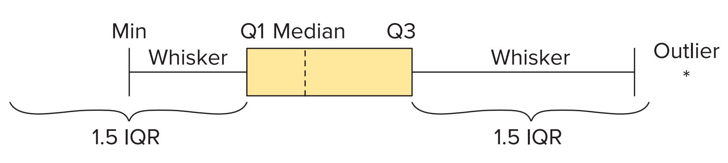
3.3: Detecting Outliers 3
A common way to quickly summarize a variable is to use a five-number summary.
A five-number summary shows the minimum, the quartiles (Q1, Q2, and Q3), and the maximum.
A boxplot, also referred to as a box-and-whisker plot, is a way to graphically display a five-number summary.
Access the text alternative for slide images.

Slide 34
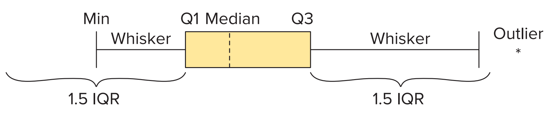
3.3: Detecting Outliers 4
We sketch a boxplot as follows:
Draw a box encompassing the first and third quartiles.
Draw a dashed vertical line in the box at the median.
Calculate the I Q R. Draw a whisker that extends from Q1 to the minimum value that is not further from 1.5*I Q R from Q1.
Similarly, draw a line that extends from Q3 to the maximum value that is not farther than 1.5*I Q R from Q3.
Use an asterisk (or another symbol) to indicate observations that are farther than 1.5*I Q R from the box. These observations are considered outliers.
Access the text alternative for slide images.

Slide 35
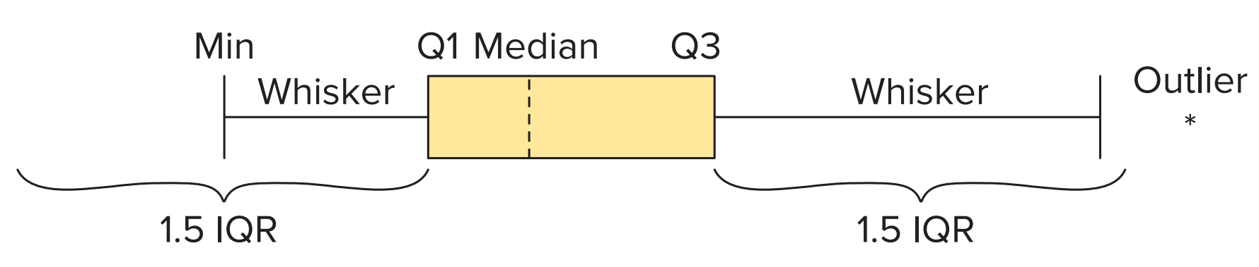
3.3: Detecting Outliers 5
A boxplot is also used to informally gauge the shape of the distribution.
Symmetry is implied if the median is in the center of the box and the left/right whiskers are equidistant from their respective quartiles.
If the median is left of center and the right whisker is longer than the left whisker, then the distribution is positively skewed.
Similarly, if the median is right of center and the left whisker is longer than the right whisker, then the distribution is negatively skewed.
If outliers exist, we need to include them when comparing the lengths of the left and right whiskers.
Access the text alternative for slide images.

Slide 36
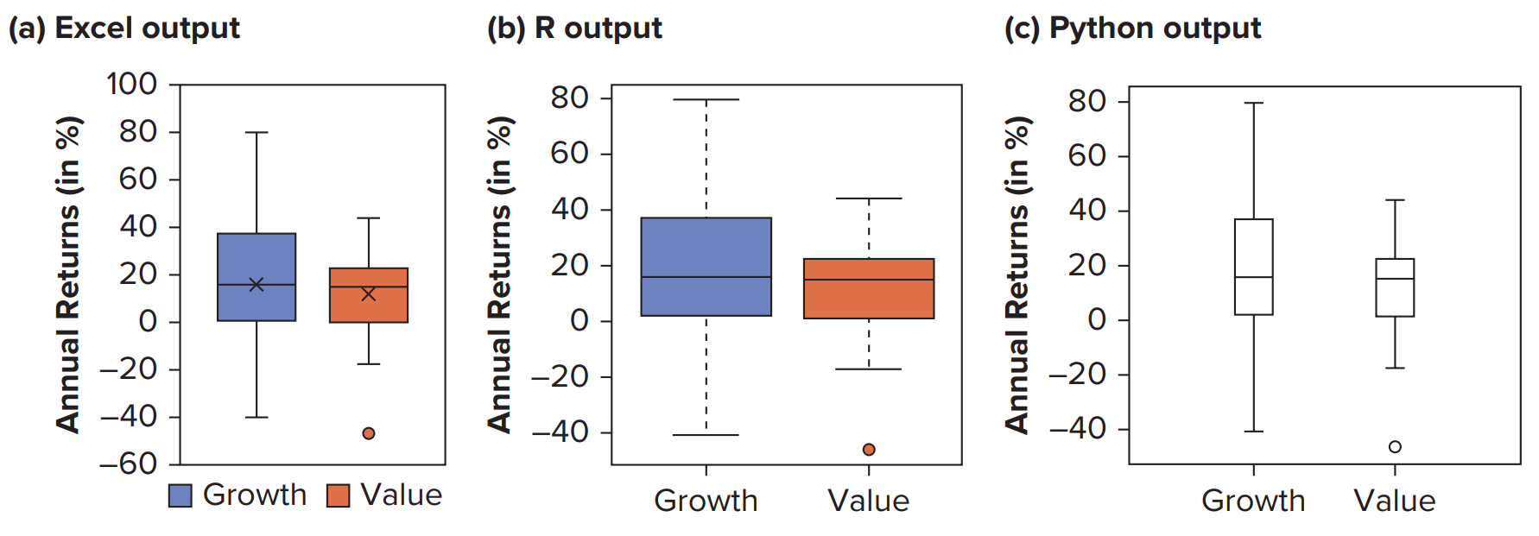
3.3: Detecting Outliers 6
Example: Construct a boxplot for the Growth and Value variables in the Growth_Value file for the Investment Decision case.
Access the text alternative for slide images.

Slide 37
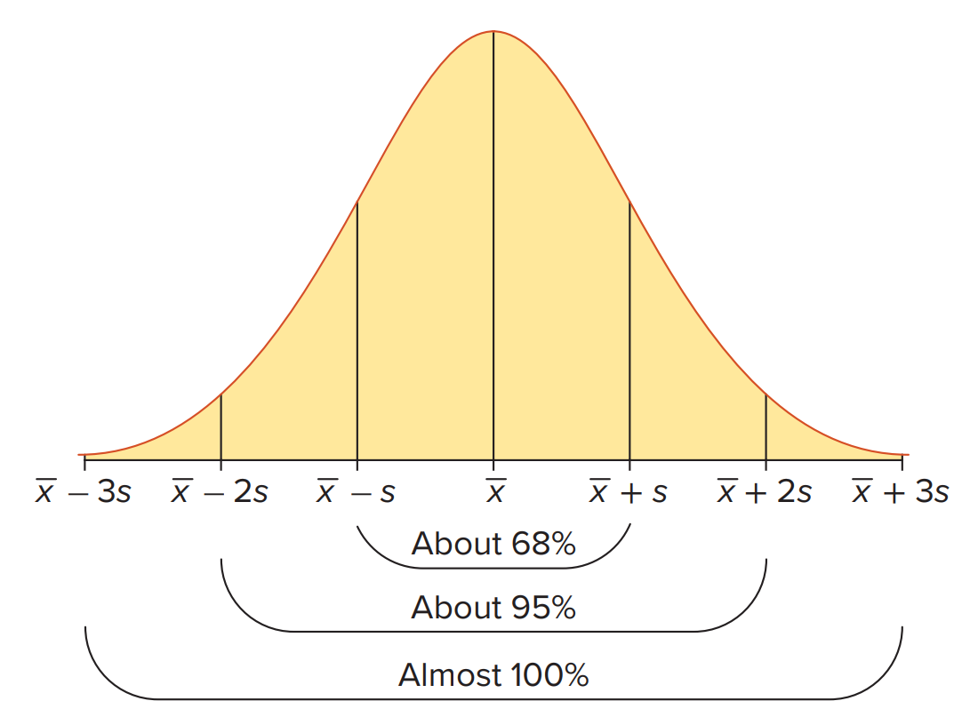
3.3: Detecting Outliers 7
The empirical rule indicates the percentage of observations that fall within a specified number of standard deviations from the mean.
Assume the observations are drawn from a relatively symmetric and bell-shaped distribution.
Approximately 68% of all observations fall in the interval
Approximately 95% of all observations fall in the interval
Approximately 100% of all observations fall in the interval
Access the text alternative for slide images.

Slide 38
3.3: Detecting Outliers 8
Example: a large lecture class has 280 students:
The mean score on an exam is 74 with a standard deviation of 8.
Approximately how many students scored within 58 and 90?
Approximately how many students scored more than 90?
58 and 90 are two standard deviations below and above the mean.
So about 95% of 280 students, or 266, scored within 58 and 90.
90 is two standard deviations above the mean.
95% of the observations fall within two standard deviations of the mean, 5% fall outside the interval.
Given the symmetry of the distribution, 2.5% scored above 90.
2.5% of the 280 students, or about 7, scored above 90 on the exam.

Slide 39
3.3: Detecting Outliers 9
It is often instructive to use the mean and the standard deviation to find the relative location of an observation.
We use the z-score to find the relative position of an observation by dividing the difference of the observation
from the mean by the standard deviation:
A z-score is a unitless measure.
It measures the distance of an observation from the mean in terms of standard deviations.
Converting observations into z-scores is also called standardizing the observations.

Slide 40
3.3: Detecting Outliers 10
Standardization is a common technique used in data analytics when dealing with variables measured using different scales.
If the distribution of a variable is relatively symmetric and bell-shaped, we can also use z-scores to detect outliers.
Since almost all observations fall within three standard deviations of the mean, it is common to treat an observation as an outlier if its z-score is more than 3 or less than −3.
Such observations must be reviewed to determine if they should remain in the data set.

Slide 41
3.3: Detecting Outliers 11
Example: What are the z-scores for the minimum and maximum values of the Growth and Value variables?
Table 3.8: Summary Statistics for the Growth and Value Variables (in %).
Fund | Minimum | Mean | Maximum | Standard Deviation
Growth | −40.90 | 15.989 | 79.48 | 25.651
Value | −46.52 | 11.996 | 44.08 | 17.998
Growth minimum:
Growth maximum: 𝑧 = 2.475.
Value minimum: 𝑧 = −3.251.
Value maximum: 𝑧 = 1.783.

Slide 42
End of Main Content
© McGraw Hill LLC. All rights reserved. No reproduction or distribution without the prior written consent of McGraw Hill LLC.

Slide 43
Accessibility Content: Text Alternatives for Images

Slide 44
Chapter 3 – Text Alternative
Return to parent-slide containing images.
Below the title is a stylised, abstract illustration of a woman’s profile. The back of her head extends into bubbles of numbers and letters. Words beside the illustration read, insights, strategy, action, feedback, profit. The authors are listed below, side by side. Jaggia, Kelly, Lertwachara, Chen. The McGraw Hill logo is at the bottom left of the page.
Return to parent-slide containing images.

Slide 45
3.3: Detecting Outliers 3 – Text Alternative
Return to parent-slide containing images.
The content at the top reads, a common way to quickly summarize a variable is to use a five-number summary. A five-number summary shows the minimum, the quartiles, Q1, Q2, and Q3, and the maximum. A boxplot, also referred to as a box-and-whisker plot, is a way to graphically display a five-number summary. The diagram at the bottom marks minimum, Q1, median, Q3, whiskers, and outlier. The maximum value is labeled 1.5 I Q R and the minimum value is labeled nearly half of 1.5 I Q R.
Return to parent-slide containing images.

Slide 46
3.3: Detecting Outliers 4 – Text Alternative
Return to parent-slide containing images.
The content at the top reads, a common way to quickly summarize a variable is to use a five-number summary. A five-number summary shows the minimum, the quartiles, Q1, Q2, and Q3, and the maximum. A boxplot, also referred to as a box-and-whisker plot, is a way to graphically display a five-number summary. The diagram at the bottom marks minimum, Q1, median, Q3, whiskers, and outlier. The maximum value is labeled 1.5 I Q R and the minimum value is labeled nearly half of 1.5 I Q R.
Return to parent-slide containing images.

Slide 47
3.3: Detecting Outliers 5 – Text Alternative
Return to parent-slide containing images.
The content at the top reads, a common way to quickly summarize a variable is to use a five-number summary. A five-number summary shows the minimum, the quartiles, Q 1, Q 2, and Q 3, and the maximum. A boxplot, also referred to as a box-and-whisker plot, is a way to graphically display a five-number summary. The diagram at the bottom marks minimum, Q 1, median, Q 3, whiskers, and outlier. The maximum value is labeled 1.5 I Q R and the minimum value is labeled nearly half of 1.5 I Q R.
Return to parent-slide containing images.

Slide 48
3.3: Detecting Outliers 6 – Text Alternative
Return to parent-slide containing images.
A text at the top reads, example: construct a boxplot for the growth and value variables in the growth value file for the investment decision case. The percentage median values of annual returns for growth and value in each boxplot are as follows. Excel output: growth, 18%, and value, 18%. R output: growth, 18%, and value, 18%. Python output: growth, 18%, and value, 18%. In each output, the maximum value for the growth is at 80%, and for value, it is at 42%. Data are approximated.
Return to parent-slide containing images.

Slide 49
3.3: Detecting Outliers 7 – Text Alternative
Return to parent-slide containing images.
The content at the top reads, the empirical rule indicates the percentage of observations that fall within a specified number of standard deviations from the mean. Assume the observations are drawn from a relatively symmetric and bell-shaped distribution. Approximately 68% of all observations fall in the interval x bar plus minus s. Approximately 95% of all observations fall in the interval x bar plus minus 2 s. Approximately 100% of all observations fall in the interval x bar plus minus 3 s. The bell curve at the bottom ranges between x bar minus 3 s and x bar plus 3 s with a peak at x bar.
Return to parent-slide containing images.

