Slide 1
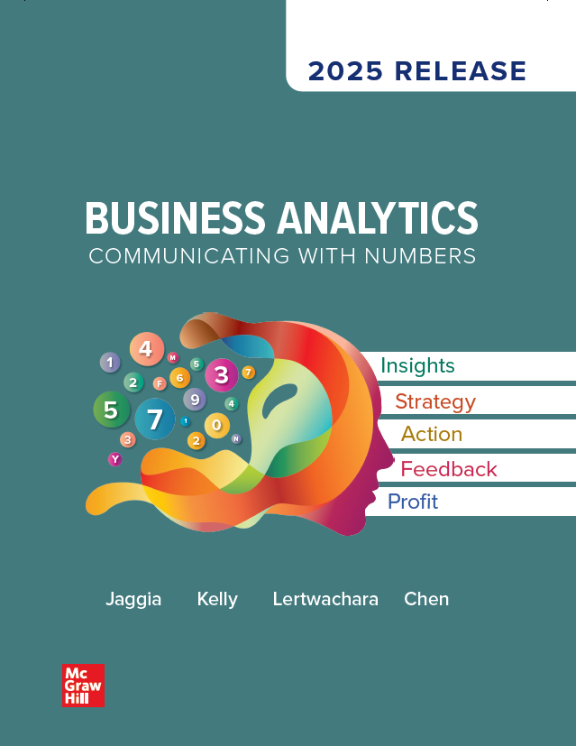
Chapter 4
Data Visualization
Access the text alternative for slide images.
© McGraw Hill LLC. All rights reserved. No reproduction or distribution without the prior written consent of McGraw Hill LLC.

Slide 2
Chapter 4 Learning Objectives (L O’s)
L O 4.1: Visualize a single variable.
L O 4.2: Visualize the relationship between two variables.
L O 4.3: Visualize the relationship between two or more variables.

Slide 3
Introductory Case: Construction Clothing
ReliableWorkWear.com is an online company that offers a large selection of construction clothing, work boots, gloves, and more that keep workers safe and comfortable on the job.
Brendan is the marketing analyst for ReliableWorkWear.com and has compiled data on 200 recent transactions.
Brendan will use the sample information to:
Convey the information from the variables in tabular form.
Convey the information from the variables in graphical form.
Discuss finding and provide strategies that may help increase sales.

Slide 4
4.1: Methods to Visualize a Single Variable 1
Tabular and graphical tools help us to organize and present data.
A categorical variable consists of observations that represent labels or names.
Data presented in this format—that is, in raw form—are very difficult to interpret.
When presented with a categorical variable, it is often useful to summarize the variable with a frequency distribution and/or a bar chart.

Slide 5
4.1: Methods to Visualize a Single Variable 2
Converting the raw data into a frequency distribution makes the data more manageable and easier to assess.
A frequency distribution for a categorical variable groups the observations into categories and records the number of observations that fall into each category.
The relative frequency distribution for each category equals the proportion of observations in each category.
A bar chart is a graphical representation of the frequency or relative frequency distribution.
Horizontal or vertical bars.
Lengths proportional to the values they are depicting.

Slide 6
4.1: Methods to Visualize a Single Variable 3
Example: Recall the Construction Clothing case.
The Transactions data file contains information on 200 recent customer purchases.
In addition to the Satisfaction variable, there are two other categorical variables.
The Repeat variable records whether or not the customer made a prior purchase (Repeat =Yes if prior purchase, No otherwise).
The Sex variable records whether the customer is male or female.
For each variable, construct its frequency distribution and bar chart, and then summarize the results.

Slide 7
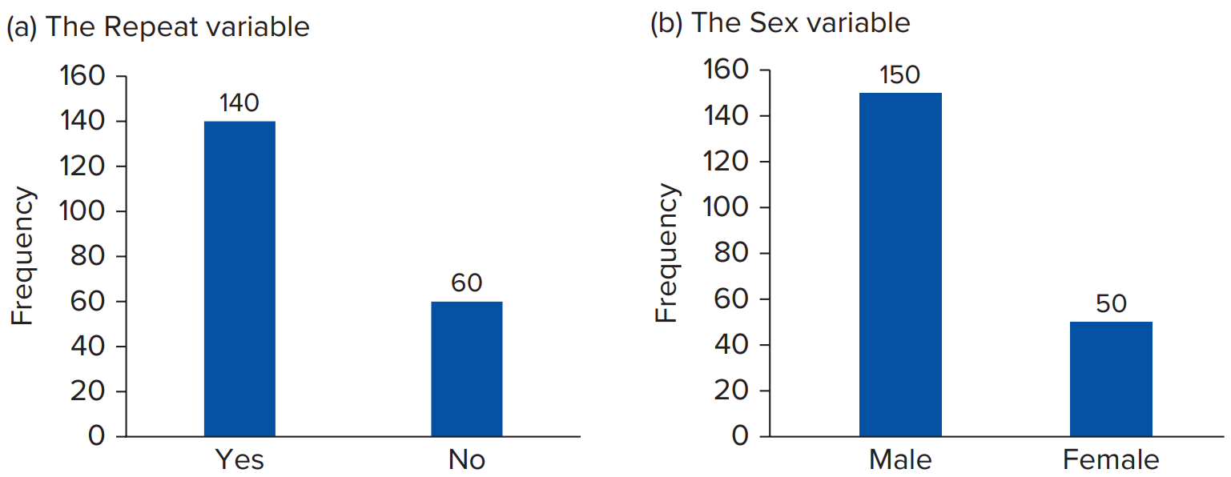
4.1: Methods to Visualize a Single Variable 4
Example.
(a) The Repeat Variable
(b) The Sex Variable
Repeat | Frequency | Relative Frequency
Yes | 140 | 0.70
No | 60 | 0.30
Sex | Frequency | Relative Frequency
Male | 150 | 0.75
Female | 50 | 0.25
Access the text alternative for slide images.

Slide 8
4.1: Methods to Visualize a Single Variable 5
With a numerical variable, each observation represents a meaningful amount or count.
Although different from a categorical variable, we still use a frequency distribution to summarize a numerical variable.
For a numerical variable, a frequency distribution groups the observations into intervals and records the number of observations that falls into each interval.
The relative frequency for each interval equals the proportion of observations in each interval.
The data are more manageable using a frequency distribution, but some detail is lost.

Slide 9
4.1: Methods to Visualize a Single Variable 6
Instead of categories, construct a series of intervals (classes or bins).
Guidelines about the intervals:
The intervals are mutually exclusive.
The number of intervals usually ranges from 5 to 20.
The intervals are exhaustive.
The intervals are easy to recognize and interpret.

Slide 10
4.1: Methods to Visualize a Single Variable 7
A histogram is the counterpart to the bar chart to visualize a frequency distribution.
A histogram is a series of rectangles where the width and height of each rectangle represent the interval width and frequency (or relative frequency) of the respective interval.
Mark off the interval limits along the horizontal axis.
The height of each bar represents either the frequency or the relative frequency for each interval.
No gaps appear between the interval limits.

Slide 11
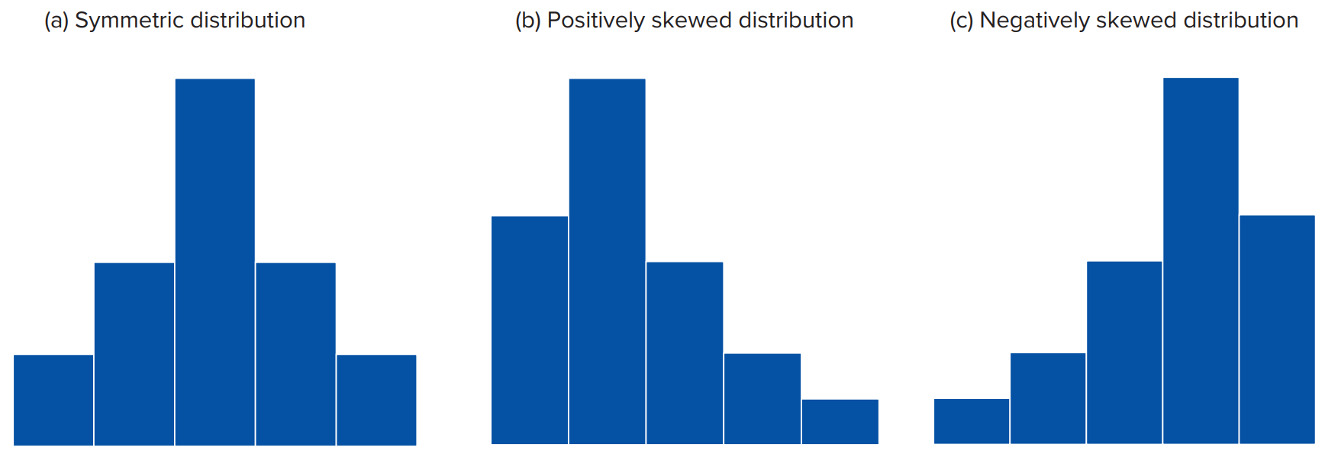
4.1: Methods to Visualize a Single Variable 8
A histogram provides information about the shape of the distribution.
Symmetric: mirror image of itself on both sides of its center.
Skewed: positive (elongated right tail) or negative (elongated left left).
Access the text alternative for slide images.

Slide 12
4.1: Methods to Visualize a Single Variable 9
Example: Recall the Construction Clothing case.
The Income variable in the Transactions data file shows the annual income.
Construct a frequency distribution and a histogram for the Income variable, and then summarize the results.

Slide 13
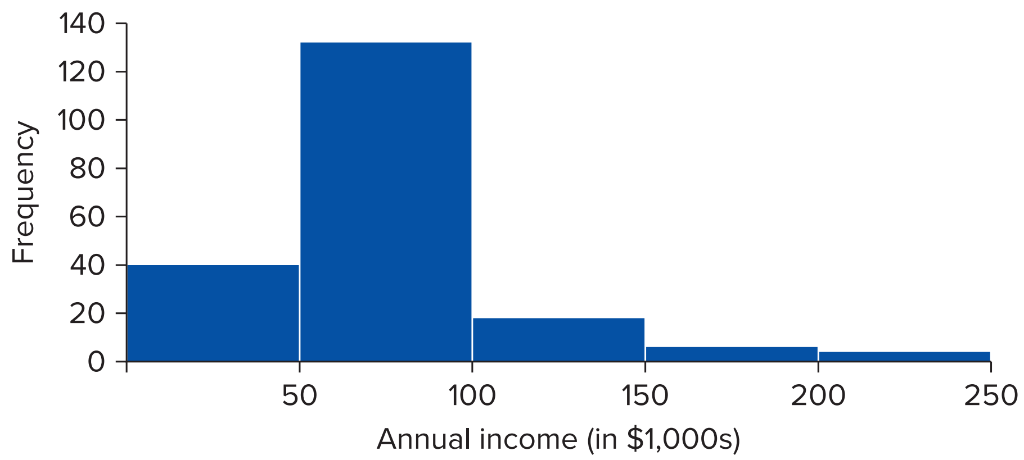
4.1: Methods to Visualize a Single Variable 10
Example.
Interval (in $1,000 s) | Frequency | Relative frequency
0 < x ≤ 50 | 40 | 0.20
50 < x ≤ 100 | 132 | 0.66
100 < x ≤ 150 | 18 | 0.09
150 < x ≤ 200 | 6 | 0.03
200 < x ≤ 250 | 4 | 0.02
Access the text alternative for slide images.

Slide 14
4.1: Methods to Visualize a Single Variable 11
The possibility exists for unintentional, as well as purposeful, distortions of graphical information.
The simplest graph should be used for a given set of data. Strive for clarity and avoid unnecessary adornments.
Axes should be clearly marked with the numbers of their respective scales; each axis should be labeled.
When creating a bar chart or a histogram, each bar/rectangle should be of the same width. Differing widths create distortions.

Slide 15
4.2: Methods to Visualize the Relationship between Two Variables 1
Use a contingency table to summarize and examine the relationship between two categorical variables.
Frequencies for two categorical variables.
Each cell represents a mutually exclusive combination of the pair of values.
The contingency table allows us to present and interpret the raw data in a much more manageable format.
Contingency tables are widely used in marketing as well as other business applications.

Slide 16
4.2: Methods to Visualize the Relationship between Two Variables 2
The information in a contingency table can be shown graphically using a stacked column chart.
A stacked column chart is an advanced version of the bar chart.
It is designed to visualize more than one categorical variable.
It allows for the comparison compositive within each category.
Each column represents the total number of responses for each level of one variable.
The segments within a column represent the other variable.

Slide 17
4.2: Methods to Visualize the Relationship between Two Variables 3
Example: An online retailer recently sent e-mails to customers that included a promotional discount.
The retailer wonders whether there is any relationship between a customer’s location in the U S (Midwest, Northeast, South, or West) and whether the customer made a purchase with the discount (Yes or No).
Summarize the Location and Purchase variables in the Promotion file by constructing a contingency table, a percent frequency table, a clustered column chart, and a stacked column chart.

Slide 18
4.2: Methods to Visualize the Relationship between Two Variables 4
Example:
Location | Purchase No | Purchase Yes | Total
Midwest | 107 | 77 | 184
Northeast | 41 | 102 | 143
South | 24 | 130 | 154
West | 18 | 101 | 119
Total | 190 | 410 | 600
Location | Purchase No | Purchase Yes | Total
Midwest | 17.83% | 12.83% | 30.67%
Northeast | 6.83% | 17.00% | 23.83%
South | 4.00% | 21.67% | 25.67%
West | 3.00% | 16.83% | 19.83%
Total | 31.67% | 68.33% | 100.00%

Slide 19
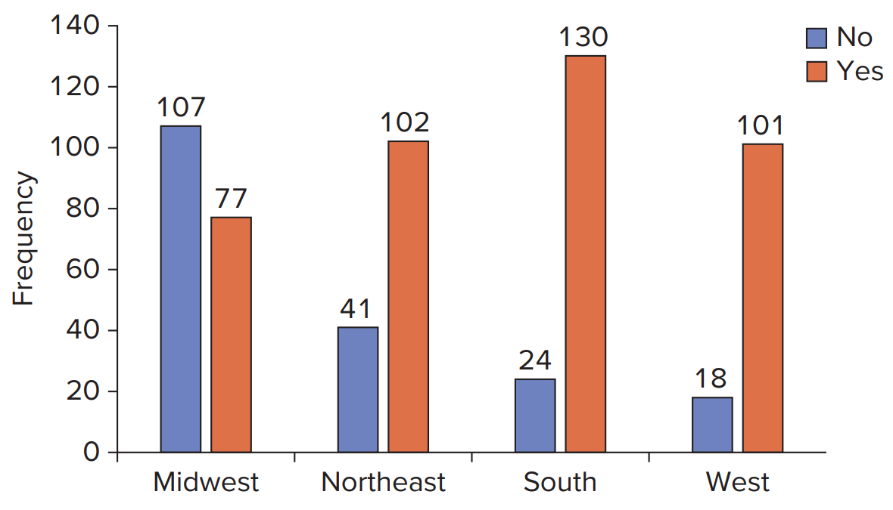
4.2: Methods to Visualize the Relationship between Two Variables 5
Example:
Access the text alternative for slide images.

Slide 20
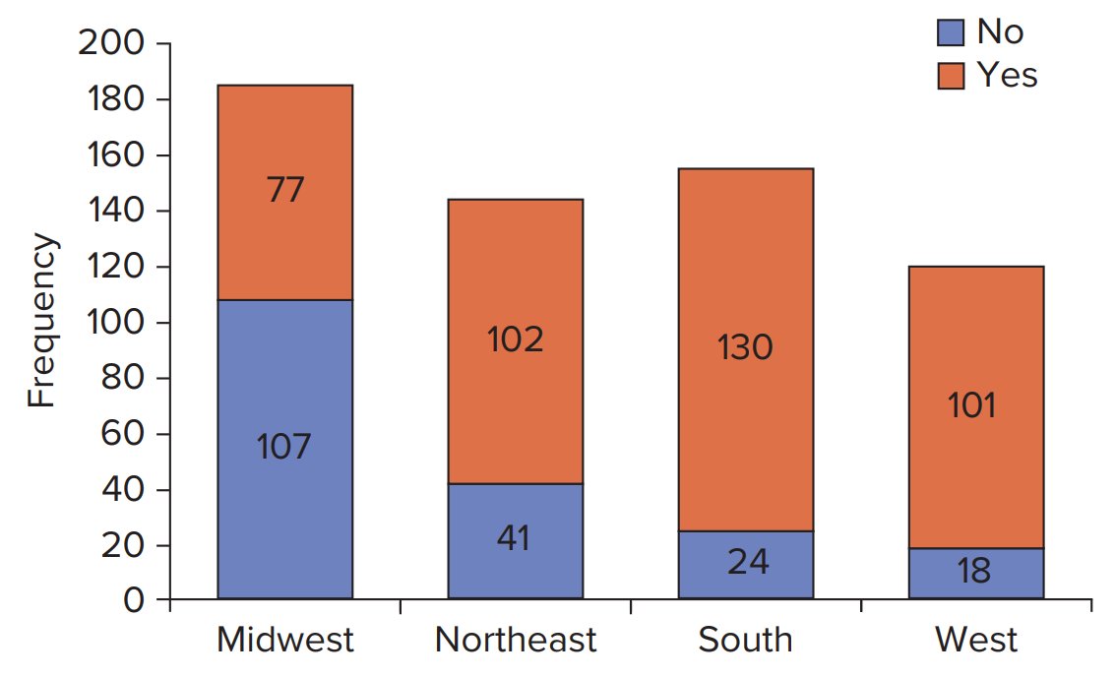
4.2: Methods to Visualize the Relationship between Two Variables 6
Example:
Access the text alternative for slide images.

Slide 21
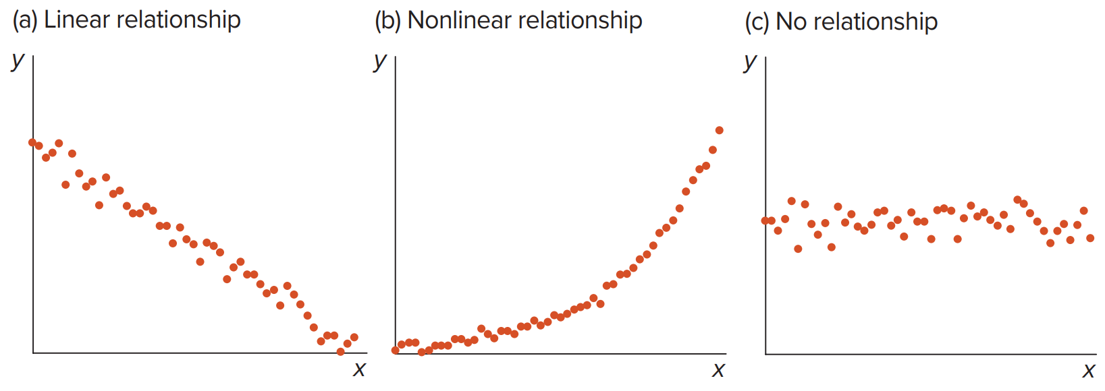
4.2: Methods to Visualize the Relationship between Two Variables 7
A scatterplot is used to determine whether or not two numerical variables are related in some systematic way.
Each point represents a paired observation for the two variables.
Refer to one variable as x (x-axis) and the other as y (y-axis).
Once plotted, the graph may reveal one of the below.
A linear relationship.
A nonlinear relationship.
No relationship.
Access the text alternative for slide images.

Slide 22
4.2: Methods to Visualize the Relationship between Two Variables 8
Example: Recall the Construction Clothing case.
The Transactions data file shows each customer’s purchase amount (Purchase in $) and the customer’s annual income (Income in $1,000 ’s) for 200 customers.
Perhaps we are interested in whether or not a customer’s annual income influences the purchase amount. Construct a scatterplot of Purchase against Income, and then summarize the results.

Slide 23
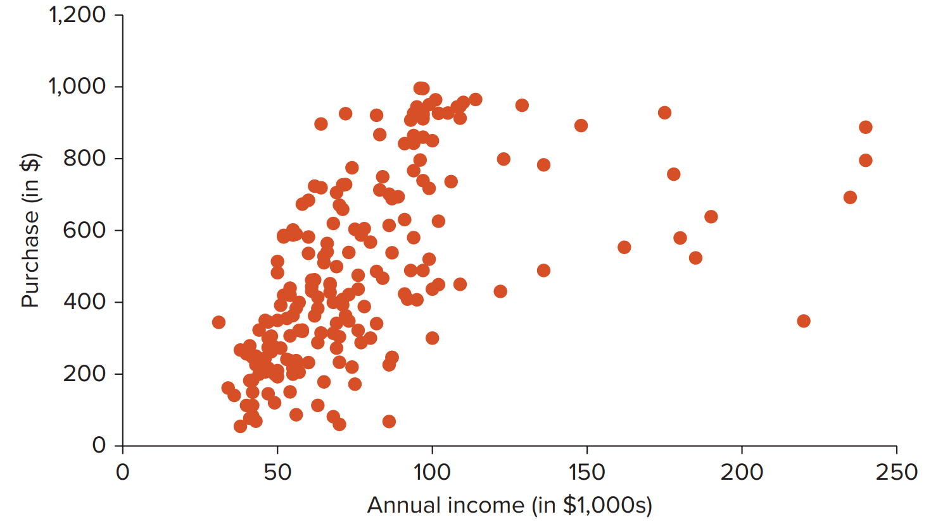
4.2: Methods to Visualize the Relationship between Two Variables 9
Example:
Access the text alternative for slide images.

Slide 24
4.3: Other Data Visualization Methods 1
A scatterplot with a categorical variable modifies a basic scatterplot by incorporating a categorical variable.
This allows us to see if the relationship between two numeric variables differs across the levels of a categorical variable.
It is common to encode the categorical variable through point color.
Giving each point a distinct hue makes it easy to show its membership to a respective category.

Slide 25
4.3: Other Data Visualization Methods 2
Example: The Birth_Life data file contains information on the following variables for 10 countries in 2010: country name (Country Name), life expectancy (Life_Exp in years), birth rate (Birth_Rate in percent), G N I per capita (G N I in $), and level of development (Development).
Construct a scatterplot of life expectancy against birth rate that also incorporates the Development variable (categorical).

Slide 26
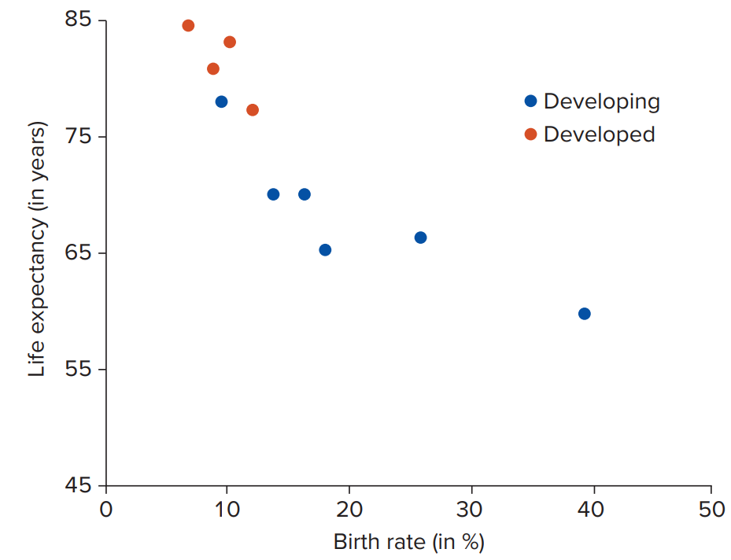
4.3: Other Data Visualization Methods 3
Example:
Access the text alternative for slide images.

Slide 27
4.3: Other Data Visualization Methods 4
A bubble plot shows the relationship between three numerical variables.
The third variable is represented by the size of the bubble (points).
Example: Revisit the Birth_Life data.
Construct a bubble plot of life expectancy against birth rate that uses the G N I variable for the size of the bubbles.
Summarize the results.

Slide 28
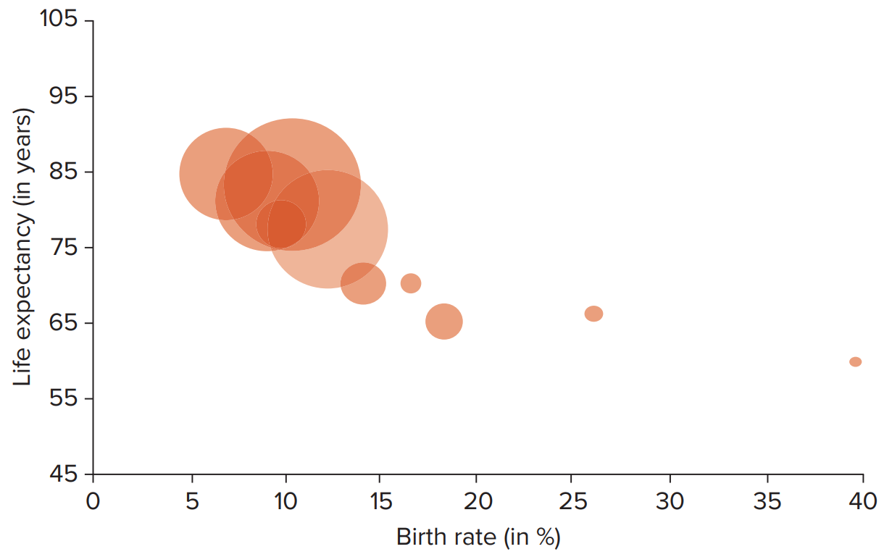
4.3: Other Data Visualization Methods 5
Example:
Access the text alternative for slide images.

Slide 29
4.3: Other Data Visualization Methods 6
A line chart displays a numerical variable as a series of data points connected by a line.
Connects the consecutive observations of a numerical variable with a line.
A line chart is especially useful for tracking changes or trends over time.
It is also easy for us to identify any major changes that happened in the past on a line chart.
When multiple lines are plotted in the same chart, we can compare these observations on one or more dimensions.

Slide 30
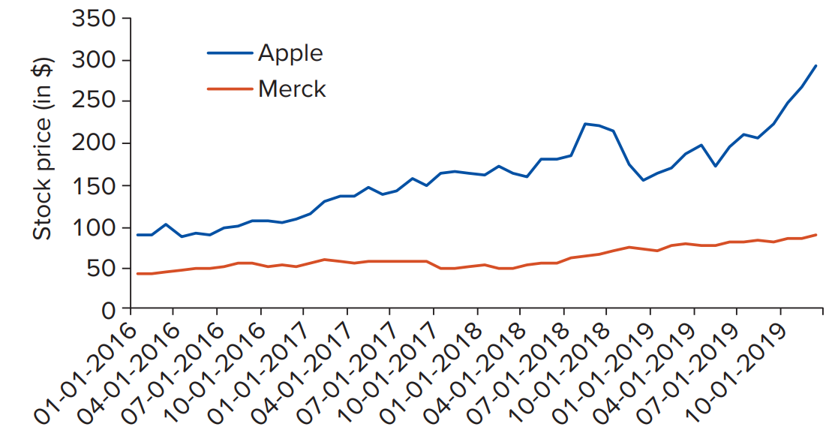
4.3: Other Data Visualization Methods 7
Example: The Apple_Merck data file contains monthly stock prices for Apple, Inc. and Merck & Co. for the years 2016 through 2019.
Construct the line charts for the stock prices for Apple and Merck. Then, summarize the results.
Access the text alternative for slide images.

Slide 31
4.3: Other Data Visualization Methods 8
A heat map uses color or color intensity to display relationships between variables.
A heat map is especially useful for identifying combinations of the categorical variables that have economic significance.
There are a number of ways to display a heat map.
They use color to communicate relationships between the variables that would be harder to understand by simply inspecting the raw data.

Slide 32
4.3: Other Data Visualization Methods 9
Example: A national bookstore chain is trying to understand customer preferences at various store locations.
The marketing department has acquired a list of 500 of the most recent transactions from four of its stores.
The data set Bookstores includes the record number (Record), which one of its four stores sold the book (BookStore), and the type of book sold (BookType).
The marketing department wants to visualize the data using a heat map to help it understand customer preferences at different stores.

Slide 33
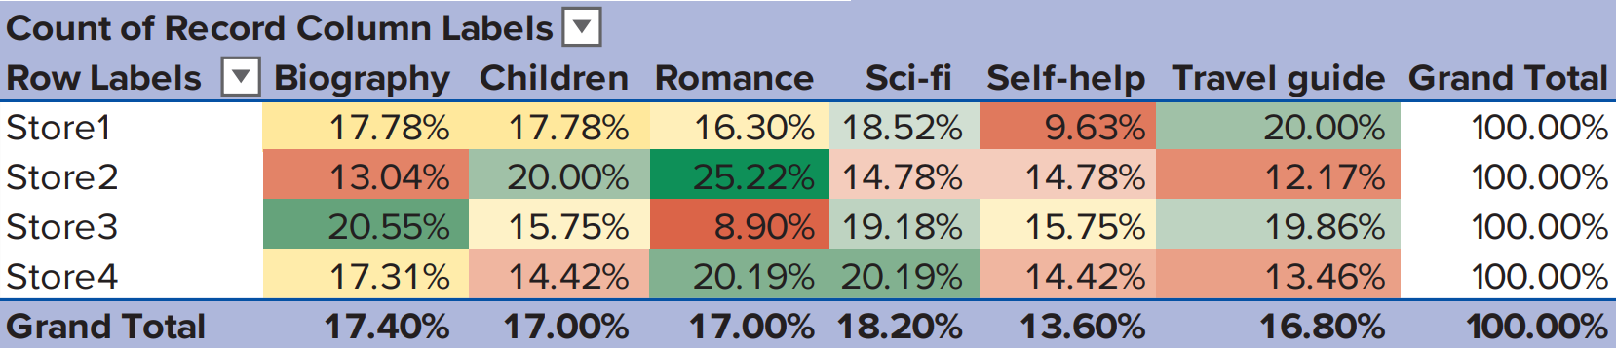
4.3: Other Data Visualization Methods 10
Example:
Access the text alternative for slide images.

Slide 34
End of Main Content
© McGraw Hill LLC. All rights reserved. No reproduction or distribution without the prior written consent of McGraw Hill LLC.

Slide 35
Accessibility Content: Text Alternatives for Images

Slide 36
Chapter 4 – Text Alternative
Return to parent-slide containing images.
Below the title is a stylised, abstract illustration of a woman’s profile. The back of her head extends into bubbles of numbers and letters. Words beside the illustration read, insights, strategy, action, feedback, profit. The authors are listed below, side by side. Jaggia, Kelly, Lertwachara, Chen. The McGraw Hill logo is at the bottom left of the page.
Return to parent-slide containing images.

Slide 37
4.1: Methods to Visualize a Single Variable 4 – Text Alternative
Return to parent-slide containing images.
The table and bar graph for the repeat variable depict the following values. Yes; frequency is 140 and relative frequency is 0.70. No; frequency is 60 and relative frequency is 0.30. The table and bar graph for the sex variable depict the following values. Male; frequency is 150 and relative frequency is 0.75. Female; frequency is 50 and relative frequency is 0.25.
Return to parent-slide containing images.

Slide 38
4.1: Methods to Visualize a Single Variable 8 – Text Alternative
Return to parent-slide containing images.
The content at the top reads, a histogram provides information about the shape of the distribution. Symmetric: mirror image of itself on both sides of its center. Skewed: positive with an elongated right tail or negative with an elongated left tail. The three histograms at the bottom of different trends are labeled symmetric distribution, positively skewed distribution, and negatively skewed distribution.
Return to parent-slide containing images.

Slide 39
4.1: Methods to Visualize a Single Variable 10 – Text Alternative
Return to parent-slide containing images.
The table lists frequency and relative frequency values, and the bar graph plots frequency values at intervals of annual income in thousand dollars. The values are as follows. Between greater than 0 and less than or equal to 50 thousand dollars, frequency, 40, and relative frequency, 0.20. Between greater than 50 and less than or equal to 100 thousand dollars, frequency, 132, and relative frequency, 0.66. Between greater than 100 and less than or equal to 150 thousand dollars, frequency, 18, and relative frequency, 0.09. Between greater than 150 and less than or equal to 200 thousand dollars, frequency, 6, and relative frequency, 0.03. Between greater than 200 and less than or equal to 250 thousand dollars, frequency, 4, and relative frequency, 0.02.
Return to parent-slide containing images.

Slide 40
4.2: Methods to Visualize the Relationship between Two Variables 5 – Text Alternative
Return to parent-slide containing images.
The graph plots frequency values for yes and no variables for different directions. The values are as follows. Midwest: no, 107, and yes, 77. Northeast: no, 41, and yes, 102. South: no, 24, and yes, 130. West: no, 18, and yes, 101.
Return to parent-slide containing images.

Slide 41
4.2: Methods to Visualize the Relationship between Two Variables 6 – Text Alternative
Return to parent-slide containing images.
The graph plots frequency values for yes and no variables for different directions. The values are as follows. Midwest: no, 107, and yes, 77. Northeast: no, 41, and yes, 102. South: no, 24, and yes, 130. West: no, 18, and yes, 101.
Return to parent-slide containing images.

Slide 42
4.2: Methods to Visualize the Relationship between Two Variables 7 – Text Alternative
Return to parent-slide containing images.
The content at the reads, a scatterplot is used to determine whether or not two numerical variables are related in some systematic way. Each point represents a paired observation for the two variables. Refer to one variable as the x or x-axis and the other as the y or y-axis. Once plotted, the graph may reveal one of the below: A linear relationship. A nonlinear relationship. No relationship. The scatterplots of y versus x labeled linear relationship, nonlinear relationship, and no relationship plot a cluster of dots in gradually decreasing, gradually increasing, and nearly linear trends, respectively.
Return to parent-slide containing images.

Slide 43
4.2: Methods to Visualize the Relationship between Two Variables 9 – Text Alternative
Return to parent-slide containing images.
It depicts clustered dots between an annual income of 40 and 110 thousand dollars and scattered dots afterward up to an annual income of 250 thousand dollars. The dots are presented between purchases of 10 and 1,000 dollars. Values are estimated.
Return to parent-slide containing images.

Slide 44
4.3: Other Data Visualization Methods 3 – Text Alternative
Return to parent-slide containing images.
It plots 2 clusters of dots for developing and developed in decreasing trends with increasing birth rates. Their highest and lowest values are as follows. Developing. (10, 78) and (40, 57). Developed. (8, 85) and (11, 77). Values are estimated.
Return to parent-slide containing images.

Slide 45
4.3: Other Data Visualization Methods 5 – Text Alternative
Return to parent-slide containing images.
It depicts that as the birth rate increases, life expectancy decreases. The largest birth expectancy up to 90 years is observed between 4 and 13 percent birth rate, whereas the smallest birth expectancy of 57 is observed at 40 percent birth rate. Data are approximated.
Return to parent-slide containing images.

Slide 46
4.3: Other Data Visualization Methods 7 – Text Alternative
Return to parent-slide containing images.
The content at the top reads, example: The Apple Merck data file contains monthly stock prices for Apple l n c and Merck and Co for the years 2016 through 2019. Construct the line charts for the stock prices for Apple and Merck. Then, summarize the results. The line graph at the bottom plots 2 increasing lines with fluctuations labeled Apple and Merck from January 1, 2016, to January 10, 2019. The lines of Apple and Merck have the highest values of 290 dollars and 100 dollars, respectively, on January 10, 2019. Values are estimated.
Return to parent-slide containing images.

Slide 47
4.3: Other Data Visualization Methods 10 – Text Alternative
Return to parent-slide containing images.
The column headers are labeled biography, children, romance, sci-fi, self-help, travel guide, and grand total. The rows are labeled store 1, store 2, store 3, store 4, and grand total. The grand totals of data inputs in columns labeled biography, children, romance, sci-fi, self-help, and travel guide are 17.40%, 17.00%, 17.00%, 18.20%, 13.60%, and 16.80%, respectively. The grand total value of data inputs for each store mentioned in the eighth column is 100%.
Return to parent-slide containing images.

