Slide 1

Chapter 5
Probability and Probability Distributions
Access the text alternative for slide images.
© McGraw Hill LLC. All rights reserved. No reproduction or distribution without the prior written consent of McGraw Hill LLC.

Slide 2
Chapter 5: Learning Objectives (L Os)
L O 5.1: Describe probability concepts and the rules of probability.
L O 5.2: Apply the total probability rule and Bayes’ theorem.
L O 5.3: Describe a discrete random variable and its probability distribution.
L O 5.4: Calculate probabilities for binomial and Poisson distributions.
L O 5.5: Describe the normal distribution and calculate its associated probabilities.

Slide 3
Introductory Case: Marijuana Legalization
Alexis is analyzing the demographic breakdown of marijuana supporters, and compiles information on support based on age group.
Age group | Support
Millennial (born between 19 81 and 19 96) | 71%
Generation X (born between 19 65 and 19 80) | 57
Baby Boomer (born between 19 46 and 19 64) | 56
Silent Generation (born between 19 28 and 19 45) | 33
Source: Pew Research Center, survey conducted August 23-September 2, 2016.
She would like to use the data to accomplish the following tasks.
Calculate and interpret relevant conditional, unconditional, and joint probabilities.
Calculate and interpret the probability of all Americans who support the legalization of marijuana.

Slide 4
5.1: Probability Concepts and Probability Rules 1
A probability is a numerical value that measures the likelihood that an event occurs.
Between zero (0) and one (1).
0 → impossible event that never occurs.
1 → a definite event that always occurs.
An experiment is a process that leads to one of several possible outcomes.
Actual outcome is not known with certainty before the experiment begins.
Diversity of outcomes is due to uncertainty.

Slide 5
5.1: Probability Concepts and Probability Rules 2
Sample space of an experiment.
Denoted S.
Contains all possible outcomes of the experiment.
Examples:
Letter grades in a course: S = {A, B, C, D, F}.
Passing a course or not: S = {pass, fail}.
An event is any subset of outcomes of the experiment.
Simple event if it contains a single outcome.
May contain several outcomes.

Slide 6
5.1: Probability Concepts and Probability Rules 3
Exhaustive events:
All possible outcomes of an experiment belong to the events.
Include all outcomes in the sample space.
Mutually exclusive events:
They do not share any common outcomes.
The occurrence of one event precludes the occurrence of others.
Examples:
Grades of A and B are not exhaustive events because they do not include all feasible grades in the sample space. But, the events are mutually exclusive.
Pass and fail are exhaustive and mutually exclusive.

Slide 7
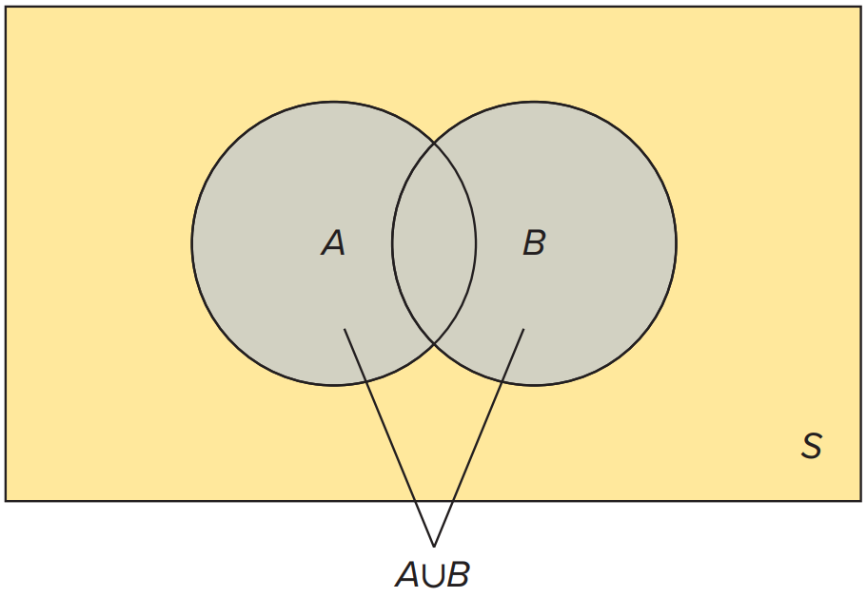
5.1: Probability Concepts and Probability Rules 4
We can define events based on one or more outcomes of the experiment and also combine events to form new events.
Venn Diagram.
Sample space S with a rectangle.
Two circles to represent the events A and B.
Union of two events:
Denoted
All outcomes in A or B (or both).
The portion in the Venn diagram that is included in either A or B.
Access the text alternative for slide images.

Slide 8
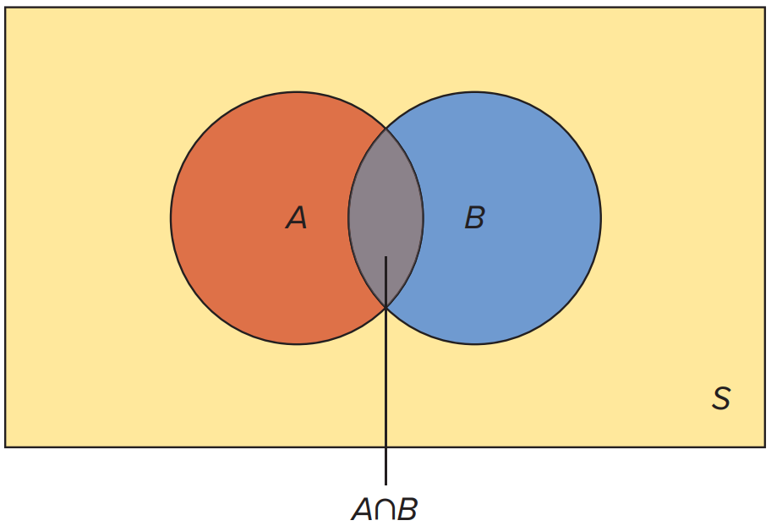
5.1: Probability Concepts and Probability Rules 5
Intersection of two events:
Denoted
All outcomes in A and B.
The portion in the Venn diagram that is included in both A and B, the overlap.
Access the text alternative for slide images.

Slide 9
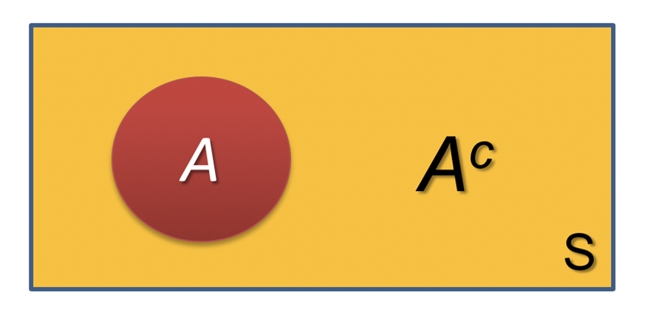
5.1: Probability Concepts and Probability Rules 6
Complement of an event A:
Denoted
All outcomes in the sample space S that are not in A.
The portion in the Venn diagram that is everything in S that is not included in A.

Slide 10
5.1: Probability Concepts and Probability Rules 7
Defining properties of probability.
The probability of an event A is a value between 0 and 1;
that is,
The sum of the probabilities of any list of mutually exclusive and exhaustive events equals 1.
There are three types of probabilities.
Subjective: calculated by drawing on personal and subjective judgement.
Empirical: calculated as a relative frequency of occurrence.
Classical: based on logical analysis.

Slide 11

5.1: Probability Concepts and Probability Rules 8
Complement rule:
The probability of the complement of an event is equal to one minus the probability of the event.
This follows from

Slide 12
5.1: Probability Concepts and Probability Rules 9
Example: 37% of female open house attendees will purchase a membership. What is the probability that a randomly selected female will not purchase a membership?
Define A as the event that a randomly selected female will purchase a membership.

Slide 13
5.1: Probability Concepts and Probability Rules 10
Addition rule:
Used to find the probability of the union of two events.
The probability that A or B occurs, or that at least one of these events occurs.
is double-counted in both
is called the joint probability.
Access the text alternative for slide images.

Slide 14
5.1: Probability Concepts and Probability Rules 11
Example: Anthony feels that he has a 75% chance of getting an A in Statistics and a 55% chance of getting an A in Managerial Economics. He also believes he has a 40% chance of getting an A in both classes.
a. What is the probability that he gets an A in at least one of these courses?
b. What is the probability that he does not get an A in either of these courses?

Slide 15
5.1: Probability Concepts and Probability Rules 12
Example:
Let
correspond to the probability of getting an A in Statistics,
Let
correspond to the probability of getting an A in Managerial
Economics,
Also,
a.
b. The probability that he does not receive an A in either of these two
courses is the complement of the union; that is,
So using the complement rule we have

Slide 16
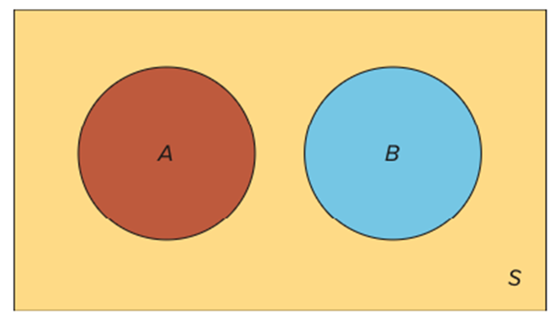
5.1: Probability Concepts and Probability Rules 13
For mutually exclusive events A and B, the probability of
their intersection is zero
There is no double counting.

Slide 17
5.1: Probability Concepts and Probability Rules 14
Suppose the probability that a recent business college graduate finds a suitable job is 0.80.
Let A represent finding a job,
This is not conditional on another event, so it is an unconditional probability.
The probability of finding a suitable job is 0.90 if the recent business graduate has prior work experience.
Let B represent prior work experience,
The probability of an event is conditional on the occurrence of another event, so it is a conditional probability.
The probability of finding a suitable job increases from 0.80 to 0.90 when conditioned on prior work experience.

Slide 18
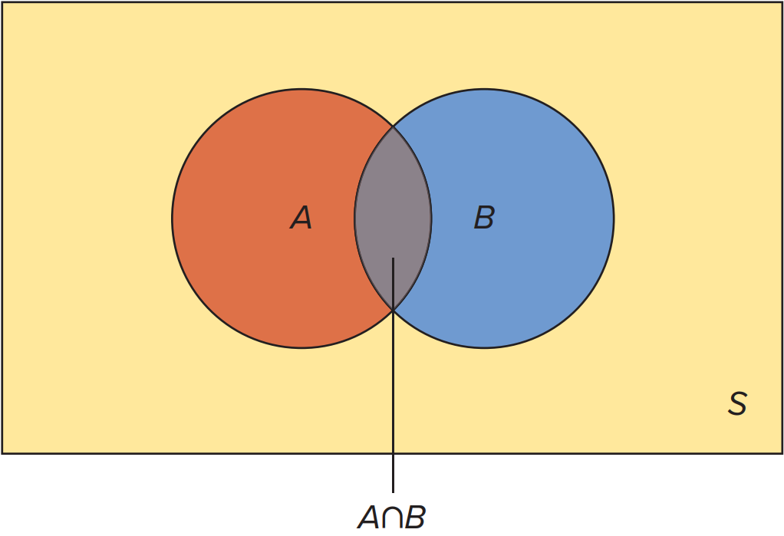
5.1: Probability Concepts and Probability Rules 15
Given two events A and B, each with a positive probability of occurring, the probability that A occurs given that B has occurred is derived as
Because
is conditional on B (B has occurred), the sample
space reduces to B.
portion in the Venn diagram that is included in B.
Similarly,
Access the text alternative for slide images.

Slide 19
5.1: Probability Concepts and Probability Rules 16
The conditional probability,
is greater than the
unconditional probability
when B exerts a positive
influence on A.
The conditional probability,
is less than the
unconditional probability
when B exerts a negative
influence on A.

Slide 20
5.1: Probability Concepts and Probability Rules 17
Example: An economist predicts a 60% chance that country A will perform poorly and a 25% chance that country B will perform poorly.
There is also a 16% chance that both countries will perform poorly.
What is the probability that country A performs poorly given that country B performs poorly?

Slide 21
5.1: Probability Concepts and Probability Rules 18
Example:
Let A represent the event that country A performs poorly,
Let B represent the event that country B performs poorly,
The probability that country A performs poorly and country B performs
poorly is
The probability that country A performs poorly given country B
performs poorly is
The conditional probability is greater than the unconditional probability, so country B performing poorly exerts a positive influence on country A performing poorly.

Slide 22
5.1: Probability Concepts and Probability Rules 19
We can find the joint probability as the product of probabilities using the conditional probability formula; this is the multiplication rule.
The joint probability of events A and B is derived as
Example: A manager believes that 14% of consumers will respond positively to the firm’s social media. Also, 24% of those who respond positively will become loyal customers.
What is the probability that the next recipient of their social media campaign will react positively and become a loyal customer?

Slide 23
5.1: Probability Concepts and Probability Rules 20
Example:
Let R represent the event that a consumer who responds
positively to a social media campaign, so
Let L represent the event that a consumer is loyal, so
The probability that a consumer responds positively to a social media campaign and is loyal is given by

Slide 24
5.1: Probability Concepts and Probability Rules 21
Two events are independent if the occurrence of one event does not affect the probability of the occurrence of the other event.
Events are considered dependent if the occurrence of one is related to the probability of the occurrence of the other event.
Two events, A and B, are independent if.

Slide 25
5.1: Probability Concepts and Probability Rules 22
Example: Suppose that for a given year there is a 2% chance that your desktop computer will crash and a 6% chance that your laptop computer will crash.
Moreover, there is a 0.12% chance that both computers will crash.
Is the reliability of the two computers independent of each other?

Slide 26
5.1: Probability Concepts and Probability Rules 23
Example:
Let D represent the outcome that your desktop crashes,
Let L represent the outcome that your laptop crashes,
The joint probability is
Calculate
So,
If your laptop crashes, it does not alter the
probability that your desktop also crashes.
The reliability of the two computers is independent.

Slide 27
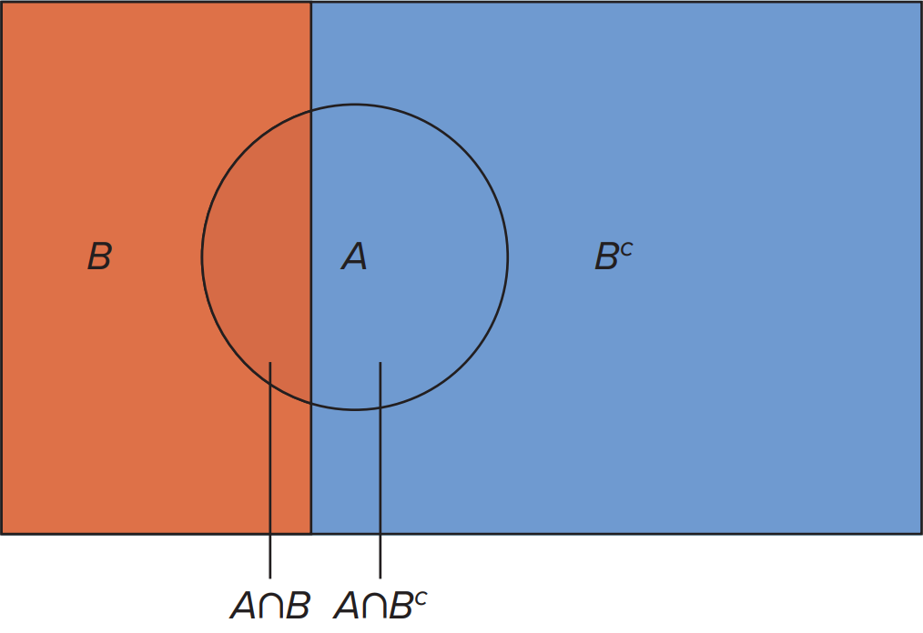
5.2: The Total Probability Rule and Bayes’ Theorem 1
The total probability rule expresses the probability of an event, A, in terms of probabilities of the intersection of A with any mutually exclusive and exhaustive events.
The total probability rule based on two events,
is given by
Access the text alternative for slide images.

Slide 28
5.2: The Total Probability Rule and Bayes’ Theorem 2
Bayes’ theorem is a procedure for updating probabilities based on new information; it uses the total probability rule.
The original probability is an unconditional probability called a prior probability, in the sense that it reflects only what we know before the arrival of new information.
On the basis of new information, we update the prior probability to arrive at a conditional probability called a posterior probability.
The posterior probability
can be found using the information
on the prior probability
along with conditional probabilities as,

Slide 29
5.2: The Total Probability Rule and Bayes’ Theorem 3
Example: In a lie-detector test, an individual is asked to answer a series of questions while connected to a polygraph (lie detector).
This instrument measures and records several physiological responses of the individual on the basis that false answers will produce distinctive measurements.
Assume that 99% of the individuals who go in for a polygraph test tell the truth.
These tests are considered to be 95% reliable. In other words, there is a 95% chance that the test will detect a lie if an individual actually lies.
Let there also be a 0.5% chance that the test erroneously detects a lie even when the individual is telling the truth.
An individual has just taken a polygraph test and the test has detected a lie. What is the probability that the individual was actually telling the truth?

Slide 30
5.2: The Total Probability Rule and Bayes’ Theorem 4
Example:
Let D and T correspond to the events that the polygraph detects a lie and that
an individual is telling the truth,
We formulate
We can use Bayes’ theorem to find
Although we can use this formula directly, we can use the below table to help solve the problem systematically.

Slide 31
5.3: Random Variables and Discrete Probability Distributions 1
A random variable is a function that assigns numerical values to the outcomes of an experiment.
A discrete random variable assumes a countable number of distinct values.
A continuous random variable is characterized by an uncountable values within an interval.

Slide 32
5.3: Random Variables and Discrete Probability Distributions 2
Every discrete random variable is associated with a probability distribution.
is the probability that a random variable assumes a
particular value.
Each probability is between 0 and 1, or
The sum of the probabilities equals 1, or
A discrete random variable can also be defined in terms of
their cumulative distribution function,

Slide 33
5.3: Random Variables and Discrete Probability Distributions 3
The expected value is also referred to as the mean.
It is a weighted average of all possible values of X.
Denoted as
It is calculated as
The variance and standard deviation are both measures of variability.
The variance is denoted
The variance is calculated as
The standard deviation is denoted by

Slide 34
5.3: Random Variables and Discrete Probability Distributions 4
Example: Juan Jimenez is the owner of a large car dealership in Chicago.
Juan decides to construct an incentive compensation program that equitably and consistently compensates employees on the basis of their performance.
He offers an annual bonus of $10,000 for superior performance, $6,000 for good performance, $3,000 for fair performance, and $0 for poor performance.
Based on prior records, he expects an employee to perform at superior, good, fair, and poor performance levels with probabilities 0.15, 0.25, 0.40, and 0.20, respectively.
a. Calculate the expected value of the annual bonus amount.
b. Calculate the variance and the standard deviation of the annual bonus amount.
c. What is the total annual amount that Juan can expect to pay in bonuses if he has 25 employees?

Slide 35
5.3: Random Variables and Discrete Probability Distributions 5
Example:
Let the random variable X denote the bonus amount (in $1,000’s).
a. The expected value is
b. The variance is
The standard deviation is
c. If Juan has 25 employees, we can expect to pay $4,200×25 = $105,000 in bonuses.

Slide 36
5.4: The Binomial and Poisson Distributions 1
A Bernoulli process is a series of n independent and identical trials of an experiment where each trial has the below characteristics.
There are only two possible outcomes: success and failure.
The probabilities of success and failure remain the same from trial to trial.
p is the probability of success.
1− p is the probability of failure.
A binomial random variable x is defined as the number of successes achieved in the n trials of a Bernoulli process.
The possible values of x are 0, 1, ⋯ , n.

Slide 37
5.4: The Binomial and Poisson Distributions 2
For a binomial random variable X, the binomial distribution are the attached probabilities.
For x = 0, 1, 2,⋯ n.
Note
There are two parts of the formula.
is how many sequences with x successes and n − x failures.
is the probability of any particular sequence with x successes and
n − x failures.
The mean is
The variance is

Slide 38
5.4: The Binomial and Poisson Distributions 3
Example: A firm has estimated 30% of customers react positively to its new web features.
Suppose five adults are randomly selected.
a. What is the probability that none of the customers react positively to the firm’s new we features?
b. Calculate the expected number of customers that react positively to the firm’s new web features?

Slide 39
5.4: The Binomial and Poisson Distributions 4
Example:
This problem satisfies the conditions for a Bernoulli process with n = 5 adults.
A customer reacts positively with probability p = 0.30.
Or a customer does not react positively with probability 1 − p = 0.70.
a.
b. The mean is

Slide 40
5.4: The Binomial and Poisson Distributions 5
It is cumbersome to find binomial probabilities with the formula, especially when X assumes a wide range of values.
With Excel: BINOM.DIST.
With R: dbinom and pbinom.

Slide 41
5.4: The Binomial and Poisson Distributions 6
Example: People turn to social media to stay in touch with friends and family members, connect with old friends, catch the news, look for employment, and be entertained.
According to a recent survey, 68% of all U S adults are Facebook users.
Consider a sample of 100 randomly selected American adults.
a. What is the probability that exactly 70 American adults are Facebook users?
b. What is the probability that no more than 70 American adults are Facebook users?

Slide 42
5.4: The Binomial and Poisson Distributions 7
Example:
Let X denote the number of American adults who are Facebook users.
We also know that p = 0.68 and n = 100.
a.
BINOM.DIST(70, 100, 0.68, FALSE).
dbinom(70, 100, 0.68).
b.
BINOM.DIST(70, 100, 0.68, TRUE).
pbinom(70, 100, 0.68).

Slide 43
5.4: The Binomial and Poisson Distributions 8
An experiment satisfies a Poisson process if:
The number of successes with a specified time or space interval equals any integer between zero and infinity.
The number of successes counted in nonoverlapping intervals are independent.
The probability of success in any interval is the same for all intervals of equal size and is proportional to the size of the interval.
For a Poisson process, we define the number of successes achieved in a specified time or space interval as a Poisson random variable.

Slide 44
5.4: The Binomial and Poisson Distributions 9
For a Poisson random variable X, the probability of x successes over a given interval of time or space is
This is for x = 0, 1, 2, ⋯.
is the mean number of successes.
is the base of the natural logarithm.
The mean is
The variance is

Slide 45
5.4: The Binomial and Poisson Distributions 10
Example: Anne is concerned about staffing needs at the Starbucks that she manages.
She believes that the typical Starbucks customer averages 18 visits to the store over a 30-day month.
a. How many visits should Anne expect in a 5-day period from a typical Starbucks customer?
b. What is the probability that a customer visits the chain five times in a 5-day period?

Slide 46
5.4: The Binomial and Poisson Distributions 11
We use the Poisson process condition that the probability that success occurs in any interval is the same for all intervals of equal size and is proportional to the size of the interval.
Here, the relevant mean will be based on the rate of 18 visits over a 30-day month.
a. Given the rate of 18 visits over a 30-day month, we can
write the mean for the 30-day period as
So the
mean for the 5-day period is
b.

Slide 47
5.4: The Binomial and Poisson Distributions 12
It is cumbersome to find Poisson probabilities with the formula.
With Excel: POISSON.DIST.
With R: dpois and ppois.

Slide 48
5.4: The Binomial and Poisson Distributions 13
Example: The sales volume of craft beer continues to grow in the U S According to one estimate, 1.5 craft breweries open every day.
Assume this number represents an average that remains constant over time.
a. What is the probability that no more than 10 craft breweries open every week?
b. What is the probability that exactly 10 craft breweries open every week?

Slide 49
5.4: The Binomial and Poisson Distributions 14
Example:
a.
POISSON.DIST(10, 10.5, TRUE).
ppois(10, 10.5).
b.
POISSON.DIST(10, 10.5, FALSE).
dpois(10, 10.5).

Slide 50
5.5: The Normal Distribution 1
A continuous random variable is completely described by its probability density
function, denoted
The graph of
approximates the relative frequency polygon for the
population.
The area under
over all values of X must equal one.
The probability the variable assumes a value with an interval,
is defined as the area under
between points a and b.
Unlike a discrete random variable,
for any value.
There is zero area under
at a single point.
x is a single value and there is an uncountable number of possible values.
As a result,

Slide 51
5.5: The Normal Distribution 2
A simple probability distribution for a continuous random variable is called the continuous uniform distribution.
This distribution is appropriate when the underlying random variable has an equally likely chance of assuming a value within a specified range.
Example: Suppose you are informed that your new refrigerator will be delivered between 2:00 pm and 3:00 pm.
Let X denote the delivery time, this is bounded below by 2:00 pm and above by 3:00 pm for a total range of 60 minutes.
The probability of a delivery between 2:00 pm and 2:30 is

Slide 52
5.5: The Normal Distribution 3
The normal distribution is one of the most widely used continuous distributions.
Bell-shaped and symmetric around its mean.
Gaussian distribution.
One reason for its extensive use is that closely approximates the probability distribution for a wide range of random variables.
Another important function of the normal distribution is that it serves as the cornerstone of statistical inference.

Slide 53
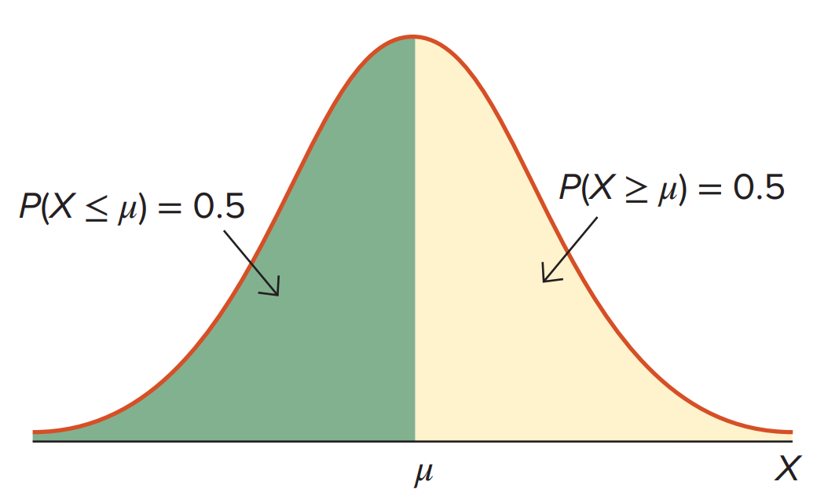
5.5: The Normal Distribution 4
A graph depicting the normal probability density function
is often referred to as the normal curve or bell curve.
Use the cumulative distribution function
to compute
probabilities: the area under the normal curve up to the value x.
Use tables or software to find probabilities.
Excel: NORM.DIST
R: pnorm.
Access the text alternative for slide images.

Slide 54
5.5: The Normal Distribution 5
Example: Scores on a management aptitude exam are normally distributed with a mean of 72 and a standard deviation of 8.
a. What is the probability that a randomly selected manager will score above 60?
b. What is the probability that a randomly selected manager will score between 68 and 84?

Slide 55
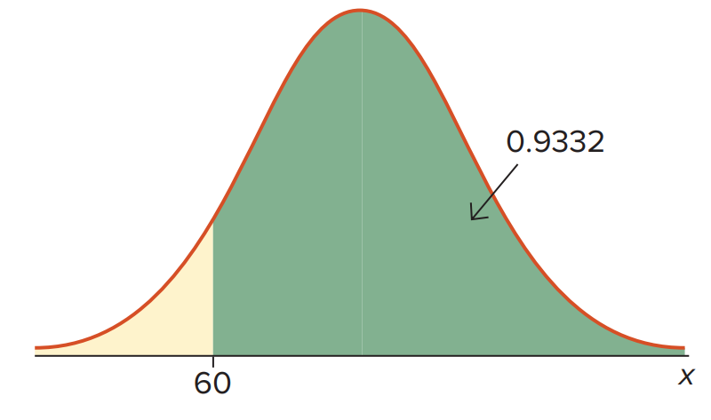
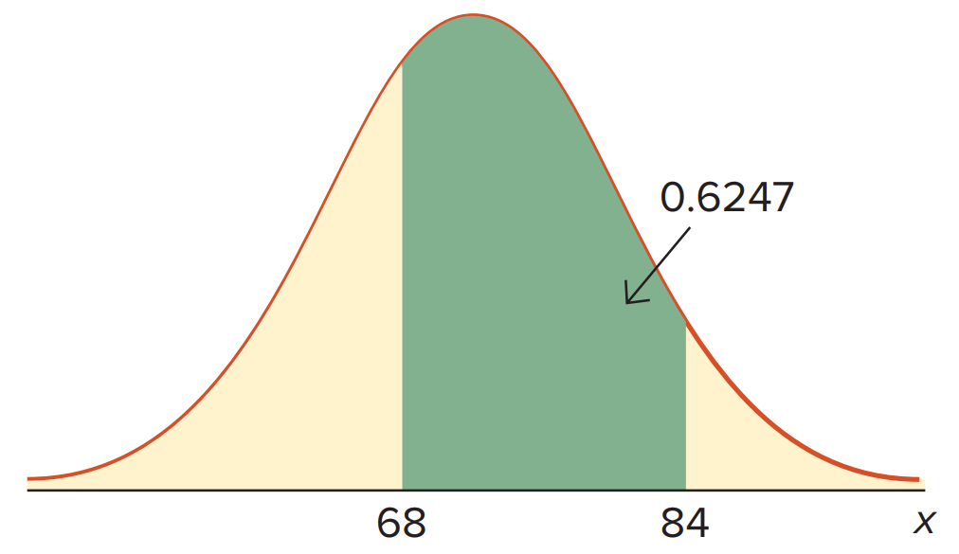
5.5: The Normal Distribution 6
Example:
Let X represent scores with
a.
1-NORM.DIST(60, 72, 8, TRUE).
pnorm(60,72,8, lower.tail = FALSE).
b.
NORM.DIST(84, 72, 8, TRUE) − NORM.DIST(68, 72, 8, TRUE).
pnorm(84,72,8, lower.tail=TRUE) − pnorm(68,72,8, lower.tail=TRUE).

Slide 56
5.5: The Normal Distribution 7
Given probabilities, we can compute values of X.
Example: Scores on a management aptitude exam are normally distributed with a mean of 72 and a standard deviation of 8.
a. What is the lowest score that will place a manager in the top 10% (90th percentile) of the distribution?
b. What is the highest score that will place a manager in the bottom 25% (25th percentile) of the distribution?

Slide 57
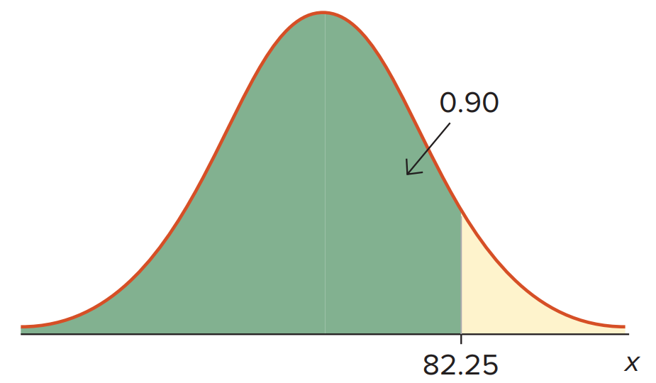
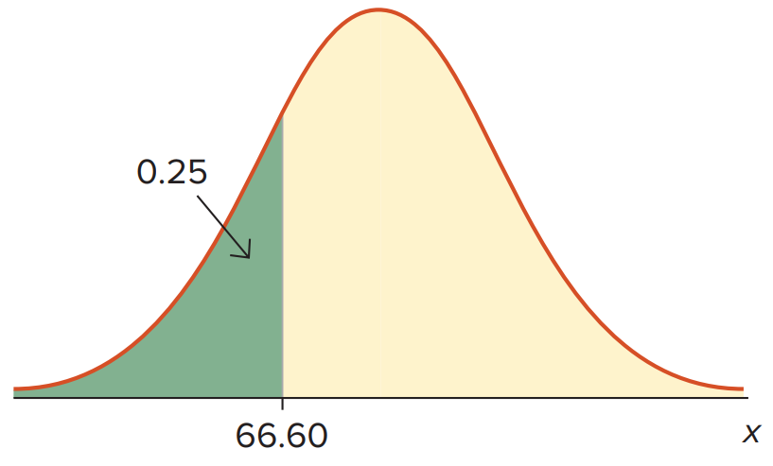
5.5: The Normal Distribution 8
Example:
Let X represent scores with
a. The 90th percentile is 82.24.
NORM.INV(0.90, 72, 8).
qnorm(0.90,72,8).
b. The 25th percentile is 66.64.
NORM.INV(0.25, 72, 8).
qnorm(0.25,72,8).

Slide 58
End of Main Content
© McGraw Hill LLC. All rights reserved. No reproduction or distribution without the prior written consent of McGraw Hill LLC.

Slide 59
Accessibility Content: Text Alternatives for Images

Slide 60
Chapter 5 – Text Alternative
Return to parent-slide containing images.
Below the title is a stylised, abstract illustration of a woman’s profile. The back of her head extends into bubbles of numbers and letters. Words beside the illustration read, insights, strategy, action, feedback, profit. The authors are listed below, side by side. Jaggia, Kelly, Lertwachara, Chen. The McGraw Hill logo is at the bottom left of the page.
Return to parent-slide containing images.

Slide 61
5.1: Probability Concepts and Probability Rules 4 – Text Alternative
Return to parent-slide containing images.
The universal set containing the circles is labeled as S. The lines point to the circles and A union B is labeled.
Return to parent-slide containing images.

Slide 62
5.1: Probability Concepts and Probability Rules 5 – Text Alternative
Return to parent-slide containing images.
The common area between the circles is labeled A intersection B. The universal set containing the circles is labeled S.
Return to parent-slide containing images.

Slide 63
5.1: Probability Concepts and Probability Rules 10 – Text Alternative
Return to parent-slide containing images.
The universal set containing the circles is labeled as S. The lines point to the circles and A union B is labeled.
Return to parent-slide containing images.

Slide 64
5.1: Probability Concepts and Probability Rules 15 – Text Alternative
Return to parent-slide containing images.
The common area between the circles is labeled A intersection B. The universal set containing the circles is labeled S.
Return to parent-slide containing images.

Slide 65
5.2: The Total Probability Rule and Bayes’ Theorem 1 – Text Alternative
Return to parent-slide containing images.
The area common to the circle A and part B is labeled A intersection B. The area common to circle A and B complement is labeled A intersection B complement.
Return to parent-slide containing images.

Slide 66
5.5: The Normal Distribution 4 – Text Alternative
Return to parent-slide containing images.
The left portion is P of X less than or equal to mu is equal to 0.5. The right portion is P of X greater than or equal to mu is equal to 0.5. The right end of the graph is z.
Return to parent-slide containing images.

