Slide 1
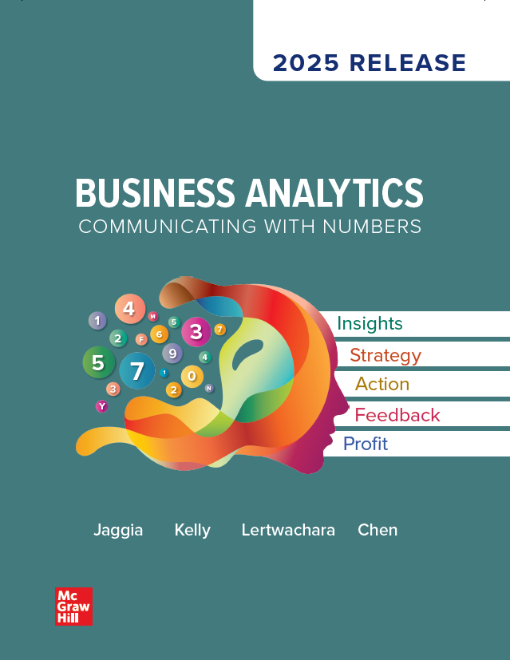
Chapter 7
Regression Analysis
Access the text alternative for slide images.
© McGraw Hill LLC. All rights reserved. No reproduction or distribution without the prior written consent of McGraw Hill LLC.

Slide 2
Chapter 7 Learning Objectives (L Os)
L O 7.1: Estimate and interpret a linear regression model.
L O 7.2: Interpret goodness-of-fit measures.
L O 7.3: Conduct tests of significance.
L O 7.3: Address common violations of the O L S assumptions.

Slide 3
Introductory Case: College Scorecard 1
College costs and student debt are on the rise!
Students and parents struggle to find clear, reliable data on critical questions of college affordability and value.
The Department of Education (D O E) published a redesigned College Scorecard that reports the most reliable national data on college costs and students’ outcomes at specific colleges.
Fiona Schmidt, a college counselor, believes that the information from the College Scorecard can help her as she advises families.

Slide 4
Introductory Case: College Scorecard 2
Fiona wonders what college factors influence post-college earnings and wants answers to the following questions:
If a college costs more or has a higher graduation rate, should a student expect to earn more after graduation?
If a greater percentage of the students are paying down debt after college, does this somehow influence post-college earnings?
And finally, does the location of a college affect post-college earnings?

Slide 5
Introductory Case: College Scorecard 3
Information from 116 colleges on the following variables:
Notes: All data were downloaded from https://collegescorecard.ed.gov from May 24-26.2016; see website for complete description of data.
Use the information to:
Make predictions for post-college earnings using regression analysis.
Interpret goodness-of-fit measures for the post-college earnings model.
Determine which factors are statistically significant in explaining post-college earnings.

Slide 6
7.1: The Linear Regression Model 1
Regression analysis is one of the most widely used techniques in predictive analytics.
Captures the relationship between two or more variables.
Predict an outcome of a target variable based on several input variables.
Make assessments and robust predictions by determining which of the relationships matter the most and which we can ignore.
Formulate a mathematical model that relates the outcome of a target variable, called the response variable, to one or more other input variables, called the predictor variables.

Slide 7
7.1: The Linear Regression Model 2
Use information on the predictor variables to describe and/ or predict changes in the response variable.
No matter the response variable, we cannot expect to predict its exact (unique) value.
If the value of the response variable is uniquely determined by the values of the predictor variables, the relationship is deterministic.
There is a random component due to the omission of relevant factors (sometimes not measurable) that influence the response variable.

Slide 8
7.1: The Linear Regression Model 3
Use economic theory, intuition, and statistical measures to determine which predictor variables might best explain the response variable.
If a linear regression model only uses one predictor variable, it is called a simple linear regression model:
is the unknown intercept.
is the unknown slope.
is the predictor variable.
is the random error term.
The expected value of y for a given value of x lies on a straight line:

Slide 9
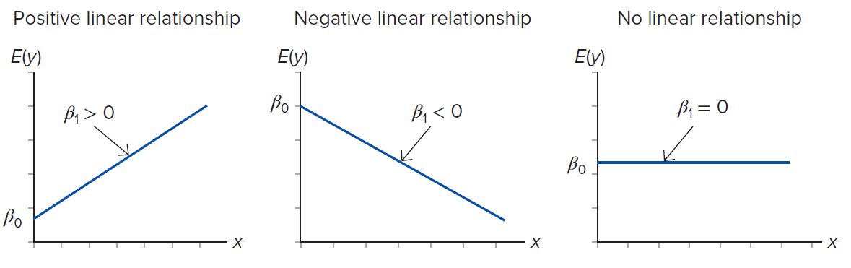
7.1: The Linear Regression Model 4
The slope parameter
determines whether the linear
relationship is positive or negative.
Access the text alternative for slide images.

Slide 10
7.1: The Linear Regression Model 5
A model with more than one predictor is referred to as a multiple linear regression model.
y is the response.
are the predictor variables.
are the unknown parameters.
is the random error term.

Slide 11
7.1: The Linear Regression Model 6
Sample data: n observations of
Use the sample data to obtain estimates of
form the sample regression equation:
(read as y-hat) is the predicted value of the response
variable given specified values of the predictor variables.

Slide 12
7.1: The Linear Regression Model 7
For given values of the predictor variables, the observed and predicted values are likely to be different.
There are many factors besides the included predictors that influence the response.
The difference between the observed and the predicted
values is the residual:

Slide 13
7.1: The Linear Regression Model 8
A regression model treats all predictor variables as numerical.
A numerical variable assumes meaningful numeric values.
A categorical variable reflects categories.
A dummy variable is used to describe two categories of a categorical variable, denoted d.
Indicator or binary variable.
d = 1 for one of the categories.
d = 1 for the other(s).
The category with d = 1 is called the reference or benchmark category.
All comparisons are made relative to this category.

Slide 14
7.1: The Linear Regression Model 9
A common approach to obtaining estimates of
is the ordinary least squares (O L S)
method.
This chooses the sample regression equation by minimizing the error sum of squares:
This gives an equation “closest” to the data.
Estimates have desirable properties if certain assumptions hold.

Slide 15
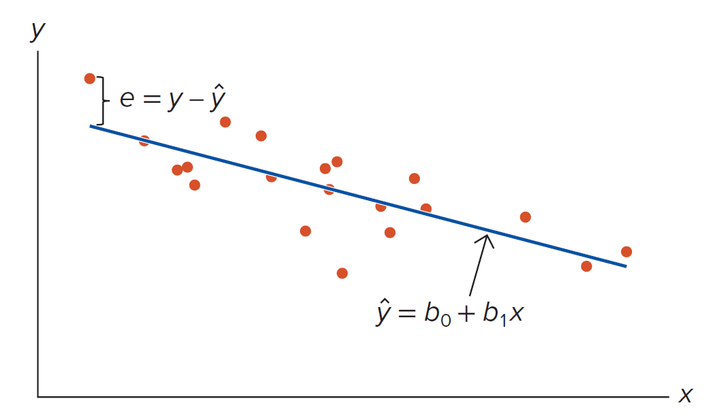
7.1: The Linear Regression Model 10
Access the text alternative for slide images.

Slide 16
7.1: The Linear Regression Model 11
It is important to interpret the estimated regression coefficients.
is the estimate of
Predicted value of
when each predictor variable assumes a
value of 0.
Not always meaningful.
is the estimate of
Change in the predicted value of the response given a unit
increase in
holding all other predictor variables constant.
Partial influence of

Slide 17
7.1: The Linear Regression Model 12
Example:
Notes: All data were downloaded from https://collegescorecard.ed.gov from May 24-26.2016; see website for complete description of data.
a. What is the sample regression equation?
b. Interpret the slope coefficients.
c. Predict the annual post-college earnings if a college’s average annual cost is $25,000, its graduation rate is 60%, its percentage of students paying down debt is 80%, and it is located in a city.

Slide 18
7.1: The Linear Regression Model 13
Example:
Regression statistics
Multiple R | 0.6552
R Square | 0.4292
Adjusted R Square | 0.4087
Standard Error | 5645.831
Observations | 116
A N O V A
 | df | SS | MS | F | Significance F
Regression | 4 | 2660691959 | 665172990 | 20.868 | 7.56E-13
Residual | 111 | 3538169765 | 31875403
Total | 115 | 6198861724
 | Coefficients | Standard error | t stat | p-value | Lower 95% | Upper 95%
Intercept | 10004.9665 | 7634.3338 | 1.311 | 0.1927 | 43392.9892 | 47424.6090
Cost | 0.4349 | 0.1110 | 3.917 | 0.0002 | 0.2149 | 0.6549
Grad | 178.0989 | 69.1940 | 2.574 | 0.0114 | 40.9864 | 315.2114
Debt | 141.4783 | 117.2120 | 1.207 | 0.2300 | −90.7851 | 373.7417
City | 2526.7888 | 1103.4026 | 2.290 | 0.0239 | 340.3229 | 4713.2548

Slide 19
7.1: The Linear Regression Model 14
Example:
a.
b. All coefficients are positive, suggesting a positive influence of each predictor variable on the response variable.
Holding all other predictor variables constant, if the average annual costs increase by $1, then, on average, predicted earnings are expected to increase by $0.4349.
All else constant, predicted earnings are $2,526.79 higher for graduates of colleges located in a city.
c.

Slide 20
7.1: The Linear Regression Model 15
Regression models are known to perform well for making predictions.
Often, they fail to establish a cause-and-effect relationship between the variables because of the nonexperimental nature of most applications.
A regression model may appear to search for causality when it basically detects correlation.
Causality can only be established through randomized experiments and/or advanced statistical models.

Slide 21
7.1: The Linear Regression Model 16
Predictions are subject to sampling variability.
The prediction will change if we use a different sample to estimate the regression model.
There is a distinction between the interval estimate for the mean of the response and the interval estimate for the individual value of the response.
Confidence interval: mean.
Prediction interval: individual.
Prediction intervals are always wider than confidence interval.

Slide 22
7.1: The Linear Regression Model 17
For specific values
the precited value is,
confidence interval for the mean value of y:
is the standard error.
prediction interval for an individual value of y:
is the standard error of the residuals.
The prediction interval incorporates the variability of the random error term.

Slide 23
7.1: The Linear Regression Model 18
Example: Consider the below model from the College Scorecard case:
Construct the 95% confidence interval for the expected Earnings if Cost equals $25,000, Grad equals 60, Debt equals 80, and City equals 1.
Construct the 95% prediction interval for the expected Earnings if Cost equals $25,000, Grad equals 60, Debt equals 80, and City equals 1.

Slide 24
7.1: The Linear Regression Model 19
Example:
With 95% confidence, we can state that the mean Earnings fall between $43,393 and $47,425 when Cost equals 25,000, Grad equals 60, Debt equals 80, and City equals 1.
With 95% confidence, the Earnings fall between $34,041 and $56,777 when Cost equals 25,000, Grad equals 60, Debt equals 80, and City equals 1.

Slide 25
7.1: The Linear Regression Model 20
A categorical variable may be defined by more than two categories.
Use multiple dummy variables to capture all categories, one for each category.
Given the intercept term, we exclude one of the dummy variables from the regression.
The excluded variable represents the reference category.
Including all dummy variables creates perfect multicollinearity.
Example: mode of transportation with three categories.
Public transportation, driving alone, or car pooling.
for public transportation and 0 otherwise.
for driving alone and 0 otherwise.
indicates car pooling.

Slide 26
7.1: The Linear Regression Model 21
Example: A government researcher is analyzing the relationship between retail sales (Sales in $ millions) and the gross national product (G N P in $ billions).
He also wonders whether there are significant differences in retail sales related to the quarters of the year.
He collects 10 years of quarterly data and creates dummy variables for the quarters.
a. Estimate
where y and x are sales and G N P,
is a quarter 1 dummy,
is a quarter 2 dummy, and
is a quarter 3 dummy.
b. Interpret the slope coefficient for quarter 1.
c. What are the predicted sales in quarter 2 if G N P is $21,000 (in billions)?

Slide 27
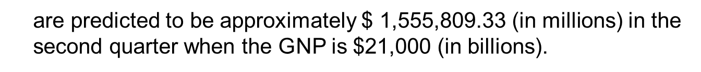
7.1: The Linear Regression Model 22
Example.
a. Output from statistical software.
 | Coefficients | Standard error | t stat | p-value
Intercept | 135609.2001 | 37106.9383 | 3.655 | 0.0008
G N P | 70.0110 | 1.9261 | 36.348 | 2.18E-29
d1 | −155654.2095 | 10767.8433 | −14.456 | 2.52E-16
d2 | −50030.3508 | 10771.8471 | −4.645 | 4.67E-05
d3 | −45187.9073 | 10731.5474 | −4.211 | 0.0002
b. All else equal, retail sales in quarter 1 are expected to be approximately $155,654 million less than sales in quarter 4.
c.
so that
Retail sales
are predicted to be approximately $ $\text{1,555,809.33}$ (in millions) in the second quarter when the G N P is $21,000 (in billions).

Slide 28
7.2: Model Selection 1
Example: Recall the College Scorecard case and consider three models. Which should we choose?
Several “goodness-of-fit” measures summarize how well the sample regression equation fits the data.
The standard error of the estimate,
The coefficient of determination,
The adjusted coefficient of determination, adjusted

Slide 29
7.2: Model Selection 2
Recall that a residual is the difference between the observed and
predicted value of the response,
The sample regression equation provides a good fit when the dispersion of the residuals is relatively small.
The sample variance,
is the average squared deviation between
the observed and predicted values.
The standard deviation of the residuals or standard error of the estimate has the same units of measurement as the response.
S S E is the error sum of squares, k denotes the number of predictors, n is the sample size.

Slide 30
7.2: Model Selection 3
For a given sample size, increasing the number of predictors reduces the numerator and denominator.
The net effect allows us to determine if the added predictor variables improve the fit.
When comparing models with the same response, the model
with the smaller
is preferred.
The coefficient of determination,
quantifies the sample
variation in the response that is explained by the sample regression equation.
It is the ratio of the explained variation of the response variable to its total variation.

Slide 31
7.2: Model Selection 4
Use analysis of variance (A N O V A) in the context of regression.
The total variation in y is the total sum of squares,
Break into two parts: explained variation and unexplained variation.
The variation in y explained by the sample regression equation is the
regression sum of squares,
The proportion of the sample variation in the response explained by the sample regression equation.
Falls between 0 and 1.
The closer to 1, the better the fit.

Slide 32
7.2: Model Selection 5
We cannot use
for model comparison when the competing models
do not include the same number of predictor variables (but have the same response).
never decreases as we add more variables.
May include variables with no economic or intuitive foundation.
Adjusted
explicitly accounts for the sample size n and the number
of predictor variables k.
Imposes a penalty for any additional predictors.
The higher the adjusted
the better the model.
When comparing models with the same response, the model with the
higher adjusted
is preferred.

Slide 33
7.2: Model Selection 6
Example: Recall the introductory case and consider three models.
a. Which of the three models is the preferred model?
b. Interpret the coefficient of determination for the preferred model.
c. What percentage of the sample variation in annual post-college earnings is unexplained by the preferred model?

Slide 34
7.2: Model Selection 7
Example:
a. Model 3 has the lowest standard error of the estimate and the
highest adjusted
b. Model 3 explains 42.92% of the sample variation in the earnings.
c. Model 3 does not explain 57.08% of the sample variation in earnings.

Slide 35
7.2: Model Selection 8
Note that goodness-of-fit measures discussed in this section use the same sample to build the model to asses it.
Unfortunately, this procedure does not gauge how well the estimated model will predict in an unseen sample.
We will discuss cross-validation techniques that evaluate predictive models by dividing the original sample into a training set to build (train) the model and a validation set to evaluate (validate) it.
The validation set is used to provide an independent performance assessment by exposing the model to unseen data.

Slide 36
7.2: Model Selection 9
Consider the linear regression model with k predictor variables:
We can conduct hypothesis tests about the unknown parameters
Joint test about all of the parameters.
Individual tests about a single parameter.
For the tests to be valid,
must be normally
distributed.
Satisfied if the random error term
is normally distributed.
If
is not normally distributed, the tests are valid only for large
sample sizes.

Slide 37
7.2: Model Selection 10
A test of joint significance is regarded as a test of the overall usefulness of a regression.
The test determines whether the predictor variables have a joint statistical influence on the response.
All of the slope coefficients equal zero: all of the predictors drop out; none of the predictors have a linear relationship with the response.
At least one of the slope coefficients does not equal zero: at least one predictor influences the response.
The test statistic measures how well the sample regression equation explains the variability in the response.

Slide 38
7.2: Model Selection 11
The test statistic is
S S R is the regression sum of squares.
S S E is the error sum of squares.
M S R is the mean square regression.
M S E is the mean square error.
This is a right-tailed F test; the p-value is
A larger test statistic provides us with more evidence to reject the null hypothesis.
A larger test statistic indicates that a large portion of the sample variation in the response is explained by the regression model, thus the model is useful.

Slide 39
7.2: Model Selection 12
Example: Recall that Model 3 was the preferred model.
Conduct a hypothesis test to determine if the predictor variables are jointly significant in explaining earnings.
We set up the following competing hypotheses:
The p-value,
is approximately zero.
Reject
At the 5% significance level, the predictor variables are jointly significant in explaining Earnings.

Slide 40
7.2: Model Selection 13
Consider the linear regression model with k predictor variables:
If
basically drops out of the equation.
There is no linear relationship between
does not influence y.
Let
be a hypothesized value of
Typically
but it could be a nonzero value.

Slide 41
7.2: Model Selection 14
The test statistic for a test of individual significance:
is the estimate for
is the standard error of the estimator
is the hypothesized value of
If the hypothesized value is zero,
Null not rejected, then
is not significant.
Null rejected, then
is significant.
Note that the testing framework for the intercept
is similar.

Slide 42
7.2: Model Selection 15
Example: Recall Model 3 was the preferred model.
Conduct a hypothesis test to determine whether cost influences earnings at the 5% significance level.
 | Coefficients | Standard error | t stat | p-value
Intercept | 10004.9665 | 7634.3338 | 1.311 | 0.1927
Cost | 0.4349 | 0.1110 | 3.917 | 0.0002
Grad | 178.0989 | 69.1940 | 2.574 | 0.0114
Debt | 141.4783 | 117.2120 | 1.207 | 0.2300
City | 2526.7888 | 1103.4026 | 2.290 | 0.0239

Slide 43
7.2: Model Selection 16
Example:
We set up the following competing hypotheses to determine whether costs influence earnings.
The p-value is 0.0002, so we reject
At the 5% significance level, Cost is significant in explaining Earnings.

Slide 44
7.2: Model Selection 17
Capital Asset Pricing Model (C A P M): Expresses the risk-adjusted return of an asset as a function of the risk-adjusted market return.
R is the rate of return on a stock or portfolio.
is the market return (typically the S&P 500).
is the risk-free interest rate (typically a Treasury bill).
are used in place of
measures how sensitive the stock’s return is to changes in the market.
Called the stock’s beta.
any change in the market leads to an identical change in the stock.
stock is more aggressive or riskier than the market.
stock is conservative or less risky than the market.
predicted to be zero, thus nonzero values indicate abnormal returns.
Called the stock’s alpha.
positive abnormal returns.
negative abnormal returns.

Slide 45
7.2: Model Selection 18
Example: Johnson & Johnson monthly stock returns.
 | Coefficients | Standard error | t stat | p-value
Intercept | −0.0007 | 0.0050 | −0.139 | 0.8899
Market_A d j | 0.7306 | 0.1091 | 6.694 | 9.57E-09
a. At the 5% significance level, is the beta coefficient less than one?
b. At the 5% significance level, are there abnormal returns? In other words, is the alpha coefficient significantly different from zero?

Slide 46
7.2: Model Selection 19
Example:
a. Formulate the competing hypotheses.
The p-value is
We reject
and conclude the
return on the J&J stock is less risky than the return on the market.
b. Formulate the competing hypotheses.
The p-value is 0.8899. We cannot reject
We cannot conclude
that there are abnormal returns for J&J stock.

Slide 47
7.2: Model Selection 20
Regression results are often reported in a table.
Notes: Parameter estimates are in the top half of the table with the p-values in parentheses; * represents significance at the 5% level. N A denotes not applicable. The lower part of the table contains goodness-of-fit measures.

Slide 48
7.3: Model Assumptions and Common Violations 1
The statistical properties of the O L S estimator and validity of testing procedures depend on assumptions.
Under the assumptions, O L S estimators have desirable properties.
They are unbiased,
They have minimum variations between samples.
These are compromised when one or more of the model assumptions are violated.
The validity of the significance tests is also impacted.
Estimated standard errors are inappropriate.
Not possible to make meaningful inferences from the t and F tests.

Slide 49
7.3: Model Assumptions and Common Violations 2
The assumptions are based on the error term
The residuals, or the observed error term,
contain
useful information about
Use the residuals to investigate the assumptions through residual plots.
Residuals versus predictor variable: nonlinear patterns.
Residuals versus predicted values
changing variability.
Residuals sequentially: correlated observations.
Residuals can also be used to detect outliers.

Slide 50
7.3: Model Assumptions and Common Violations 3
Recall that outliers are observations that stand out from the rest of the data.
An outlier observation will stand out in the residual plot.
Outliers can greatly impact the estimates.
It is not always clear what to do with them.
Outliers may indicate bad data due to incorrectly recorded (or included) observations.
These observations should be corrected or simply deleted.
Alternatively, outliers may just be due to random variations, in which case the relevant observations should remain.

Slide 51
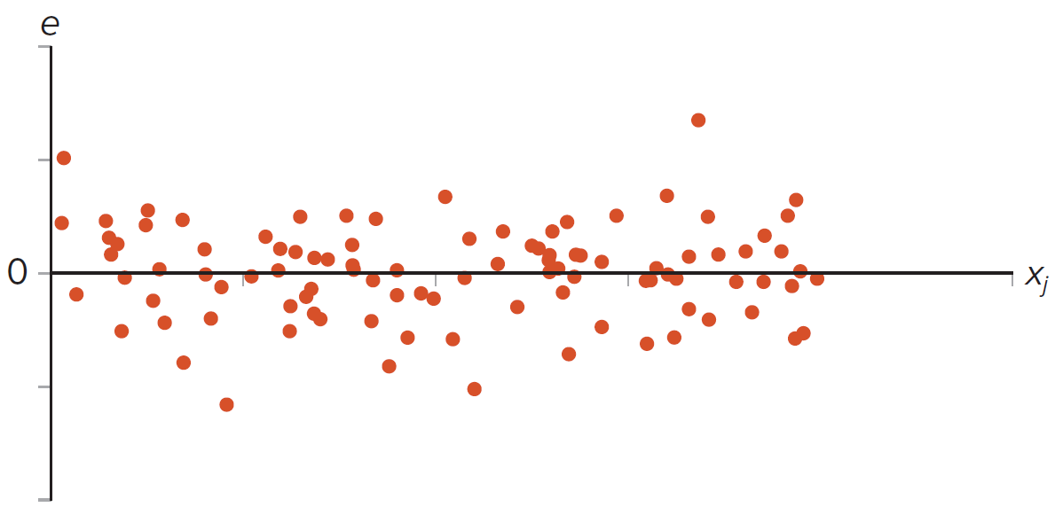
7.3: Model Assumptions and Common Violations 4
Plot the residuals on the vertical axis and the predictor variable or predicted values on the horizontal axis.
This is a residual plot with no violated assumptions.
Access the text alternative for slide images.

Slide 52
7.3: Model Assumptions and Common Violations 5
Assumption 1: The regression model is linear in the parameters and is correctly specified.
The linearity is in the parameters not in the variables.
Make economic and intuitive sense.
Include all relevant predictor variables.
Incorporate nonlinearities.
Detection.
Use residual plots to identify nonlinear patterns.
Linearity is justified if the residuals are randomly dispersed.
A discernible trend in the residuals indicates a nonlinear pattern.
Remedy.
Employ nonlinear regression.
Transform the response and predictor variables.

Slide 53
7.3: Model Assumptions and Common Violations 6
Example: A sociologist wishes to study the relationship between age and happiness.
He interviews 24 individuals and collects data on each person’s age and happiness, where happiness is measured on a scale from 0 to 100.

Slide 54
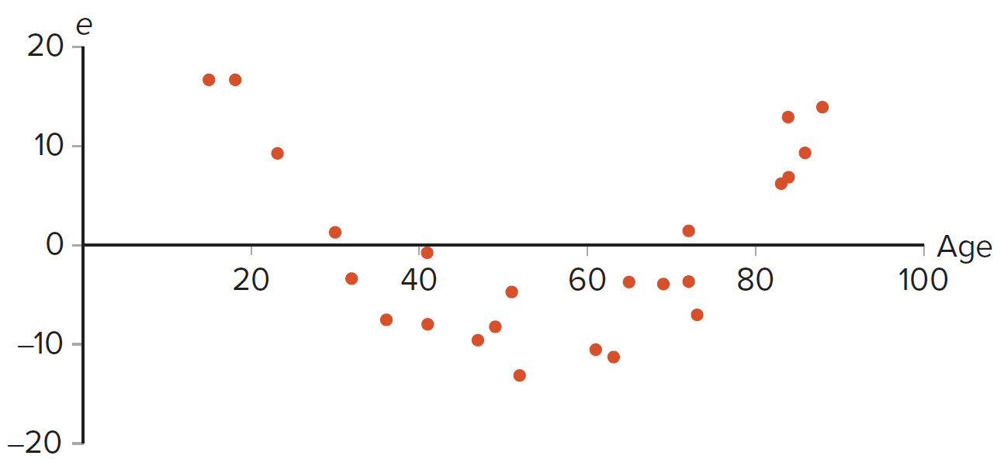
7.3: Model Assumptions and Common Violations 7
Example:
Access the text alternative for slide images.

Slide 55
7.3: Model Assumptions and Common Violations 8
Assumption 2: There is no exact linear relationship among the predictor variables, there is no multicollinearity.
Exists when two or more predictor variables have an exact linear relationship.
Difficult to disentangle the separate influences of the predictor variables.
Results in imprecise estimates of slope coefficients.
Detection:
Model can’t be estimated.
High
and significant F statistic coupled with individually insignificant predictor
variables.
High correlations between predictor variables.
Wrong signs of the estimated coefficients.
Insignificant important predictor variables.
Remedy:
Drop one of the collinear variables.
Obtain more data.
Express variables differently.
Do nothing.

Slide 56
7.3: Model Assumptions and Common Violations 9
Example: A regression model was developed to analyze the relationship between employee performance scores, including whether the employee has a college degree (College_Dummy = 1 if college degree, 0 otherwise), their age (Age in years), work experience (Experience in years), and the percentage of sales targets achieved (Targets in %).
Response Variable: Performance Scores.
Notes: The table contains parameter estimates with p-values in parentheses; * represents significance at the 5% level. N A
denotes not applicable. Adjusted
is used for model selection.

Slide 57
7.3: Model Assumptions and Common Violations 10
Assumption 3: Conditional on the values of the predictors, the variance of the error term is the same for all observations.
Constant variability.
No heteroskedasticity.
Often breaks down cross-sectional data.
Exists when the variability in the response changes with at least one other predictor variable.
O L S estimators are still unbiased.
But the standard errors are not appropriate.
Can’t use the t and F tests.
Detection.
Plot the residuals against each predictor variable or predicted values.
Residuals should be randomly dispersed.
Violated when the variability of the residuals increases or decreases.
Remedy.
Correct the standard errors.
Called White’s robust standard errors.
Not available in Excel.
R has packages.

Slide 58
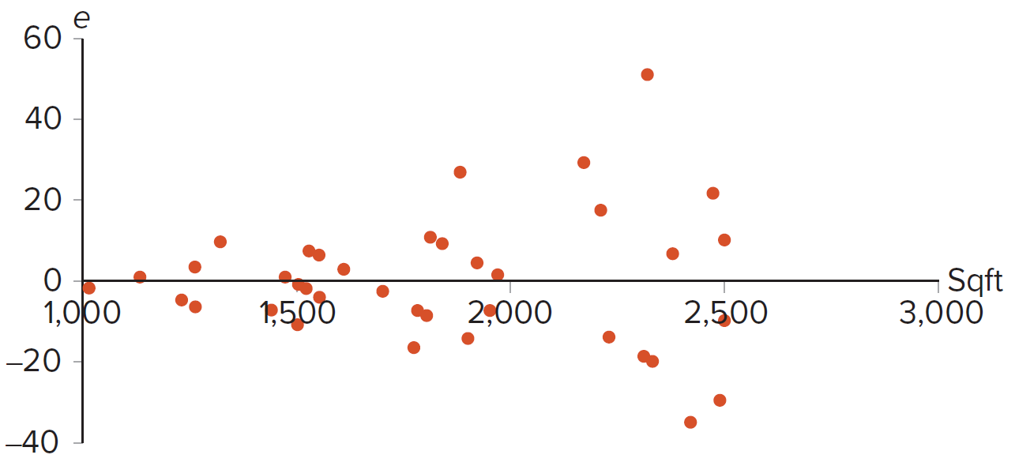
7.3: Model Assumptions and Common Violations 11
Example: Consider a simple regression model that relates a store’s monthly sales (Sales in $1,000s) to its square footage (Sqft) for a chain of convenience stores.
Access the text alternative for slide images.

Slide 59
7.3: Model Assumptions and Common Violations 12
Assumption 4: Conditional on the predictor variables, the error term is uncorrelated across observations.
No serial correlation.
Often breaks down with time series data.
O L S estimates are still unbiased.
Standard errors are inappropriate, distorted downward making the model look better than it really is.
The t and F tests may suggest the predictor variables are significant when they are not.
Detection:
Plot the residuals sequentially over time.
Should show no pattern.
Positive (or negative) residuals followed by positive (or negative) residuals consecutively.
Switching between positive and negative residuals.
Remedy: Use Newey-West robust standard errors in R.

Slide 60
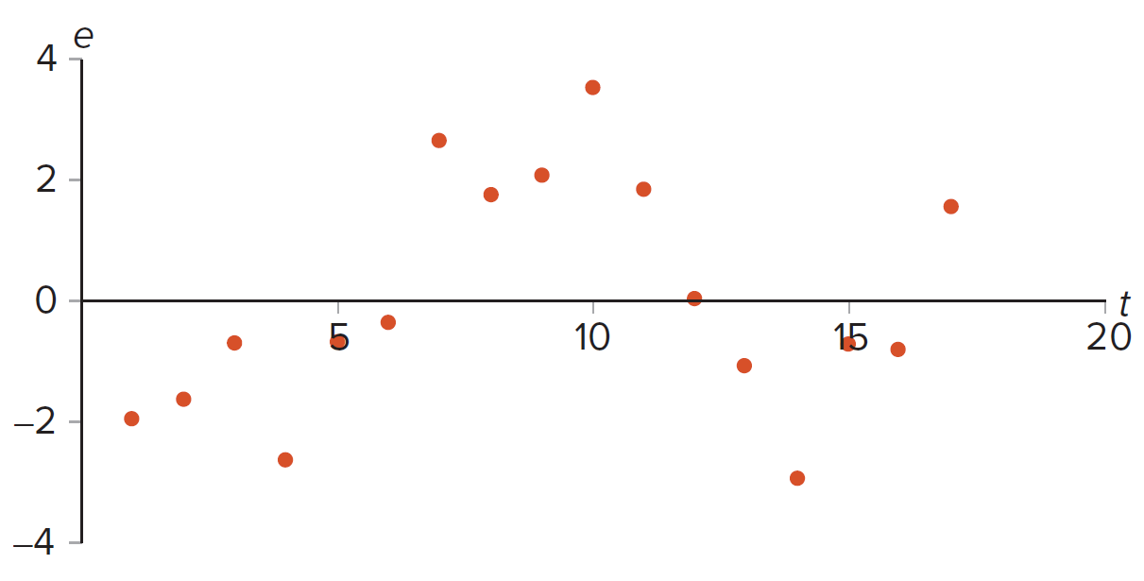
7.3: Model Assumptions and Common Violations 13
Example: Consider a model that uses advertising
and
unemployment rate
to predict the sales of a sushi restaurant
over time
Access the text alternative for slide images.

Slide 61
7.3: Model Assumptions and Common Violations 14
Assumption 6: The error term is Normally distributed.
Allows the construction of interval estimates and hypothesis tests.
If the error term is no normally distributed, then the interval estimates and hypothesis tests are valid only for large samples.

Slide 62
End of Main Content
© McGraw Hill LLC. All rights reserved. No reproduction or distribution without the prior written consent of McGraw Hill LLC.

Slide 63
Accessibility Content: Text Alternatives for Images

Slide 64
Chapter 7 – Text Alternative
Return to parent-slide containing images.
Below the title is a stylised, abstract illustration of a woman’s profile. The back of her head extends into bubbles of numbers and letters. Words beside the illustration read, insights, strategy, action, feedback, profit. The authors are listed below, side by side. Jaggia, Kelly, Lertwachara, Chen. The McGraw Hill logo is at the bottom left of the page.
Return to parent-slide containing images.

Slide 65
7.1: The Linear Regression Model 4 – Text Alternative
Return to parent-slide containing images.
For First Image: A graph of E of y versus x plots an upward-sloping line that begins from the point beta 0 on the Y axis. The line represents beta 1 greater than 0.
For Second Image: A graph of E of y versus x plots a downward-sloping line that begins from the point beta 0 on the Y axis. The line represents beta 1 less than 0.
For Third Image: A graph of E of y versus x plots a horizontal line that begins from the point beta 0 on the Y axis. The line represents beta 1 equal to 0.
Return to parent-slide containing images.

Slide 66
7.1: The Linear Regression Model 10 – Text Alternative
Return to parent-slide containing images.
The regression line follows a decreasing trend. The vertical distance between the left end of the line and the closest point above the line is labeled as e = y minus y cap. The line represents the equation y cap = b 0 + b 1 x.
Return to parent-slide containing images.

Slide 67
7.3: Model Assumptions and Common Violations 4 – Text Alternative
Return to parent-slide containing images.
The data points begin from the origin and extend along the x axis for a few units.
Return to parent-slide containing images.

Slide 68
7.3: Model Assumptions and Common Violations 7 – Text Alternative
Return to parent-slide containing images.
The data points form a concave upward curve with the valley on the negative side of the y axis. The data appoints begin from (15,16) and ends at (87, 14). Its lowest point is in (53, negative 14). Values are approximated.
Return to parent-slide containing images.

Slide 69
7.3: Model Assumptions and Common Violations 11 – Text Alternative
Return to parent-slide containing images.
Starting at the origin, the data points diverge along the x-axis. The highest point is at (2350, 50) and the lowest point is at (2400, negative 35). Values are approximated.
Return to parent-slide containing images.

Slide 70
7.3: Model Assumptions and Common Violations 13 – Text Alternative
Return to parent-slide containing images.
The data points are scattered in both quadrants. The highest point is at (10, 3.5) and the lowest point is at (14, negative 3). Values are approximated.
Return to parent-slide containing images.

