Slide 1
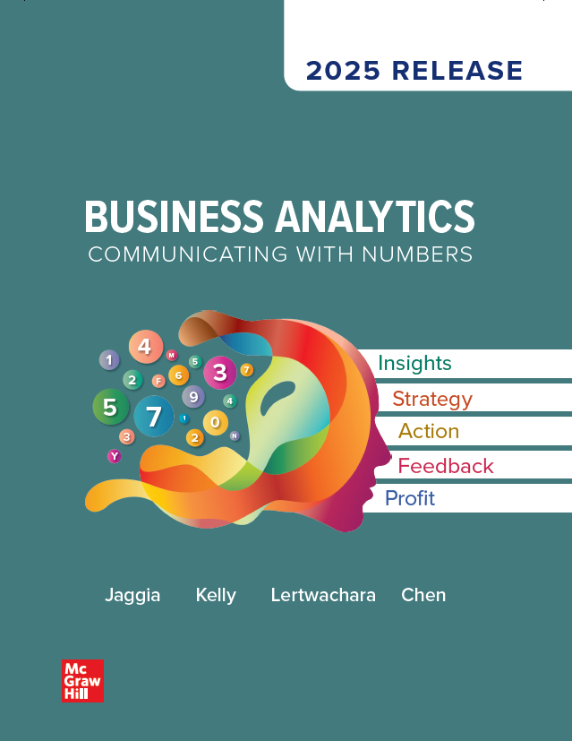
Chapter 8
More Topics in Regression Analysis
Access the text alternative for slide images.
© McGraw Hill LLC. All rights reserved. No reproduction or distribution without the prior written consent of McGraw Hill LLC.

Slide 2
Chapter 8: Learning Objectives (L Os)
L O 8.1: Estimate and interpret regression models with interaction variables.
L O 8.2: Estimate and interpret nonlinear regression models.
L O 8.3: Use cross-validation techniques to evaluate regression models.

Slide 3
Introductory Case: Gender Gap in Manager Salaries 1
The salary difference between men and women has shrunk over the years, particularly among younger workers, but it still persists.
According to a Pew Research Center analysis, women earned 82% of what men earned in 2021.
Ara Lily is completing her M B A degree from Bentley University, located just outside Boston.
She is upset that the gender gap in salaries continues to exist in the American workplace.
For a class project, she decides to analyze the gender gap in salaries of project managers.

Slide 4
Introductory Case: Gender Gap in Manager Salaries 2
Ara gains access to the salary (in $ 1,000s) for 200 project managers in small-to middle-sized firms in the Boston area.
In addition, she has data on the firm size, the manager’s experience (in years), whether the manager is a female (Female equals 1 if female, 0 otherwise), and whether the manager has a graduate degree (Grad equals 1 if graduate degree, 0 otherwise).
Analyze the determinants of a project manager’s salary.
Estimate and interpret a regression model with relevant interaction variables.
Determine whether there is evidence of a gender gap in salaries.

Slide 5

8.1: Regression Models with Interaction Variables 1
Recall the sample regression equation$:$
measures the change in the predicted value of the response given in a
unit increase
holding all other predictor variables constant.
is the partial (or marginal) effect of
(the partial derivative).
This partial effect does not depend on other predictor variables.
It is natural for the partial effect of a predictor variable on the response to depend on another predictor variable.
For example, sales as a function of online advertising expenditure and online presence.
How online advertising expenditures affect sales may depend on the online presence.
Online advertising expenditures and online presence may have an interaction effect.

Slide 6
8.1: Regression Models with Interaction Variables 2
We capture these effects by incorporating interaction variables in the regression model.
Each interaction variable is a product of two interacting predictor variables.
The interaction effect in a regression model occurs when the partial effect of a predictor variable on the response depends on the value of another predictor variable.
Three types of interaction variables:
The interaction between two dummy variables.
The interaction between a dummy variable and a numerical variable.
The interaction between two numerical variables.

Slide 7
8.1: Regression Models with Interaction Variables 3
Consider a regression model with two dummy variables
and an interaction variable
The estimated model is
The partial effect of
this depends on
the partial effect of
the partial effect of
The partial effect of
this depends on
the partial effect of
the partial effect of
Tests of significance can be conducted on the interaction variables.

Slide 8
8.1: Regression Models with Interaction Variables 4
Example: Data were collected on the starting salary of business graduates (Salary in $ 1,000s) along with their cumulative G P A, whether they have an M I S concentration (M I S = 1 if yes, 0 otherwise), and whether they have a statistics minor (Statistics = 1 if yes, 0 otherwise).
a. Estimate and interpret the effect of G P A, M I S, and Statistics on Salary. Predict the salary of a business graduate with and without a M I S concentration and a statistics minor. Use a G P A of 3.5 for making predictions.
b. Extend the model from part a to include the interaction between M I S and Statistics. Predict the salary of a business graduate with and without a M I S concentration and a statistics minor. Use a G P A of 3.5 for making predictions.

Slide 9
8.1: Regression Models with Interaction Variables 5
Example.
Notes: Parameter estimates are followed with the p-values in parentheses; N A denotes not applicable; * represents significance at the 5% level.

Slide 10
8.1: Regression Models with Interaction Variables 6
Example.
All predictor variables exert a positive and significant influence on the starting salary.
The M I S concentration and a statistics minor are predicted to fetch an additional starting salary of $6,607 and $6,731.
No M I S concentration and no statistics minor.
The predicted salary is $67,187.
M I S concentration and statistics minor.
The predicted salary is $80,525.

Slide 11
8.1: Regression Models with Interaction Variables 7
Example.
The interaction is positive and significant. The coefficient indicates that graduates with an M I S concentration and Statistics minor earn $3,492 more than graduates with an M I S concentration or Statistics minor.
This model has a higher adjusted
and provides a better fit.
No M I S concentration and no statistics minor.
The predicted salary is $67,588.
M I S concentration and statistics minor.
The predicted salary is $81,939.

Slide 12

8.1: Regression Models with Interaction Variables 8
Consider a regression model with a numerical variable x, a dummy variable d, and an interaction variable xd.
The estimated model is
The partial effect of x on
this depends on d.
d = 0: the partial effect of
d = 1: the partial effect of
The partial effect of d on
this depends on x.
Difficult to interpret because x is numerical.
Common to interpret this partial effect at the sample mean

Slide 13
8.1: Regression Models with Interaction Variables 9
Example: The manager of a marketing agency is interested in evaluating the impact of employee training programs on performance.
For the response variable, she uses the lead conversion rate (Rate), defined as the percentage of leads that turn into actual sales.
The predictor variables include the experience (Experience, in years) and the training participation (Yes/No) of the employees.

Slide 14
8.1: Regression Models with Interaction Variables 10
Example:
a. Create a dummy variable labeled Training, which assigns a value of 1 for employees who participate in training and 0 for those who do not. Estimate and interpret the effect of Experience and Training on the lead conversion rate. Use the estimated model to predict the lead conversion rate for an employee with five years of experience who has participated in training. What is the­ corresponding rate with 20 years of experience?
B. It is believed that training participation may be especially effective for ­ managers with fewer years of experience. Extend the above model by incorporating the appropriate interaction variable to predict the lead conversion rate for an employee with five years of experience who has participate in training. What is the corresponding rate with 20 years of experience?

Slide 15
8.1: Regression Models with Interaction Variables 11
Example:
Model 1:
Model 2:
Notes: Parameter estimates are followed with the p-values in parentheses; N A denotes not applicable; * represents significance at the 5% level.

Slide 16
8.1: Regression Models with Interaction Variables 12
Example.
a.
For any level of experience, employees who participated in training have a 1.6706% higher lead conversion rate than those who did not participate in training.
The negative coefficient implies that the effect of training is weaker for more experienced employees.
Experience = 5, Training = 1.
b.
The negative coefficient implies that the effect of training is weaker for more experienced employees.
Experience = 5, Training = 1.

Slide 17
8.1: Regression Models with Interaction Variables 13
Consider a regression model with two numerical variables,
and an interaction variable
The estimated model is
The partial effect of
this depends on
The partial effect of
this depends on
The partial effects of both variables are difficult to interpret.
Consider the partial effects at the sample means
At
the partial effect of
the partial effect on
will be greater (smaller) at values higher
(lower) than

Slide 18
8.1: Regression Models with Interaction Variables 14
Example: Consider the data collected on the number of applications received (Applicants), marketing expense (Marketing, in $ 1,000s), and the percentage employed within three months (Employed).
a. Estimate and interpret the effect of Marketing and Employed on the number of applications received. For a given marketing expense of $80,000, predict the number of applications received if 50% of the graduates were employed within three months. Repeat the analysis with 80% employed within three months.
b. Extend the model in part a to include the interaction between Marketing and Employed. For a given marketing expense of $80,000, predict the number of applications received if 50% of the graduates were employed within three months. Repeat the analysis with 80% employed within three months.

Slide 19
8.1: Regression Models with Interaction Variables 15
Example.
Notes: Parameter estimates are followed with the p-values in parentheses; N A denotes not applicable; * represents significance at the 5% level.

Slide 20
8.1: Regression Models with Interaction Variables 16
a. Example.
b.
Given Employment, a $10,000 increase in the marketing expense is predicted to bring in 3.55 more applicants.
Given Marketing, a 10% increase in Employed brings in 10.149 more applicants.
Marketing = 80, Employed = 50.
The predicted number of applicants is 30.
Marketing = 80, Employed = 80.
The predicted number of applicants is 60.

Slide 21
8.1: Regression Models with Interaction Variables 17
c.
Marketing = 80, Employed = 50, Marketing × Employed = 80 × 50.
The predicted number of applicants is 33.
Marketing = 80, Employed = 80, Marketing × Employed = 80 × 80.
The predicted number of applicants is 59.

Slide 22
8.1: Regression Models with Interaction Variables 18
Example: The objective outlined in the introductory case is to analyze a possible gender gap in the salaries of project managers.
Notes: * represents significance at the 5% level.

Slide 23
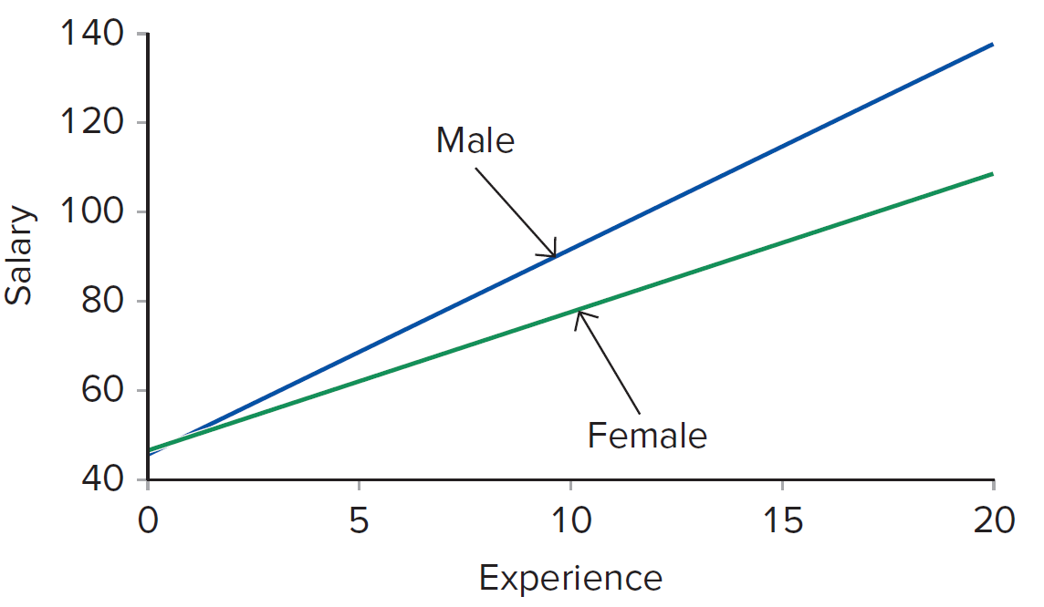
8.1: Regression Models with Interaction Variables 19
Example.
Fix size and grad, the effect of experience on salary depends on gender.
Access the text alternative for slide images.

Slide 24
8.2: Regression Models for Nonlinear Relationships 1
Linear regression is often justified on the basis of its computational simplicity.
An implication of the a simple linear regression model is that if x goes
up by one unit, then the expected y changes by
regardless of x.
However, in many applications, the relationship between the variables cannot be represented by a straight line.
The linearity assumption discussed places the restriction of linearity on the parameters and not on the variables.
We can capture many interesting nonlinear relationships, within the framework of the linear regression model, by simple transformations of the response and/or the predictor variables.

Slide 25
8.2: Regression Models for Nonlinear Relationships 2
From microeconomics, you may have learned that a firm’s (or industry’s) average cost curve tends to be “U-shaped.”
Due to economies of scale, the average cost y of a firm initially decreases as output x increases.
However, as x increases beyond a certain point, its impact on y turns positive.
Other applications show the influence of the predictor variable initially positive but then turning negative, leading to an “inverted U-shape.”
The quadratic regression model is appropriate when the slope, capturing the influence of x on y, changes in magnitude as well as sign.
The model can be extended to include multiple predictor variables.

Slide 26
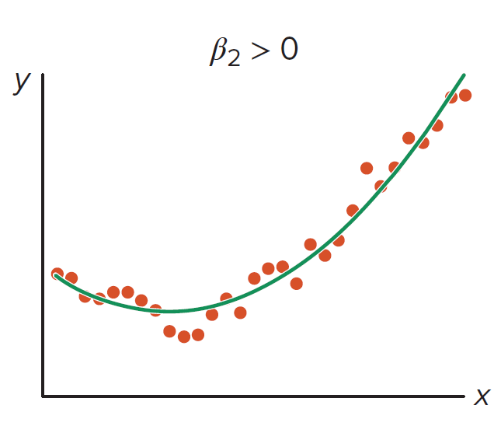
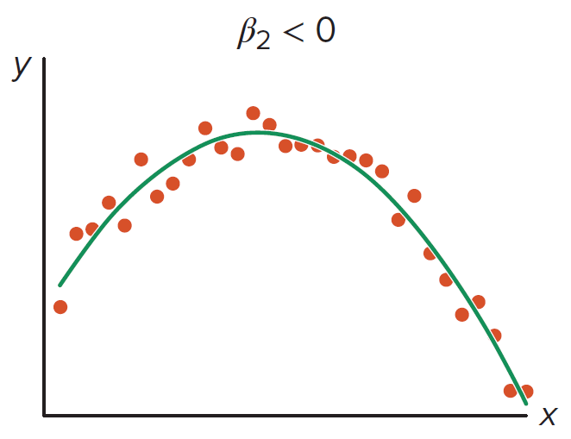
8.2: Regression Models for Nonlinear Relationships 3

Slide 27
8.2: Regression Models for Nonlinear Relationships 4
Use O L S to obtain the sample regression equation.
Cannot interpret
in the usual way, focus on
The partial effect of x on
can be approximated by
reaches a maximum/minimum at
Maximum when
Minimum when
Maximum/minimum reached when
is positive/negative.
Use adjusted
to compare linear and quadratic models.

Slide 28
8.2: Regression Models for Nonlinear Relationships 5
Example: It is widely believed that wages of workers decline as they get older. A young worker can expect wages to rise with age only up to a certain point, beyond which wages begin to fall.
a. Plot Wage against Age and evaluate whether a linear or quadratic regression model better captures the relationship. Verify your choice by using the appropriate goodness-of-fit measure.
b. Use the appropriate model to predict hourly wages of a college graduate with age equal to 30, 50, or 70.
c. According to the model, at what age will a college graduate attain the highest wages?

Slide 29
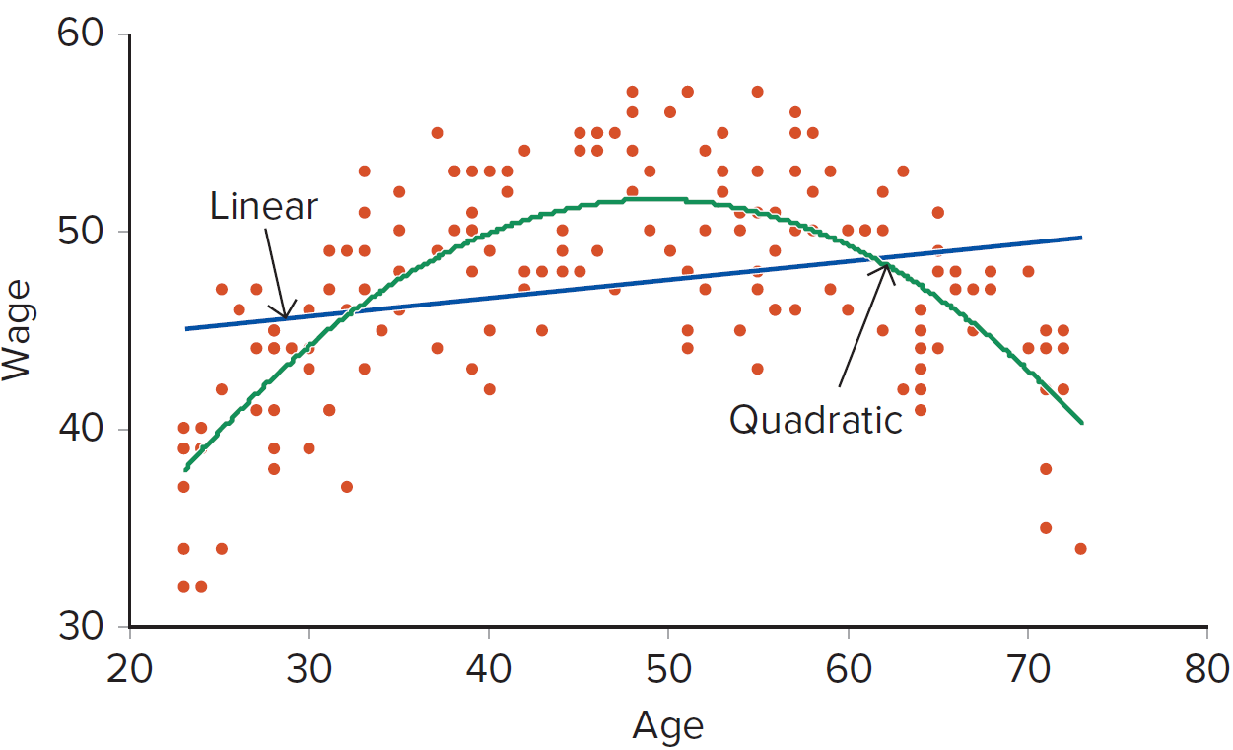
8.2: Regression Models for Nonlinear Relationships 6
Example.
a. Scatterplot of wage verses age.
Access the text alternative for slide images.

Slide 30
8.2: Regression Models for Nonlinear Relationships 7
Example.
a. Models and regression output.
Linear regression model:
Quadratic regression model:
Notes: Parameter estimates are in the main body of the table with the p-values in parentheses; N A denotes not applicable;
* represents significance at the 5% level. The last row presents adjusted
for model comparison.

Slide 31
8.2: Regression Models for Nonlinear Relationships 8
Example.
The age at which the maximum wage occurs is given occurs at
It is important to note that a non–college graduate would also attain the highest wage at 49.18 years as well since there is no interaction.

Slide 32
8.2: Regression Models for Nonlinear Relationships 9
Another common transformation that captures nonlinearity is based on the natural logarithm.
Logs are known to stabilize the variance and are applied to skewed variables.
Regression coefficients interpreted as percent changes.
This is useful because many relationships are naturally expressed in terms of percentages.
Example: incomes, house prices, and sales.

Slide 33
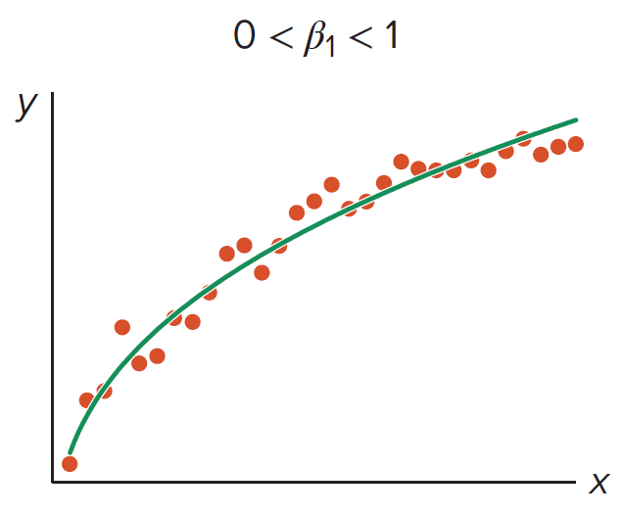
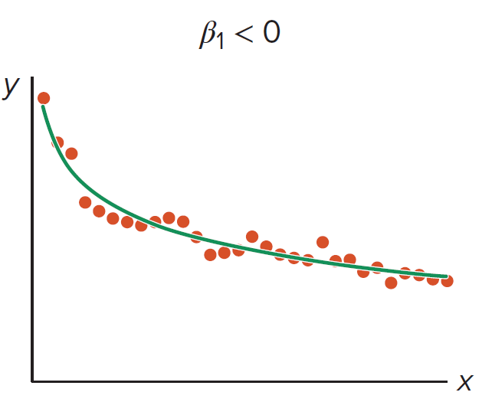
8.2: Regression Models for Nonlinear Relationships 10
In a log-log regression model, both the response and predictor are
transformed using natural logs:
The relationship is a curve that depends on the slope coefficient
Access the text alternative for slide images.

Slide 34
8.2: Regression Models for Nonlinear Relationships 11
measures the approximate percentage change in
when x
increases by 1%.
positive relationship,
increases as a slower rate.
positive relationship,
increases as a faster rate.
negative relationship;
decreases as a slower rate.
is a measure of elasticity.
The log-log regression model is nonlinear in the variables but it is still linear in the coefficients.
Using an anti-log reverse transformation to each side has been known to underestimate the expected value of y.
Predictions are made by
use unrounded coefficients.

Slide 35
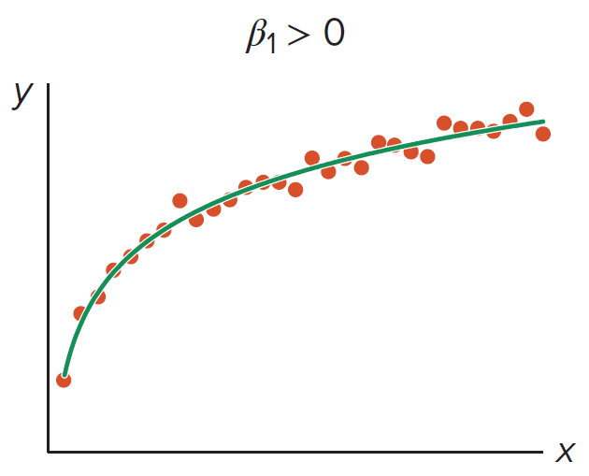
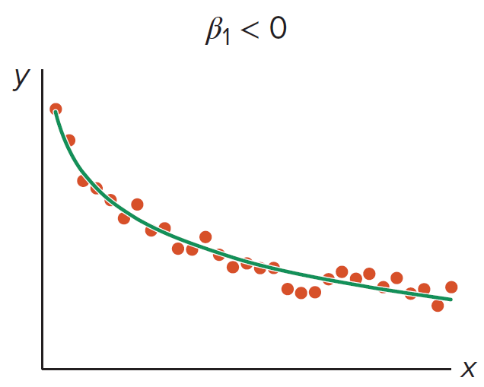
8.2: Regression Models for Nonlinear Relationships 12
A logarithmic regression model is a semi-log model that transforms
only the predictor variable:
Attractive when only the predictor variable is better captured in percentages.
measures the approximate change in
when x increases
by 1%.
Predictions are made by
Access the text alternative for slide images.

Slide 36
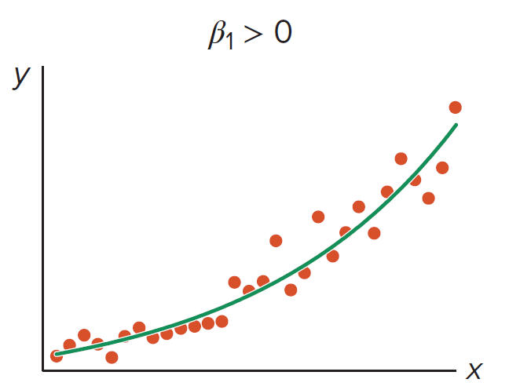
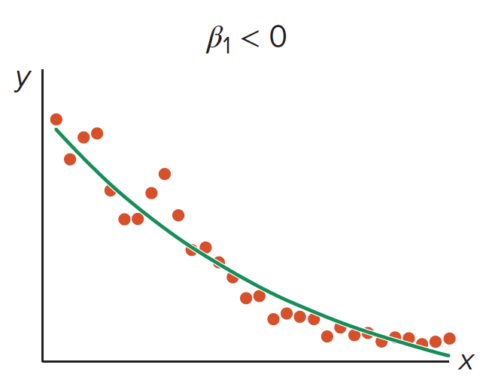
8.2: Regression Models for Nonlinear Relationships 13
An exponential regression model is a semi-log model that transforms
only the response variable:
measures the approximate percentage change in
when
x increases one unit.
Predictions are made by
Access the text alternative for slide images.

Slide 37
8.2: Regression Models for Nonlinear Relationships 14
Note: It is advisable to use unrounded coefficients for making predictions.

Slide 38
8.2: Regression Models for Nonlinear Relationships 15
Example: Real estate investment in college towns is known to provide good returns.
Students offer a steady stream of rental demand as cash-strapped public universities are unable to house their students beyond freshman year.
This demand is projected to grow as more children of baby boomers head to college.
a. Plot rent against each of the three predictor variables and evaluate whether the relationship is best captured by a line or a curve. Identify variables that may require a log-transformation.
b. Estimate the linear and the relevant log regression models to predict rent for a 1,600-square-foot rental with 3 bedrooms and 2 bathrooms.

Slide 39
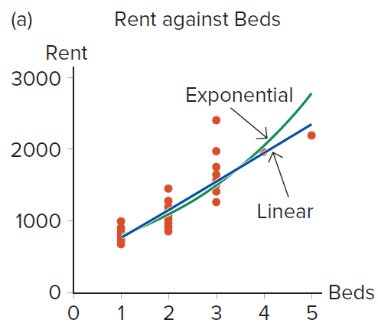
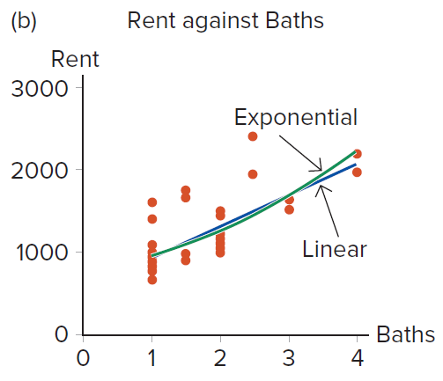
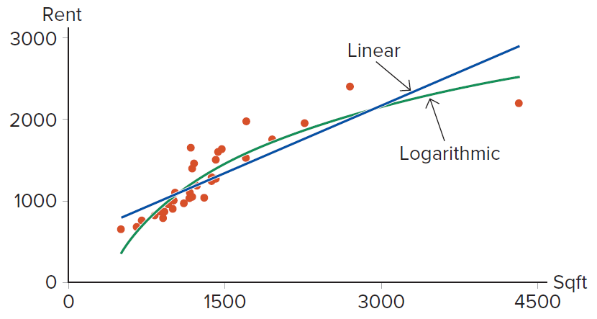
8.2: Regression Models for Nonlinear Relationships 16
Example.
Access the text alternative for slide images.

Slide 40
8.2: Regression Models for Nonlinear Relationships 17
Example:

Slide 41
8.2: Regression Models for Nonlinear Relationships 18
Example.
Notes: Parameter estimates are followed with the p-values in parentheses; N A denotes not applicable; * represents significance at the 5% level.

Slide 42
8.2: Regression Models for Nonlinear Relationships 19

Slide 43
8.2: Regression Models for Nonlinear Relationships 20
We cannot use adjusted
to compare models that
use y as the response to models that use
as the
response.
Compute the correlation between the observed and
predicted values of each model:
Then use an alternative way to compute

Slide 44
8.2: Regression Models for Nonlinear Relationships 21
Example: Revisit the rent models.
Use the Excel function C O R R E L to find the correlation between
Rent and
Model 1: 0.8092.
Model 2: 0.8482.
Model 3:--
Model 4: 0.7554.

Slide 45
8.3: Cross-Validation Methods 1
All of the model evaluation measures thus far assess predictability in the sample data that was used to build the model.
These measures do not help gauge how well an estimated model will predict an unseen sample.
It is possible a model performs well with the sample data used for estimation, but then performs miserably once a new sample is evaluated.
Overfitting occurs when an estimated model describes quirks of the data rather than the relationships between variables.
Model becomes too complex.
Fails to describe the behavior in a new sample.
Predictive power for new samples is compromised.

Slide 46
8.3: Cross-Validation Methods 2
We need a measure of the predictive power of a model based on a set of data not used in estimation.
Cross-validation is a technique that evaluates predictive models by partitioning the sample.
Training set: use to build/train the model.
Validation set: use to evaluate/validate the model.
Use the root mean square error (R M S E) on the validation set.
is a true prediction for an observation in the validation set.
n* is the number of observations in the validation set.
R M S E will be lower for the training set than the validation set.

Slide 47
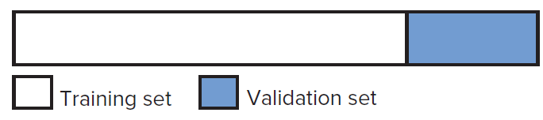
8.3: Cross-Validation Methods 3
The holdout method partitions the sample data set into two independent and mutually exclusive data sets.
Partition the sample into two parts: training and validation sets.
Use the training set to estimate competing models.
Use the estimates from the training set to predict the response in the validation set.
Calculate R M S E (or other performance measures) for each competing model. The preferred model will have the smallest R M S E.
We would like the model with the best performance in the training set to also have the best performance in the validation set.
Conflicting results are a sign of overfitting using the training set.

Slide 48
8.3: Cross-Validation Methods 4
Example: Consider two models from the introductory case.
Model 1 used Size, Experience, Female, and Grad.
Model 2 used Size, Experience, Female, and Grad, also includes the interactions between Female with Experience, Female with Grad, and Size with Experience.
Use the holdout method to compare the predictability of both models using the first 150 observations for training and the remaining 50 observations for validation.

Slide 49
8.3: Cross-Validation Methods 5
Example.
Estimation based on the training set.
Notes: N A denotes not applicable.

Slide 50
8.3: Cross-Validation Methods 6
Example.
Validation results.

Slide 51
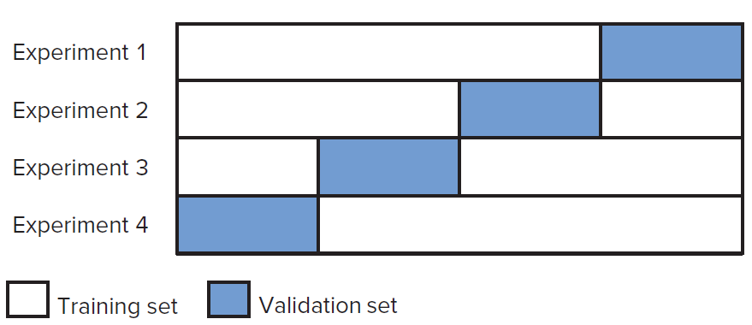
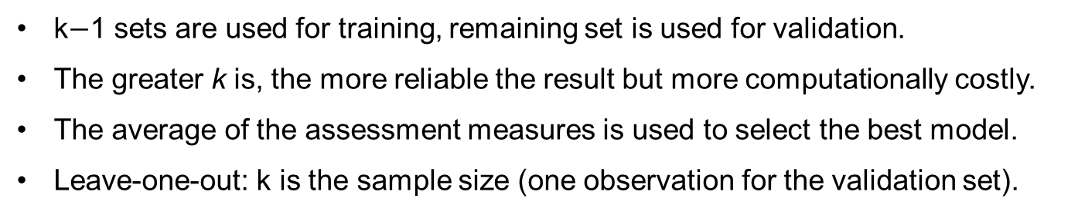
8.3: Cross-Validation Methods 7
The limitation to the previous approach is the experiment is only performed once.
One partition for training/validation.
Model selection can be sensitive to how the data are partitioned.
k-fold cross-validation method partitions the sample data into k subsets.
k$−$1 sets are used for training, remaining set is used for validation.
The greater k is, the more reliable the result but more computationally costly.
The average of the assessment measures is used to select the best model.
Leave-one-out: k is the sample size (one observation for the validation set).
Access the text alternative for slide images.

Slide 52
8.3: Cross-Validation Methods 8
Example: Consider two models from the introductory case.
Model 1 used Size, Experience, Female, and Grad.
Model 2 used Size, Experience, Female, and Grad, also includes the interactions between Female with Experience, Female with Grad, and Size with Experience.
Use the k-fold cross-validation method to compare the predictability of the models using k = 4.

Slide 53
8.3: Cross-Validation Methods 9
Example.
Observations in validation set | Model 1 | Model 2
151 to 200 | 11.31 | 12.54
101 to 150 | 12.26 | 11.88
51 to 100 | 13.30 | 12.09
1 to 50 | 13.76 | 13.46
Average | 12.66 | 12.49

Slide 54
End of Main Content
© McGraw Hill LLC. All rights reserved. No reproduction or distribution without the prior written consent of McGraw Hill LLC.

Slide 55
Accessibility Content: Text Alternatives for Images

Slide 56
Chapter 8 – Text Alternative
Return to parent-slide containing images.
Below the title is a stylised, abstract illustration of a woman’s profile. The back of her head extends into bubbles of numbers and letters. Words beside the illustration read, insights, strategy, action, feedback, profit. The authors are listed below, side by side. Jaggia, Kelly, Lertwachara, Chen. The McGraw Hill logo is at the bottom left of the page.
Return to parent-slide containing images.

Slide 57
8.1: Regression Models with Interaction Variables 19 – Text Alternative
Return to parent-slide containing images.
The lines for male and female begin from (0, 47) and end at (20, 138) and (20, 108). Values are approximated. The line for male shows a steeper incline compared to the female line.
Return to parent-slide containing images.

Slide 58
8.2: Regression Models for Nonlinear Relationships 6 – Text Alternative
Return to parent-slide containing images.
The line for linear follows a positive slope from (23, 38) to (73, 50). The curve follows a concave downward trend and intersects the line at (32, 45) and (62, 48). Values are approximated.
Return to parent-slide containing images.

Slide 59
8.2: Regression Models for Nonlinear Relationships 10 – Text Alternative
Return to parent-slide containing images.
For First Image: The regression line follows a logarithmically increasing trend.
For Second Image: The regression line follows a logarithmically decreasing trend.
Return to parent-slide containing images.

Slide 60
8.2: Regression Models for Nonlinear Relationships 12 – Text Alternative
Return to parent-slide containing images.
For First Image: The regression line follows a logarithmically increasing trend.
For Second Image: The regression line follows a logarithmically decreasing trend.
Return to parent-slide containing images.

Slide 61
8.2: Regression Models for Nonlinear Relationships 13 – Text Alternative
Return to parent-slide containing images.
For First Image: The regression line follows an exponentially increasing trend.
For Second Image: The regression line follows an exponentially decreasing trend.
Return to parent-slide containing images.

Slide 62
8.2: Regression Models for Nonlinear Relationships 16 – Text Alternative
Return to parent-slide containing images.
For First Image: The linear trendline follows a straight increasing slope, while the exponential curve increases rapidly after a slight bend.
For Second Image: The linear trendline follows a straight increasing slope, while the exponential curve increases rapidly after a minor bend.
For Third Image: The linear trendline follows a straight increasing slope, while the logarithmic curve increases rapidly and then dips below the linear line.
Return to parent-slide containing images.

Slide 63
8.3: Cross-Validation Methods 7 – Text Alternative
Return to parent-slide containing images.
Each horizontal row corresponds to a separate experiment, Experiments 1 through 4. Each row has 2 unequal portions. The smaller portion within each row illustrate the validation set, while the other portion is training set. The smaller portion forms an increasing step trend from experiment 4 to 1 in the overall chart.
Return to parent-slide containing images.

