Slide 1
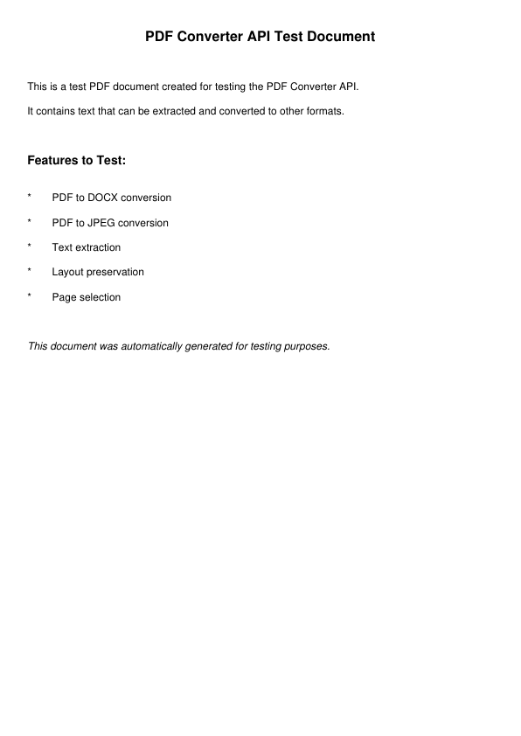
Page 1 - PDF Conversion

