Slide 1
Android-Controlled Bomb Disposal Robotic Arm Vehicle

Slide 2
Introduction:
BVLOS (Beyond Visual Line of Sight) Telemetry System that solves the fundamental problem of range limitations in traditional RF (Radio Frequency) control.
Building a Bomb Disposal Robotic Arm Vehicle is a sophisticated project that combines power electronics, mechanical linkages, wireless communication, and software integration.

Slide 3
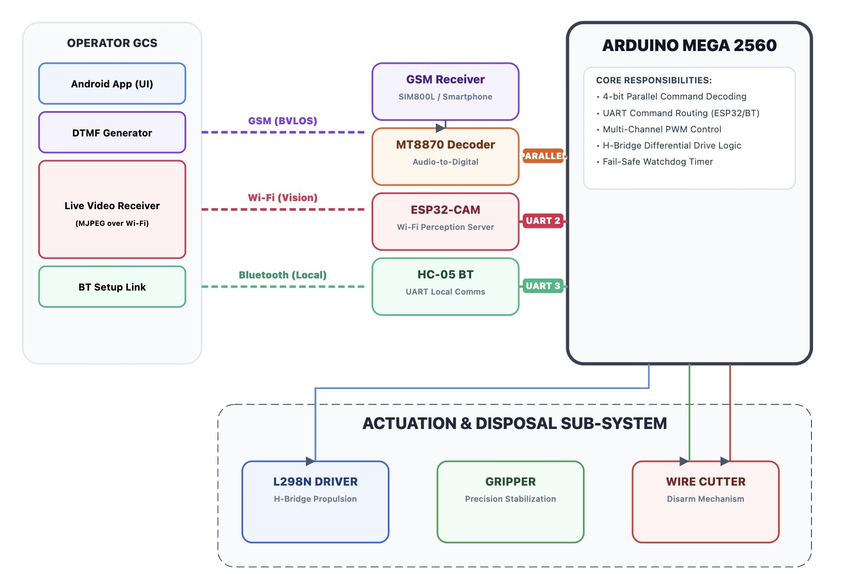
BVLOS HYBRID CONTROL ARCHITECTURE

Slide 4
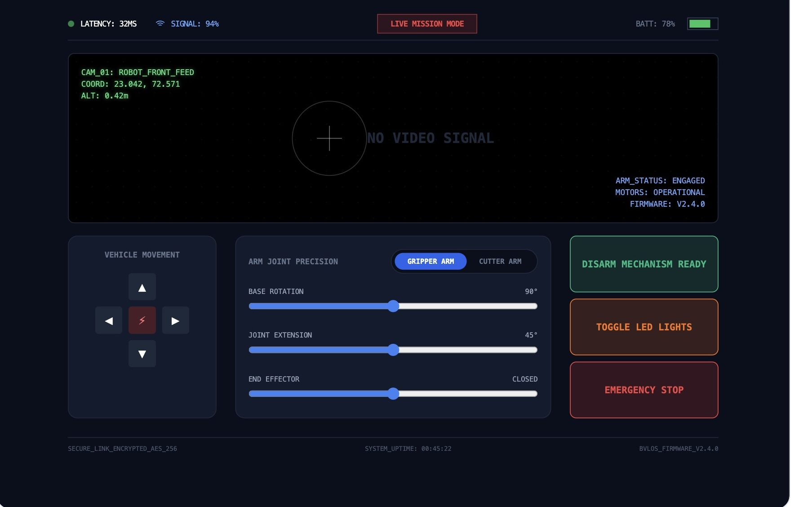
BVLOS Bomb Disposal Robot: App Architecture

Slide 5
The Hybrid Telemetry Architecture
Tri-Level Range Logic:
Bluetooth Path: HC-05 / BLE Module Integration: This connects directly to the Main MCU (via Serial UART).
"Pre-flight Checks" or maintenance.
When you are standing next to the robot, you don't want to use cellular data or call the robot.
You use Bluetooth for quick calibration.
Wi-Fi Path: Used for high-bandwidth video (Perception) when the robot is within ~100-300 meters.
GSM Path: The primary BVLOS link.
Once the robot moves beyond the Wi-Fi radius, you switch to the
DTMF/GSM control for global reach.
Hybrid Connectivity: The App UI is versatile enough to handle different connection states automatically.

Slide 6
Technical Summary Table
Feature | Bluetooth | Wi-Fi | GSM (Cellular)
Max Range | ~100m | ~300m (Standard) | Global (Tower dependent)
Data Rate | Low (2-3 Mbps) | High (Standard 600+ Mbps) | Moderate to High (4G/5G)
Power Consumption | Very Low | Moderate | High (during bursts)
Infrastructure | Peer-to-Peer | Requires Router/AP | Requires Service Provider
BVLOS Suitability | None | Limited (Line of Sight) | High (Primary Choice)

Slide 7
Hardware Components
Microcontroller: Arduino Mega 2560 (due to the high number of PWM pins needed for servos).
Locomotion Motors: High-torque DC Gear Motors with an L298N or BTS7960 H-Bridge driver.
Arm Actuators: High-torque Servo Motors (e.g., MG996R) for the base, elbow, wrist, and gripper.
Communication: HC-05 (Bluetooth) for short-range and ESP32 (Wi-Fi) for longer range/video streaming.
Power Supply: 11.1V or 14.8V LiPo battery.
Buck Converter (Step-down) to provide a stable 5V/6V for the servos and 3.3V for the controller.

Slide 8
Hardware Components
MT8870 Decoder DTMF to Digital: Decodes the specific 2-tone frequencies into a 4-bit binary code.
L298N H-Bridge Motor Driver: Manages high-current DC motors while isolating digital logic from EMF noise.
On-Board Phone Cellular Interface: Provides global connectivity without needing a custom LTE module.
ESP32-CAM / IP Cam: Provides the FPV (First Person View) required for navigation.
The Gripper (Precision Handling): Its primary roles are:
Manipulation: Moving the bomb to a "Blast Pit" or a "Containment Vessel" if it’s too dangerous to disarm on-site.
Steadying: Holding a specific component steady while another tool (like a cutter) works on it.
Unscrewing: Removing a detonator or a fuse cap.
The Disarm Mechanism (The "Cutter")

Slide 9
Hardware Components
In addition to a Wire Cutter, this mechanism could include:
Mechanical Wire Snips: Dual-blade cutters for thin trigger wires.
Water-Jet Disrupter: In advanced robots, the "disarm" tool is actually a high-pressure water cannon that "shreds" the internal circuitry of the bomb faster than the electricity can reach the detonator.
PCB Drill: A small high-speed drill to create an opening for a neutralizing agent or to sever a copper trace on a circuit board without moving the whole device.
Non-Conductive Ceramic Blades: Used specifically to cut wires without causing a short circuit (which could trigger an explosion).

Slide 10
Hardware Components
Additional Features for the Robot Arm
Additional features that can be added to the robot arm are as follows
X-Ray Mount: A holder for a portable X-ray panel so you can see the internal firing circuit without opening the casing.
Capacitor Discharge Tool: A probe used to safely drain the energy from the bomb's firing capacitor so it no longer has the "power" to explode.
Chemical Sniffer: A sensor at the tip of the arm to detect the specific type of explosive (C4, TNT, Nitrate) based on vapor.

Slide 11
Step-by-Step Development
Step A: The Mechanical Linkage (Manipulator)
DOF Calculation: Design for 4 DOF (Base rotation, Shoulder, Elbow, Gripper).
Same design for the cutter.
Torque Math: We calculated the Stall Torque required for the shoulder motor based on the weight of the arm + the payload at maximum extension (Torque = Force X Distance).
Step B: The Android Application (The "Client")
Development Environment: MIT App Inventor (fast prototyping)
GUI Design: Use Sliders (for precise arm movement) and Joysticks (for vehicle movement).
Data Protocol: Send characters or string packets via Bluetooth or Wi-Fi.
Example: "F" for forward, "S90" to set Servo 1 to 90 degrees.

Slide 12
BVLOS Bomb Disposal Robot: App Architecture
System Communication Map
Robot Side: ESP32-CAM (handling the arm logic and the video stream).
Cloud Layer: Firebase Realtime Database (for control commands) + Web Real-Time Communication (WebRTC) or Real-Time Streaming Protocol (RTSP for video).
App Side (MIT App Inventor): The Ground Control Station (GCS)

Slide 13
BVLOS Bomb Disposal Robot: App Architecture
Component Setup (Designer View)
Webview (Video Feed): Used to display the camera stream from the robot.
FirebaseDB: To send coordinates for the arm and directional commands for the vehicle.
Vertical Arrangements: To create "Joystick" areas for movement and "Slider" areas for the robotic arm joints (Base, Elbow, Wrist, Gripper).
Clock Component: To check for "Connection Heartbeat" (ensuring the robot is still online).

Slide 14
BVLOS Bomb Disposal Robot: App Architecture
Core Logic Implementation
A. The Control Heartbeat (Safety First)
BVLOS requires a "Dead Man's Switch."
If the app crashes, the robot must stop.
App Logic: Every 500ms, the App updates a heartbeat tag in Firebase to 1.
Robot Logic: If the robot sees the heartbeat hasn't updated in 2 seconds, it enters "Safe Mode" (stops all motors).

Slide 15
BVLOS Bomb Disposal Robot: App Architecture
B. Movement & Arm Controls
Instead of many buttons, use Sliders for the robotic arm to allow precise movement (crucial for bomb disposal).
Blocks Logic:
When Slider_Elbow.PositionChanged:
Call FirebaseDB.StoreValue(tag="Arm_Elbow", value=thumbPosition)
When Button_Forward.TouchDown:
Call FirebaseDB.StoreValue(tag="Move", value="F")
When Button_Forward.TouchUp:
Call FirebaseDB.StoreValue(tag="Move", value="S") (Stop)

Slide 16
BVLOS Bomb Disposal Robot: App Architecture
C. The Visual Interface
Bomb disposal requires situational awareness.
Used a Web Viewer component pointing to the IP address of the robot's video stream (e.g., http://[Robot_IP]:8080/stream).
Overlay: Placed transparent buttons over the Web Viewer so you can "touch" the screen to move while looking at the video.

Slide 17
BVLOS Bomb Disposal Robot: App Architecture
4. Crucial BVLOS Considerations
Latency Monitoring: Added a label that calculates the time difference between sending a command and receiving an "ACK" (Acknowledgement) from the robot.
If latency exceeds 300ms, the operator should slow down.
GPS Telemetry: If the robot is in a field, include the Map component to see the robot's position relative to the "Blast Zone."

Slide 18
BVLOS Bomb Disposal Robot: App Architecture
5. Suggested UI Layout
Top 70%: Web Viewer (Real-time Video).
Bottom Left: D-Pad for Vehicle movement.
Bottom Right: 4-5 Sliders for the Robotic Arm joints.
Center Top: Battery voltage and Signal Strength indicators.

Slide 19
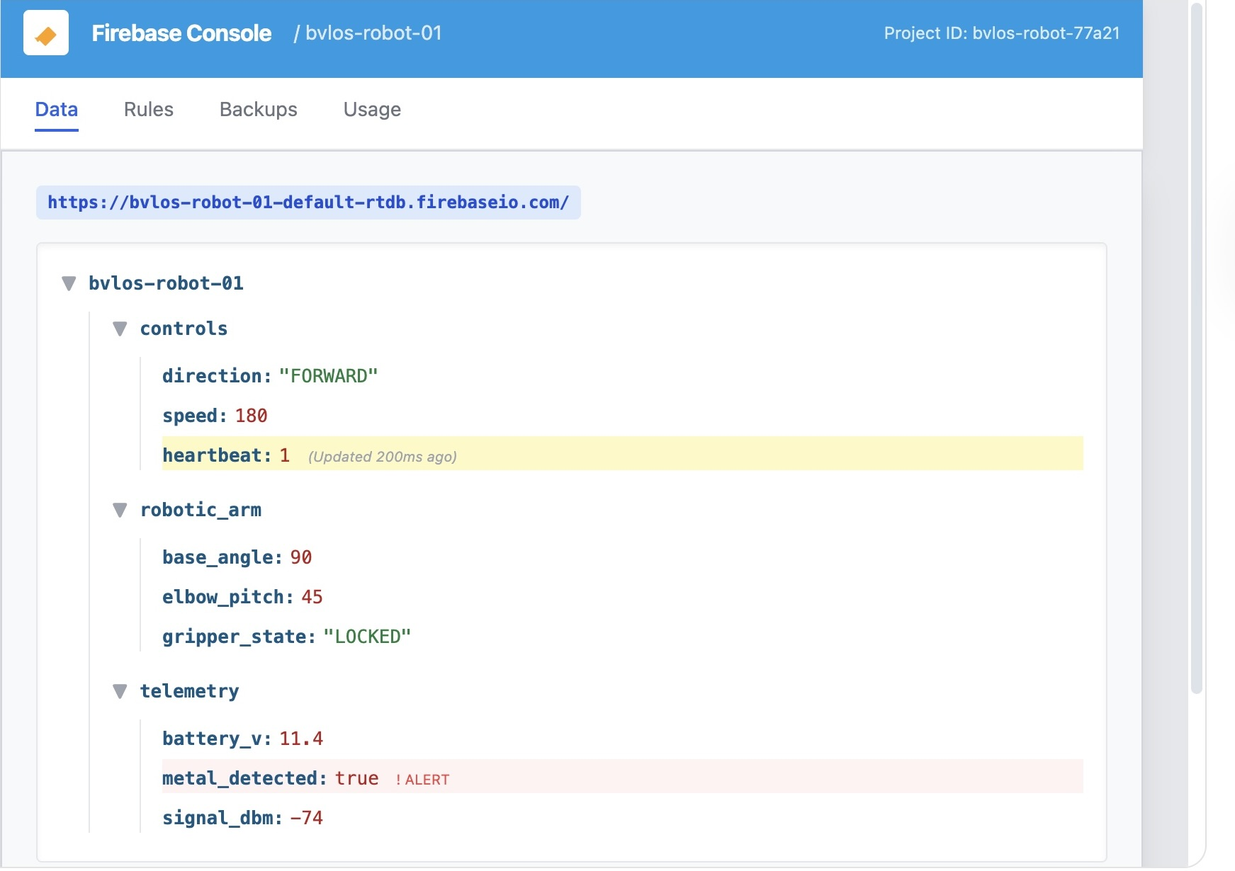
Fire base console

Slide 20
Step-by-Step Development
Step C: The Firmware (The "Magic")

Slide 21
Technical Breakdown: DTMF Control via GSM
This is the "Bridge" between the cellular network and the hardware.
How it works: When you press a key on your phone during a call, it sends two simultaneous frequencies (e.g., Key '2' is 770Hz + 1336Hz).
Decoding: The MT8870 filters these tones and sets 4 output pins (Q1-Q4) to a binary state.
The Intercept: The StD (Delayed Steering) pin on the MT8870 goes HIGH only when a valid tone is detected.
This is used as an Interrupt to the Arduino to prevent "ghost" movements from noise.

Slide 22
DTMF Binary Table
Key | Q4 | Q3 | Q2 | Q1 | Binary | Action Example
2 | 0 | 0 | 1 | 0 | 2 | Forward
4 | 0 | 1 | 0 | 0 | 4 | Left
5 | 0 | 1 | 0 | 1 | 5 | Stop
6 | 0 | 1 | 1 | 0 | 6 | Right
8 | 1 | 0 | 0 | 0 | 8 | Backward

Slide 24
Engineering Challenges & Mitigation Strategies
Signal Latency & Synchronization (The "Human-in-the-Loop" Problem)
The Challenge: There was an asynchronous delay between the GSM control path (low bandwidth, high reliability) and the Wi-Fi video path (high bandwidth, variable reliability).
This was leading to "over-steering," where the operator moves the robot too far because the video hasn't caught up yet.
The Solution: We implemented a Command-Pulse Strategy.
Instead of a continuous movement signal, each DTMF keypress triggered a discrete, 500ms burst of movement.
This forced the operator to "pulse" the controls, naturally allowing the video feed to sync between movements.

Slide 25
Engineering Challenges & Mitigation Strategies
Audio Signal Integrity & DTMF Decoding
The Challenge: Cellular networks use lossy voice compression (Codecs).
These codecs were distorting the high-frequency components of the DTMF tones, leading to "ghosting" or failed decodes at the MT8870.
The Solution: We tuned the RC Filter circuit at the input of the MT8870 to sharpen the tone detection and used a shielded auxiliary cable to prevent the robot's motor PWM noise from leaking into the audio path.

Slide 26
Engineering Challenges & Mitigation Strategies
Electromagnetic Interference (EMI)
The Challenge: We have three high-frequency radios in close proximity: The GSM phone (850/1900MHz), the Wi-Fi Camera (2.4GHz), and the DC Motor brushes (broadband spark noise).
The Solution:
Physical Separation: We mounted the Wi-Fi antenna as far as possible from the GSM antenna.
Snubber Circuits: We added 0.1µF ceramic capacitors across the DC motor terminals to suppress the high-frequency "brush noise" that was causing the Arduino to reset intermittently.

Slide 27
Engineering Challenges & Mitigation Strategies
Power Domain Isolation
The Challenge: High-torque movements cause "Voltage Sag" (Brownouts).
When the motors start, the sudden current draw can drop the voltage enough to reset the Arduino or cause the on-board phone to disconnect from the call.
The Solution: We designed a Dual-Rail Power System.
The logic (Arduino/MT8870) was powered through a dedicated low-dropout (LDO) regulator with a large bulk capacitor (2200µF), while the motors were powered directly from the battery through the H-Bridge.

Slide 28
Engineering Challenges & Mitigation Strategies
Mechanical & Environmental Constraints
The Challenge: Bomb disposal environments are often cluttered. The robotic arm adds a high center of gravity, making the vehicle prone to tipping.
The Solution: We lowered the center of mass by placing the heavy Lead-Acid or LiPo batteries at the very bottom of the chassis and used a "Tracked" locomotion system to increase the surface area for better traction on uneven debris.

Slide 29
Future Endeavors
Enhanced Perception and Autonomy
Computer Vision Integration: Moving beyond simple MJPEG streaming to include OpenCV-based object detection to help the operator automatically identify trigger wires or specific explosive components.
Thermal and X-Ray Imaging: Integrating the X-Ray Mount discussed in your hardware requirements to allow the operator to visualize internal firing circuits without physical contact.
Automated Target Tracking: Implementing software logic that uses the ESP32-CAM to "lock on" to a target, allowing the robotic arm to maintain a steady position even if the vehicle chassis moves slightly.

Slide 30
Future Endeavors
Advanced Communication and Telemetry
5G/LTE Integration: Replacing the current GSM/DTMF bridge with a high-speed 5G module to significantly reduce the 300ms+ latency often found in traditional cellular links.
Satellite Link Redundancy: For remote "No-Man's-Land" operations where cellular towers are unavailable, a satellite-based telemetry link would ensure the BVLOS capability remains global.
Enhanced Haptic Feedback: Developing a bilateral control system where the Android GCS provides physical vibration or resistance (haptics) to the operator based on the force the gripper is exerting on an object.

Slide 31
Future Endeavors
Specialized Neutralization Tools
Advanced Disarm Payloads: Expanding the "Cutter" mechanism to include a high-pressure water-jet disrupter to shred circuitry instantly or non-conductive ceramic blades to prevent accidental shorts.
Environmental Sensing: Adding a Chemical Sniffer at the tip of the arm to identify explosive vapors like C4 or TNT before the arm makes physical contact.
Capacitor Discharge Tool: Integrating a dedicated probe to safely drain energy from a bomb's firing capacitor.

Slide 32
Future Endeavors
Mechanical and Power Resilience
Active Stabilization: Implementing an IMU (Inertial Measurement Unit) to detect when the high center of gravity might cause a tip-over, and automatically adjusting the arm's position to counter-balance the weight.
Energy Density Upgrades: Moving from Lead-Acid to high-capacity Solid-State batteries to improve operating time while keeping the center of mass low.
Swarm Coordination: Developing the firmware to allow a single Android GCS to control multiple robots, allowing one robot to provide a "side-view" camera feed while the other performs the delicate disarm task.

