Slide 1


VBA Code Malware Detection by Machine Learning
Presented by:
Adnan Azem
Jode Shibli

Slide 2

Introduction to VBA Code Malware Detection
What is VBA Code?
VBA coding refers to writing instructions in the Visual Basic for Applications (VBA) language to create macros, automate tasks, and add custom functionality to Excel.
What is macro?
A macro is an action or a set of actions that you can run as many times as you want.
Importance in Cybersecurity
VBA code malware poses a significant threat to organizations as it can be used to deliver malware, steal sensitive information, and compromise system security. Detecting and mitigating VBA code malware is crucial to protecting against cyberattacks and ensuring the integrity of computer systems and data.

Slide 3
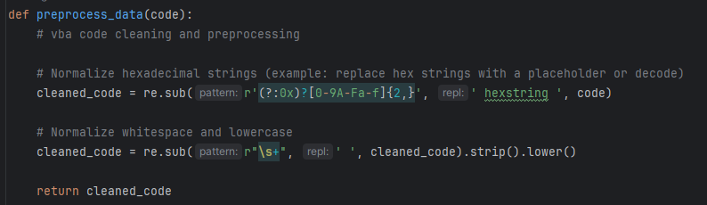
Data Preprocessing
Basic and extended text cleaning for normalization.
Handling of hexadecimal strings to address obfuscation.

Slide 4
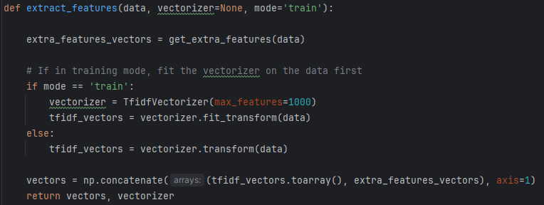
Data Preprocessing
TF-IDF Vectorization: Applied with and without `max_features` to refine feature relevance.

Slide 5
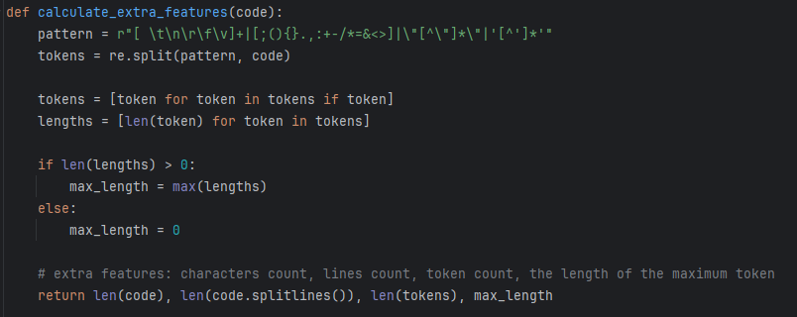
Feature Extraction
Extracting 4 Extra features to capture the syntactical complexity and structure of the VBA code.

Slide 6
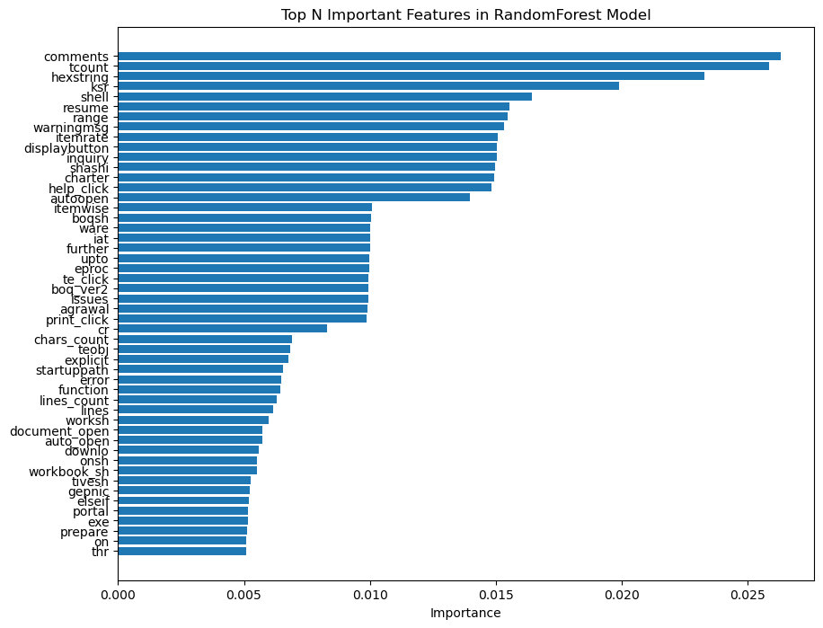

(50)
Model Training
We use`RandomForestClassifier` for model training.
In this model we choose the following parameters:
n_estimators=100,
random_state=42

Slide 7
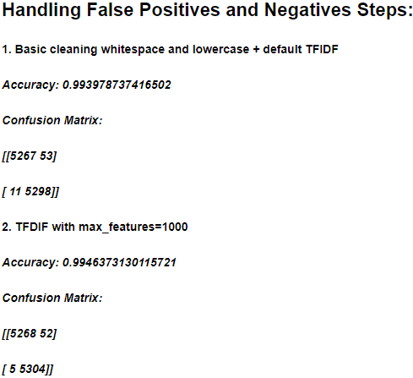
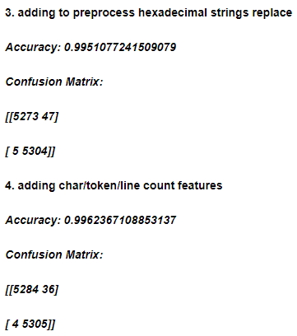
Handling False Positives and Negatives
Improvements:
Highlighted accuracy improvements from basic to advanced preprocessing techniques:
Basic TF-IDF: 0.9939 accuracy.
TF-IDF with `max_features=1000`: 0.9946 accuracy.
Hexadecimal preprocessing: 0.9951 accuracy.
Addition of textual features: 0.9962 accuracy.

Slide 8
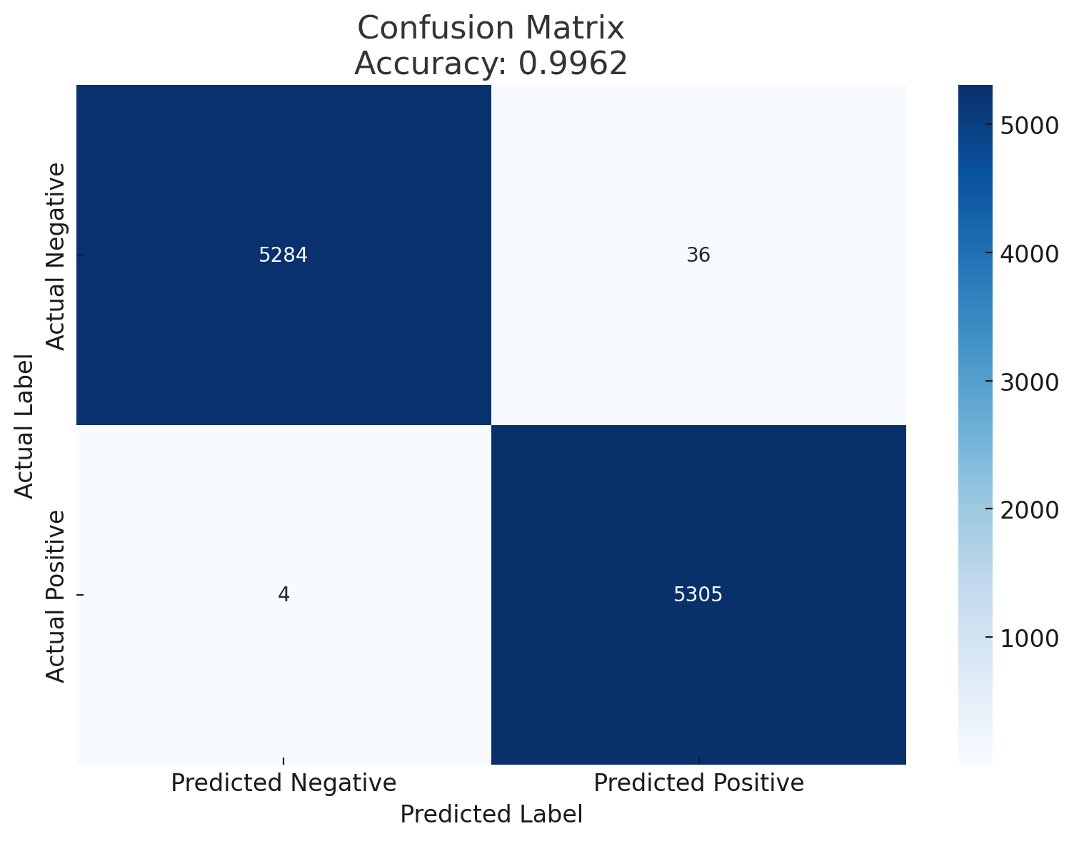
Final Result

Slide 9
Thank you

