Slide 1

Malicious URL Detection
Written by:
Adnan Azem - 212068597
Jode Shibli - 322309295

Slide 2
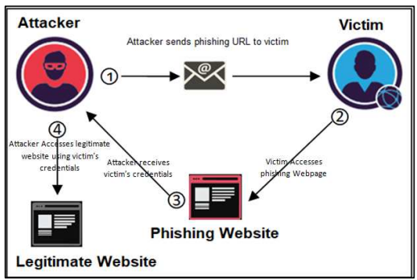
Project Description
As part of our research, we created a model that allows you to perform a real-time check on any domain you want to access and determine whether it is malicious or valid.

Slide 3
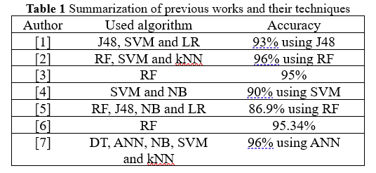
Previous works
Although many anti-phishing techniques exist today, it is still challenging to achieve high-precision detection with a low negative detection ratio. The image shows the results of several different anti-phishing techniques.

Slide 4

Our innovation
There are many methods for creating malicious domains, In our project, we chose to delve into the types of domains created by DGA. DGA stands for Domain Generation Algorithm, an algorithm designed to generate a large number of unique domains automatically. This is a common tool for creating new domains for phishing attacks. That's why we expanded our models and trained them on DGA-generated data to cover as many domains as possible.

Slide 5

Data Collection
The first dataset we found at Kaggle website which is balanced dataset, because the creation of the dataset has involved 2 different datasets from Kaggle which are as follows:
First Dataset: 450,176 URLs, out of which 77% benign and 23% malicious URLs.
Second Dataset: 651,191 URLs, out of which 428103 benign or safe URLs, 96457 defacement URLs, 94111 phishing URLs, and 32520 malware URLs.
The second dataset we found at Kaggle website which has been collected from Alexa website ranking a blacklist of previous DGA domain names.
This dataset contains 4 files two DGA files, one alexa ranking dataset and an english words dataset.

Slide 6

Feature Extraction
For the first dataset, we exported a total of 19 features, and ended up using 17 of them. We divided the features into three categories:
Length based Features
Count based Features
Binary Features

Slide 7
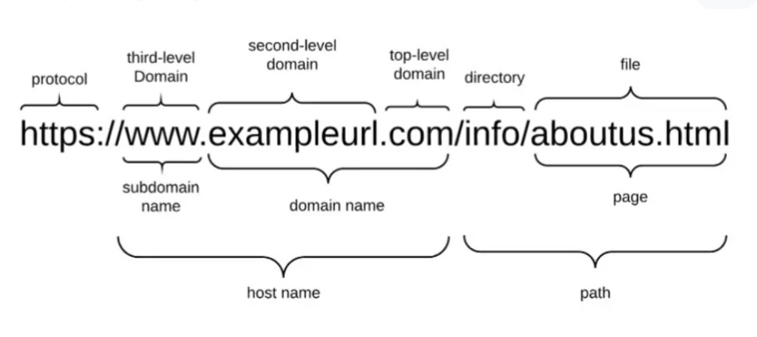
Length Features
For this category of features, we relied on the lengths of the URL parts
Length Of URL
Length of Hostname
Length Of Path
Length Of First Directory
Length Of Top Level Domain

Slide 8

Count Features
For this category of features, we relied on URL content and suspicious signs:
Count Of- '@'
Count Of - '?'
Count Of- '%'
Count Of- '.'
Count Of- '='
Count Of - 'http’
Count Of - 'https’
Count Of- 'www'
Count Of- Digits
Count Of- Letters
Count Of- Redirections

Slide 9

Binary Features
For this category of features, we were based on whether the URL is built specifically
Use of IP or not
Use of Shortening URL or not

Slide 10
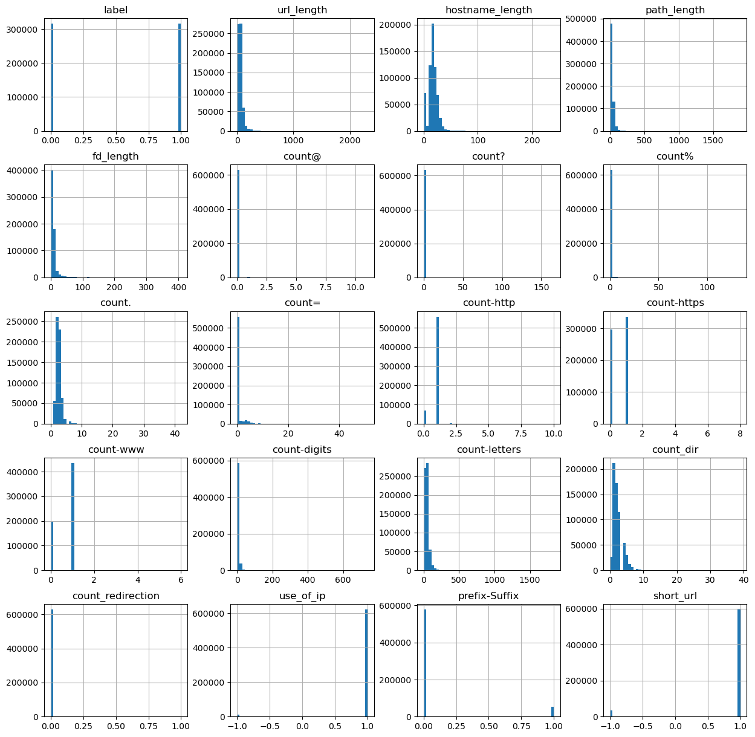
Dataset Investigation
Distribution features
In the image you can see the distribution of values between all the different features

Slide 11
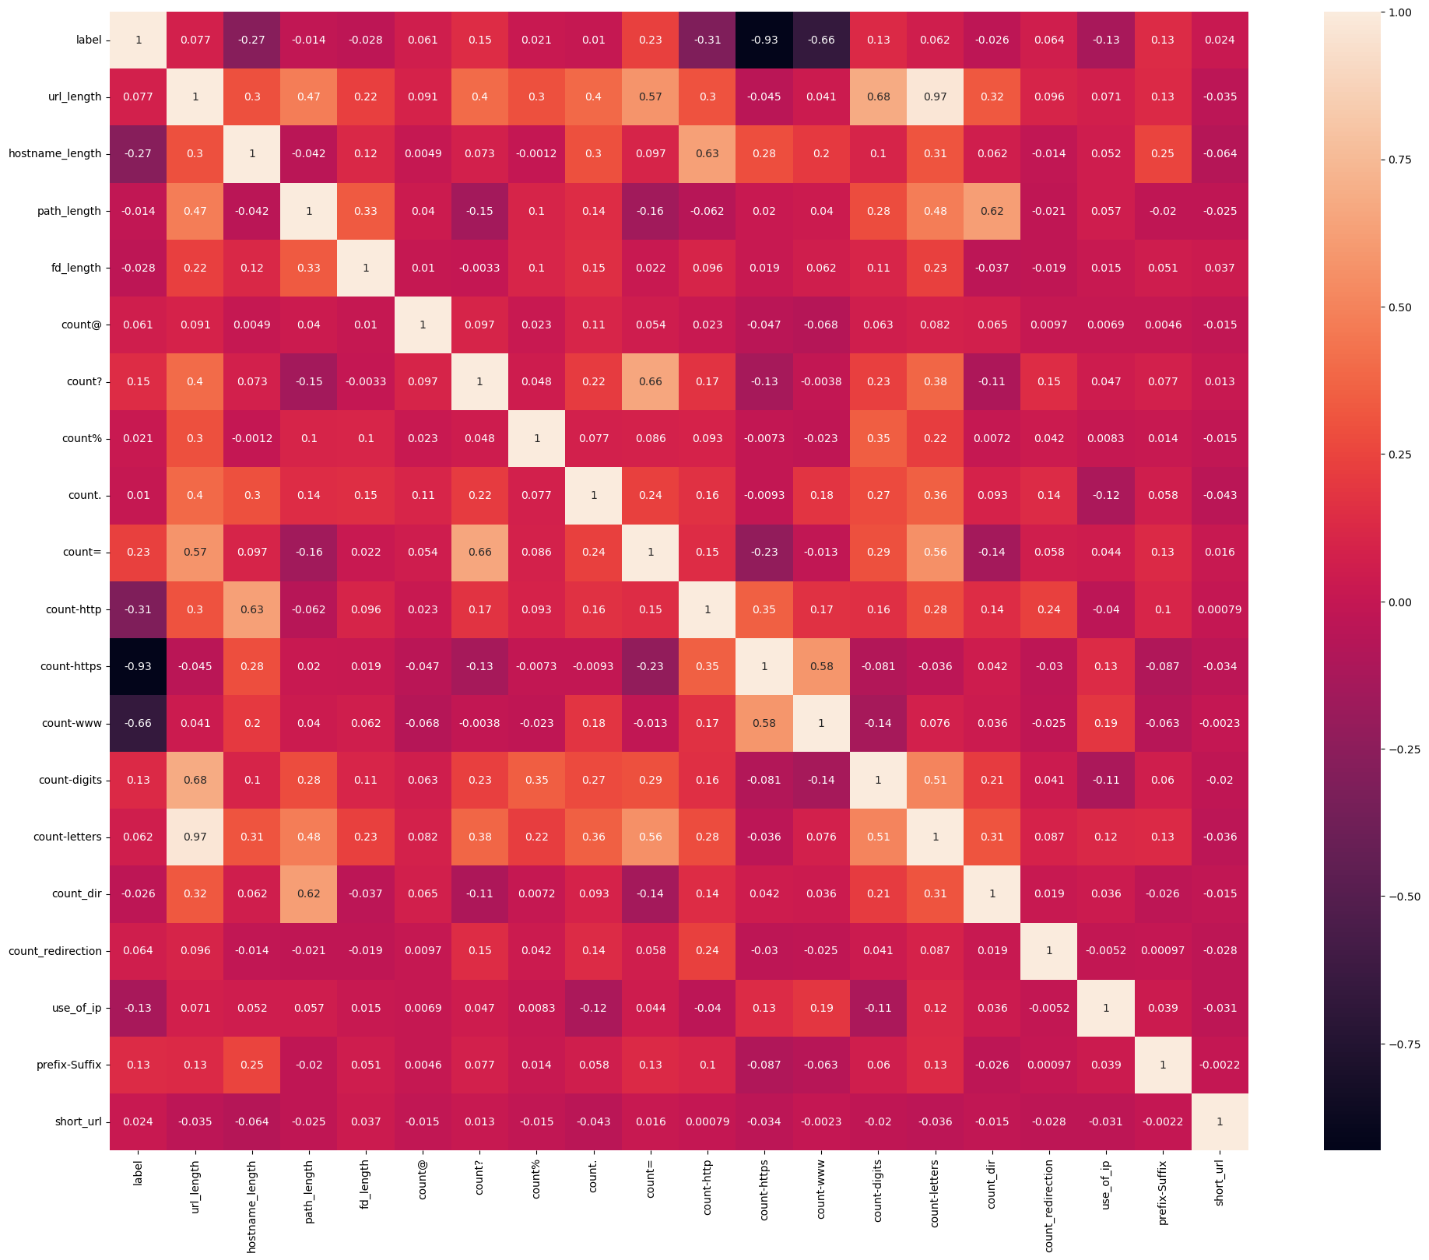
Dataset Investigation
Correlation heatmap

Slide 12
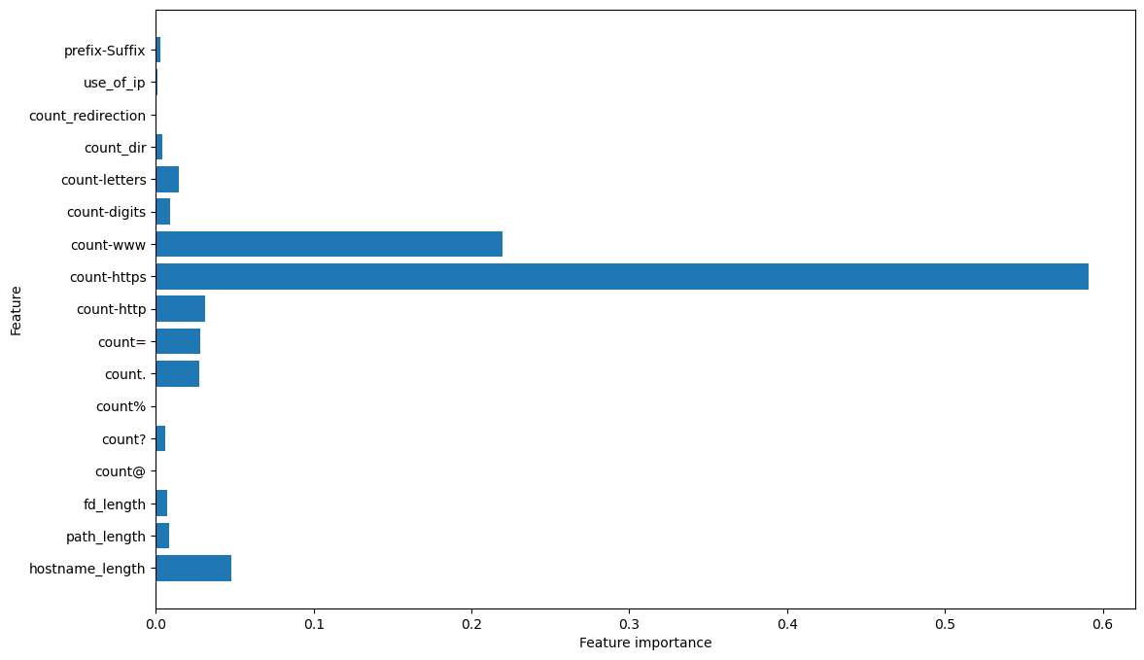
Strong characteristics for the basic model
Within each data set there were some strong characteristics by which we could almost accurately identify whether the domain was malicious or not, the same characteristics were:
count – ‘https’
count – ‘www’
count – ‘http’
Length of Hostname

Slide 13
Feature Extraction
For the second dataset, we exported a total of 18 features, and ended up using all of them. We divided the features into three categories:
Structural Features
Linguistic Features
Statistical Features

Slide 14
Structural Features
Domain Name Length
Number of Subdomains
Subdomain Length Mean
Has www Prefix
Has valid TLD
Contains Single-Character Subdomain
Contains TLD as Subdomain
Underscore Ratio
Contains IP Address

Slide 15
Linguistic Features
Contains Digits
Vowel Ratio
Digit Ratio
Ratio of Repeated Characters
Ratio of Consecutive Consonants
Ratio of Consecutive Digits

Slide 16
Statistical Features
Entropy
words gram
alexia gram

Slide 17
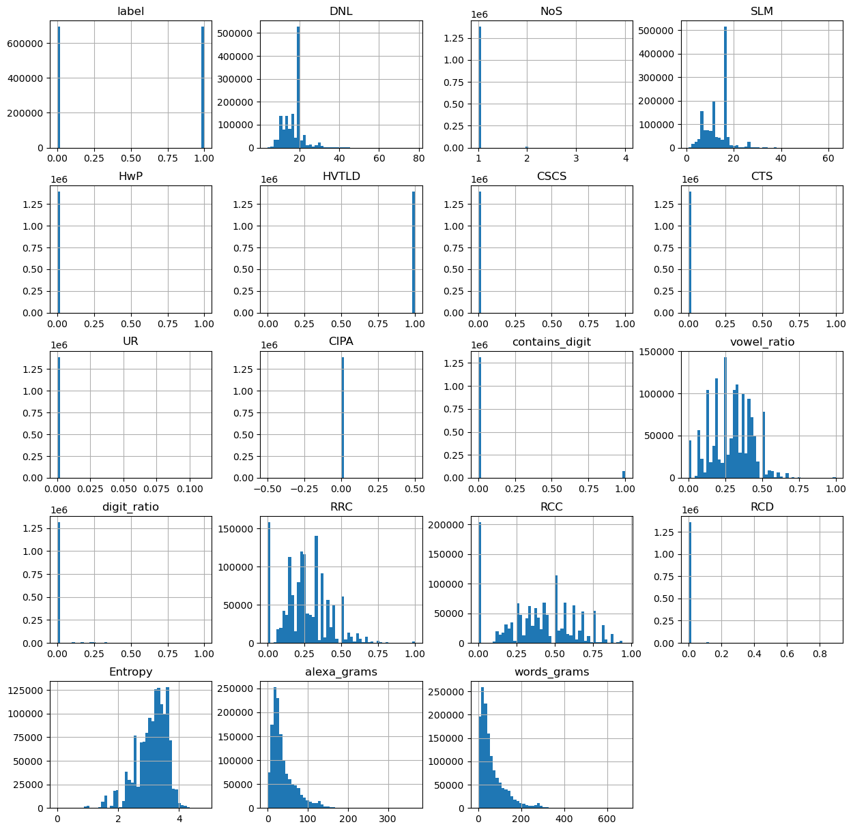
Dataset Investigation
Distribution features
In the image you can see the distribution of values between all the different features

Slide 18
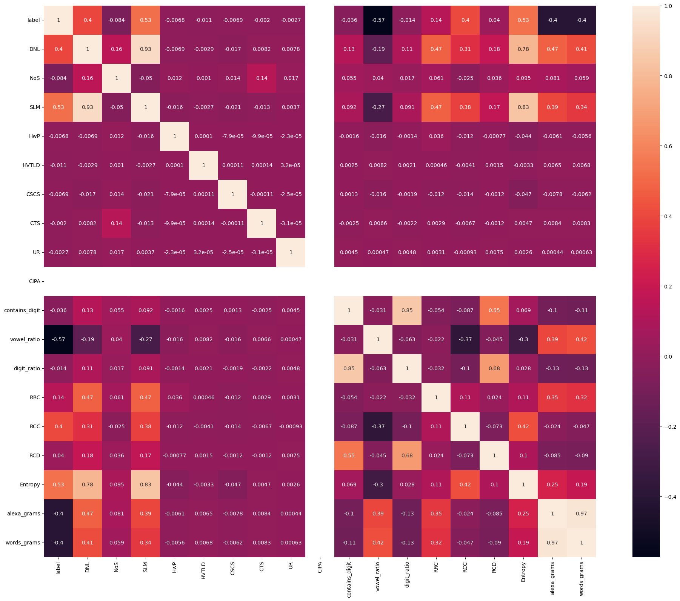
Dataset Investigation
Correlation heatmap

Slide 19

Training models for the first dataset
During the project we trained 4 models:
Logistic Regression: 99.49% accuracy and 99% F1-score.
Random Forest: 99.64% accuracy and 100% F1-score.
Decision Tree: 99.45% accuracy and 99% F1-score.
XGBoost : 99.64% accuracy and 100% F1-score.

Slide 20
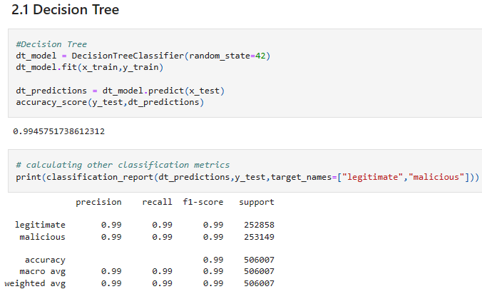
Results of the Decision Tree Model

Slide 21
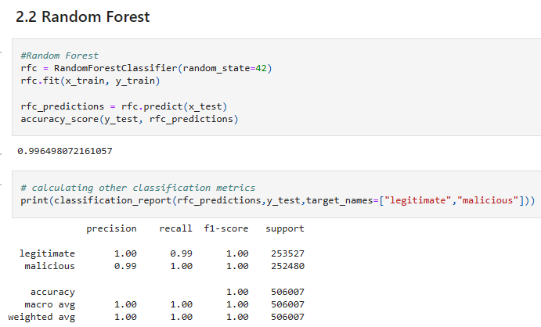
Results of the Random Forest model

Slide 22
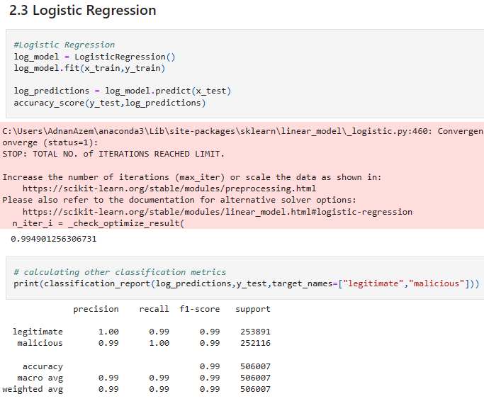
Results of the Logistic Regression model

Slide 23
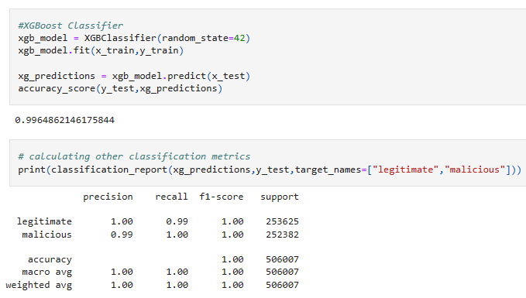
Results of the XGBoost model

Slide 24
Training model for the second dataset
During the project we trained 4 models :
LightGBM: 98.54% accuracy.
Random Forest: 98.71% accuracy.
XGBoost: 98.68% accuracy.
Gradient-boosted: 97.64% accuracy.

Slide 25
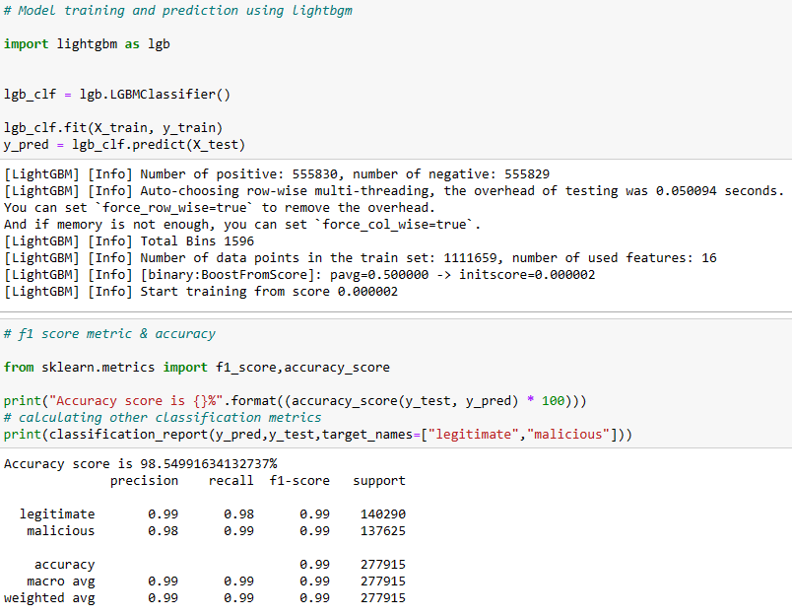
Results of the LightGBM Model

Slide 26
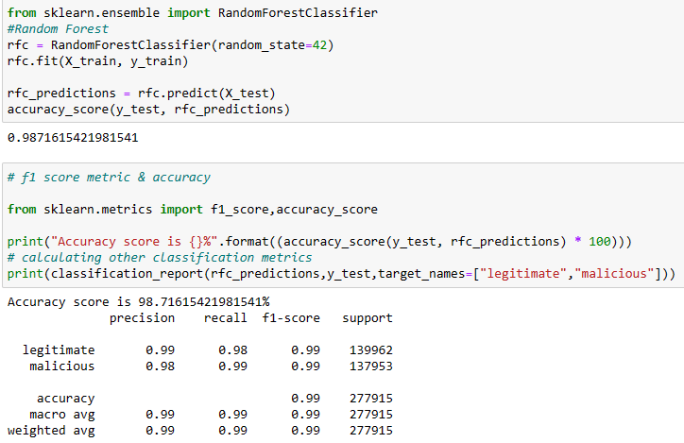
Results of Random Forest Model

Slide 27
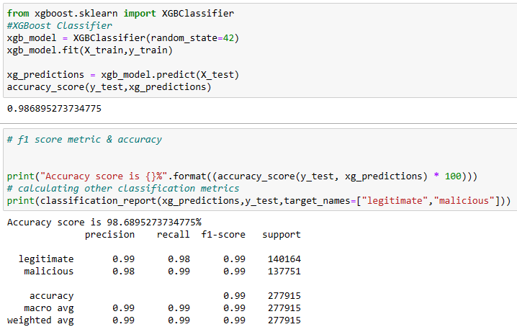
Results of XGBoost Model

Slide 28
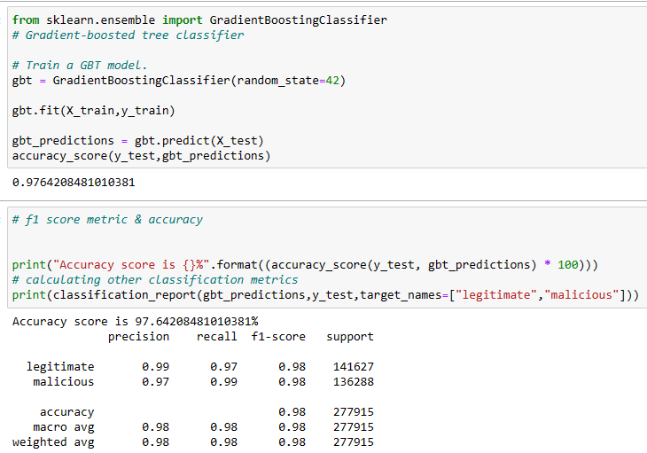
Results of Gradient-boosted tree Model

Slide 29
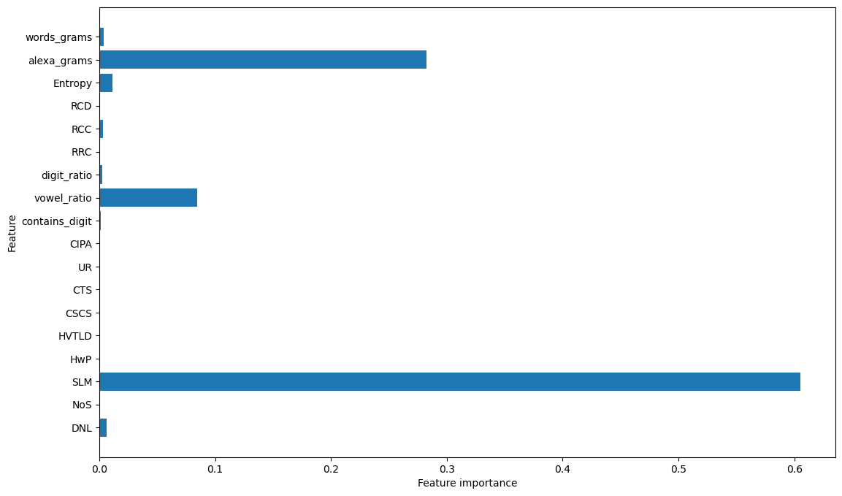
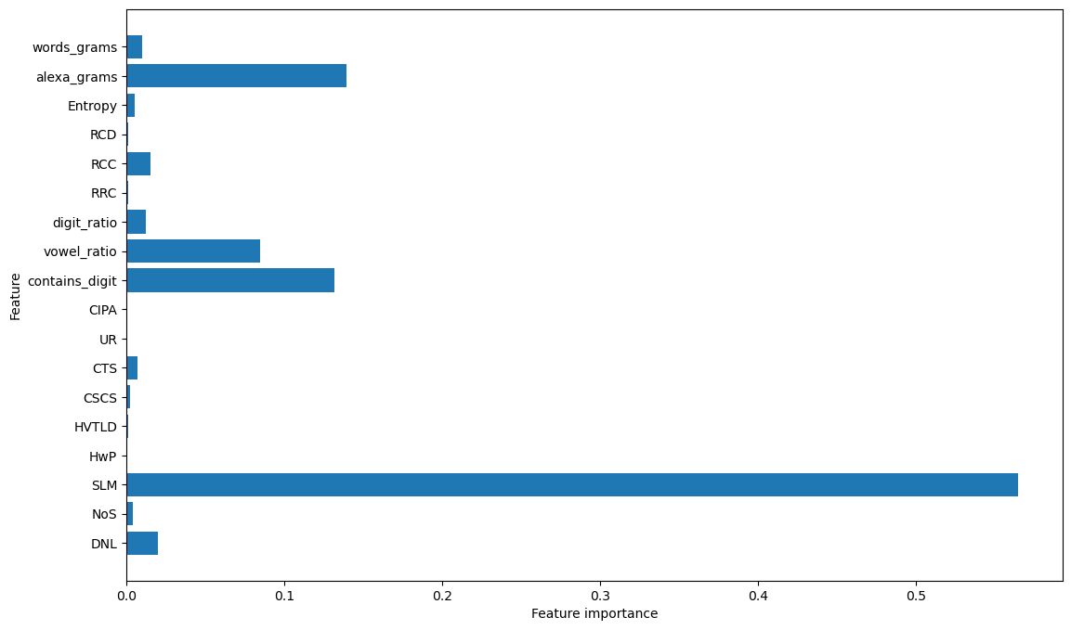
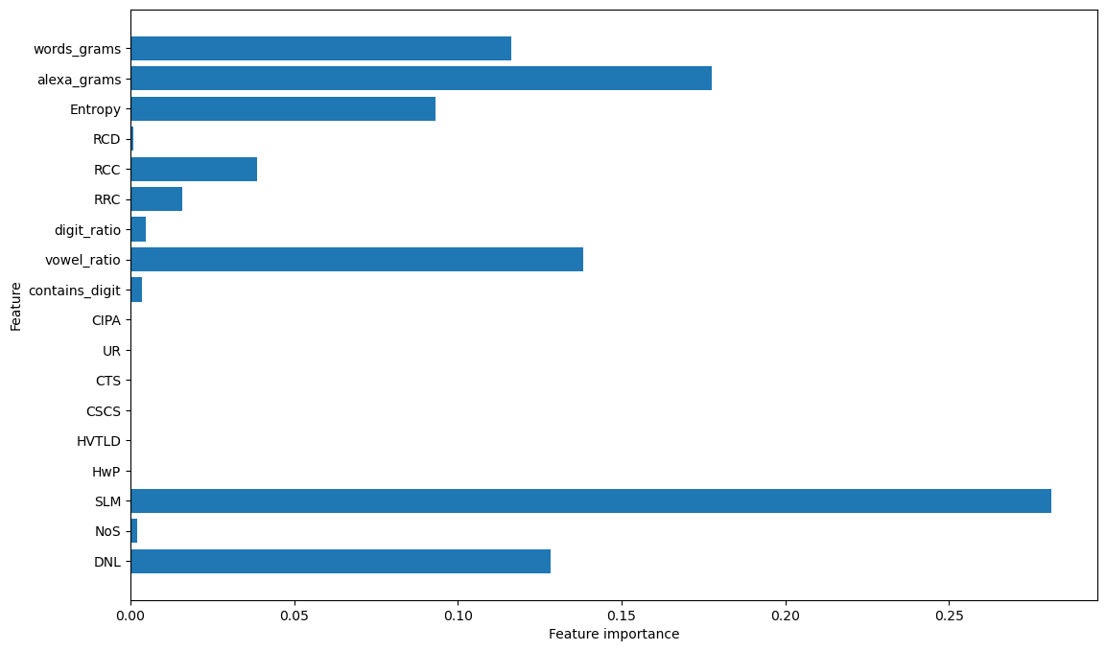
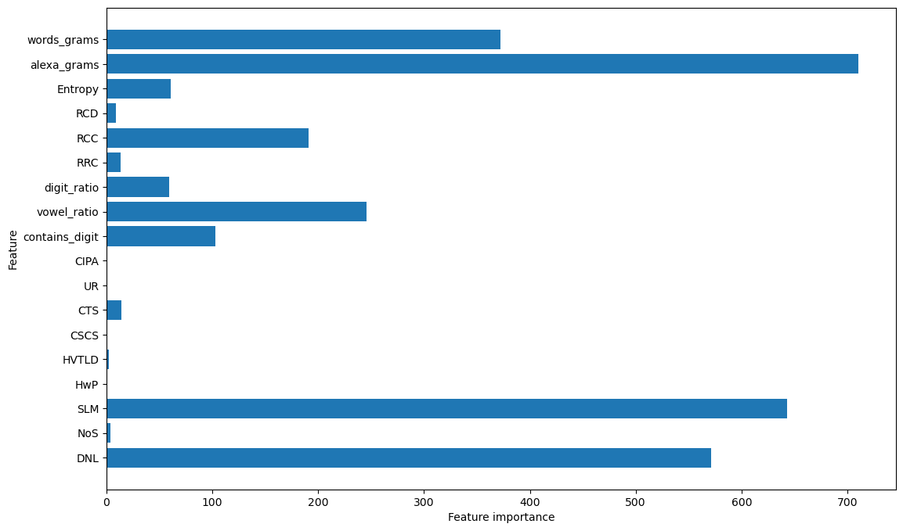
Strong characteristics for the 4 models
Gradient-boosted
XGBoost
Random Forest
LightGBM

Slide 30

Project summary and expansion
During the project, we created an initial basic model that we trained on a data set containing 650,000 domains, half of which are malicious. The model worked fine and showed good detection accuracy results, but it covers a small amount of domain types.
In the new model, we chose to train on another type of data generated by DGA.
DGA has many different types of algorithms that make up different families of domains, in our project we trained on more different families out of 50+ other known families.
In terms of expanding the project, it is possible to train the model on additional algorithms that we did not use, and each time a new algorithm is discovered, train the model on it as well, thus covering a larger number of different types of domains.

