Slide 1
bluemine (Ticket Tracking System)
Group Members:
Muhammad Adnan Inayat
Ameer Hamza Cheema
Asif Ahmad
Talah Zameer

Slide 2
Project description: -
We can’t keep track of official matters through verbal communication as one can accept/ deny any commitment made by him/ her. It’s the need of the hour that all official matters must be booked and tracked for future reference. Doing it manually (paper based) is very hectic so we have planned to develop web-based ticket tracking system. It will provide option to create issues/ticket. Users can also check progress. It will keep a record of users who is originating issue, type of issue, assigned to which person, deadline etc.

Slide 3
Technologies : -
Frontend: -
HTML, CSS, JavaScript, Bootstrap, Angular
Backend: -
Node.js, LoopBack

Slide 4
Target users: -
This system can be used by offices of all types of industries.
Features: -
Initiate ticket
Check status of issued tickets
Send reminder
Write comments

Slide 5
5. Automatic notification
6. Collective discussion on issue
7. Tracking of work towards resolution of issues

Slide 6
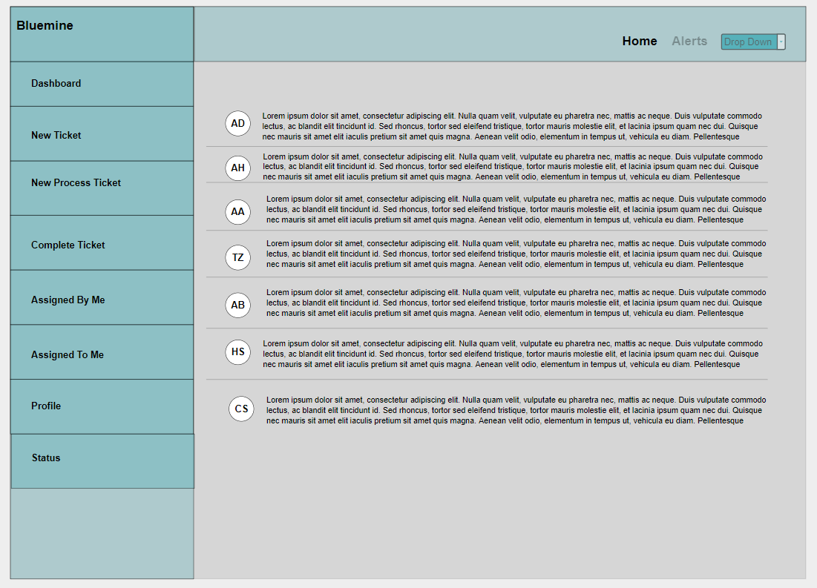
home

Slide 7
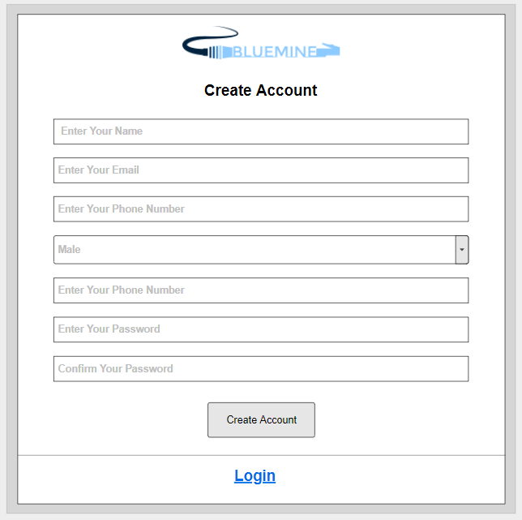
Signup : -

Slide 8
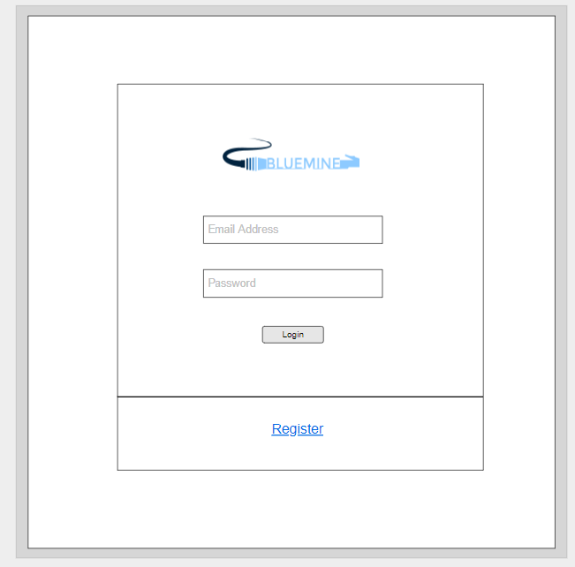
Signin : -

Slide 9
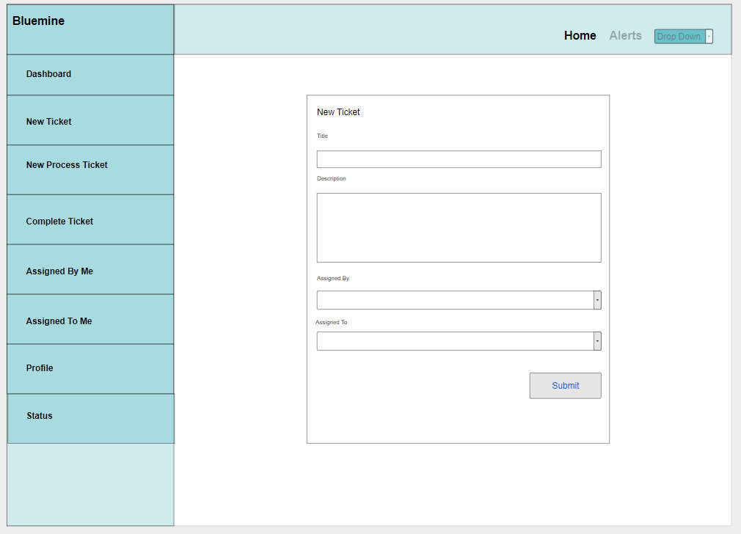
New Ticket : -

Slide 10
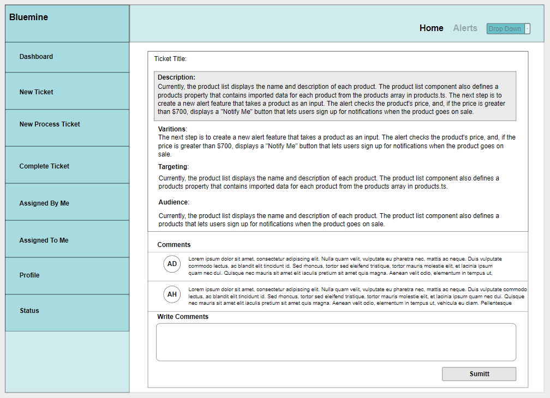
Comments : -

