Slide 1
[enter title]
[enter name]

Slide 2
Agenda
Part 1
Top 5 – Metrics By Category
Key Insights
Team Structure
Other Metrics
Part 2
BCG Matrix
Target City 12
Target City 16
Target City 9
Target City 5

Slide 3
PART 1

Slide 4
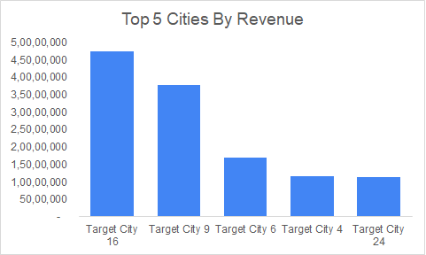
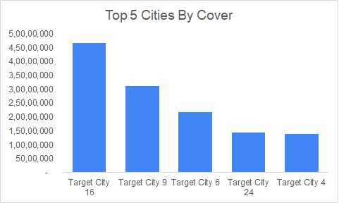
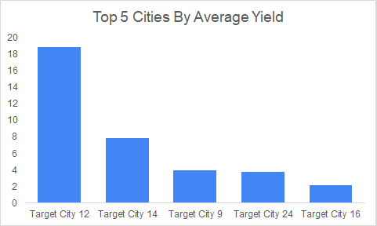
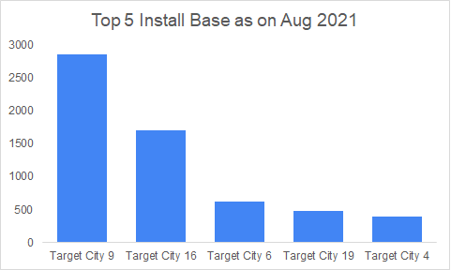
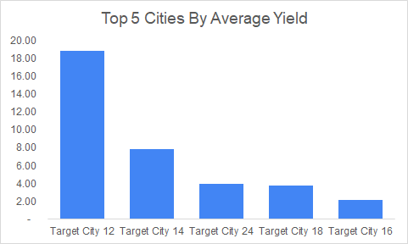
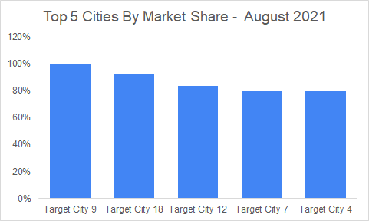
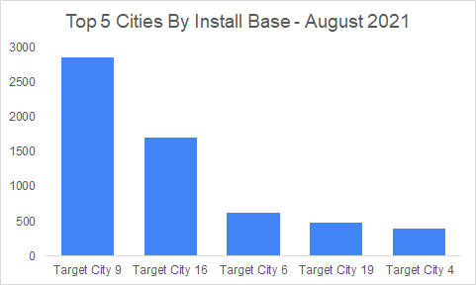
Top 5 – Metrics By Category

Slide 5
Key Insights
The company is dominating the space with over 71% of market share as on August 2021
Target City 9
The company is strongest here with 100% market share and maximum install base as on August 2021
The number of covers despite having 100% market share suggest the city isn’t a metro city
Target City 16
This seems to be the biggest market with highest revenue and cover despite of below average market share and low yield

Slide 6
Key Insights
Target City 12
The city ranks bottom in all the parameters except the average yield which is almost 3 times more than the second best city and market share where it ranks 3rd
Target City 5
The city ranks at the bottom among all the city the company is operating in

Slide 7
Team Structure
The ideal team structure should be as follows:
Higher the market share lower requirement of AE and higher requirement of AM
Target City 9
Target City 18
Target City 12
Lower the market share higher the requirement of AE and lower requirement of AM
Target City 5
Target City 24
Target City 6

Slide 8
Other Metrics
Total number of restaurants in the city to understand the % of market captured by company and competitors
Total population of target group in the city

Slide 9
PART 2

Slide 10
BCG Matrix
Cash Cow Target City 9 | Star Target City 16
Dog Target City 5 | Question Mark Target City 12

Slide 11
Target City 12
Focus
Increase cover
Action Plan
Aggressive marketing
Implementation
Promotional discount on covers

Slide 12
Target City 16
Focus
Increase market share
Action Plan
Increase Install Base
Implementation
Deploy maximum AEs on field to get more and more restaurants on board

Slide 13
Target City 9
Focus
Increase yield
Action Plan
Provide greater value to customer
Implementation
Deploy maximum AMs to establish better relationship with restaurants
Aid restaurants to provide premium service and wider variety

Slide 14
Target City 5
Focus
Survive / exit
Action Plan
Minimize resource
Implementation
Do nothing or exit the market

