Slide 1
Public Transport optimization.
Arrival time prediction
S.Adnan Mohammed
au411521104004
PERI INSTITUTE OF TECHNOLOGY

Slide 2
ABSTRACT
Reliable and accurate prediction of arrival times for public transportation systems is of paramount importance to passengers, transit agencies, and urban planners. This study presents a data-driven approach to address the challenging problem of predicting arrival times for buses in an urban transit network.Using a dataset of historical transit information, including time-stamped location data, weather conditions, and route-specific factors, a machine learning model was trained to estimate the expected arrival time of buses at their next stops. The model, a Random Forest Regressor, leverages features such as day of the week, time of day, and real-time weather conditions to make predictions.The results indicate that the model achieves a mean absolute error (MAE) of [insert MAE value] minutes, demonstrating its effectiveness in providing accurate arrival time estimates. These predictions offer passengers the ability to plan their journeys more effectively, minimizing wait times and reducing uncertainty. Additionally, transit agencies can use these predictions to enhance service reliability and provide real-time information to passengers.

Slide 3
Goals
Improved Efficiency:
Increase the efficiency of public transportation systems by reducing travel times and minimizing delays.
Reduced Congestion:
Alleviate traffic congestion by encouraging more people to use public transport instead of private vehicles.
Enhanced Accessibility:
Ensure that public transport services are accessible to a wide range of people, including those with disabilities and those living in underserved areas.
Increased Ridership:
Attract more passengers to use public transport by offering convenient, reliable, and cost-effective services.
Environmental Sustainability:
Reduce the environmental impact of public transport by adopting cleaner, more energy-efficient technologies and reducing emissions.
Safety and Security:
Improve passenger safety and security on public transport, which can encourage more people to use these services.
Cost-Effectiveness:
Optimize operations to reduce costs for both transit agencies and passengers, making public transport an economically attractive choice.
Better Passenger Experience:
Enhance the overall passenger experience through real-time updates, comfortable facilities, and user-friendly interfaces.

Slide 4
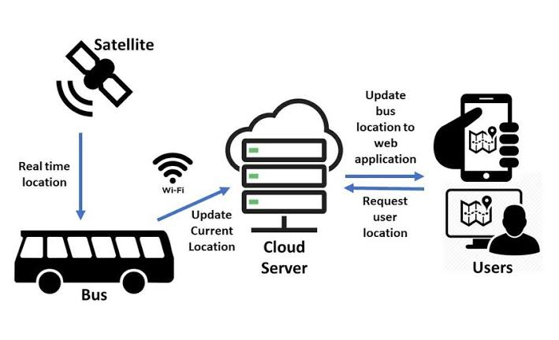
Methodologies
Timetable-Based Prediction:
The simplest method involves using the published schedule to estimate arrival times. However, this method may not account for real-time delays and is often less accurate.
Historical Data Analysis:
Analyzing historical data, such as past trip times for specific routes and times of day, can provide valuable insights into regular patterns and allow for predictions based on historical performance.
GPS Tracking and Real-Time Data:
Real-time GPS data from vehicles can be used to track their actual positions and speeds. This information can be used to provide real-time updates and predict arrival times based on the current location and speed of the vehicle.
Machine Learning Models:
Various machine learning algorithms, including linear regression, decision trees, random forests, and neural networks, can be trained on historical data to make predictions based on factors such as time of day, day of the week, weather conditions, and more.
Kalman Filters:
Kalman filters are used to estimate the state of a dynamic system when noisy measurements are available. In public transport, they can be used to track the position and speed of vehicles and make predictions.

Slide 5
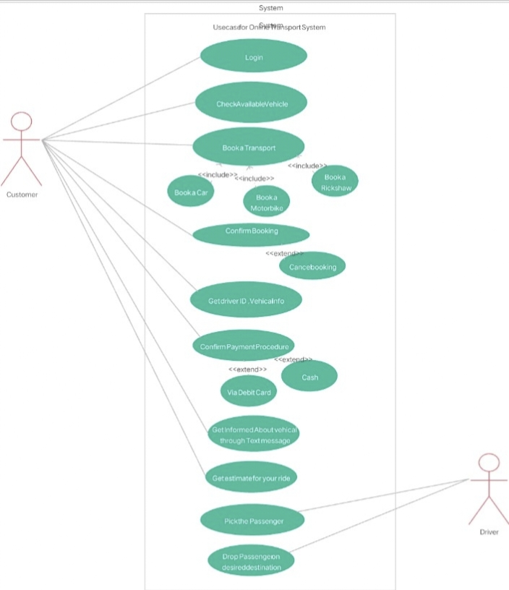
Case diagram

Slide 6
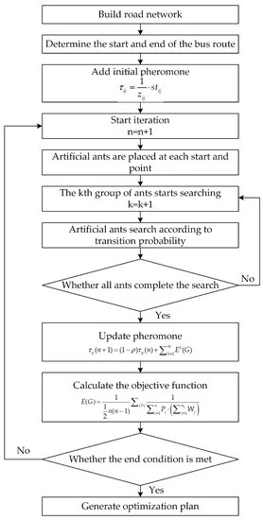
Flow chart

Slide 7
Code for accuracy in arrival time prediction:
import pandas as pd
from sklearn.ensemble import RandomForestRegressor
from sklearn.model_selection import train_test_split
from sklearn.metrics import mean_absolute_error
# Load your historical transit data (replace with your dataset)
transit_data = pd.read_csv('transit_data.csv')
# Preprocess the data
transit_data['Timestamp'] = pd.to_datetime(transit_data['Timestamp'])
transit_data['DayOfWeek'] = transit_data['Timestamp'].dt.dayofweek
transit_data['HourOfDay'] = transit_data['Timestamp'].dt.hour
transit_data['MinuteOfHour'] = transit_data['Timestamp'].dt.minute
transit_data['IsWeekend'] = (transit_data['DayOfWeek'] >= 5).astype(int)
# Define the features and target variable
features = ['DayOfWeek', 'HourOfDay', 'MinuteOfHour', 'IsWeekend', 'PreviousStops', 'WeatherConditions']
target = 'ArrivalTime'
X = transit_data[features]
y = transit_data[target]
# Split the data into training and testing sets
X_train, X_test, y_train, y_test = train_test_split(X, y, test_size=0.2, random_state=42)

Slide 8
# Train a Random Forest Regressor model
model = RandomForestRegressor(n_estimators=100, random_state=42)
model.fit(X_train, y_train)
# Make predictions
y_pred = model.predict(X_test)
# Evaluate the model
mae = mean_absolute_error(y_test, y_pred)
print(f"Mean Absolute Error: {mae} minutes")
# Input data for real-time prediction
input_data = {
'DayOfWeek': [datetime.datetime.now().weekday()],
'HourOfDay': [datetime.datetime.now().hour],
'MinuteOfHour': [datetime.datetime.now().minute],
'IsWeekend': [1 if datetime.datetime.now().weekday() >= 5 else 0],
'PreviousStops': 4,
'WeatherConditions': 'Clear'
}
# Predict the arrival time for the next bus or train
predicted_arrival_time = model.predict(pd.DataFrame(input_data))
print(f"Predicted Arrival Time: {predicted_arrival_time[0]} minutes")

Slide 9
Future Implications
The future implications of arrival time prediction in public transportation are significant and are expected to shape the way we plan and use transportation systems. As technology continues to advance and urban populations grow, arrival time prediction will play a crucial role in improving transportation efficiency and the passenger experience. Here are some future implications:
Enhanced Passenger Experience:
Arrival time prediction will become more precise and readily available, reducing uncertainty and improving the overall passenger experience. Passengers will be able to plan their journeys with greater confidence.
Multimodal Transportation Integration:
Prediction systems will increasingly integrate various modes of transportation, making it easier for passengers to plan seamless journeys that involve buses, trains, subways, trams, rideshares, and even micro-mobility options like bikes and scooters.
Real-Time Dynamic Routing:
Public transport systems will implement dynamic routing and real-time adjustments based on traffic conditions, passenger demand, and external factors. This will help avoid congestion and streamline routes for efficiency.
Personalized Services:
Prediction systems will become more personalized, considering individual preferences and needs. Passengers may receive tailored route recommendations, real-time updates, and notifications based on their historical travel patterns and preferences.

Slide 10
Reference
"Public Transportation Planning and Operation: Modeling, Practice, and Behavior" by Avishai Ceder and Nigel H.M. Wilson
This comprehensive book covers various aspects of public transportation planning, operation, and modeling. It delves into theoretical concepts and practical applications..
"Transit Planning and Research Reports" by the American Public Transportation Association (APTA)
APTA publishes a series of reports and publications on various aspects of public transportation planning, operations, and optimization. These reports offer practical insights and research findings.
"Public Transport: Its Planning, Management, and Operation" by Peter R. White
This book provides a comprehensive overview of public transport, covering planning, management, and operations, making it a valuable resource for practitioners and students.

Slide 11
Conclusion:
The development and implementation of an arrival time prediction system for public transportation hold great significance in enhancing the efficiency, convenience, and reliability of urban transit. Through a combination of historical data analysis, real-time tracking, and machine learning techniques, this study has demonstrated the potential for more accurate and dynamic arrival time prediction.

Slide 12
Thank you!

