Slide 1
Diversity and Culture

Slide 2
Why the study of diversity and culture is important?
Broadened Perspectives: Exposure to diverse cultures fosters open-mindedness and a broader worldview, helping students understand and appreciate different perspectives.
Critical Thinking: Engaging with various cultural contexts encourages critical thinking about social issues, power dynamics, and the impact of cultural norms on behavior.
Improved Communication: Understanding cultural differences enhances communication skills, which are essential in both personal and professional contexts, especially in a globalized world.
Social Responsibility: Awareness of diversity promotes social responsibility and empathy, preparing students to engage thoughtfully with diverse communities and advocate for social justice.

Slide 3
Cont’d
Workplace Preparedness: Many careers require collaboration with people from different backgrounds. Familiarity with cultural diversity equips students to work effectively in diverse teams.
Innovation and Creativity: Exposure to varied cultural ideas can inspire creativity and innovation, as diverse viewpoints often lead to new solutions and approaches.
Personal Growth: Engaging with different cultures fosters personal development, self-awareness, and a deeper understanding of one’s own cultural identity.
Overall, the study of culture and diversity enriches the educational experience and prepares students to navigate an increasingly interconnected world.

Slide 4
Diversity
Diversity refers to the ways in which people are similar or different from each other. It may be defined by any characteristic that varies within a particular work unit such as gender, race, age, education, tenure, or functional background.
What are the benefits and challenges of diversity in the organizations?

Slide 5
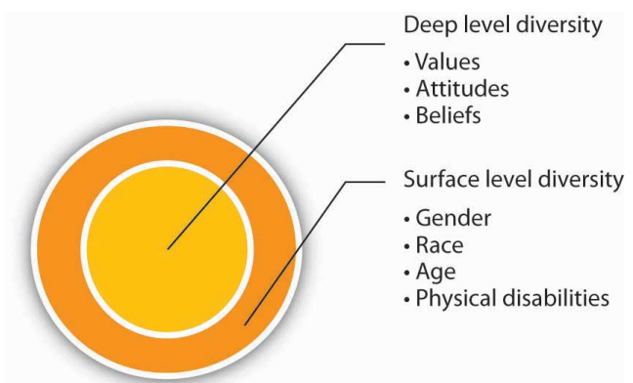
Levels of Diversity
Surface-level diversity: Differences in easily perceived characteristics, such as gender, race, ethnicity, or age, that do not necessarily reflect the ways people think or feel but that may activate certain stereotypes.
Deep-level diversity: Differences in values, personality, and work preferences that become progressively more important for determining similarity as people get to know one another better.

Slide 6
Biographical characteristics: Personal characteristics—such as age, gender, race, and ethnicity—that are objective and easily obtained from personnel records. These characteristics are representative of surface-level diversity.

Slide 7
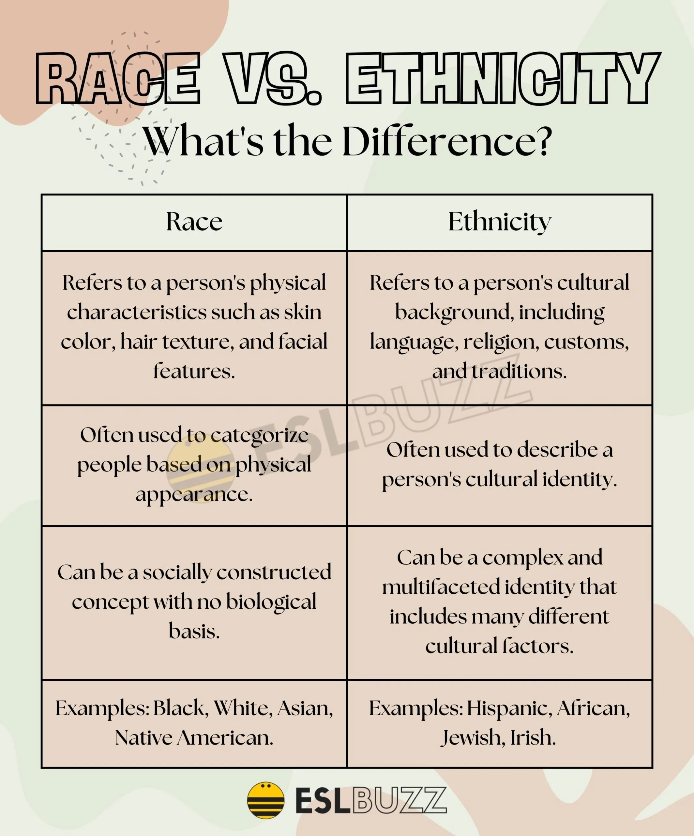

Slide 8
Age in the workplace
Age: Age in the workforce is likely to be an issue of increasing importance during the next decade for many reasons. For one, the workforce is aging worldwide in most developed countries.
Stereotypes of older workers as being behind the times, grumpy, and inflexible are changing. Managers often see a number of positive qualities that older workers bring to their jobs, such as experience, judgment, a strong work ethic, and a commitment to quality.

Slide 9
Generational Differences
Baby Boomers
Baby Boomers are roughly between the ages of 55 and 75. This generation of workers tends to seek advancement and be goal-oriented in their careers. They value in-person interaction and some structure, or hierarchy, in the workplace.

Slide 10
Generation X
Members of Generation X are currently between the ages of 40 and 60, roughly speaking. These employees are approaching the midpoint of their careers and potential peak-earning years. As the first generation to experience both parents working outside the home, these employees tend to be hard-working, adaptable, and digitally savvy.

Slide 11
Cont’d
Generation Y (Millennials)
Millennials are workers currently between the ages of 20 and 40. These employees are characterized as tech-savvy, achievement-oriented, and focused on using their professional careers to better the world. These workers seek to make their work mean something more than just a paycheck.

Slide 12
Generation Z
Generation Z is the youngest group in the workforce, currently between the ages of 18 and 25 (though, note that many members of Gen Z aren’t of the legal age to enter the labor market just yet). So far, this generation seems most motivated by salary. They are the first true digital natives, having never grown up without the internet. Gen Z is also one of the most diverse generations to enter the workforce in history.

Slide 13
5 benefits of age diversity in the workplace
1. Increased productivity
2. Improve skill diversity
3. Build an inclusive business
4. Create mentorship opportunities
5. Improve employee retention
Source: https://vervoe.com/age-diversity/

Slide 14
Prejudice and stereotypes
Prejudice is a preconceived, biased feeling or belief about a particular group of people or things.
Stereotypes are characteristics that society instinctively attributes to groups of people to classify them according to age, weight, occupation, skin color, gender, etc.
https://open.maricopa.edu/culturepsychology/chapter/stereotypes-prejudice-and-discrimination/

Slide 15
Discrimination
Discrimination: Actions or behaviors that create, maintain, or reinforce some groups’ advantages over other groups and their members.

Slide 16
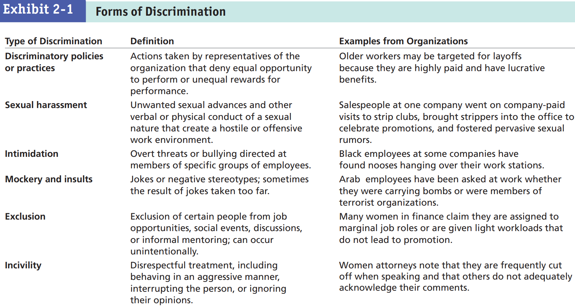

Slide 17
Culture
The word "culture" derives from a French term, which in turn derives from the Latin "colere," which means to tend to the earth and grow, or cultivation and nurture” (Cristina De Rossi)
In this sense culture is the man-made environment and the people living in a society actually grow their way of life over time.
Western culture, European culture, Bengali cultureetc.

Slide 18
Defining Culture
Culture … is that complex whole which includes knowledge, belief, arts, morals, laws, customs, and any other capabilities and habits acquired by man as a member of society. (Edward B. Taylor ,1871:1)
Culture is the ways of thinking, the ways of acting, and the material objects that together form a people’s way of life (Macionis, 2012: 54)

Slide 19
Characteristics of Culture
Culture is learnt; Culture is not inherited biologically, but learnt socially by man. It is not an inborn tendency. There is no cultural instinct as such culture is often “Learned ways of behavior”.
Culture is social; Culture does not exist in isolation. Neither is it an individual phenomenon. It is a product of society. It originates and develops through social interactions. It is shared by the members of society.

Slide 20
Cont’d
Culture is shared; Culture in the sociological sense, is something shared. It is not something that an individual alone can possess. For example, customs, traditions, beliefs, ideas, values, morals etc. are all shared by people of a group or society.
Culture is transmissive; Culture is capable of being transmitted from one generation to the other. Parents pass on culture traits to their children, and they in turn to their children, and so on. Culture is transmitted not through genes but by means of language. Language is the main vehicle of culture.

Slide 21
Cont’d
Culture is dynamic and adaptive; Though culture is relatively stable it is not altogether static. It is subjected to slow but constant changes. Culture is responsive to the changing conditions of the physical world as it assists us to survive and adapt to the changes.
Culture varies from society to society; Every society has a culture of its own. It differs from society to society. Culture of every society is unique to itself. Cultures are not uniform.

Slide 22
Components of Culture
• Values
• Norms
• Symbols
• Language

Slide 23
Values and beliefs
Values – Collective concept of what is good, bad, desirable, proper, and improper and that serve as broad guidelines for social living.
Values indicate what people find important and morally right (or wrong)
  Respect for parents, elders
  Cleanliness
  Generosity
Values are broad principles that support beliefs.
Beliefs are specific thoughts or ideas that people hold to be true.

Slide 24
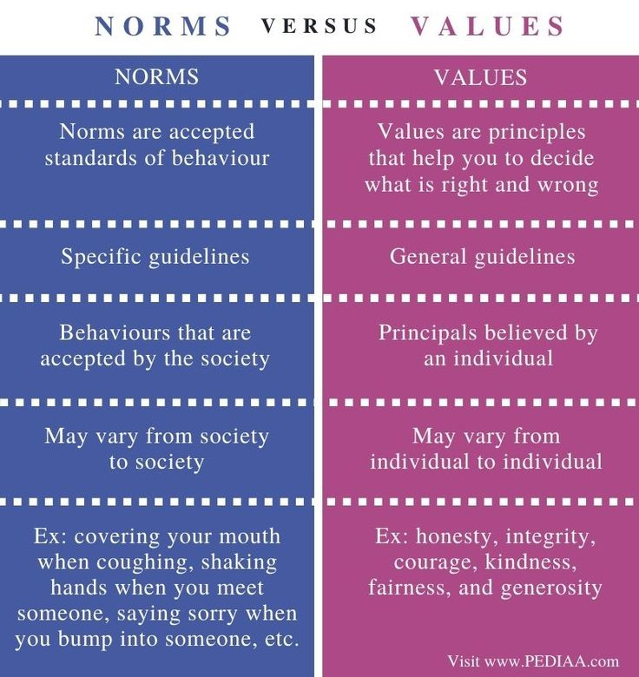
Norms
Norms; rules developed by a group of people that specify how people must, should, may, should not and must not behave in various situations.
These are rules and expectations by which a society guides the behavior of its members.

Slide 25
Folkways, Mores, and Laws
Folkways are informal norms or everyday customs that may be violated without serious consequences within a particular culture.
Norms of routine or casual interaction (ex. Shaking hands, eating styles, saying excuse me)
Mores –(pronounced MOR-ays). Mores norms that are widely observed and have great moral significance. Often breaking norms lead to being outcast or imprisonment (ex. Incest, rape, murder) are strict norms that control moral and ethical behavior.
Laws- are formal, standardized norms that have been enacted by legislatures and are enforced by formal sanctions.

Slide 26
Taboos
Taboos are mores specifying what actions are prohibited in a culture.
Taboos are mores so strong that their violation is considered to be extremely offensive and even unmentionable.
Taboo meaning a culture absolutely forbids them. Eating human flesh – cannibalism, Incest

Slide 27
Symbols
Symbols: A symbol is an object, word, or action that stands for something else.
Symbol is anything that carries a particular meaning recognized by people who share a culture (a flag, a word, a flashing red light, a raised fist, an animal etc).
Symbols help us communicate ideas. A siren is a symbol that denotes an emergency situation and sends the message to clear the way immediately
Non-verbal gestures can be very “symbolic” and diverse.

Slide 28
Language
Language: Culture is the social heritage of the humans that is transmitted to the future generation mainly through language.
Language is a system of words and symbols used to communicate with other people. Language is a set of symbols that expresses ideas and enables people to think and communicate with one another.
Verbal (spoken) language and nonverbal (written or gestured) language help us describe reality.

Slide 29
Ethnocentrism & Cultural Shock
Ethnocentrism; the tendency to judge other cultures according to the norms and values of our own culture. Ethnocentrism is based on the assumption that one’s own way of life is superior to all others.
Culture shock is the term we use to describe the feelings of confusion and uncertainty that are experienced when you come into contact with a culture that is vastly different from your own.
Culture shock can be commonly seen in foreign students, immigrants and refugees. Suddenly, you find yourself unable to understand.

Slide 30
Hofstede’s Cultural Dimensions
Hofstede’s Framework: One of the most widely referenced approaches for analyzing variations among cultures was introduced in the late 1970s by Geert Hofstede.
Hofstede surveyed more than 116,000 IBM employees in forty countries about their work-related values and found that managers and employees varied on five value dimensions of national culture:

Slide 31
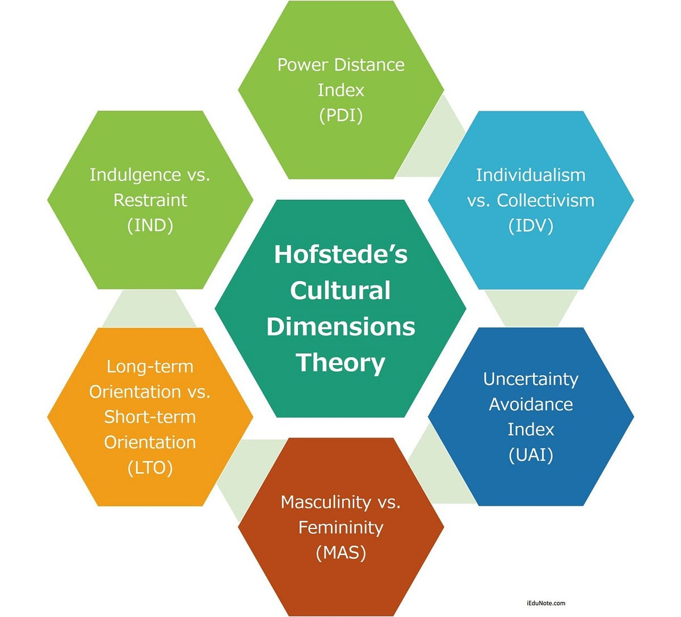

Slide 32
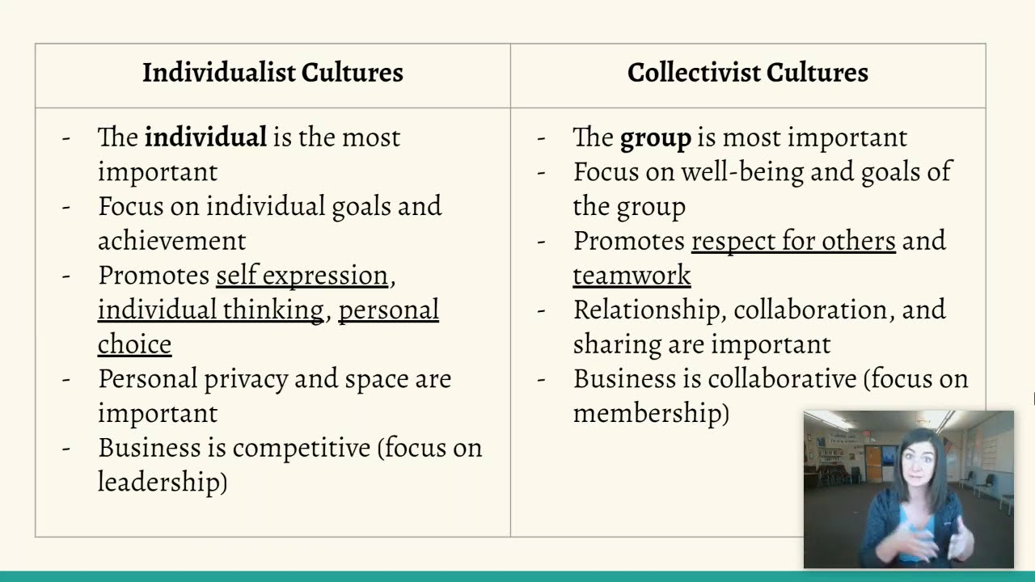
Source: Hannah Bierbaum

Slide 33
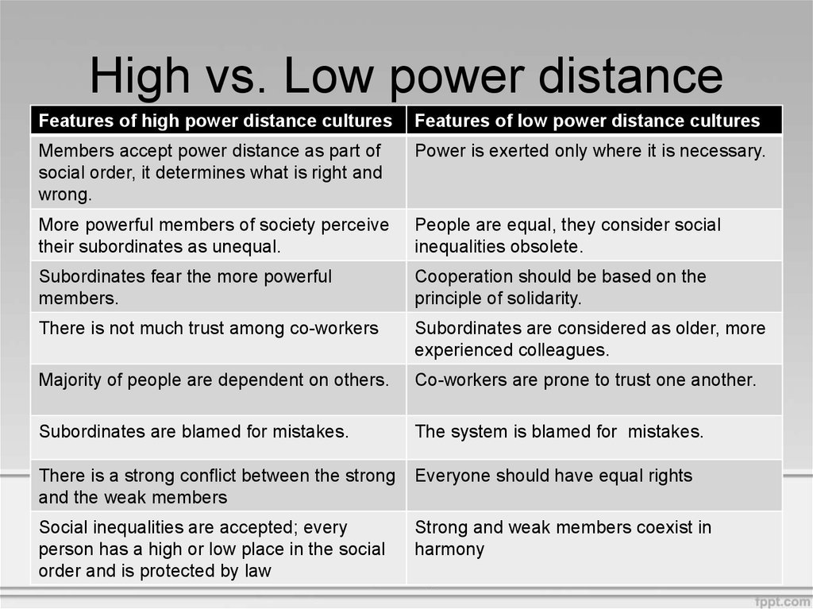

Slide 34
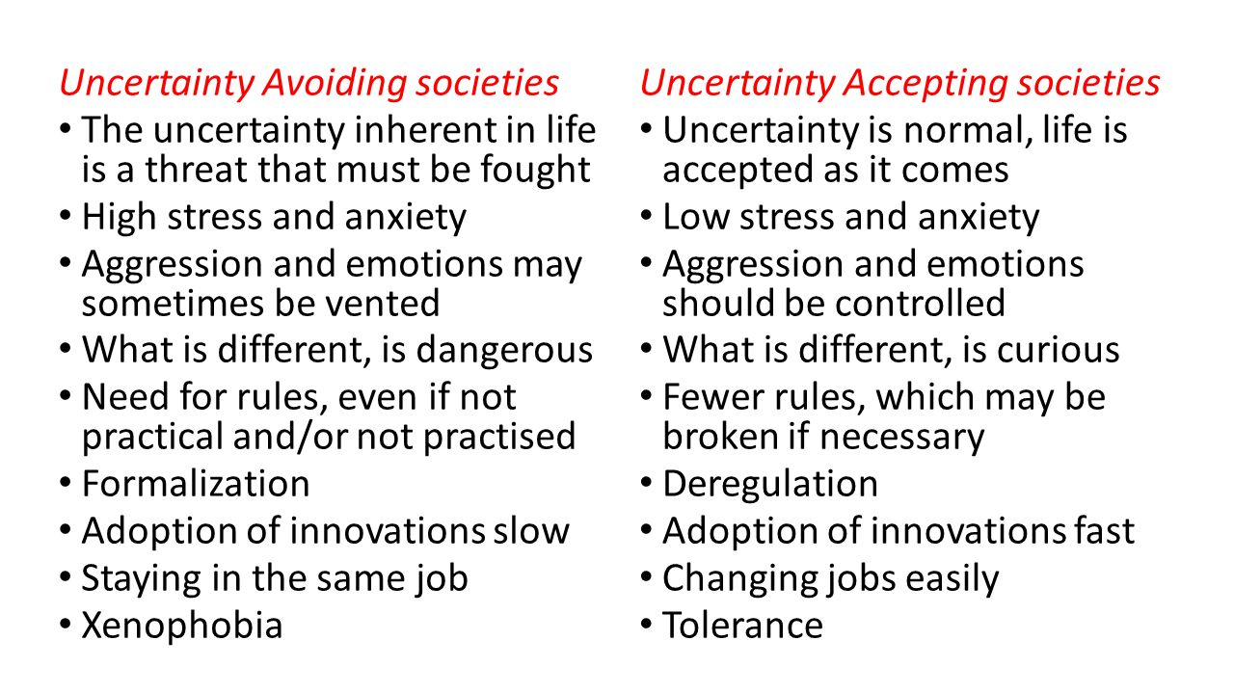

Slide 35
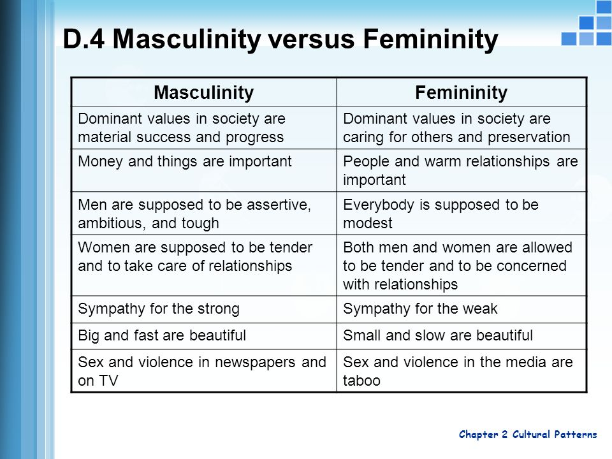

Slide 36
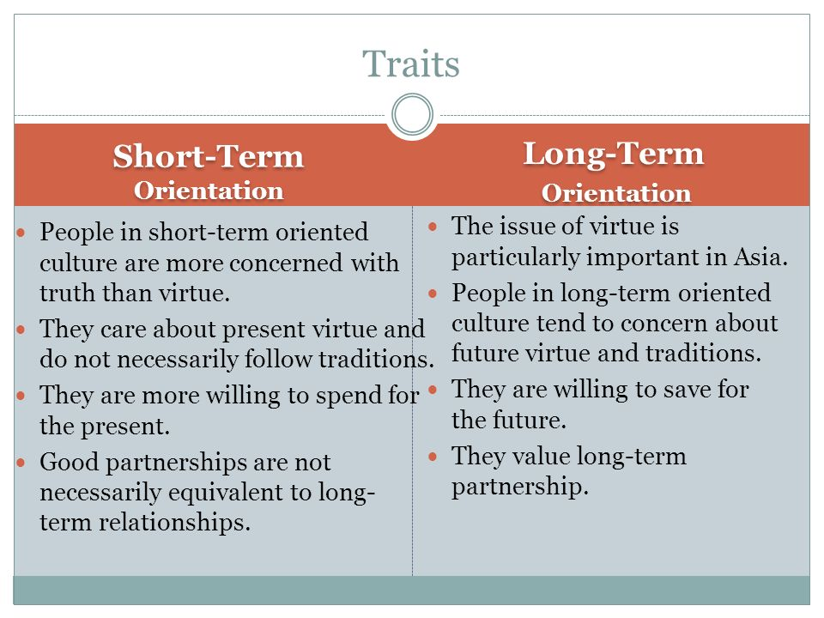

Slide 37
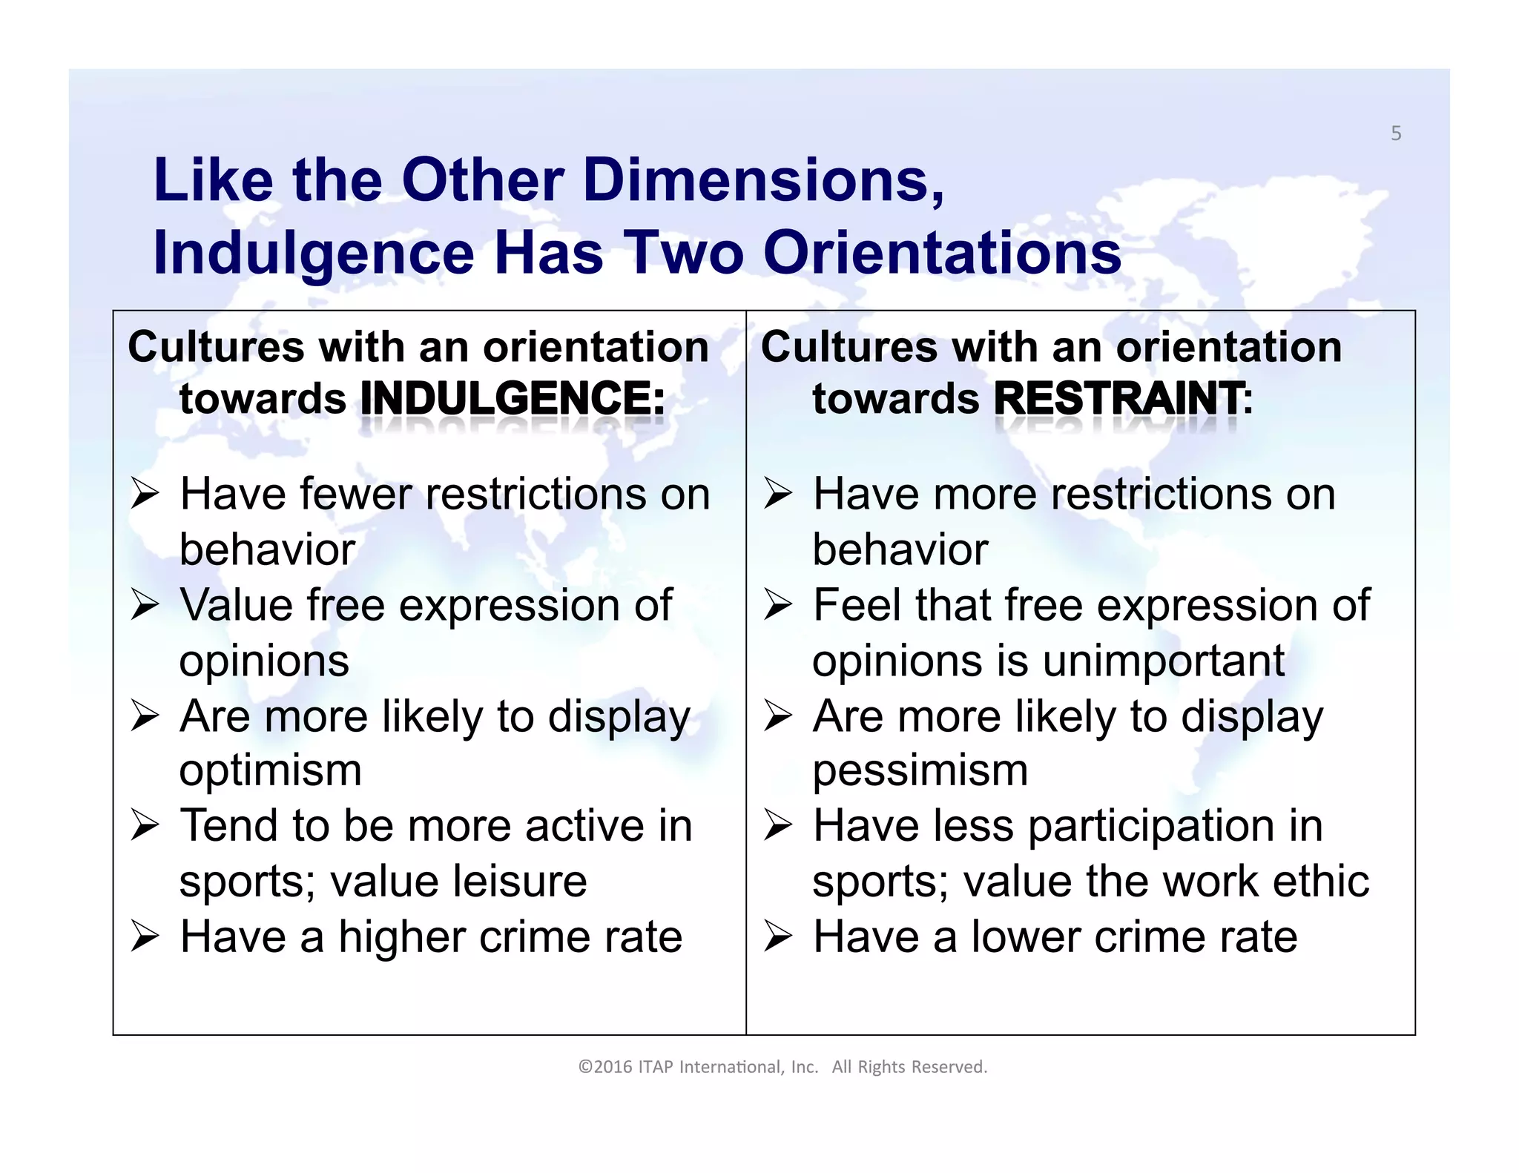

Slide 38
Suggestions for Managing Cultural Diversity
Help Employees Build Cultural Intelligence
Avoid Ethnocentrism
Listen to Locals
Recognize That Culture Changes
Do Not Always Assume That Culture Is the Problem

